Slide 1
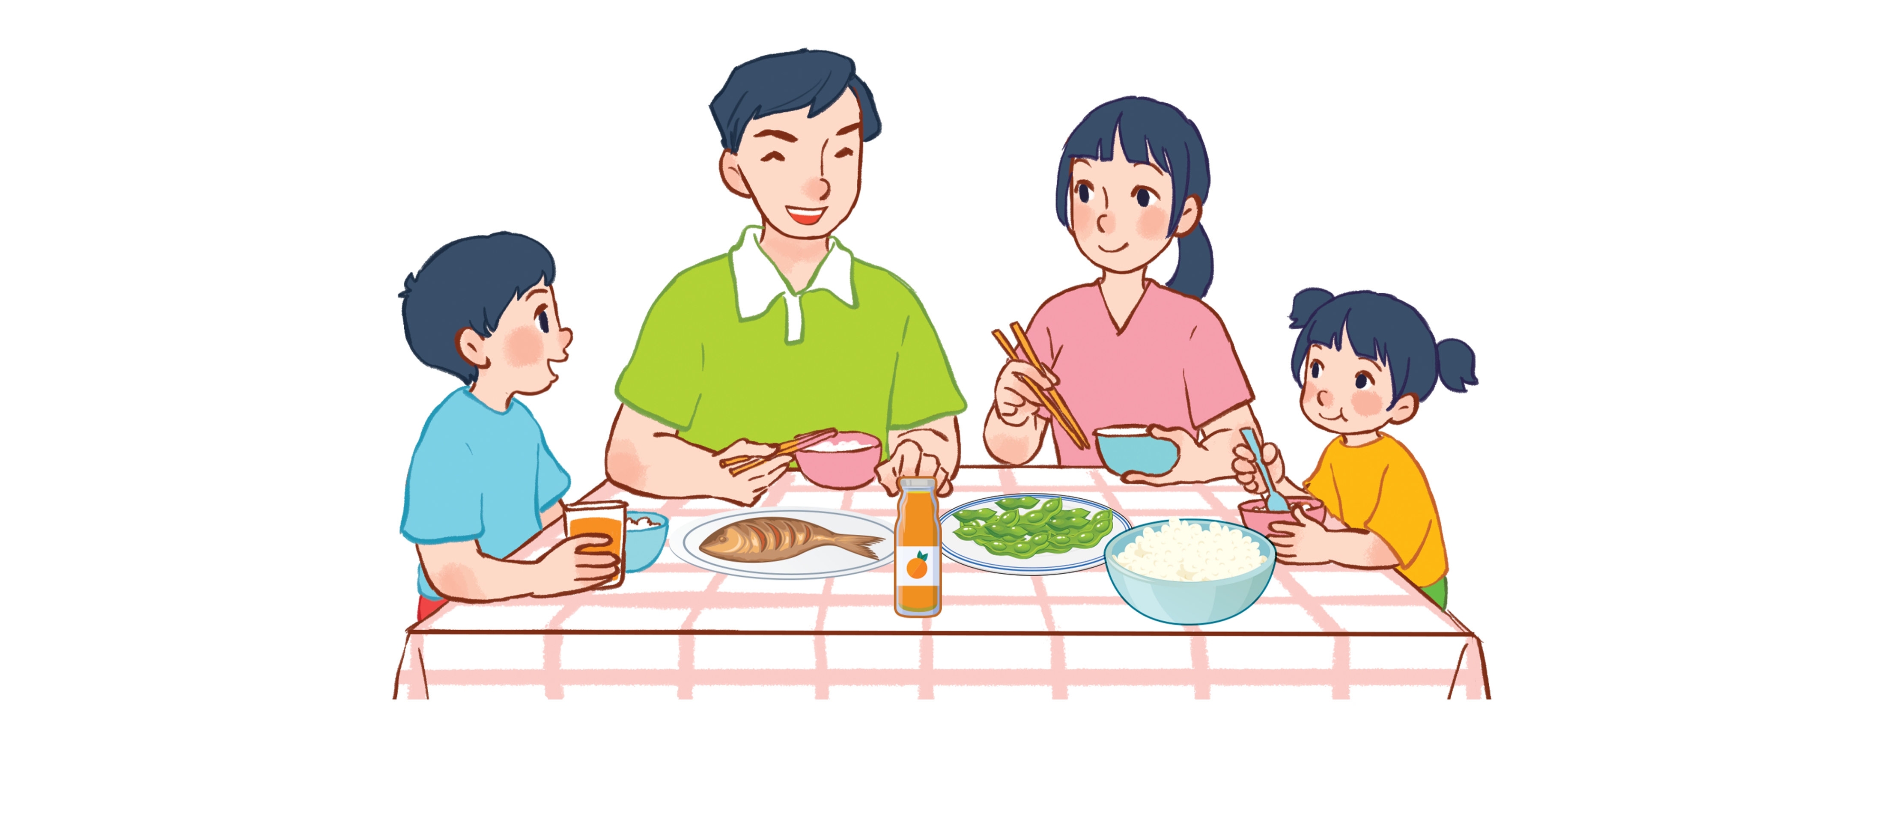
Unit 15
At the dining table
Lesson 2 - period 4

Slide 2
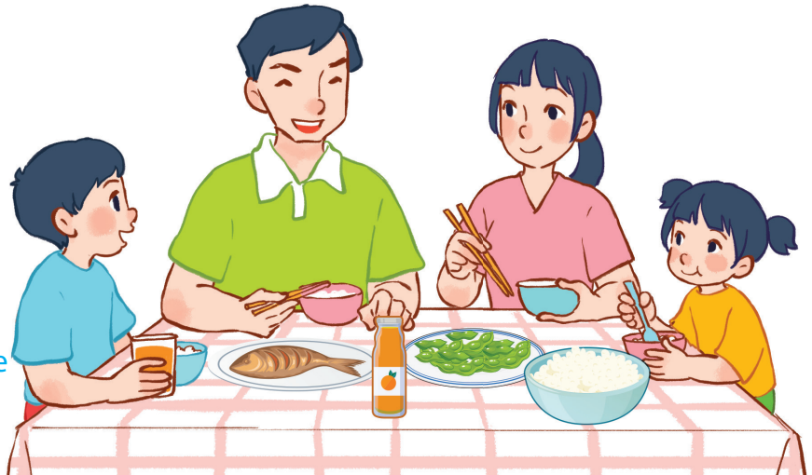
15
At the dining table
LESSON 2 – PERIOD 4

Slide 3
At the dining table
Warm-up
and review
Look, complete and read.
Fun corner
and wrap-up
Listen and number.
Let’s play.

Slide 4
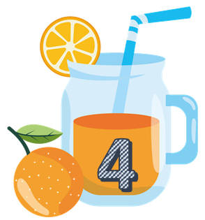
Team A
Team B
Warm-up
and review
Notes:
Divide the class into 2 teams..
Each team chooses one jar mug of juice to go to the question.
Have pupils look, read and choose the right option.
Click the ‘score’ mug to get back to the menu for pupils to choose another question.
Pupils continue their turns until there is no mug of juice left.
The team who gets the most points is the winner.

Slide 5
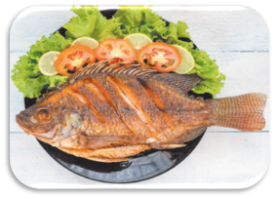
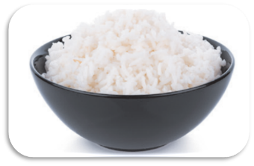
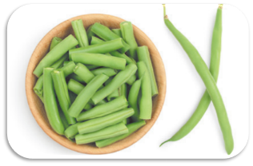
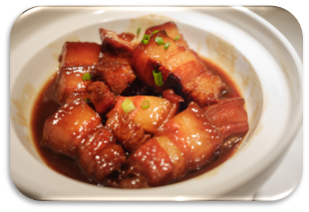
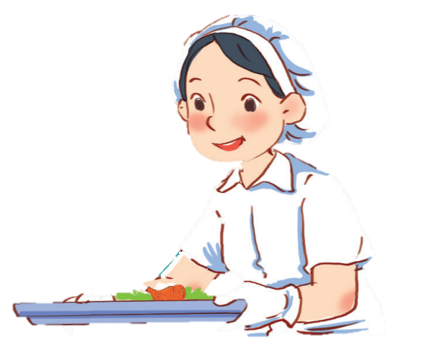
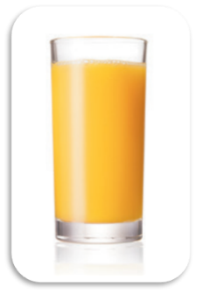
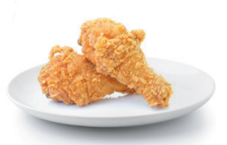
TIME
IS UP
I’d like some juice.
What would you like to drink?
30

Slide 6
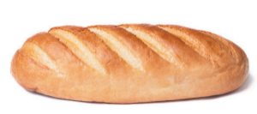
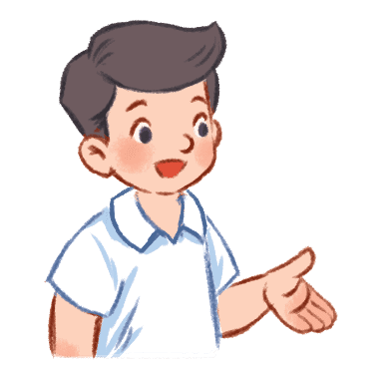
TIME
IS UP
I’d like some bread.
What would you like to eat?
50

Slide 7
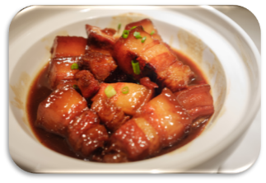
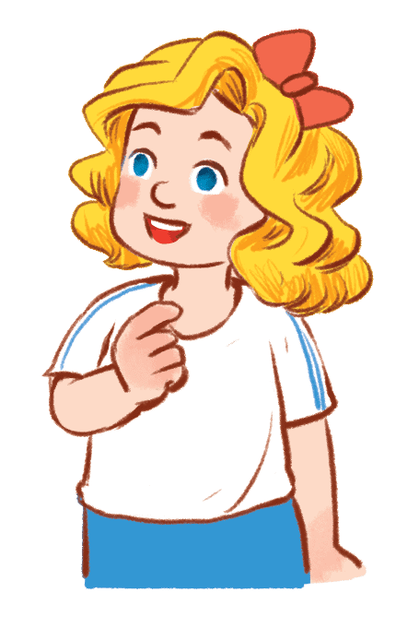
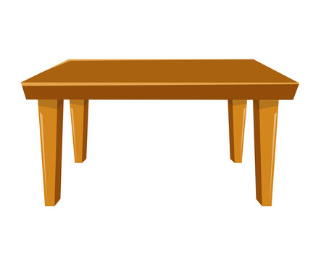
TIME
IS UP
What would you like to eat?
I’d like some meat.
40

Slide 8
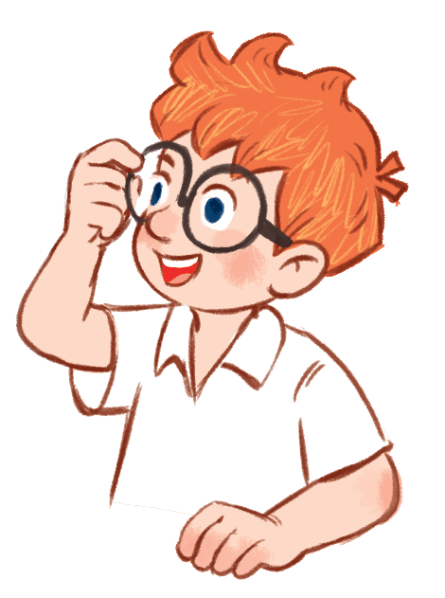
TIME
IS UP
I’d like some milk.
20
What would you like to drink?

Slide 9
TIME
IS UP
I’d like some chicken.
What would you like to eat?
30

Slide 10
TIME
IS UP
I’d like some water.
What would you like to drink?
30

Slide 11
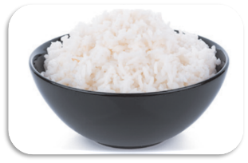
TIME
IS UP
50
What would you like to eat?
I’d like some fish.

Slide 12
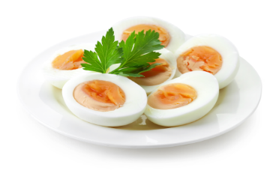
TIME
IS UP
I’d like some eggs.
What would you like to eat?
40

Slide 13
3
4
1
2

Slide 14
bread
chicken
eggs
juice

Slide 16
Fun corner
and wrap-up
FOOD MAZE
Notes:
Have pupils look, read and choose the correct picture to lead the food eater to the food or drink.
This game is just for fun.

Slide 17
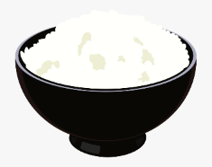
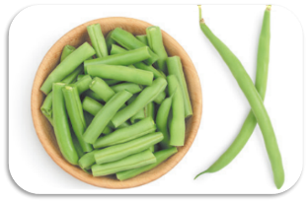
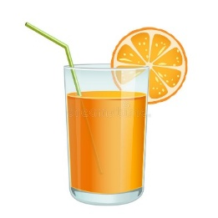
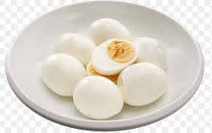
What would you like to eat and drink?
I would like some milk.
I would like some rice.
I would like some juice.
I would like some chicken.
I would like some bread.
I would like some eggs.
I would like some fish.
I would like some water.
I would like some beans.
Notes:
Look at the sentence then choose the right picture of the food or drinks.

Slide 18
Website: sachmem.vn
Fanpage: www.facebook.com/sachmem.vn

