Slide 1
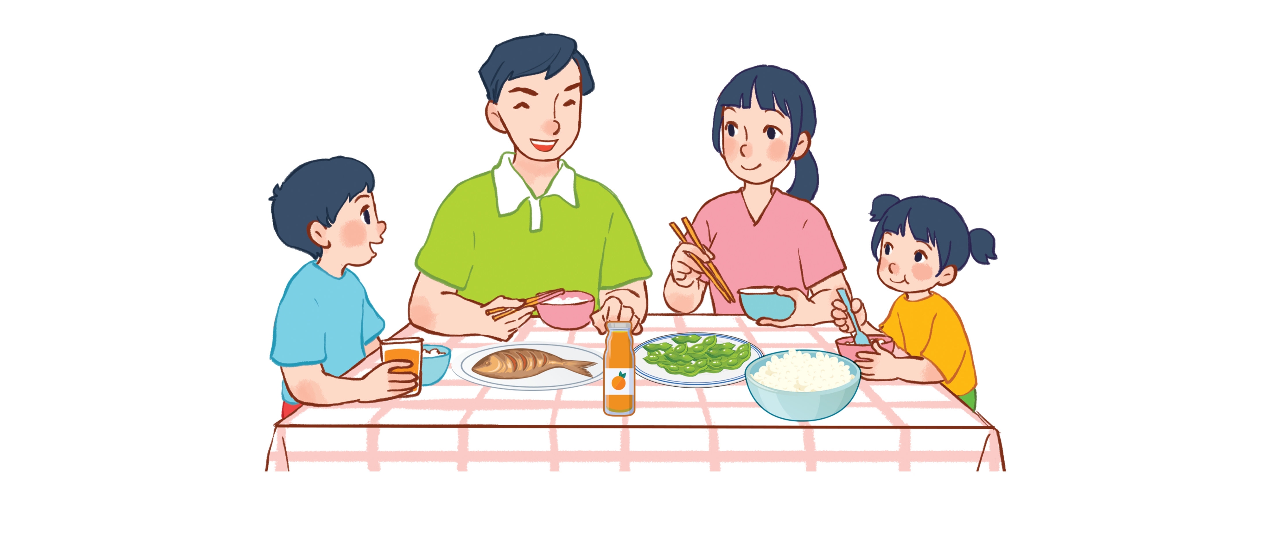
Unit 15
At the dining table
Lesson 2 - period 3

Slide 2
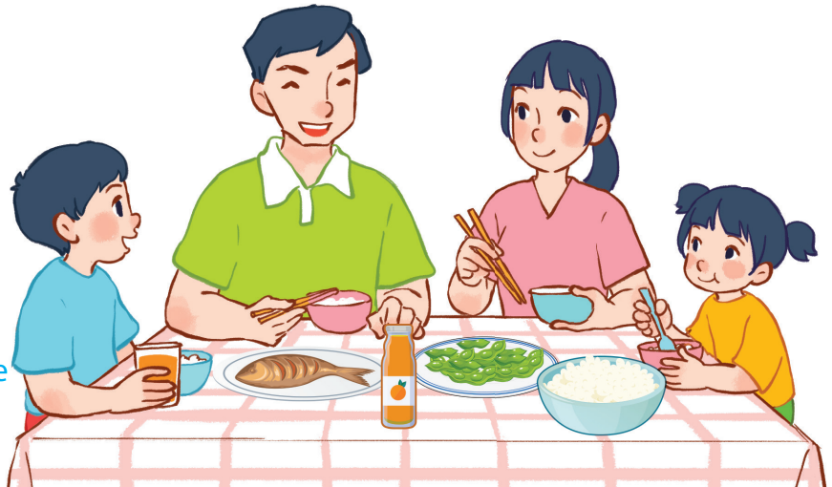
15
At the dining table
LESSON 2 – PERIOD 3

Slide 3
At the dining table
Warm-up
and review
Listen, point and say.
Fun corner
and wrap-up
Look, listen
and repeat.
Let’s talk.

Slide 4
Team A
Team B
Warm-up
and review
Notes:
Divide the class into 2 teams.
Each team chooses one jar mug of juice to go to the question.
Have pupils find what is missing and say out loud the name of the missing food or drinks.
Back to the menu for pupils to choose another question.
Pupils continue their turns until there is no mug left.
The team that gets the most points is the winner.

Slide 5
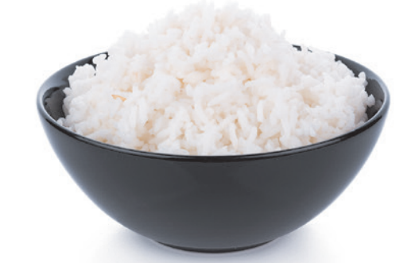
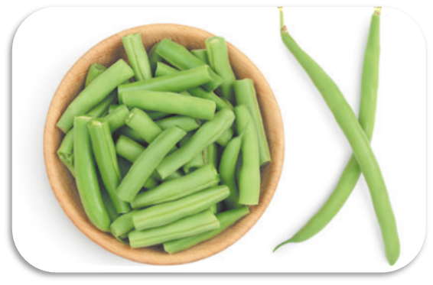
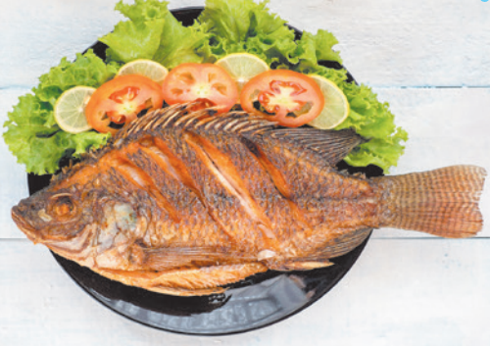
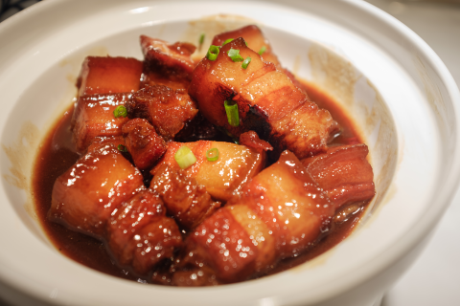
What’s missing on the table?

Slide 6
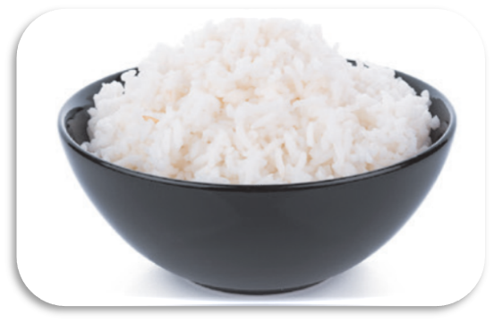
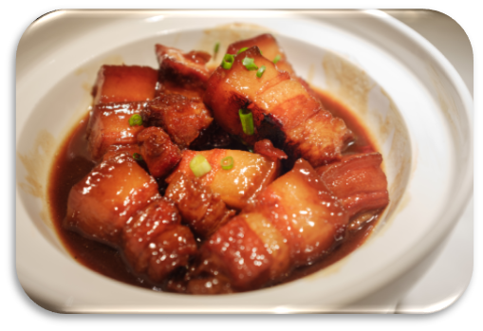
Choose and get points!
20
30
50
Notes:
Let students choose one dish to get points for their team.

Slide 7
What’s missing on the table?

Slide 8
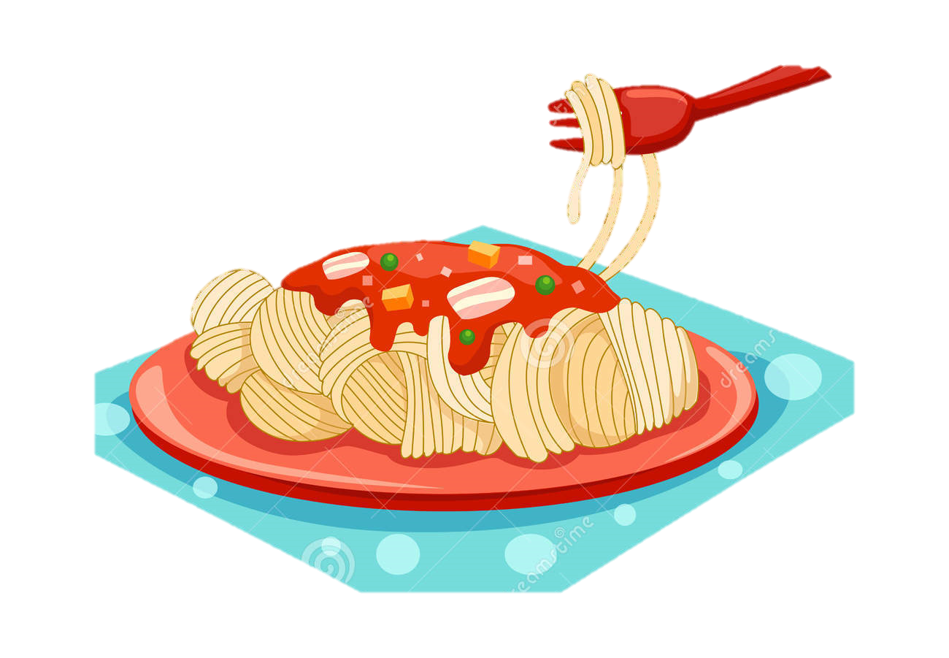
Choose and get points!
10
30
20
Notes:
Let students choose one dish to get points for their team.

Slide 9
What’s missing on the table?

Slide 10
Choose and get points!
60
40
50
Notes:
Let students choose one dish to get points for their team.

Slide 11
What’s missing on the table?

Slide 12
Choose and get points!
50
60
70
Notes:
Let students choose one dish to get points for their team.

Slide 13
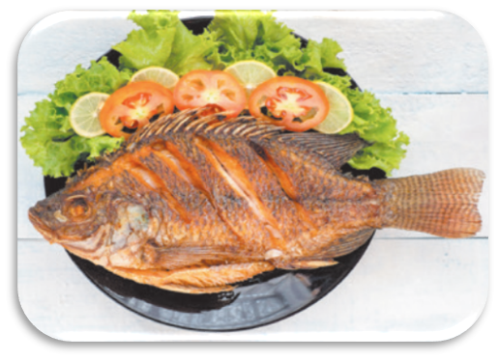
What’s missing on the table?

Slide 14
Choose and get points!
40
30
20
Notes:
Let students choose one dish to get points for their team.

Slide 15
What’s missing on the table?

Slide 16
Choose and get points
60
80
70
Notes:
Let students choose one dish to get points for their team.

Slide 17
What’s missing on the table?

Slide 18
Choose and get points!
20
30
50
Notes:
Let students choose one dish to get points for their team.

Slide 19
What’s missing on the table?

Slide 20
Choose and get points!
90
80
70
Notes:
Let students choose one dish to get points for their team.

Slide 21
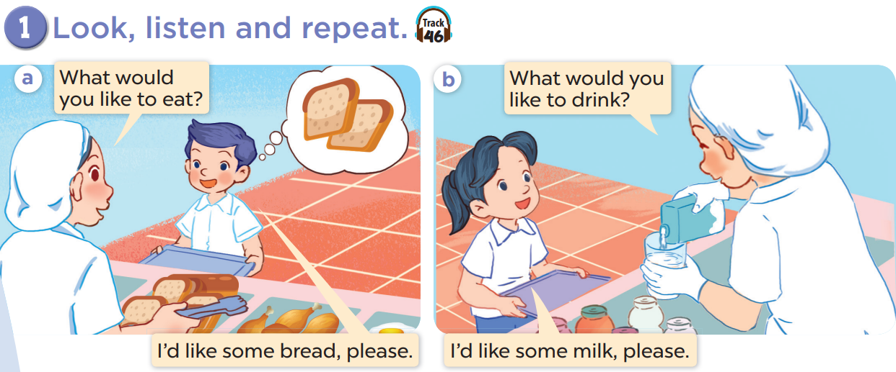

Slide 22
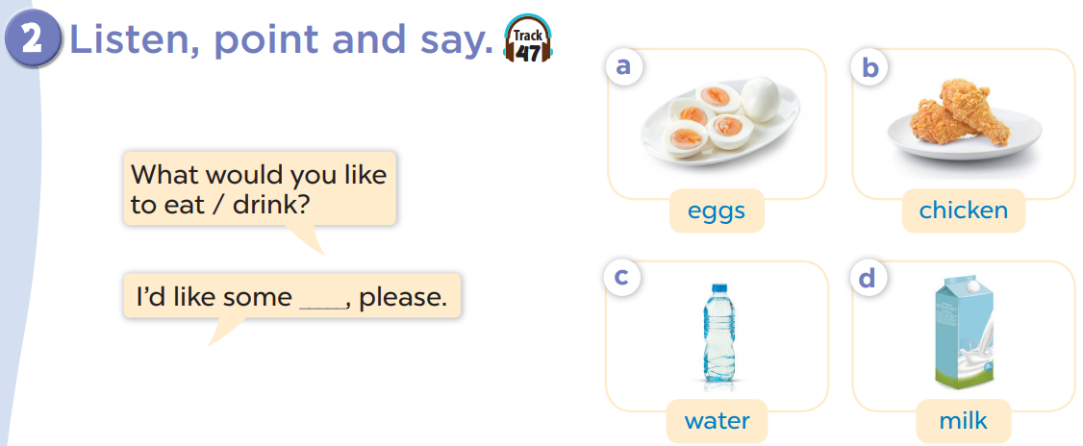

Slide 23
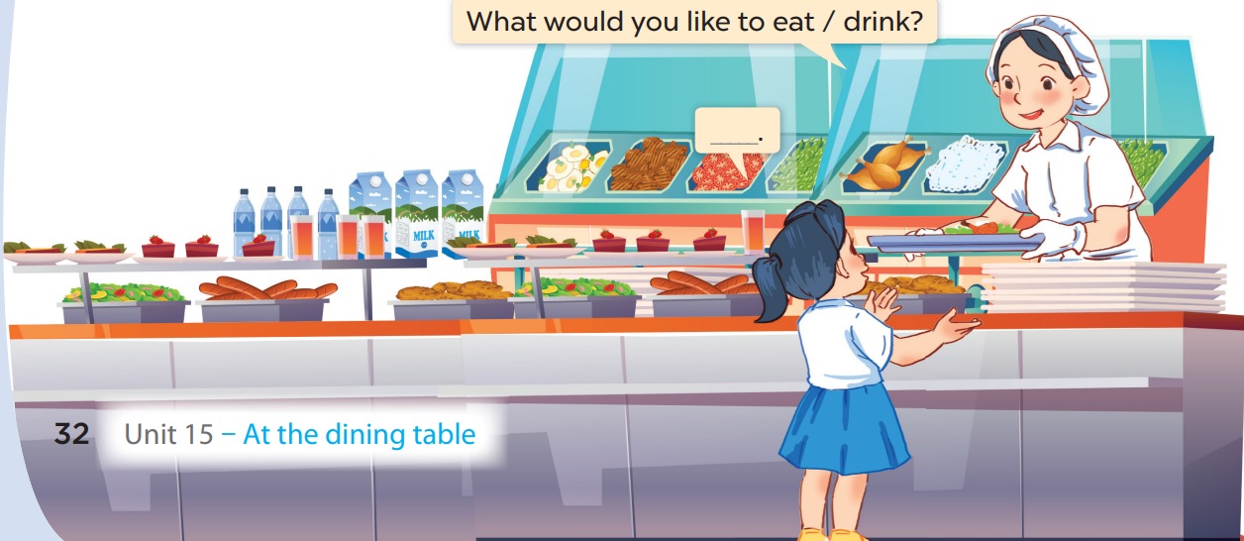
3. Let’s talk.

Slide 24
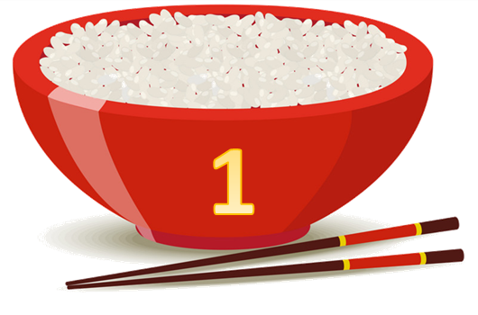
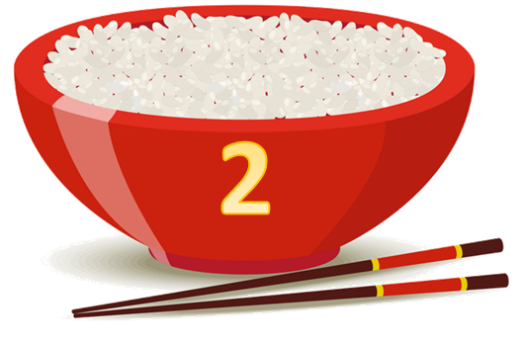
Team A
Team B
Fun corner
and wrap-up
Notes:
Divide the class into 2 teams.
Each team chooses one bowl to go to the question. Have pupils look, read and choose the right picture.
Back to the menu for pupils to choose another question.
Pupils continue their turns until there is no bowl left.

Slide 25
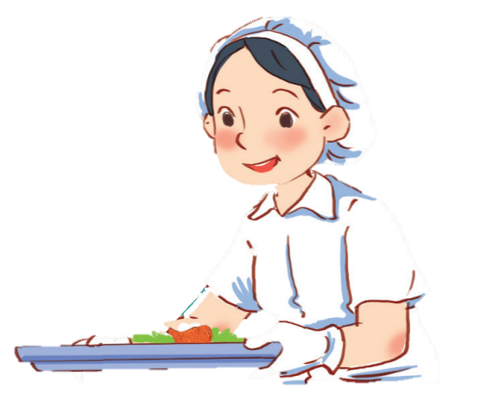
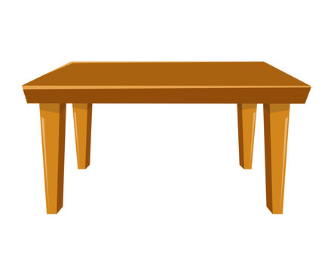
What would you like to drink?
I’d like some juice.
30

Slide 26
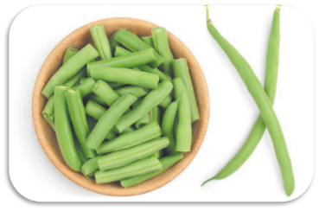
What would you like to eat?
I’d like some beans.
30

Slide 27
What would you like to drink?
I’d like some milk.
20

Slide 28
What would you like to eat?
I’d like some rice.
40

Slide 29
What would you like to drink?
I’d like some water.
60

Slide 30
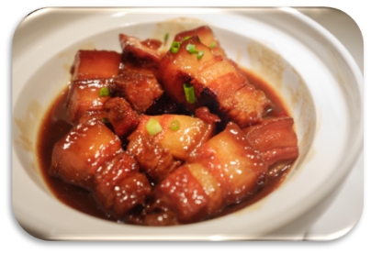
What would you like to eat?
I’d like some meat.
60

Slide 31
What would you like to drink?
I’d like some coke.
50

Slide 32
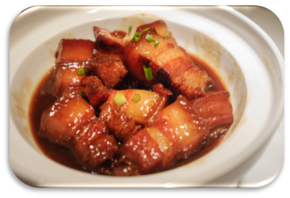
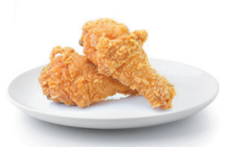
What would you like to eat?
I’d like some chicken.
80

Slide 33
Website: sachmem.vn
Fanpage: www.facebook.com/sachmem.vn

