Slide 1
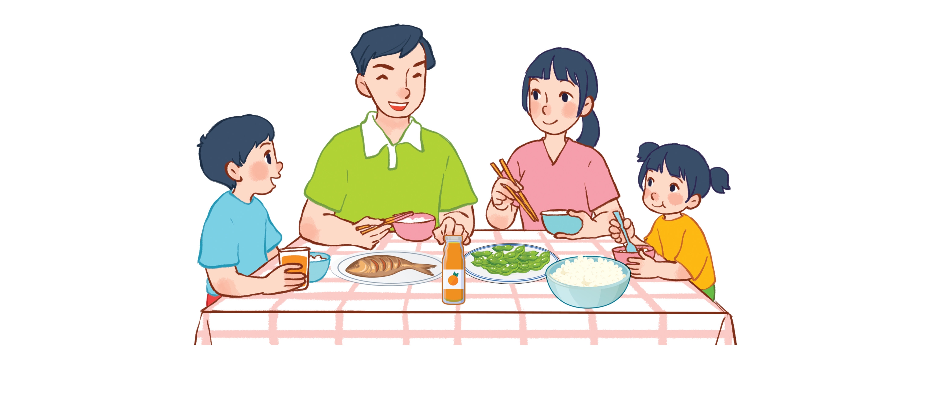
Unit 15
At the dining table
Lesson 1 - period 2

Slide 2
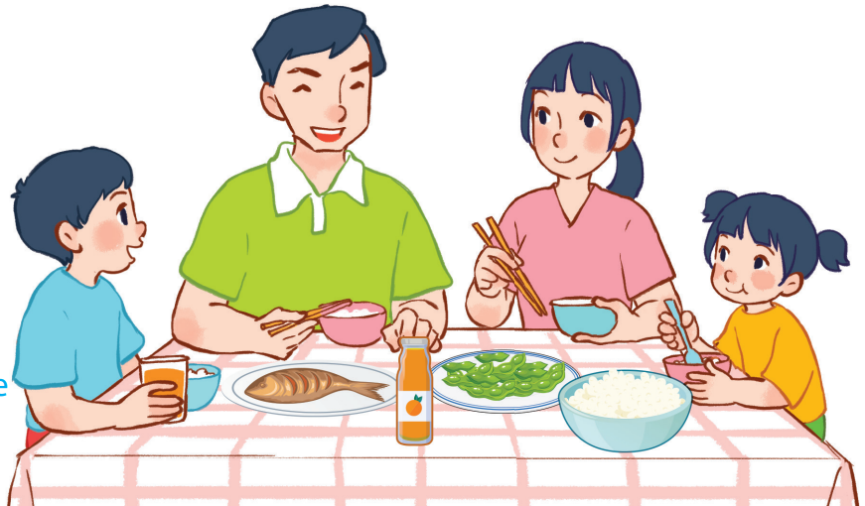
15
At the dining table
LESSON 1 – PERIOD 2

Slide 3
At the dining table
Warm-up
and review
Look, complete and read.
Fun corner
and wrap-up
Listen and tick.
Let’s sing.

Slide 4
Team A
Team B
Warm-up
and review
Notes:
Divide the class into 2 teams.
Each team chooses one jar mug of juice to go to the question. Have pupils look, read and choose the right option.
Click the score mug to get back to the menu for pupils to choose another question.
Pupils continue their turns until there is no mug left.

Slide 5
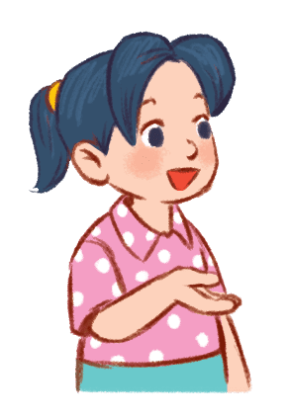
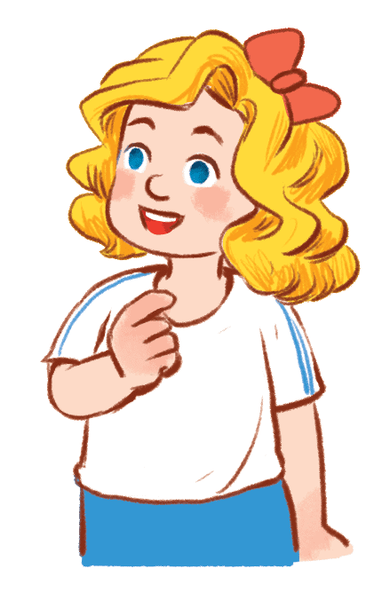
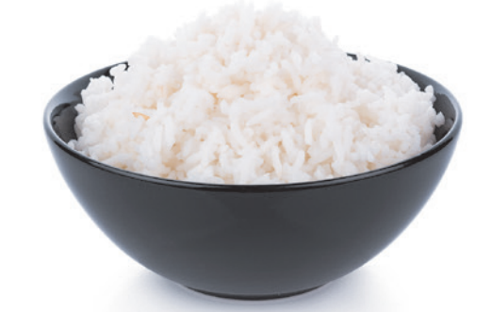
Would you like some ……………?
Yes, please.
40
bread
rice
cake

Slide 6
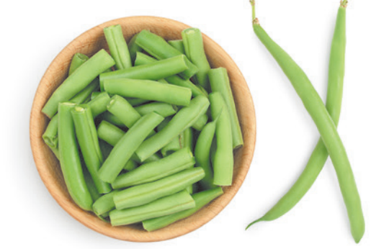
Would you like some ……………?
No, thanks.
30
beans
apples
pears

Slide 7
Would you like some ……………?
No, thanks.
20
beans
meat
fish

Slide 8
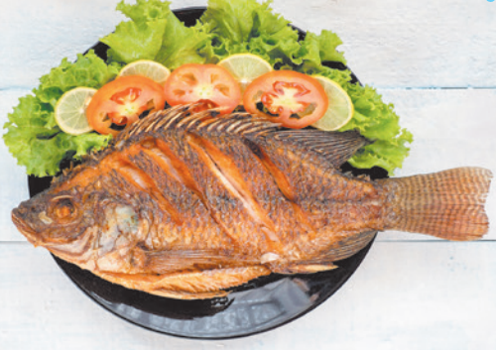
Would you like some ……………?
Yes, please.
60
meat
fish
chicken

Slide 9
Would you like some ……………?
Yes, please.
40
water
juice
milk

Slide 10
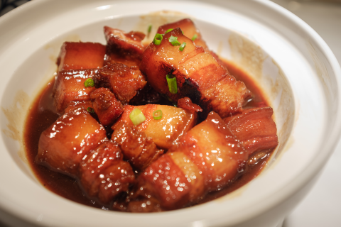
Would you like some ……………?
No, thanks.
20
meat
fish
chicken

Slide 11
Would you like some ……………?
Yes, please.
30
milk
juice
water

Slide 12
Would you like some ……………?
Yes, please.
50
water
milk
juice

Slide 14
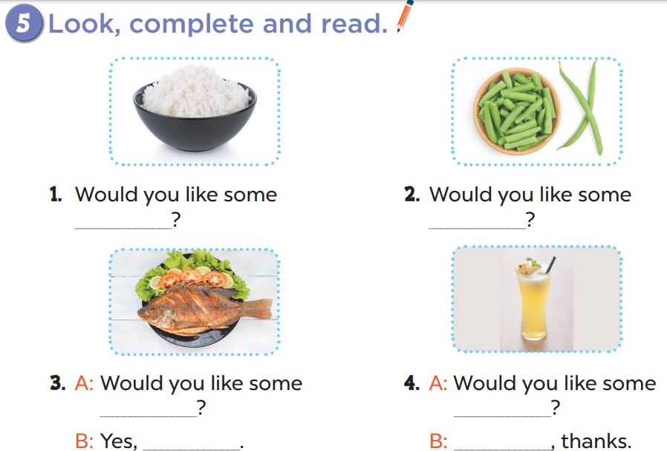
rice
beans
fish
juice
please
No

Slide 15
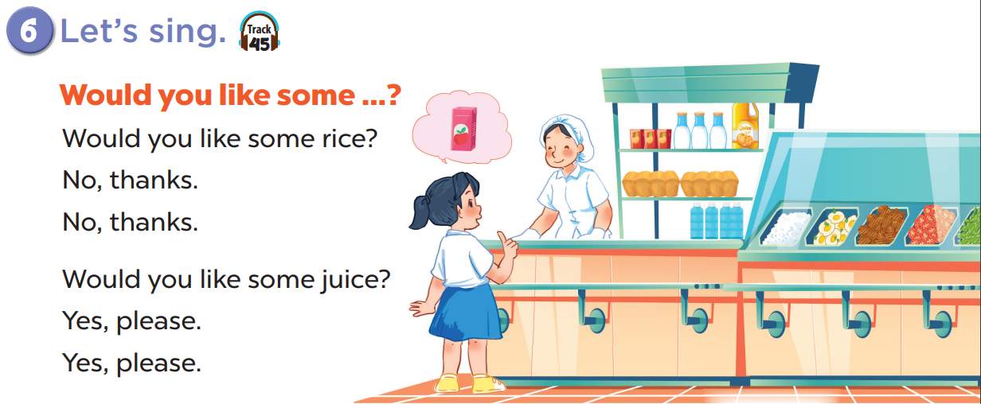

Slide 16
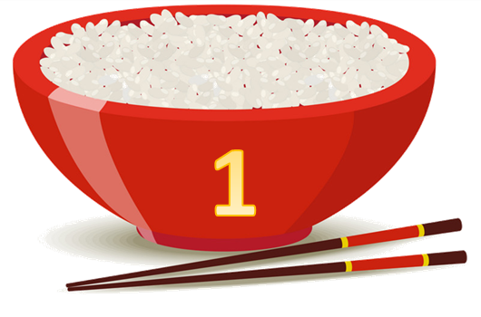
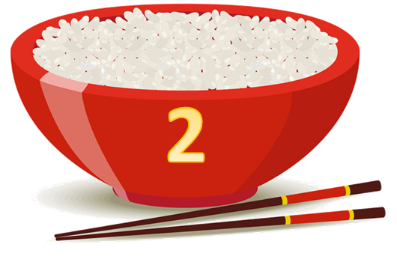
Team A
Team B
Fun corner
and wrap-up
Notes:
Divide the class into 2 teams.
Each team chooses one bowl to go to the question. Have pupils look, read and choose the right option.
Click the ‘score’ bowl to get back to the menu for pupils to choose another question.
Pupils continue their turns until there is no bowl left.

Slide 17
Listen and choose.
60
apples
beans
pears
Notes:
Click the character on the left side to listen and choose the right options. Click the character on the right side to hear the answer.

Slide 18
Listen and choose.
30
rice
soup
noodles
Notes:
Click the characters to listen and choose the right options.

Slide 19
Listen and choose.
40
chicken
meat
fish
Notes:
Click the characters to listen and choose the right options.

Slide 20
Listen and choose.
30
chicken
meat
fish
Notes:
Click the characters to listen and choose the right options.

Slide 21
Listen and choose.
30
juice
milk
water
Notes:
Click the characters to listen and choose the right options.

Slide 22
Listen and choose.
40
juice
water
milk
Notes:
Click the characters to listen and choose the right options.

Slide 23
Listen and choose.
20
milk
water
juice
Notes:
Click the characters to listen and choose the right options.

Slide 24
Listen and choose.
10
apple juice
water
milk
Notes:
Click the characters to listen and choose the right options.

