Slide 1
01
Warm-up

Slide 2
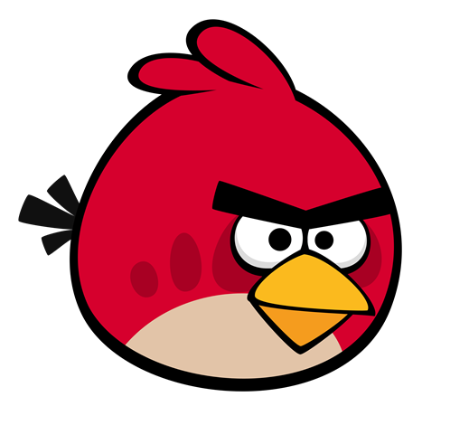
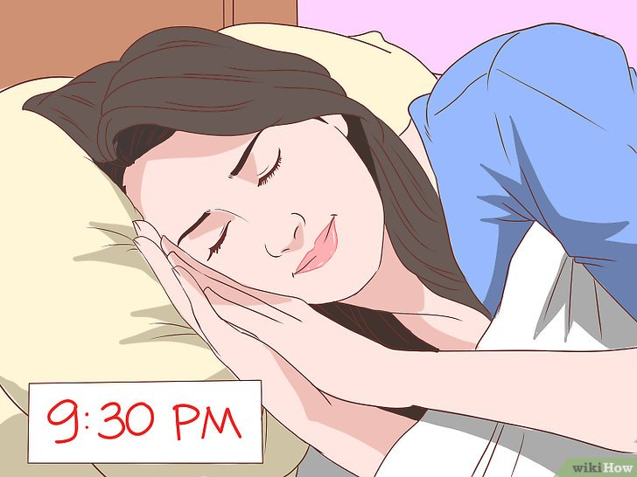
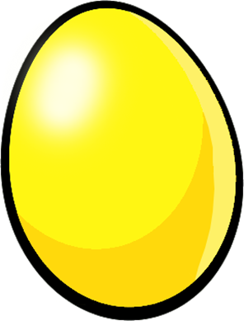
Câu hỏi 3
This Photo by Unknown Author is licensed under CC BY
Have breakfast
Go to bed
-1
-1
-1
Go to school
Get up

Slide 3
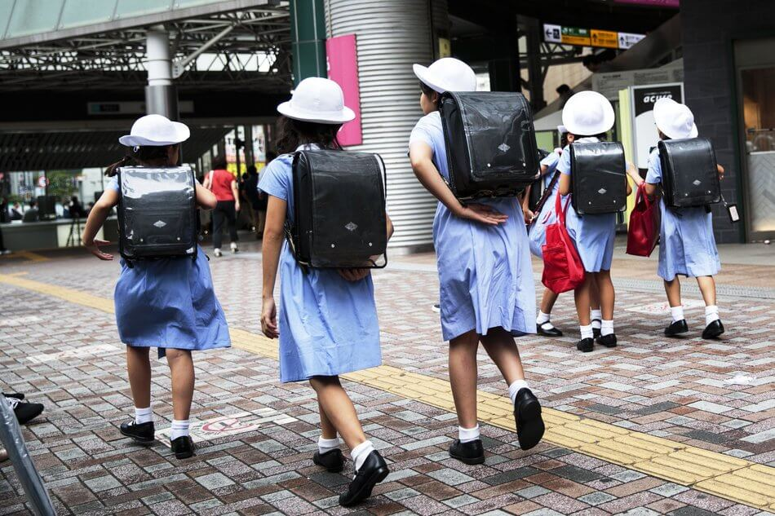
Câu hỏi 2
This Photo by Unknown Author is licensed under CC BY
Get up
Have breakfast
-1
-1
-1
Go to school
Go to bed

Slide 4
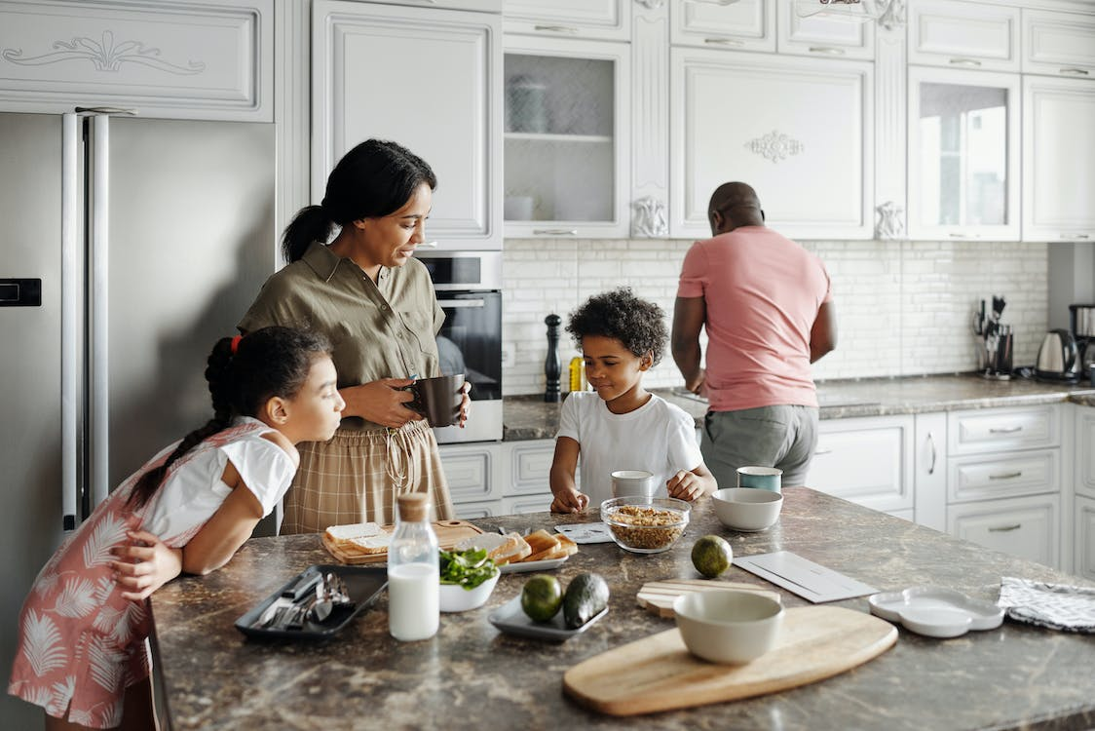
Câu hỏi 1
Have breakfast
Go to school
-1
-1
-1
Go to bed
Get up

Slide 5
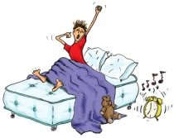
Câu hỏi 4
This Photo by Unknown Author is licensed under CC BY-NC-ND
This Photo by Unknown Author is licensed under CC BY
Have breakfast
Go to school
-1
-1
-1
Go to bed
Get up

Slide 6
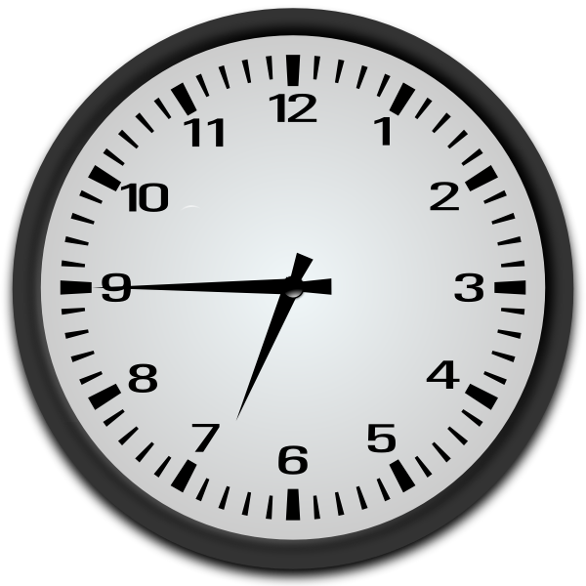
Câu hỏi 3
I go to school at seven fifteen.
I go to school at six forty-five.
-1
-1
-1
I go to school at seven forty-five.
I go to school at seven o’clock.

Slide 7
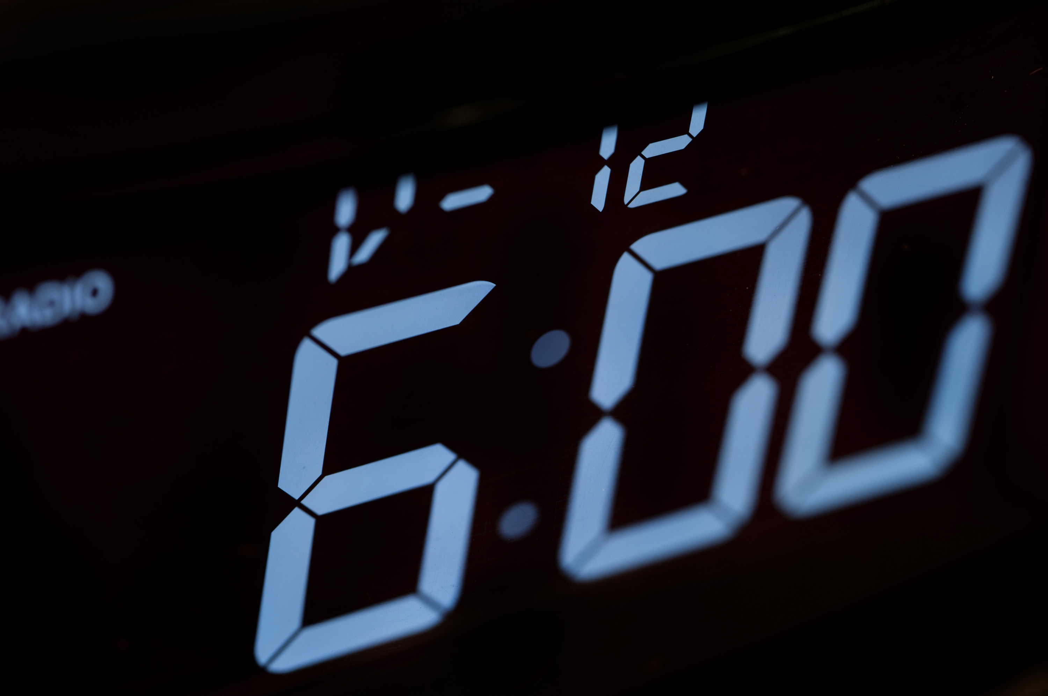
Câu hỏi 2
This Photo by Unknown Author is licensed under CC BY
I get up at six fifteen.
I get up at six forty-five.
-1
-1
-1
I get up at six o’clock.
I get up at six thirty.

Slide 8
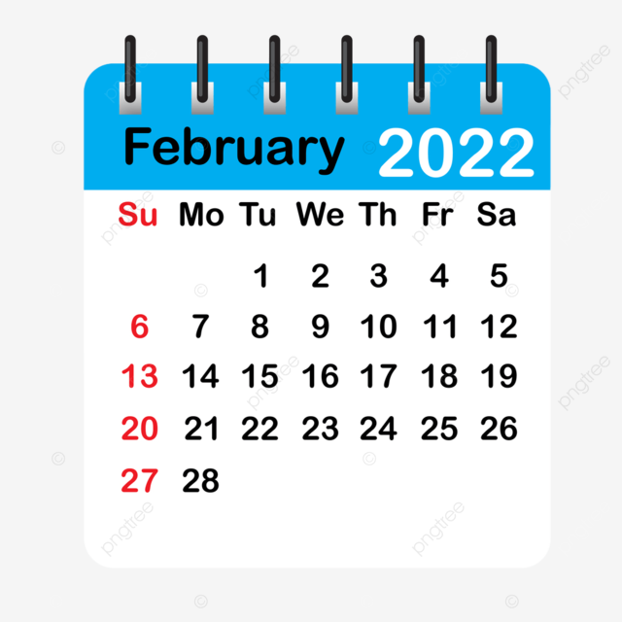

Slide 9
My week
LESSON 1 - PERIOD 1
SUNDAY
SUNDAY
MONDAY
TUESDAY
WEDNESDAY
THURSDAY
FRIDAY
SATURDAY

Slide 10
02
Activity 1 Look, listen and repeat.

Slide 12
Game: What is missing?

Slide 13
03
Activity 2 Listen, point and say.

Slide 15
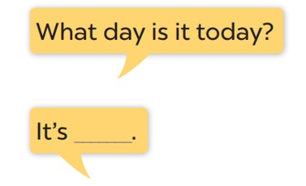
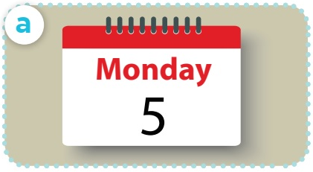

Slide 16
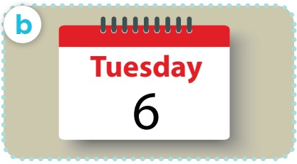

Slide 17
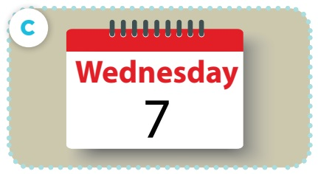

Slide 18
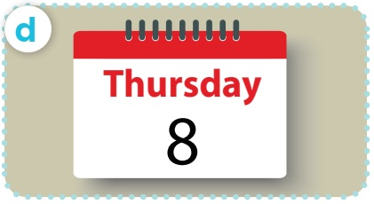

Slide 19
04
Activity 3 Let’s talk.

Slide 20
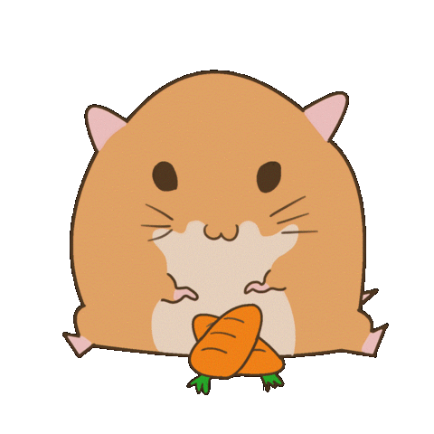
LISTEN AND GUESS WHAT DAY IT IS.
O
I
ED
TH
TU
MONDAY
FRIDAY
WEDNESDAY
THURSDAY
TUESDAY
Notes:
TEACHER SPELLS THE FIRST LETTER OF ANY DAY/ OR SPELLS ANY LETTER IN A DAY, PUPILS GUESS.

Slide 21
05
Fun corner & wrap-up

Slide 22
QUESTION 1:
FIND THE THE MISSING LETTER.
TU_SDAY
E
Notes:
Repeat the question when the letter blinks
Key: TUESDAY

Slide 23
QUESTION 2:
The 3 letters stand next to each other in all days of the week.
(3 chữ cái đứng cạnh nhau trong tất cả các ngày trong tuần.)
DAY
Notes:
DAY

Slide 24
QUESTION 3:
How many days do you go to school in a week? (bạn đi học bao nhiêu ngày trong một tuần?)
5 days
Notes:
5

Slide 25
QUESTION 4:
The days you have English lessons (kể tên những ngày bạn có môn tiếng Anh)
Wednesday and Thursday
Notes:
Pupils’ answer

Slide 26
QUESTION 5:
The days have the letter ‘s’ (kể tên những ngày có chữ cái “s” )
Tuesday, Wednesday, Thursday

Slide 27
QUESTION 6:
The day with more letters than the other days in a week ( kể tên ngày có nhiều chữ cái hơn những ngày khác trong tuần)
Wednesday
Notes:
WEDNESDAY

