Slide 1
Unit 7: Our timetable
Lesson 3- period 6

Slide 2
01
Warm up

Slide 4
02
Read and circle

Slide 8
03
Let’s write

Slide 9
Lucy
English
science
Tuesdays
music
Fridays
music

Slide 11
04
Project

Slide 12
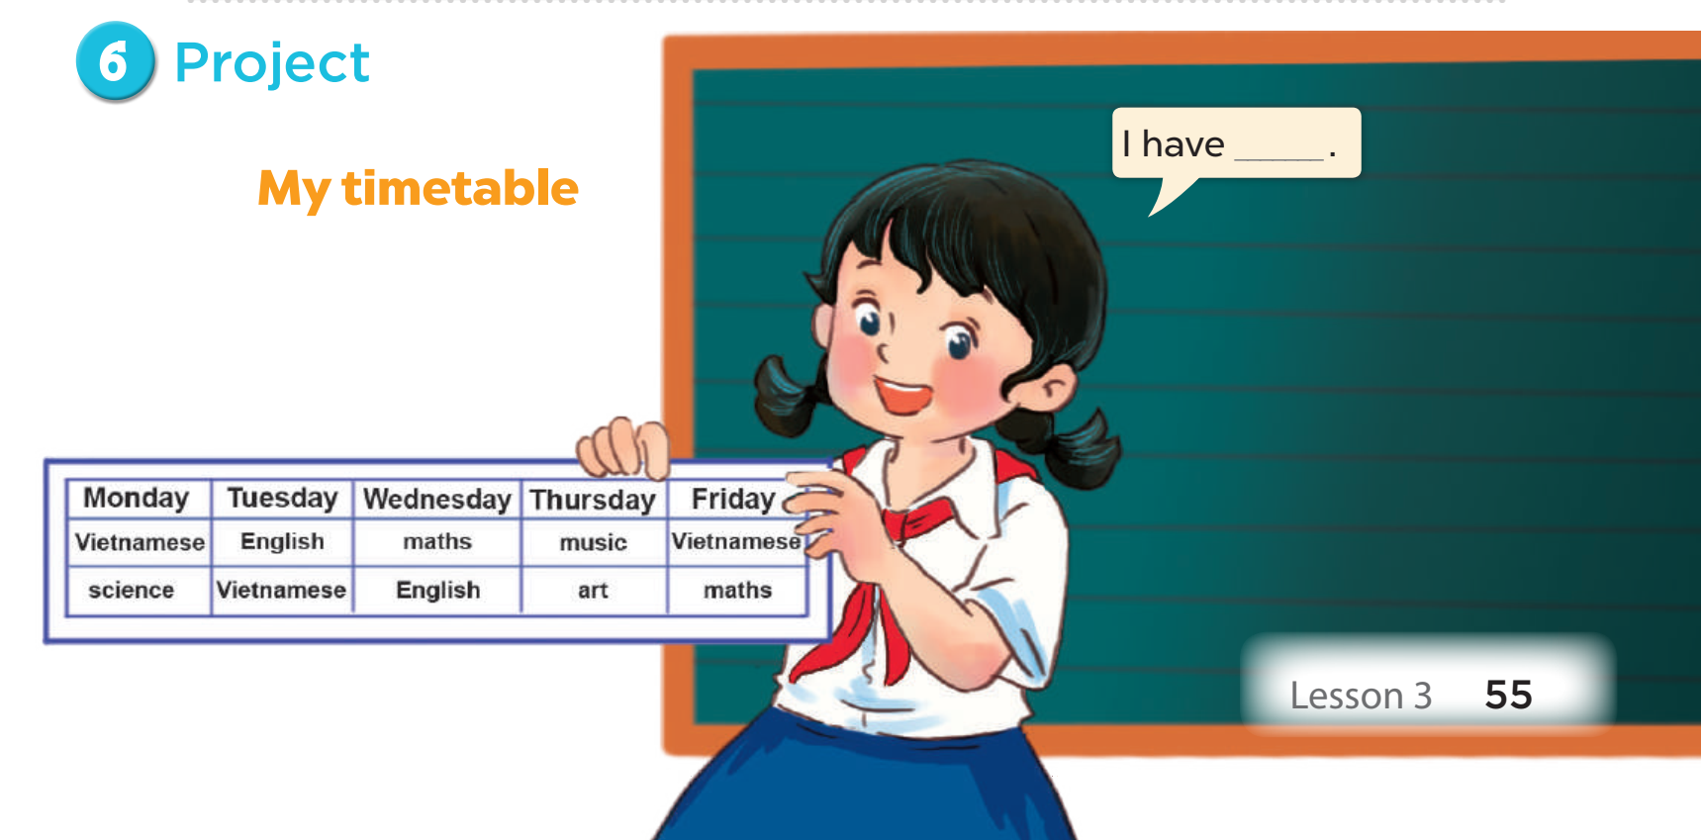

Slide 13
05
Wrap up and fun time

Slide 14
Fridays./Mondays/ I/to/
school/go/from
Check
I go to school from Mondays to Fridays.

Slide 15
every/day./I/maths/have
Check
I have maths every day.

Slide 16
Fridays./and/have/science
Mondays/I/on
Check
I have science on Mondays and Fridays.

Slide 17
much./ like/I/science/very
Check
I like science very much.

