Slide 1
Our School Facilities
Lesson 1 – Period 2

Slide 2
Table of contents
01
Warm up
Guessing game
04
02
03
Activity 6
Let’s play
05
Activity 4
Listen and number
Activity 3
Let’s talk
Activity 5
Look, complete and read

Slide 4

Open the card
Remove

Slide 5

school
Remove

Slide 6

city
Remove

Slide 7

village
Remove

Slide 8

mountains
Remove

Slide 9
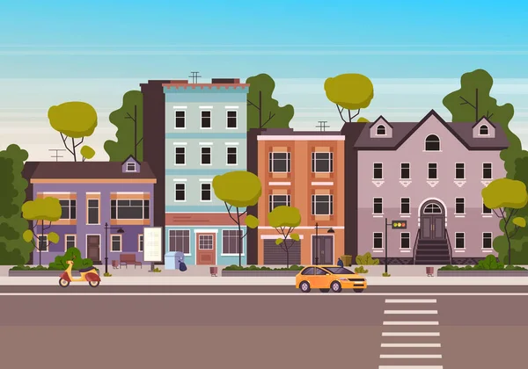
town
Remove

Slide 10
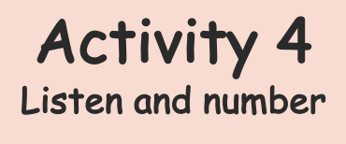

Slide 11


Where is your school?
It’s in the town.

Slide 12

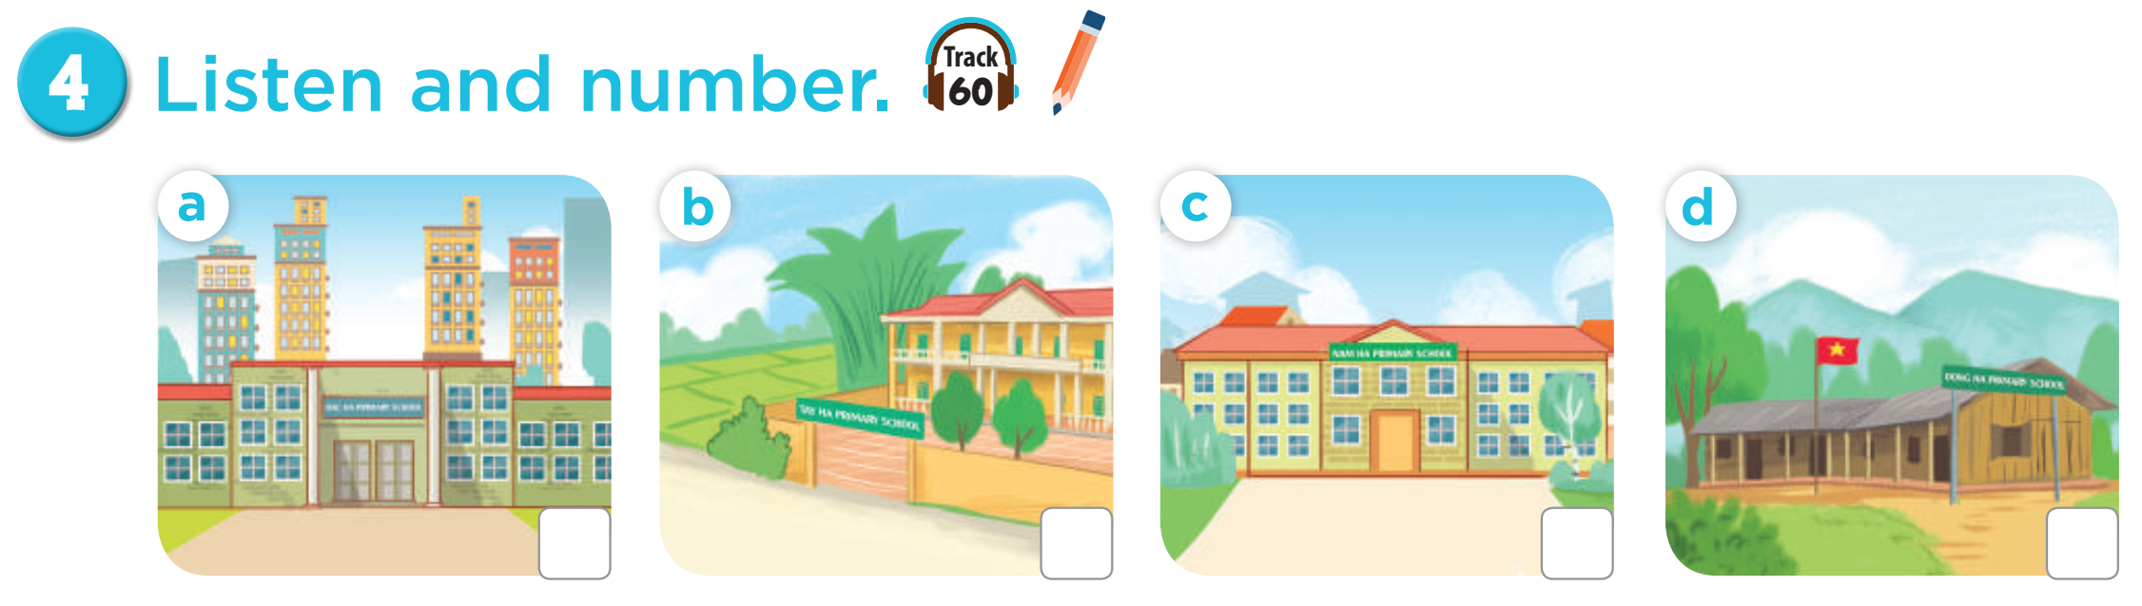
Listen and number
Listen and check
3
4
1
2

Slide 13
Listen and check
1

Slide 15








Slide 16
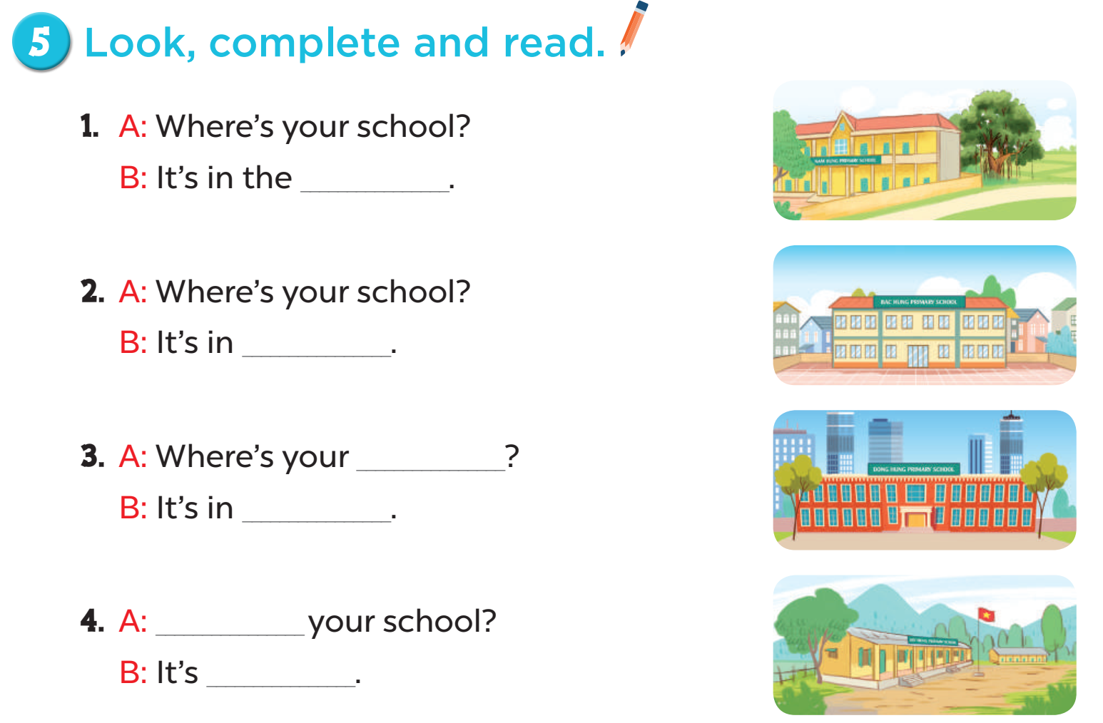
Where’s your school?
It’s in the _____.
village

Slide 17



Congratulations

Slide 18
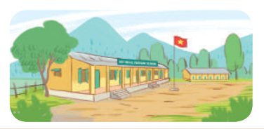
____ your school?
It’s in the mountains.
Where’s

Slide 19
Congratulations

Slide 20

Where’s your school?
____ in the city.
It’s
Notes:
Câu này có thể hỏi học sinh là What is it? trước. Và sau đó yêu cầu chúng nó đánh vần ạ.

Slide 21
Congratulation

Slide 22

Where’s your school?
It’s ____ the town.
in
Notes:
Câu này yêu cầu học sinh đọc câu hỏi và sau đó có thể cho nó chọn một đứa khác để trả lời.

Slide 23
Congratulation

Slide 24
Where’s your ____?
It’s in the city.
school

Slide 25
Congratulation

Slide 26
Where ___ your school?
It’s in the village.
is

Slide 27
Congratulation

Slide 28
My school is in the mountains.
YES or NO
NO

Slide 29
Congratulation

Slide 30
My school is in the ___.
A. city
B. village
C. town

Slide 31
Congratulation

Slide 33
village

Slide 34
the town

Slide 35
school
the city

Slide 36
Where is
in the mountains

Slide 38

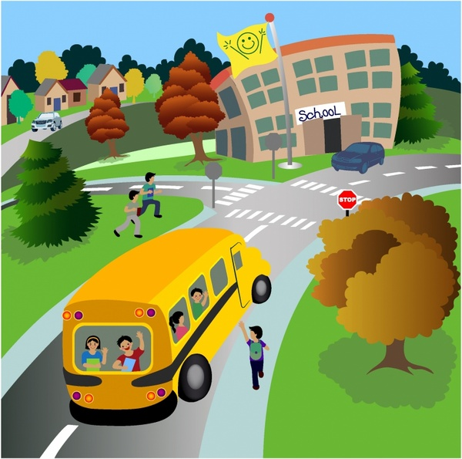
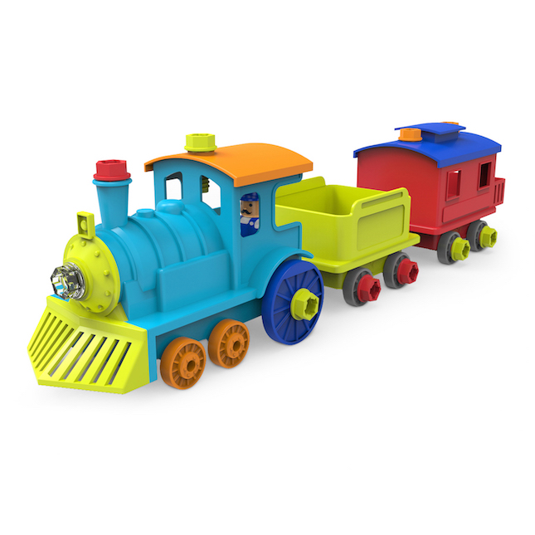


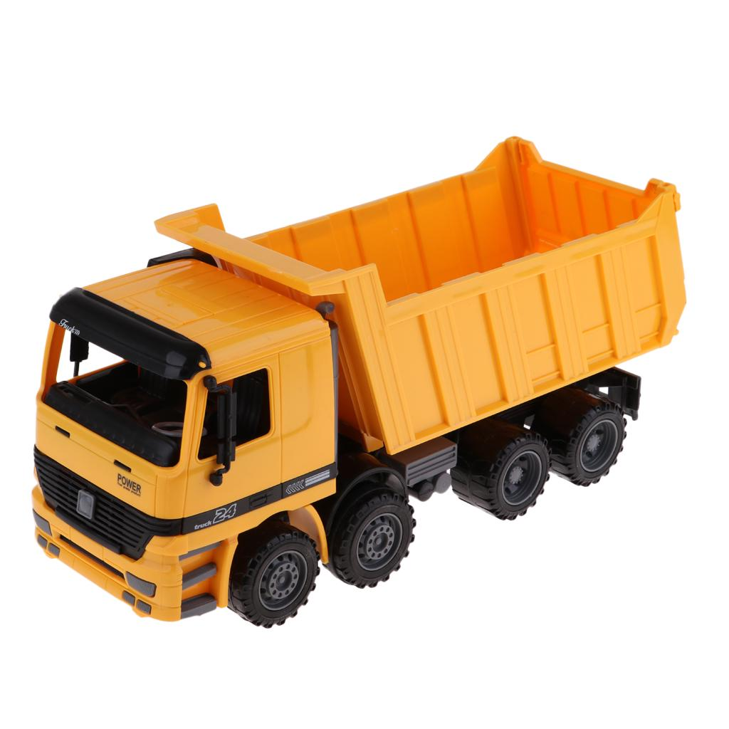
1
2
3
5
school
mountains
4
city
6
7
8
10
town
village
9

Slide 39
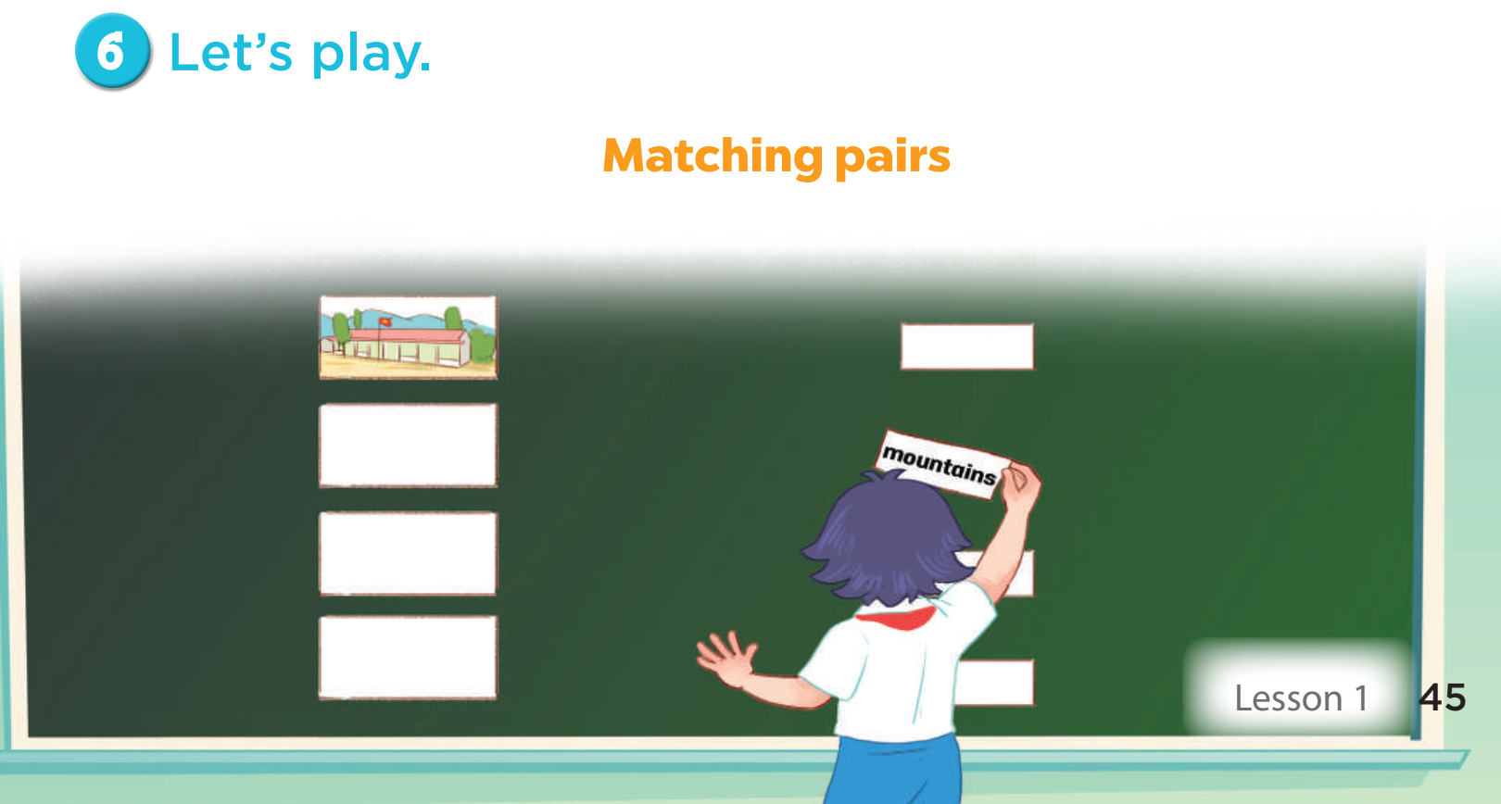

Slide 41
