Slide 1
Our School Facilities
Lesson 1 – Period 1

Slide 2
Table of contents
01
Warm up
Sing and dance
04
02
03
Activity 2
Listen, point and say
05
New words
Activity 3
Let’s talk
06
Activity 1
Look, listen and repeat
Fun time

Slide 4


Slide 6

mountains

Slide 7

village

Slide 8
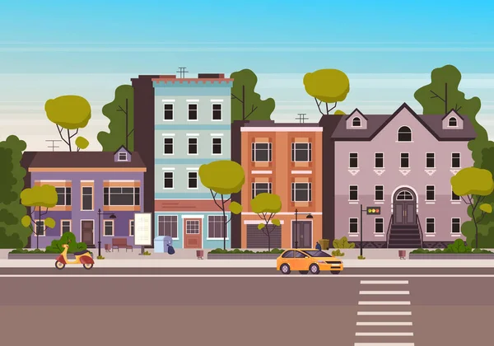
town

Slide 9

city

Slide 10
mountains
village
town
city

Slide 11

Where’s the minion?

Slide 12





Slide 13
In the city.

Slide 14
In the mountains.

Slide 15
In the village.

Slide 16
In the mountains.

Slide 17
In the city.

Slide 18
In the town.

Slide 19
In the city.

Slide 21

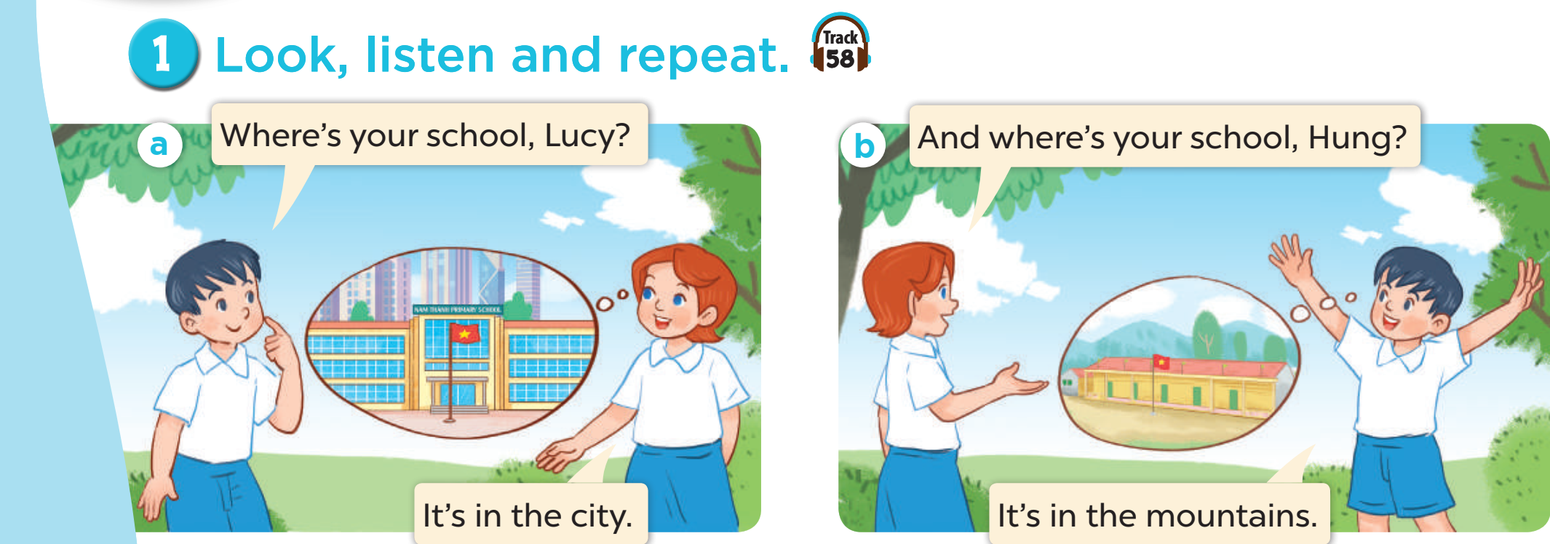
Hung and Lucy are talking about their schools.
Listen

Slide 22
Listen and repeat.

Slide 23
Listen and repeat.

Slide 24
Where is Lucy’s school?
It’s in the city.

Slide 25
Where is Hung’s school?
It’s in the mountains.

Slide 26
Work in pairs. Play roles.
Listen and repeat.

Slide 28
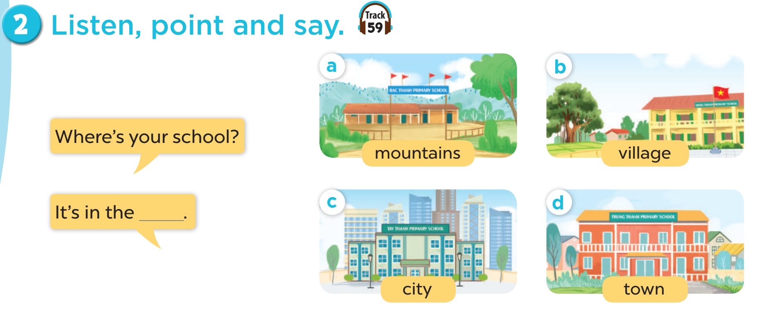
Work in pairs. Play roles.
Listen and repeat.

Slide 29
Where is your school?
It’s in the mountain.

Slide 30
Where is your school?
It’s in the village.

Slide 31
Where is your school?
It’s in the city.

Slide 32
Where is your school?
It’s in the town.

Slide 34
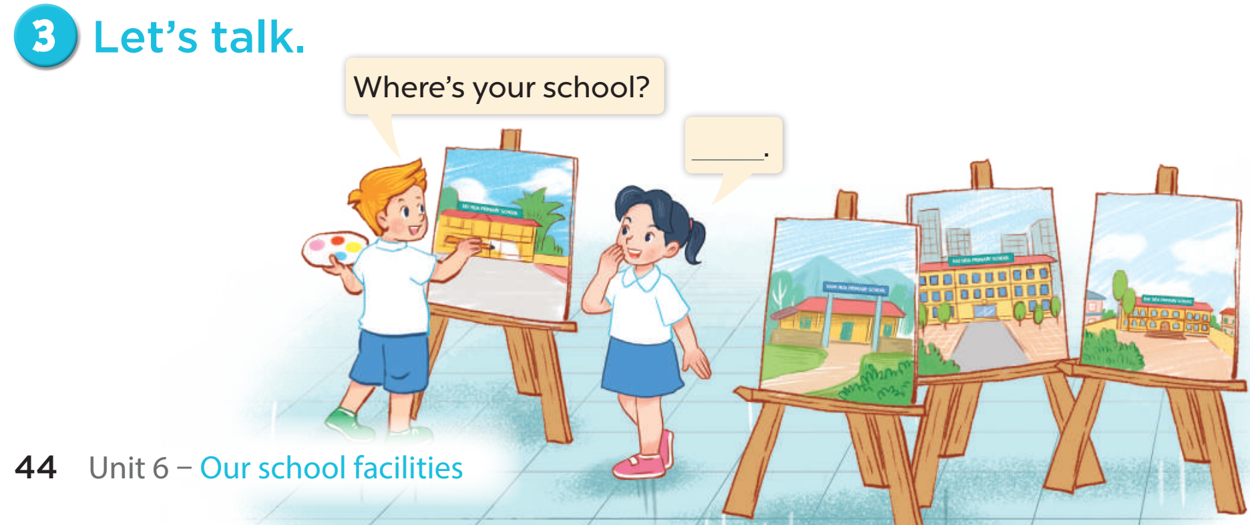

Slide 35


Slide 37




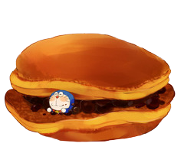

I can’t find my red bean cakes.
Please help me find them.
I’m hungry!

Slide 38

= Mystery
power-up
= points

Slide 39
O
P
Q
R
S
T
U
V
W
X
Y
Z
End game.

Slide 40



_____ is your school? It’s in the city.
Where

Slide 42
Where is your school?
It’s in the ____.
city

Slide 44

Where is your school?
It’s in the mountains.

Slide 46
Where are the children?
A. at home B. at school
B. at school

Slide 48
How many children?
4 children

Slide 50

Is it a village?
Yes, it is.

Slide 52
Where is the minion?
It’s in the village.

Slide 54
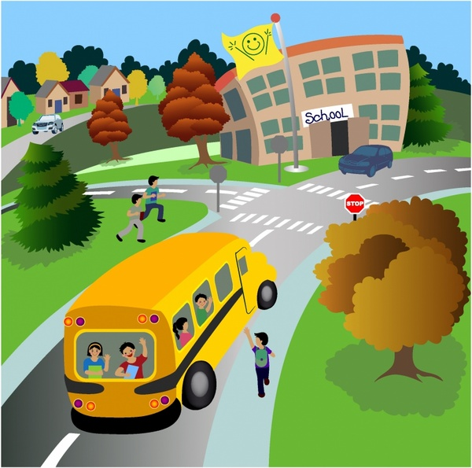
It’s a village.
A
B
A

Slide 56
It’s a city.
Yes or No
No. It’s a town.

Slide 58
My school is in the mountains.
A
B
B

Slide 59







Slide 60
Change points!

Slide 61
Steal 3 points!

Slide 62
7 points!

Slide 63
Where is the school?
It’s in the town.

Slide 64




Slide 65
Steal 3 points!

Slide 66




Slide 67
9 points!

Slide 68
town / the / in / school / is / My /.
My school is in the town.

Slide 69




Slide 70
10 points!

Slide 71
Change points!

