Slide 2









Our Home
Lesson 2 - Period 3

Slide 3

Table of contents
01
02
03
Look, listen and repeat.
Listen, point and say.
Warm-up and review
04
05
Let's talk.
Fun corner and
wrap-up

Slide 4

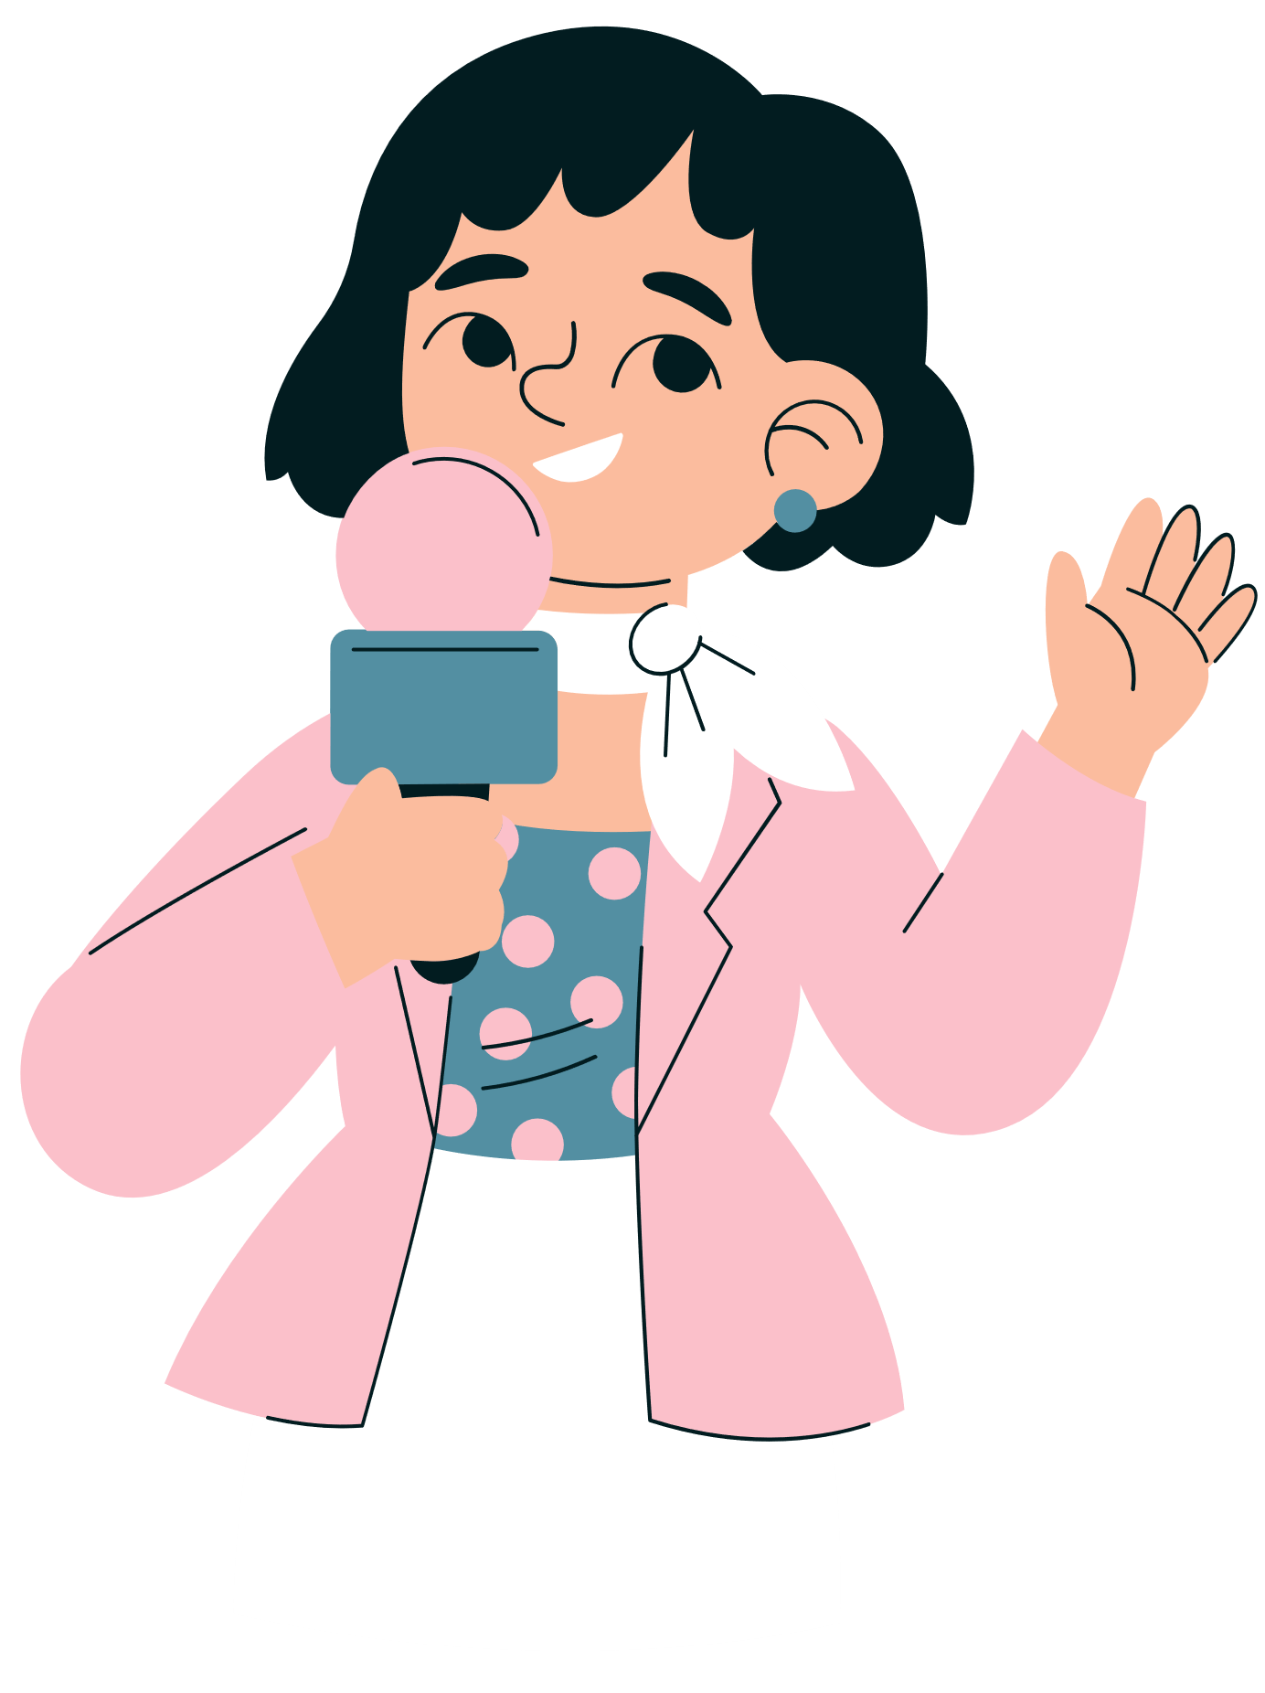

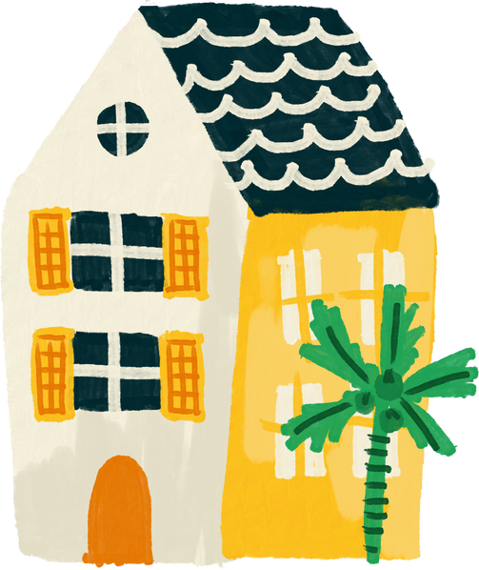
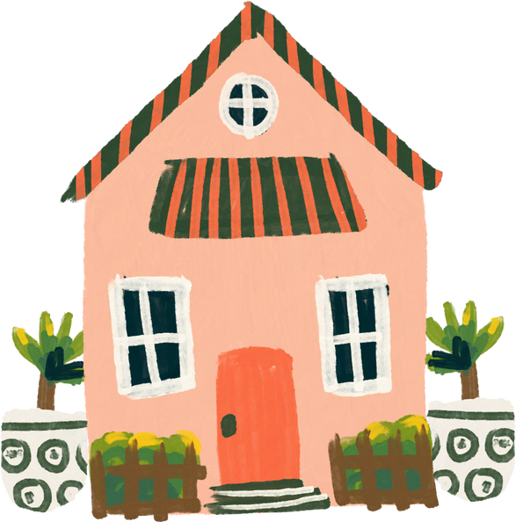
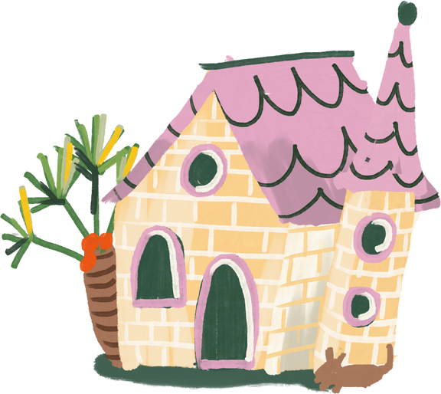
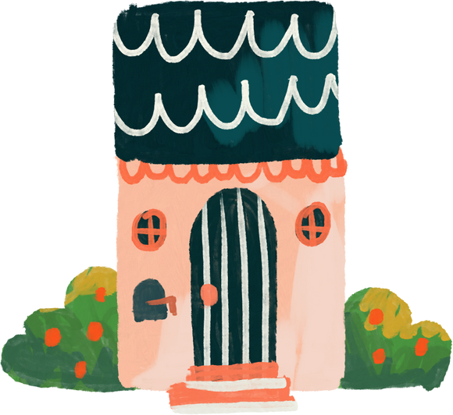
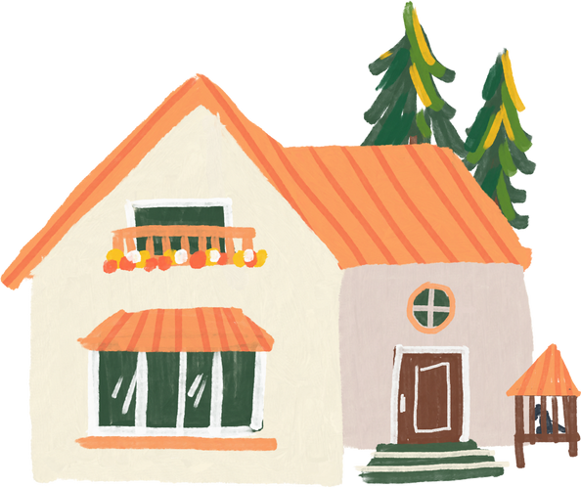
01
Warm-up and review
SLAP THE BOARD
SLAP THE BOARD
Notes:
- T numbers SS in each team
- T call out a number, ss with that number stand up and say the answee
- SS who have the fastest and correct answer will get 2 points, the slower correct answer will get 1 point

Slide 5

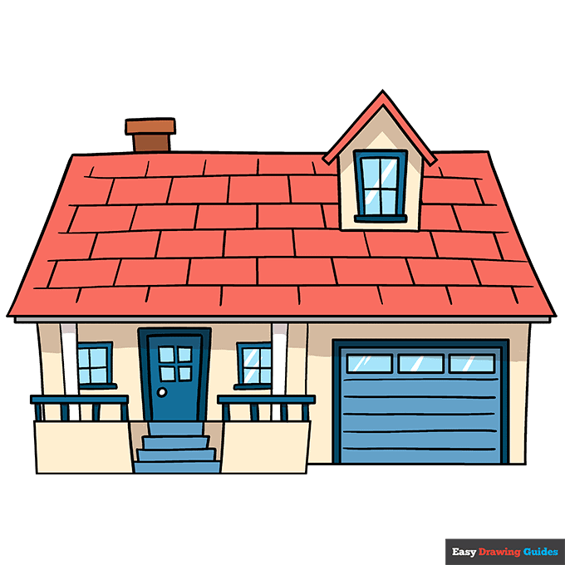
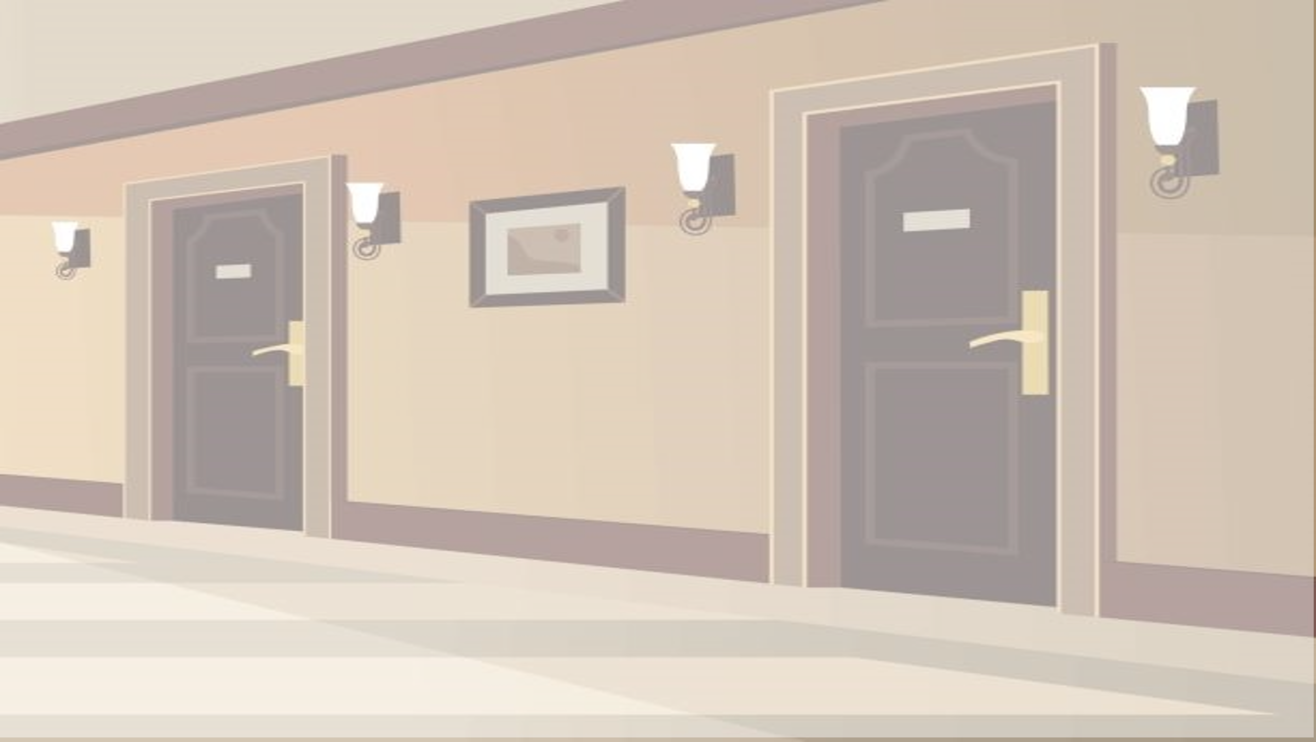
I live in a tower.
z
A
B
C

Slide 6



I live in a building.
z
A
B
C

Slide 7
I live in a flat.
z
A
B
C

Slide 8
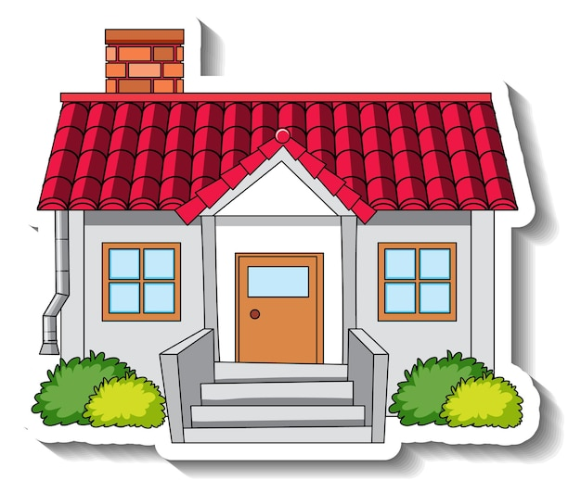
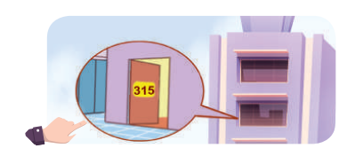
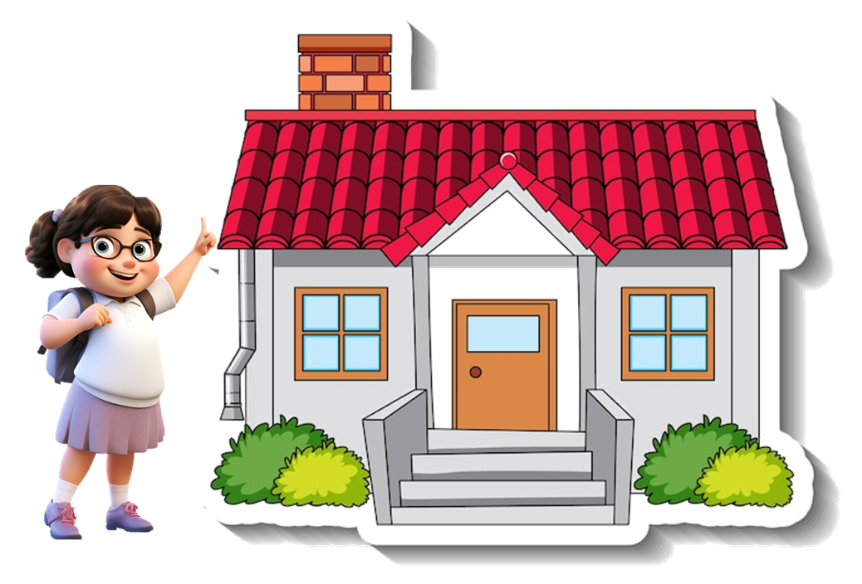


I live in that house.
A
B
C

Slide 9

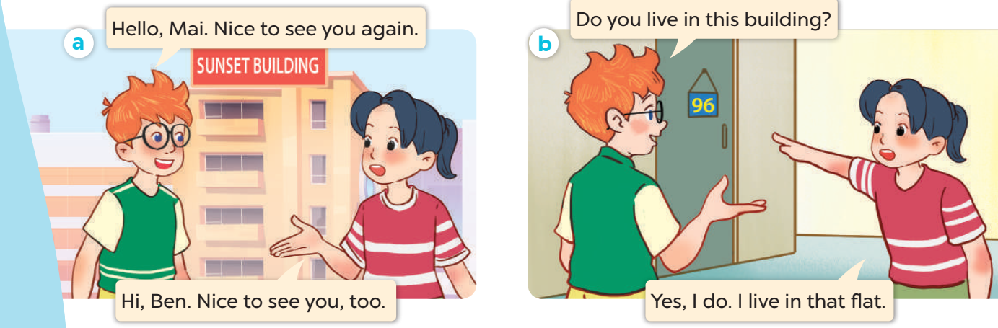
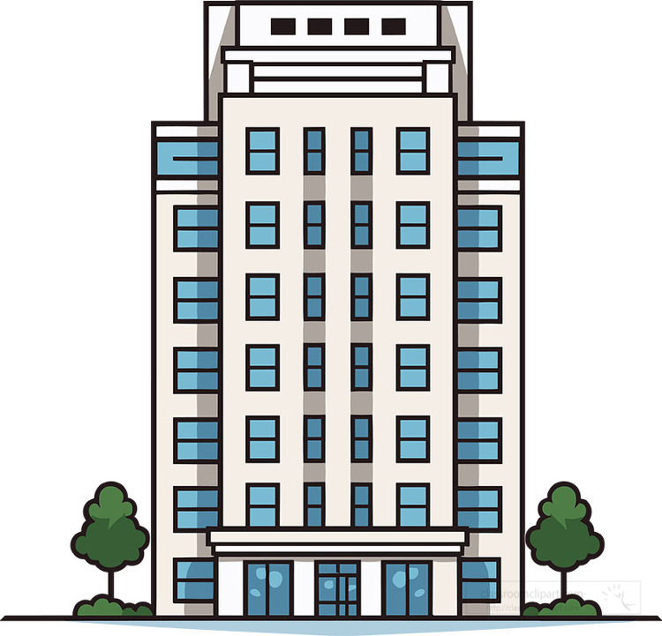
I live in this building.
A
B
C

Slide 10
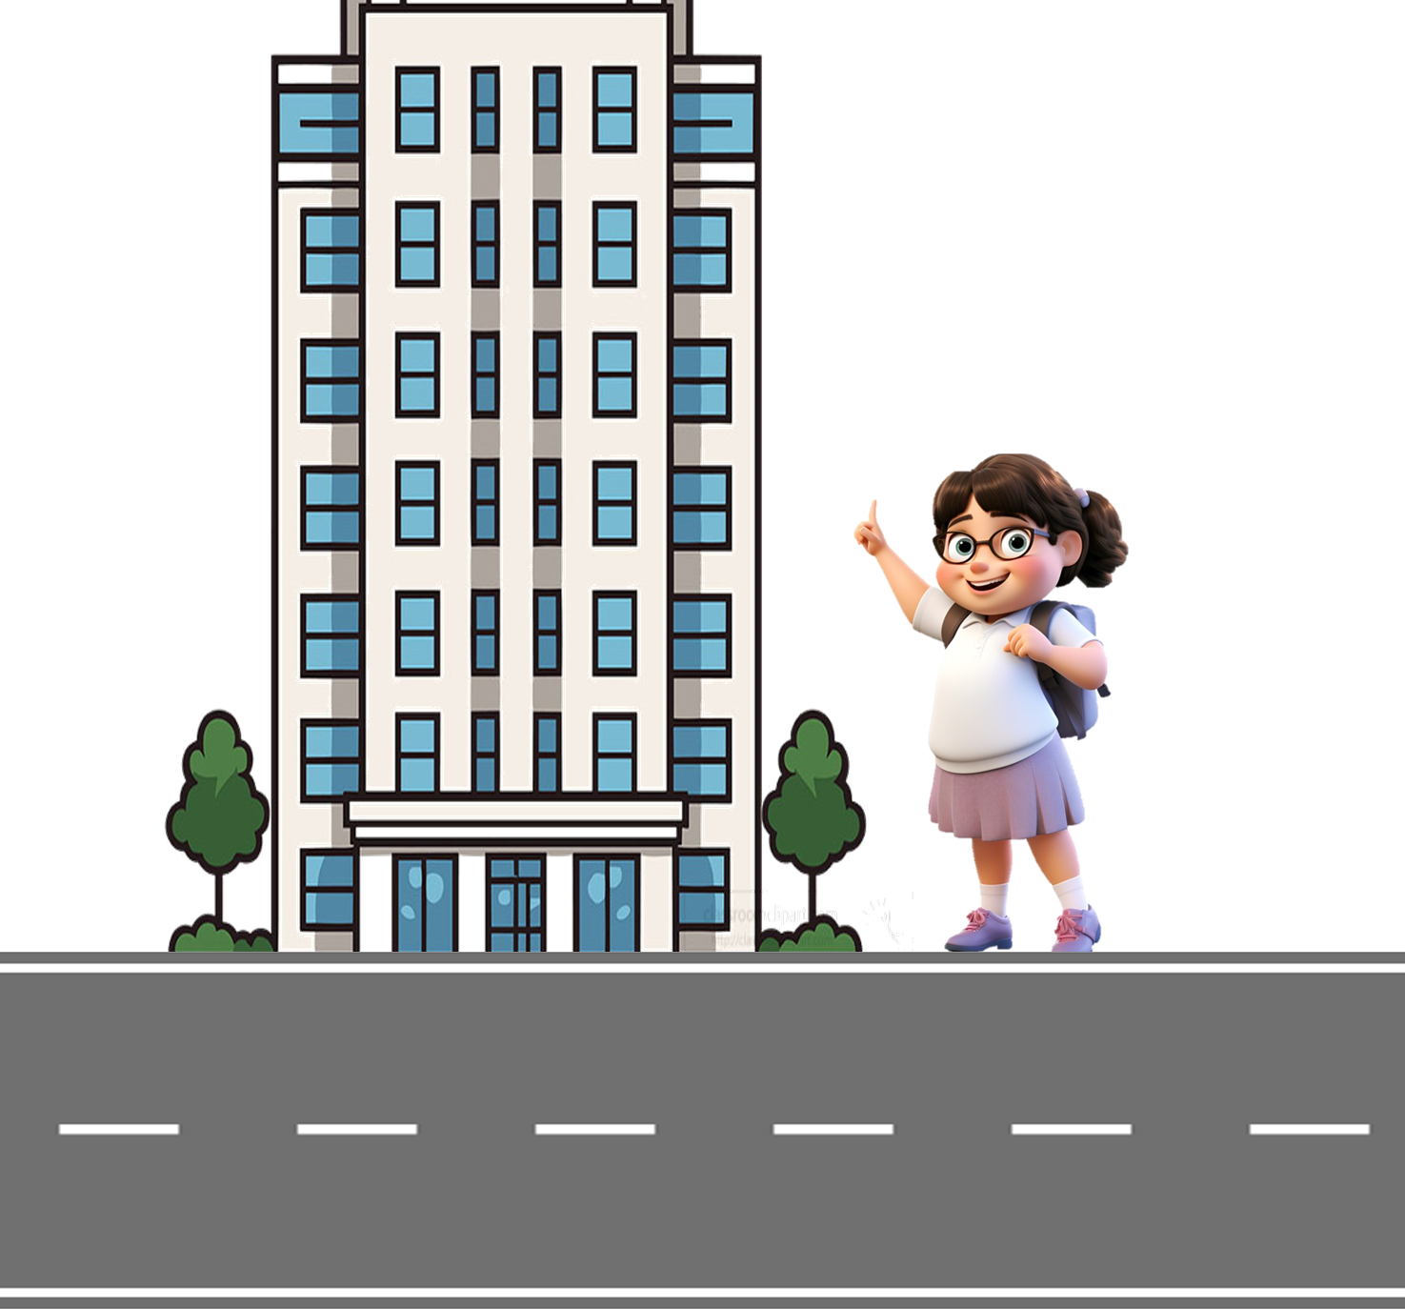
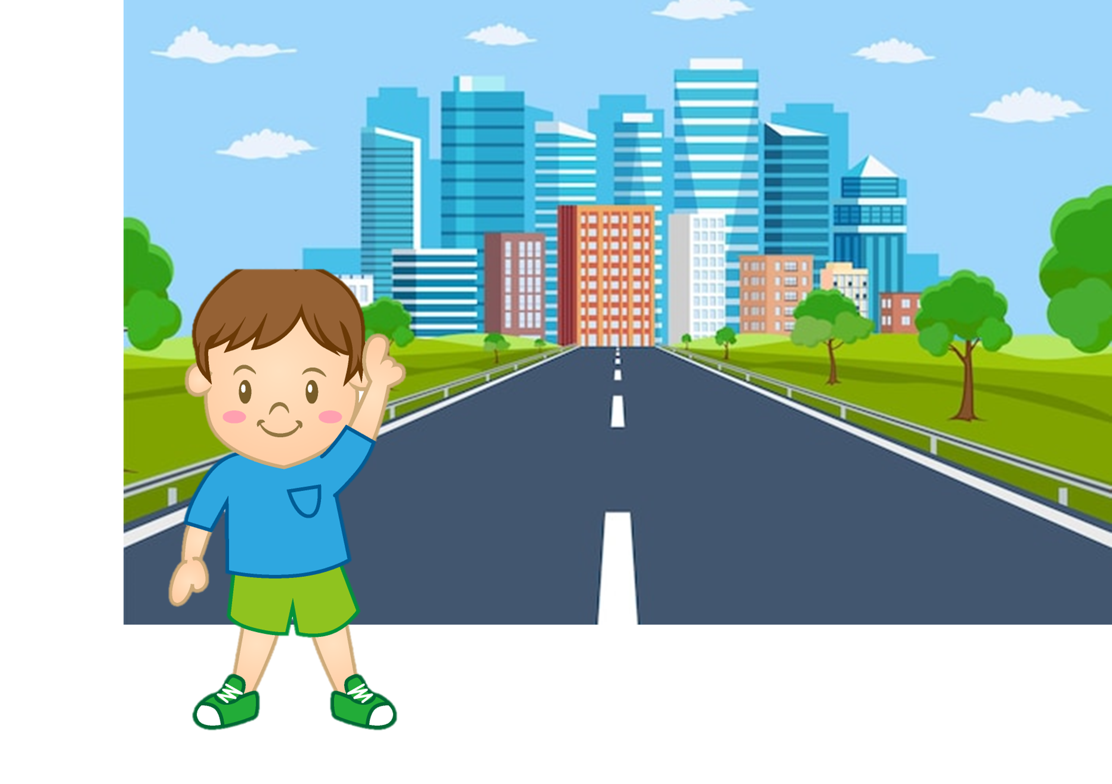
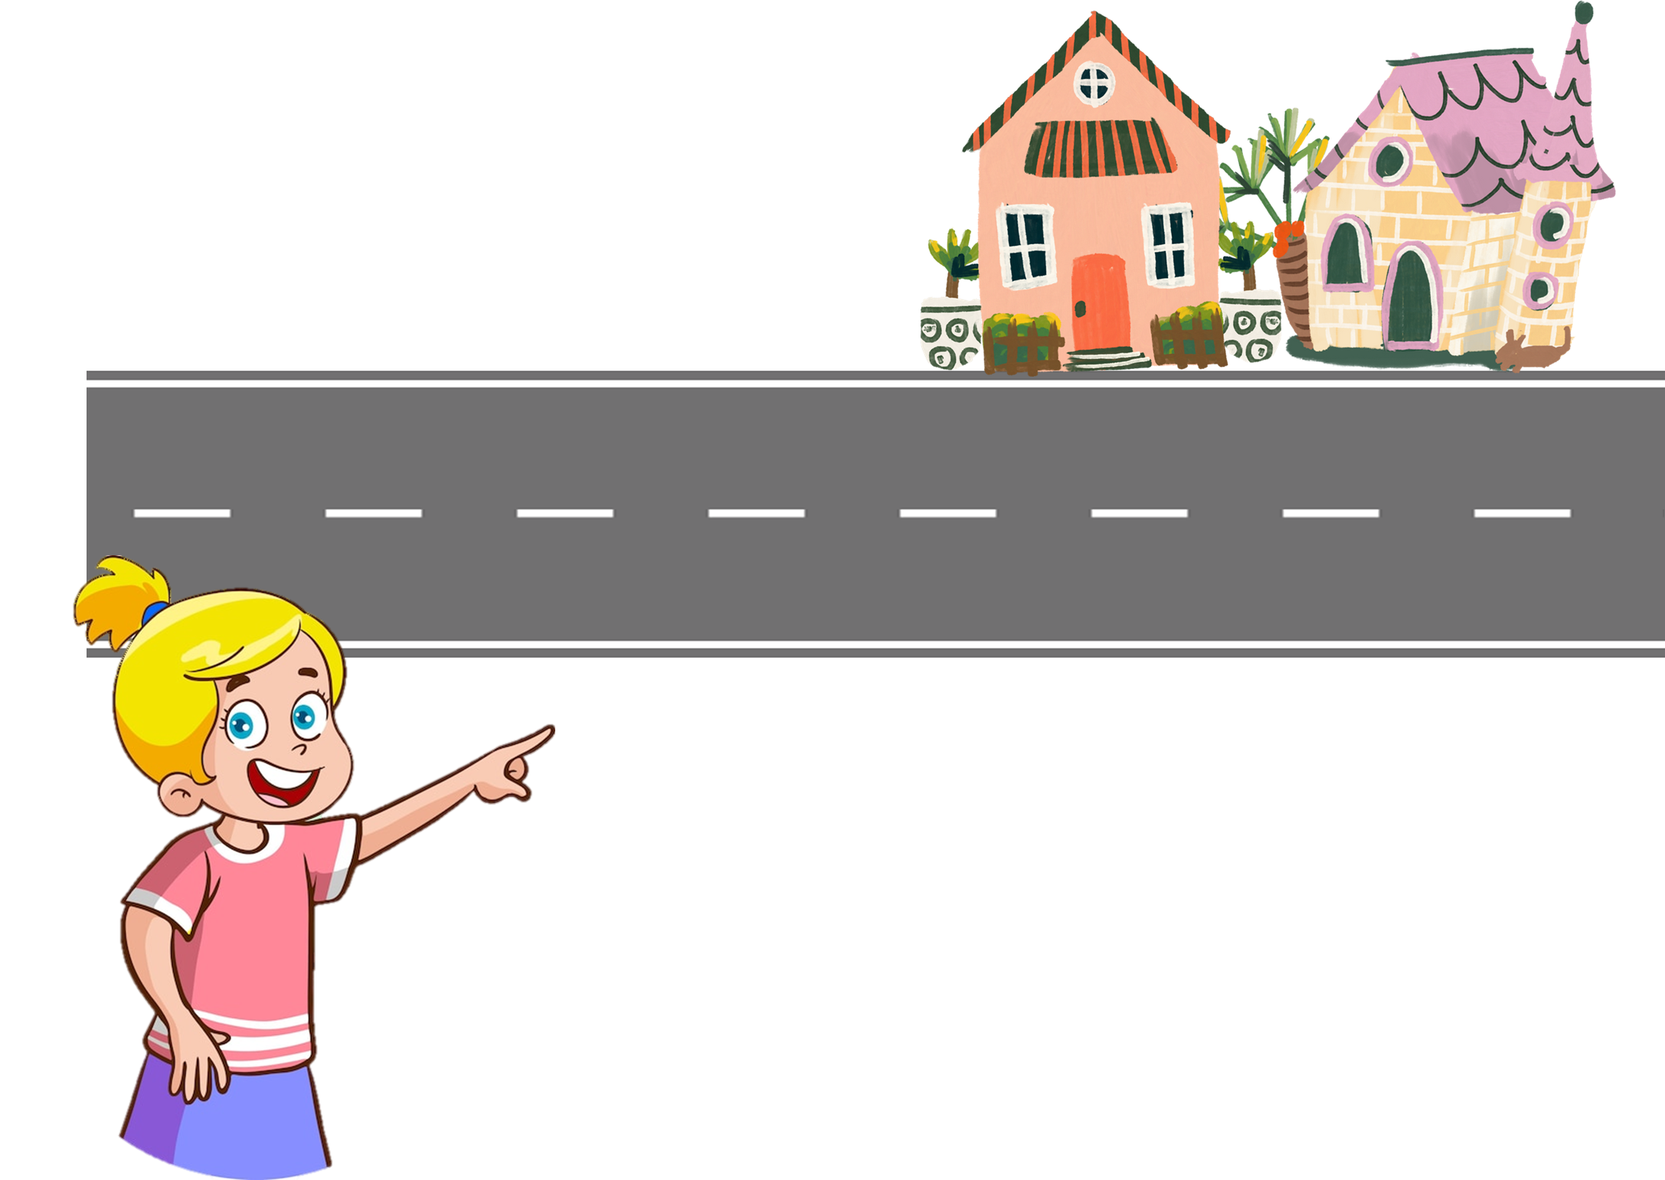
I live in that tower.
z
A
B
C

Slide 11
Review
Numbers 1 - 100

Slide 12
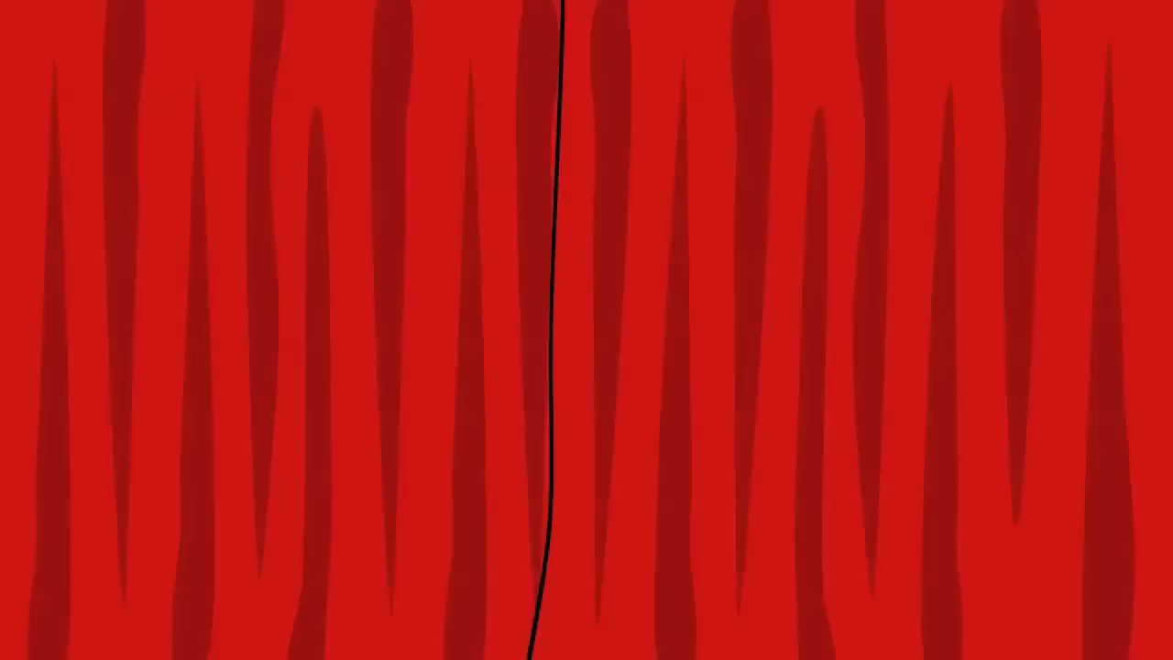
Numbers 1-20

Slide 13
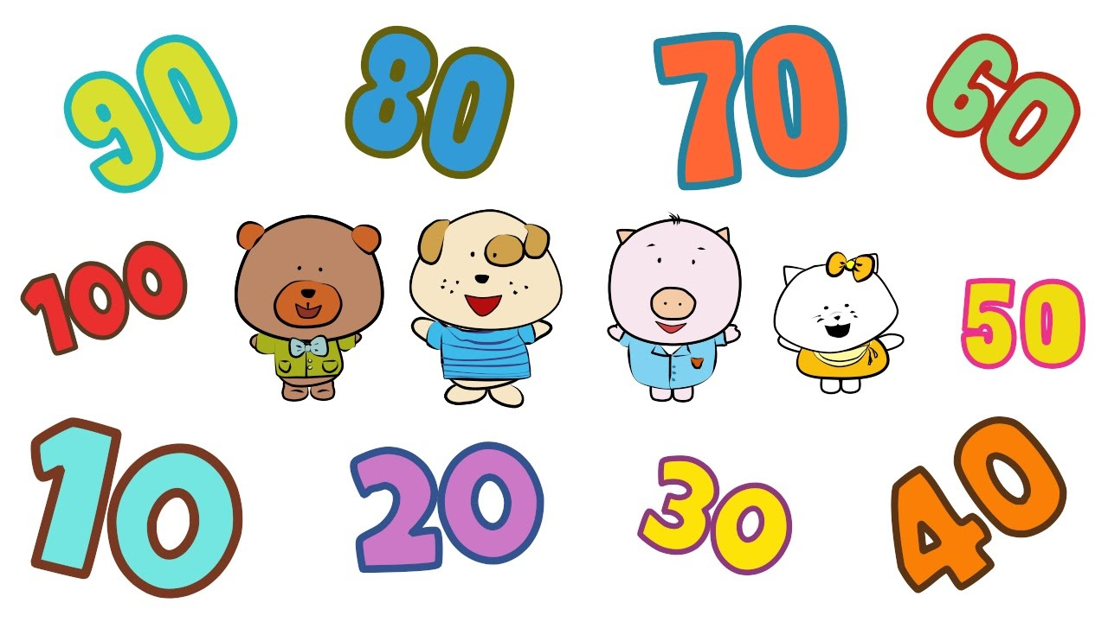

Count by tens to 100

Slide 14

How to say a number?
= 60 and 5
sixty-five

Slide 15

How to say a number >100
= one-one-six

Slide 16
Let's say the numbers!
74
55
37
91
42
245
126
168
29
383

Slide 17
02
Look, listen and repeat.
Notes:
- T numbers SS in each team
- T call out a number, ss with that number stand up and say the answee
- SS who have the fastest and correct answer will get 2 points, the slower correct answer will get 1 point

Slide 18
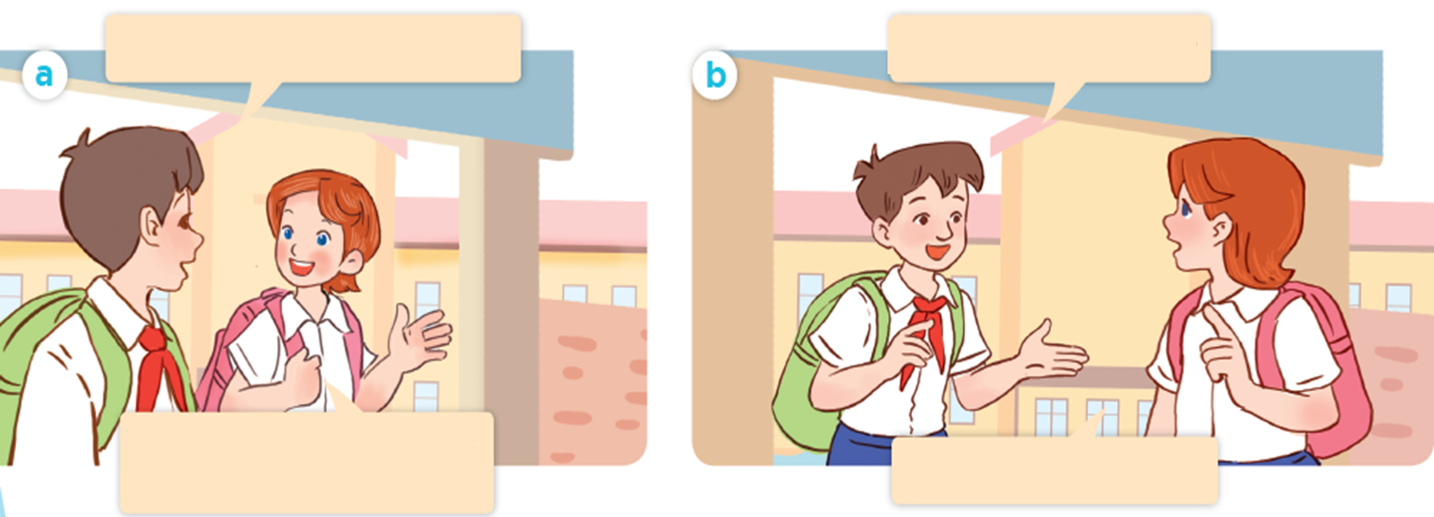
Where are they going?
Look! Where are they?

Slide 19


Look, listen and repeat.
Do you live near the school?
Yes, I do. I live about one
kilometre from here.

Slide 20
Look, listen and repeat
What's your address?
It's 45 Ba Trieu Street.

Slide 21
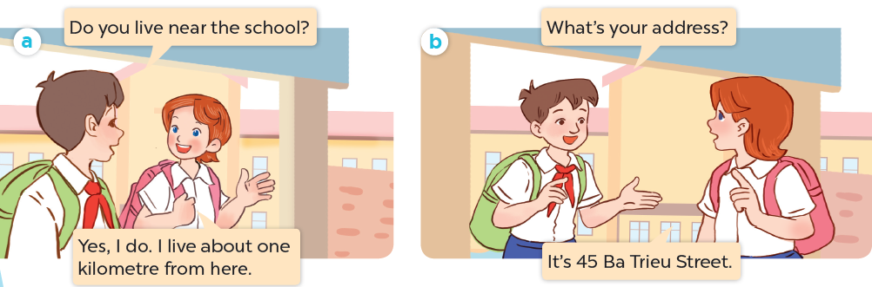
Look, listen and repeat

Slide 22
What's your address?
It's 45 Ba Trieu Street.

Slide 23
03
Listen, point and say.
Notes:
- T numbers SS in each team
- T call out a number, ss with that number stand up and say the answee
- SS who have the fastest and correct answer will get 2 points, the slower correct answer will get 1 point

Slide 24
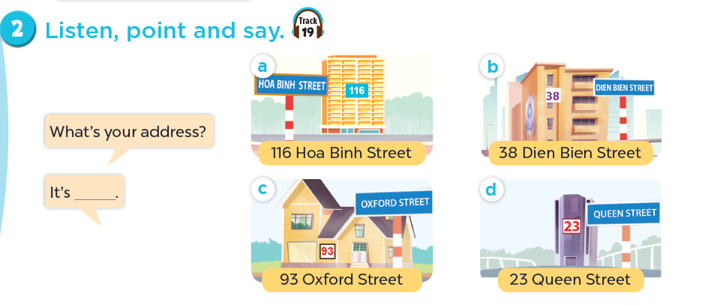
Listen, point and say.

Slide 25
Listen, point and say.
116 Hoa Binh Street

Slide 26
Listen, point and say.
38 Dien Bien Street

Slide 27
Listen, point and say.
93 0xford Street

Slide 28
Listen, point and say.
23 Queen Street

Slide 29


What's your address?
Ba Trieu
45
It's 45 Ba Trieu street.

Slide 30

What's your address?
Queen
134
It's 134 Queen street.

Slide 31
What's your address?
It's _______ street.

Slide 32

Listen, point and say.
What's your address?
It's 116 Hoa Binh Street.
116 Hoa Binh Street

Slide 33
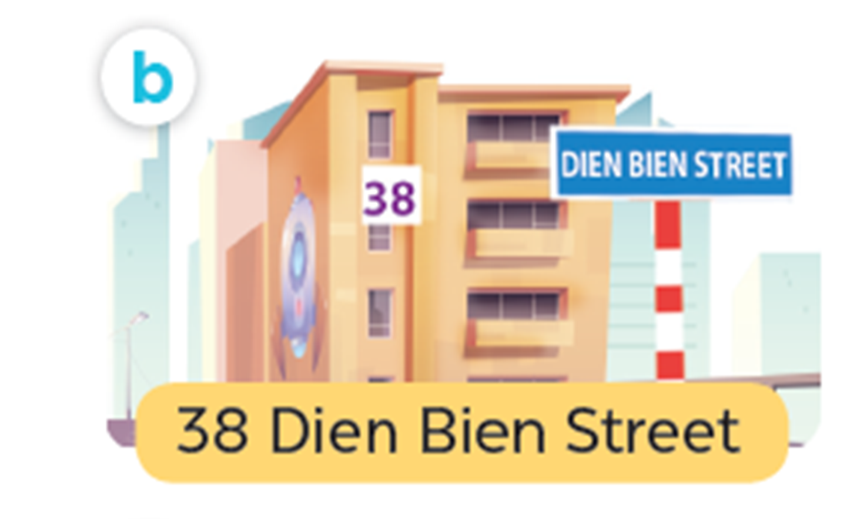
Listen, point and say.
What's your address?
It's 38 Dien Bien Street.
38 Dien Bien Street

Slide 34
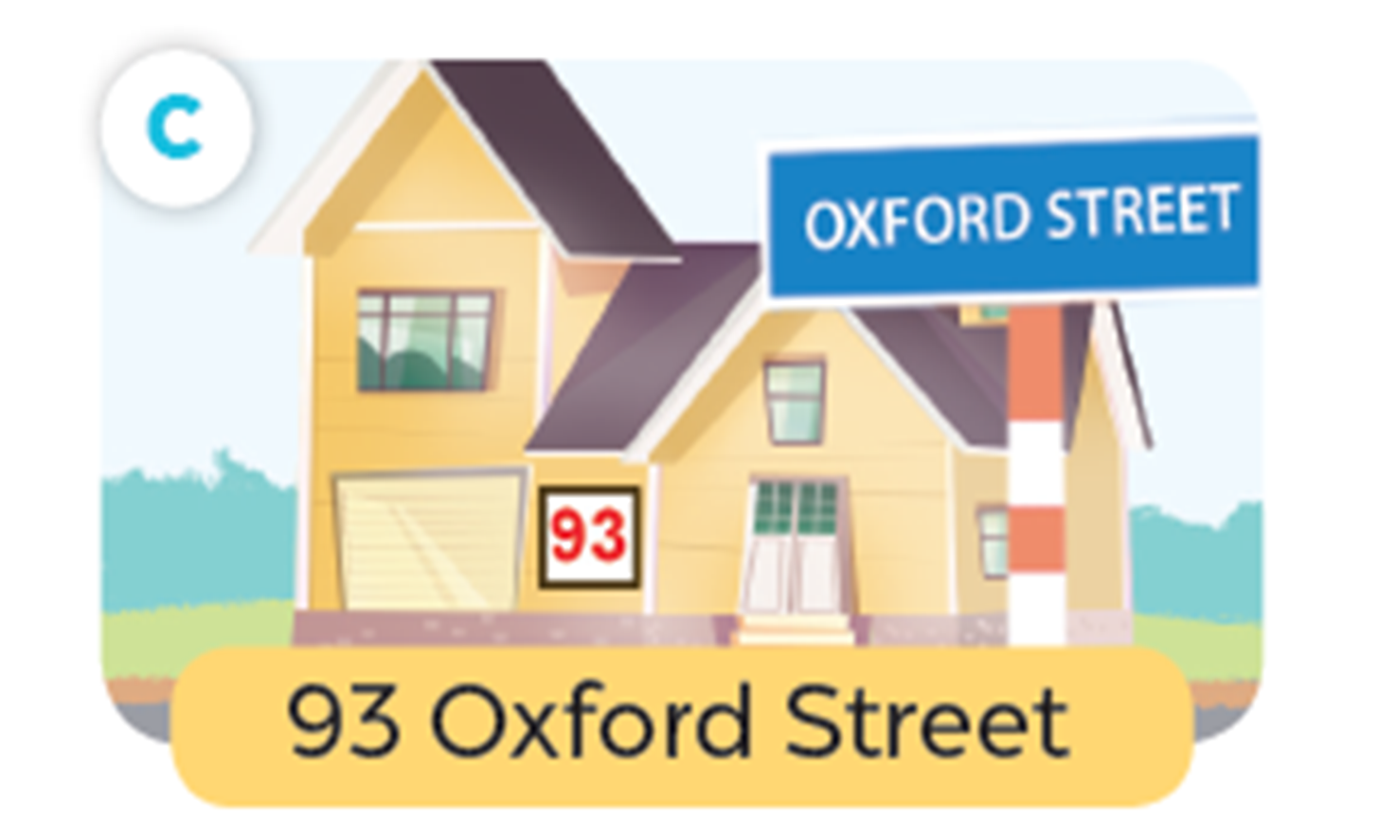
Listen, point and say.
What's your address?
It's 93 Oxford Street.
93 0xford Street

Slide 35
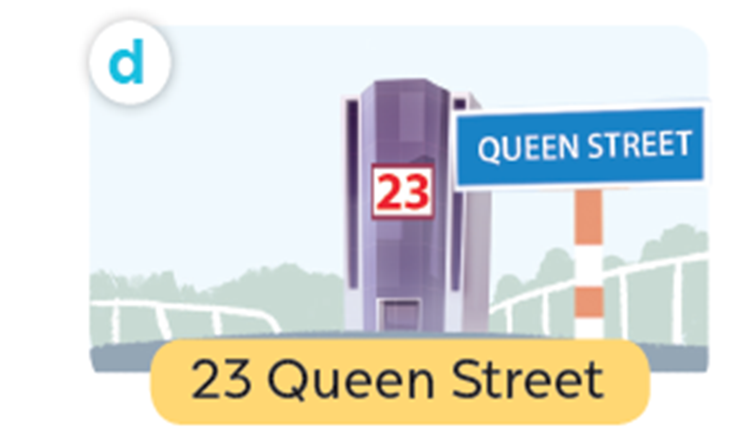
Listen, point and say.
What's your address?
It's 23 Queen Street.
23 Queen Street

Slide 36
Work in pairs. Practise.
What’s your address ?
116 Hoa Binh Street
38 Dien Bien Street
It’s ______ .
93 Oxford Street
23 Queen Street

Slide 37
04
Let's talk.
Notes:
- T numbers SS in each team
- T call out a number, ss with that number stand up and say the answee
- SS who have the fastest and correct answer will get 2 points, the slower correct answer will get 1 point

Slide 38
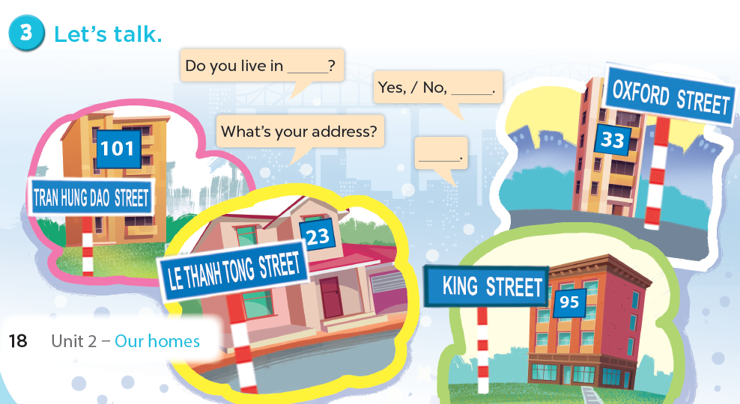
Let's talk.

Slide 39
05
Fun corner and wrap-up
Notes:
- T numbers SS in each team
- T call out a number, ss with that number stand up and say the answee
- SS who have the fastest and correct answer will get 2 points, the slower correct answer will get 1 point

Slide 40


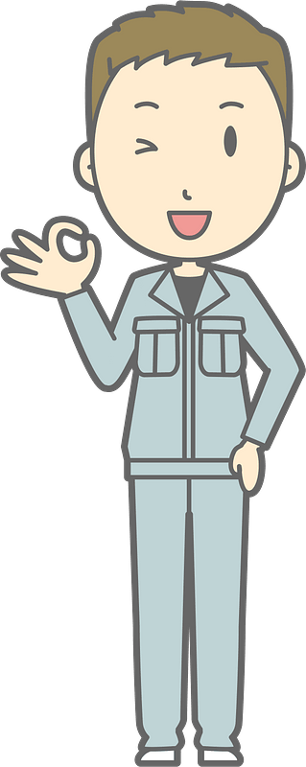
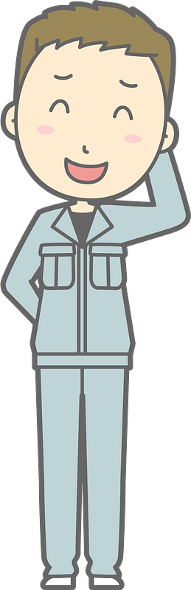

Bad
Luck
Billy
Notes:
This template is for educational, non-commercial purposes only. For more free game templates like this one, visit https://www.taysteachingtoolkit.com

Slide 41




This is Billy.
He has bad luck.

Slide 42

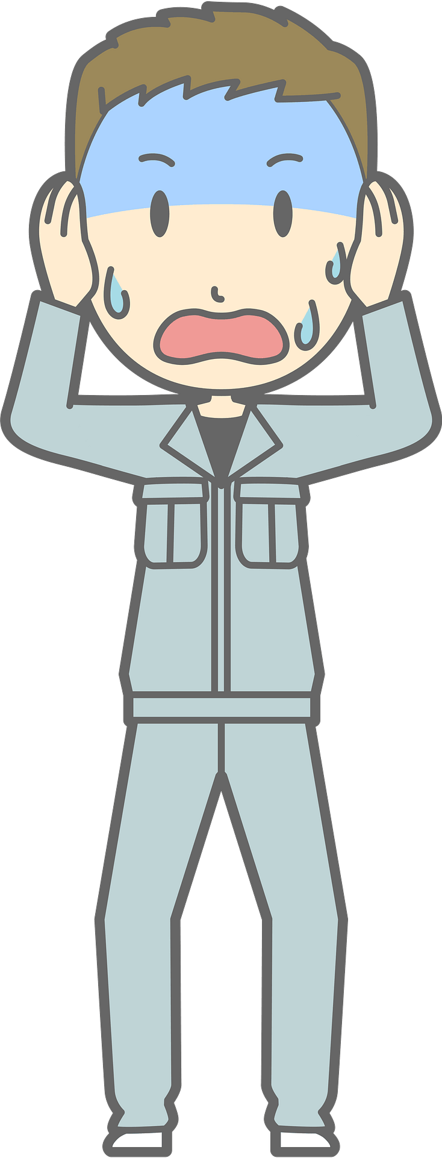
Dark clouds like
to follow him…

Slide 43


…and strike him
with lightning!
Notes:
Skeleton image designed by creazilla.com

Slide 44
Don’t worry,
Billy is okay…

Slide 45
…but, don’t have
bad luck like Billy.

Slide 46
How to play:
Everyone stands up.
One person reads the question on the screen.
Then, the next person goes.
If Billy is struck by lightning when
you’re reading, you’re out (sit down).
The last person standing is the winner!
Notes:
TEACHER NOTES:
When I say ”Then, the next person goes.” I mean the next person reads the same word/sentence on the screen. The order of students reading is up to you and what makes the most sense for your class.
Feel free to adjust the instructions as needed for your class.
Skeleton image designed by creazilla.com

Slide 47
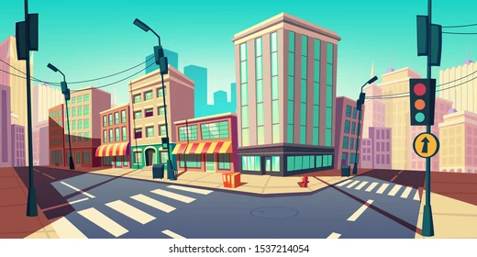

What's your address?
Ready?
67
Notes:
TEACHER NOTES:
Replace the text in the box with your key vocabulary/sentences.
OR if you want to make it into a speaking activity, delete the text and put an image in the box.
When playing the game, click/press the spacebar to send in the dark clouds.
Students start reading the text in the box after the dark cloud music stops.
Lightning will strike automatically after the dark clouds appear, no need to click again. The time when it strikes is different on each slide (view the animation pane to view or change the timing).
After the lightning strikes Billy and the student reading sits down, click/press the spacebar to go to the next slide.
Currently, there are 30 game slides in total (meant for 31 students). However, feel free to add or delete slides as needed for the number of students in your class.
If you want to adjust the time of when the lightning strikes, go to the “Animations” tab and open the ”Animation Pane.” Then, click on the “Lightning Strike” animation and adjust the delay time in the timing window.
If using the game more than once with the same class and are worried students will remember the lightning strike timing on each slide, no need to adjust the times of each lightning strike animation, just reorder the slides to save time and make the game feel fresh.
Skeleton image designed by creazilla.com

Slide 48


What's your address?
Ready?
108
Oxford
Notes:
TEACHER NOTES:
Replace the text in the box with your key vocabulary/sentences.
OR if you want to make it into a speaking activity, delete the text and put an image in the box.
When playing the game, click/press the spacebar to send in the dark clouds.
Students start reading the text in the box after the dark cloud music stops.
Lightning will strike automatically after the dark clouds appear, no need to click again. The time when it strikes is different on each slide (view the animation pane to view or change the timing).
After the lightning strikes Billy and the student reading sits down, click/press the spacebar to go to the next slide.
Currently, there are 30 game slides in total (meant for 31 students). However, feel free to add or delete slides as needed for the number of students in your class.
If you want to adjust the time of when the lightning strikes, go to the “Animations” tab and open the ”Animation Pane.” Then, click on the “Lightning Strike” animation and adjust the delay time in the timing window.
If using the game more than once with the same class and are worried students will remember the lightning strike timing on each slide, no need to adjust the times of each lightning strike animation, just reorder the slides to save time and make the game feel fresh.
Skeleton image designed by creazilla.com

Slide 49
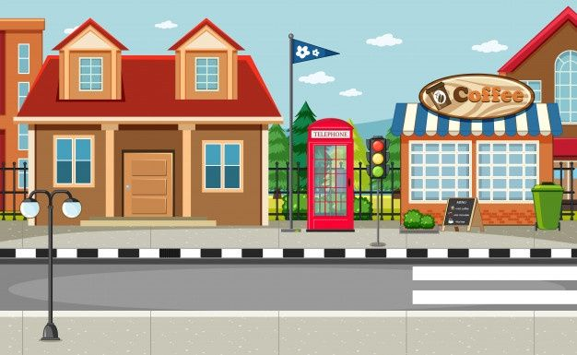
What's your address?
Ready?
76
Hung Vuong
Notes:
TEACHER NOTES:
Replace the text in the box with your key vocabulary/sentences.
OR if you want to make it into a speaking activity, delete the text and put an image in the box.
When playing the game, click/press the spacebar to send in the dark clouds.
Students start reading the text in the box after the dark cloud music stops.
Lightning will strike automatically after the dark clouds appear, no need to click again. The time when it strikes is different on each slide (view the animation pane to view or change the timing).
After the lightning strikes Billy and the student reading sits down, click/press the spacebar to go to the next slide.
Currently, there are 30 game slides in total (meant for 31 students). However, feel free to add or delete slides as needed for the number of students in your class.
If you want to adjust the time of when the lightning strikes, go to the “Animations” tab and open the ”Animation Pane.” Then, click on the “Lightning Strike” animation and adjust the delay time in the timing window.
If using the game more than once with the same class and are worried students will remember the lightning strike timing on each slide, no need to adjust the times of each lightning strike animation, just reorder the slides to save time and make the game feel fresh.
Skeleton image designed by creazilla.com

Slide 50
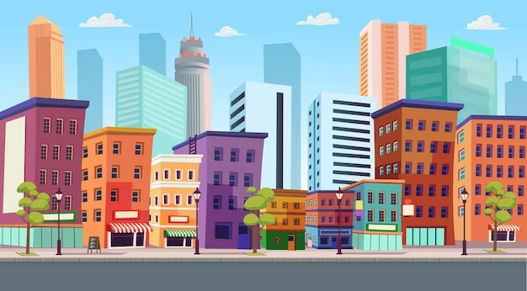
What's your address?
Ready?
25
Power
Notes:
TEACHER NOTES:
Replace the text in the box with your key vocabulary/sentences.
OR if you want to make it into a speaking activity, delete the text and put an image in the box.
When playing the game, click/press the spacebar to send in the dark clouds.
Students start reading the text in the box after the dark cloud music stops.
Lightning will strike automatically after the dark clouds appear, no need to click again. The time when it strikes is different on each slide (view the animation pane to view or change the timing).
After the lightning strikes Billy and the student reading sits down, click/press the spacebar to go to the next slide.
Currently, there are 30 game slides in total (meant for 31 students). However, feel free to add or delete slides as needed for the number of students in your class.
If you want to adjust the time of when the lightning strikes, go to the “Animations” tab and open the ”Animation Pane.” Then, click on the “Lightning Strike” animation and adjust the delay time in the timing window.
If using the game more than once with the same class and are worried students will remember the lightning strike timing on each slide, no need to adjust the times of each lightning strike animation, just reorder the slides to save time and make the game feel fresh.
Skeleton image designed by creazilla.com

Slide 51

_____________?
It's 33 Oxford street.
Ready?
Notes:
TEACHER NOTES:
Replace the text in the box with your key vocabulary/sentences.
OR if you want to make it into a speaking activity, delete the text and put an image in the box.
When playing the game, click/press the spacebar to send in the dark clouds.
Students start reading the text in the box after the dark cloud music stops.
Lightning will strike automatically after the dark clouds appear, no need to click again. The time when it strikes is different on each slide (view the animation pane to view or change the timing).
After the lightning strikes Billy and the student reading sits down, click/press the spacebar to go to the next slide.
Currently, there are 30 game slides in total (meant for 31 students). However, feel free to add or delete slides as needed for the number of students in your class.
If you want to adjust the time of when the lightning strikes, go to the “Animations” tab and open the ”Animation Pane.” Then, click on the “Lightning Strike” animation and adjust the delay time in the timing window.
If using the game more than once with the same class and are worried students will remember the lightning strike timing on each slide, no need to adjust the times of each lightning strike animation, just reorder the slides to save time and make the game feel fresh.
Skeleton image designed by creazilla.com

Slide 52
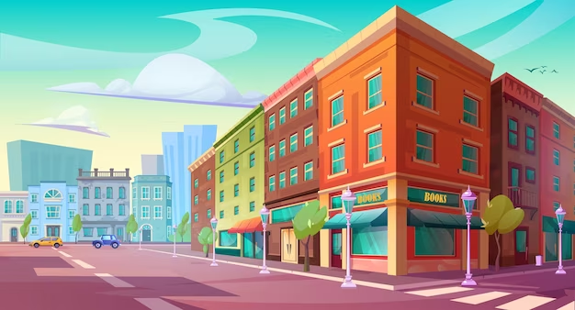
What's your address?
Ready?
246
Cau Giay
Notes:
TEACHER NOTES:
Replace the text in the box with your key vocabulary/sentences.
OR if you want to make it into a speaking activity, delete the text and put an image in the box.
When playing the game, click/press the spacebar to send in the dark clouds.
Students start reading the text in the box after the dark cloud music stops.
Lightning will strike automatically after the dark clouds appear, no need to click again. The time when it strikes is different on each slide (view the animation pane to view or change the timing).
After the lightning strikes Billy and the student reading sits down, click/press the spacebar to go to the next slide.
Currently, there are 30 game slides in total (meant for 31 students). However, feel free to add or delete slides as needed for the number of students in your class.
If you want to adjust the time of when the lightning strikes, go to the “Animations” tab and open the ”Animation Pane.” Then, click on the “Lightning Strike” animation and adjust the delay time in the timing window.
If using the game more than once with the same class and are worried students will remember the lightning strike timing on each slide, no need to adjust the times of each lightning strike animation, just reorder the slides to save time and make the game feel fresh.
Skeleton image designed by creazilla.com

Slide 53
Website: hoclieu.vn
Fanpage: facebook.com/www.tienganhglobalsuccess.vn

