Slide 2
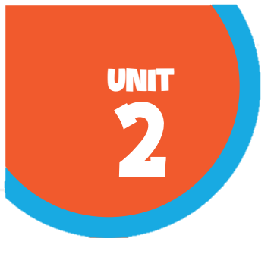








Our home
Lesson 1 - Period 1

Slide 3

Table of contents
01
02
03
Look, listen and repeat.
Listen, point and say.
Warm-up and review
04
05
Let's talk.
Fun corner and wrap-up

Slide 4



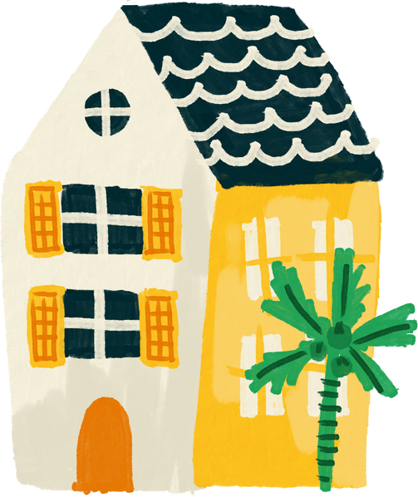

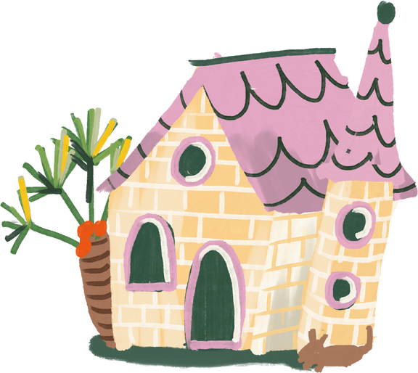
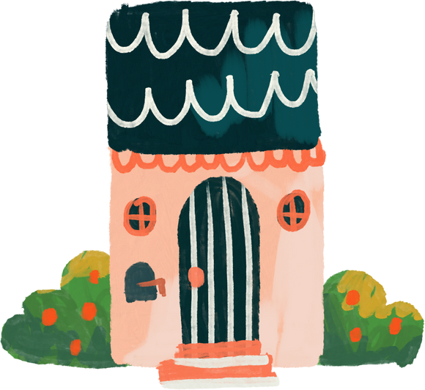
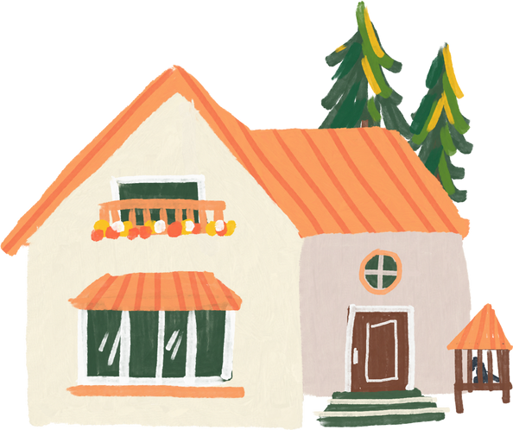
01
Warm-up and review

Slide 5



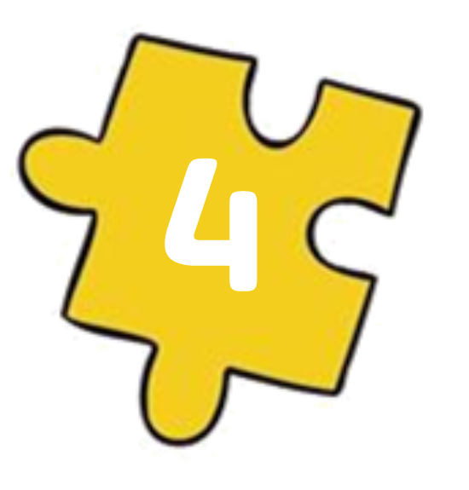
Guess the key word
Collect the letters.
E
O
HOME
M
H
Next Activity

Slide 6
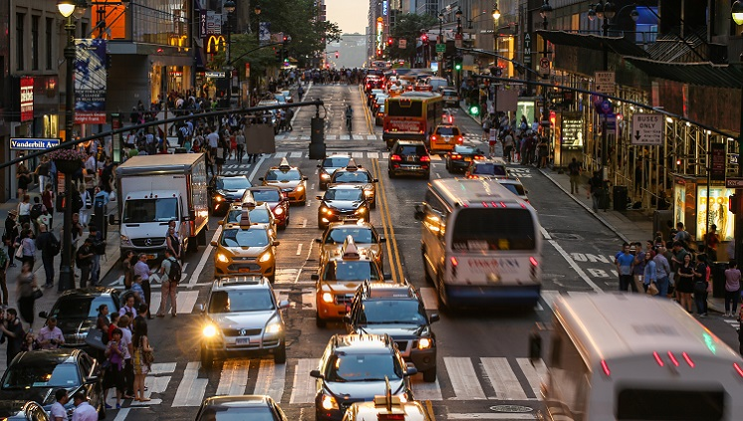
It's a busy .
st_ _e_
street

Slide 7
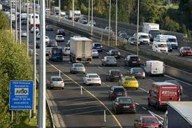
It's a noisy .
r_ _ _
road

Slide 8
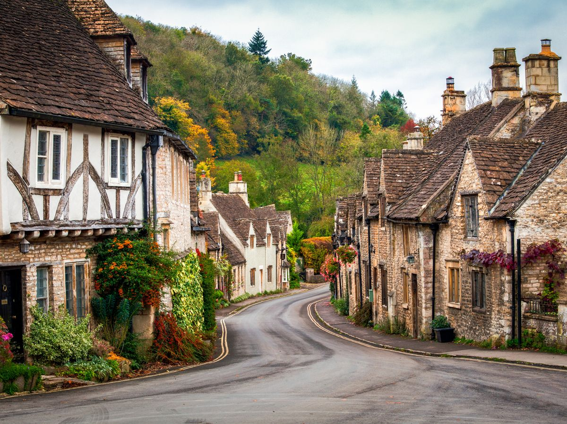
It's a quiet .
village
v_l_ag_

Slide 9

It's a big ..
c_ _y
city

Slide 10
02
Look, listen and repeat.

Slide 11
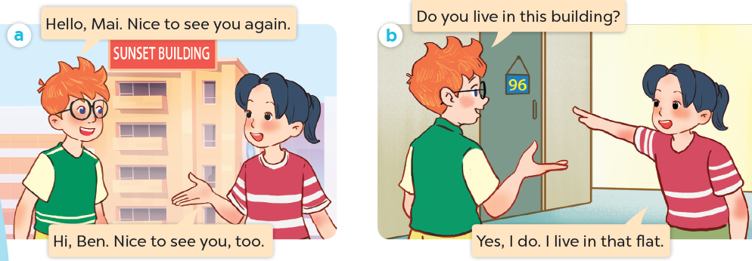
What are they talking about?
Where are they?
Who are they?

Slide 12

Look, listen and repeat.

Slide 13
Look, listen and repeat.

Slide 14
Look, listen and repeat.

Slide 15
03
Listen, point and say.

Slide 16
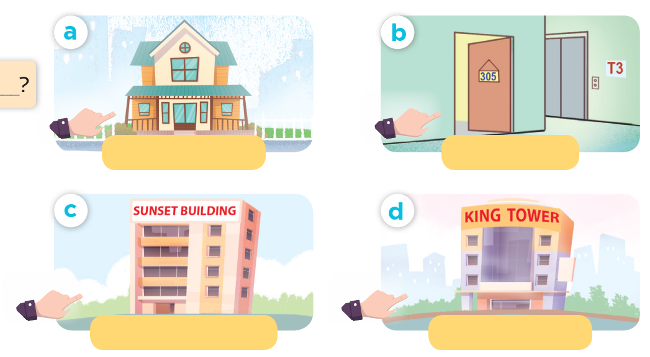
Look and say.

Slide 17
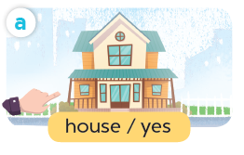
Listen, point and say.
house / yes

Slide 18
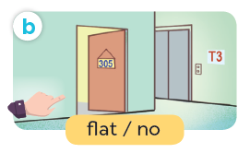
Listen, point and say.
flat / no

Slide 19
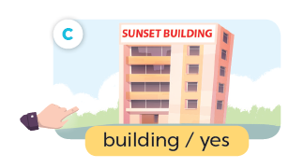
Listen, point and say.
building / yes

Slide 20
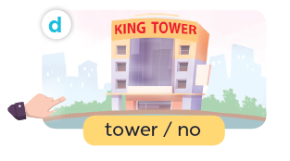
Listen, point and say.
tower / no

Slide 21
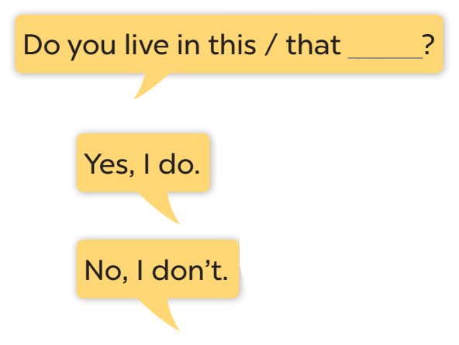




Slide 22
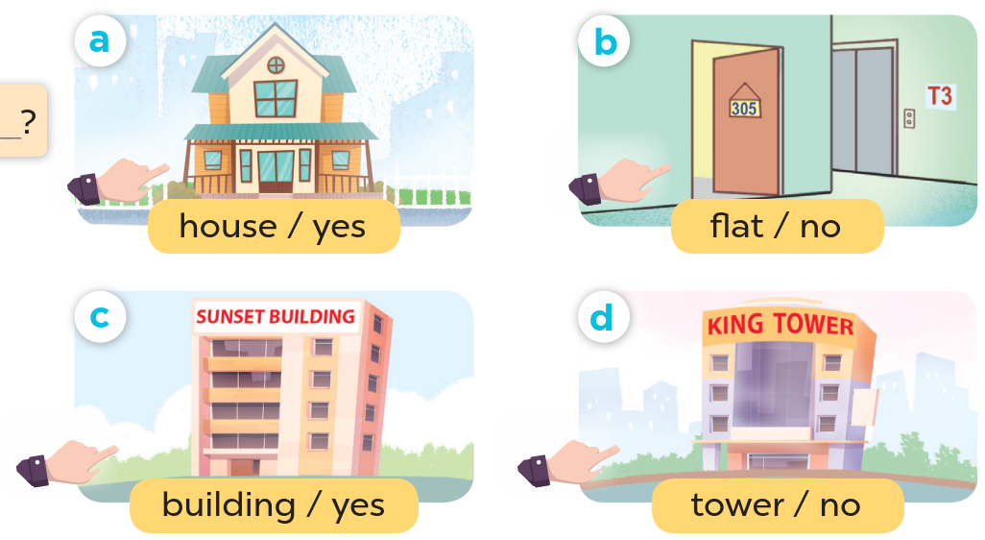
Look at the hands.

Slide 23
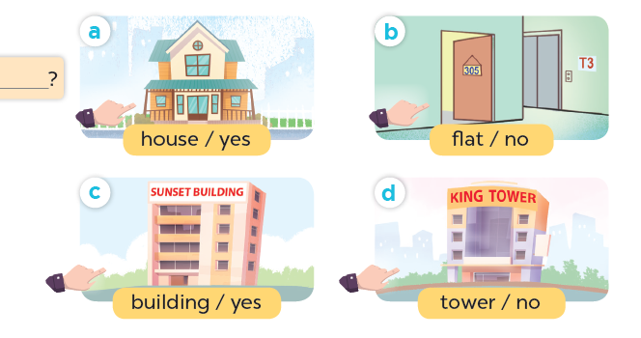
Listen, point and say.
Do you live in this house?
Yes, I do.
house / yes

Slide 24
Listen, point and say.
Do you live in this flat?
No, I don't.
flat / no

Slide 25
Listen, point and say.
Do you live in that building?
Yes, I do.
building / yes

Slide 26
Listen, point and say.
Do you live in that tower?
No, I don't.
tower / no

Slide 27
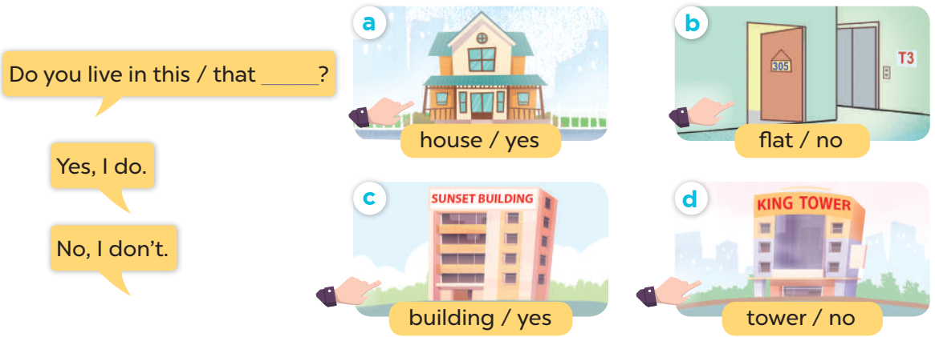
Work in pairs. Ask and answer.

Slide 28
04
Let's talk.

Slide 29
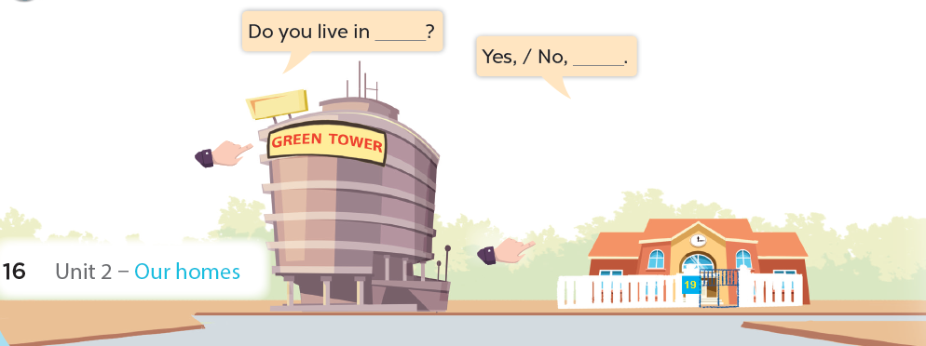

Slide 30
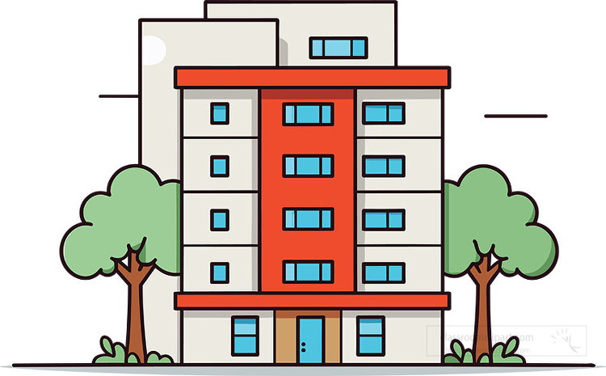


Do you live in that building?
No, I don't.

Slide 31

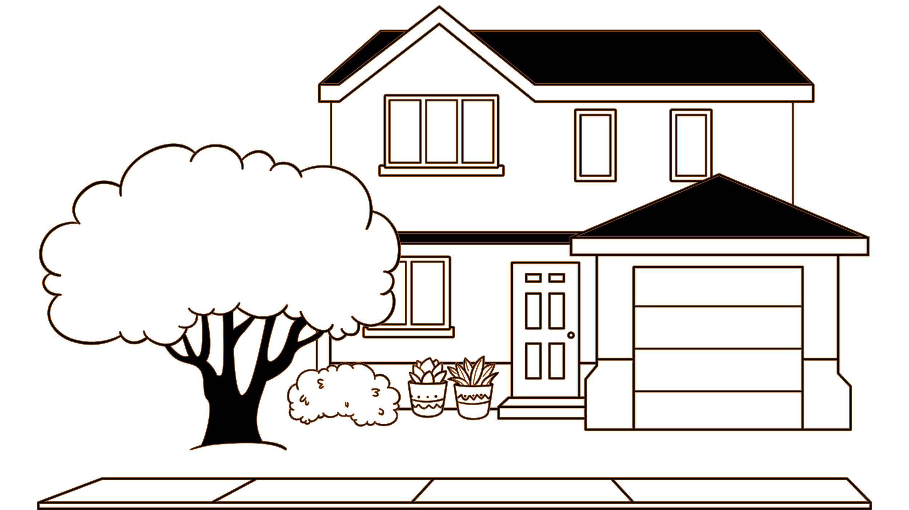
Do you live in this house?
Yes, I do.

Slide 32
05
Fun corner and wrap-up
Lucky letter

Slide 33

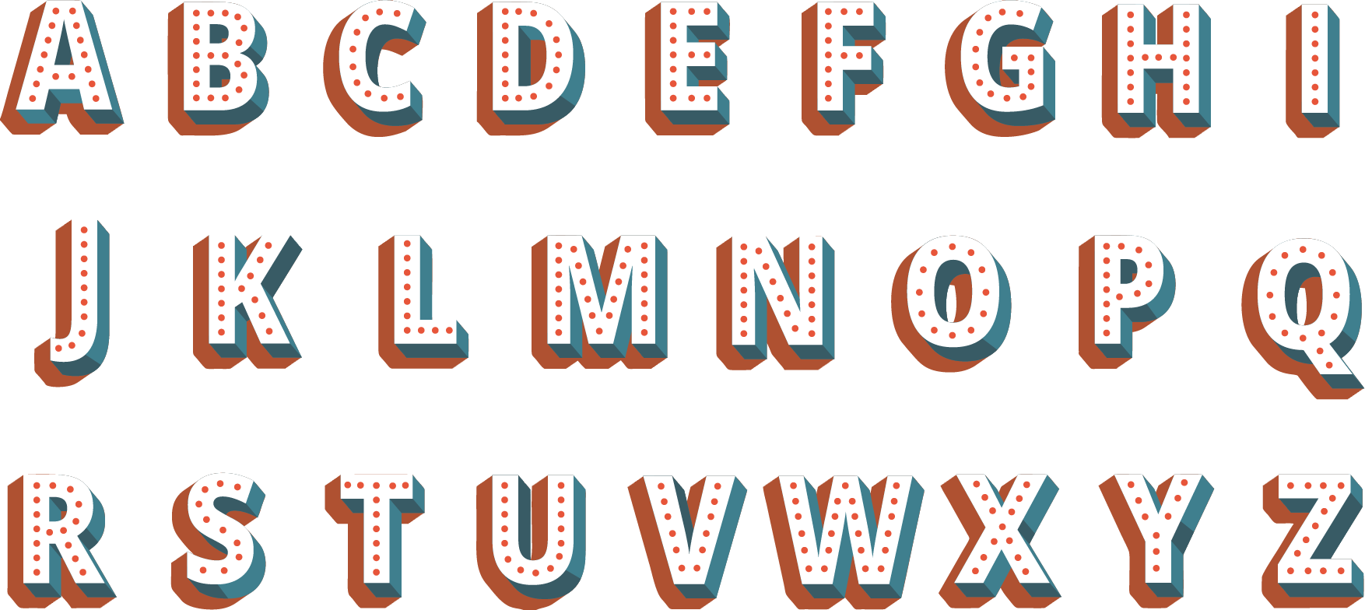
1
2
1
1
3
1
1
2

Slide 34
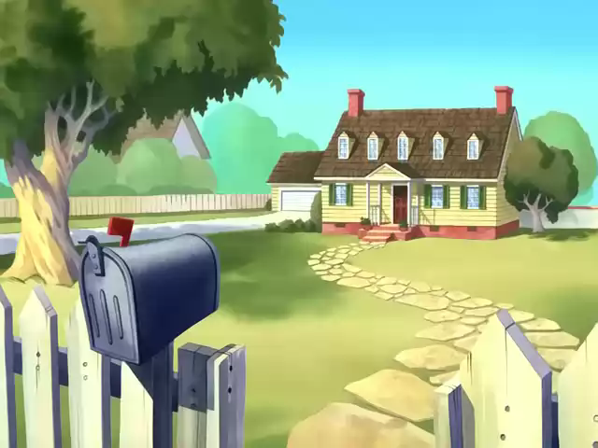

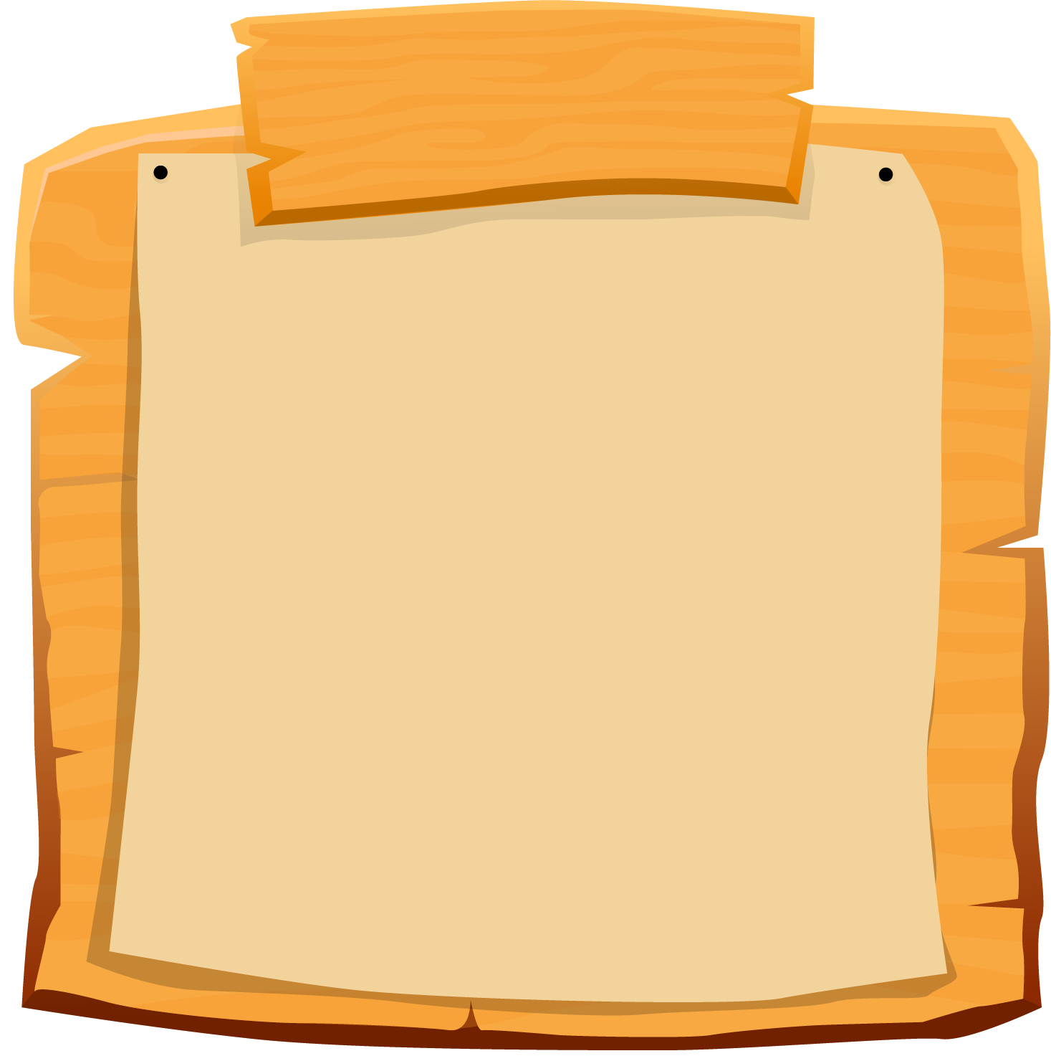

SCOREBOARD
Boys
Girls
0
1
2
3
4
5
6
7
8
9
0
1
2
3
4
5
6
7
8
9
Questions
Notes:
- Teacher clicks on each team's score board to add up on the score.
- Teacher click on the Questions sign to get back to the questions slide

Slide 35
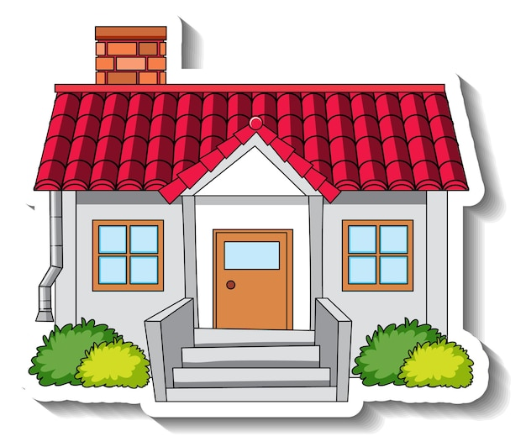
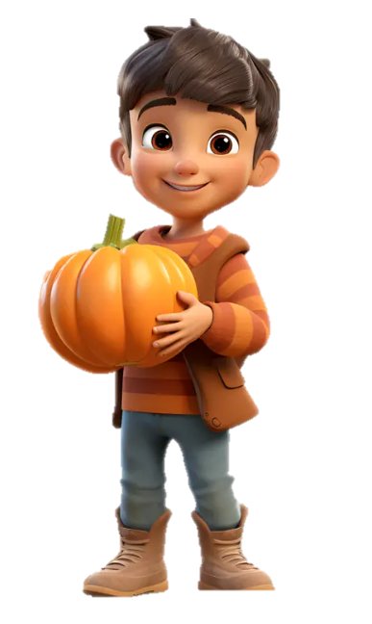

Do you live in this house?
Yes, I do.

Slide 36




Do you live in that house?
Yes, I do.

Slide 37
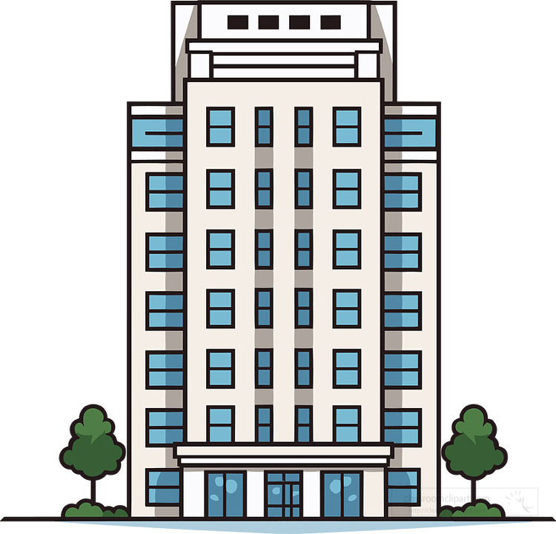
Moon Building
Do you live in this building?
No, I don't.

Slide 38
Moon Building
Do you live in that building?
No, I don't.

Slide 39

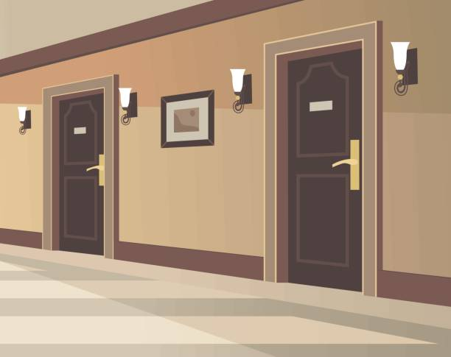


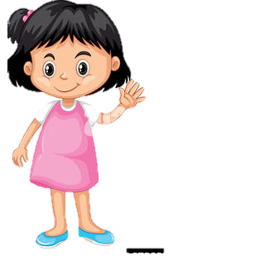
Do you live in this flat?
No, I don't.

Slide 40

Do you live in that flat?
Yes, I do.

Slide 41

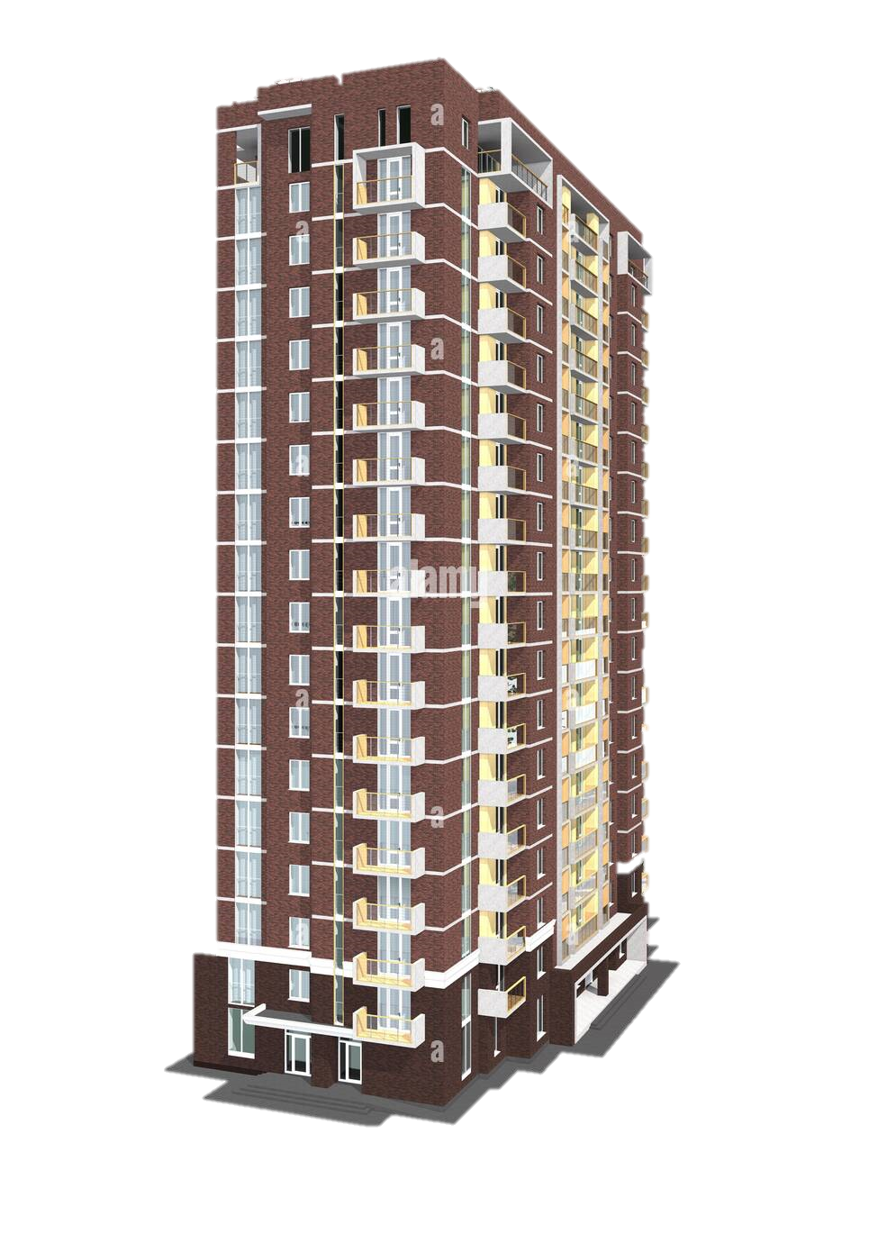
Do you live in this tower?
Yes, I do.
Queen Tower

Slide 42



Prince Tower
Do you live in that tower?
No, I don't.

Slide 43
Website: hoclieu.vn
Fanpage: facebook.com/www.tienganhglobalsuccess.vn

