Slide 2
Unit 1. All about me!
Lesson 3 - Period 5

Slide 3
Table of contents
01
Warm-up and review
02
Listen and repeat.
03
Circle, listen and check.
04
Let’s chant.
05
Fun corner and wrap-up

Slide 4
01
Warm-up and review

Slide 5
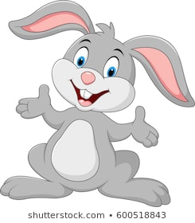
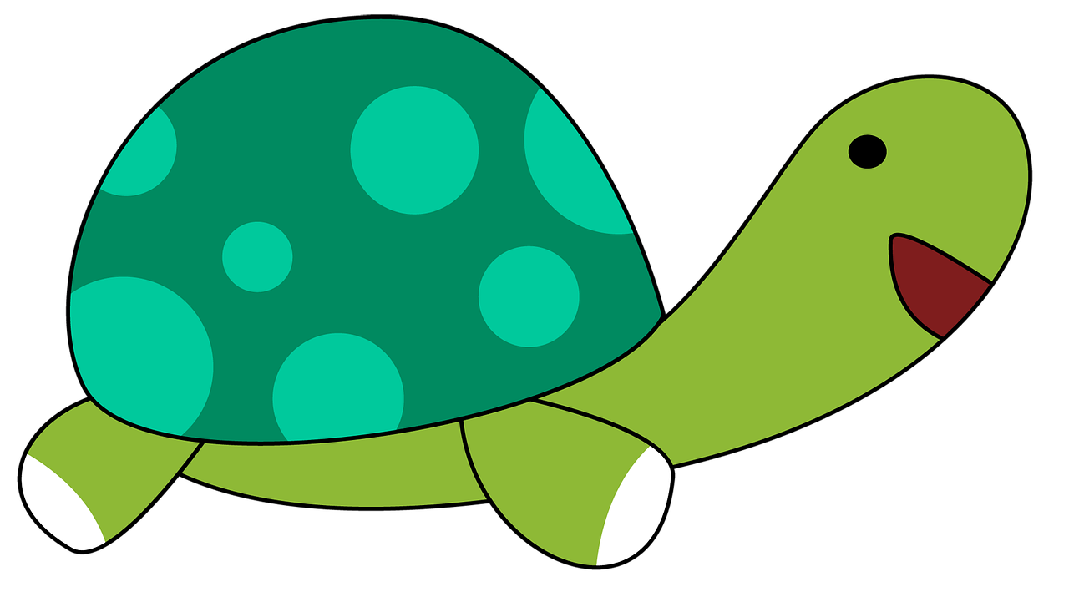
Team Turtle
Team Rabbit

Slide 6
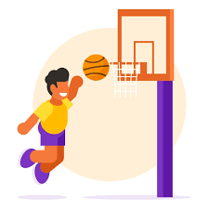
Choose the correct answer a,b or c.
A: What’s your favourite _______?
B: It’s basketball.
a
b
c
food
animal
sport

Slide 7
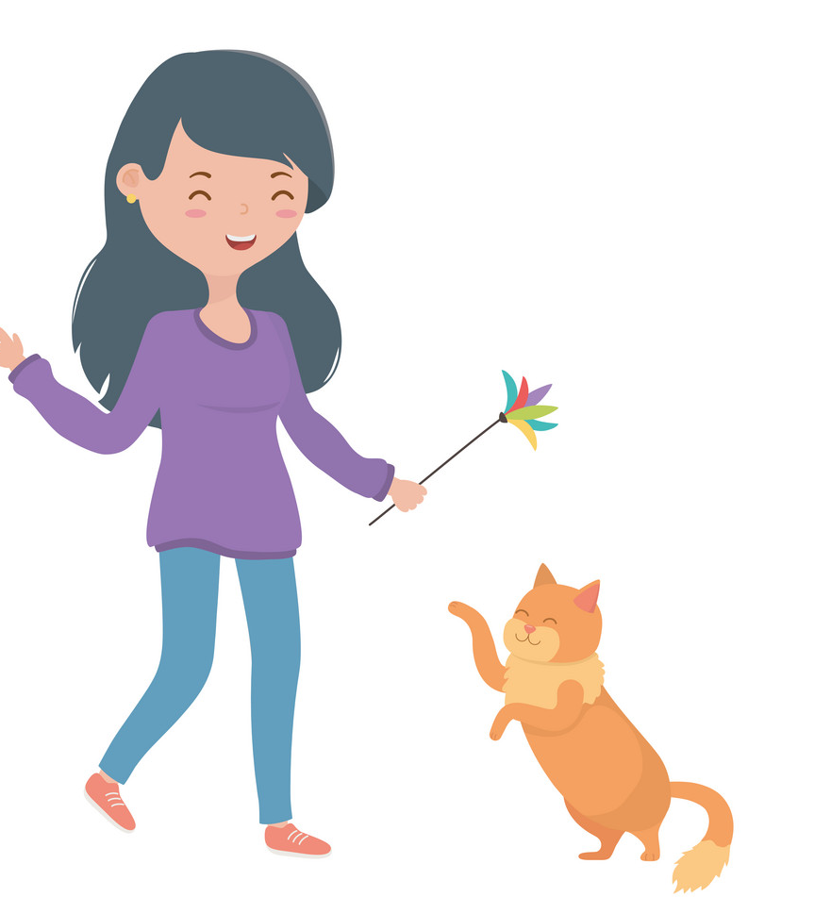
Choose the correct answer a,b or c.
A: What’s your favourite animal?
B: It’s _____.
a
b
c
cat
a cat
a dog

Slide 8
Choose the correct answer a,b or c.
A: What’s your favourite colour?
B: ___ red.
a
b
c
It
A
It’s

Slide 9
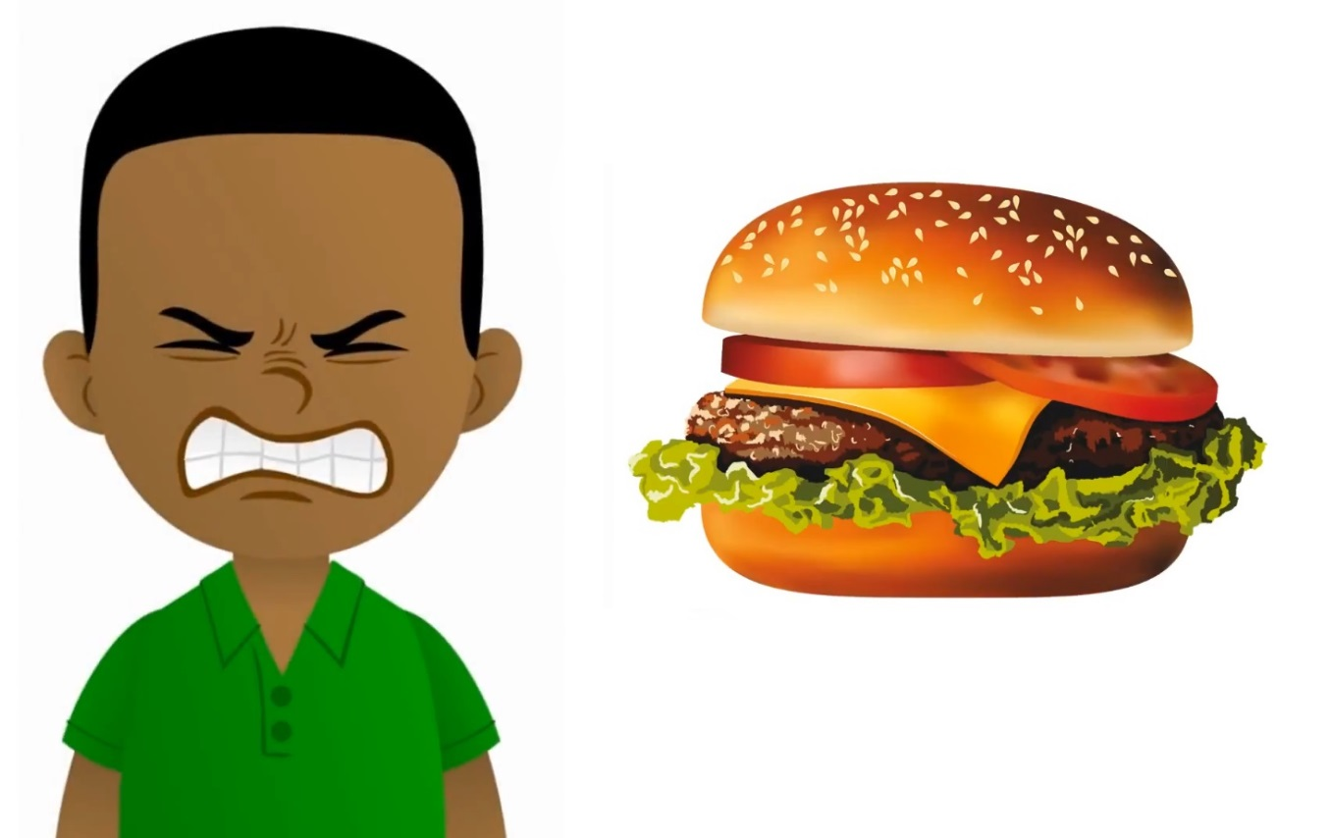
Choose the correct answer a,b or c.
A: My favourite food is hamburger.
Do you like hamburger, too?
B: No, I ____.
a
b
c
don’t
do
am

Slide 10
Summary
Notes:
GV nháy vào biểu tượng của đội chơi để tính điểm cho các đội. Mỗi lần nháy 1 ngôi sao xuất hiện.

Slide 11
02
Listen and repeat.

Slide 12
Listen and repeat.
'
I like dolphins.
dolphin
'

Slide 13
Listen and repeat.
'
'
tennis
He plays tennis on Sundays.

Slide 14
Listen and repeat.
'
'
dolphin
I like dolphins.
'
'
tennis
He plays tennis on Sundays.

Slide 15
03
Circle, listen and check.

Slide 16
Circle, listen and check.
1.
a. dolphin
b. giraffe
c. behind
2.
a. Japan
b. July
c. England
3.
a. tennis
b. hello
c. goodbye

Slide 17
Circle, listen and check.
1.
a. dolphin
b. giraffe
c. behind

Slide 18
Circle, listen and check.
2.
a. Japan
b. July
c. England

Slide 19
Circle, listen and check.
3.
a. tennis
b. hello
c. goodbye

Slide 20
Circle, listen and check.
1.
a. dolphin
b. giraffe
c. behind
2.
a. Japan
b. July
c. England
3.
a. tennis
b. hello
c. goodbye

Slide 21
04
Let’s chant.

Slide 22
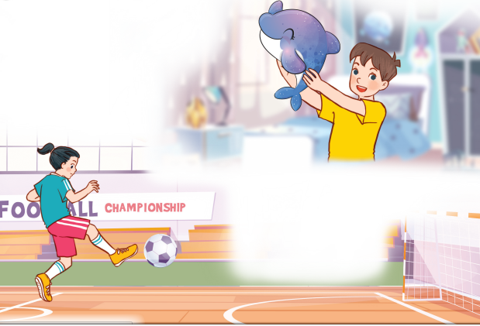
Let’s chant.
What’s your favourite animal?
Do you like pandas?
No, I don’t.
I don’t like pandas.
I like dolphins.
What’s your favourite sport?
Do you like tennis?
No, I don’t.
I don’t like tennis.
I like football.

Slide 23
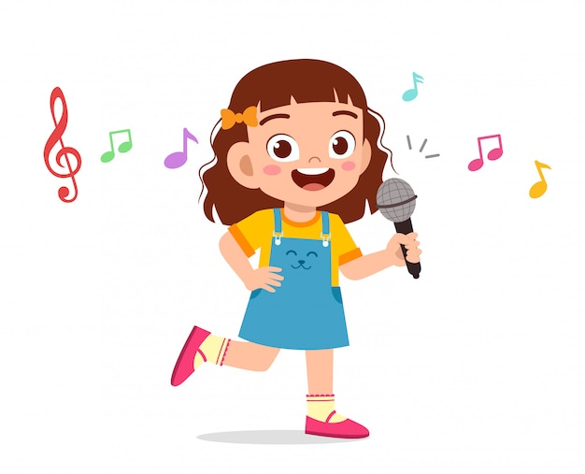
Let’s chant.
What’s your favourite animal?
Do you like pandas?
No, I don’t.
I don’t like pandas.
I like dolphins.
What’s your favourite sport?
Do you like tennis?
No, I don’t.
I don’t like tennis.
I like football.

Slide 24
05
Fun corner and wrap-up

Slide 25
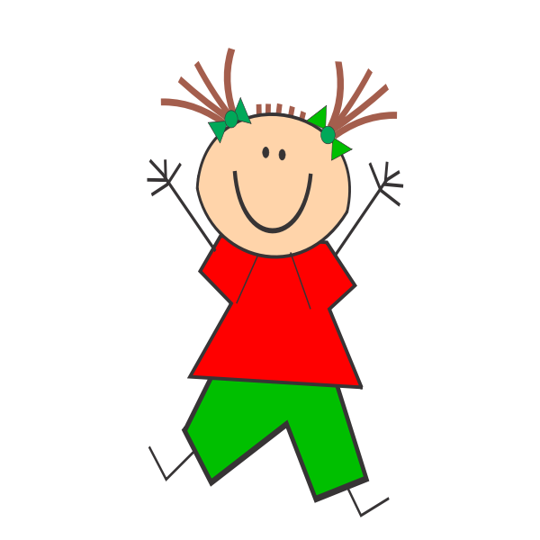
Jumping Games

Slide 26
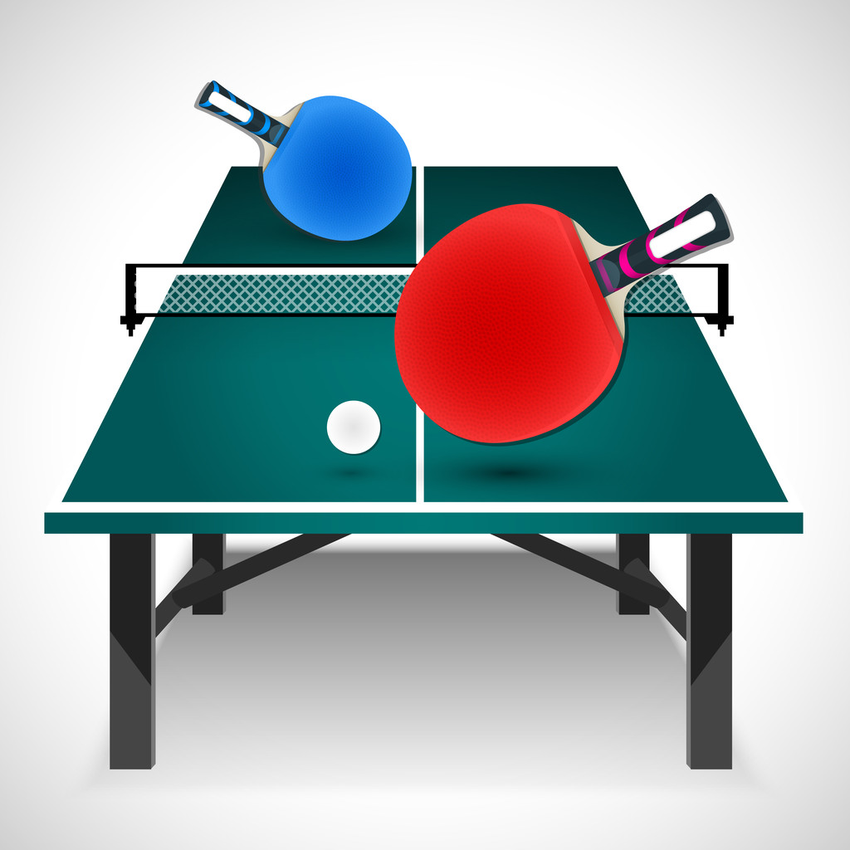
table tennis

Slide 27
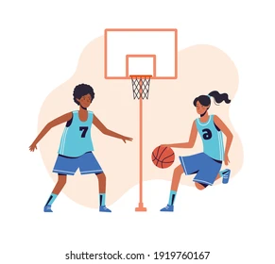
football

Slide 28
Japan

Slide 29
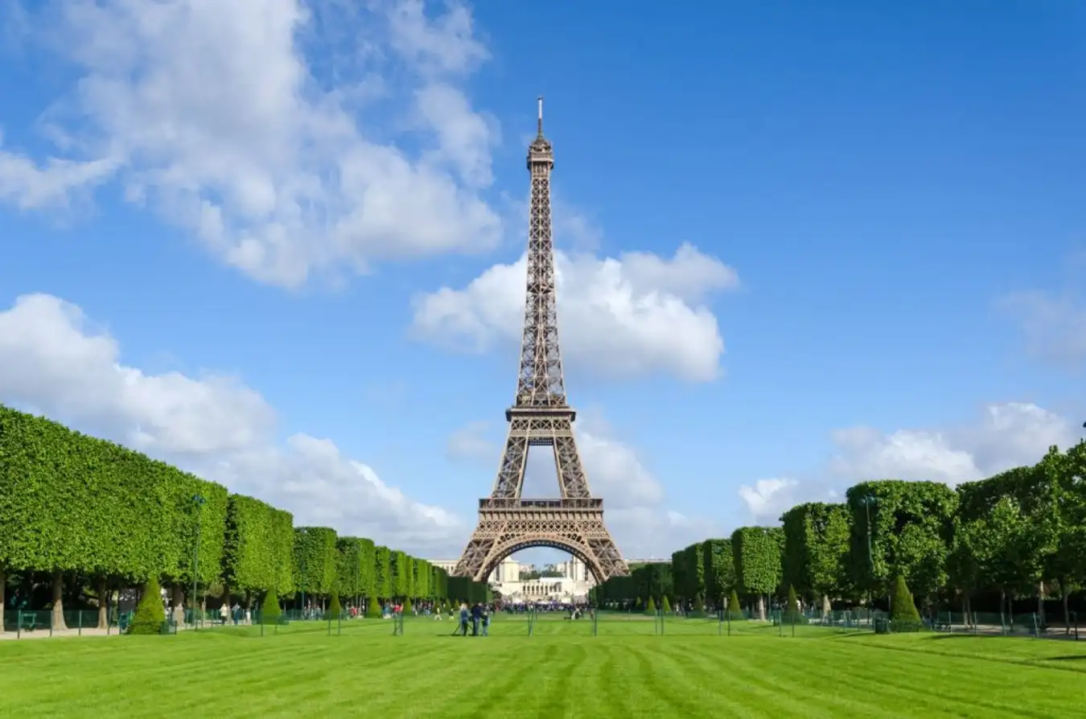
England

Slide 30
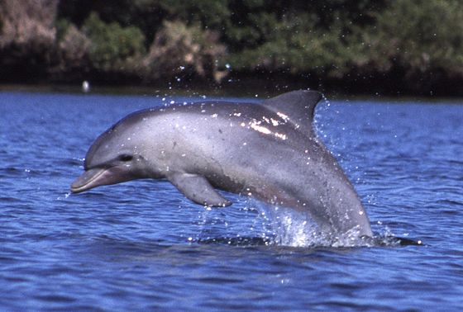
dolphin

Slide 31
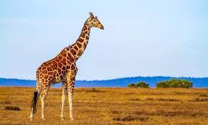
giraffe

Slide 32
Website: hoclieu.vn
Fanpage: https://www.facebook.com/tienganhglobalsuccess.vn/

