Slide 2

Unit 1. All about me!
Lesson 1 - Period 2

Slide 3

Table of contents
01
Warm-up and review
02
Listen and tick.
03
Read and complete.
04
Let’s sing.
05
Fun corner and wrap-up

Slide 4
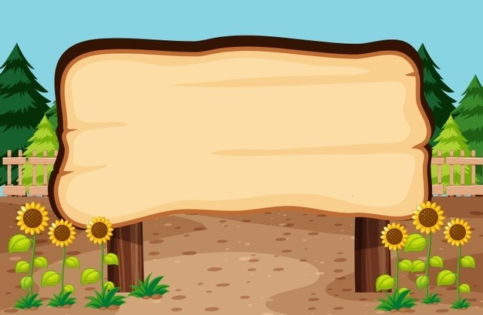

01
Warm-up and review

Slide 5


Can you tell me about yourself?
I’m in ____.
I live in the ___.

Slide 6


Slide 7

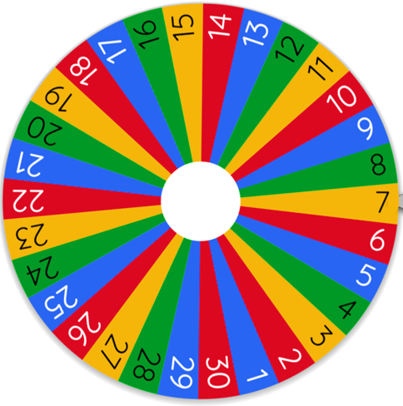
I’m in ___.
Can you tell me about yourself?
Spin
I live in the ___.
Notes:
Giáo viên nhấn vào vòng quay để quay và nhấn vào vòng quay để dừng. Làm liên tục đến khi kết thúc trò chơi.

Slide 8
02
Listen and tick.

Slide 9

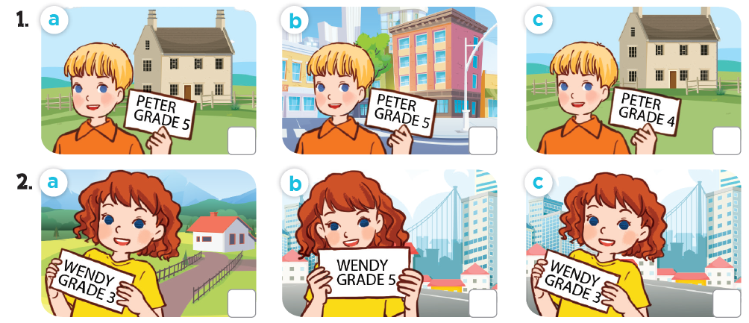
Listen and tick.

Slide 10
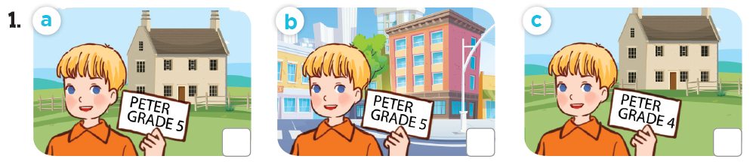
Listen and tick.
✓

Slide 11

Listen and tick.
✓

Slide 12
Listen and tick.
✓
✓

Slide 13
03
Read and complete.

Slide 14
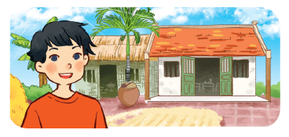



Read and complete.

Slide 15
Read and complete.
1. A: Can you tell me about yourself?
B: Sure. My name’s Ba. I live in the _____.
village

Slide 16
Read and complete.
2. A: Can you tell me about yourself?
B: Well, I’m Minh. I’m in _______.
Class 5B

Slide 17
Read and complete.
3. A: Can you ____ me about yourself?
B: Sure. I’m Phong. I live in the_________.
tell
city / town

Slide 18
Read and complete.
4. A: Can you tell me about _______?
B: Well, I’m Andy. I live in the ________________.
yourself
countryside / village

Slide 19
Read and complete.
1. A: Can you tell me about yourself?
B: Sure. My name’s Ba. I live the _____.
2. A: Can you tell me about yourself?
B: Well, I’m Minh. I’m in _______.
village
Class 5B
tell
yourself
3. A: Can you ____ me about yourself?
B: Sure. I’m Phong. I live in the _________.
4. A: Can you tell me about ________?
B: Well, I’m Andy. I live in the ________________.
city / town
countryside / village

Slide 20
04
Let’s sing.

Slide 21
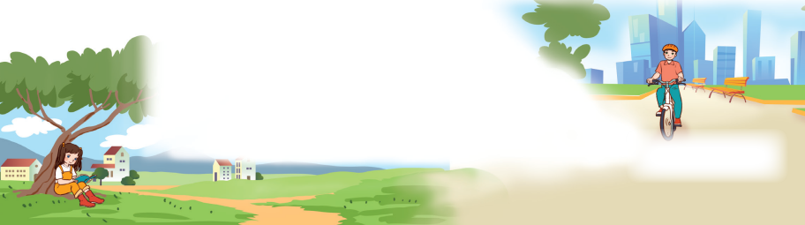
Let’s sing.
All about me!
I’m Lisa.
I’m in Grade 3.
I live in the countryside.
Where do you live?
I’m Alan.
I’m in Grade 5.
I live in the city.
Where do you live?

Slide 22


All about me!
I’m Lisa.
I’m in Grade 3.
I live in the countryside.
Where do you live?
I’m Alan.
I’m in Grade 5.
I live in the city.
Where do you live?

Slide 23

Video: https://www.youtube.com/watch?v=cvZ175neuss&list=PL8_ETpRL2xNZB9cLCxiQ99OV2IDn572U9&index=2

Slide 24
05
Fun corner and wrap-up

Slide 25




Slide 26
Can you tell me about yourself?
I’m in ____.
I live in the ___.

Slide 27
Website: hoclieu.vn
Fanpage: https://www.facebook.com/tienganhglobalsuccess.vn/

