Slide 2
Unit 15
OUR
HEALTH
Lesson 3 – Period 6

Slide 3
Table of Contents
Warm-up and Review
Activity 4: Read and match.
Activity 5: Let’s write.
Activity 6: Project
Fun corner and Wrap-up

Slide 4
01
Warm-up and Review

Slide 5
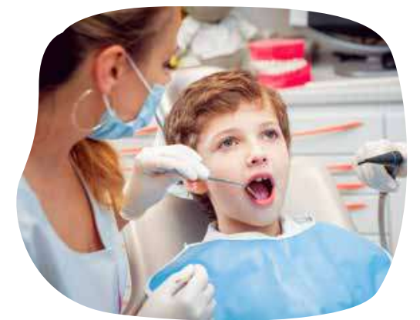
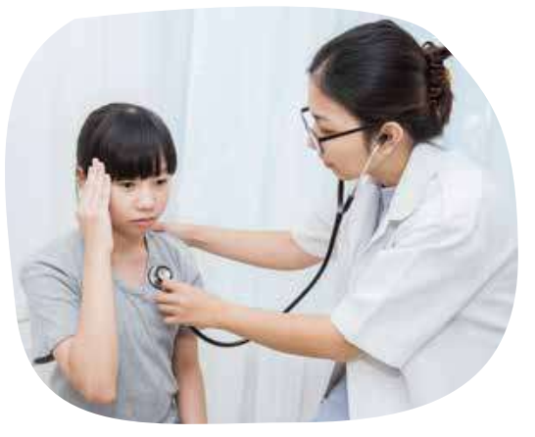
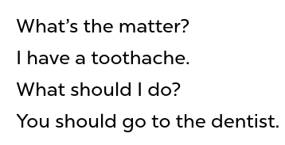
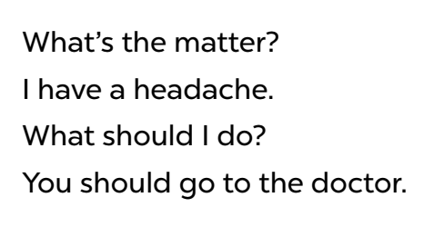
Listen and chant.

Slide 7
02
Activity 4
Read and match.

Slide 8
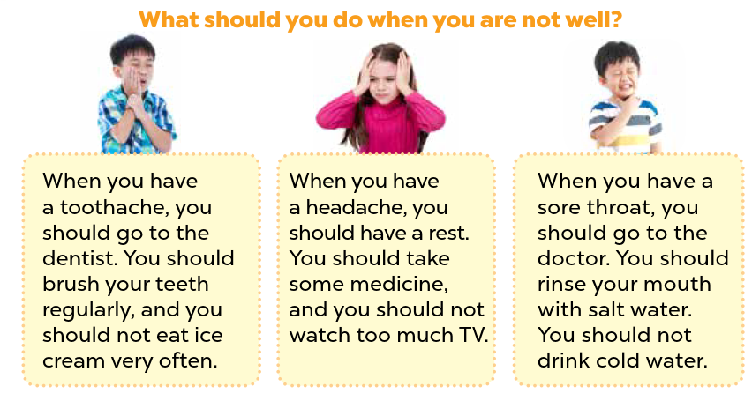
Look and read.
Notes:
Step 1: Set a time limit and ask pupils to read through the poster to get a general idea of it.

Slide 9
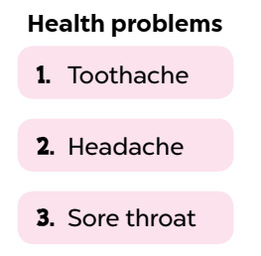
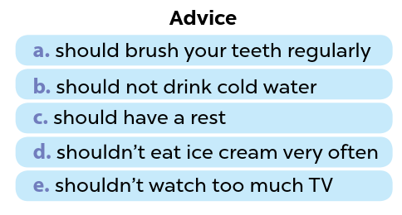
Look and read.
Notes:
Step 2: Ask pupils to read the items in the columns Health problem and Advice.
Encourage them to underline some key words that can help them find the correct answer.

Slide 10
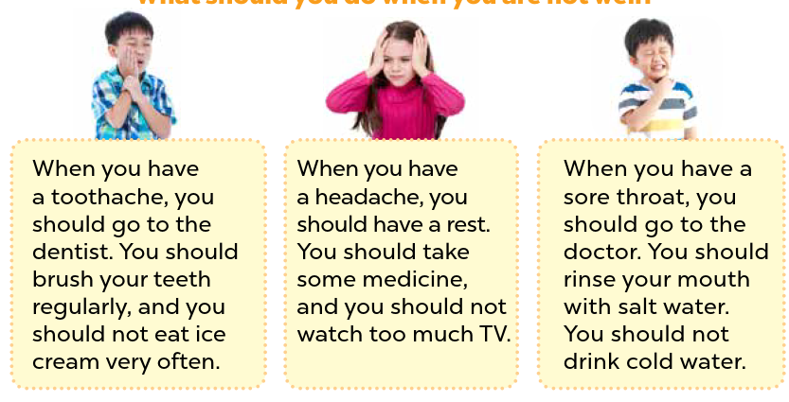
Page 35
Read and match.
Advice
Health problems
a. should brush your teeth regularly.
1. Toothache
b. should not drink cold water.
c. should have a rest.
2. Headache
d. shouldn’t eat ice cream very often.
3. Sore throat
e. shouldn’t watch much TV.
Notes:
Tell them to read the poster again to choose the correct answer. Let pupils do the activity independently.

Slide 11
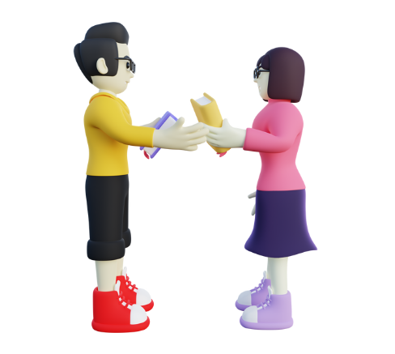
Swap your books and check your answers.
Notes:
Then pupils swap their books with a partner and check the answers.
Go around the class and offer help if necessary.

Slide 12
Read and say.
Advice
Health problems
a. should brush your teeth regularly.
1. Toothache
b. should not drink cold water.
2. Headache
c. should have a rest.
d. shouldn’t eat ice cream very often.
3. Sore throat
e. shouldn’t watch much TV.
Notes:
*Key: 1. a, d; 2. c, e; 3. b

Slide 14
03
Activity 5
Let’s write.

Slide 15
Read these sentences.
1. Minh has a headache.
2. Linda has a toothache.
3. Linh has a sore throat.
Notes:
Step 1: Ask pupils to read the title Giving advice and sentences about Minh’s, Linda’s and Linh’s health problems. Tell pupils that they should write about 40 words.

Slide 16
Read, think and give advice.
1. Minh has a headache.
Advice
2. Linda has a toothache.
3. Linh has a sore throat.
Minh has a headache. He should/shouldn’t……………………………………………………
Notes:
Tell pupils that they should talk and then write about 40 words.
Step 2: Give pupils enough time to write their reports.

Slide 17
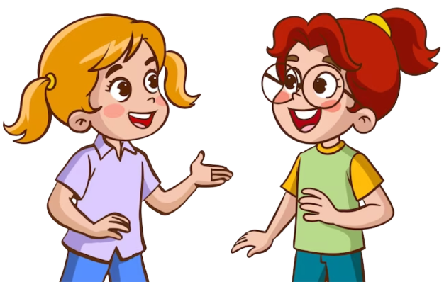
Read, think and give advice.
1. Minh has a headache.
2. Linda has a toothache.
Advice
3. Linh has a sore throat.
Minh has a headache. He should………….
Notes:
Let pupils work in pairs or groups for cross checks. Go ground the class and give support when necessary.

Slide 18
Read, think and give advice.
1. Minh has a headache.
2. Linda has toothache.
Advice
3. Linh has a sore throat.
Minh has a headache. He should
have a rest.
Linda has a toothache. She shouldn’t eat too much ice cream. She should also brush her teeth regularly. Linh has a sore throat. She should take some medicine and drink warm water.
Notes:
Step 3: Have some pupils read their completed reports aloud. Give corrections and feedback where necessary.

Slide 20
04
Activity 6
Project

Slide 21
Look and listen.
Notes:
Step 1: Point at the sample survey and explain that pupils are going to report the results of their surveys about their surrounding people’s health problems and advice they would like to give to them.

Slide 22
Look and listen.
Notes:
Step 2: Revise some words and sentence patterns that pupils may use for their presentations. Give pupils some time to practise their presentations by themselves and within groups. Go around the classroom to monitor and offer support.

Slide 23
Look and listen.
Advice
Health problems
a. should brush your teeth regularly.
1. Toothache
b. should not drink cold water.
c. should have a rest.
2. Headache
d. shouldn’t eat ice cream very often.
3. Sore throat
e. shouldn’t watch much TV.
Notes:
Step 2: Revise some words and sentence patterns that pupils may use for their presentations.

Slide 24
Practice!!!!
Notes:
Give pupils some time to practise their presentations by themselves and within groups. Go around the classroom to monitor and offer support.

Slide 25
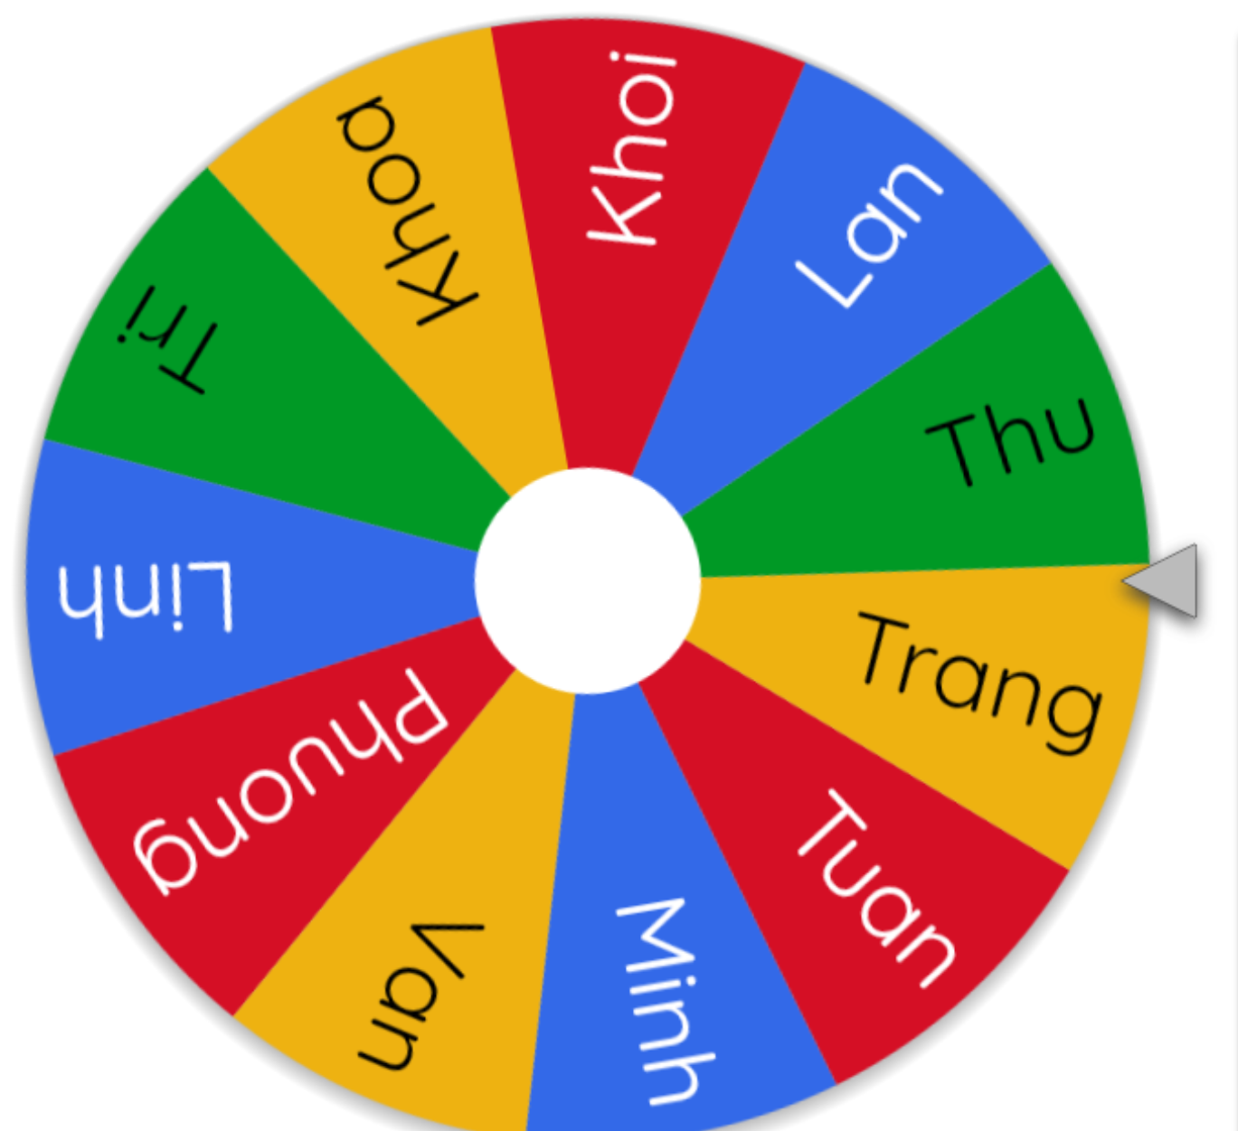
Presentation!!!!
Notes:
Step 3: Select a few pupils to give their presentations in front of the class. Give corrections and feedback where necessary.
Use this link to choose pupils in random: https://wheelofnames.com/

Slide 27
05
Fun corner and Wrap-up

Slide 28
Whisper Game
Notes:
Click the PINK flower to end the game.

Slide 29
Answer
May has a toothache.
Notes:
Click the yellow flower to back to the Number slide.

Slide 30
Answer
Alex has a headache.
Notes:
Click the yellow flower to back to the Number slide.

Slide 31
Answer
Ben has a sore throat.
Notes:
Click the yellow flower to back to the Number slide.

Slide 32
You get a gift from the teacher!!!
Notes:
Click the yellow flower to back to the Number slide.

Slide 33
Answer
Bill has a stomach ache.
Notes:
Click the yellow flower to back to the Number slide.

Slide 35
Website: hoclieu.vn
Fanpage: https://www.facebook.com/tienganhglobalsuccess.vn/

