Slide 2
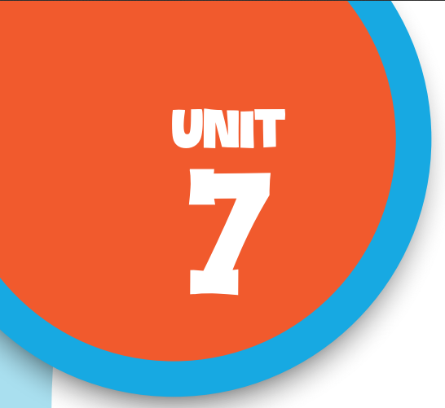
Our favourite
school activities
Lesson 3 - Period 5

Slide 3
Table of contents
01
Warm-up & Review
02
Listen and repeat.
03
Circle, listen and check.
04
Let’s chant.
05
Fun corner & Wrap-up

Slide 4
01
Warm-up
& Review

Slide 5
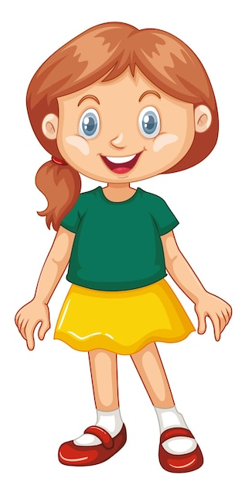
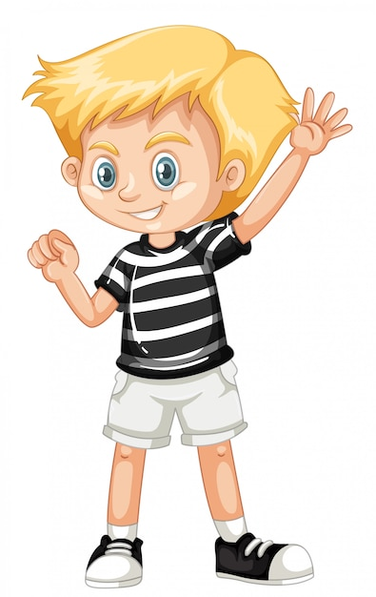
Interview
What school activity
do you like?
I like .

Slide 6
Interview
Why do you like it?
Because I think
it’s .

Slide 7
02
Listen
and repeat.

Slide 8
Listen and repeat.
'solving He likes 'solving maths problems.
'reading Her favourite school activity
is 'reading books.

Slide 9
03
Circle, listen and check.

Slide 10
Circle the word having different stress.
1.a.solving b.downstairs c.because
2.a.goodbye b.swimming c.enjoy
3.a.before b.guitar c.writing

Slide 11
Listen and check.
1.a.solving b.downstairs c.because
2.a.goodbye b.swimming c.enjoy
3.a.before b.guitar c.writing

Slide 12
04
Let’s chant.

Slide 13
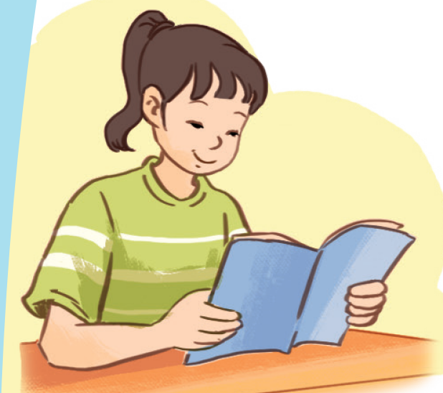
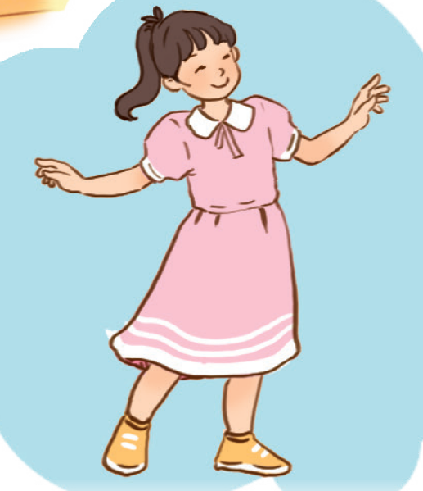
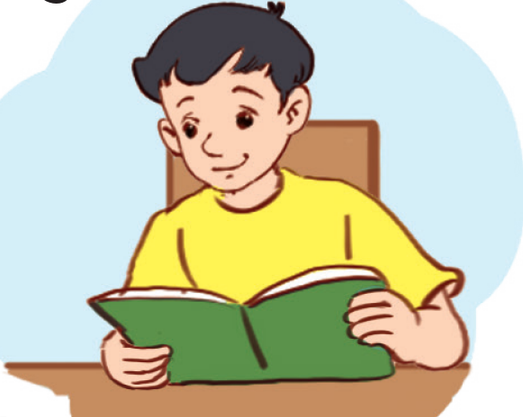
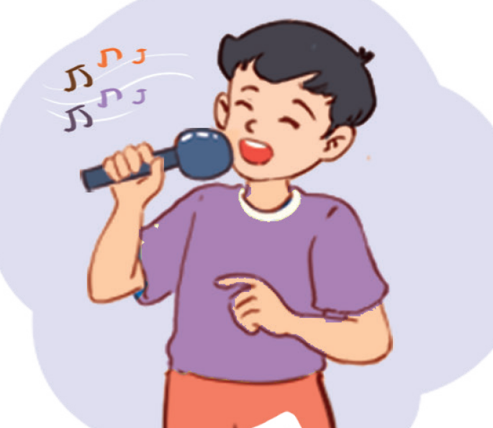
Name the school activities
reading
dancing
reading
singing

Slide 14
Look and read.
Clap and chant.
Listen and repeat.
What school activities does she like?
What school activities does she like?
She likes reading and dancing.
Does she like drawing and painting?
No, she doesn’t. She likes reading and dancing.
What school activities does he like?
He likes reading and singing.
Does he like drawing and swimming?
No, he doesn’t. He likes reading and singing.

Slide 15
Compose the chant.
What school activities does she like?
What school activities does she like?
She likes reading and dancing.
Does she like drawing and painting ?
No, she doesn’t. She likes reading and dancing.
What school activities does he like?
He likes reading and singing.
Does he like drawing and swimming?
No, he doesn’t. He likes reading and singing.

Slide 16
05
Fun corner & Wrap-up

Slide 17
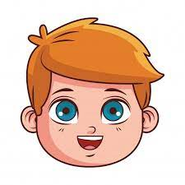
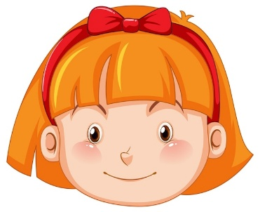
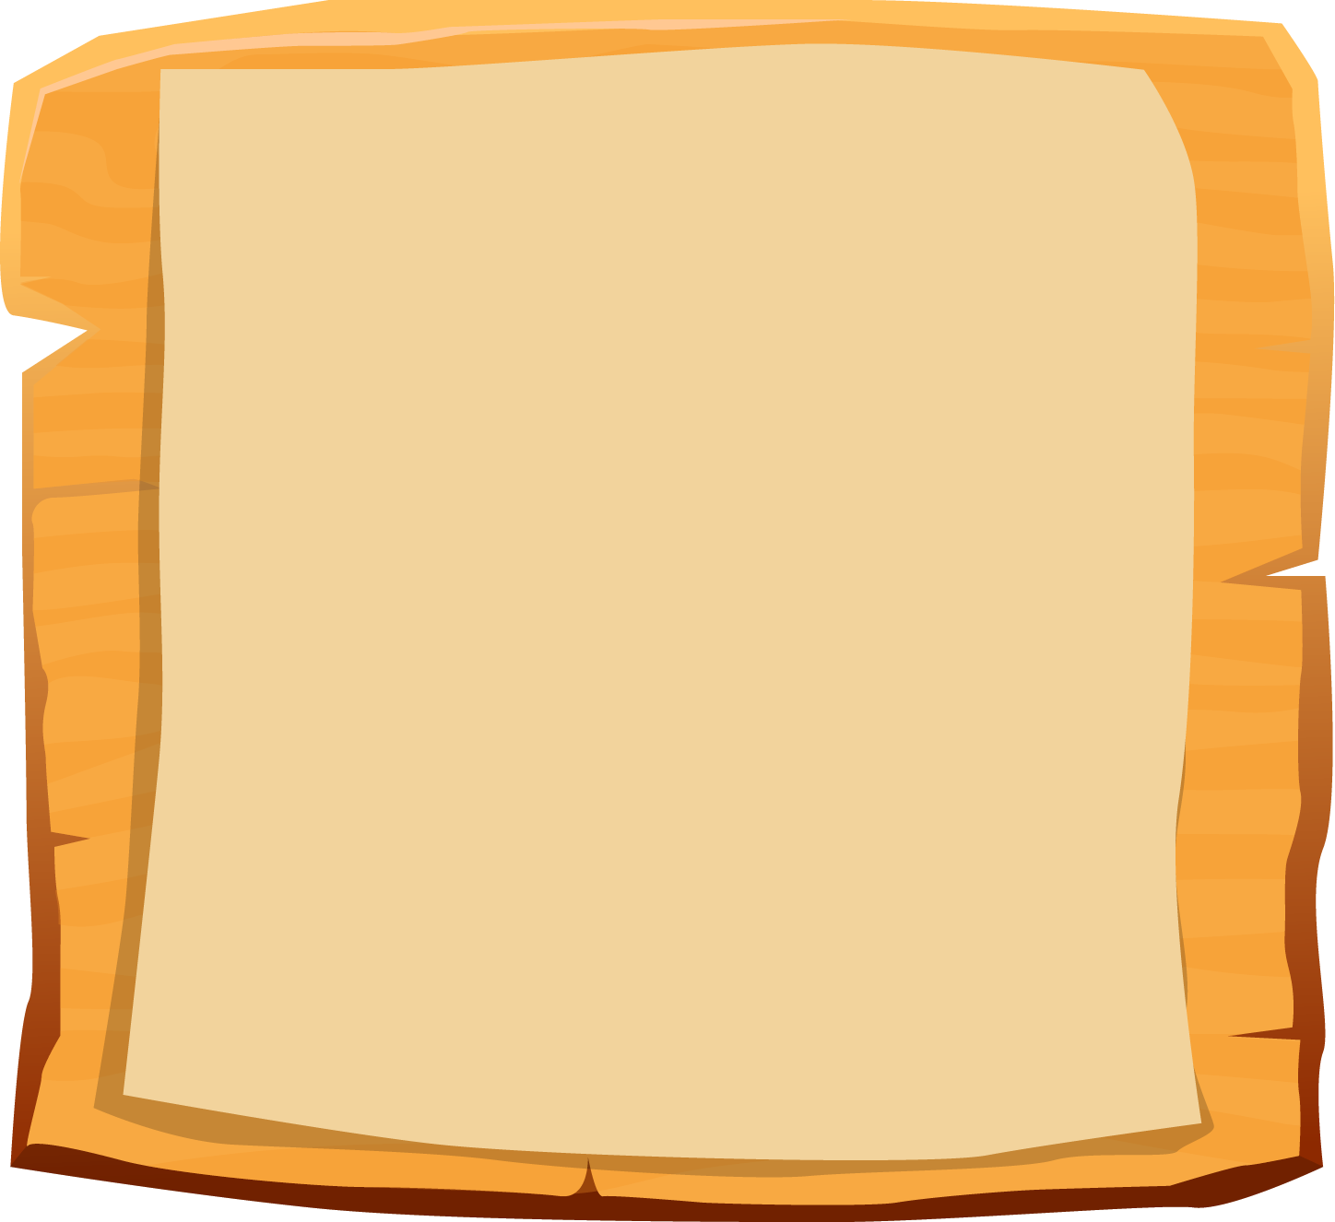
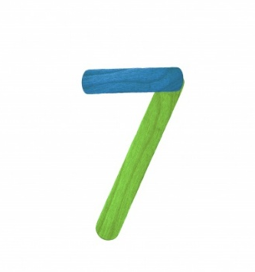

Slide 18
A: What school activity does he like?
“
He likes reading books.
B: __________________

Slide 19
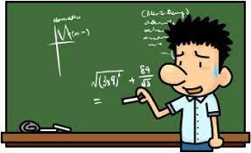
A: Do you like solving
maths problems?
No, I don’t.
B: ________

Slide 20
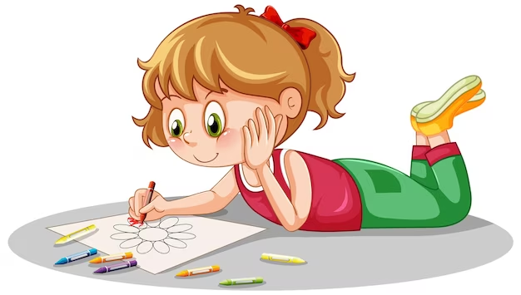
A: What school activity does she like?
She likes drawing.
B: ______________

Slide 21
swimming
A: Why does he like _______?
B: Because he thinks it’s fun.

Slide 22
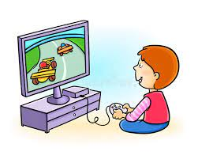
A: Does he like playing games?
Yes, he does.
B: __________

Slide 23
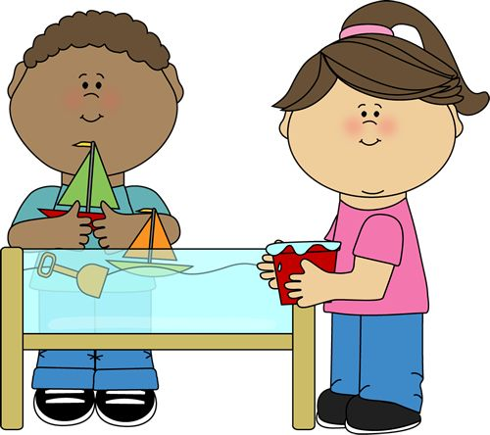
doing projects
A: Why do you like ___________?
B: Because I think
it’s good for
group work.

Slide 24
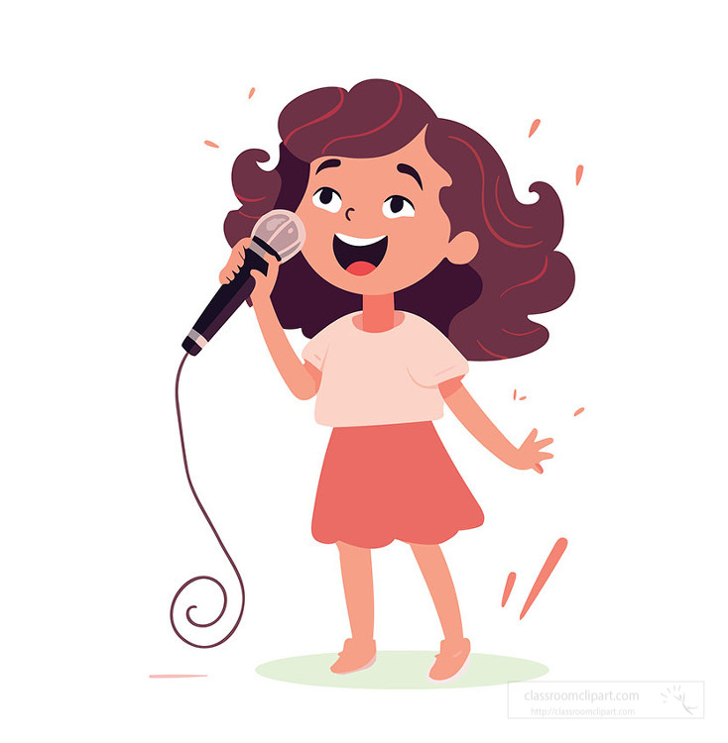
A: What school activity
do you like?
I like singing.
B: ___________

Slide 25
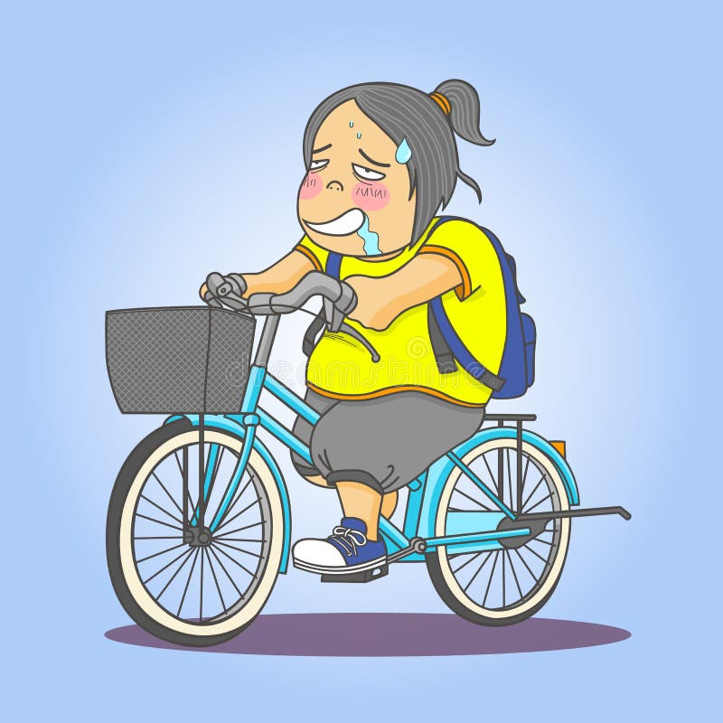
A: Why doesn’t she like
__________?
riding a bike
B: Because she thinks
it isn’t interesting.

Slide 26
Website: hoclieu.vn
Fanpage: https://www.facebook.com/tienganhglobalsuccess.vn/

