Slide 1
Welcome
To our class
F
F
Teacher’s name: Bui Thi Hoa
School’s name: Hung Dao Primary School

Slide 2
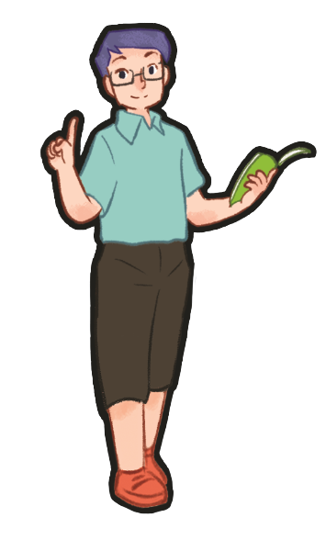
Warm-up

Slide 4
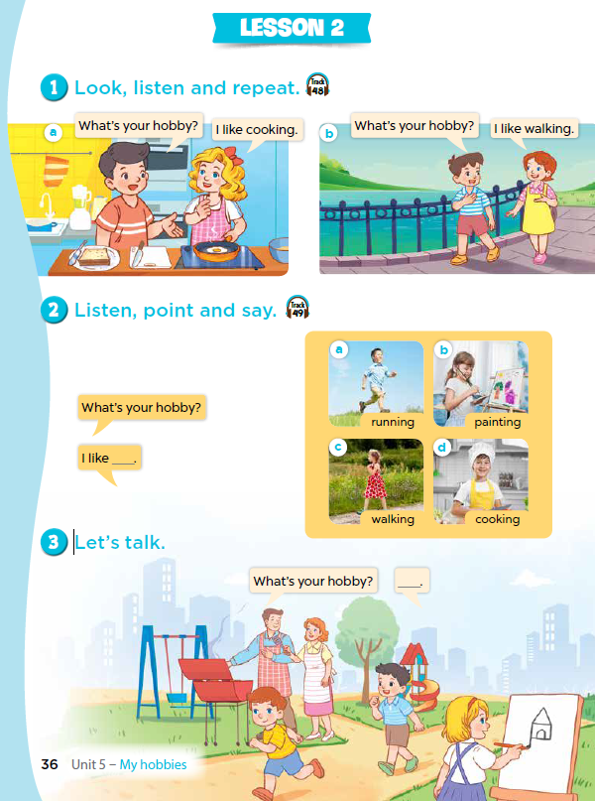
My hobbies
5
LESSON 2
Part: 1,2,3
on page 36

Slide 5
1. Look, listen and repeat
Notes:
Review Numbers 1-10 and Alphabet

Slide 7
*Hỏi: Sở thích của bạn là gì?
What’s your hobby?
I like _________.

Slide 8
2. Listen, point and say
Notes:
Review Numbers 1-10 and Alphabet

Slide 9
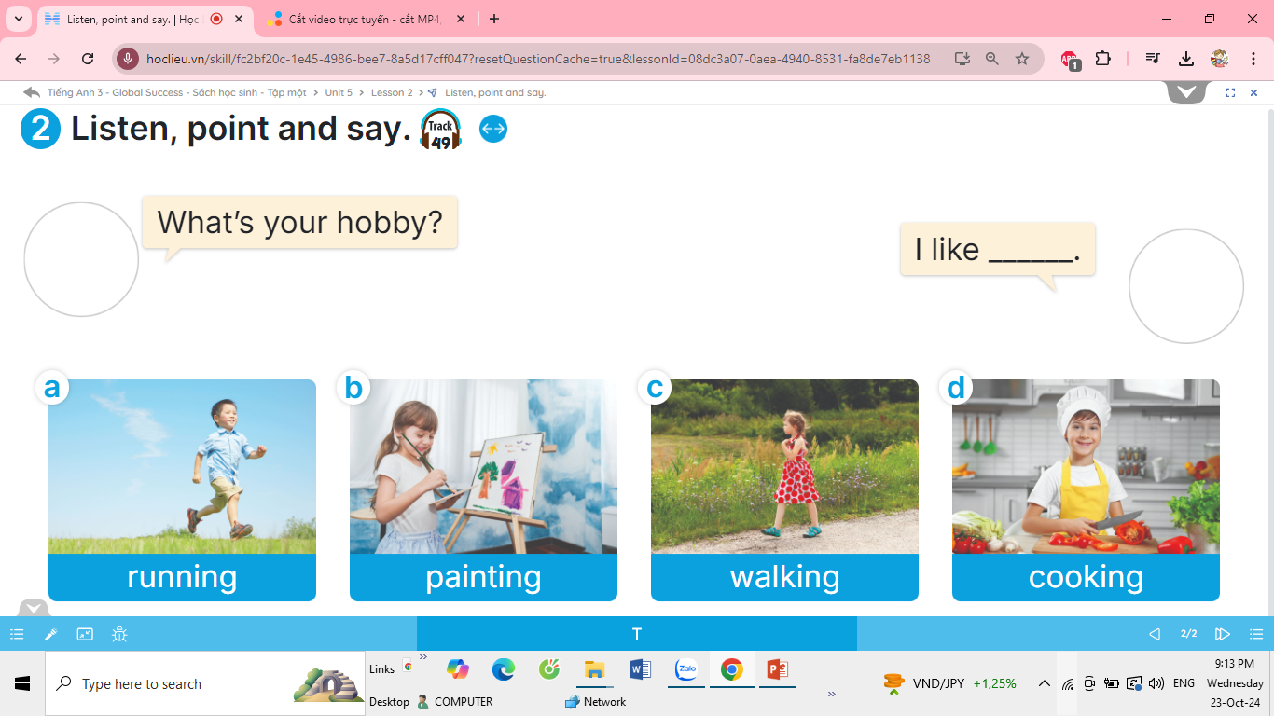

Slide 10
cooking

Slide 11
walking

Slide 12
running

Slide 13
painting

Slide 17
What’s your hobby ?
I like _________________.

Slide 20
What’s your hobby?
Notes:
T shows 4 pictures on the board and asks pupils to practise more.

Slide 21
3. Let’s talk

Slide 22
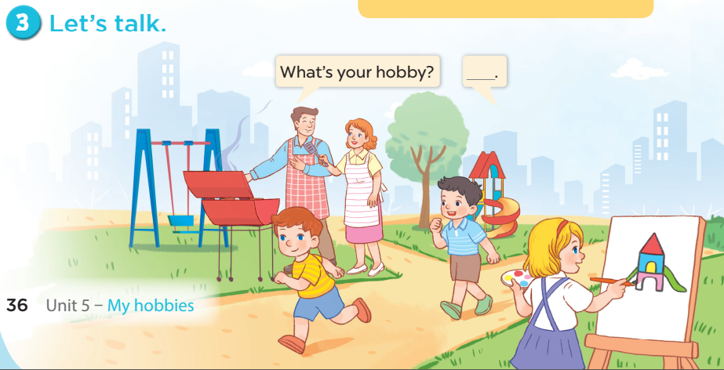
Notes:
Step 1: Draw pupils’ attention to the picture. Tell them about the activity. Ask questions to help
them understand the context (see Input).
Step 2: Put pupils into pairs and encourage them to ask and answer questions using the target
sentence patterns. Go around the classroom to offer support where necessary.
Step 3: Invite some pairs to stand up to perform their exchanges.

Slide 23
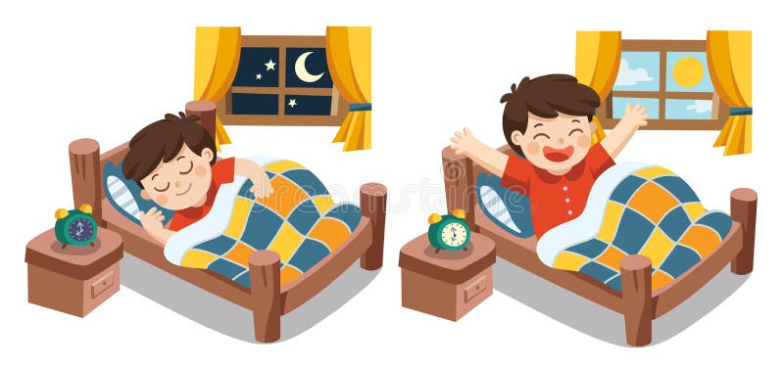
“sleep and wake up” game

Slide 24
What’s your hobby?

Slide 29
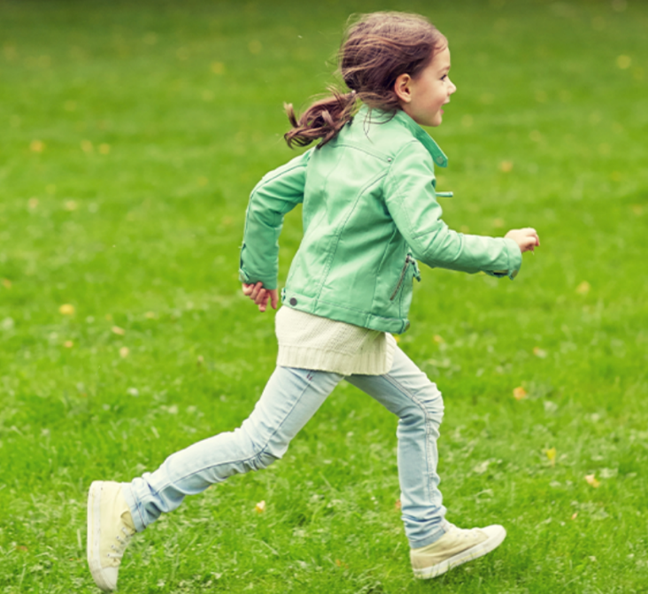
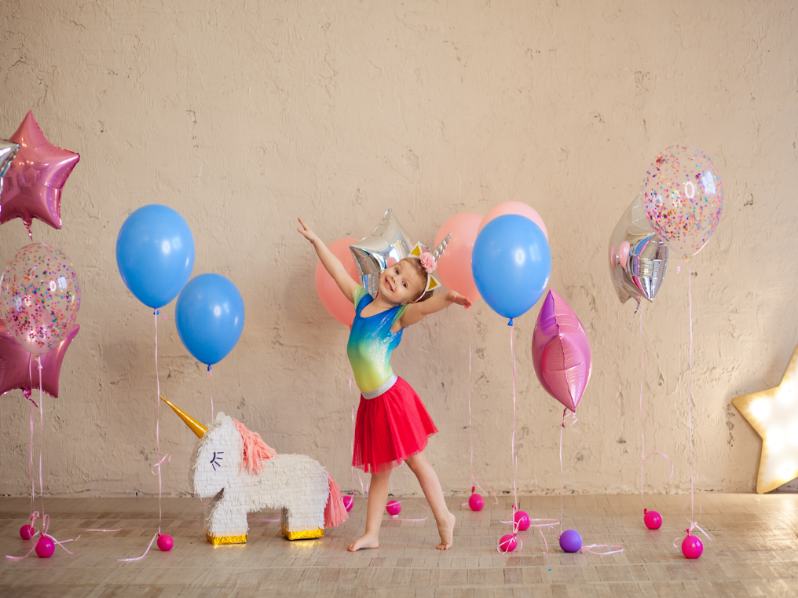
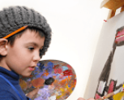
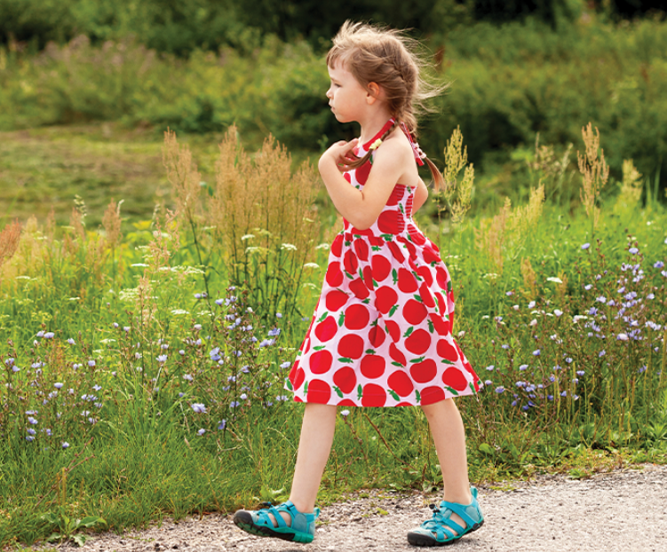
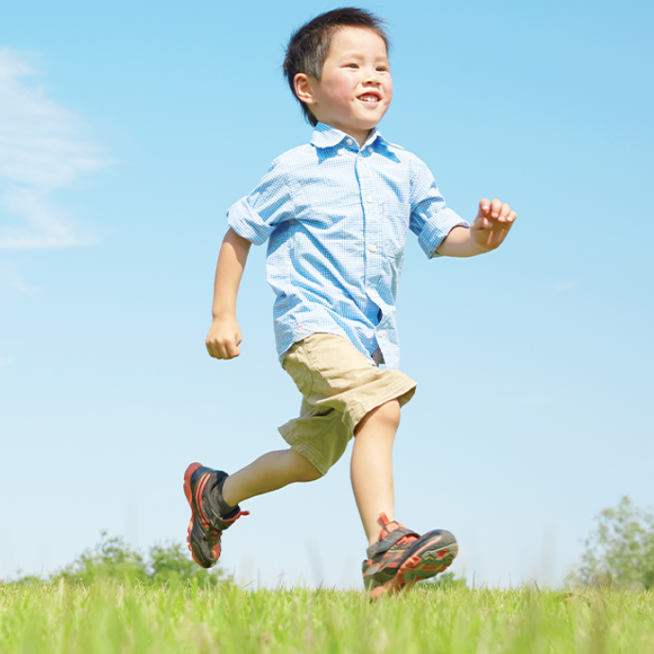
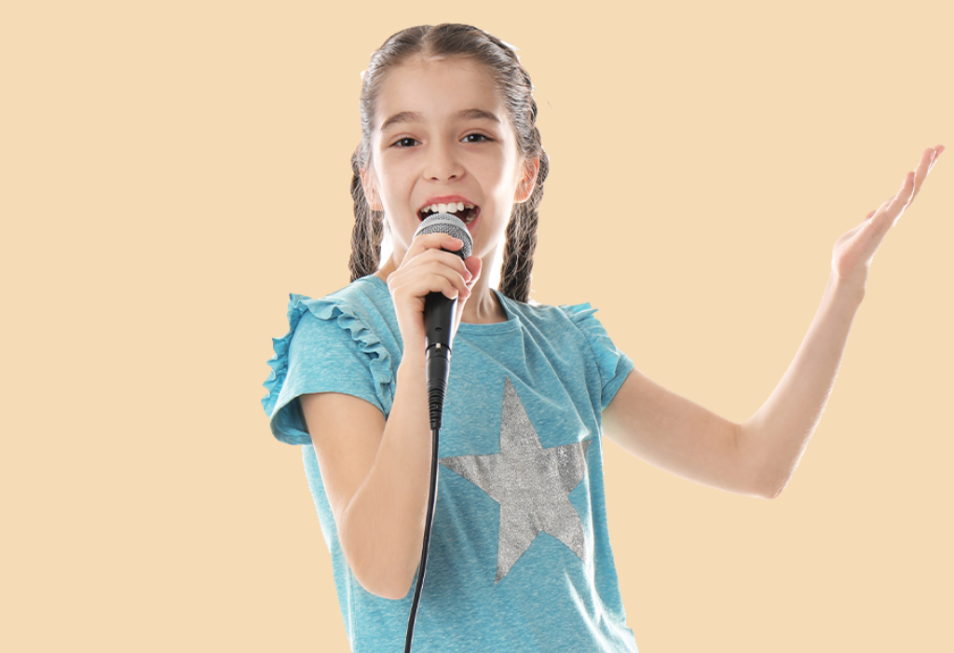
Notes:
T lets the pupils review the pictures of hobbies. (flash cards)

Slide 30
*Hỏi: Sở thích của bạn là gì?
What’s your hobby
?
I like ________
It’s ________
________
My hobby is________
Notes:
Jigsaw puzzle:
Click on the puzzles and let the pupils get when the pictures of hobbies revealed.

Slide 31
Notes:
T lets the pupils review the pictures of hobbies. (flash cards)

Slide 32
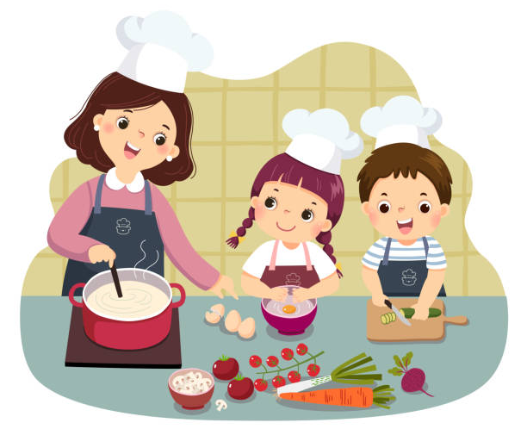
Notes:
T lets the pupils review the pictures of hobbies. (flash cards)

