Slide 1





WELCOME TO OUR CLASS
3B
CO THANH PRIMARY SCHOOL
TEACHER: BUI THI CAM VAN

Slide 2
Warm-up
Sing a song: My hobby.

Slide 3
Fitting pictues
Game:

Slide 4


6
Our school
LESSON 1 (1-3)

Slide 5
Contents
01
Activity 1
02
Activity 2
03
Activity 3
Look, listen and repeat.
Listen, point and say.
Let’s talk.

Slide 6
1. Look, listen and repeat.

Slide 7
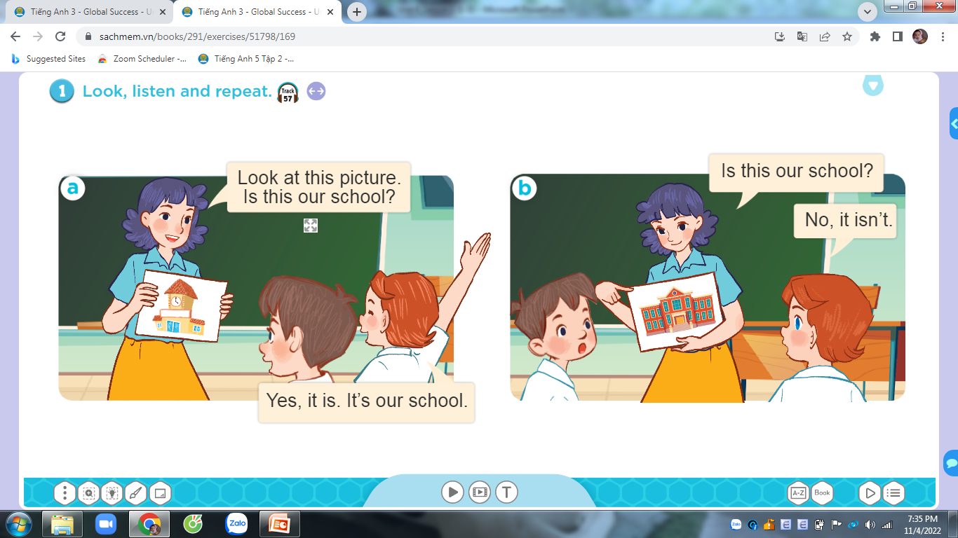

Slide 8
2. Listen, point and say.

Slide 9
New words

Slide 10
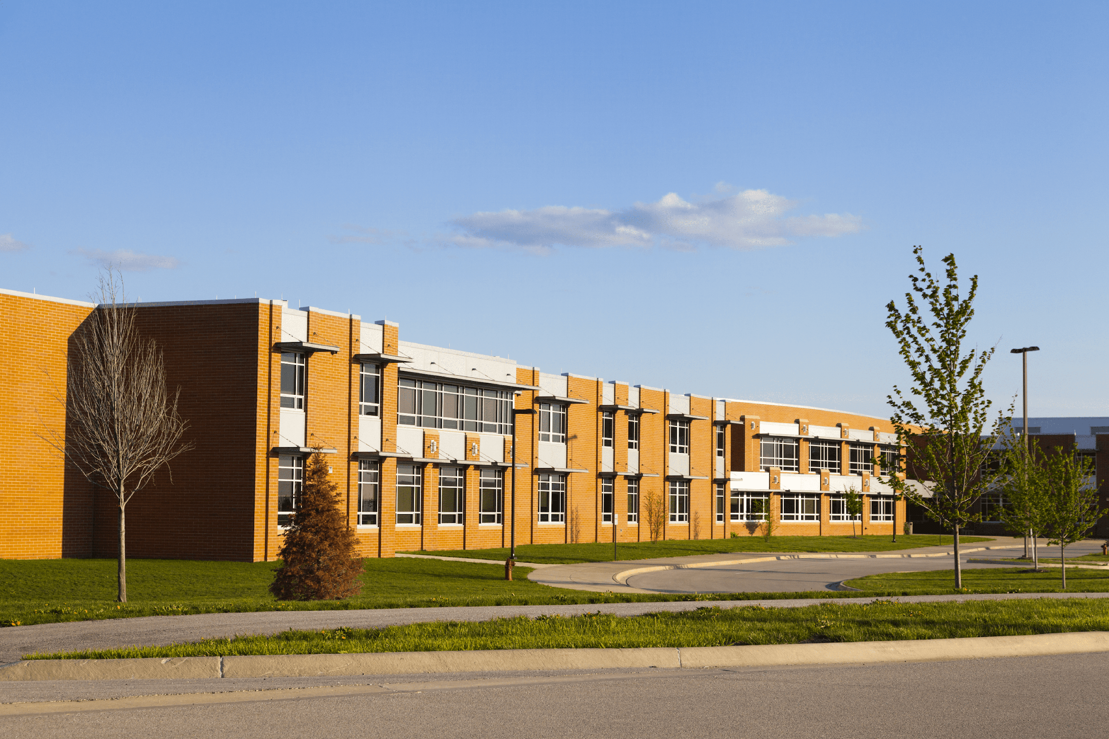
school

Slide 11
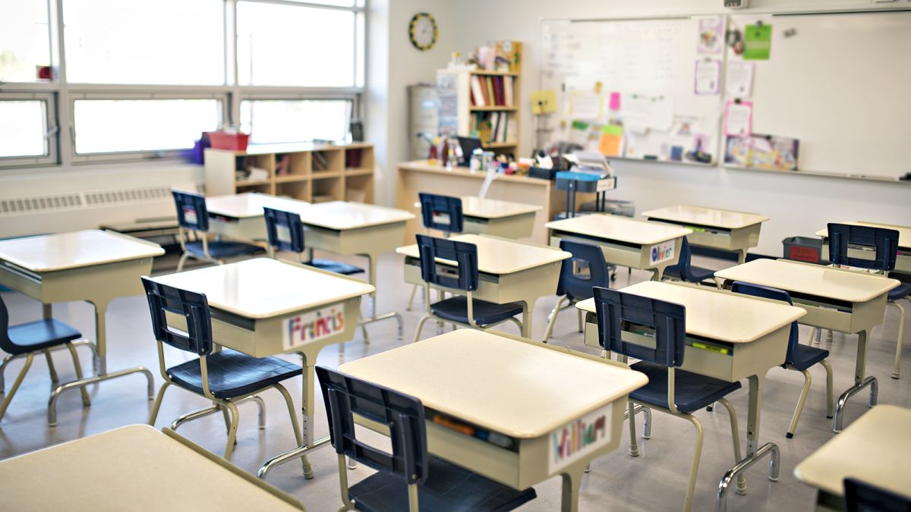
classroom

Slide 12
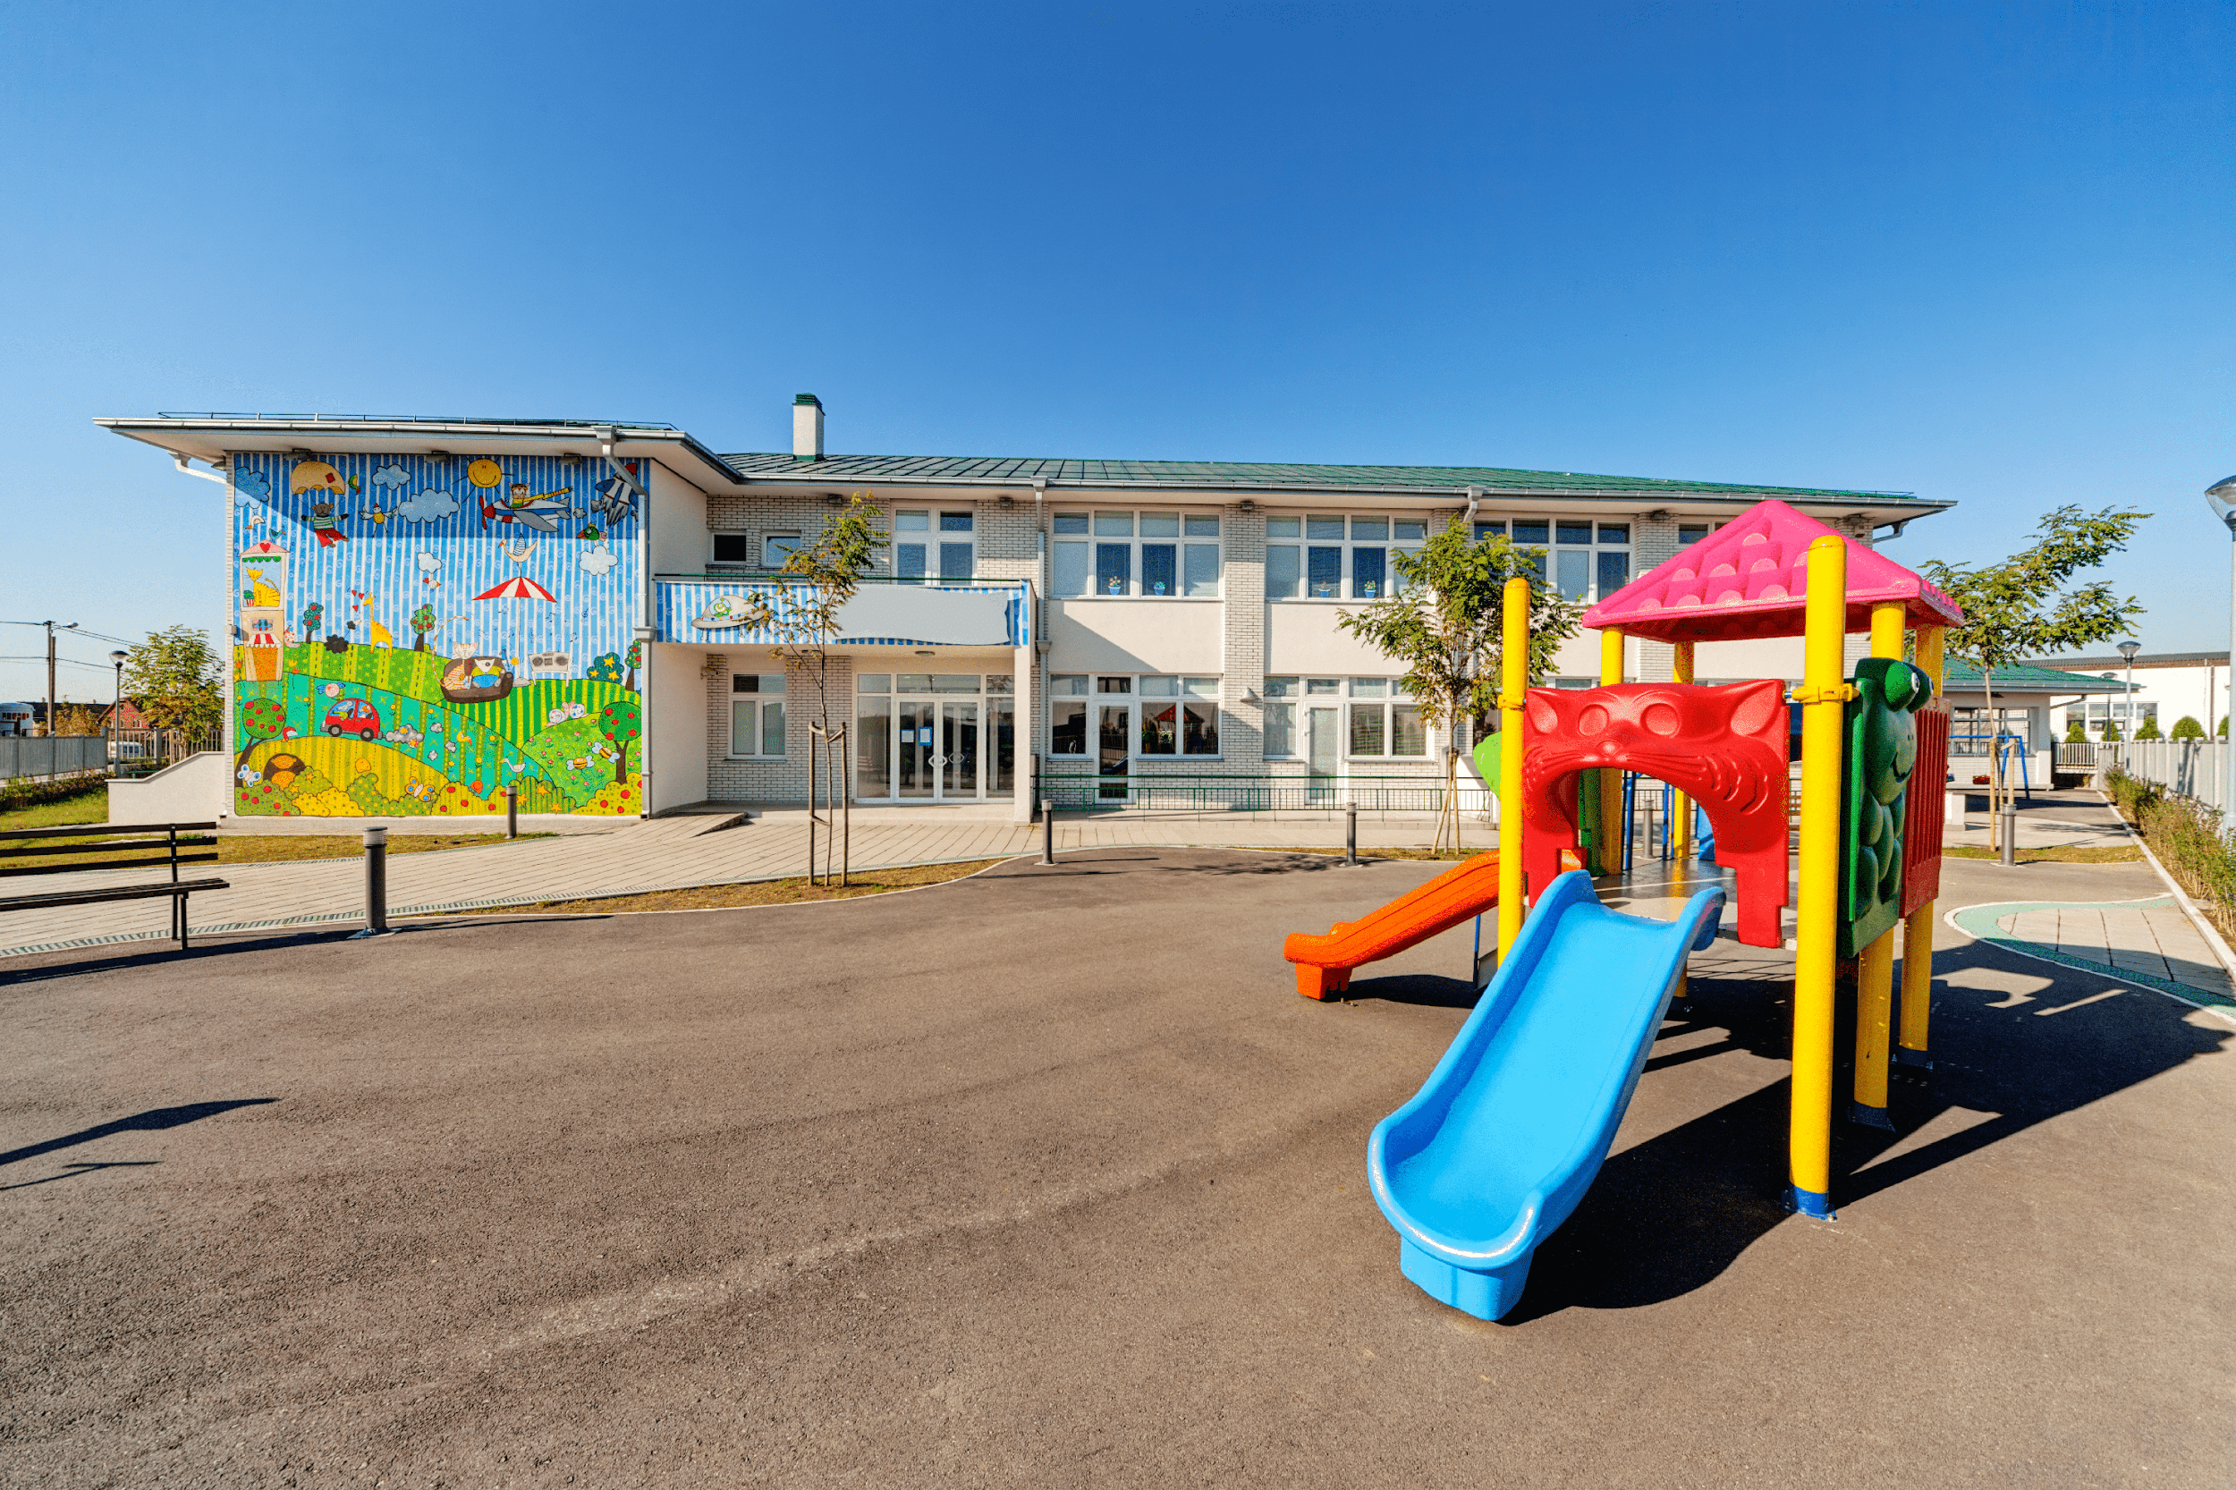
playground

Slide 13

library

Slide 14
New word
School: Trường học
Classroom: Lớp học
Playground: sân chơi
Library: Thư viện
our: của chúng mình

Slide 15


Mẫu câu hỏi - trả lời về trường học:
school
Is this our.................?
classroom
playground
Yes, it is.
library
No, it isn’t.

Slide 16
Look and guess.

Slide 17
playground

Slide 18
classroom

Slide 19
library

Slide 20
school

Slide 21
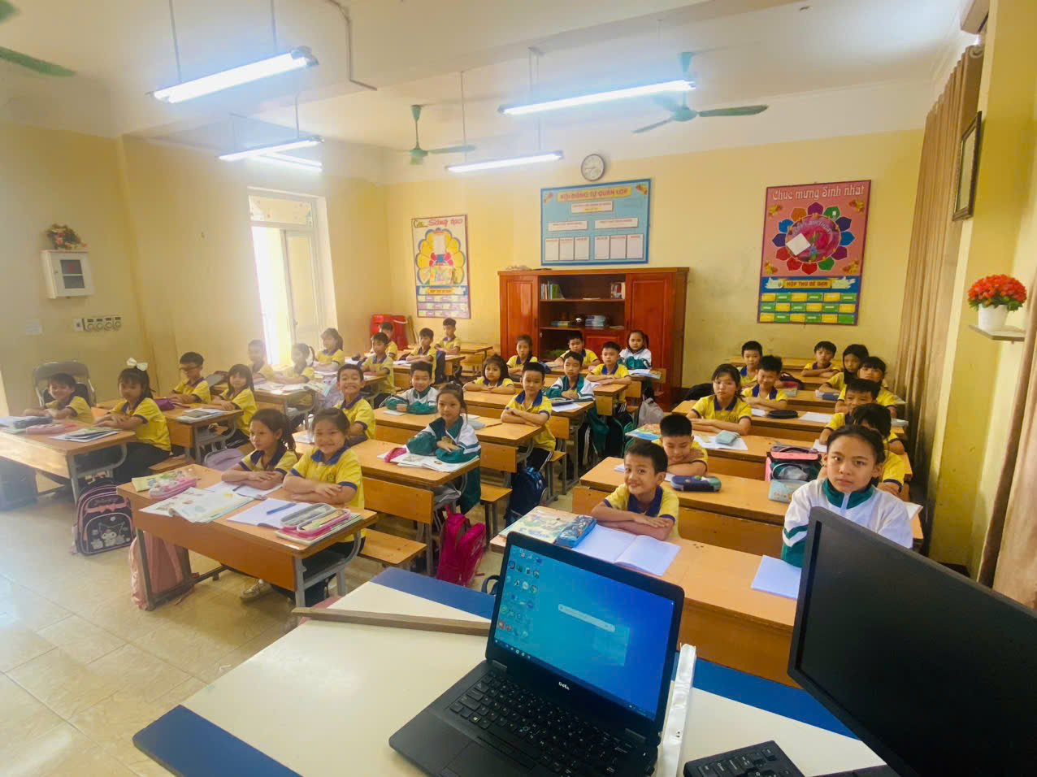
Is this our classroom?
Yes, it is.

Slide 22
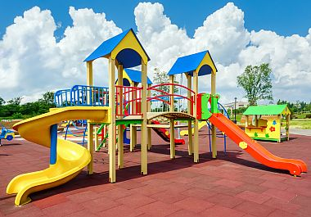
Is this our playground?
No, it isn’t.

Slide 23
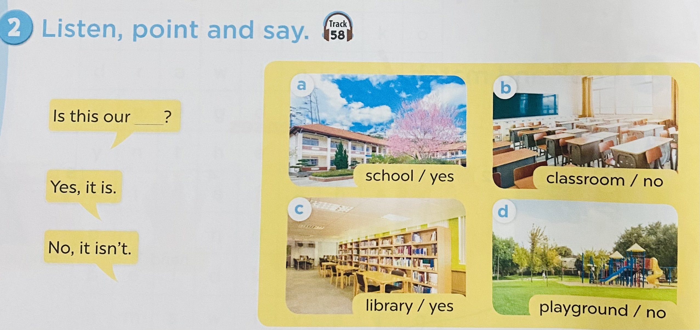

Work in pairs. Practise 2’.

Slide 24
3.Let’s talk.

Slide 25
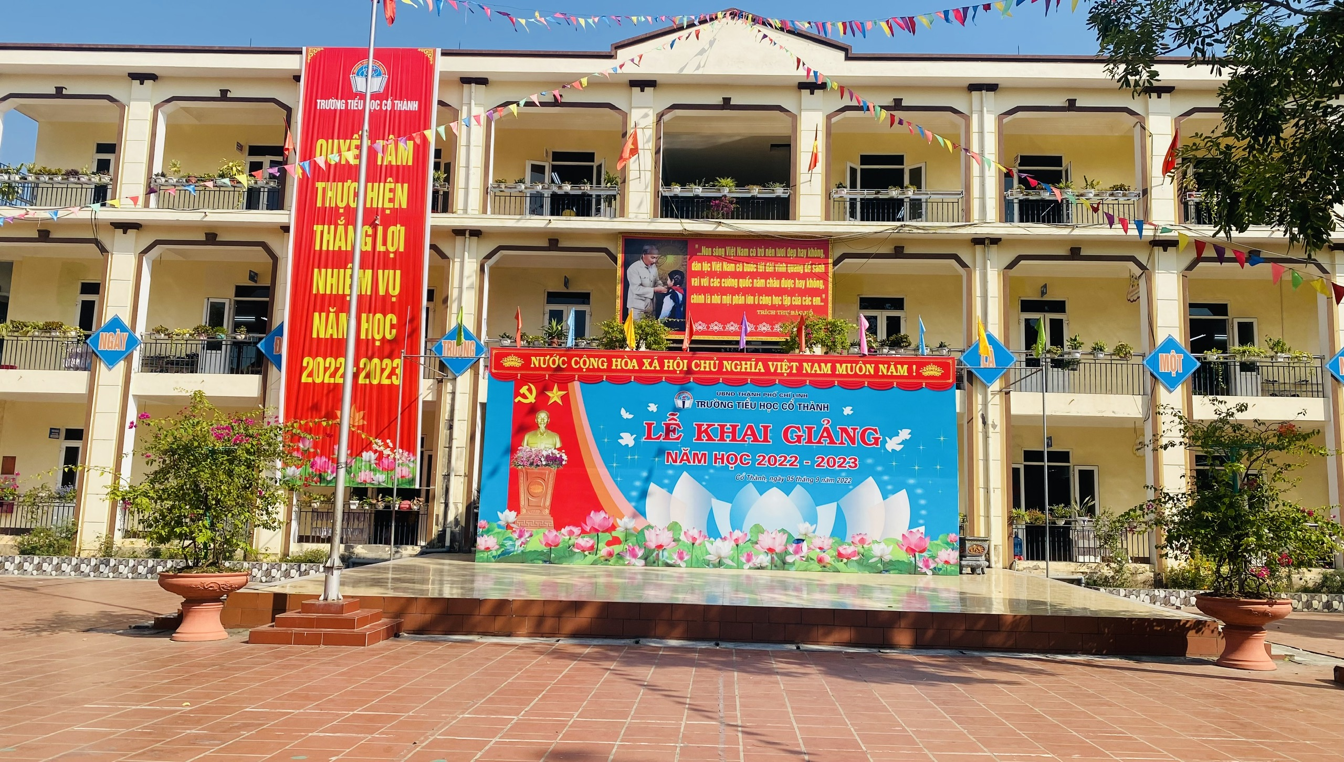

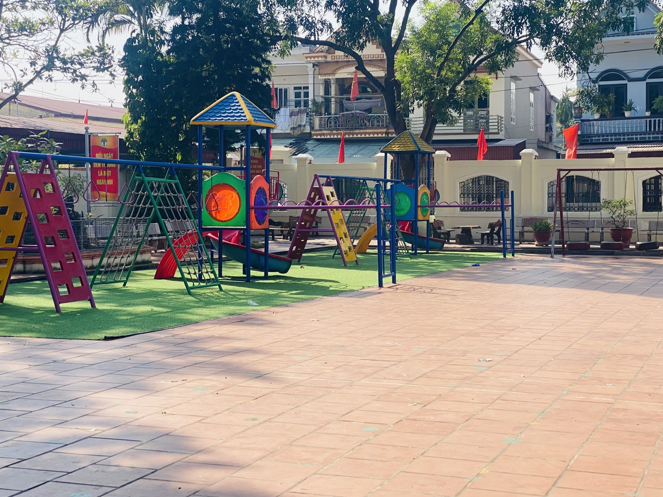
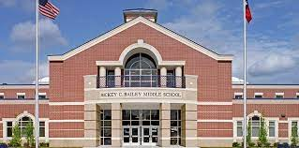
Is this our........?

Slide 26
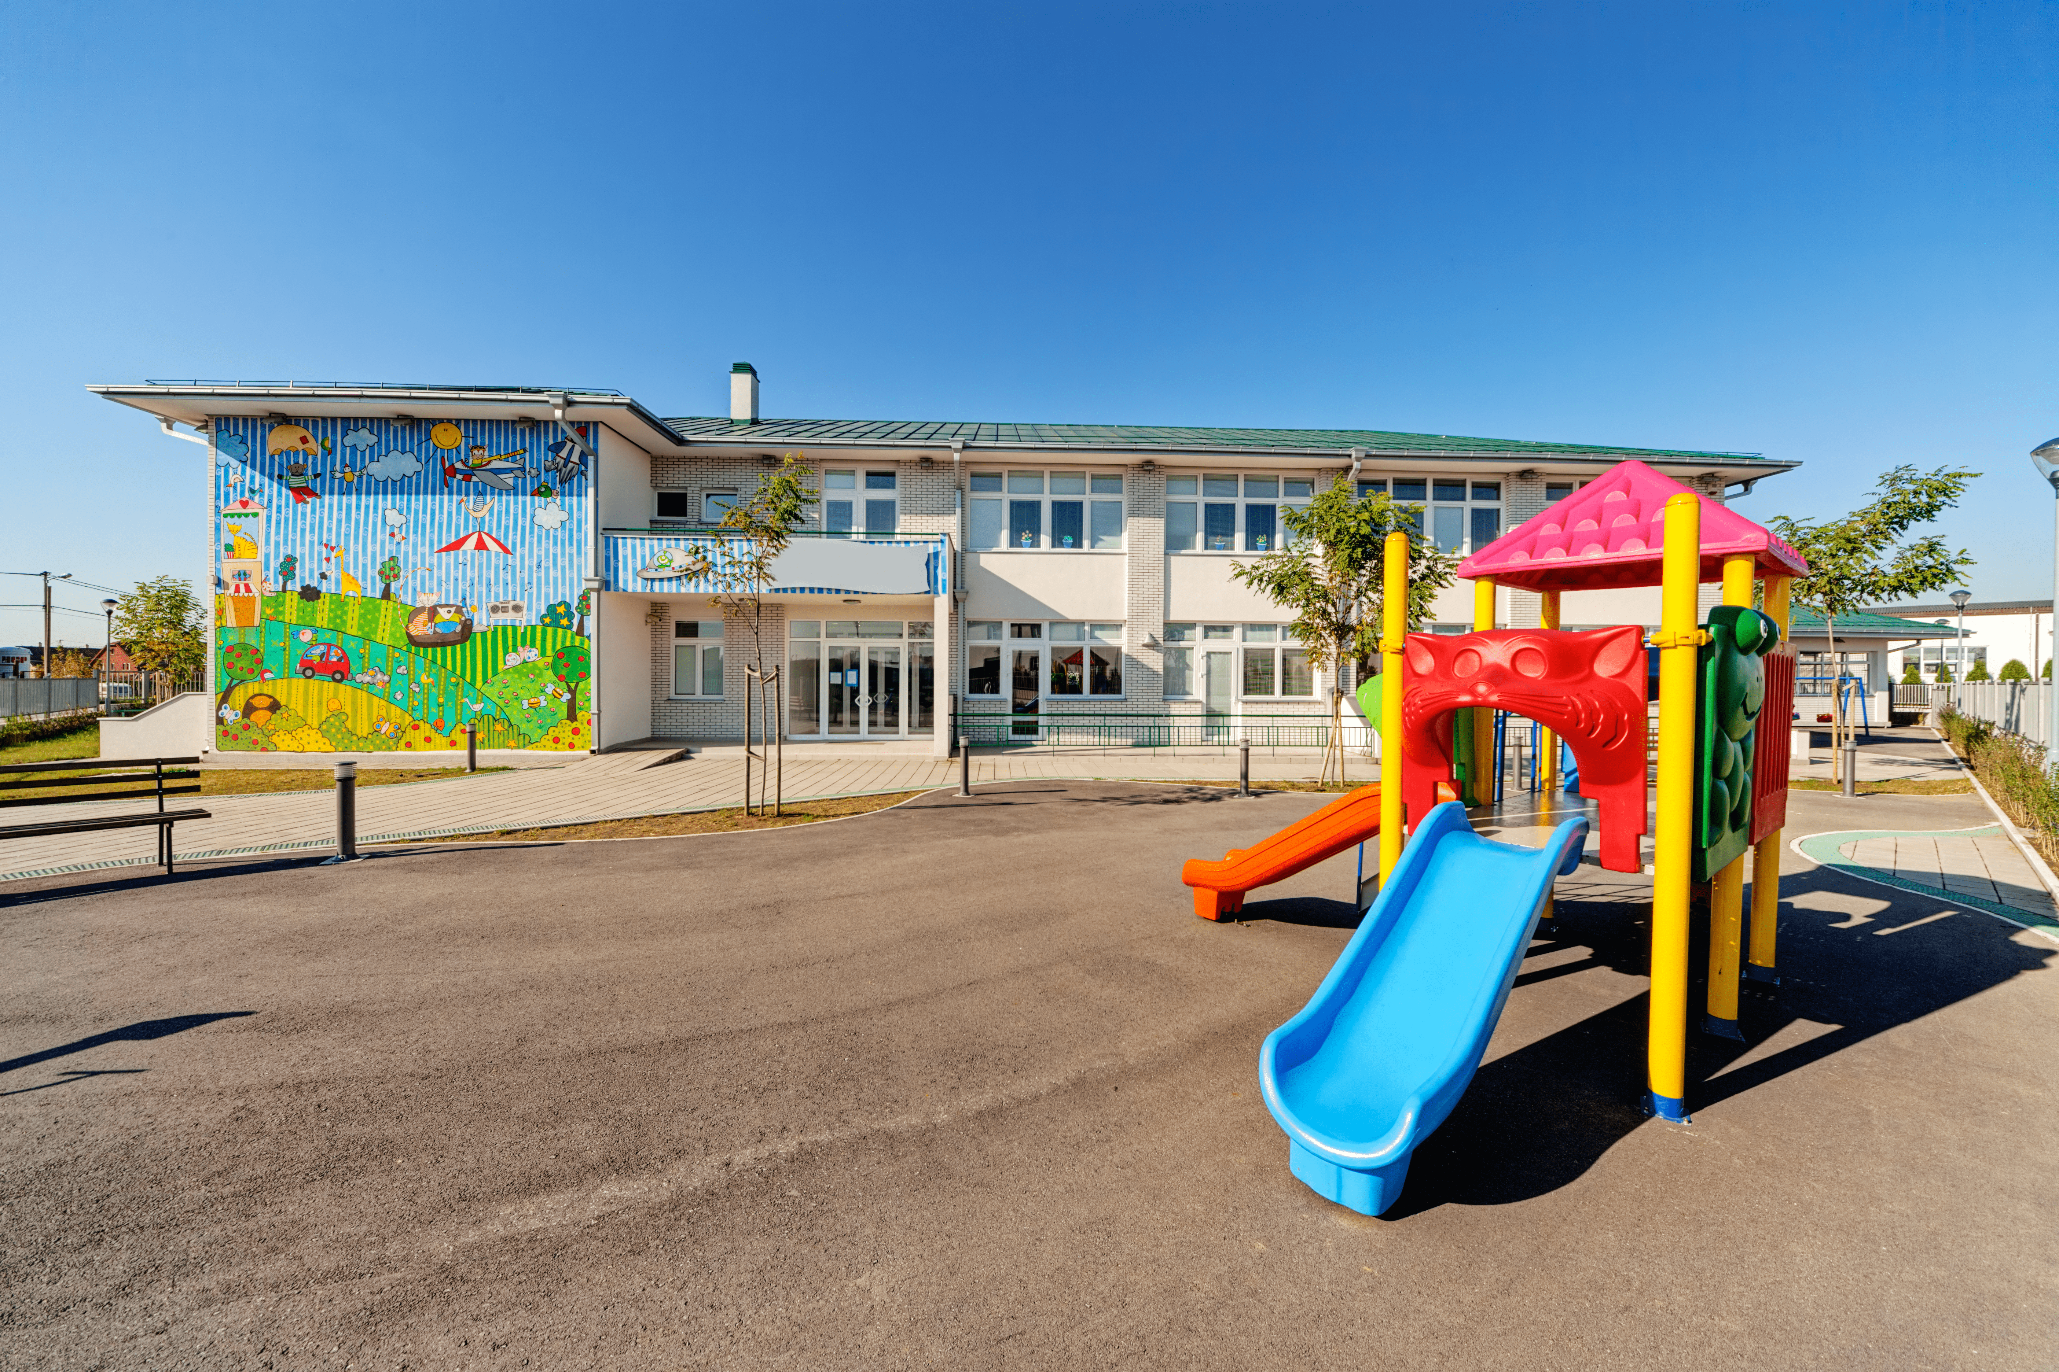
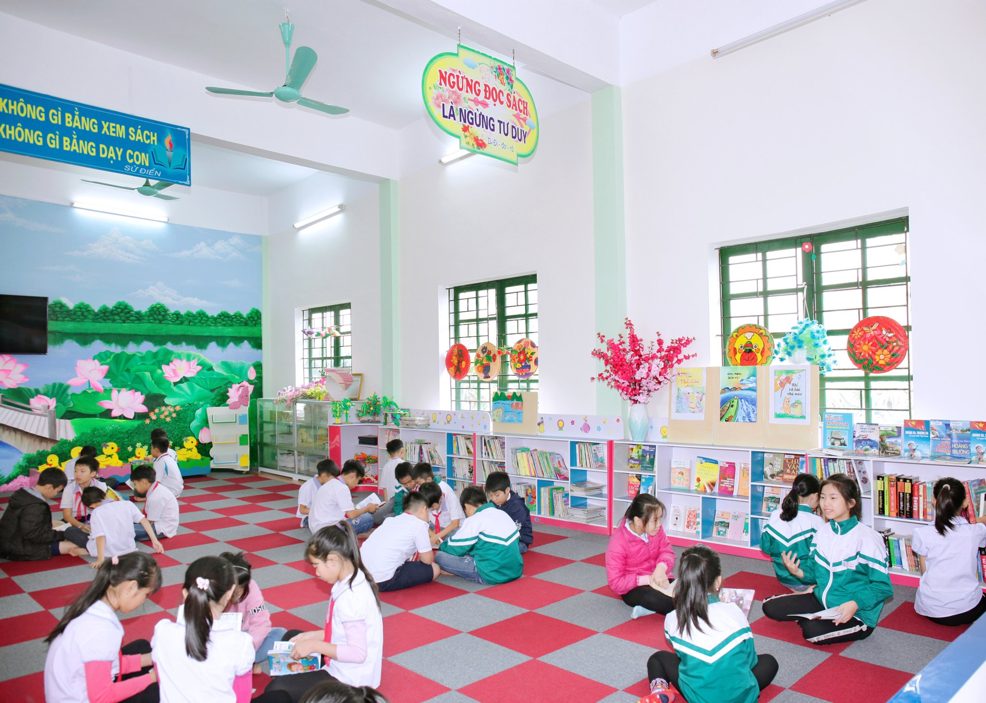
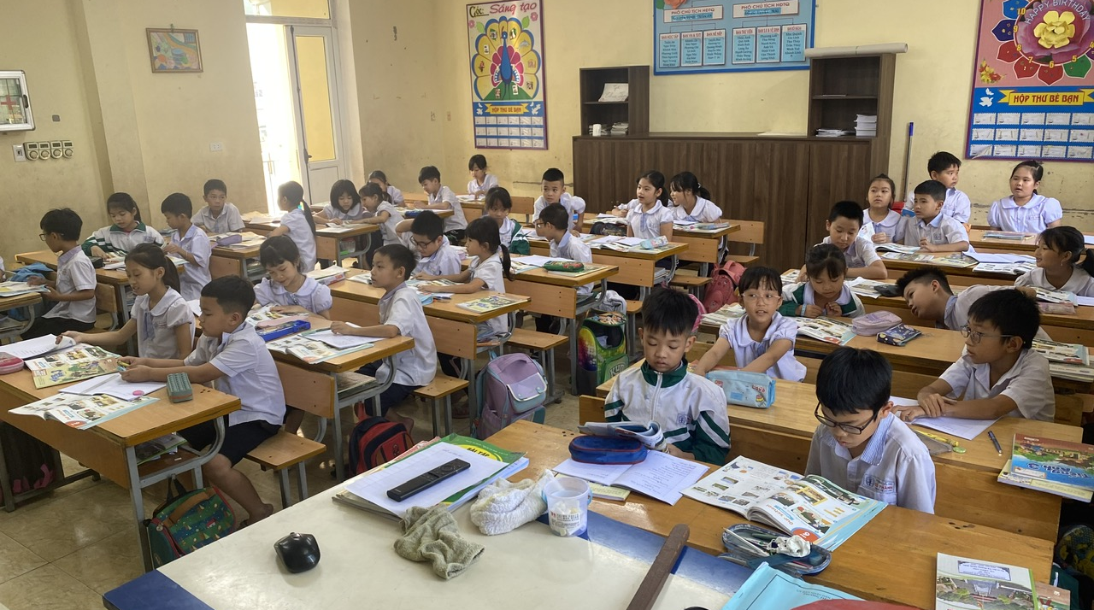
Game: passing the ball.

Slide 27
Mẫu câu hỏi - trả lời về trường học:
school
Is this our.................?
classroom
playground
Yes, it is.
library
No, it isn’t.

Slide 28

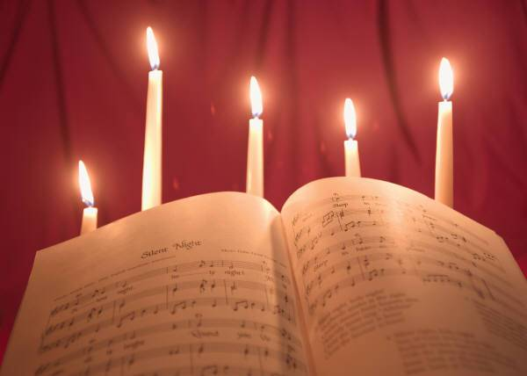


Homework
- Learn the new words by heart.
- Prepare Unit 6, Lesson 1 (4-6) for the next period.

Slide 29

GOODBYE- THANK YOU VERY MUCH

