Slide 1





Slide 2



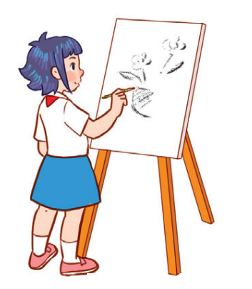

Unit 8
Period 1

Slide 3
Contents
Look, listen and repeat.
Listen, point and say.
Warm-up and review
Let’s talk.
Fun corner and wrap-up
2
1
2
1
3
3
5
4
5
4

Slide 4
Warm-up and review
Warm-up and review
1
1
1
Game: Who’s faster?

Slide 5
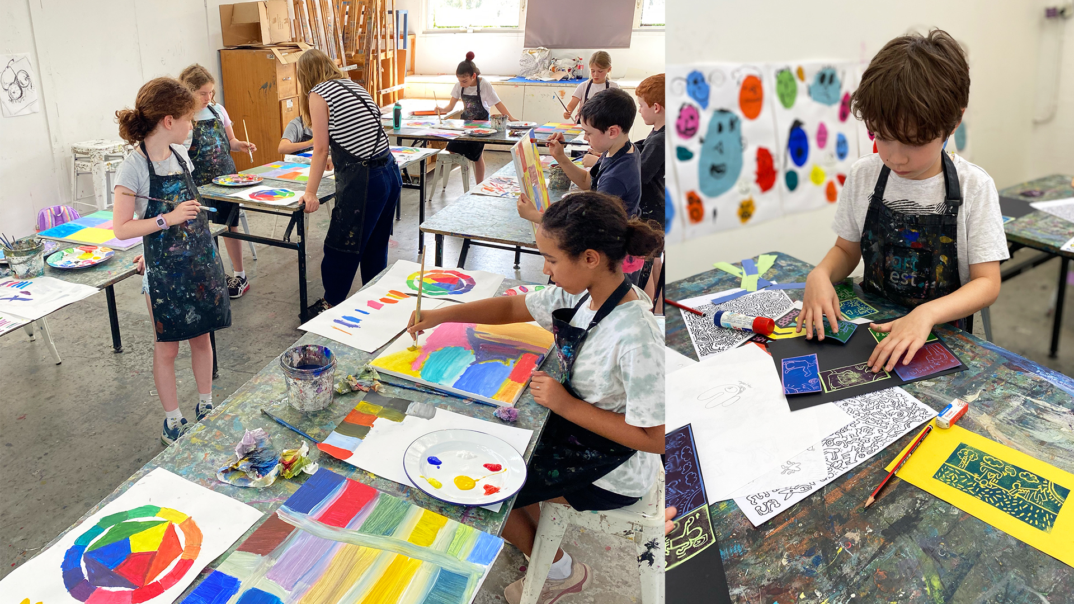
LOOK AT THE PICTURES, SAY THEN SPELL!
art

Slide 6

music

Slide 7
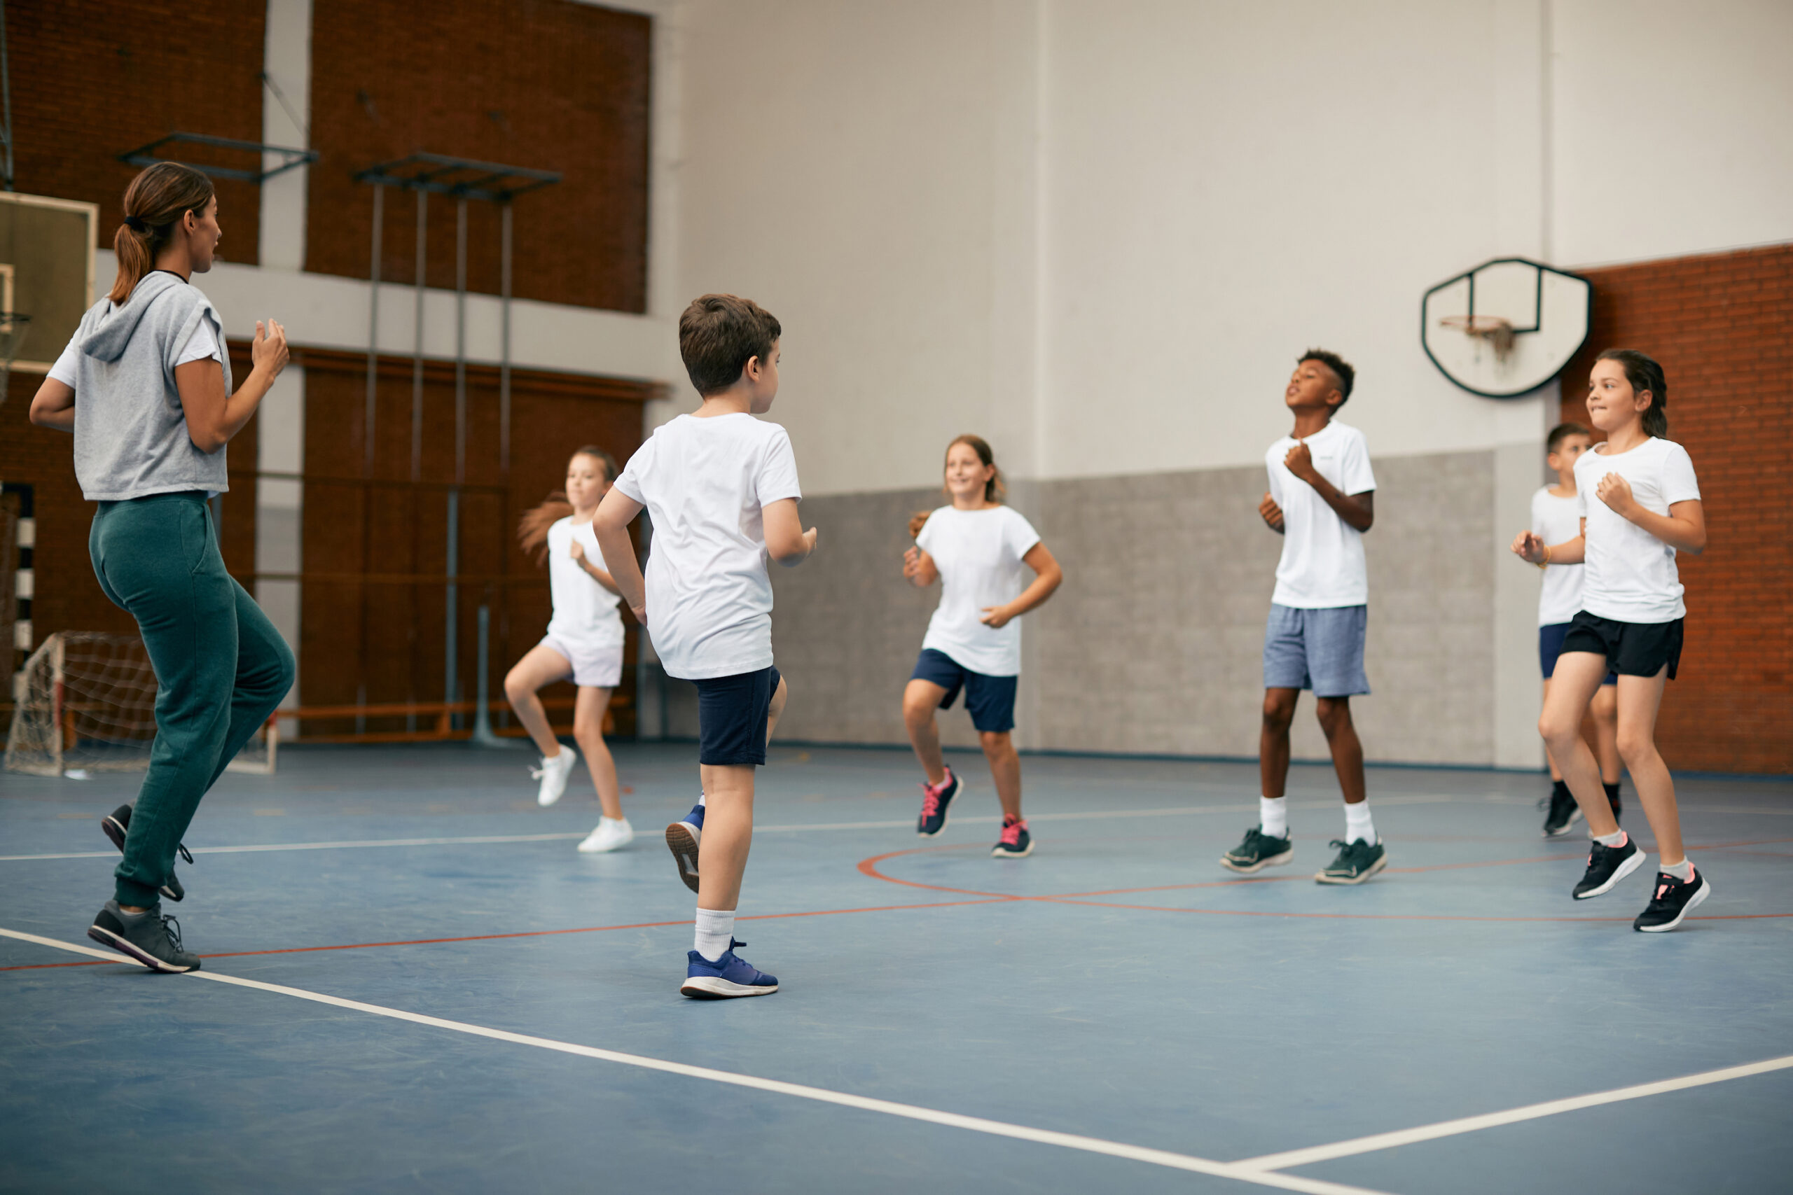
PE

Slide 8

IT

Slide 9

Notes:
Link: https://www.youtube.com/watch?v=2G85e-xBPX4&t=14s

Slide 10
2
Look, listen and repeat.
2
10

Slide 11

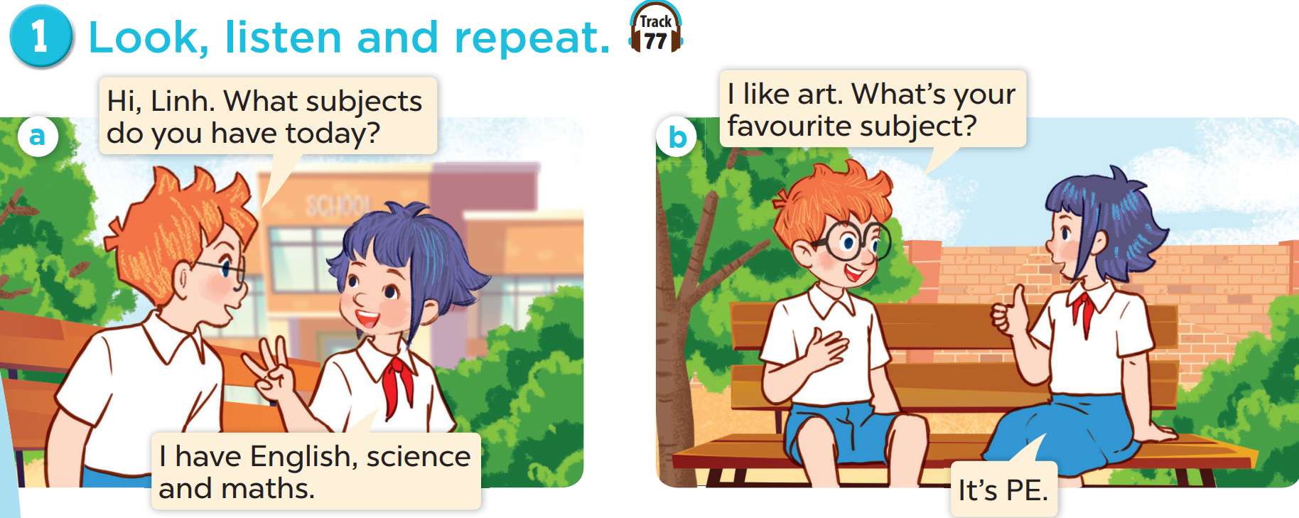

Slide 13
3
Listen, point and say.
3
13

Slide 14
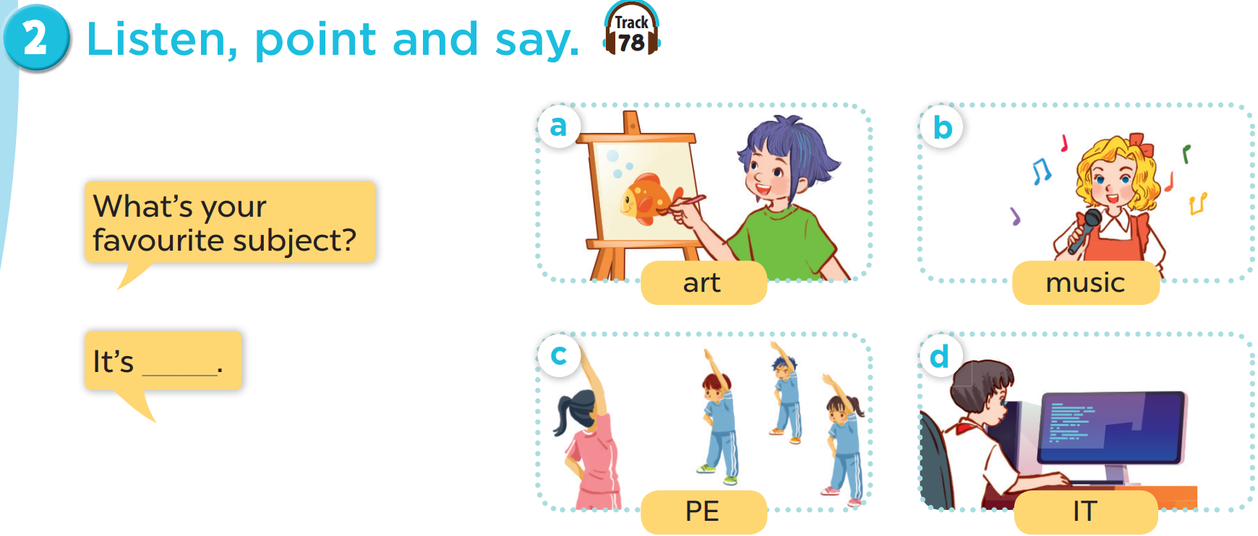

Slide 15

4
Let’s talk.
4
15

Slide 16
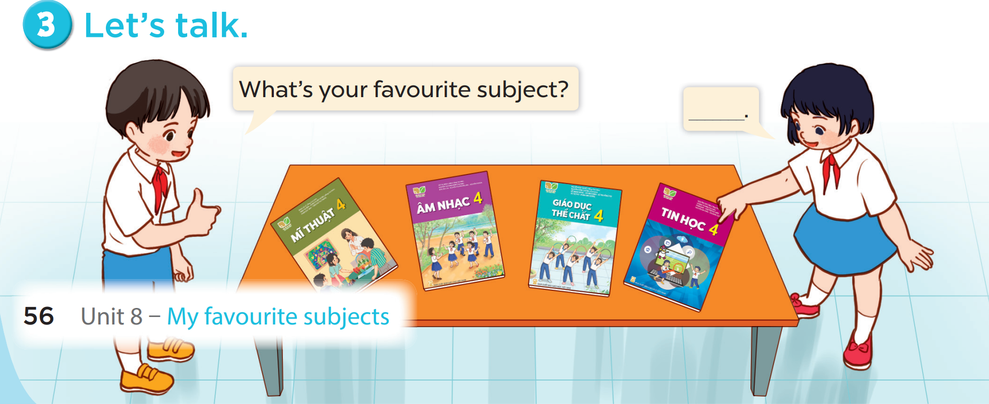

Slide 17
5
Fun corner and wrap-up
5
Game: Matching game

Slide 18






1
2
3
MATHS
4
5
6
PE
SCIENCE
7
8
9
ART
IT
MUSIC
10
11
12
Notes:
Click on the blue part to show pictures/words, if pupils get the correct pairs, leave the square open.
If pupils answer incorrectly, click on the red circle to cover the square again.
Repeat until pupils match all the words with the corresponding pictures.

