Slide 1
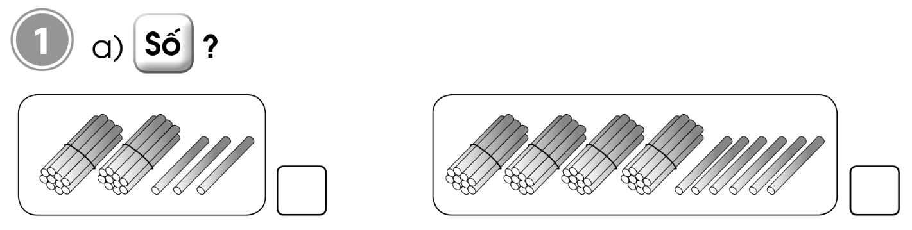
23
46

Slide 2
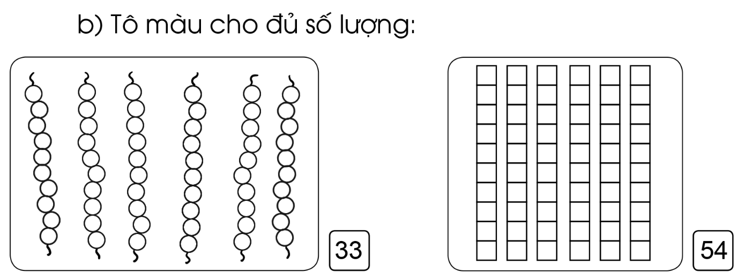

Slide 3
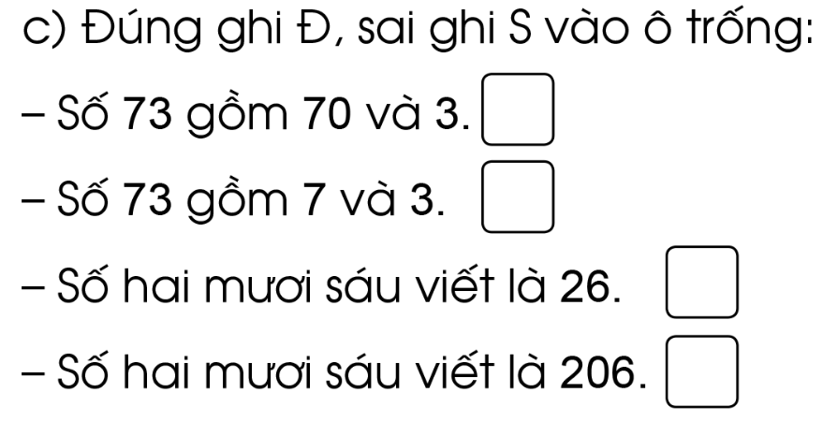
đ
s
đ
s

Slide 4
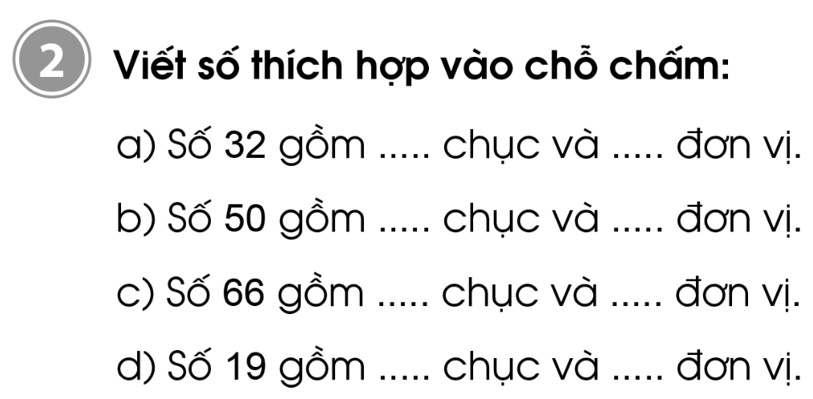
2
8
5
0
6
6
1
9

Slide 5
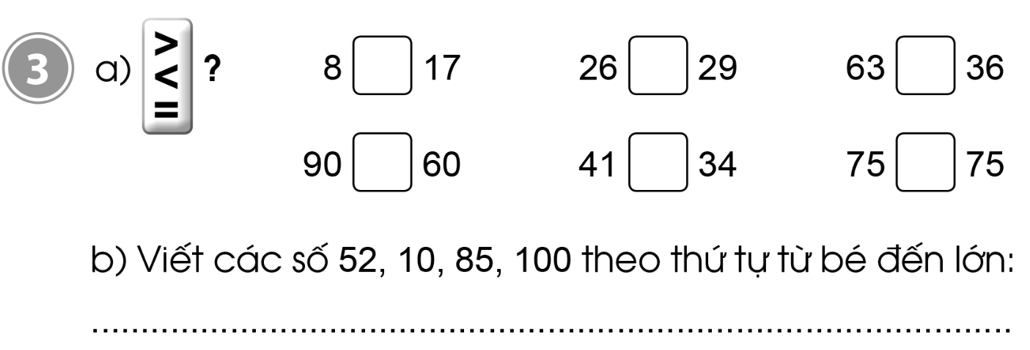
<
<
>
>
>
=
10, 52, 85, 100

Slide 6
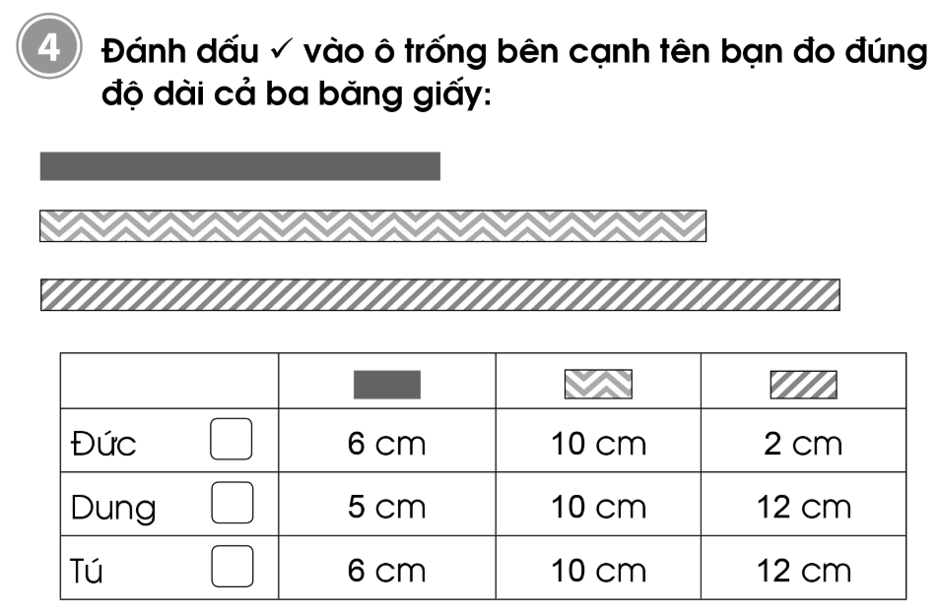

6
10
12

Slide 7
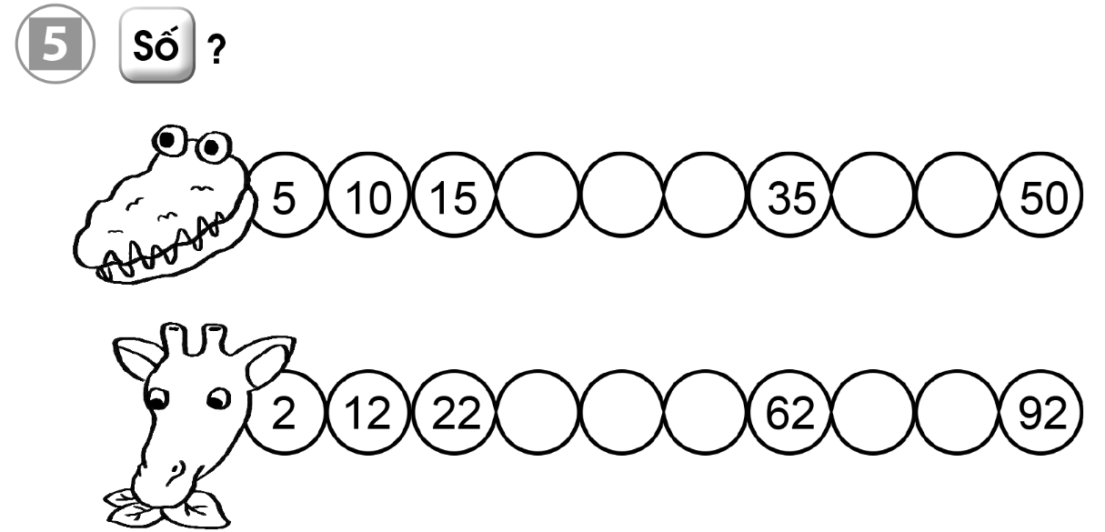
20
25
30
40
45
32
42
52
72
82

