Slide 2






UNIT 17
STORIES
FOR CHILDREN
Lesson 2 – Period 4

Slide 3











Table of Contents
Warm-up and Review
Listen and circle.
Read and complete.
Listen, complete and sing.
Fun corner and Wrap-up

Slide 4


01
Warm-up and Review

Slide 5

What and Where
Notes:
- Tell pupils that they are going to say and write the words.

Slide 6
Game: WHAT and WHERE
work
sing
cook
run
Notes:
Ask pupils to read the words aloud. Delete the words in the circle one by one.
Click the word to disappear it.
Click the pink circles to make it appear.

Slide 7
Game: WHAT and WHERE
work
sing
cook
run
Notes:
Point to the empty circle and ask pupils to read it again.
Ask pupils to come to the board and rewrite the words with the correct places in the circles.
Check the answers as the class by clicking on the pink circle chosen.
Have pairs of pupils use these words to ask and answer questions about a character in a story.

Slide 8
Game: WHAT and WHERE
work
sing
cook
run

Slide 9
Game: WHAT and WHERE
work
sing
cook
run

Slide 10
Game: WHAT and WHERE
work
sing
cook
run
Notes:
Have pairs of pupils use these words to ask and answer questions about a character in a story.

Slide 11



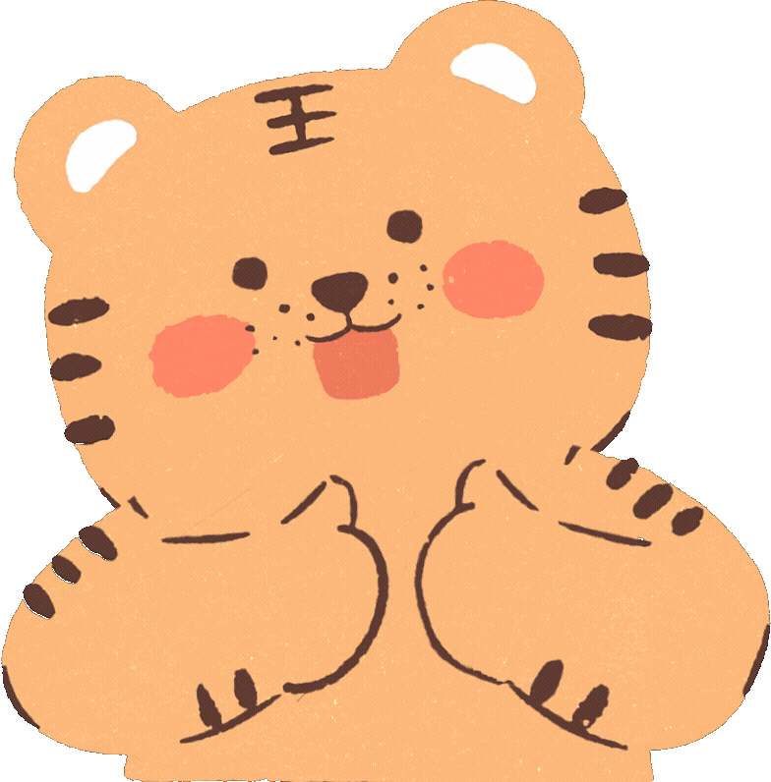



Slide 12
02
Listen and circle.

Slide 13


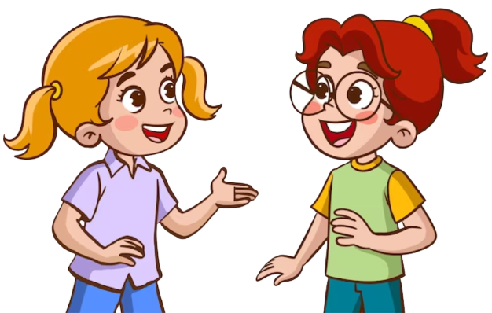
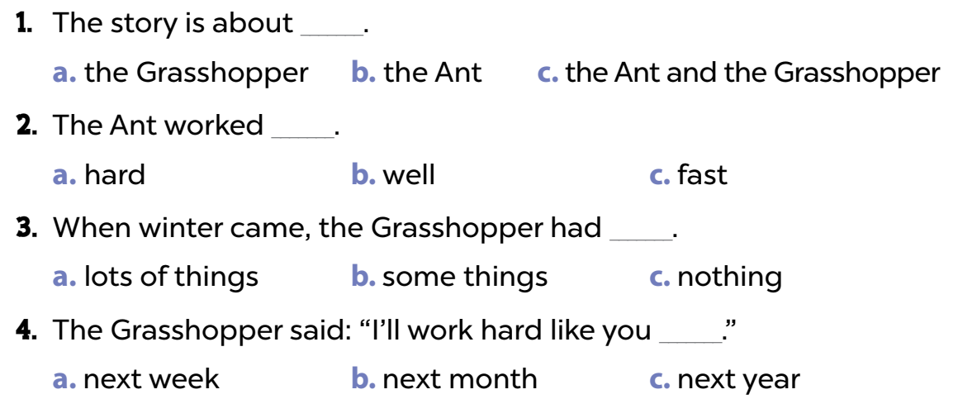
Read and guess the answers.
1. The story is about _______.
a. a grasshopper b. an ant c. an ant and a grasshopper
2. The ant worked _______.
a. hard b. well c. fast
3. When winter came, the grasshopper did not have any _______.
a. water b. friends c. food
4. The grasshopper said: “I’ll work hard like you _______.”
a. next week b. next month c. next year

Slide 14
Listen.
1. The story is about _______.
a. a grasshopper b. an ant c. an ant and a grasshopper
2. The ant worked _______.
a. hard b. well c. fast
3. When winter came, the grasshopper did not have any _______.
a. water b. friends c. food
4. The grasshopper said: “I’ll work hard like you _______.”
a. next week b. next month c. next year

Slide 15
Listen and circle.
1. The story is about _______.
a. a grasshopper b. an ant c. an ant and a grasshopper
2. The ant worked _______.
a. hard b. well c. fast
3. When winter came, the grasshopper did not have any _______.
a. water b. friends c. food
4. The grasshopper said: “I’ll work hard like you _______.”
a. next week b. next month c. next year

Slide 16
Work in pairs to check your answers.

Slide 17
Let’s check the answers.
1. The story is about _______.
a. a grasshopper b. an ant c. an ant and a grasshopper
2. The ant worked _______.
a. hard b. well c. fast
3. When winter came, the grasshopper did not have any _______.
a. water b. friends c. food
4. The grasshopper said: “I’ll work hard like you _______.”
a. next week b. next month c. next year

Slide 19
03
Read and complete.

Slide 20
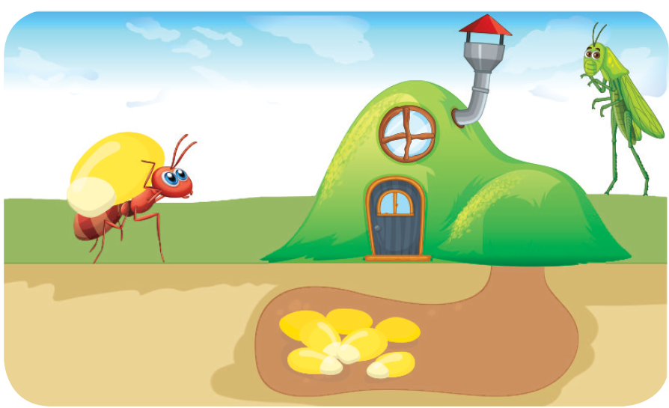
Look and answer.
1. Who are the main characters in this story?
2. How did they work?

Slide 21

Look and answer.
A: Who are the main
characters in the story?
B: They’re the ant and the
_____________ .
A: _______ did the ant work?
B: He worked __________ to
gather food for the winter.
grasshopper
How
hard

Slide 22
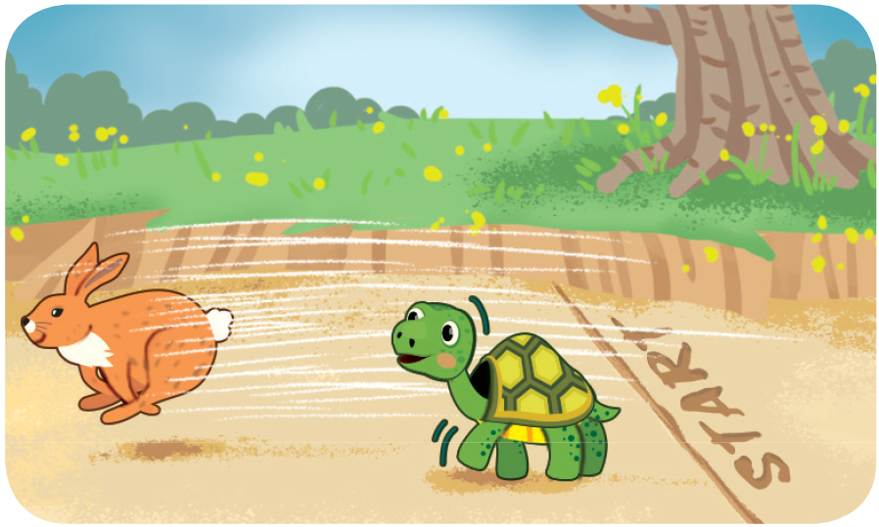
Look and answer.
1. Who are the main characters in this story?
2. How did they run?

Slide 23

Look and answer.
A: How did the hare run?
B: He ran _____ .
A: _______ he win the race?
B: No, he didn’t. He stopped
and fell asleep. The tortoise
won the race.
fast
Did

Slide 24
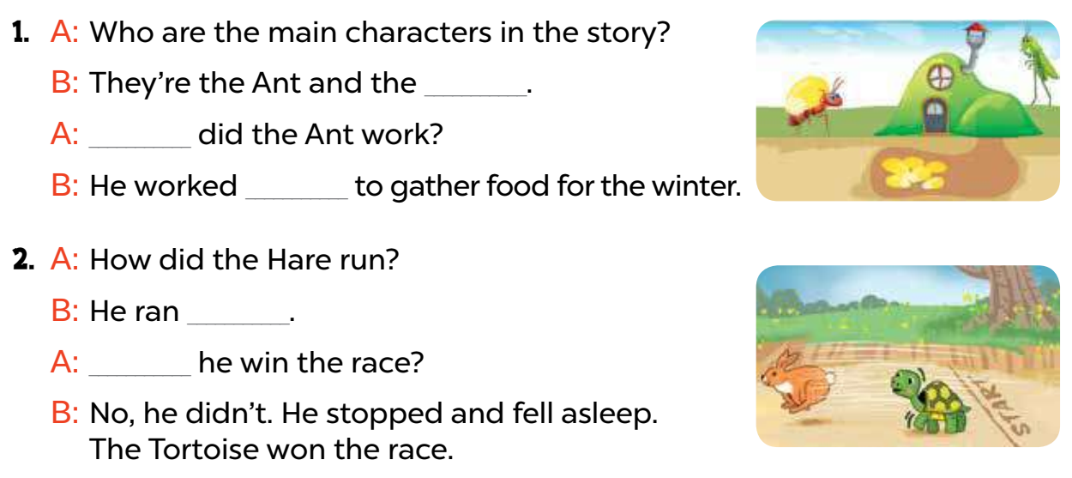
Swap your books and check your answers.
1. A: Who are the main characters in the story?
B: They’re the ant and the _______________.
A: ______ did the ant work?
B: He worked ______ to gather food for the winter.
2. A: How did the hare run?
B: He ran ______.
A: _____ he win the race?
B: No, he didn’t. He stopped and fell asleep.
The tortoise won the race.
grasshopper
How
hard
fast
Did

Slide 25


True or False

Slide 26

False
The main characters
in the story 1 are the ant and the hare.
True

Slide 27
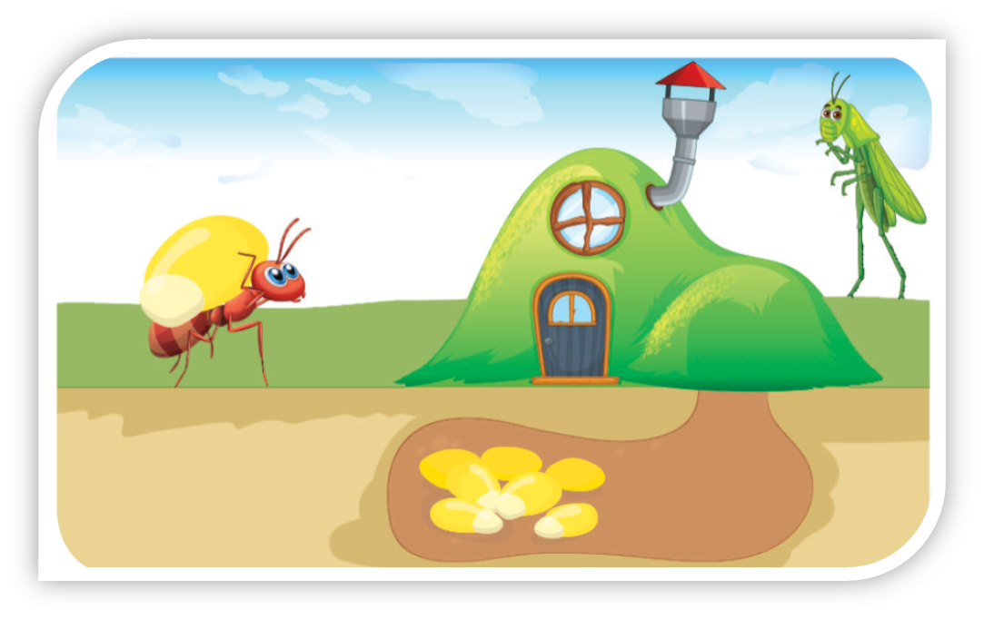
False
They are the ant and the grasshopper.

Slide 28

False
The ant worked very hard to gather food for the winter.
True

Slide 29
True

Slide 30

False
The hare ran fast, and
he won the race.
True

Slide 31
False
He ran fast but he didn’t win the race.

Slide 32

The tortoise won the race finally.
True
False

Slide 33
True

Slide 34

Great Job!

Slide 35
04
Listen, complete and sing.

Slide 36


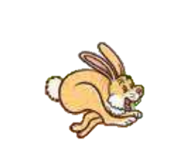
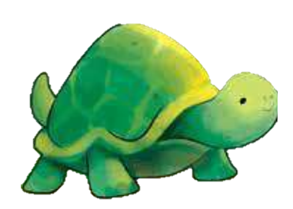
Listen to the teacher carefully.
The tortoise and the hare
The hare said to the tortoise
“Let’s go, go, go!”
The hare ran (1) _________.
But the tortoise was slow.
The (2) _________ was near the finish line.
He stopped, stopped, stopped.
The hare fell asleep.
And the (3) _________ won the race.

Slide 37
Read and guess.
The tortoise and the hare
The hare said to the tortoise
“Let’s go, go, go!”
The hare ran (1) _________.
But the tortoise was slow.
The (2) _________ was near the finish line.
He stopped, stopped, stopped.
The hare fell asleep.
And the (3) _________ won the race.

Slide 38
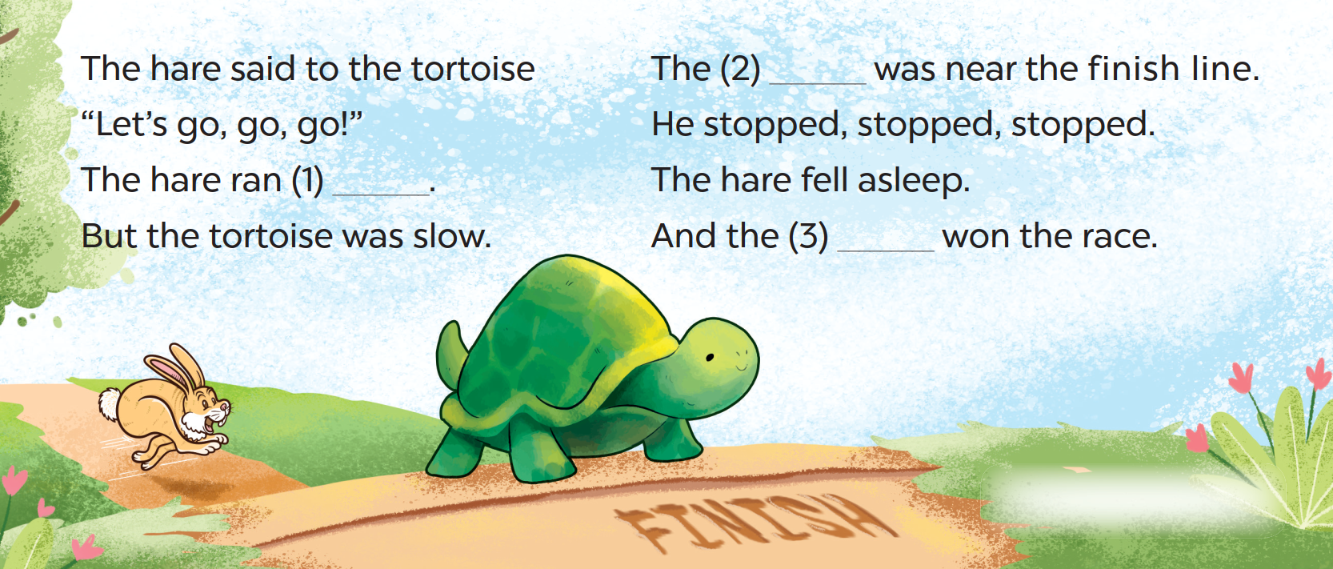
Read and guess.
The tortoise and the hare

Slide 39
Listen and complete.
The tortoise and the hare
The hare said to the tortoise
“Let’s go, go, go!”
The hare ran (1) _________.
But the tortoise was slow.
The (2) _________ was near the finish line.
He stopped, stopped, stopped.
The hare fell asleep.
And the (3) _________ won the race.

Slide 40
Listen and sing along.
The tortoise and the hare
The hare said to the tortoise
“Let’s go, go, go!”
fast
The hare ran (1) ______ .
But the tortoise was slow.

Slide 41
Listen and sing along.
The tortoise and the hare
hare
The (2) _______ was near the finish line.
He stopped, stopped, stopped.
The hare fell asleep.
tortoise
And the (3) __________ won the race.

Slide 42
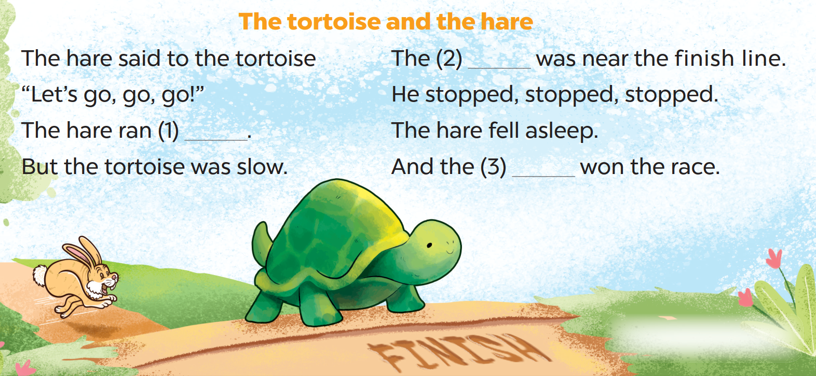
Listen, sing and clap.

Slide 44
05
Fun corner and Wrap-up

Slide 45




Board
Game

Slide 46
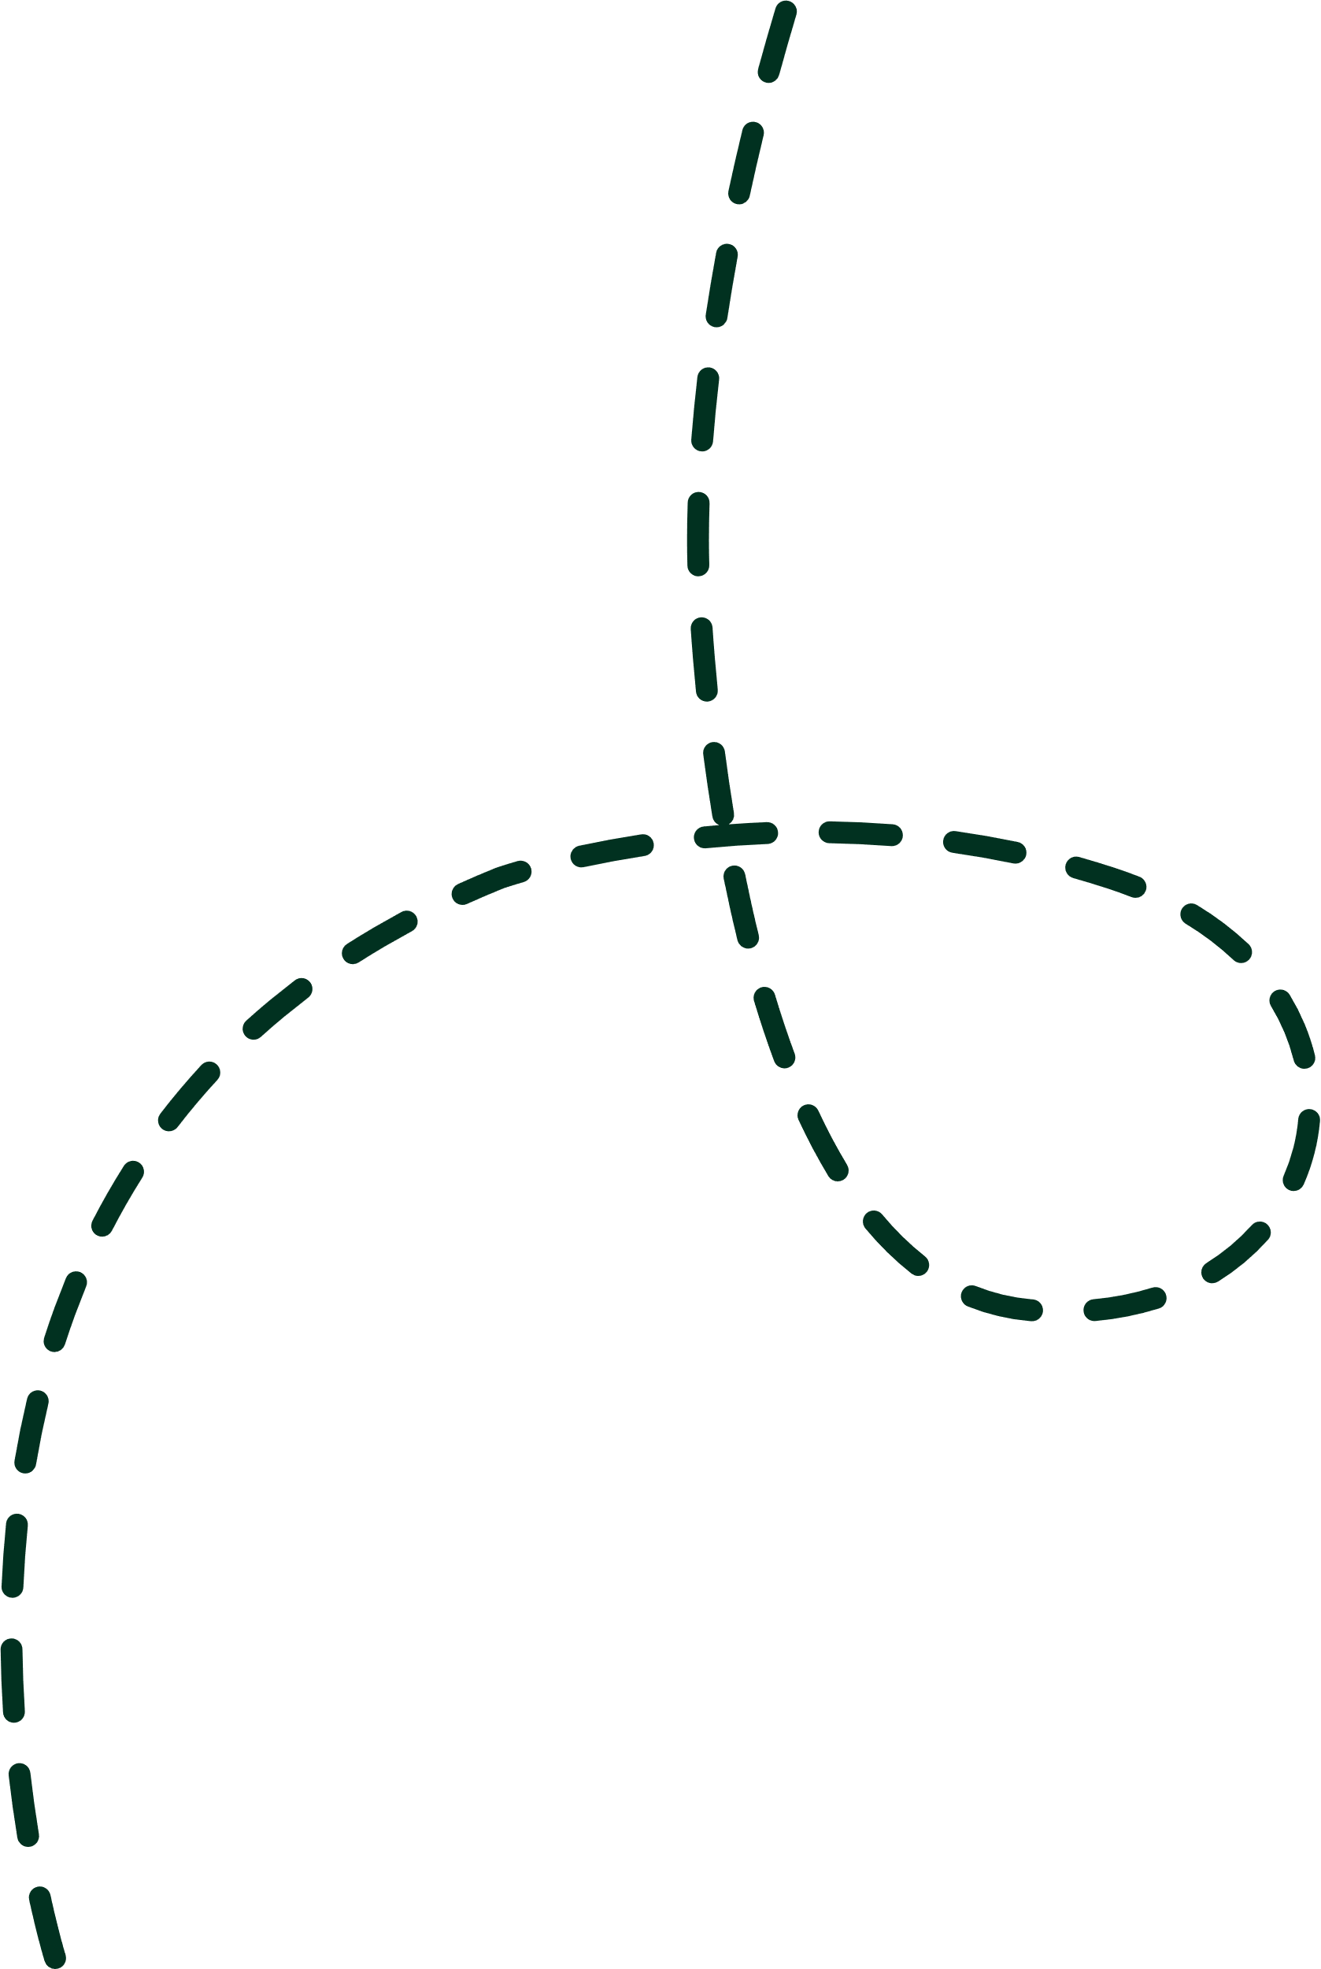

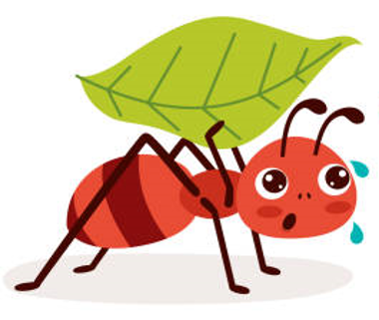
A: How did the ant work?
B: He worked very hard.

Slide 47
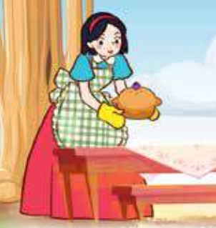
B: She cooked very well.
A: How did Snow White cook?

Slide 48
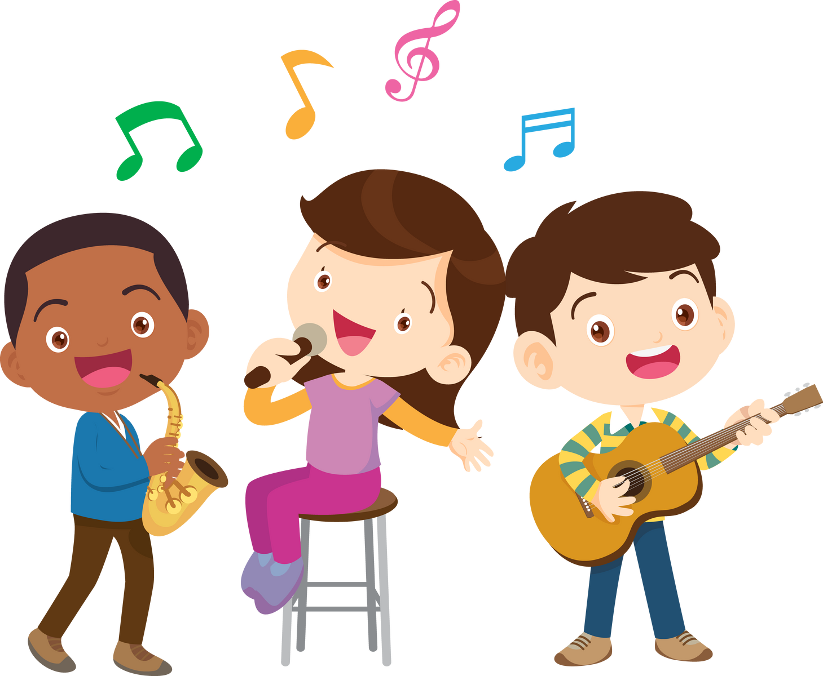
A: How did the students sing?
B: They sang well. /
They sang beautifully.

Slide 49
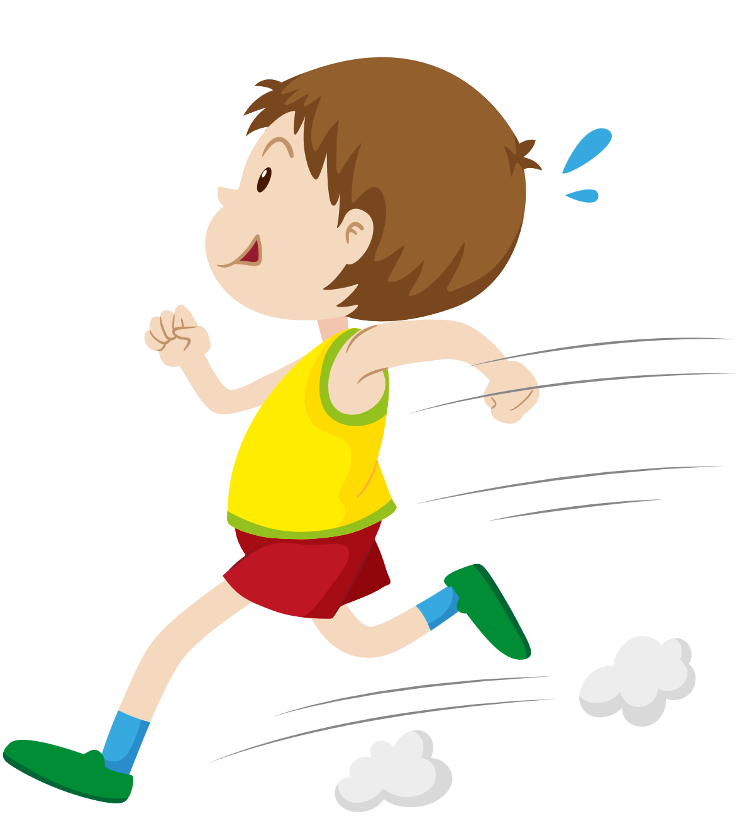
A: How did the boy run?
B: He ran quickly. /
He ran fast.

Slide 50

A: How did the man work?
B: He worked very hard.

Slide 51


You did a good job!

Slide 52
Website: hoclieu.vn
Fanpage: https://www.facebook.com/tienganhglobalsuccess.vn/

