Slide 2

Unit 16
Seasons and the weather
Lesson 3 - Period 5

Slide 3


Table of contents
01
Warm-up and Review
02
Listen and repeat.
03
Listen and repeat.
Pay attention to the intonation.
04
Let’s chant.
05
Fun corner and Wrap-up

Slide 4


01
Warm-up and Review

Slide 5


Slide 6




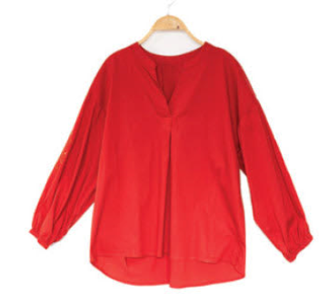
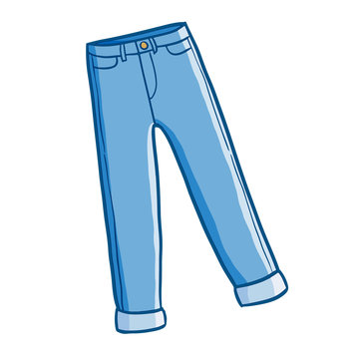
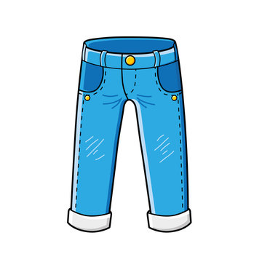


Matching pairs.

Slide 7
02
Listen and repeat.

Slide 8


Listen and repeat.
It’s cloudy in autumn.

Slide 9
Listen and repeat.
I wear jeans in winter.

Slide 10
Listen and repeat.
It’s cloudy in autumn.
I wear jeans in winter.

Slide 11
Listen and repeat.
It’s cloudy in _____.
I wear ____ in winter.

Slide 12
03
Listen and repeat.
Pay attention to the intonation.

Slide 13
Read.
1. It’s humid in spring.
2. Dresses are perfect for today.
3. I wear trousers in summer.
4. Jackets are good for winter.

Slide 14
Listen and repeat.
Pay attention to the intonation.
1. It’s humid in spring.

Slide 15
Listen and repeat.
Pay attention to the intonation.
2. Dresses are perfect for today.

Slide 16
Listen and repeat.
Pay attention to the intonation.
3. I wear trousers in summer.

Slide 17
Listen and repeat.
Pay attention to the intonation.
4.Jackets are good for winter.

Slide 18
Listen and repeat.
1. It’s humid in spring.
2. Dresses are perfect for today.
3. I wear trousers in summer.
4. Jackets are good for winter.

Slide 19
04
Activity 3. Let’s chant.

Slide 20



Let’s chant.
It’s hot in summer.
I wear shorts.
You wear a dress.
And you wear a hat.
We like summer outfits.
It’s cold in winter.
I wear a jumper.
You wear trousers.
We wear scarves outside.
We like winter clothes.

Slide 21


Let’s chant.
It’s hot in summer.
I wear shorts.
You wear a dress.
And you wear a hat.
We like summer outfits.
It’s cold in winter.
I wear a jumper.
You wear trousers.
We wear scarves outside.
We like winter clothes.

Slide 22
05
Fun corner and Wrap-up

Slide 23

Whisper
Game

Slide 24


Team 1
Whisper Game
Team 2
Round 1
Round 2
Round 3
Round 4
Notes:
GV ghi điểm cho HS bằng cách nháy vào tên team. Mỗi lần nháy 1 ngôi sao xuất hiện.

Slide 25


Slide 26
Website: hoclieu.vn
Fanpage: https://www.facebook.com/tienganhglobalsuccess.vn/

