Slide 2
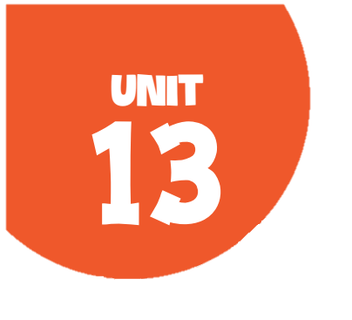
OUR SPECIAL DAYS
Lesson 3 - Period 5

Slide 3
Table of contents
1
2
3
4
Warm up
Activity 1
Listen and repeat.
Activity 2
Listen and underline one more stressed word.
Then repeat.
Activity 3
Let’s chant.
Fun corner
5
Let's play.

Slide 4
01
Warm-up
Guess the food and drinks.

Slide 5
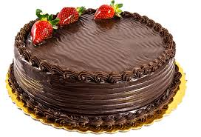
cake
SHOW

Slide 6
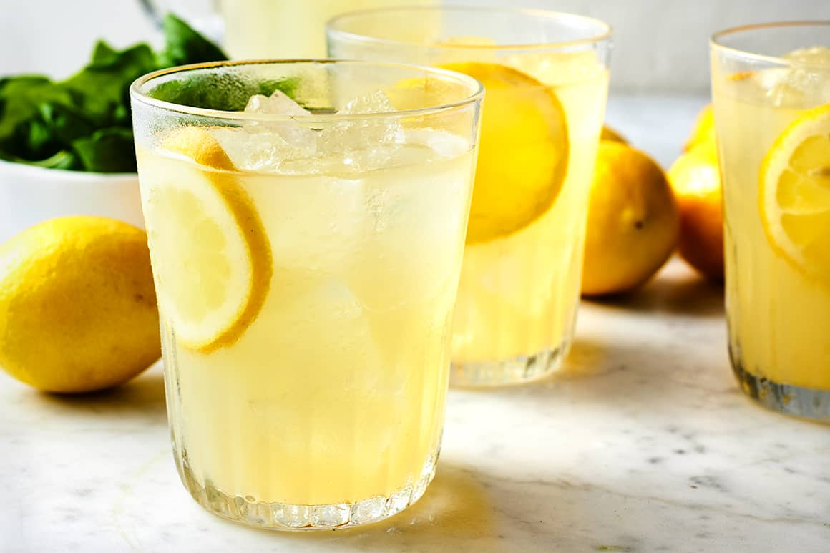
lemonade
SHOW

Slide 7
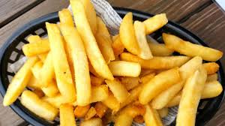
chips
SHOW

Slide 8
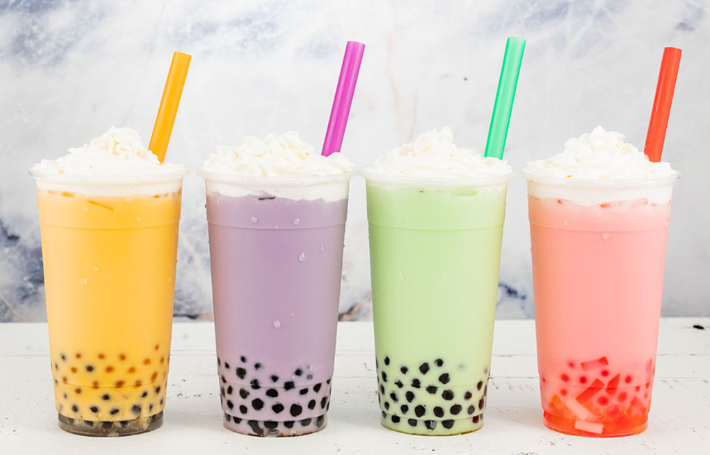
milk tea
SHOW

Slide 9
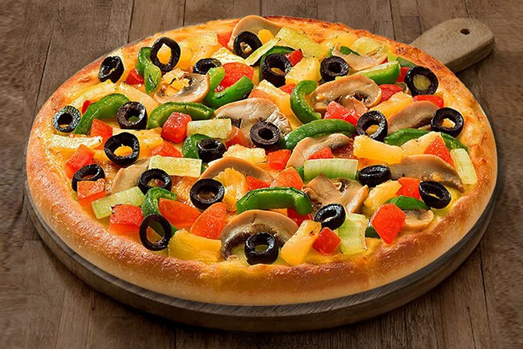
pizza
SHOW

Slide 10
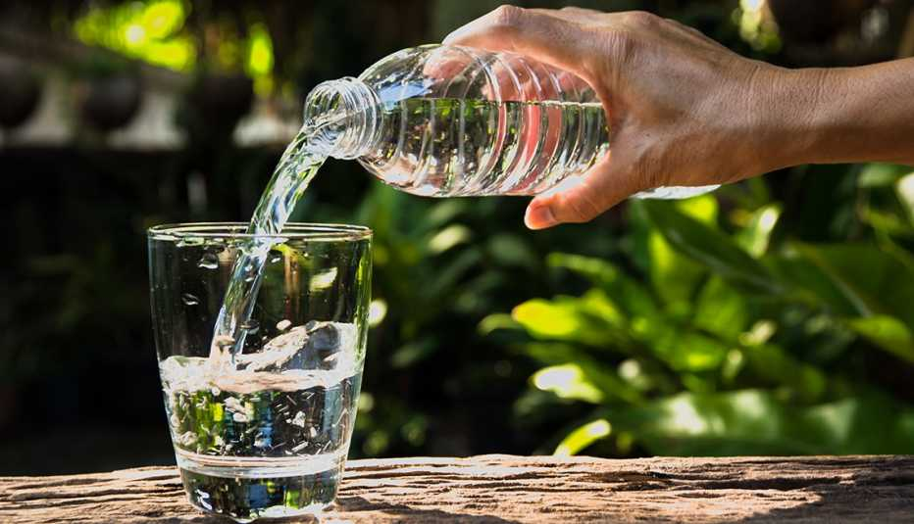
water
SHOW

Slide 11
02
Activity 1
Listen and repeat.

Slide 12

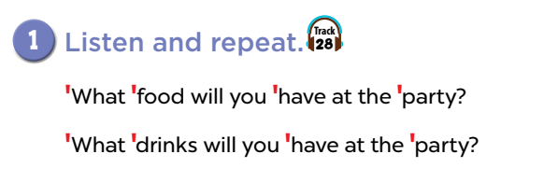

Slide 13
03
Activity 2
Listen and underline one more stressed word. Then repeat.

Slide 14
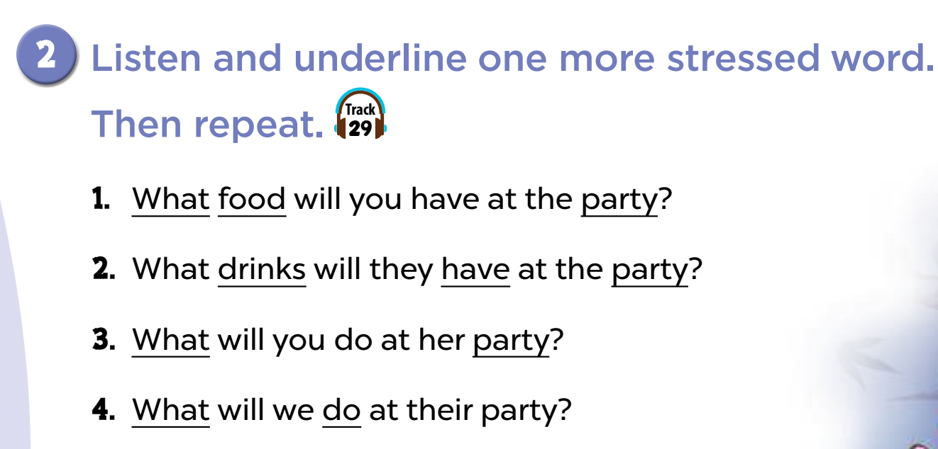

Slide 16
Activity 3
04
Let’s chant.

Slide 17
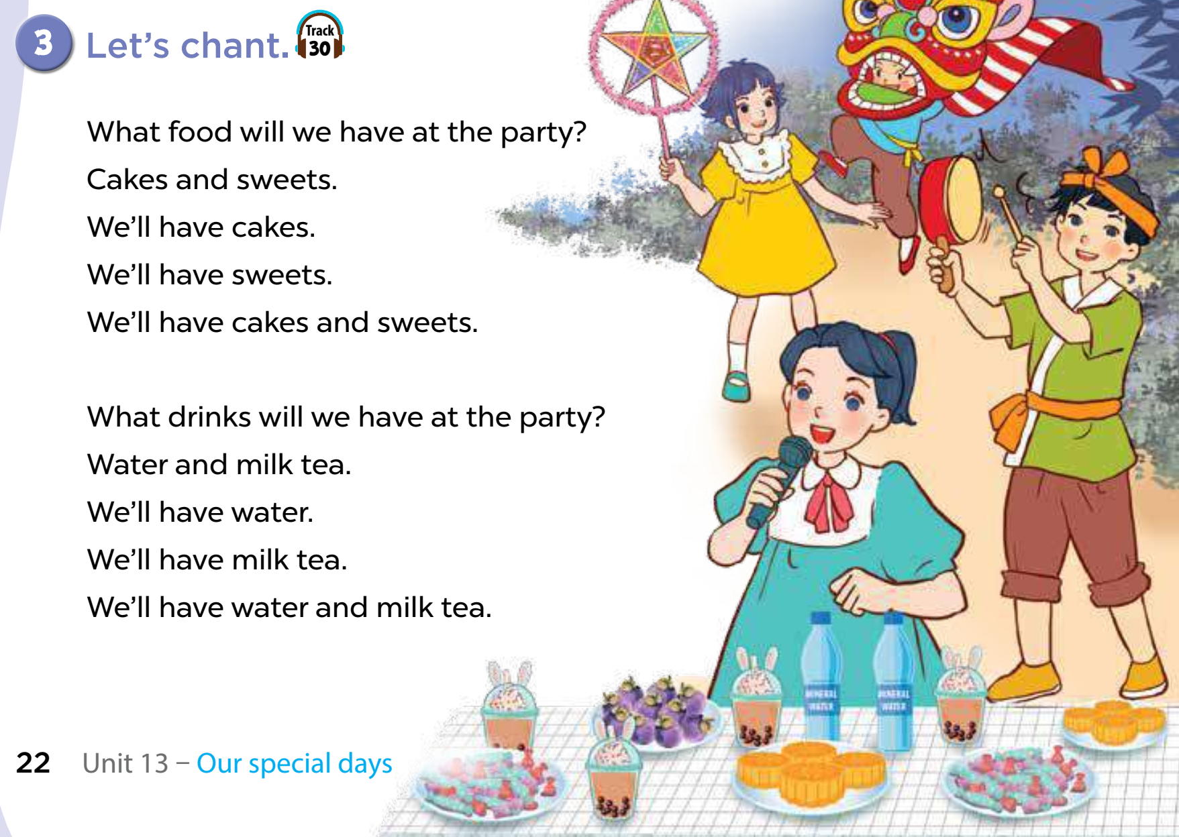
Look, name the food and drinks.
water
milk tea
sweets
cakes

Slide 18
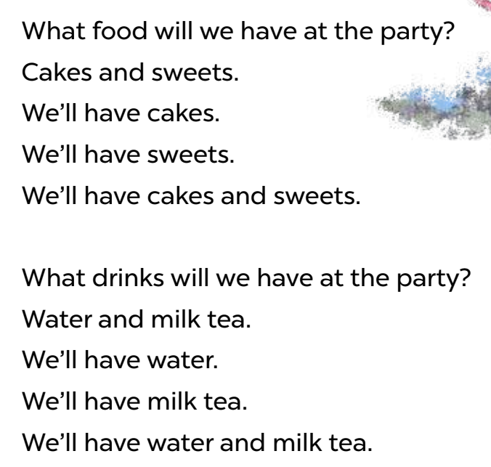
Let’s chant.

Slide 19
Fun Corner
05
Play the game: Food party game

Slide 20











Slide 21

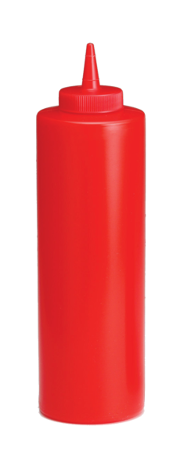




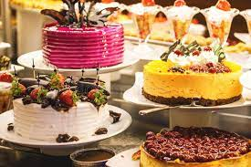



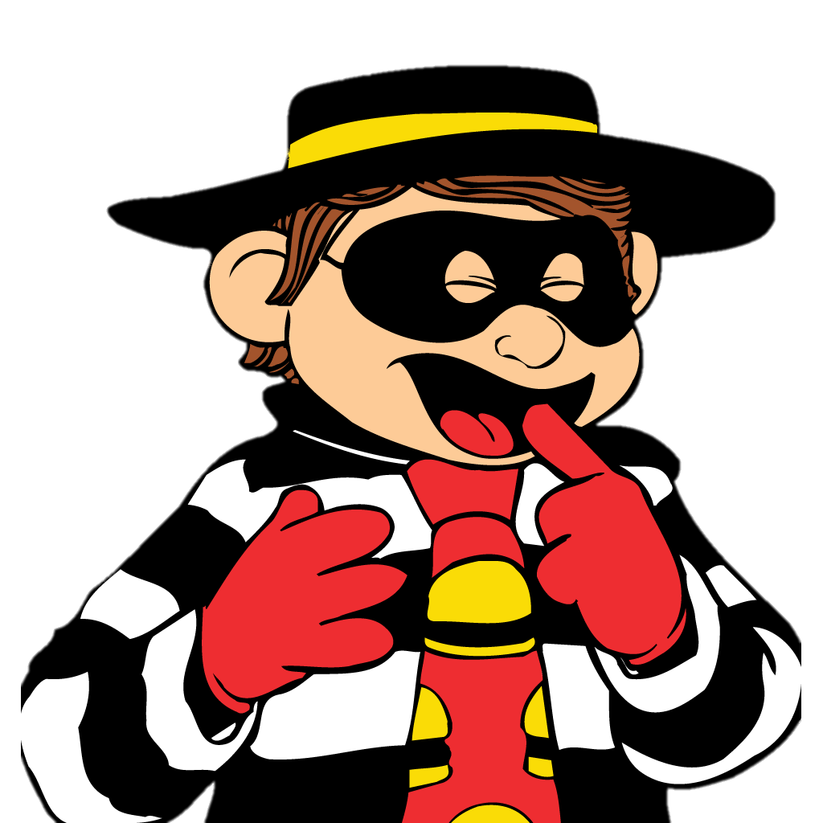
What food will we have at the party?
We’ll have cakes.
Notes:
Click on the red tray to reveal the answer.
Wrong answer click on [Hamburglar] to return to the main menu.
Correct answer click on [Ronald] to continue.

Slide 22

What food will we have at the party?
We’ll have pizza.
Notes:
Click on the red tray to reveal the answer.
Wrong answer click on [Hamburglar] to return to the main menu.
Correct answer click on [Ronald] to continue.

Slide 23
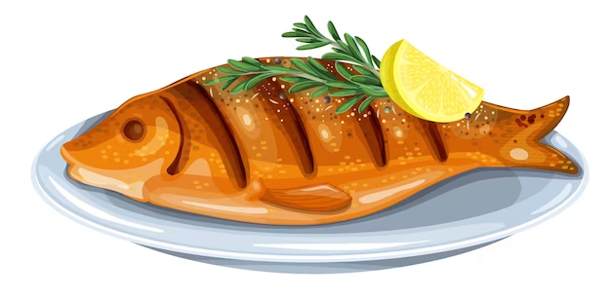
What food will we have at the party?
We’ll have fish.
Notes:
Click on the red tray to reveal the answer.
Wrong answer click on [Hamburglar] to return to the main menu.
Correct answer click on [Ronald] to continue.

Slide 24
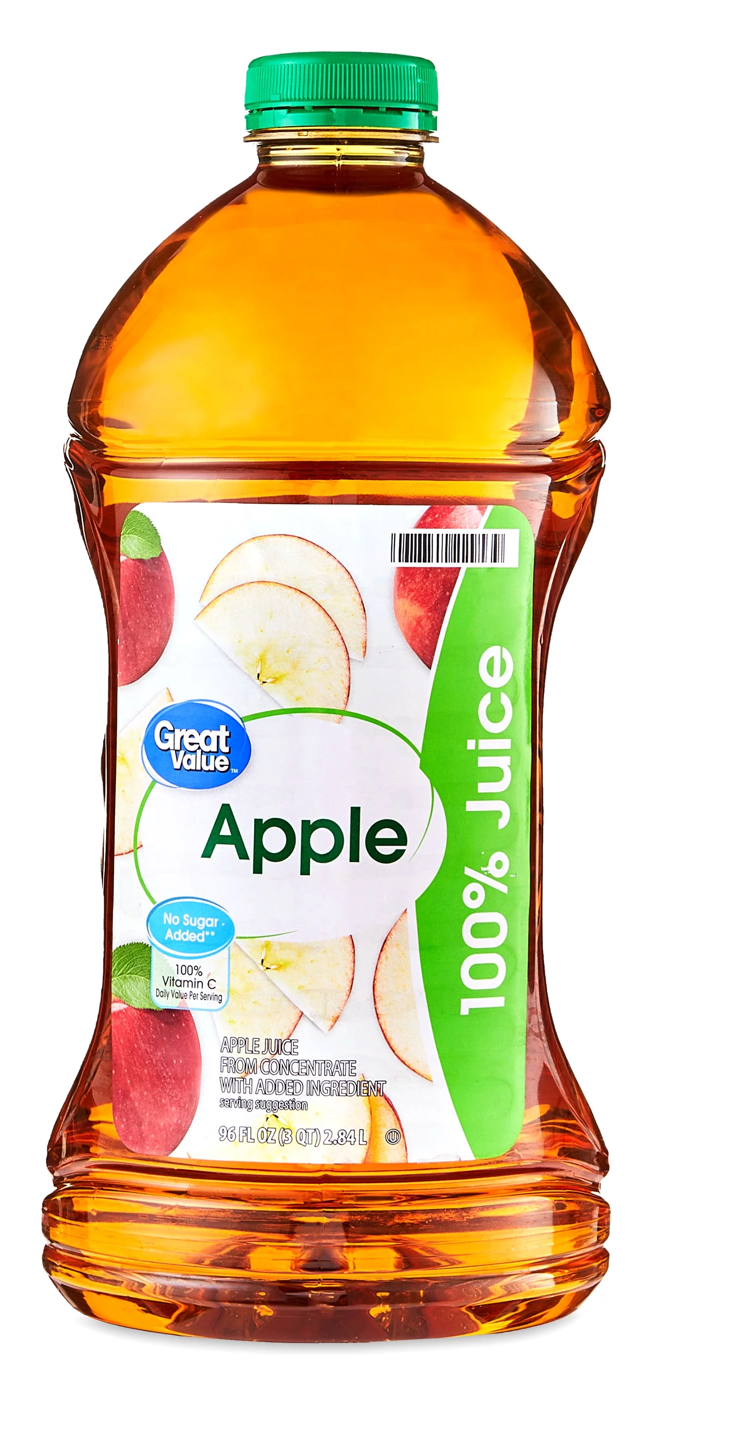
What drinks will you have at the party?
We’ll have apple juice.
Notes:
Click on the red tray to reveal the answer.
Wrong answer click on [Hamburglar] to return to the main menu.
Correct answer click on [Ronald] to continue.

Slide 25

What drinks will you have at the party?
We’ll have water.
Notes:
Click on the red tray to reveal the answer.
Wrong answer click on [Hamburglar] to return to the main menu.
Correct answer click on [Ronald] to continue.

Slide 26
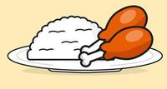
What food will you have at the party?
We’ll have chicken and rice.
Notes:
Click on the red tray to reveal the answer.
Wrong answer click on [Hamburglar] to return to the main menu.
Correct answer click on [Ronald] to continue.

Slide 27
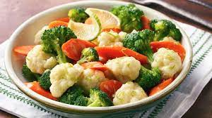
What food will we have at the party?
We’ll have vegetables.
Notes:
Click on the red tray to reveal the answer.
Wrong answer click on [Hamburglar] to return to the main menu.
Correct answer click on [Ronald] to continue.

Slide 28
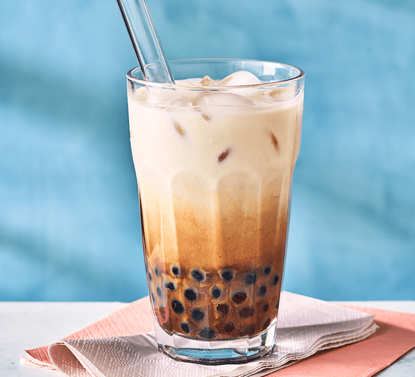
What drinks will we have at the party?
We’ll have milk tea.
Notes:
Click on the red tray to reveal the answer.
Wrong answer click on [Hamburglar] to return to the main menu.
Correct answer click on [Ronald] to continue.

Slide 29
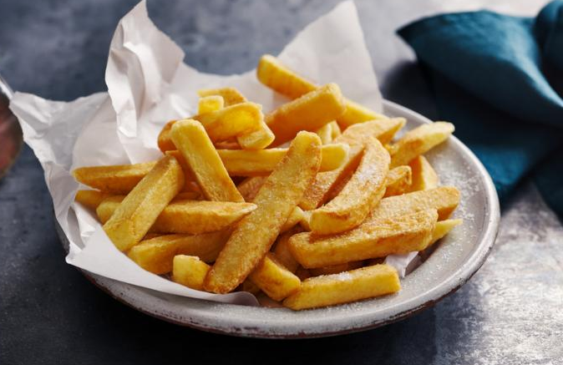
What food will we have at the party?
We’ll have chips.
Notes:
Click on the red tray to reveal the answer.
Wrong answer click on [Hamburglar] to return to the main menu.
Correct answer click on [Ronald] to continue.

Slide 30
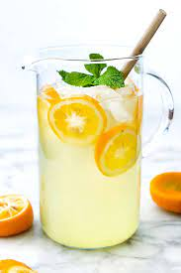
What drinks will we have at the party?
We’ll have lemonade.
Notes:
Click on the red tray to reveal the answer.
Wrong answer click on [Hamburglar] to return to the main menu.
Correct answer click on [Ronald] to continue.

Slide 31

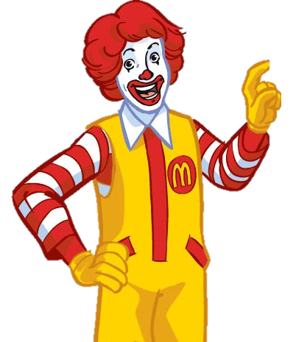
You got a burger!
Notes:
Extra

Slide 32
You got 4 burgers!

Slide 33
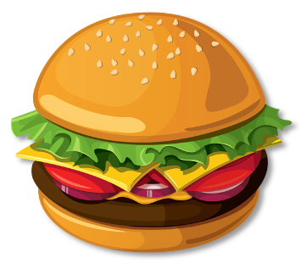
You got 2 burgers!

Slide 34

You got 6 burgers!

Slide 35

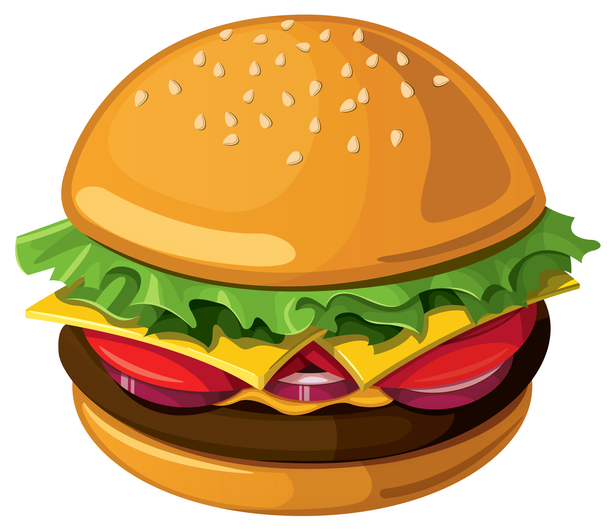
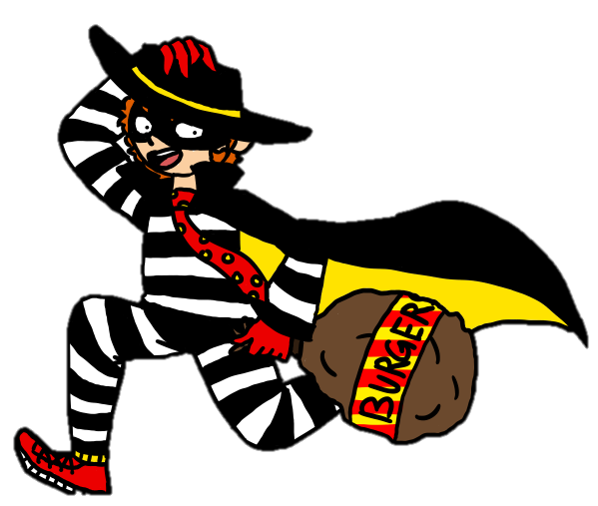
You got 7 hamburgers!
You got a hamburger!

Slide 36
You got 4 hamburgers!

Slide 37
You got 3 burgers!

Slide 38
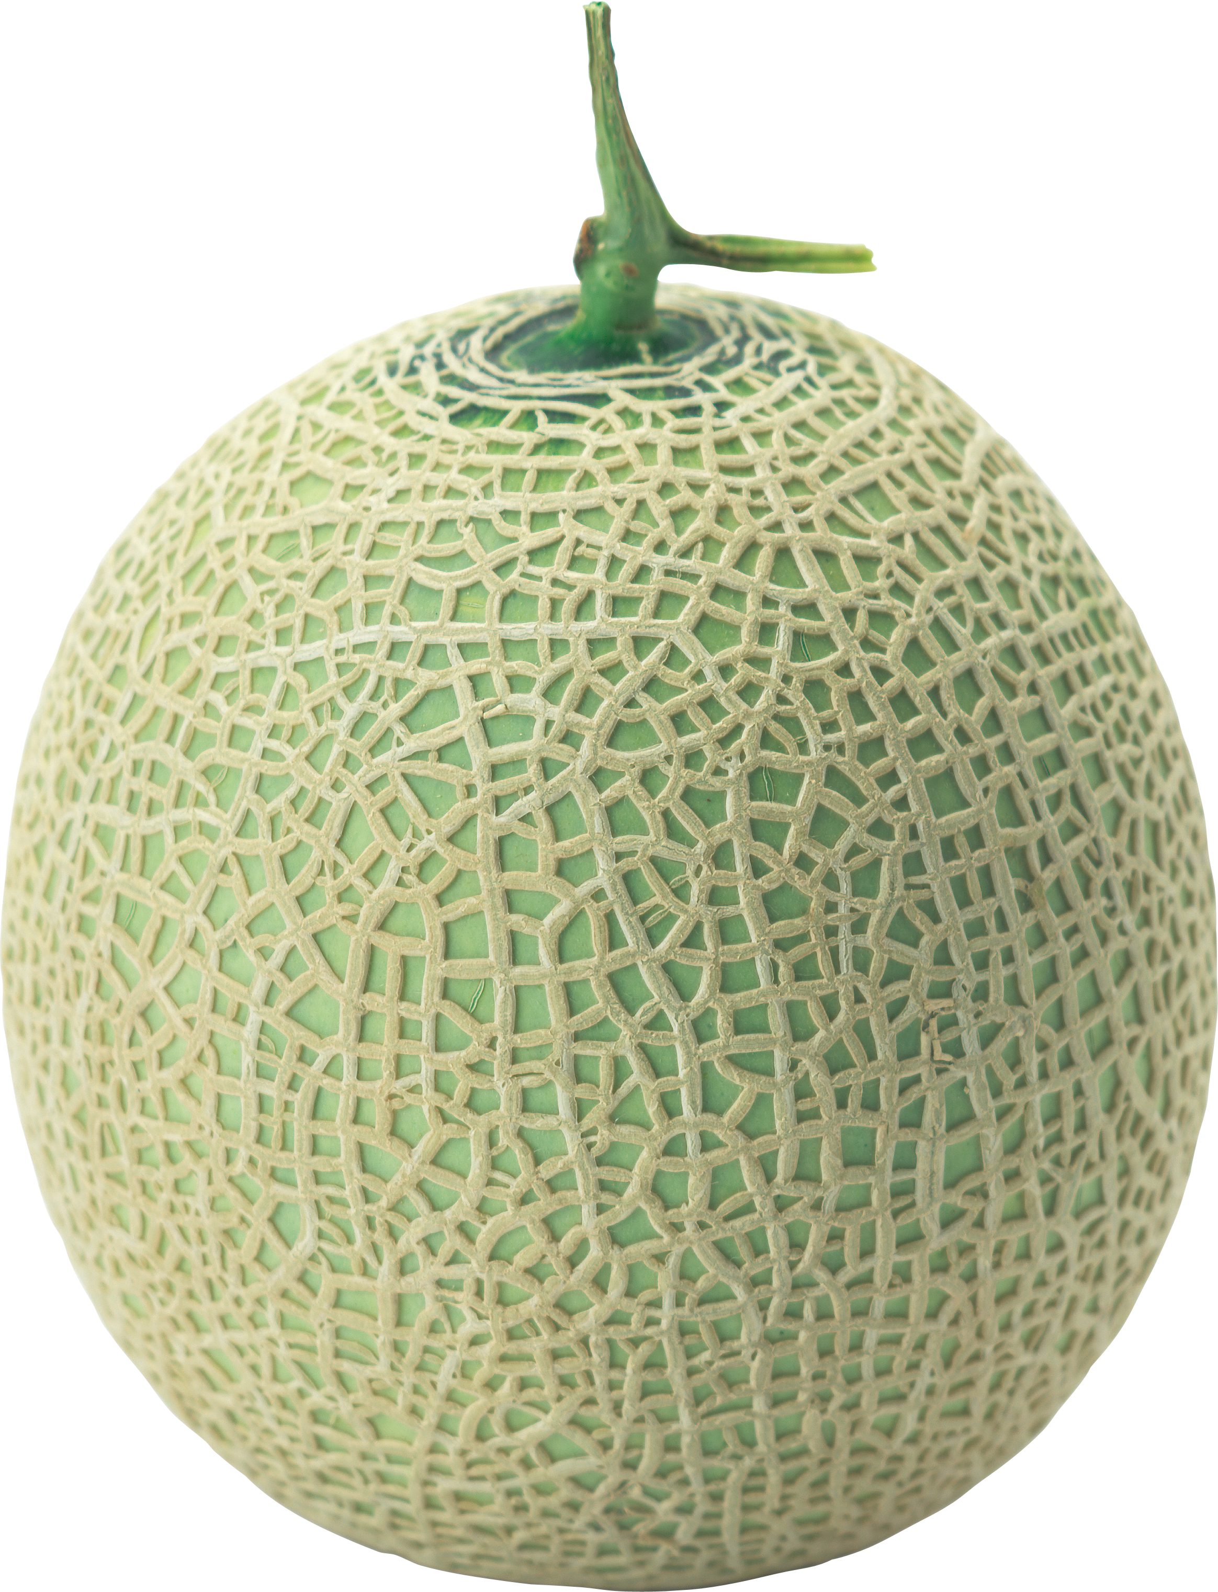
You got 3 melons!
You got 2 melons!

Slide 39

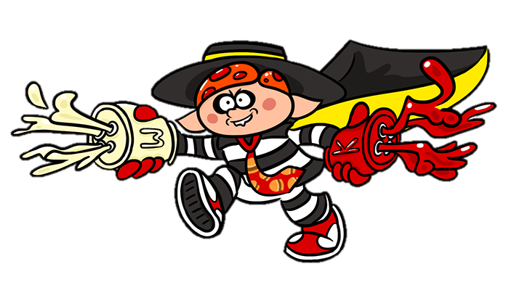

You got 6 hamburgers!
You got hamburglarized!

Slide 40
You got 7 burgers!
You got 2 burgers!

Slide 41
Website: hoclieu.vn
Fanpage: https://www.facebook.com/tienganhglobalsuccess.vn/

