Slide 1
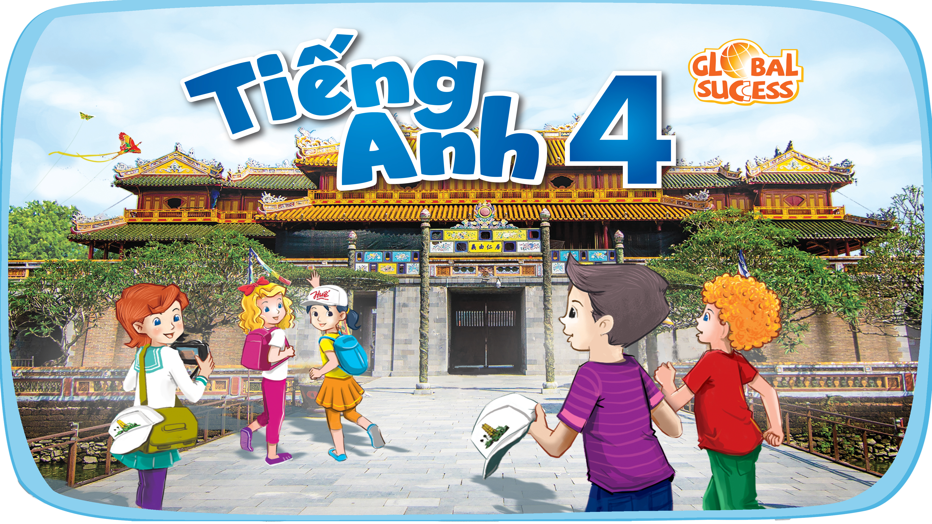

Slide 2


Our summer holidays
10
Lesson 2 – Period 3

Slide 3


Table of contents
Look, listen and repeat.
01
Warm-up
02
03
New words
Listen, point and say.
05
Let’s talk.
06
04
Fun corner

Slide 4
01
Warm-up
Let’s sing.

Slide 5


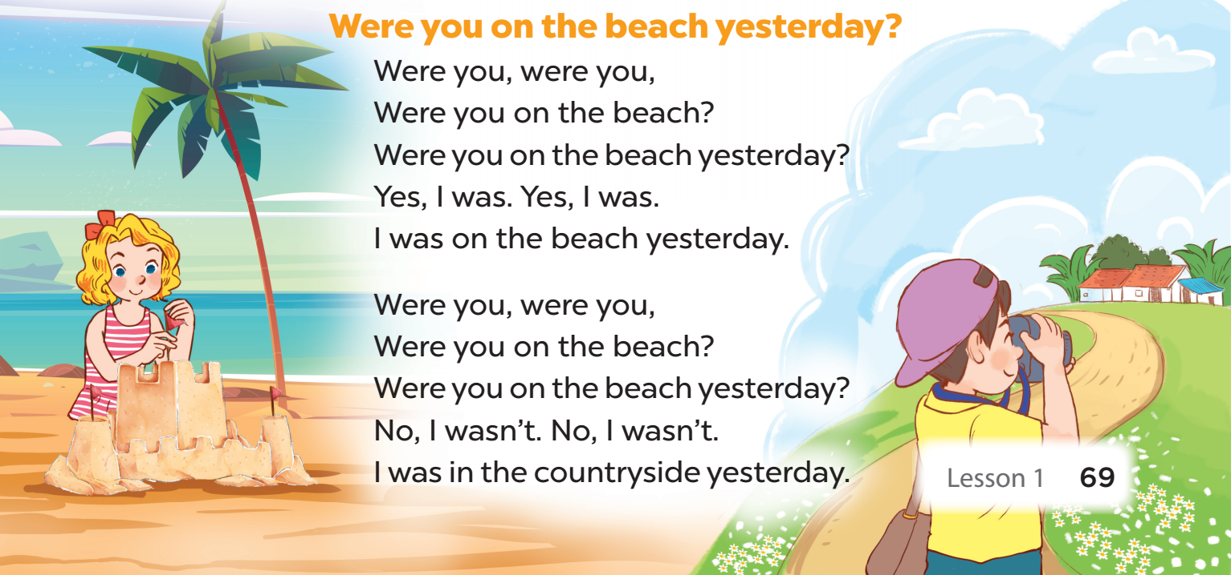

Slide 6
02
Activity 1
Look, listen and repeat.

Slide 7
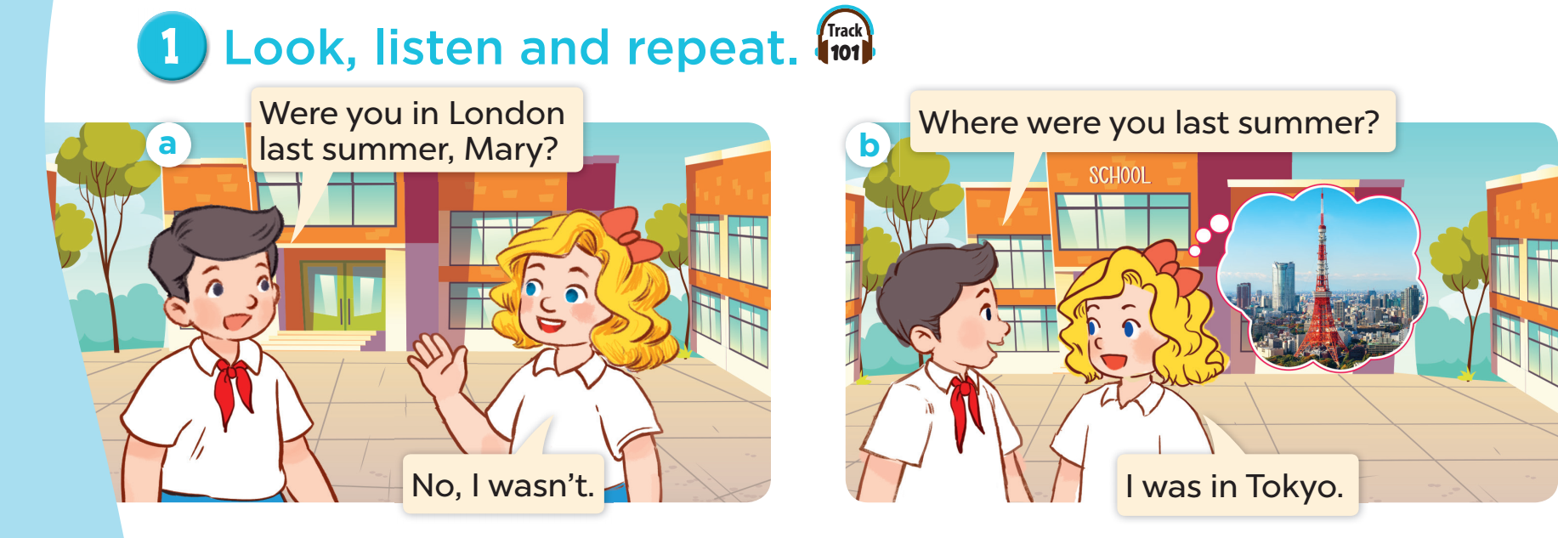

Slide 8
03
NEW WORDS
Cities

Slide 9
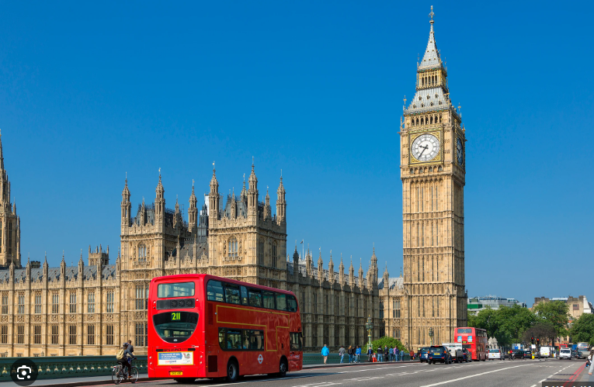
London

Slide 10
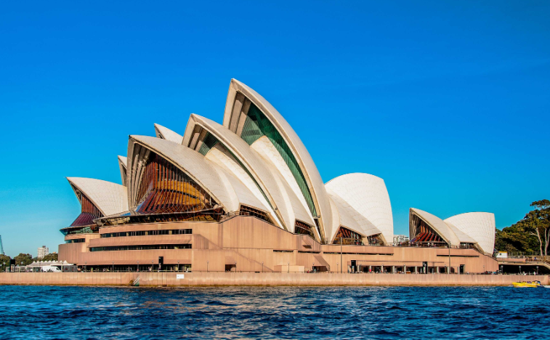
Sydney

Slide 11
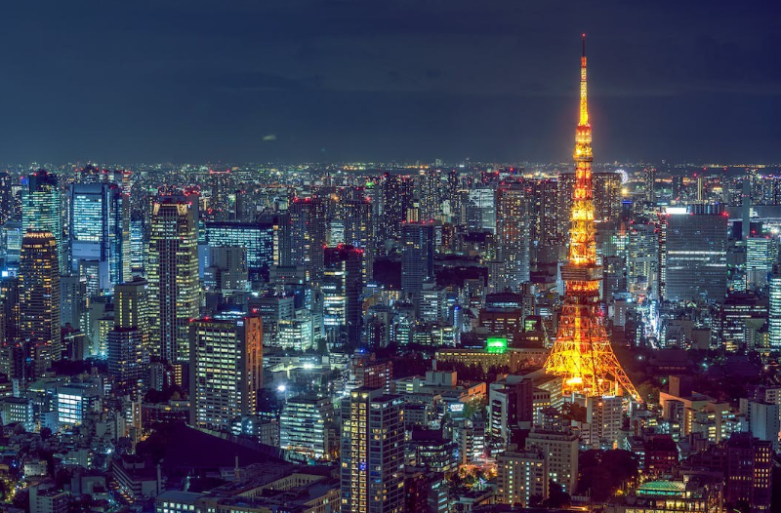
Tokyo

Slide 12
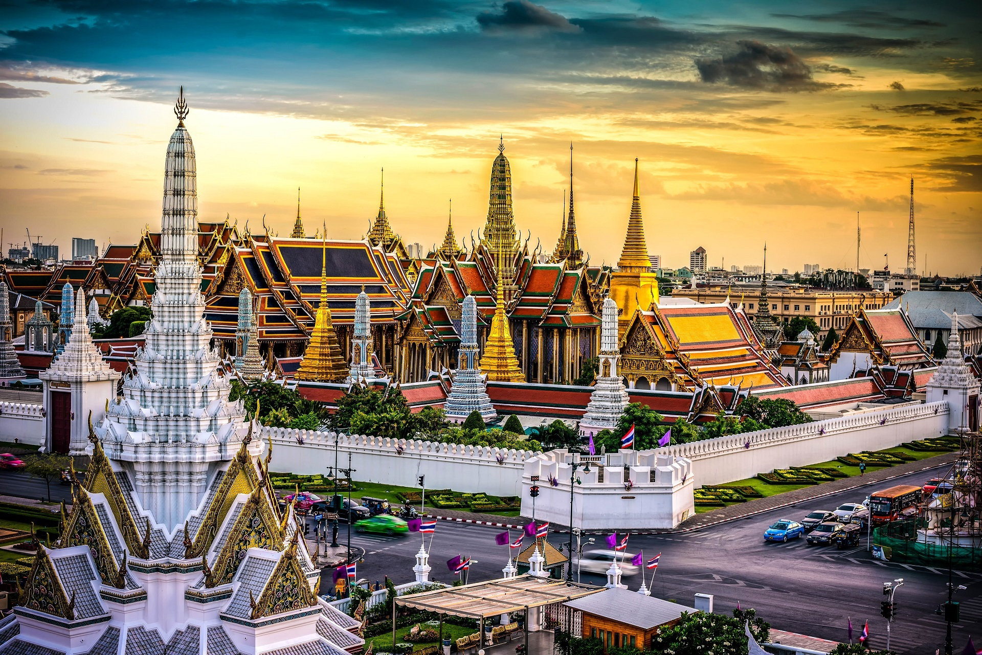
Bangkok

Slide 13
Quiz Time

Slide 14


It’s a city in Thailand.
Bangkok
Sydney
Tokyo
A
B
C

Slide 15
The “Shell” Opera House is here.
Sydney
London
Tokyo
A
B
C

Slide 16
It’s in England.
Sydney
London
Bangkok
A
B
C

Slide 17
This city is in Japan.
Sydney
London
Tokyo
A
B
C

Slide 18
04
Activity 2
Listen, point and say.

Slide 19


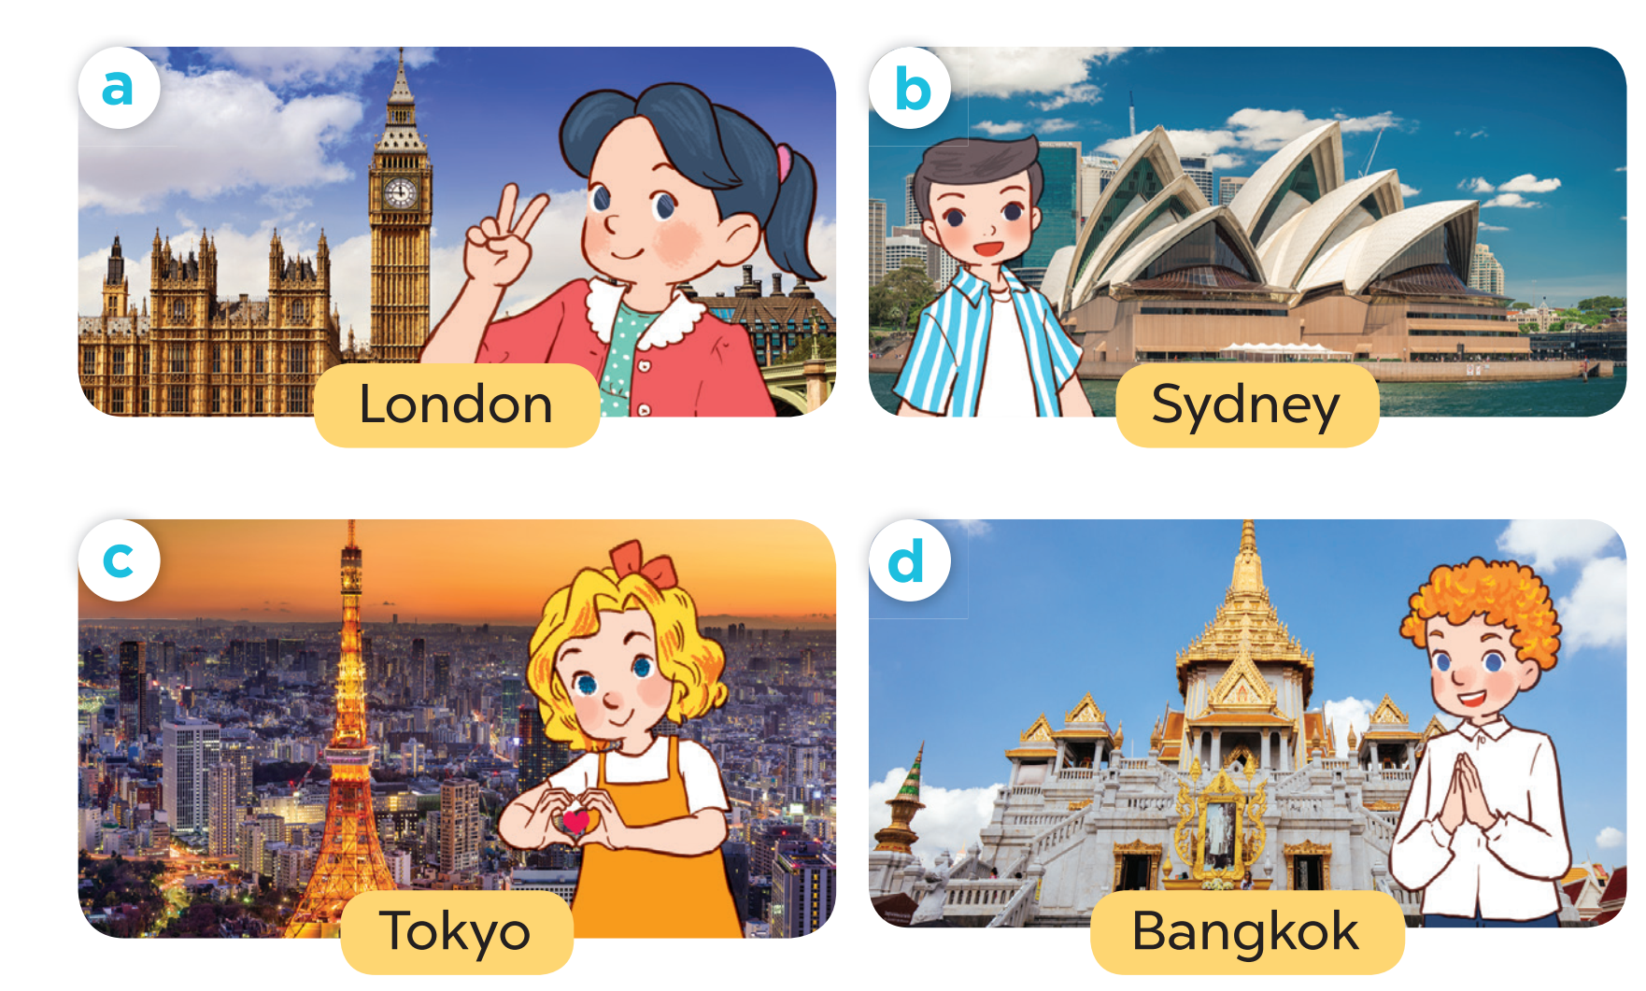
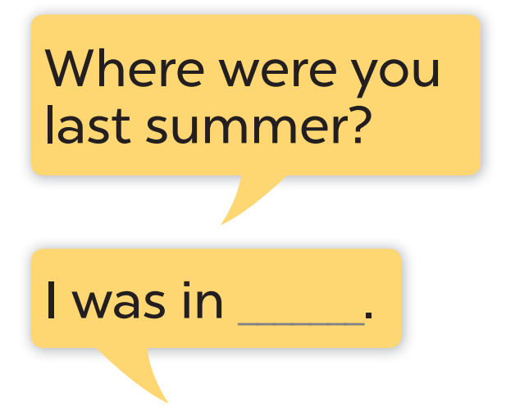

Slide 20

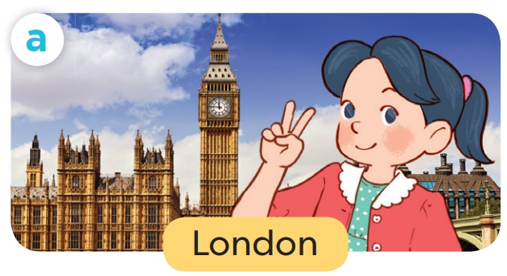
Work in pairs. Role-play.
Where were you
last summer?
I was in London.

Slide 21
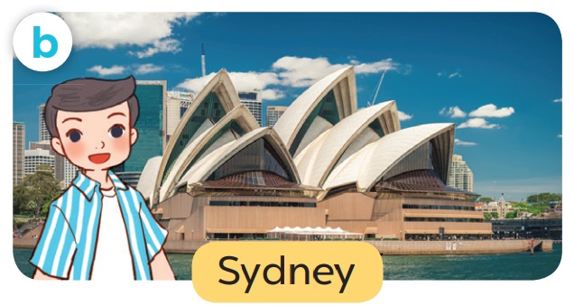
Work in pairs. Role-play.
Where were you last summer?
I was in Sydney.

Slide 22
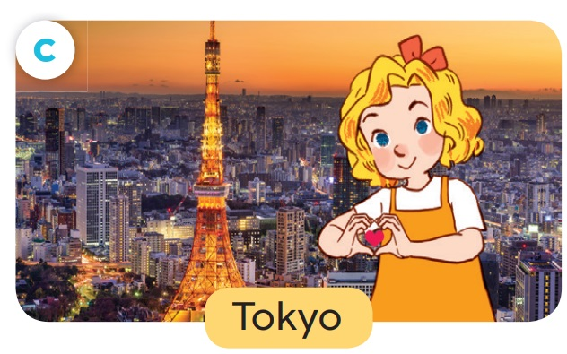
Work in pairs. Role-play.
Where were you last summer?
I was in Tokyo.

Slide 23
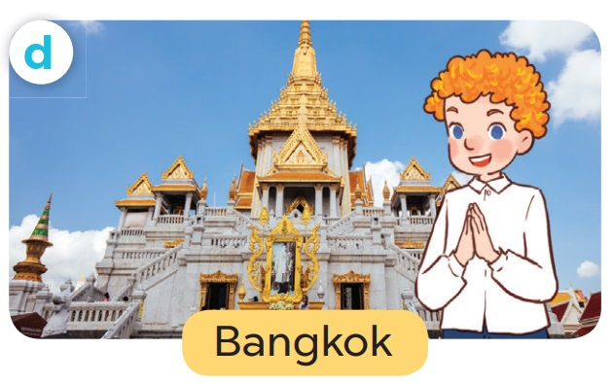
Work in pairs. Role-play.
Where were you last summer?
I was in Bangkok.

Slide 24
05
Activity 3
Let’s talk.

Slide 25
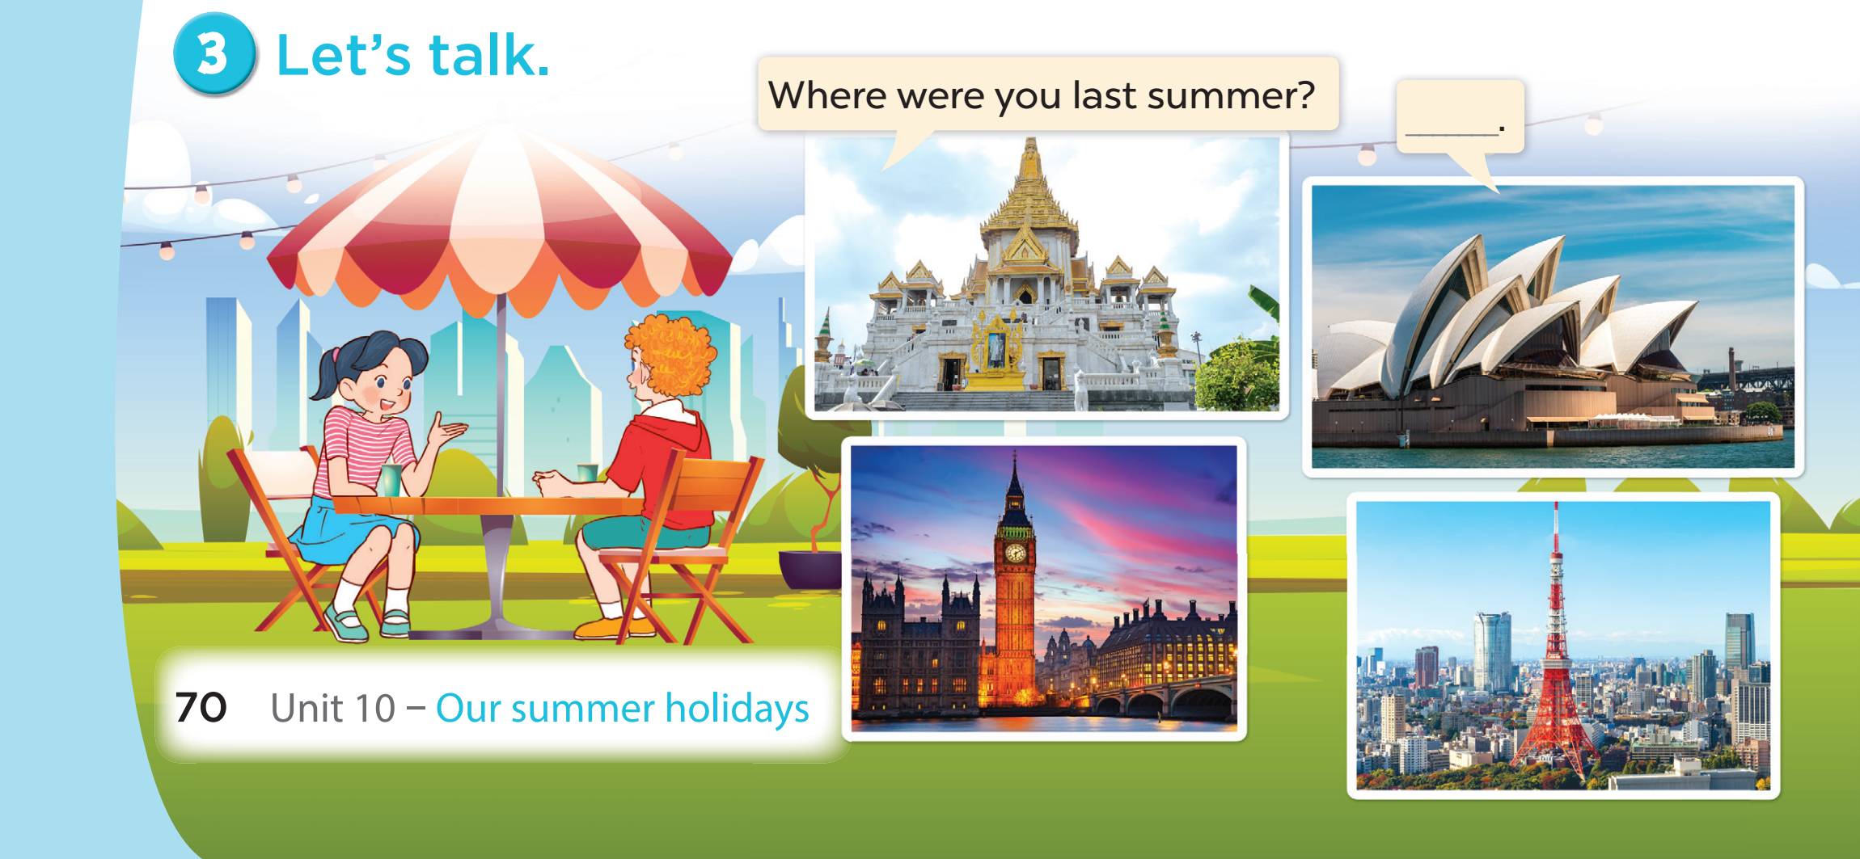

Slide 26
06
FUN CORNER

Slide 27

8
1
7
5
3
2
6
4
LUCKY STAR
Exit

Slide 28




Where were you last summer?
You are given 3 candies.
I was in Tokyo.
GO HOME

Slide 29
Where were you last summer?
You are given 1 candy.
I was in London.
GO HOME

Slide 30
Where were you last summer?
You are given 3 candies
I was in Bangkok.
GO HOME

Slide 31
Where were you last summer?
You are given 2 candies.
I was in Sydney.
GO HOME

Slide 32
- Where ____ you last summer?
- I ____ in America.
You are given 2 candies.
were - was
GO HOME

Slide 33
- ____ were you last summer?
- I was in China.
You are given 3 candies.
Where
GO HOME

Slide 34
Were you in London last summer?
You are given 2 candies.
Yes, I was. / No, I wasn’t.
GO HOME

Slide 35
Were you on the beach last summer?
You are given 4 candies.
Yes, I was. / No, I wasn’t.
GO HOME

Slide 36


Slide 37

Website: hoclieu.vn
Fanpage: facebook.com/www.tienganhglobalsuccess.vn

