Slide 1


Slide 2


Our summer holidays
10
Lesson 1 – Period 1

Slide 3


Table of contents
01
02
Look, listen and repeat.
03
Warm-up
New words
04
Listen, point
and say.
05
Let’s talk.
06
Fun corner

Slide 4
01
Warm-up
Let’s chant.

Slide 5
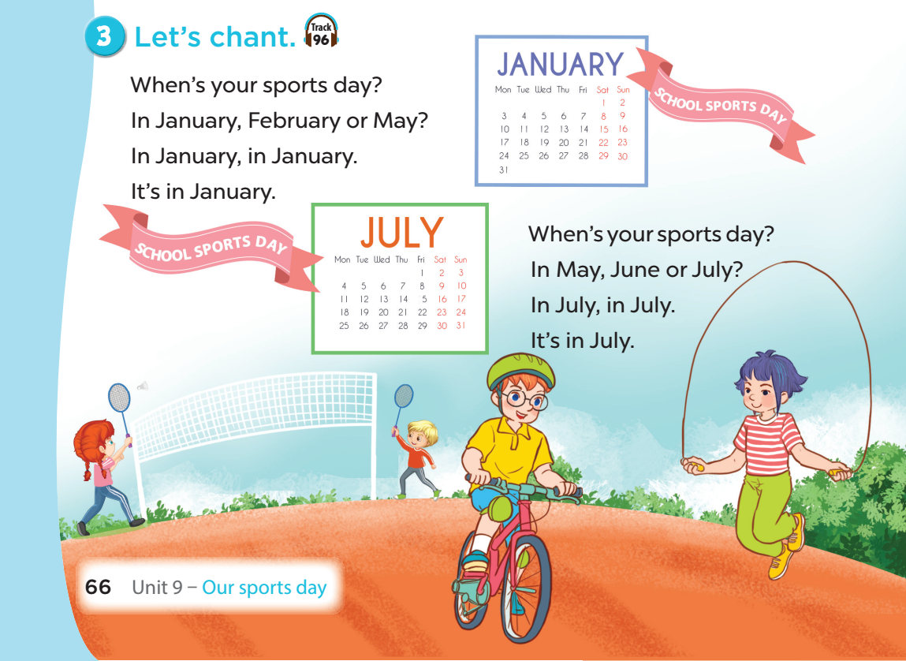


Slide 6
02
Activity 1
Look, listen and repeat.

Slide 7
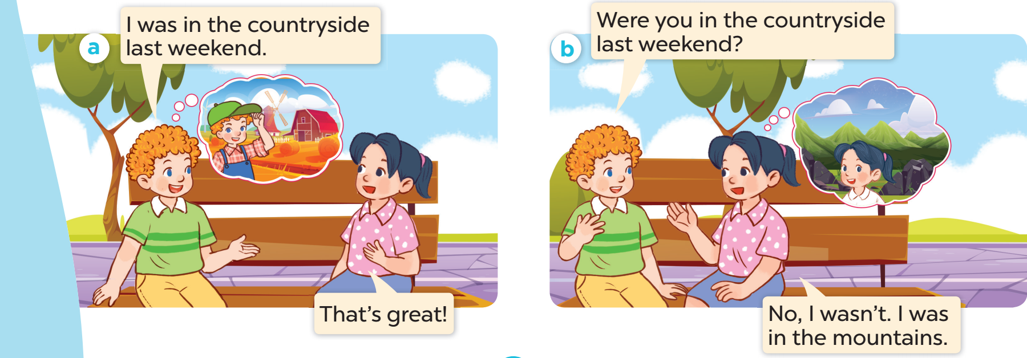

Look and listen.

Slide 8
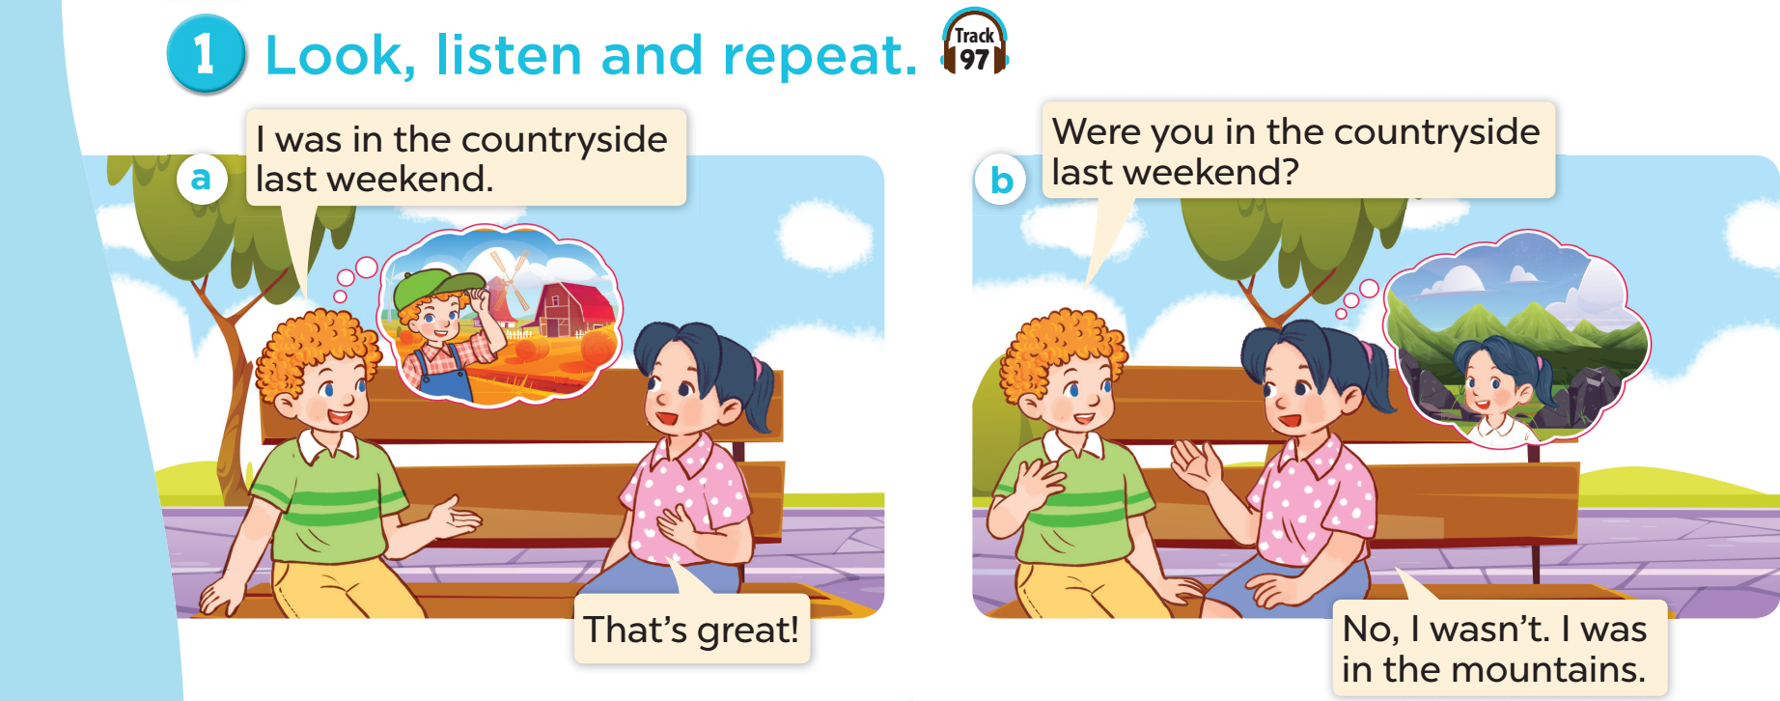

Slide 9
03
New words
Places

Slide 10
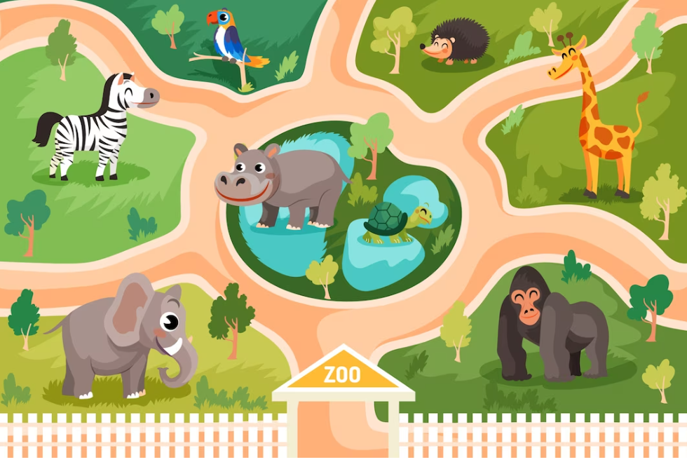
at the
zoo

Slide 11

on the
beach

Slide 12

in the
countryside

Slide 13
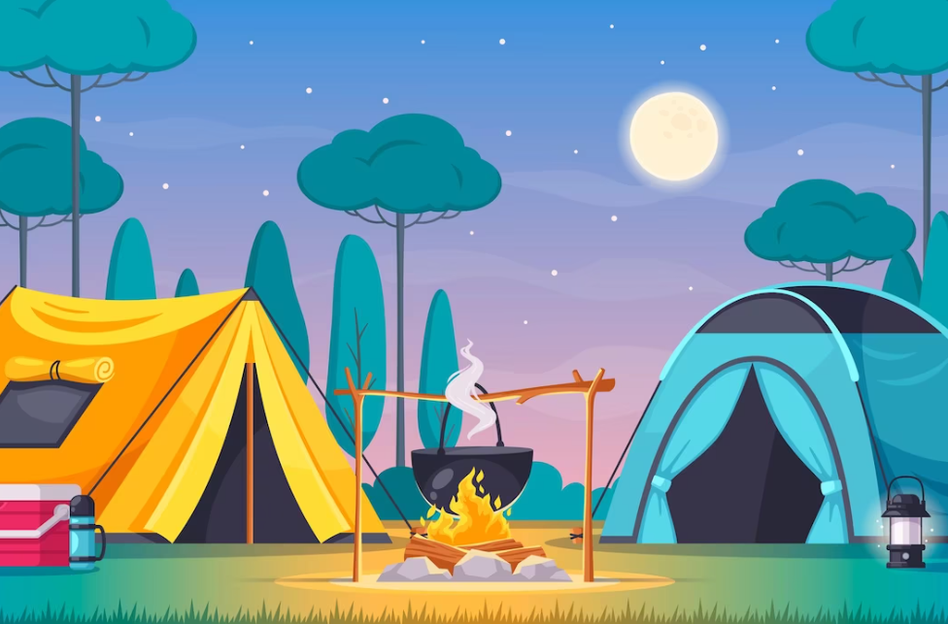
at the
campsite

Slide 14
beach
countryside
campsite
zoo

Slide 15

Where’s the minion?

Slide 16
on the beach

Slide 17
at the zoo

Slide 18
in the countryside

Slide 19
at the campsite

Slide 20
04
Activity 2
Listen, point and say.

Slide 21
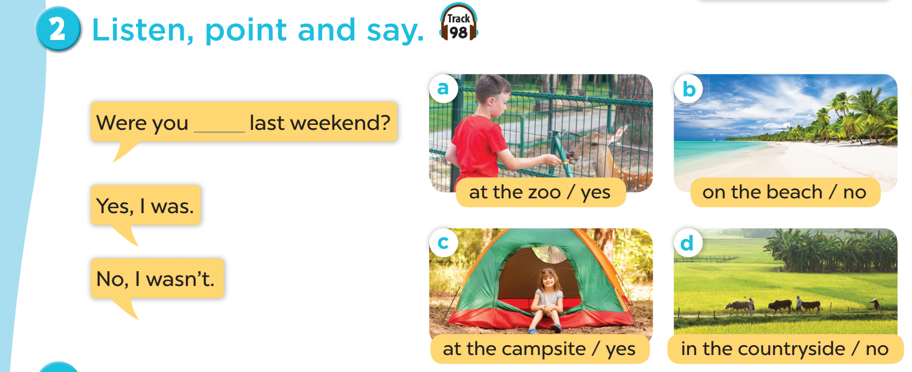

Slide 22

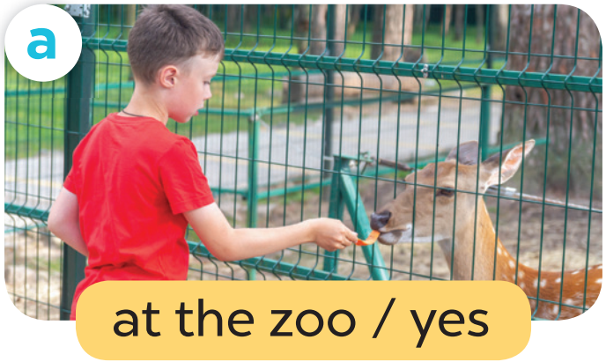

Work in pairs. Role play.
Were you at the zoo last weekend?
Yes, I was.

Slide 23


Work in pairs. Role play.
Were you on the beach last weekend?
No, I wasn’t.

Slide 24

Work in pairs. Role play.
Were you at the campsite last weekend?
Yes, I was.

Slide 25

Work in pairs. Role play.
Were you in the countryside last weekend?
No, I wasn’t.

Slide 26
05
Activity 3
Let’s talk.

Slide 27
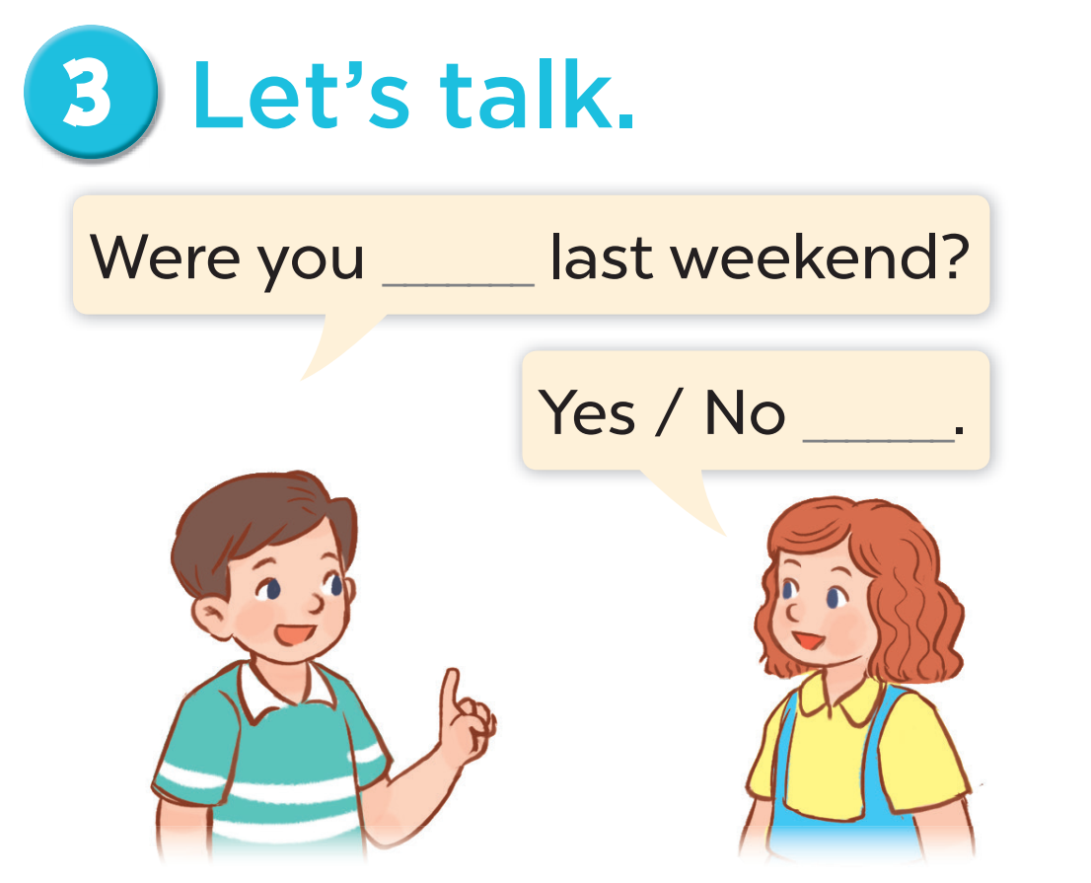
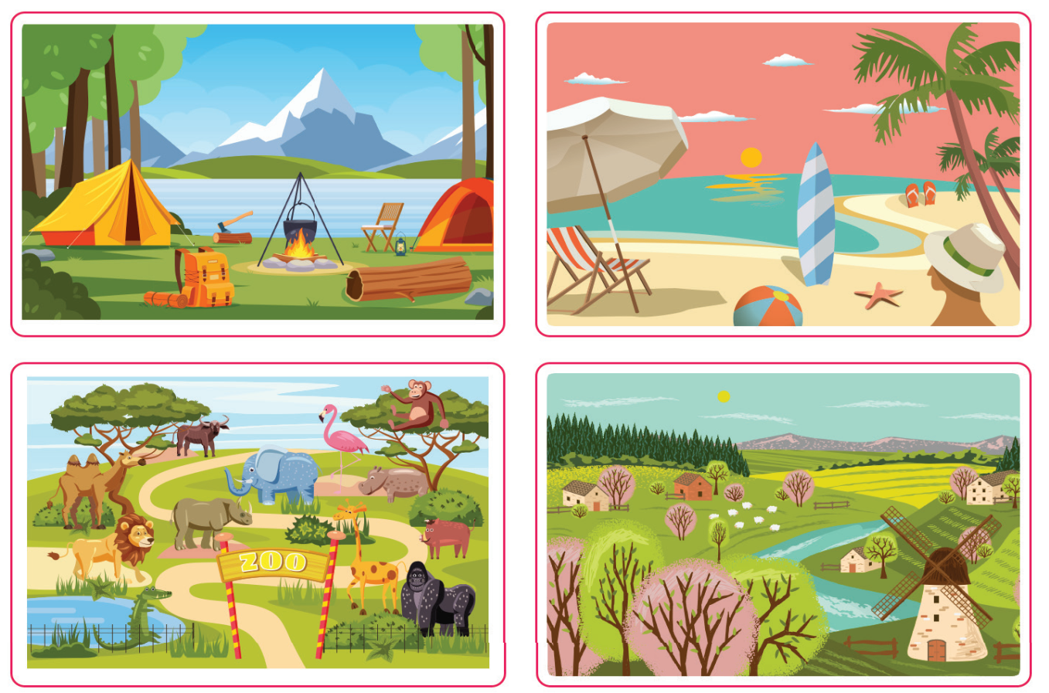

Slide 28
06
FUN CORNER

Slide 29

Notes:
This template is for educational, non-commercial purposes only. For more free game templates like this one, visit https://www.taysteachingtoolkit.com

Slide 30
Let’s play!

Slide 31




Were you in the countryside last weekend? (No)
No, I wasn’t.
A
B
C
Notes:
Click to hide the Pokémon
Click again to shuffle the Pokéballs
Once the Pokéballs have stopped shuffling, music will start playing to let students know it’s time to write (~25 seconds, feel free to delete if you don’t want the music)
After music stops, click reveal where the Pokémon.
Click to go to the next slide
(Also note: To save space, for longer sentences you can use the top text box for the part of the sentences that are the same and the bottom text boxes for the parts that are different. i.e. TOP TEXT BOX SAYS: Where is the // BOTTOM TEXT BOXES SAY: bathroom – library – park > Then, students write either: Where is the bathroom? Where is the library? OR Where is the park? - Feel free to delete this box if not needed or use it for other purposes.)

Slide 32

Were you on the beach last weekend? (Yes)
Yes, I was.
A
B
C
Notes:
Click to hide the Pokémon
Click again to shuffle the Pokéballs
Once the Pokéballs have stopped shuffling, music will start playing to let students know it’s time to write (~25 seconds, feel free to delete if you don’t want the music)
After music stops, click reveal where the Pokémon.
Click to go to the next slide
(Also note: To save space, for longer sentences you can use the top text box for the part of the sentences that are the same and the bottom text boxes for the parts that are different. i.e. TOP TEXT BOX SAYS: Where is the // BOTTOM TEXT BOXES SAY: bathroom – library – park > Then, students write either: Where is the bathroom? Where is the library? OR Where is the park? - Feel free to delete this box if not needed or use it for other purposes.)

Slide 33

Were you at the campsite last weekend? (No)
No, I wasn’t.
A
B
C
Notes:
Click to hide the Pokémon
Click again to shuffle the Pokéballs
Once the Pokéballs have stopped shuffling, music will start playing to let students know it’s time to write (~25 seconds, feel free to delete if you don’t want the music)
After music stops, click reveal where the Pokémon.
Click to go to the next slide
(Also note: To save space, for longer sentences you can use the top text box for the part of the sentences that are the same and the bottom text boxes for the parts that are different. i.e. TOP TEXT BOX SAYS: Where is the // BOTTOM TEXT BOXES SAY: bathroom – library – park > Then, students write either: Where is the bathroom? Where is the library? OR Where is the park? - Feel free to delete this box if not needed or use it for other purposes.)

Slide 34

Were you at the zoo last weekend? (Yes)
Yes, I was.
A
B
C
Notes:
Click to hide the Pokémon
Click again to shuffle the Pokéballs
Once the Pokéballs have stopped shuffling, music will start playing to let students know it’s time to write (~25 seconds, feel free to delete if you don’t want the music)
After music stops, click reveal where the Pokémon.
Click to go to the next slide
(Also note: To save space, for longer sentences you can use the top text box for the part of the sentences that are the same and the bottom text boxes for the parts that are different. i.e. TOP TEXT BOX SAYS: Where is the // BOTTOM TEXT BOXES SAY: bathroom – library – park > Then, students write either: Where is the bathroom? Where is the library? OR Where is the park? - Feel free to delete this box if not needed or use it for other purposes.)

Slide 35


Slide 36

Website: hoclieu.vn
Fanpage: facebook.com/www.tienganhglobalsuccess.vn

