Slide 2
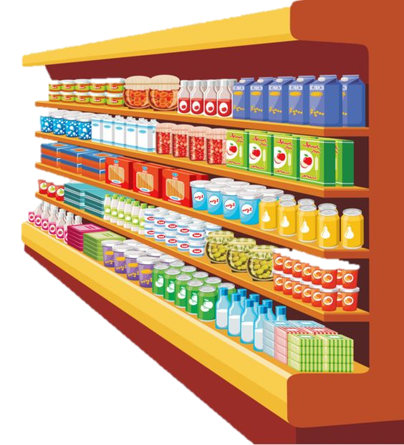
Unit 6
In the grocery store
Lesson 3 - Period 3

Slide 3










Classroom Rules

Slide 4



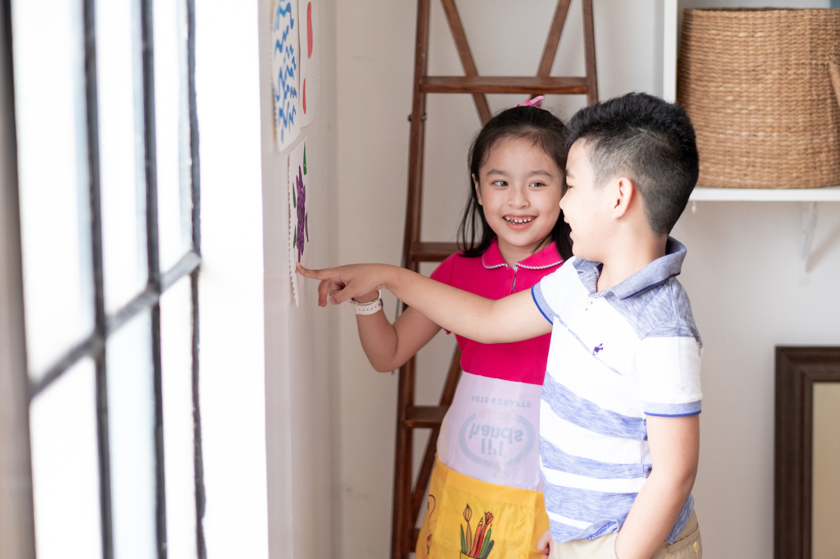



Rule 1
Listen to
your friend
talking in front.

Slide 5






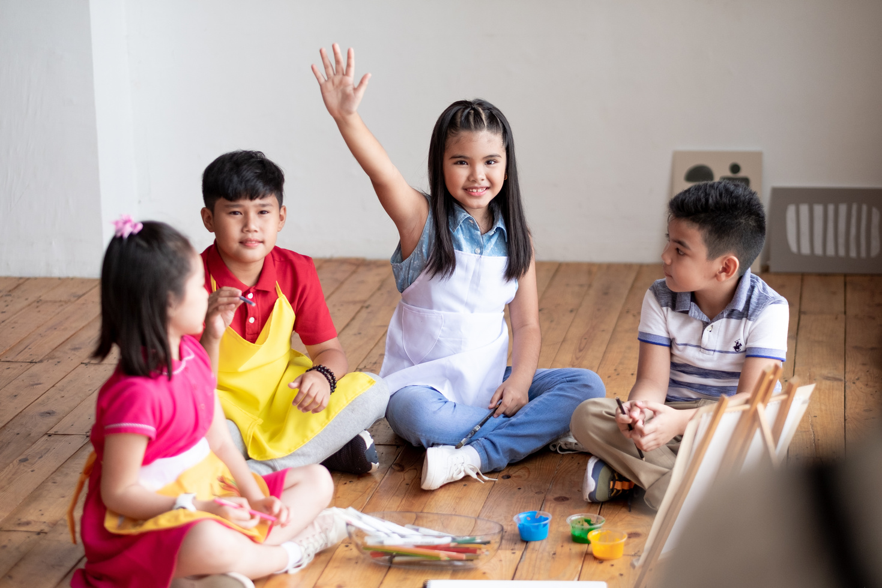

Rule 2
Raise your hand
if you have a question.

Slide 6




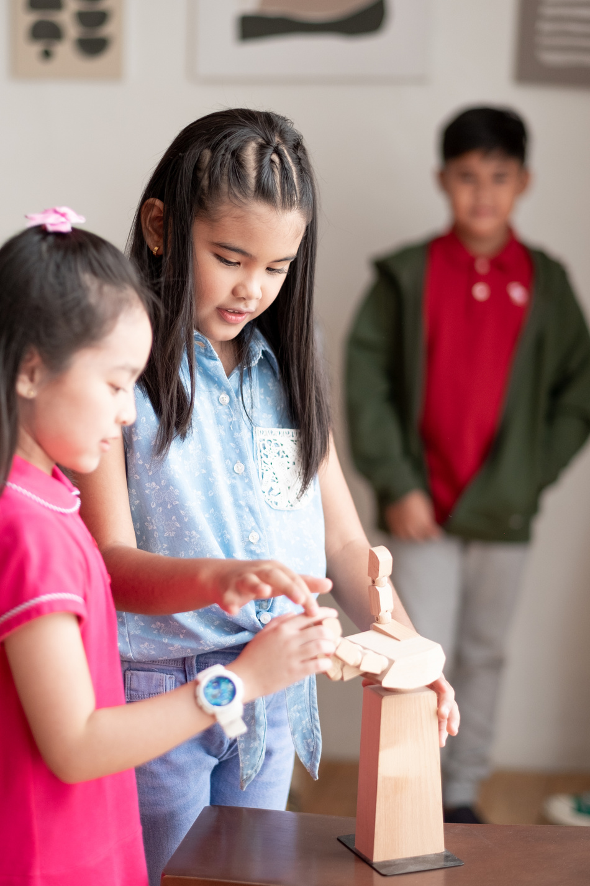


Rule 3
Wait for
your turn.

Slide 7








TABLE OF CONTENTS
1
Warm-up and review.
2
Activity 6: Listen and repeat.
3
Activity 7: Let’s talk.
4
Activity 8: Let’s sing.
5
Fun corner and wrap-up.

Slide 8

01
Warm-up and Review.

Slide 9












20
19
18
17
16
15
14
13
12
11
10
9
8
7
6
5
4
3
2
1
0
20
19
18
17
16
15
14
13
12
11
10
9
8
7
6
5
4
3
2
1
0
KIM’S GAME
START
Round 1
Round 2
Round 3
Round 4
Notes:
Lượt 1 : GV cho HS xem 1 set gồm 3 tranh sau đó HS kể ại những gì đã xem được.
Lượt 2: chơi tương tự nhưng số lượng tranh tăng thêm 1 hình.
- Lượt 3&4: tương tự nhưng số lượng tranh tăng lên 1- 2 hình và tùy theo khả năng của HS thì GV có thể cho dừng lại hoặc chơi tiếp.

Slide 10




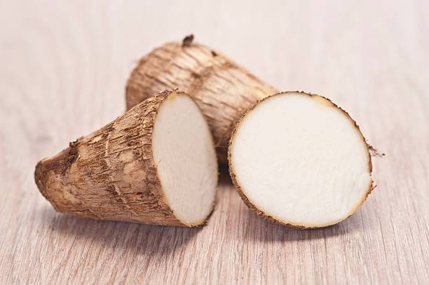

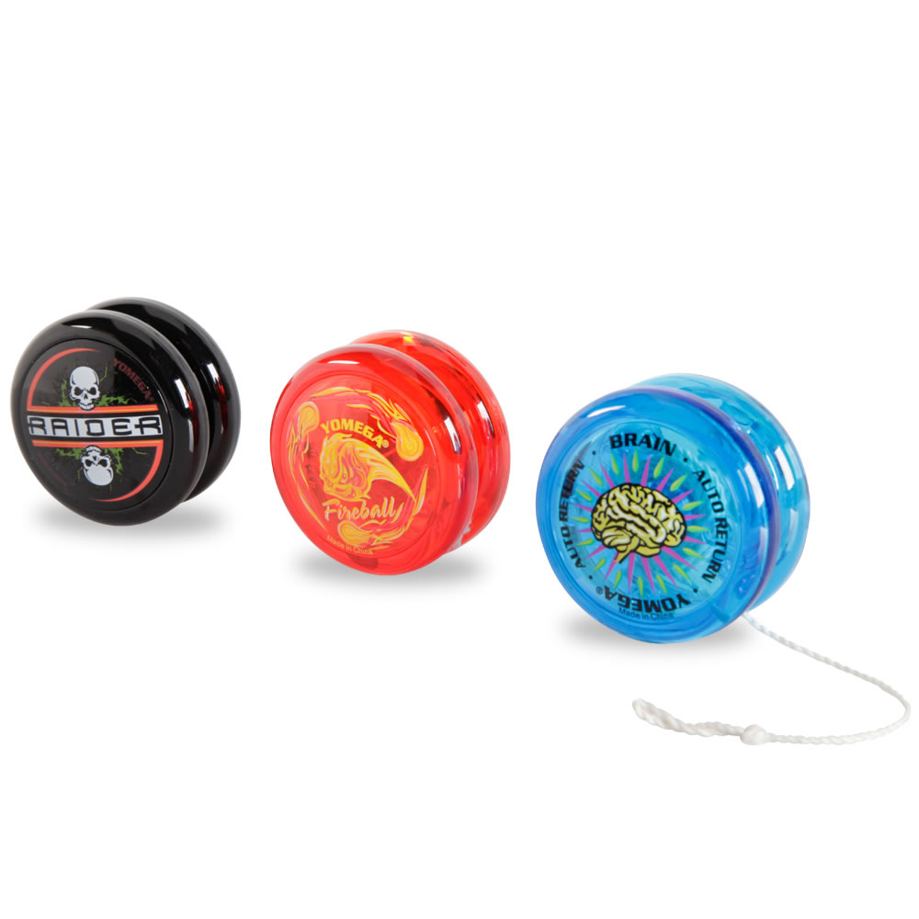





KIM’S GAME
START
FINISH

Slide 11

KIM’S GAME
FINISH
START

Slide 12
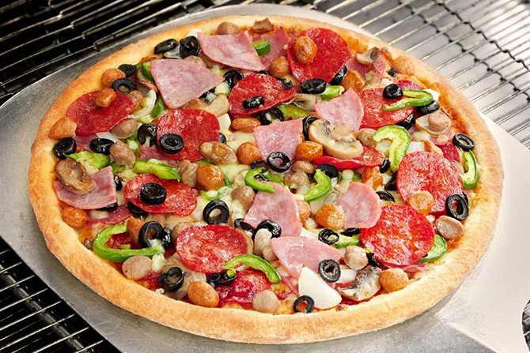
KIM’S GAME
FINISH
START

Slide 13

KIM’S GAME
FINISH
START

Slide 14












Slide 15


06
Activity 6
Listen and repeat.

Slide 16




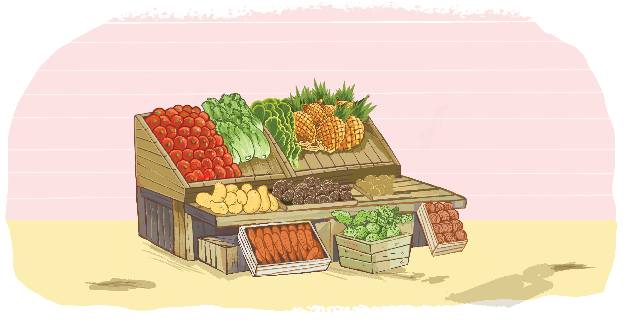
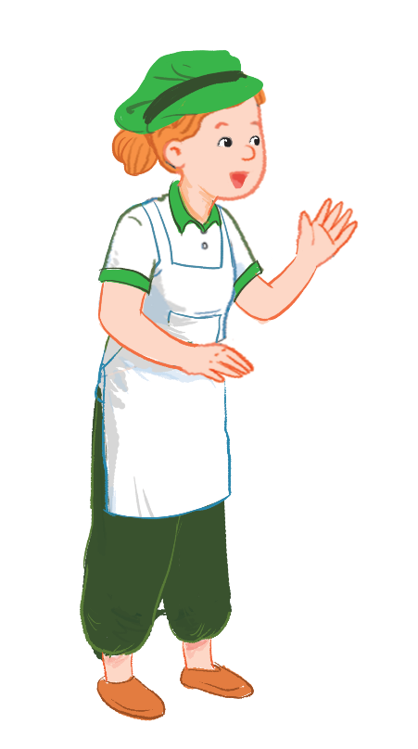
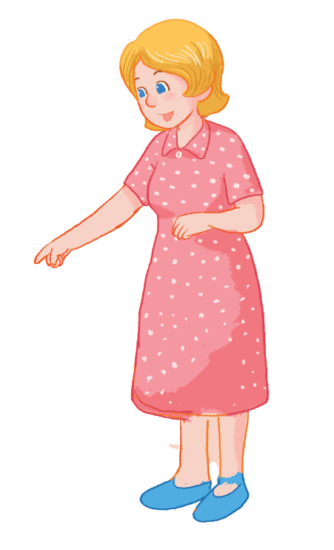
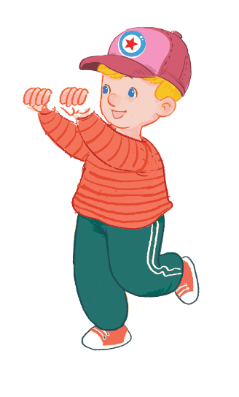

Listen and repeat.
I want some yams.
I want some yams.
I want some yams.
I want some yams.
What do you want?
What do you want?
What do you want?
What do you want?

Slide 17

07
Activity 7
Let’s talk.

Slide 18


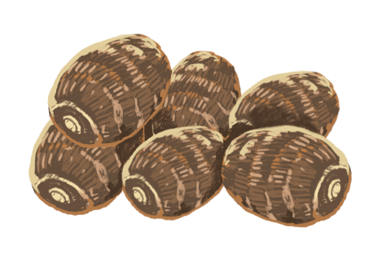

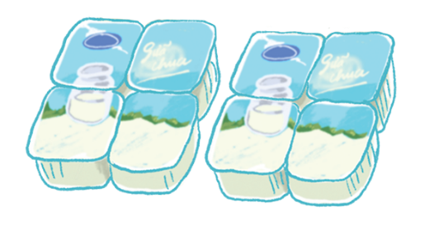
Let’s talk.
What do you want?
I _____ .
a
b
c

Slide 19

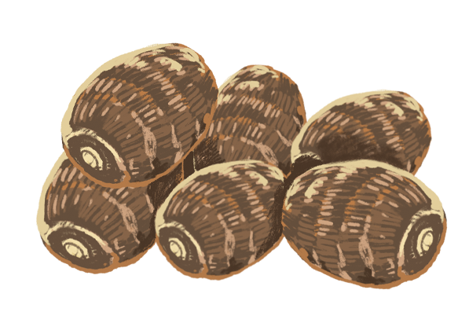
What do you want?
I ______ .
a

Slide 20
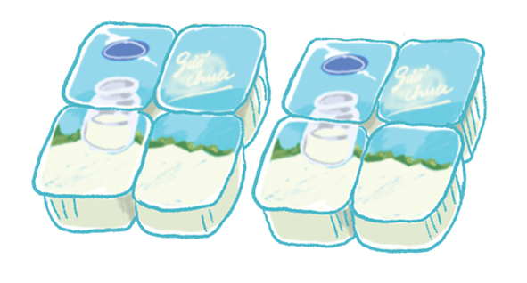
What do you want?
I ______.
b

Slide 21
What do you want?
I ______ .
c

Slide 22

08
Activity 8
Let’s sing.

Slide 23






Let’s sing!
Yo-yos and yogurt.
Yo-yos and yogurt.
Yo-yos and yogurt.
Yo-yos and yogurt.
I want some yo-yos.
I want some yo-yos.
I want some yo-yos.
I want some yo-yos.
I want some yogurt.
I want some yogurt.
I want some yogurt.
I want some yogurt.
Yams and apples.
Yams and apples.
Yams and apples.
Yams and apples.
Mum wants some yams.
Mum wants some yams.
Mum wants some yams.
Mum wants some yams.
Mum wants some apples.
Mum wants some apples.
Mum wants some apples.
Mum wants some apples.

Slide 24
05
Fun corner and
Wrap-up.

Slide 25


Option 1
Option 2

Slide 26

TIC-TAC-TOE
GAME

Slide 27


Slide 28

TIC-TAC-TOE GAME
1
2
3
X
O
O
X
X
O
4
5
6
O
O
X
Team X
X
X
O
Team O
X1
X2
X3
O1
O2
O3
X4
X5
X6
O4
O5
O6
7
8
9
O
O
X
X
X
O
X7
X8
X9
O7
O8
O9

Slide 29








What do you want?
I want some yogurt.
KEY
Notes:
HS trả lời sai GV click vào hình ngôi sao
HS trả lời đúng GV click vào KEY.

Slide 30
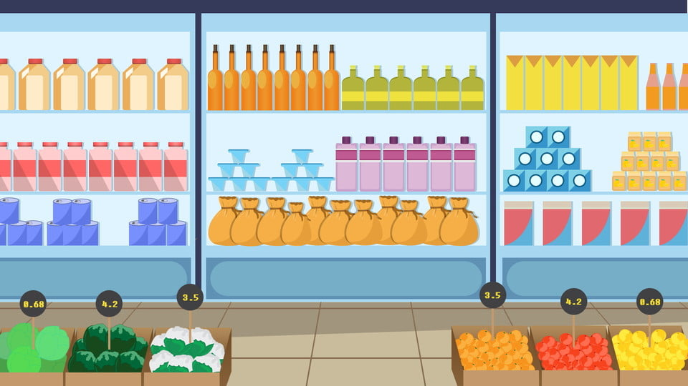
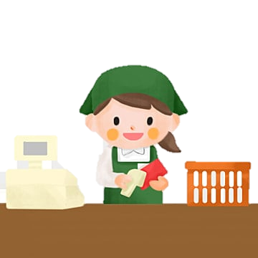


What do you want?
I want some yams.
KEY

Slide 31
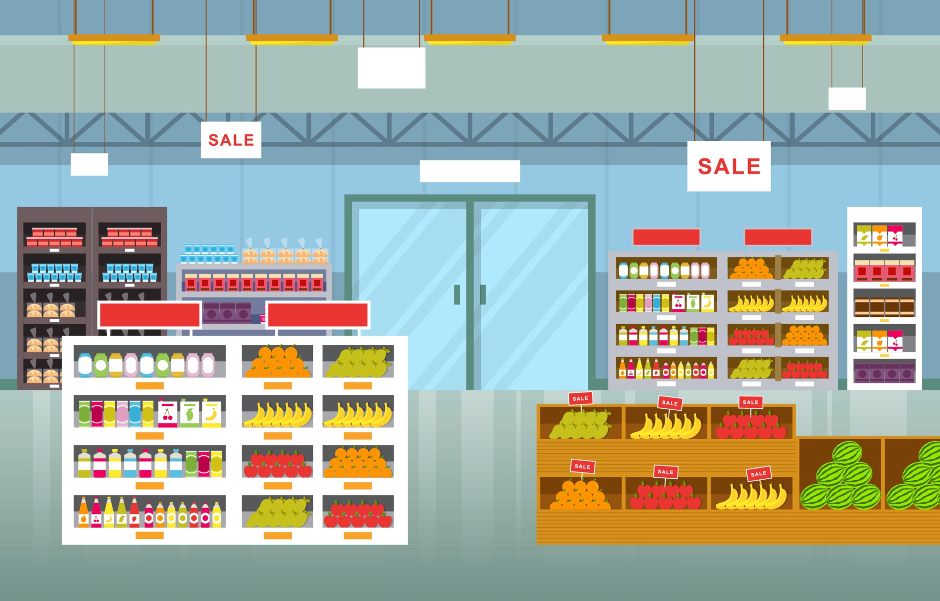




What do you want?
I want some jelly.
KEY

Slide 32
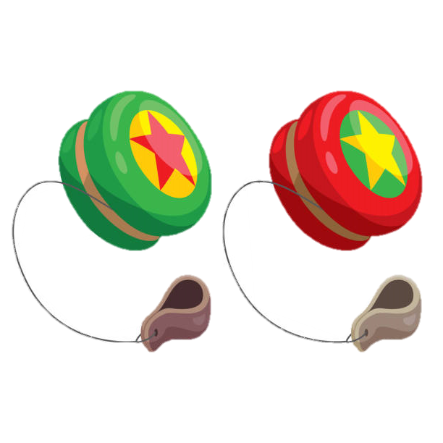
What do you want?
I want some yo-yos.
KEY

Slide 33

What do you want?
I want some apples.
KEY

Slide 34

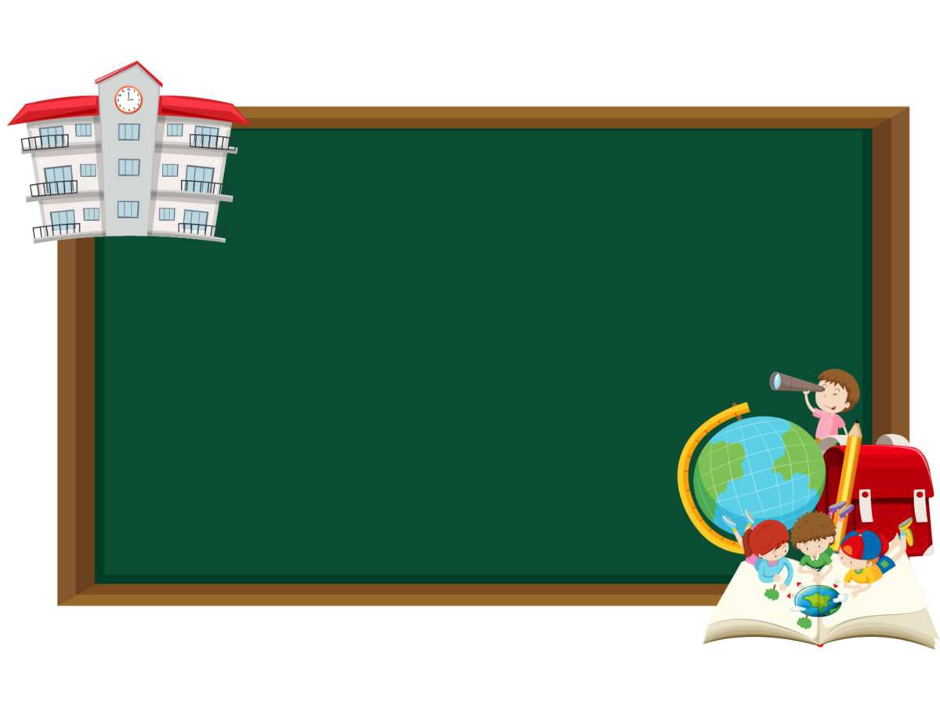


Which word is correct?
a. yams
b. yo-yos
c. yellow
KEY

Slide 35




Is there a fox?
Yes, there is.
KEY

Slide 36


Which word is correct?
a. yo-yos
b. yams
c. yogurt
KEY

Slide 37


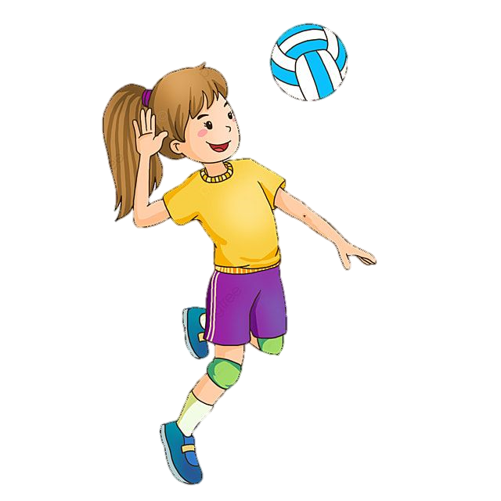


Which picture is correct?
volleyball
volleyball
volleyball
A
B
C
KEY

Slide 38


Team X
Team X
Team X
CongratulationS !!!

Slide 39
Team O
Team O
Team O
CongratulationS !!!

Slide 40
You both WON
the game!
Team X
AND
Team O
CongratulationS !!!

Slide 41
GAME
Quick reveal
TEAM 1
TEAM 2
20
19
18
17
16
15
14
13
12
11
10
9
8
7
6
5
4
3
2
1
0
20
19
18
17
16
15
14
13
12
11
10
9
8
7
6
5
4
3
2
1
0
Notes:
Chia 2 đội chơi.
GV click vào màn hình để hiện tranh. HS chỉ được nhìn qua chớp nhoáng và đọc được tên bức tranh đó thì ghi điểm.

Slide 44

Time to say goodbye!
y

Slide 45
Website: hoclieu.vn
Fanpage: https://www.facebook.com/tienganhglobalsuccess.vn/

