Slide 2

OUR SPECIAL DAYS
Lesson 2 - Period 4

Slide 3
Table of contents
1
2
3
4
Warm-up
Activity 1
Listen and tick.
Activity 2
Read and complete.
Activity 3
Let's play.
Fun corner
5
Collect the hamburgers.

Slide 4
01
Warm-up
Discuss.

Slide 5
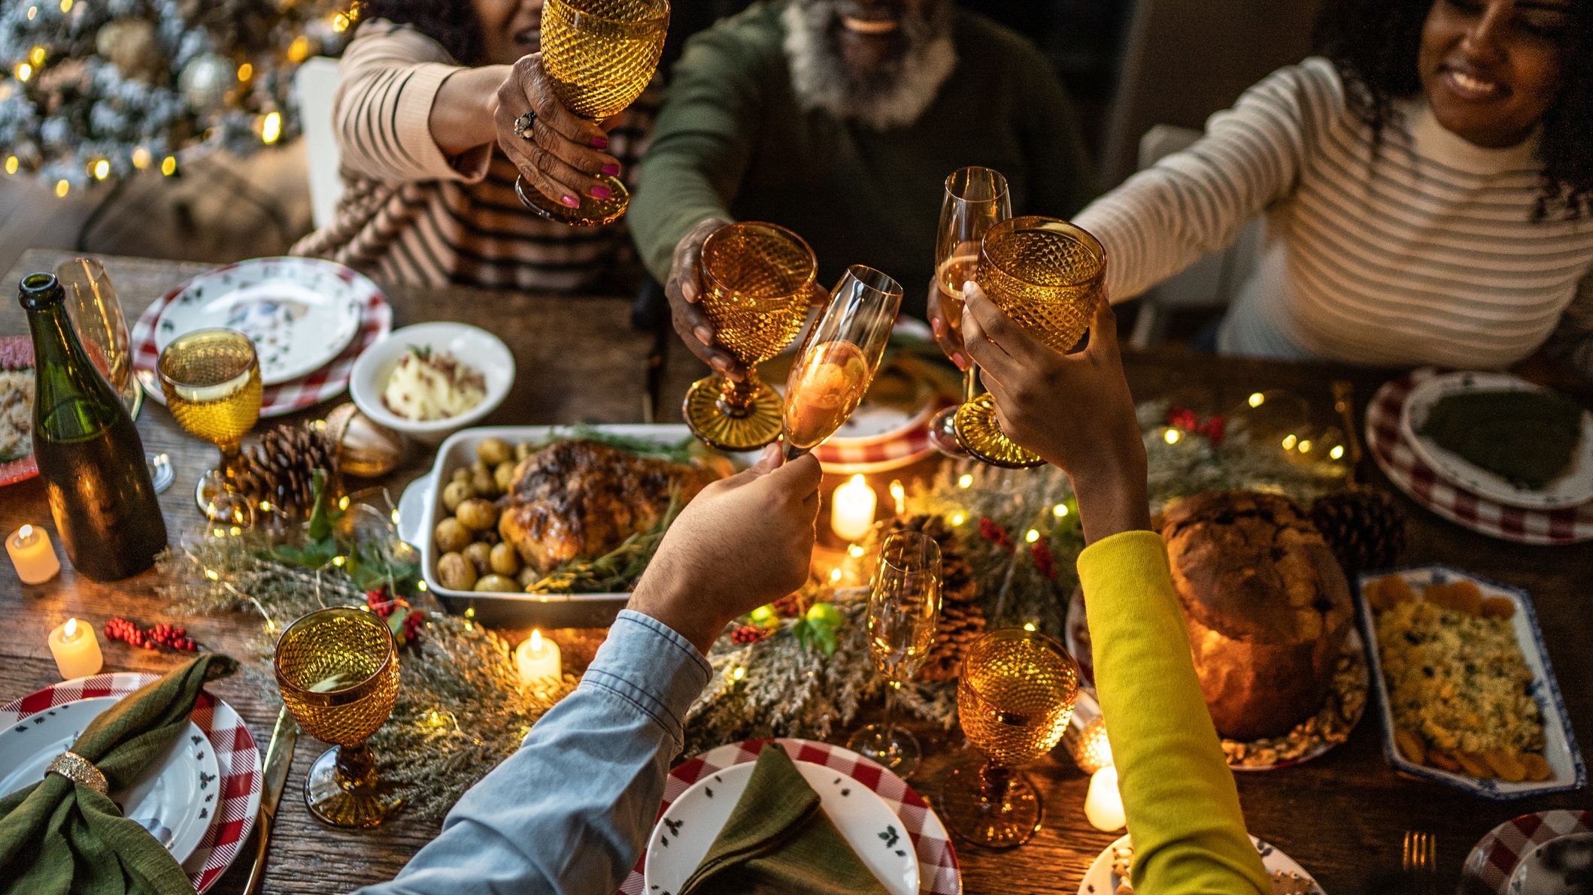
When do we have a party?
Notes:
Encourage students to say as many special occasions when we can organize parties as possible.

Slide 6
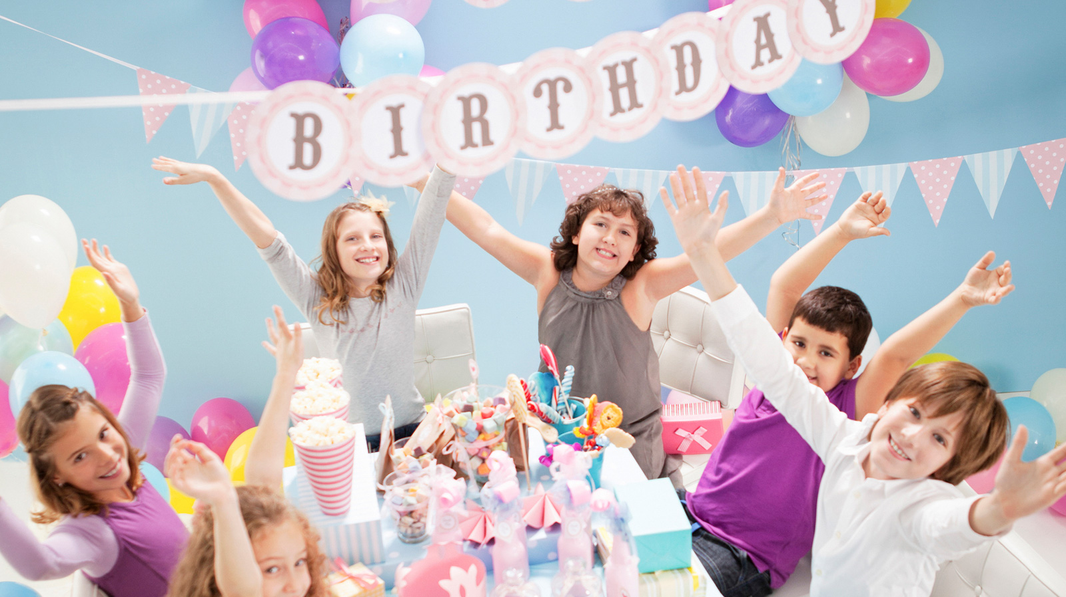
What food/drinks will you have at your birthday party?

Slide 7
02
Activity 4
Listen and tick.

Slide 8
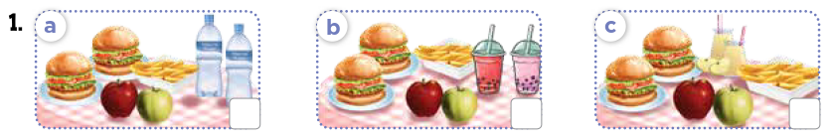
Look! What food and drinks will they have?

Slide 9
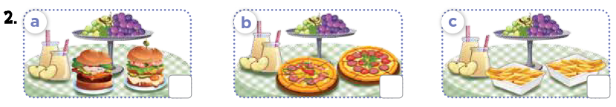
Look! What food and drinks will they have?

Slide 10

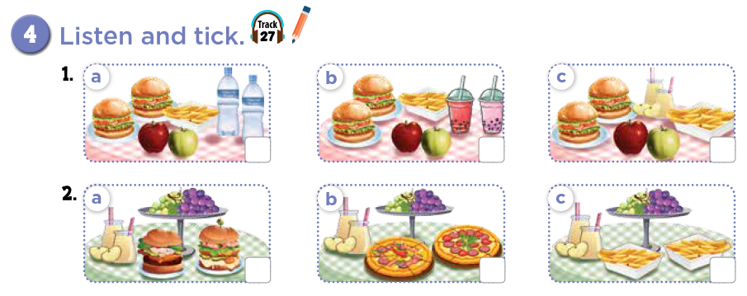

Slide 11
Let's check!



Slide 12
Listen and repeat.



Slide 13
03
Activity 5
Read and complete.

Slide 14
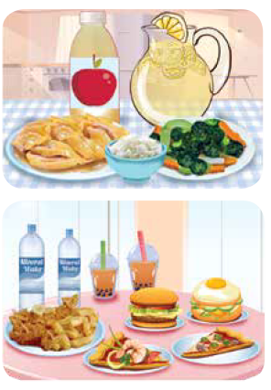
Look at the pictures.
What food and drinks do you see?

Slide 15
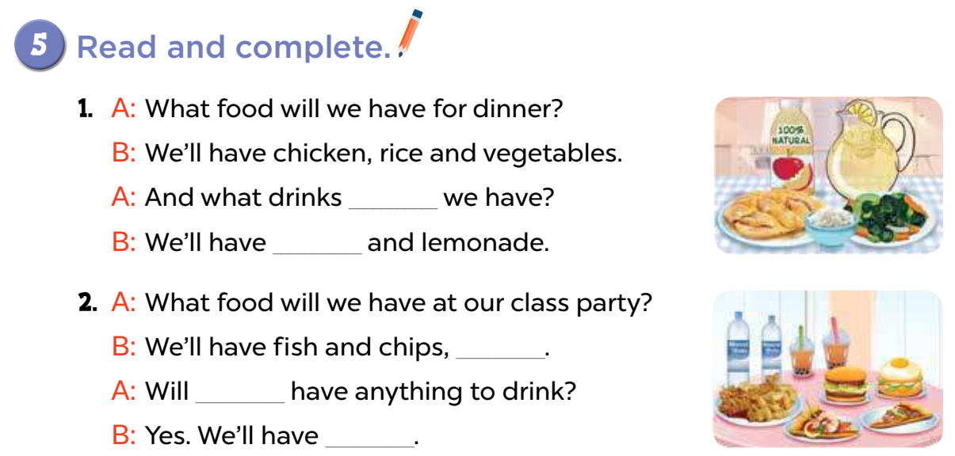
will
apple juice
___________________ and lemonade.
burgers and pizzas
____________________.
we
water and milk tea
_______________________________.

Slide 16
In pairs. Act it out.
will
apple juice
___________________ and lemonade.
burgers and pizzas
____________________.
we
water and milk tea
_______________________________.

Slide 17
Activity 6
04
Let's play.

Slide 18
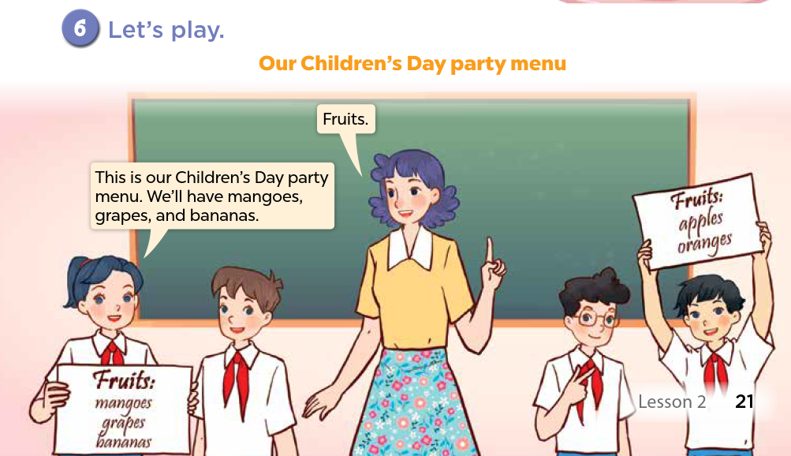

Slide 19
Fun Corner
05
Collect the hamburgers!

Slide 20









What will you have?
Pick your favourite.
Notes:
Encourage students to say "I will have ____" when picking the question.

Slide 21


What food ___ we have for dinner?
A. wills
B. drinks
C. will
D. we

Slide 22
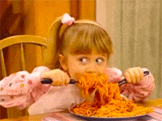
Spaghetti Time!
+ 3 points

Slide 23
A: What ___ will we have for dinner?
B: Fried rice.
A. food
B. drinks
C. day
D. candy

Slide 24
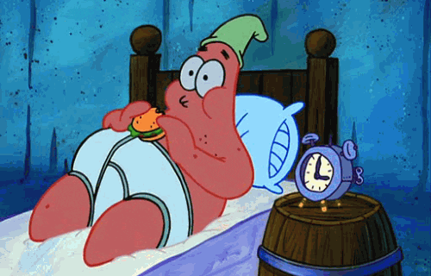
Night Food?
-1 point

Slide 25
A: What drinks will we have?
B: _________.
A. Burgers
B. Lemonade
C. Ice cream
D. Pizza

Slide 26
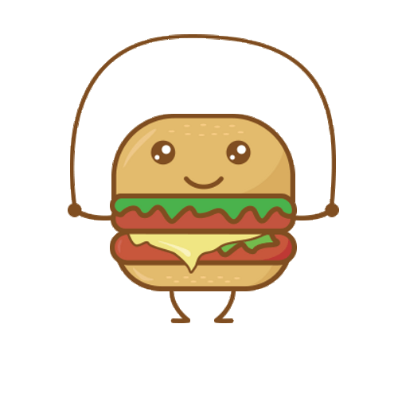
Exercise is good for you!
+2 points

Slide 27
A: What food will we have?
B: We'll have _________.
A. mineral water
B. milk tea
C. soda
D. pizza

Slide 28
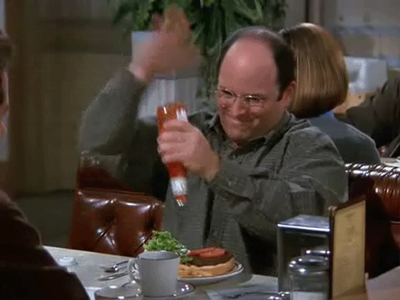
No ketchup!
-2 points

Slide 29
A: What ___ will we have at the party?
B: We'll have milk tea and soda.
A. drinks
B. food
C. water
D. fruits

Slide 30
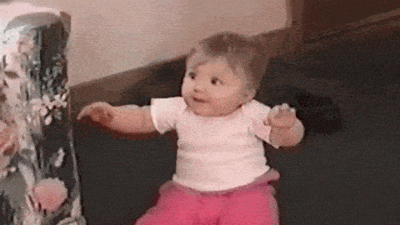
Ice cream is the best!
+5 points

Slide 31
What drinks will we have ___ the party?
A. on
B. at
C. will
D. our

Slide 32
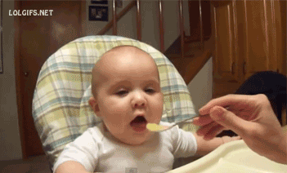
It doesn't taste good!
-3 points

Slide 33
_____ anything to drink?
A. Will you have
B. Will you has
C. You will have
D. We'll have

Slide 34
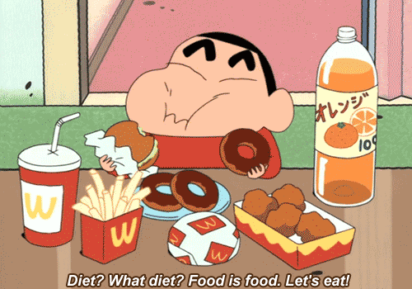
So yummy!
+4 points

Slide 35
A: What ____ will we have for Mid-Autumn Festival?
B: We'll have apples and pomelos.
A. drinks
B. songs
C. oranges
D. fruits

Slide 36
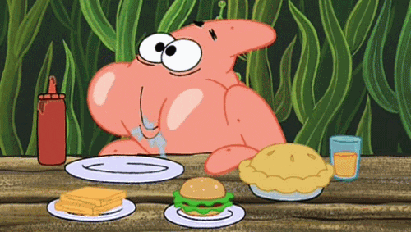
"Food" Morning!
+2 points

Slide 37
What will we have ___ breakfast?
A. on
B. for
C. will
D. in

Slide 38
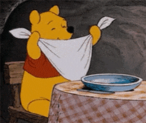
Good etiquette!
+3 points

Slide 39
Website: hoclieu.vn
Fanpage: https://www.facebook.com/tienganhglobalsuccess.vn/

