Slide 1

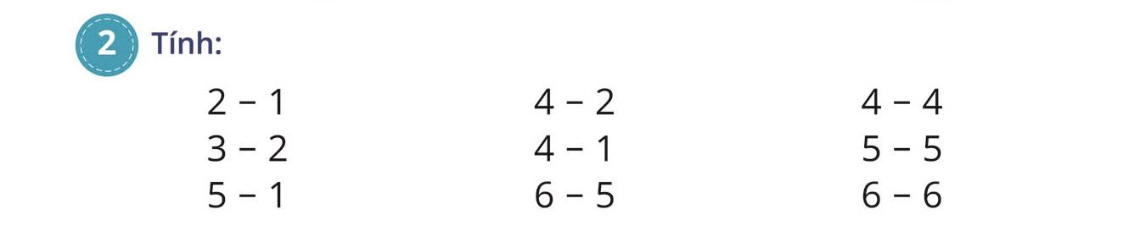
= 1
= 2
= 0
= 1
= 3
= 0
= 4
= 1
= 0

Slide 2

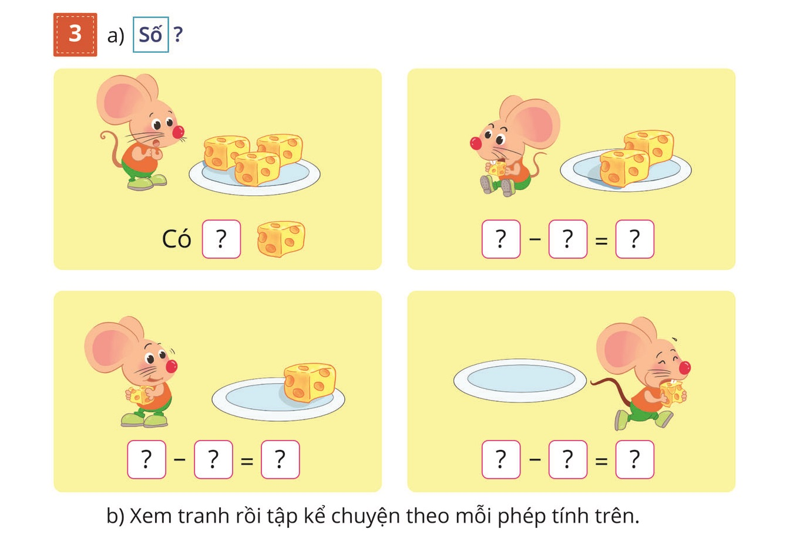

Slide 3

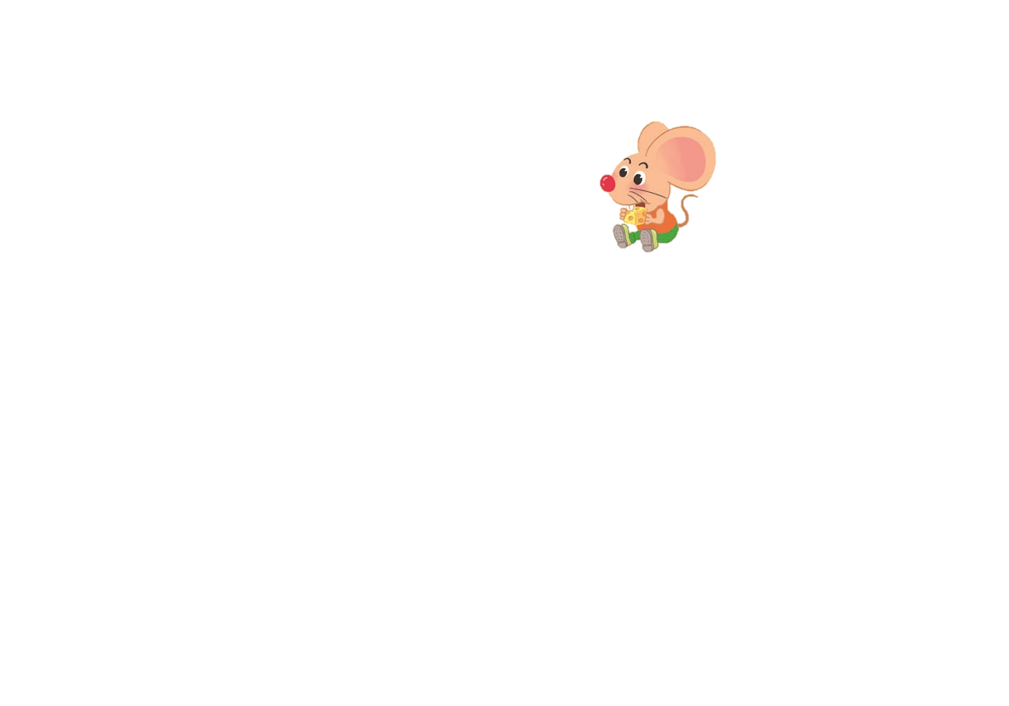
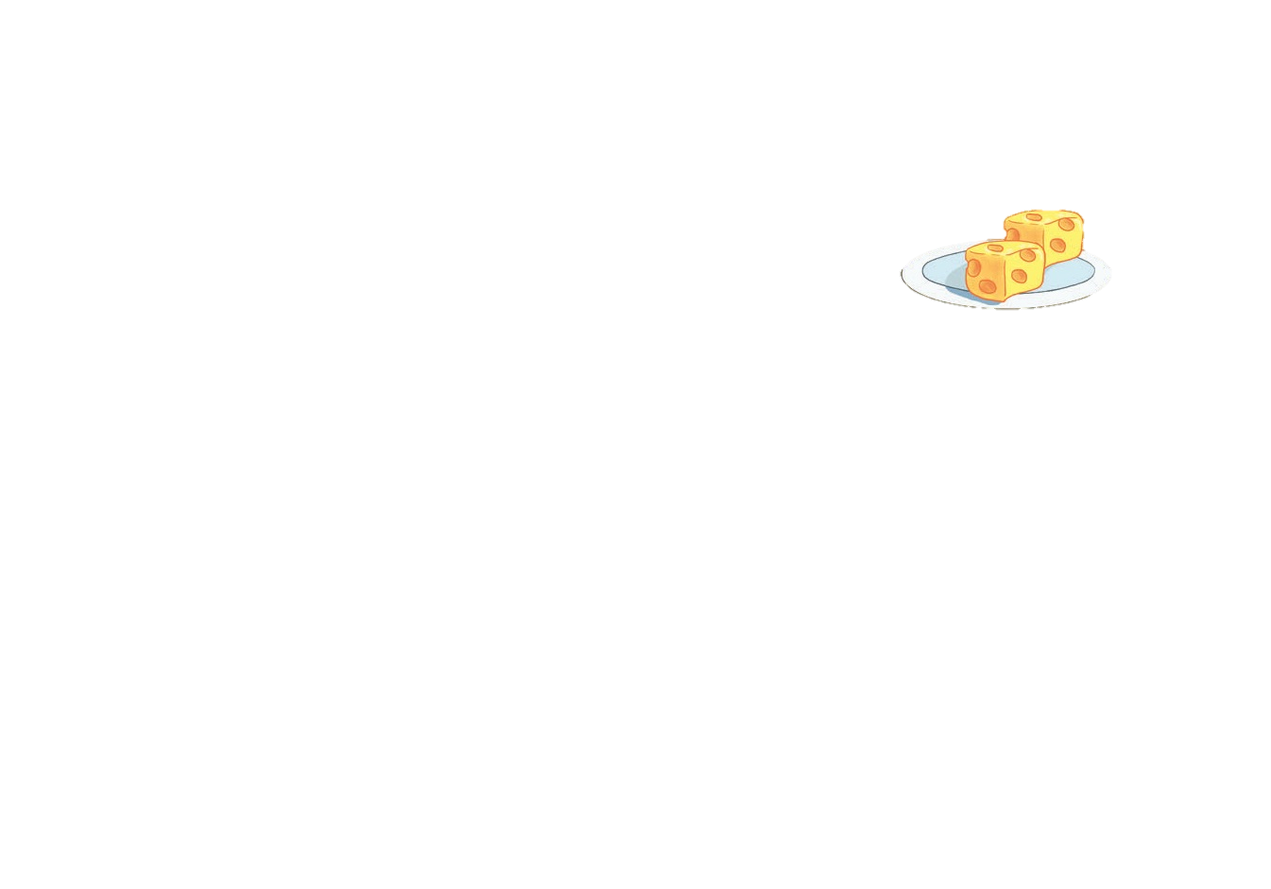

3
3
1
2

Slide 4






2
1
1
1
1
0

Slide 5
3
3
1
2
2
1
1
1
1
0

