Slide 1




Slide 2



6
Our school
LESSON 3 - PERIOD 6

Slide 3
Contents
Warm-up and review
Activity 2
01
02
Activity 3
Activity 6
03
04
Chant
Read and complete.
Let’s write.
Project
Fun corner
05
Game

Slide 4

WARM-UP AND REVIEW

Slide 5

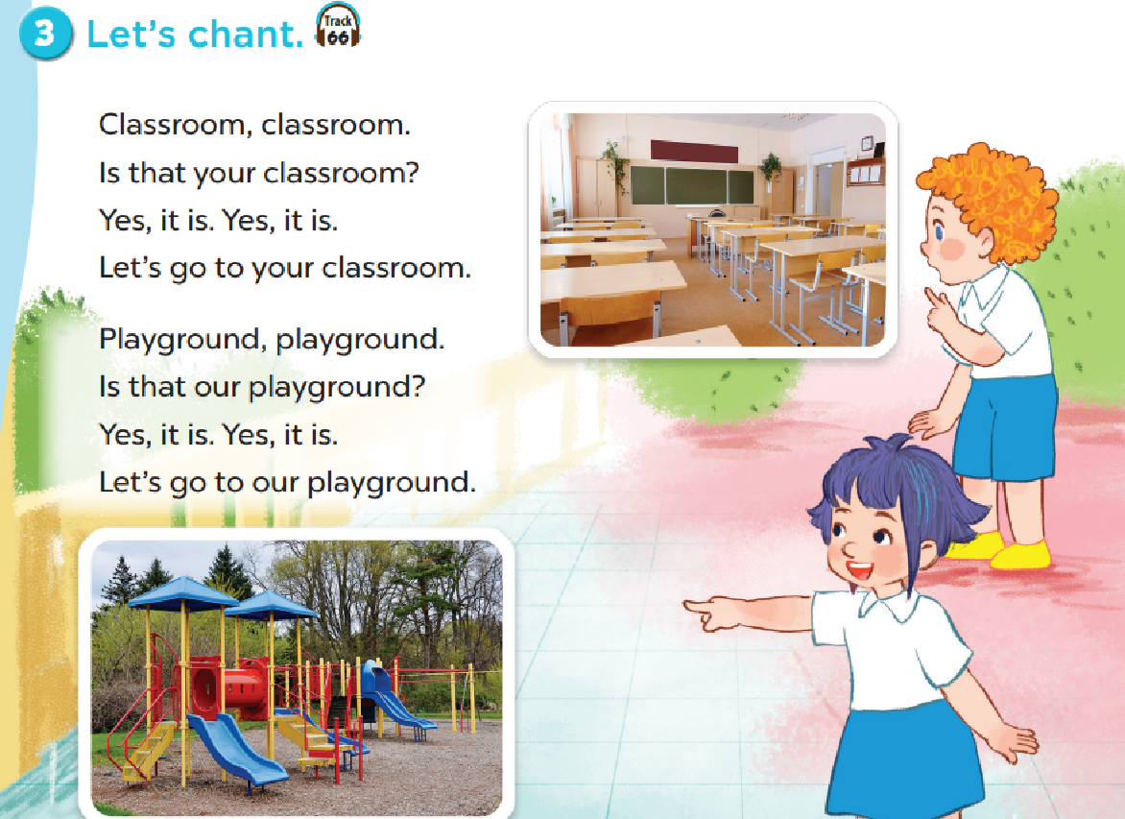

Slide 6

READ AND COMPLETE.

Slide 7
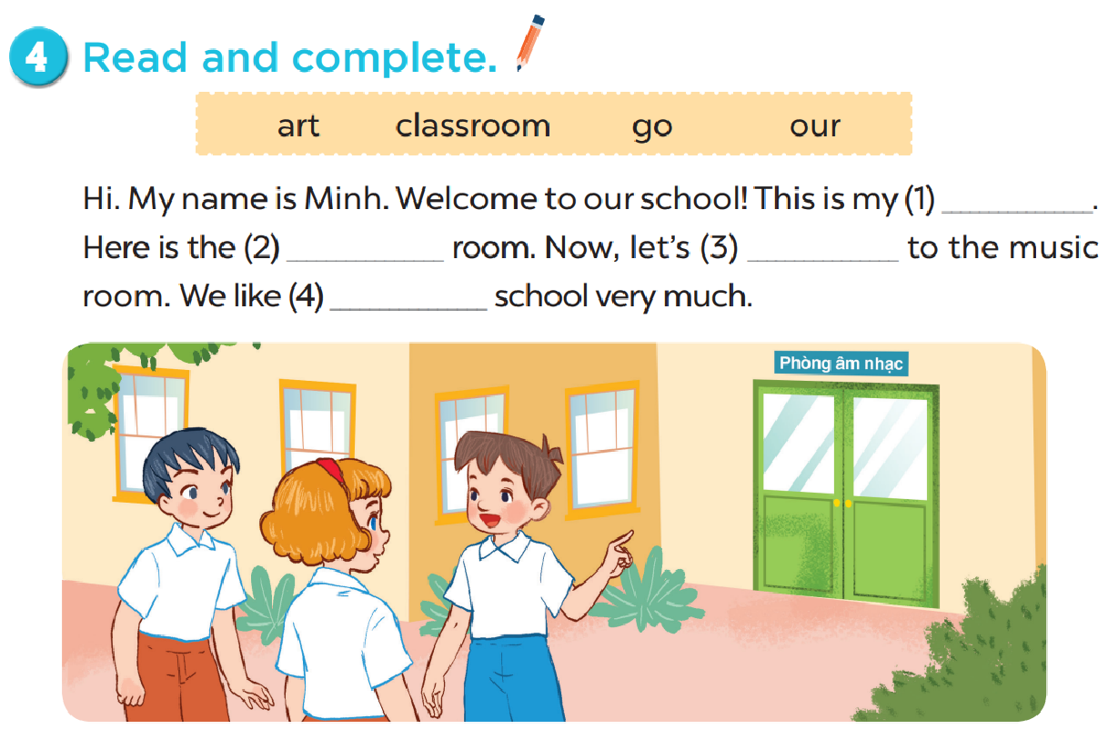
classroom
art
go
our

Slide 8

LET’S WRITE.

Slide 9
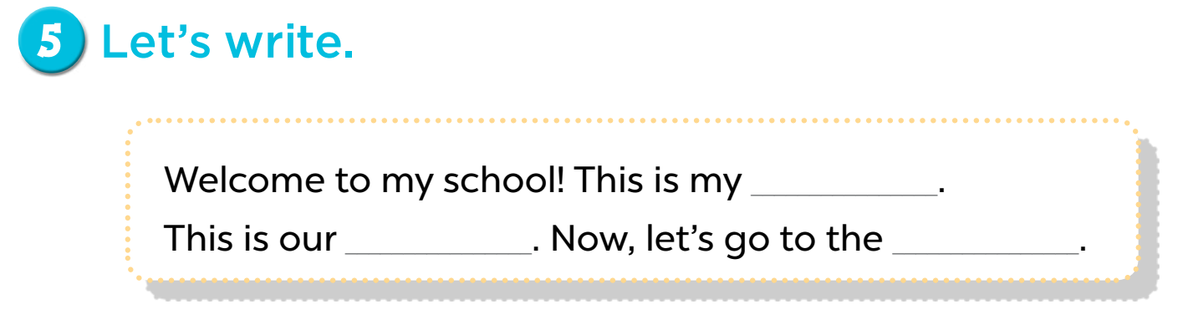

Slide 10

PROJECT

Slide 11
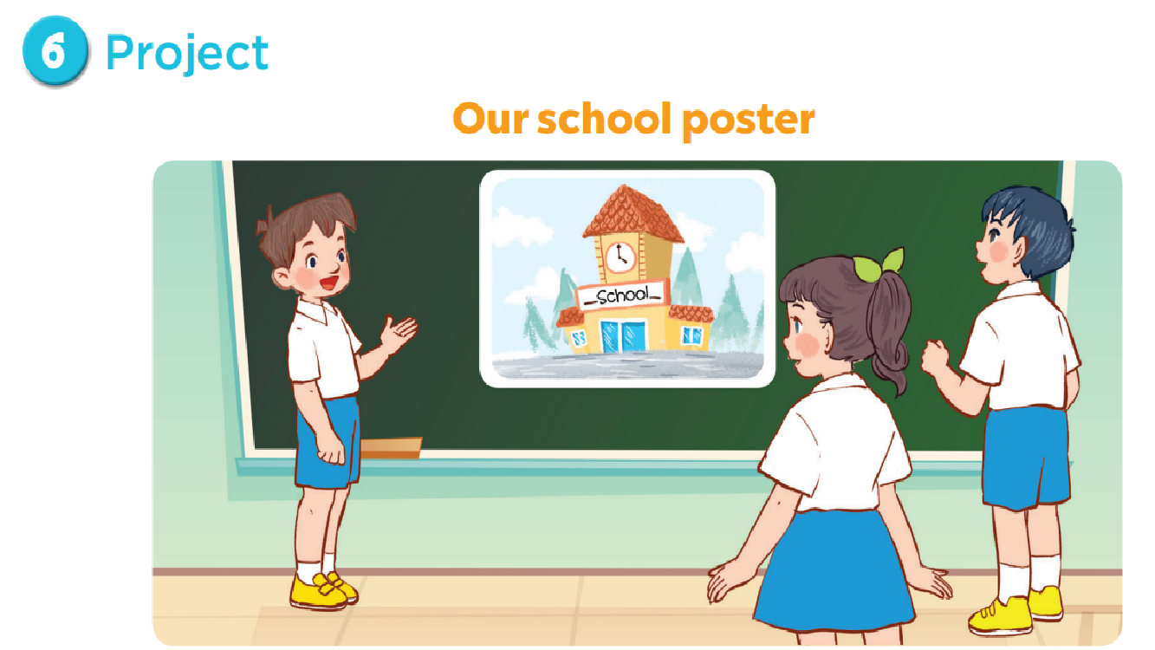

Slide 12

FUN CORNER

Slide 13
0
0
0
O
O
O
X
X
X
1
2
3
X
X
X
0
0
0
O
O
O
X
X
X
4
5
6
X
X
X
0
0
0
O
O
O
X
X
X
7
8
9
X
X
X

Slide 14

Website: hoclieu.vn
Fanpage: facebook.com/www.tienganhglobalsuccess.vn

