Slide 1



Slide 2








Period 3

Slide 3
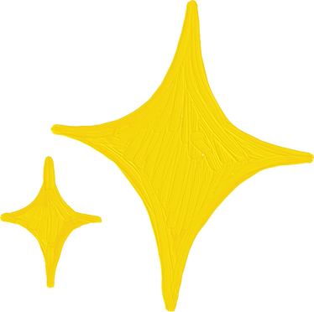
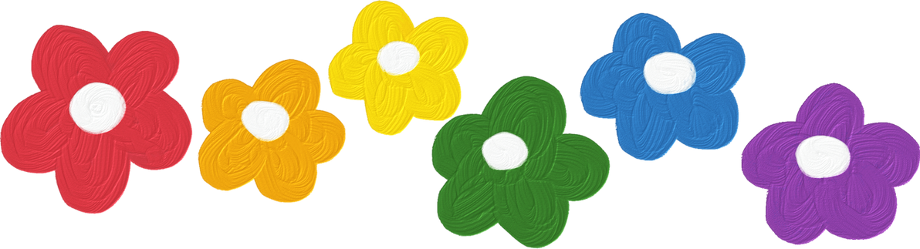
Contents
1. Warm-up and review
2. Find, circle and match.
3. Quiz time
4. Look and match.
5. Fun corner and wrap-up

Slide 4


Warm-up and review

Slide 5






Warm-up
Who is
FASTER?!!!
Notes:
Divide the class into 2 big groups. Each group has a leader to check their group’s work.
Teacher sticks the flashcards and writes numbers from 1-6 on the board.
Teacher says a number, each member from 2 groups listen to, then say the word.
The faster one to finish would be the winner.

Slide 6
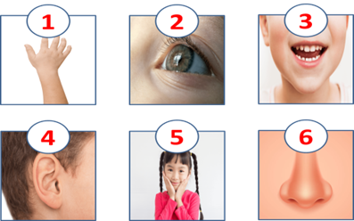

Slide 7
WORD
GAME
Notes:
- Using flashcards to review vocabulary from Unit 1 - unit 5.
- Then ask pupils to look at the given letter, rearrange them to find the correct word.
- Teacher gives points or candies to fastest pupil with correct answer.
Key: 1. Ben 2. face 3. eight 4. swimming

Slide 8



Question
1
N
B
E
Hint: This is a name

Slide 9
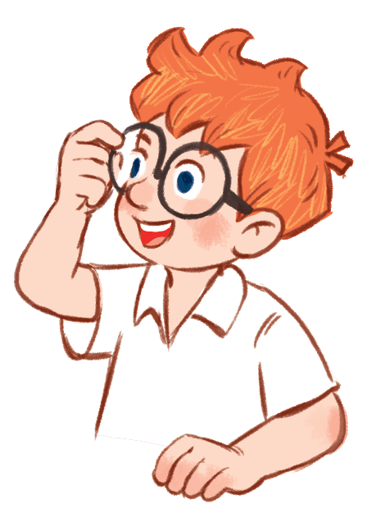
Question
1
B
E
N

Slide 10
Question
2
A
F
C
E
Hint: This is a part of your body

Slide 11

Question
2
F
A
C
E

Slide 12
Question
3
E
T
H
G
I
Hint: This is a number

Slide 13
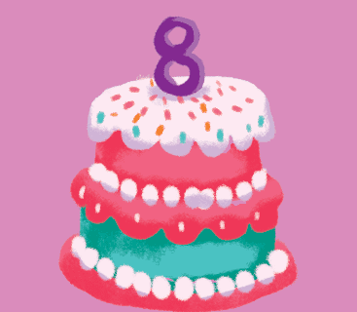
Question
3
E
I
G
H
T

Slide 14
Question
4
W
I
S
M
G
N
M
I
Hint: This is a hobby

Slide 15
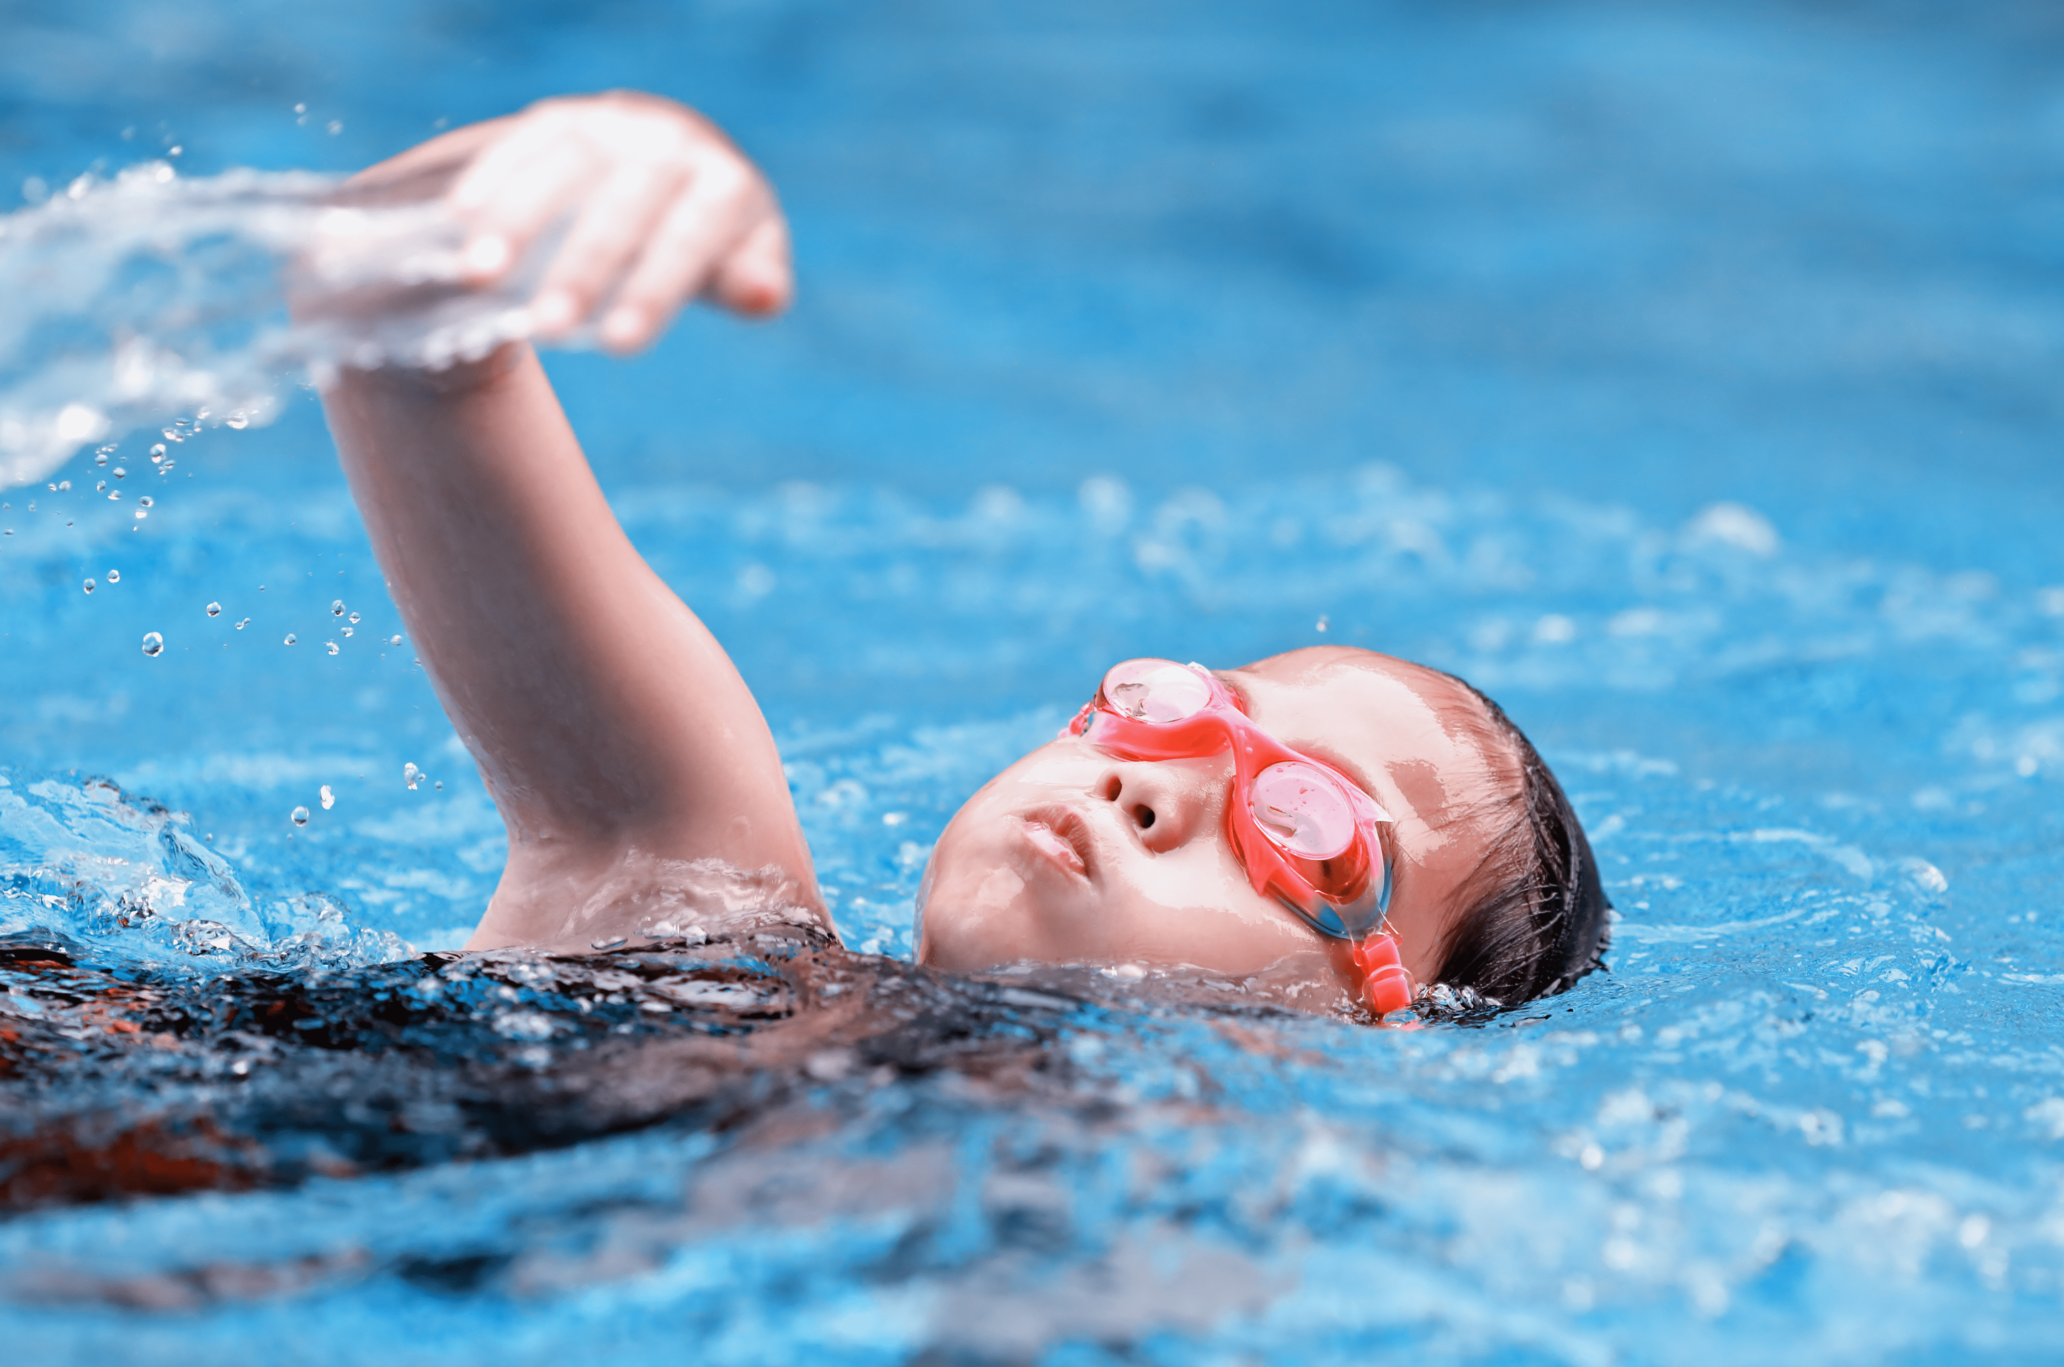
Question
4
S
W
I
M
M
I
N
G

Slide 16



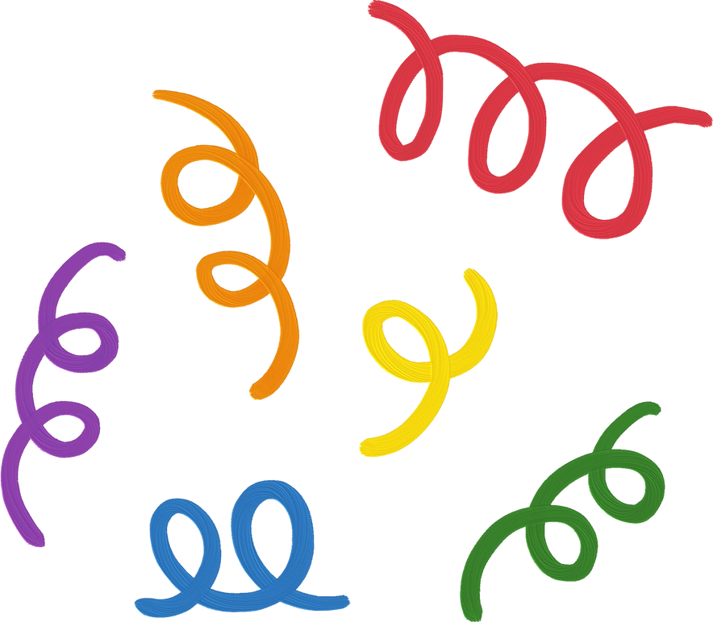
2. Find, circle
and match

Slide 17
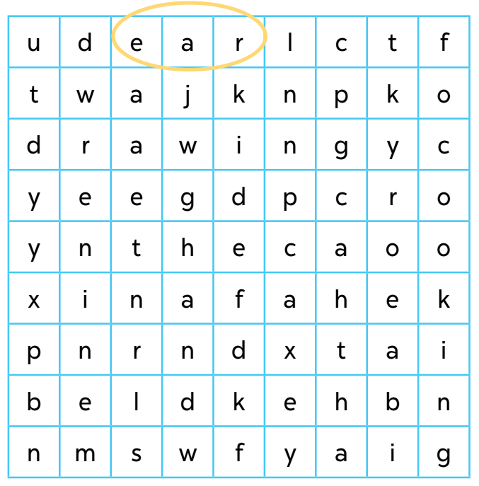

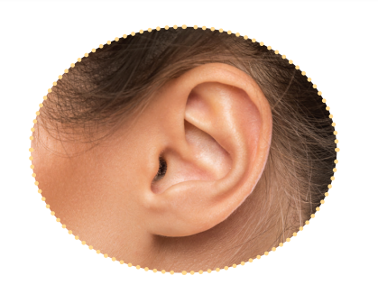

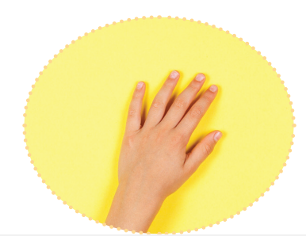


Slide 24
2. Quiz time

Slide 25
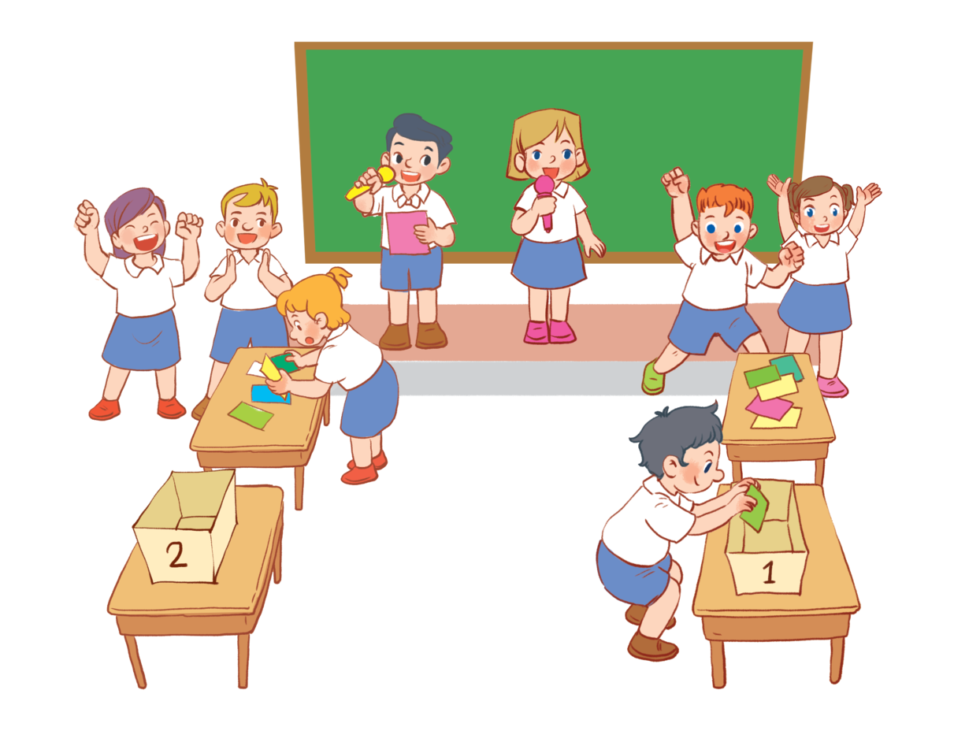

Slide 26



Have fun!!!
How to play
1
Put pupils into two teams, Team 1 and Team 2.
2
Have one representative of each team stand next to their boxes, Box 1 and Box 2.
3
Two quiz masters will read different dialogues for each pair of pupils.
After listening to the dialogue, each representative has to find the right flash card and put it in
their team’s box.
4

Slide 27
3. Look and match.

Slide 28
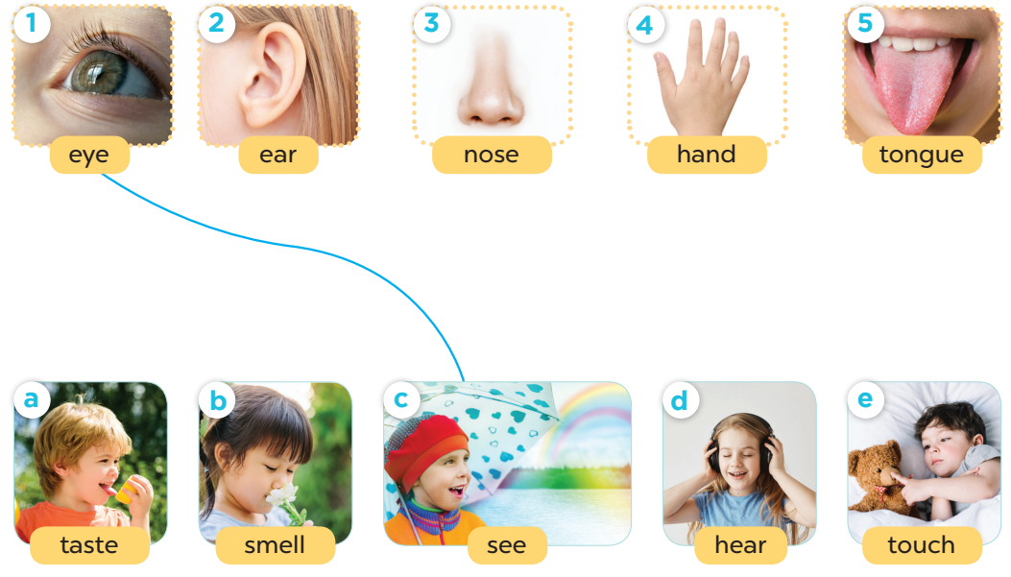

Slide 29
5. Fun corner and wrap-up

Slide 30


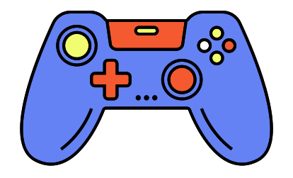

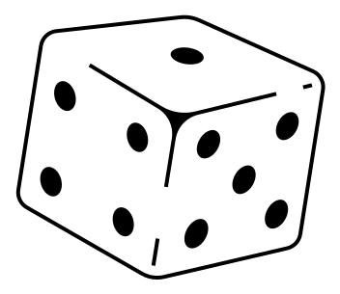



Game time!
Notes:
Vocabulary review.

Slide 31
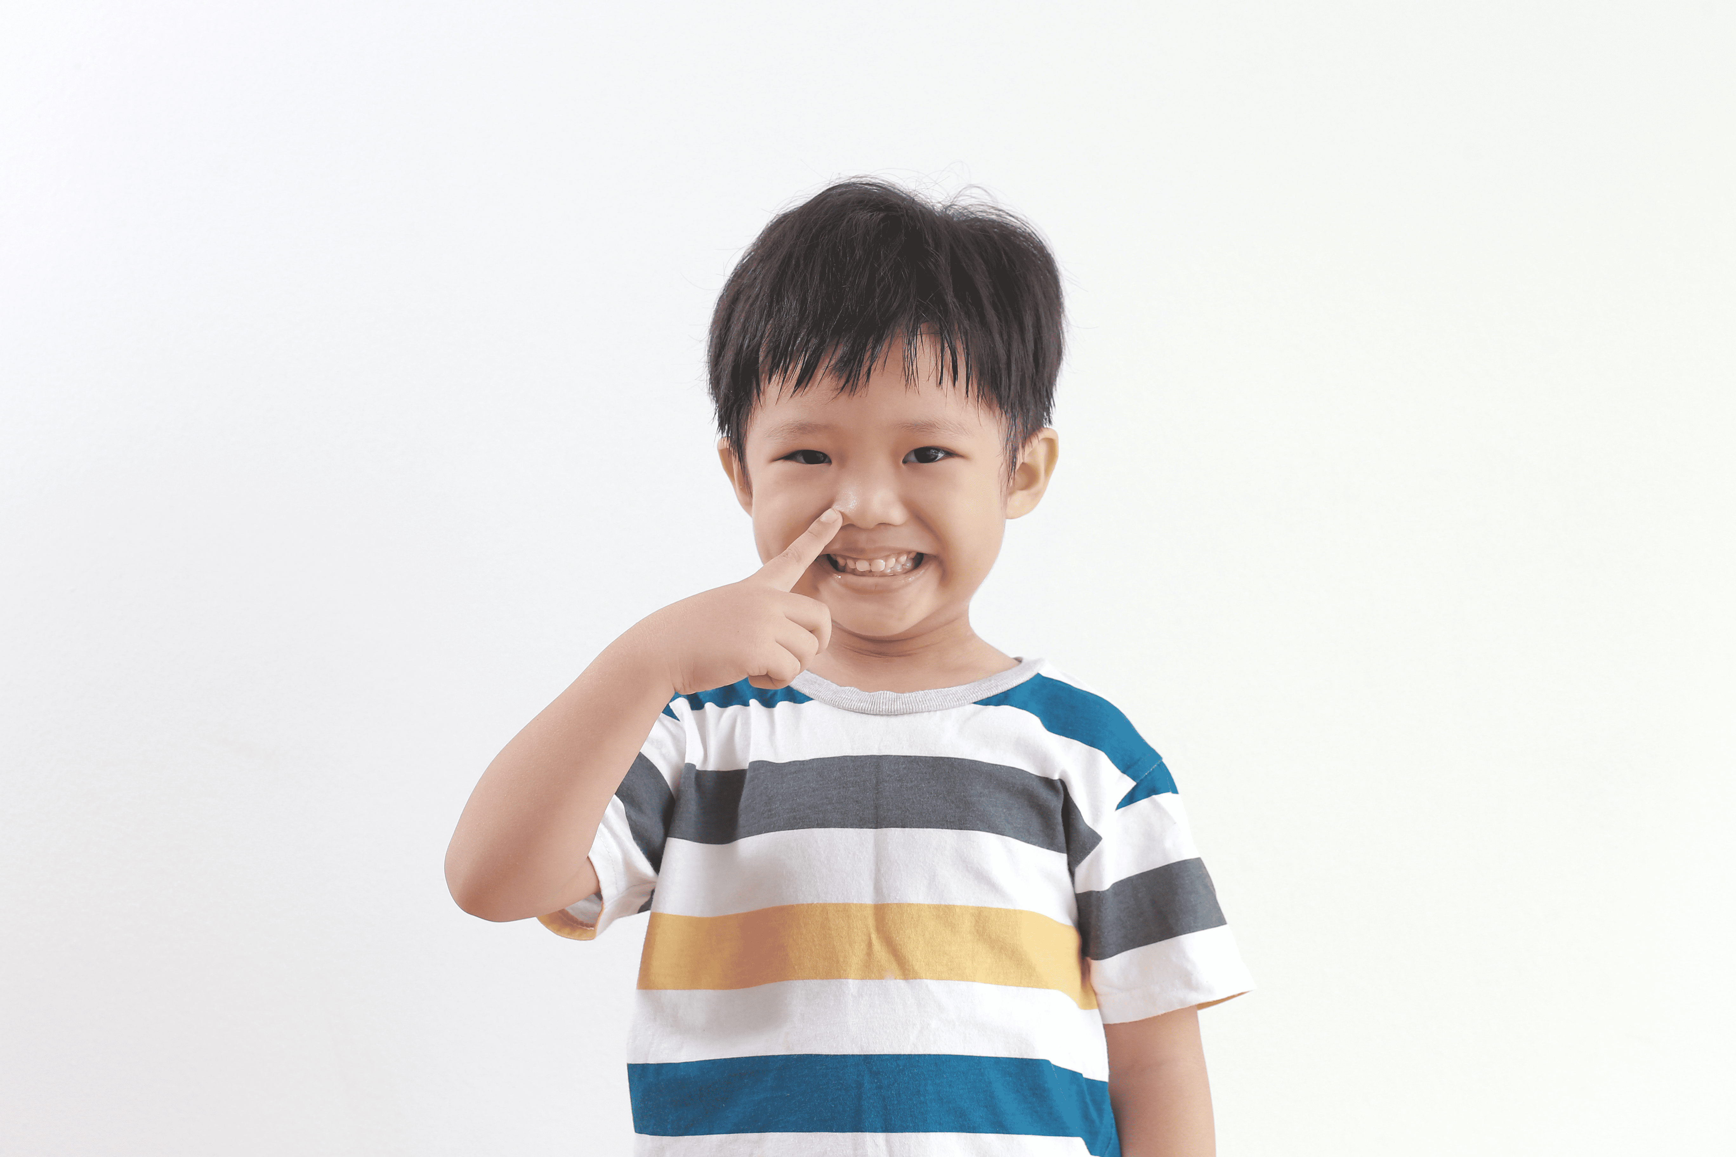
We can use it to smell.
nose
Notes:
A nose

Slide 32

It’s between number six and eight.
seven
Notes:
Number 7

Slide 33

3. We say it to greet people.
Hello/ Hi!
Notes:
Hello/ Hi!

Slide 34

4. We can use this to listen to music.
an ear/ ears
Notes:
dancing

Slide 35
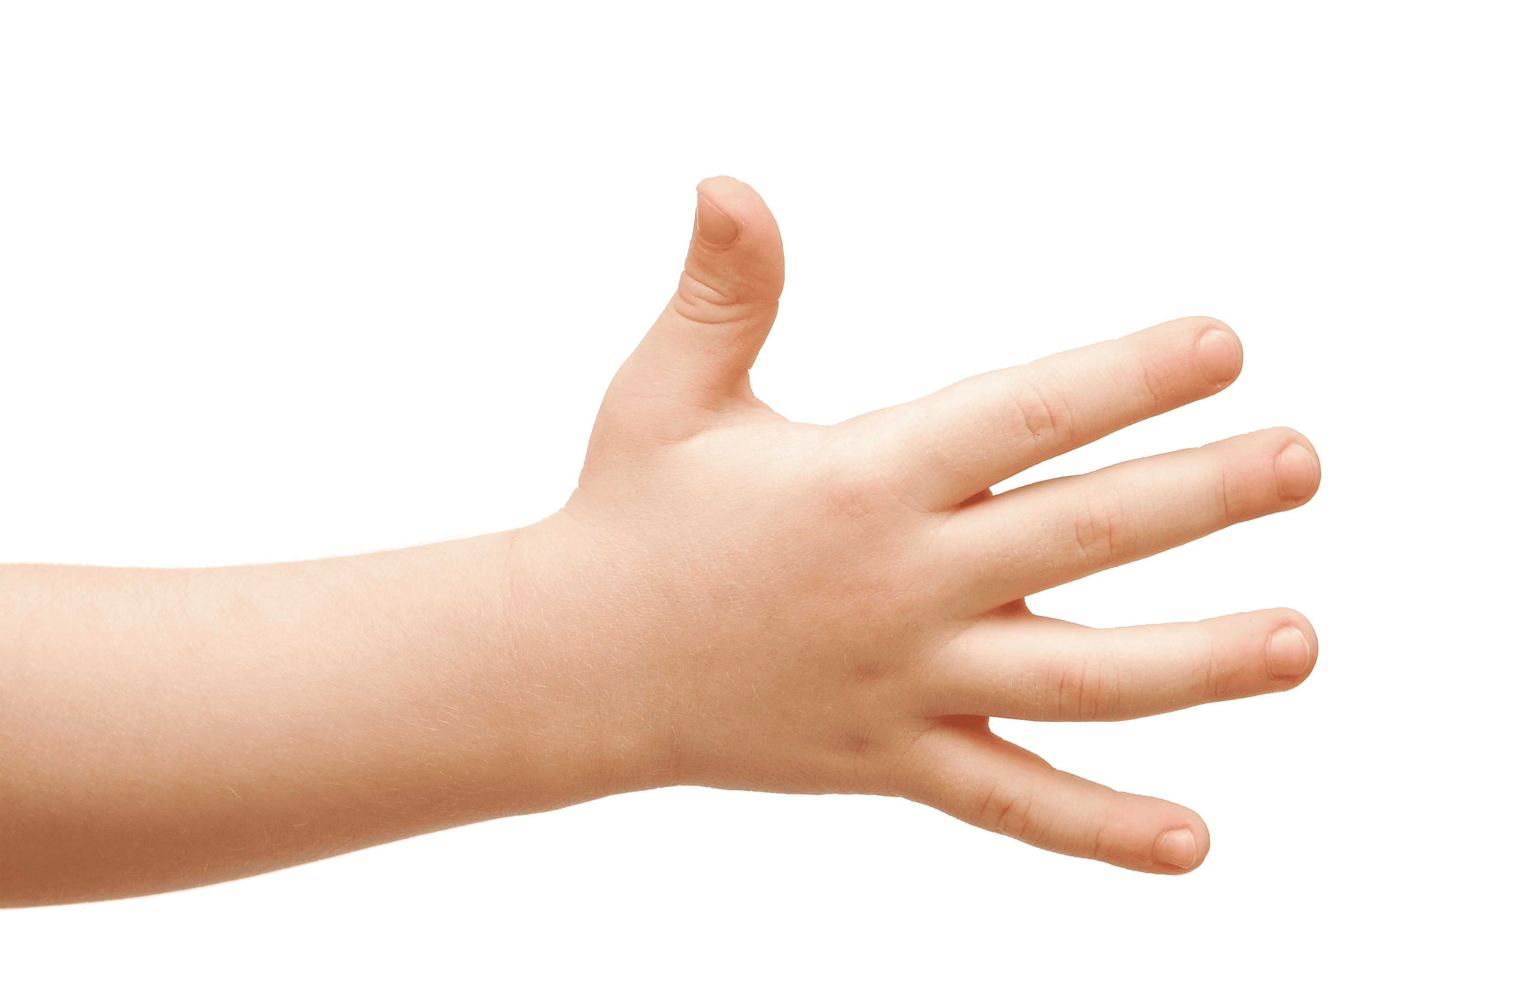
5. We use it to touch things.
a hand
Notes:
A hand

Slide 36

Website:sachmem.vn
Fanpage: www.facebook.com/sachmem.vn

