Slide 2


















5
My future job

Slide 3





TABLE OF CONTENTs
  01. Warm-up and Review
  02. Look, listen and repeat.
  03. Listen, point and say.
  04. Let’s talk.
  05. Fun corner and Wrap-up

Slide 4




01.
Warm-up
and Review

Slide 5
Quiz game

Slide 6







He cooks food in the restaurant. Who is he?
cook
pupil
pupil

Slide 7
She works at school. She teaches pupils. Who is she?
actor
teacher

Slide 8

He works in a police station. Who is he?
cook
policeman

Slide 9

She takes care of sick people.
Who is she?
doctor
farmer

Slide 10

She’s young, she studies
at school. Who is she?
pupil
teacher

Slide 11
She works on a farm. Who is she?
policeman
farmer

Slide 12

He can sing very well. Who is he?
actor
singer

Slide 13
02.
Look, listen and repeat.

Slide 14


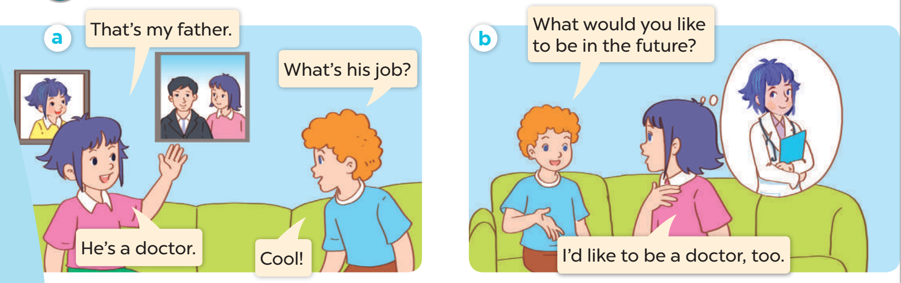

Listen and repeat.

Slide 15
03.
Listen, point and say.

Slide 16
New words
Look, listen and repeat.

Slide 17




firefighter

Slide 18

writer

Slide 19

gardener

Slide 20

reporter

Slide 21


Listen and repeat.

Slide 23
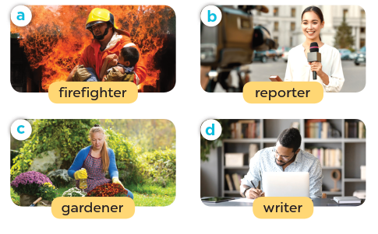
Listen, point and say.

Slide 24
03.
Let’s talk.

Slide 25
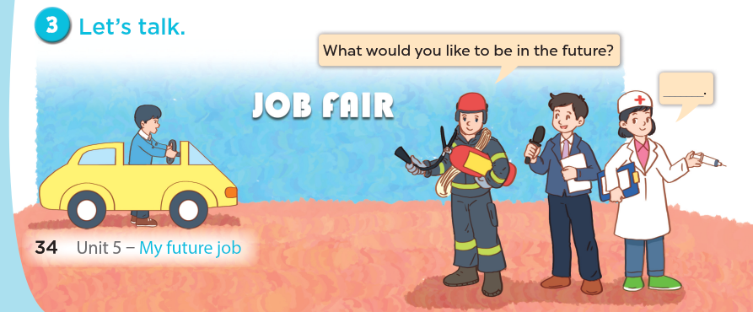

Slide 26
04.
Fun corner and Wrap-up

Slide 27
PASS THE BALL!

Slide 28
HOW TO PLAY
Pass the balls: When the music stops, whoever has a ball must stand up and either ask or answer the question on the screen.
Notes:
GV có thể thay tranh khác hoặc bỏ tranh để hs nói về mình.

Slide 29
PASS THE BALL!
STOP!

Slide 30

QUESTION:
ANSWER:
here
gardener.

Slide 31
PASS THE BALL!
STOP!

Slide 32
QUESTION:
Question here
ANSWER:
here
firefighter.

Slide 33
PASS THE BALL!
STOP!

Slide 34

QUESTION:
Question here
ANSWER:
here
writer

Slide 35
PASS THE BALL!
STOP!

Slide 36

QUESTION:
Question here
ANSWER:
here
reporter.

Slide 37
PASS THE BALL!
STOP!

Slide 38

QUESTION:
Question here
ANSWER:
here
writer

Slide 39
PASS THE BALL!
STOP!

Slide 40

QUESTION:
Question here
ANSWER:
here
gardener.

Slide 41
PASS THE BALL!
STOP!

Slide 42

QUESTION:
Question here
ANSWER:
here
reporter.

Slide 43
PASS THE BALL!
STOP!

Slide 44

QUESTION:
Question here
ANSWER:
here
reporter.

Slide 45
PASS THE BALL!
STOP!

Slide 46

QUESTION:
Question here
ANSWER:
here
writer

Slide 47
Website: hoclieu.vn
Fanpage: https://www.facebook.com/tienganhglobalsuccess.vn/

