Slide 2





EXTENTION ACTIVITIES
Period 3

Slide 3


Table of contents
01
Warm-up and Review
02
Activity 1: Choose and write the correct words on the lines.
03
Activity 2: Complete the tables about jobs.
05
Fun corner and Wrap-up
04
Activity 3: Work in groups. Talk about what you want to be in the future. Say why.

Slide 4





01
Warm-up and Review

Slide 5












HELLO EVERYONE
Let's play a game!
GUESSING GAME

Slide 6



The person putting out fires is called a ...
Question 1

Slide 7



THE ANSWER IS...
FIREFIGHTER

Slide 8

The person writing stories is called a ...
Question 2

Slide 9

THE ANSWER IS...
WRITER

Slide 10



QUESTION 3
Guess the word
D
C
T
R

Slide 11
THE ANSWER IS...
D
O
C
T
O
R

Slide 12

QUESTION 4
Guess the word
G
R
D
R

Slide 13
THE ANSWER IS...
G
A
R
D
E
N
E
R

Slide 14




QUESTION 5
Where is it?

Slide 15
THE ANSWER IS...
THEATRE

Slide 16

QUESTION 6
Where is it?

Slide 17
THE ANSWER IS...
SCHOOL

Slide 18
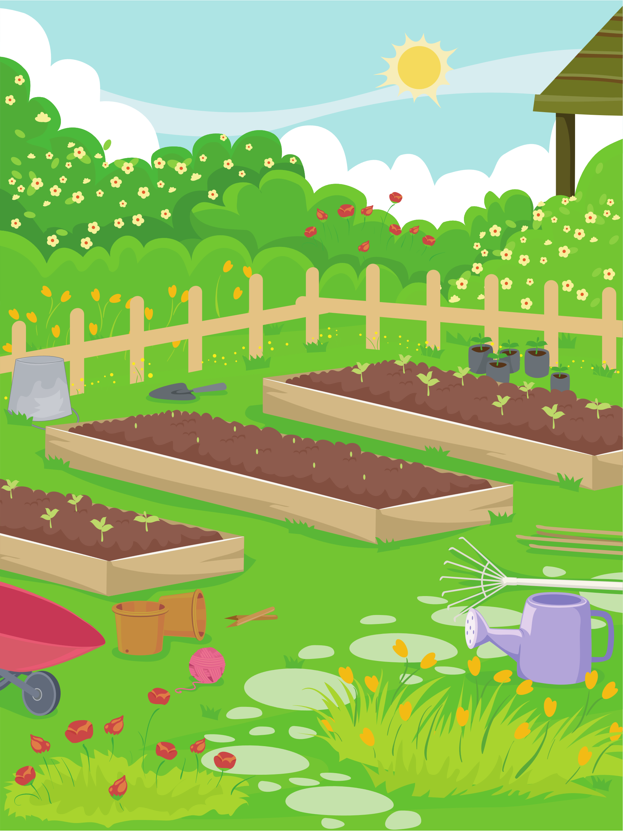
QUESTION 7
Where is it?

Slide 19
THE ANSWER IS...
GARDEN

Slide 20





THANK YOU FOR YOUR PLAYING!

Slide 21


02
Activity 1
Choose and write the correct words on the lines.

Slide 22


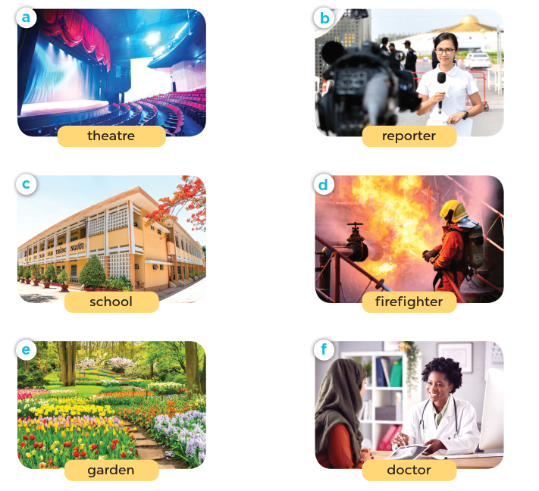


Choose and write the correct words on the lines.
1. I teach English. I have lots of pupils. Where do I work?
__________
school
2. I help sick people. I work in a hospital. What am I?
__________
doctor
3. I act and tell stories to lots of people. Where do I work?
__________
theatre
4. I report news stories. I work in an office, but I travel a lot.
What am I?
__________
reporter
5. I put out. I work in a fire station. What is my job?
__________
firefighter
6. I plant beautiful flowers and trees. Where do I work?
__________
garden

Slide 23
03
Activity 2
Complete the table about jobs.

Slide 24



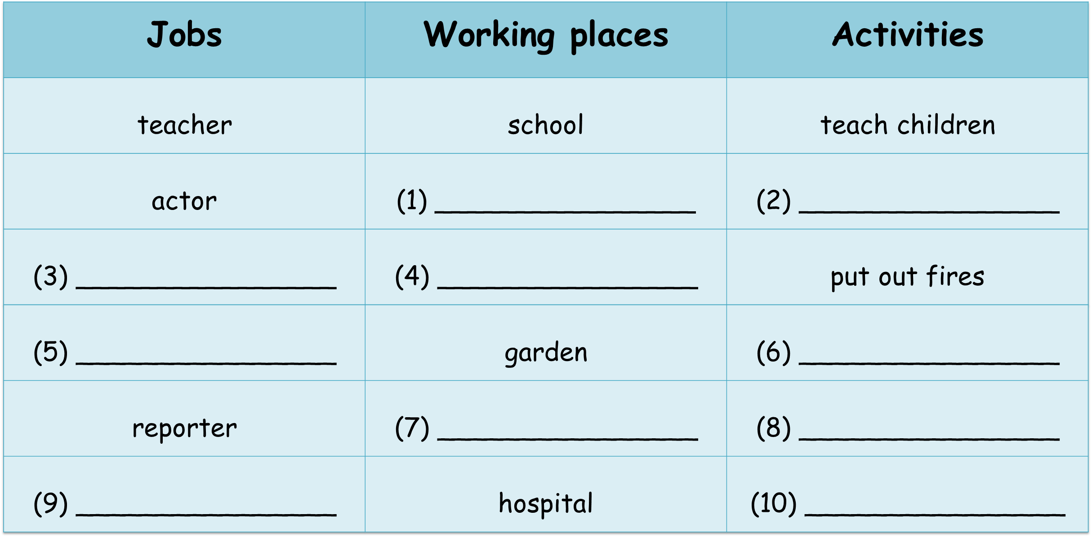
Complete the table about jobs
theatre
act and tell stories
firefighter
fire station
gardener
water the plants
office
report the news
doctor
help sick people

Slide 25
04
Activity 3
Work in groups. Talk about what you want to be in the future. Say why.

Slide 26


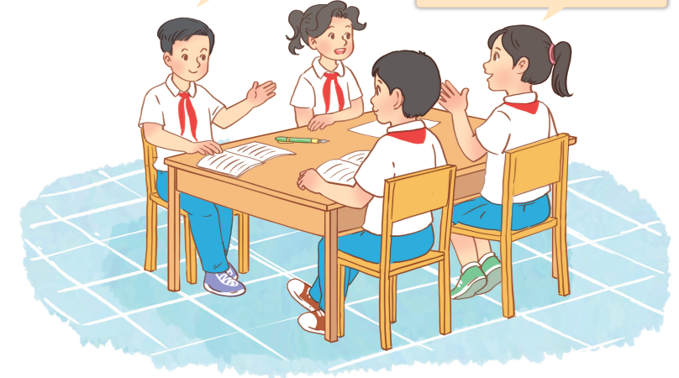
Work in groups. Talk about what you want to be in the future. Say why.
I want to be a teacher because _____.
I want to be _____ because _____.

Slide 27

Example
I’d like to teach children
I want to be a teacher because _____________________.
I want to be _____ because _____.

Slide 28
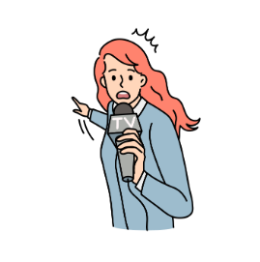
Example
a reporter
I’d like to report the news
I want to be ________ because _____________________.

Slide 29
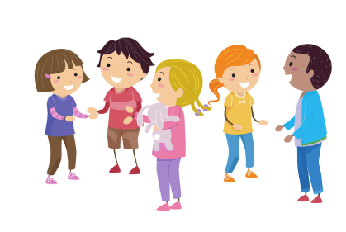
Work in groups.

Slide 30

05
Fun corner and Wrap-up.

Slide 31









Lucky numbers
Play

Slide 32











NEXT
Notes:
- Click the number to go to the Question slide.
- Click the BACK to return the game..

Slide 33




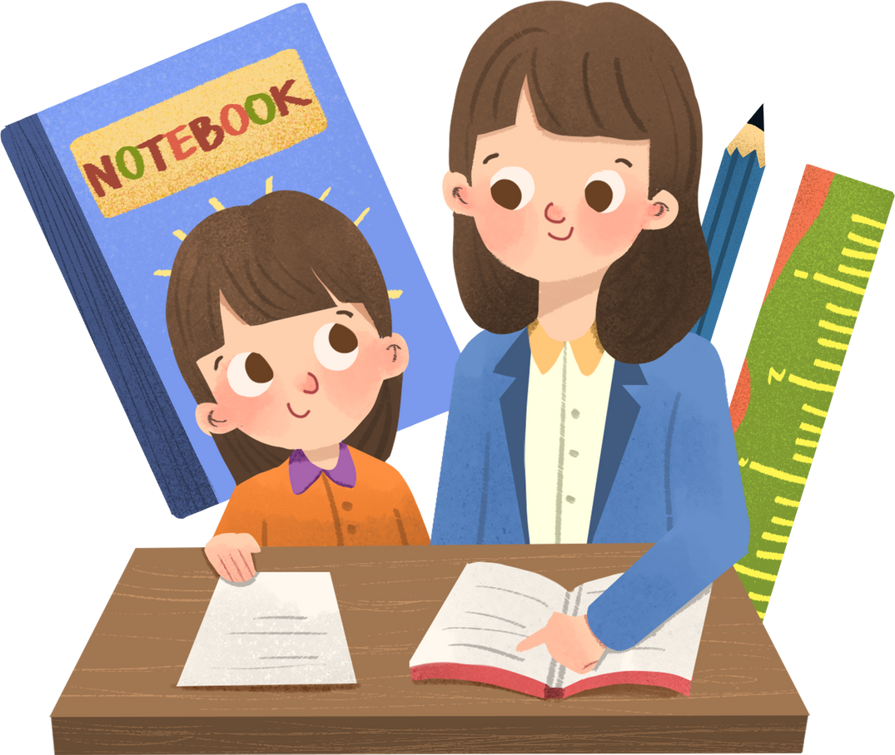


1
What would you like to be in the future?
a teacher
I’d like to be __________.

Slide 34




2
What would you like to be in the future?
a reporter
I’d like to be ____________.

Slide 35


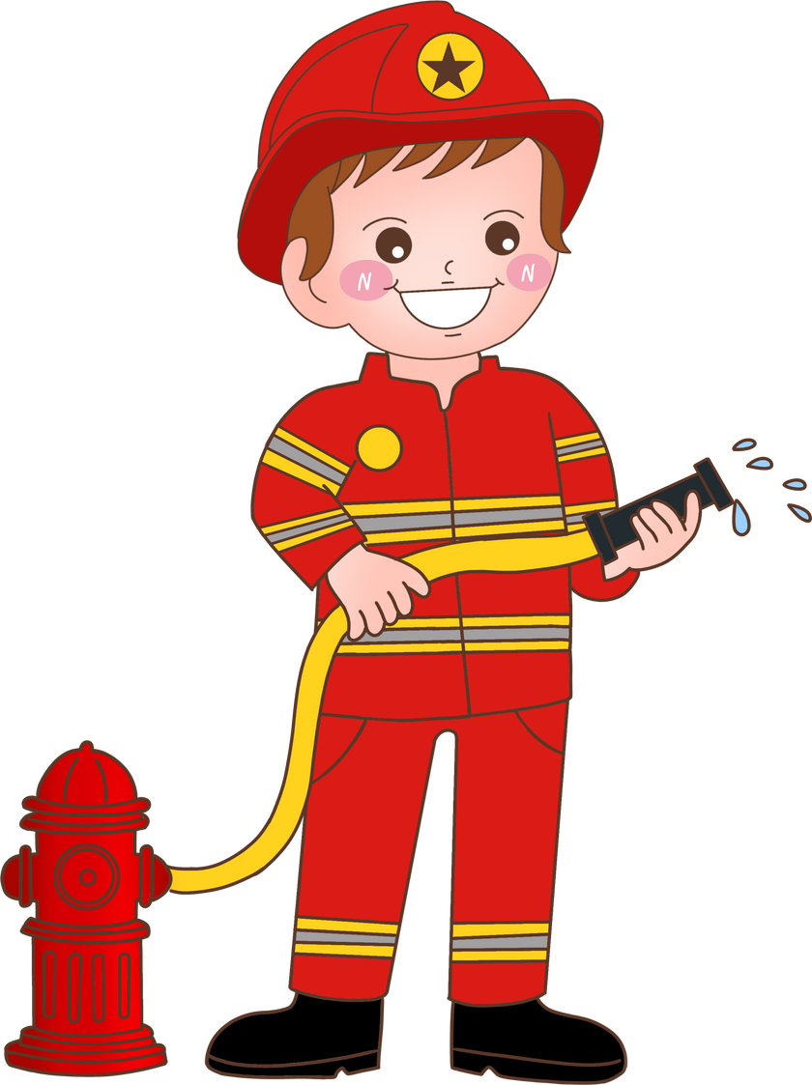

3
Why would you like to be a firefighter?
put out fires
Because I’d like to _______________.

Slide 36




4
Why would you like to be a teacher?
teach children
Because I’d like to be ________________.

Slide 37


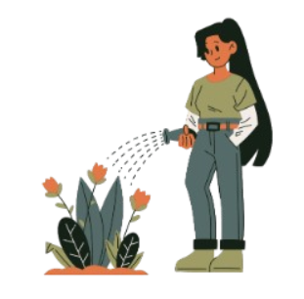

5
a gardener
I want to be ____________ because I’d like to ____________________.
water the flowers

Slide 38




6
a writer
I want to be ____________ because I’d like to ____________________.
tell stories

Slide 39

Notes:
- Click the number to go to the Question slide.
- Click the colored box to disappear the choice.

Slide 40
Website: hoclieu.vn
Fanpage: https://www.facebook.com/tienganhglobalsuccess.vn/

