Slide 1





Slide 2



My week
3
LESSON 3 PERIOD 6
SUNDAY
SUNDAY
MONDAY
TUESDAY
WEDNESDAY
THURSDAY
FRIDAY
SATURDAY

Slide 3
Table of contents
Warm-up and review
01
04
02
03
Project
Read and complete.
05
Fun corner
& wrap-up
Let’s write.

Slide 4
01
Warm-up

Slide 5
What day is it today?
It’s …
What do you do on …?
I go to school.
I study at school.
Notes:
…. the day…

Slide 6
02
Activity 4 Read and complete.

Slide 7
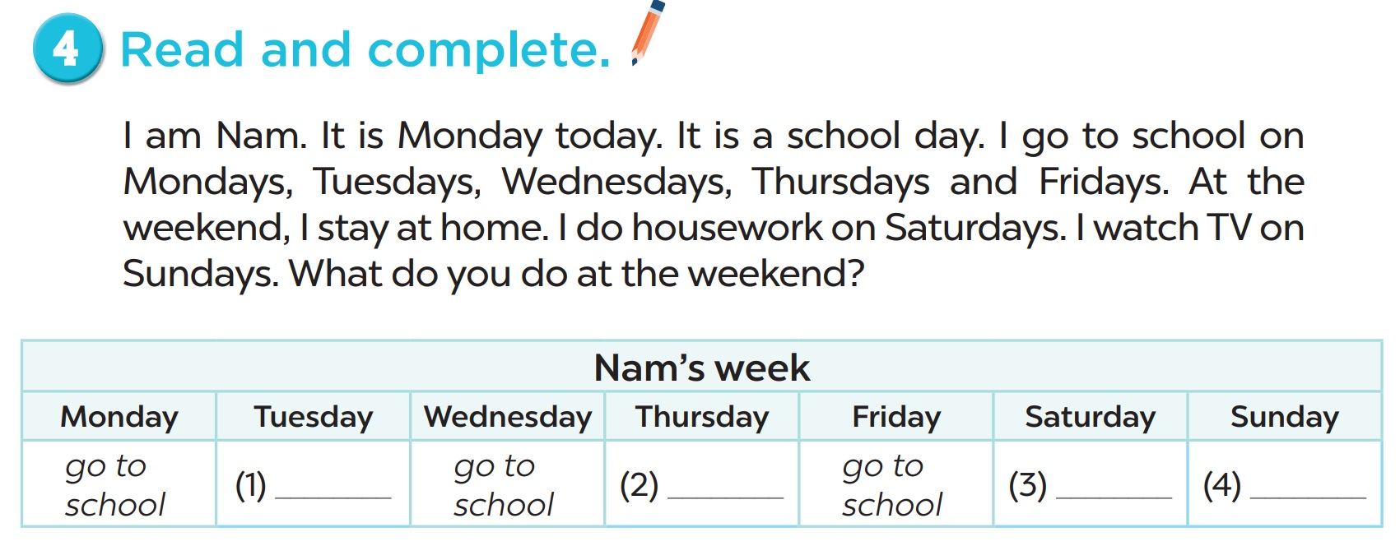

Slide 8
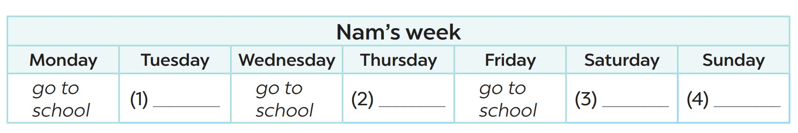
go to school
go to school
watch TV
do housework

Slide 9
I am………….., I go to school on……..…… I do housework on………..…… On Sundays, I……………..What do you do at the weekend?

Slide 10
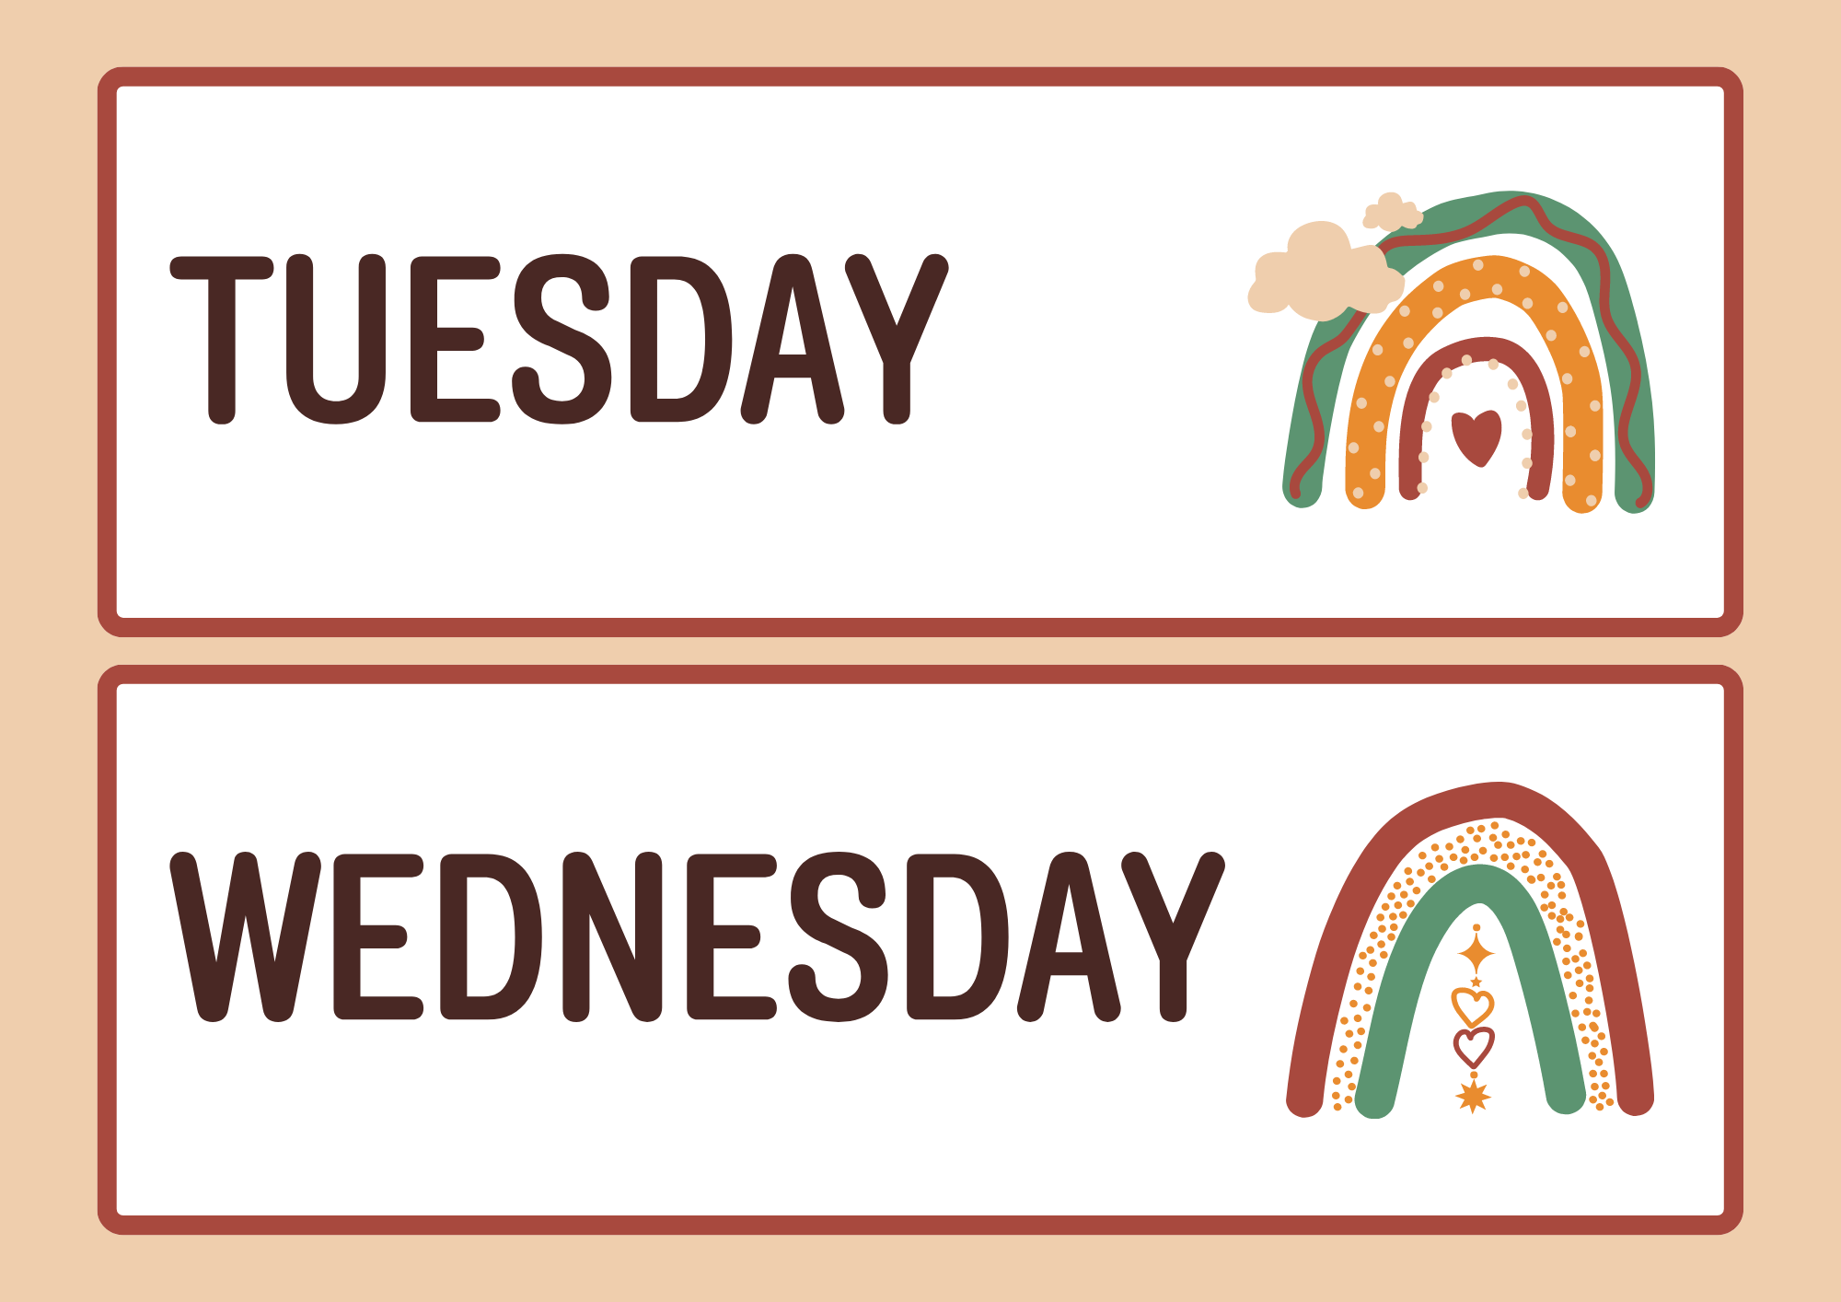

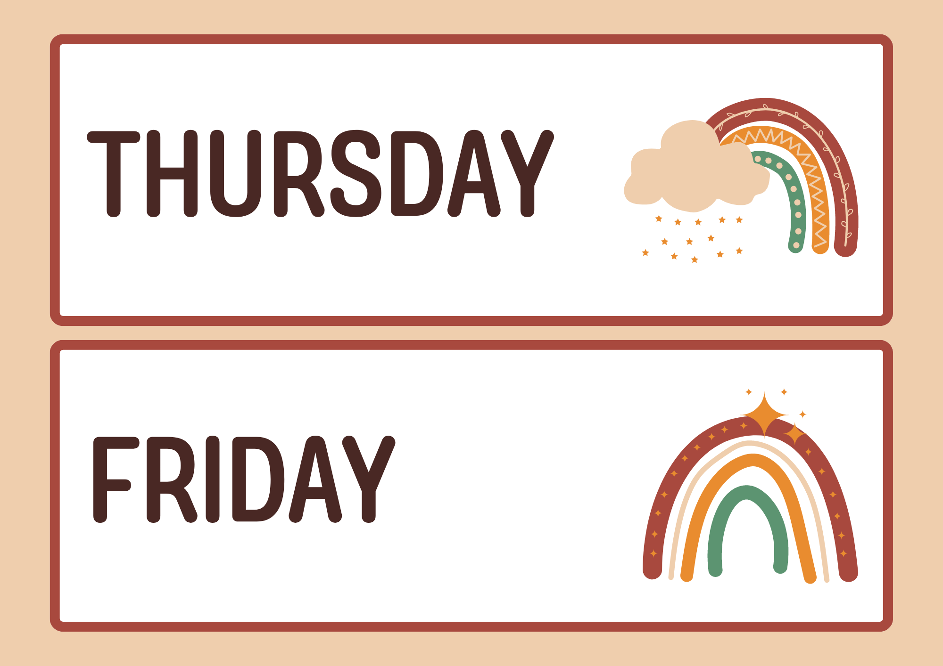

Slide 11
03
Activity 5 Let’s write.

Slide 12
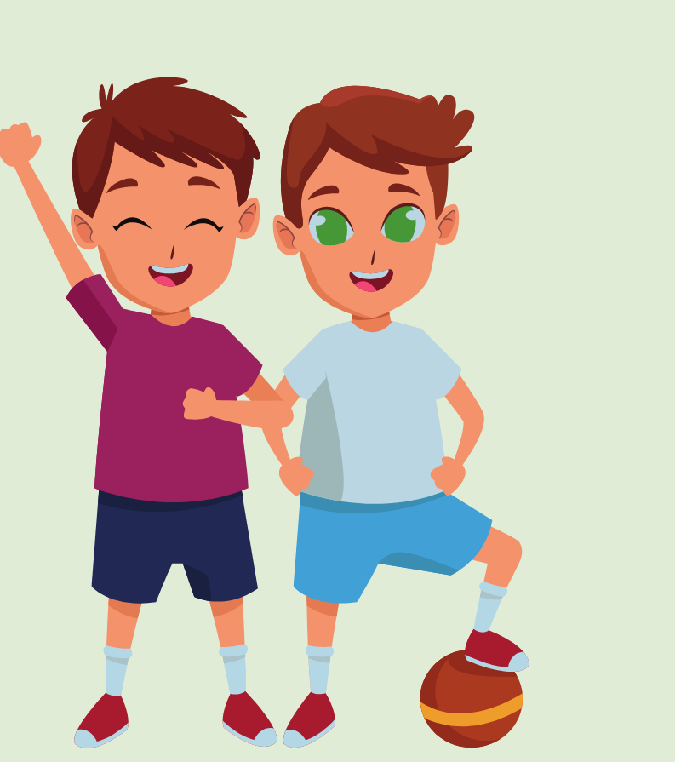

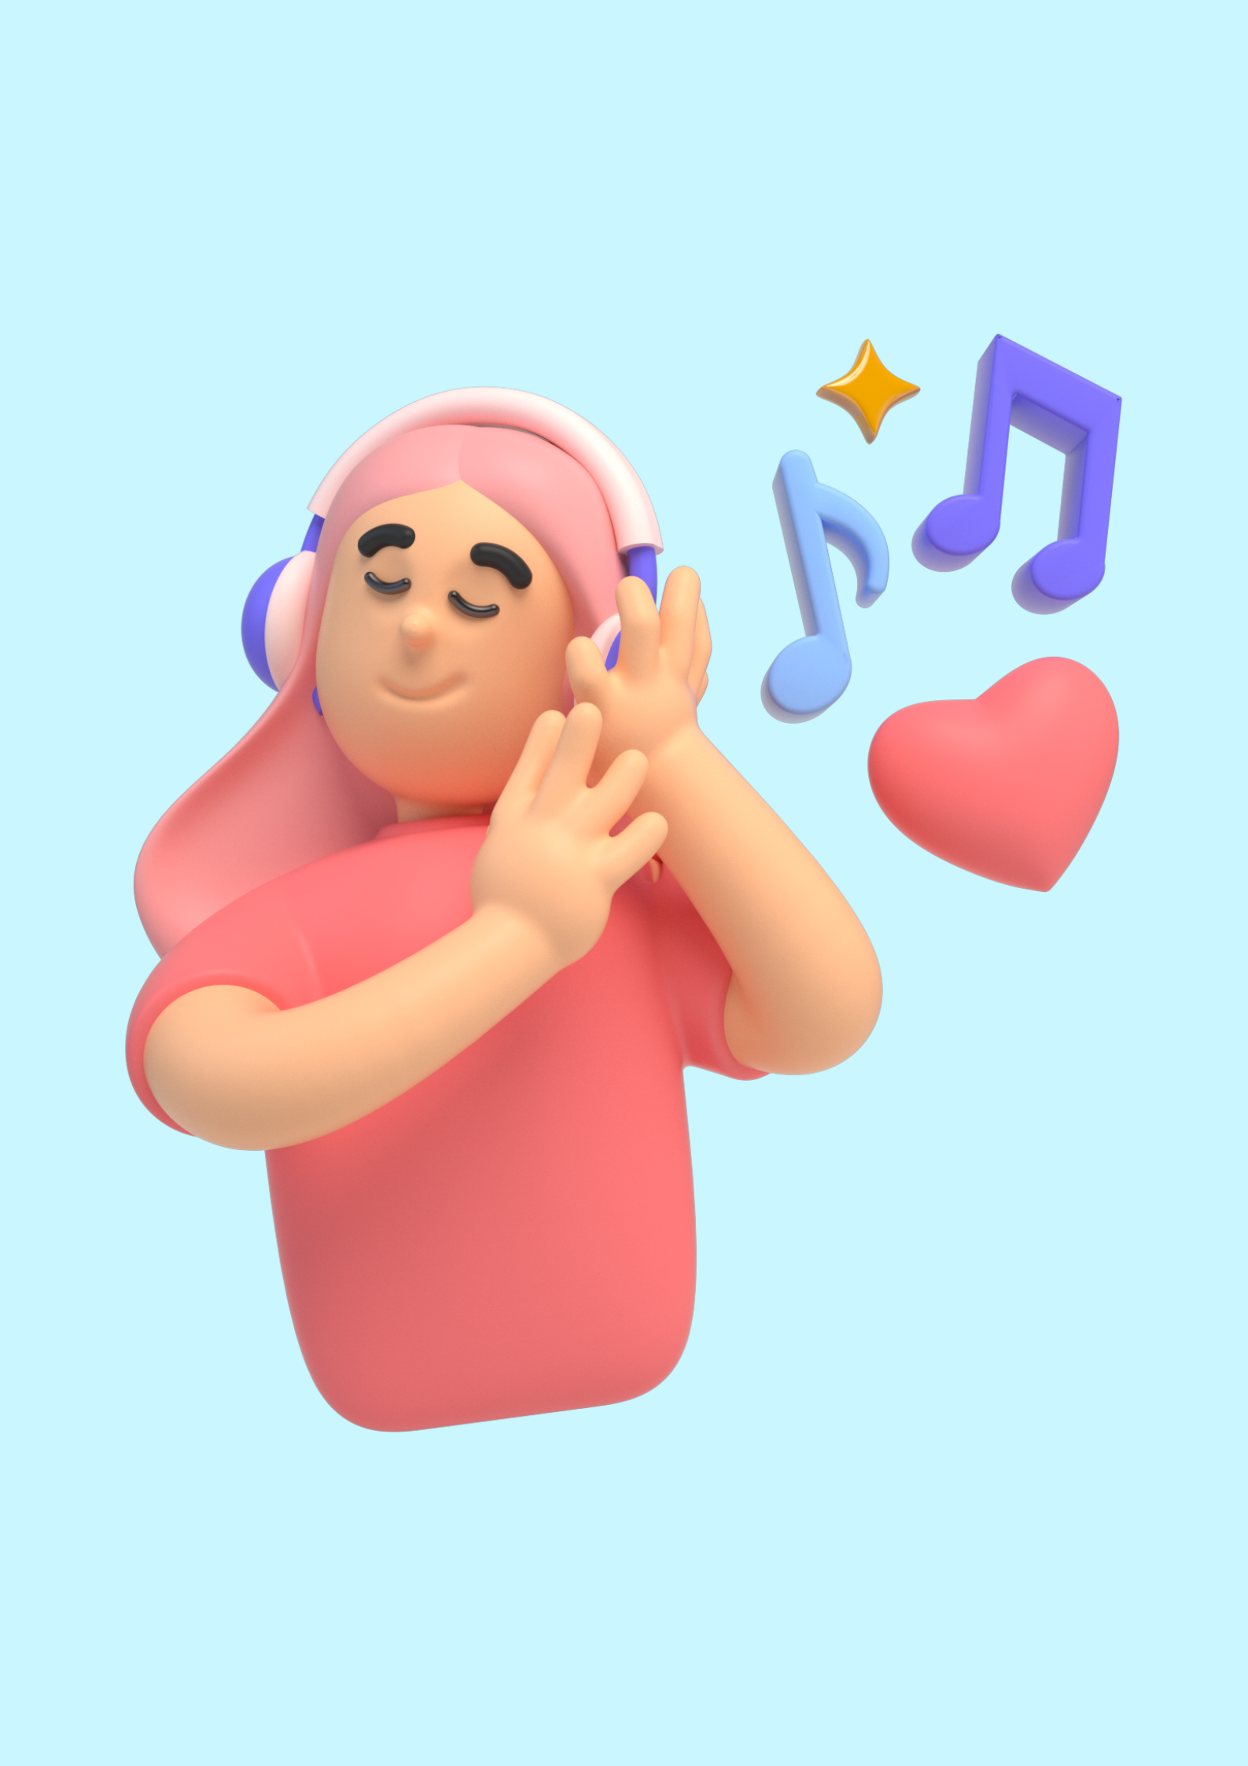

Slide 13
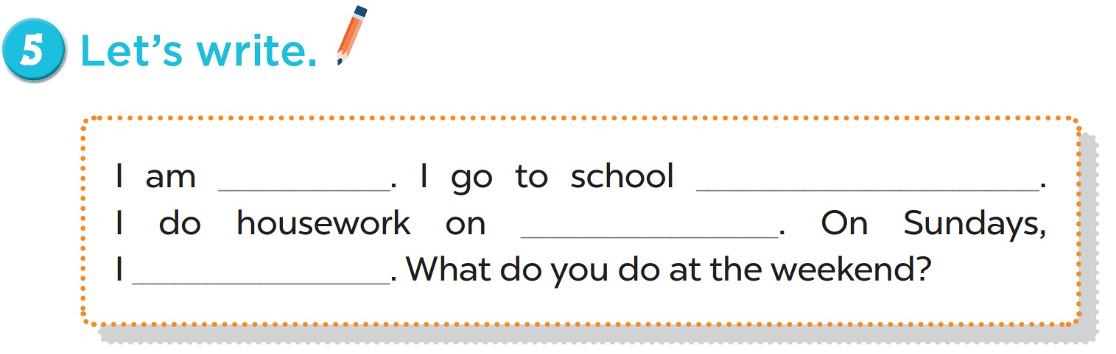

Slide 14
I am……Lan…….., I go to school on……Monday..…… I do housework on……Sunday…..…… On Sundays, I……listen to music………..What do you do at the weekend?

Slide 15
04
Activity 3 Project

Slide 16
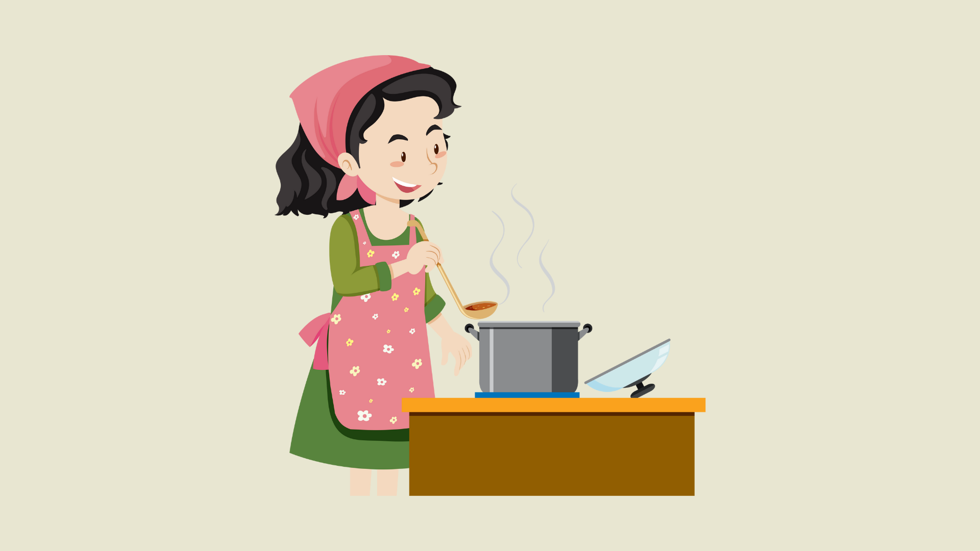

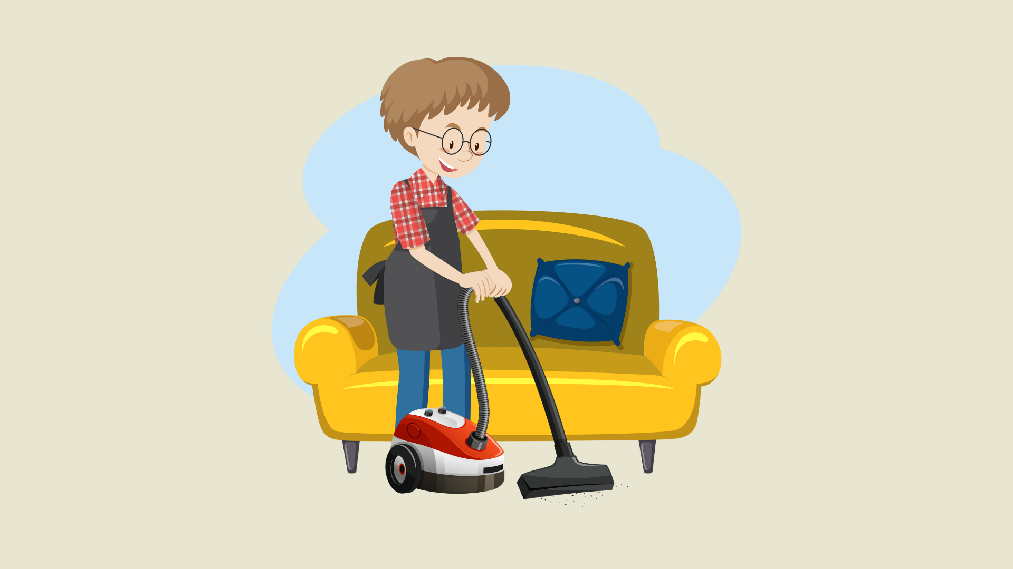

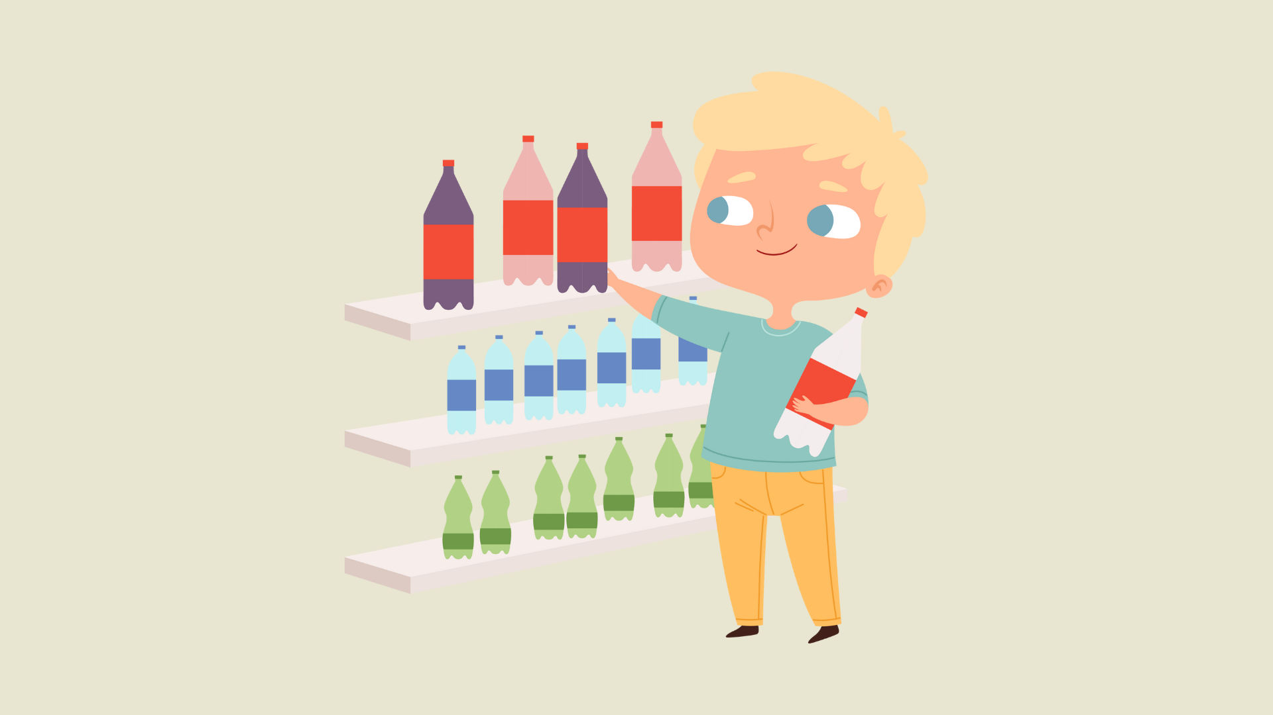
Notes:
Note: Teacher may use the pictures to help pupils review all the learnt words/ phrases before having them present their products.

Slide 17
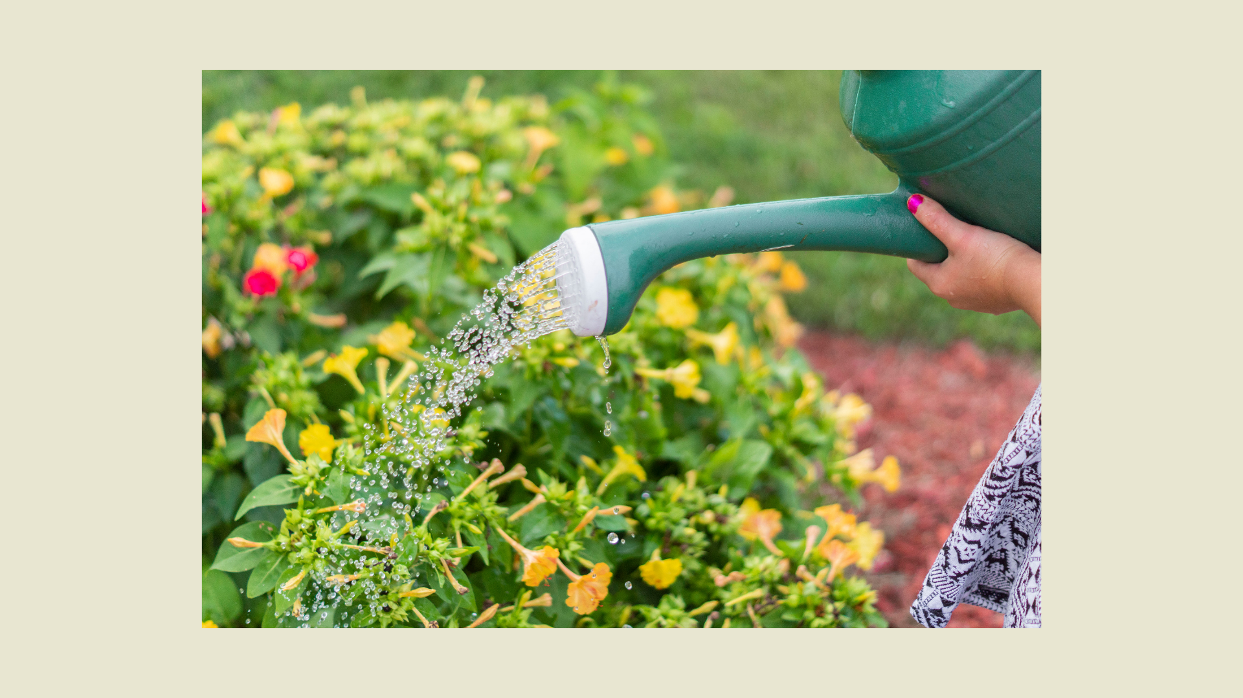
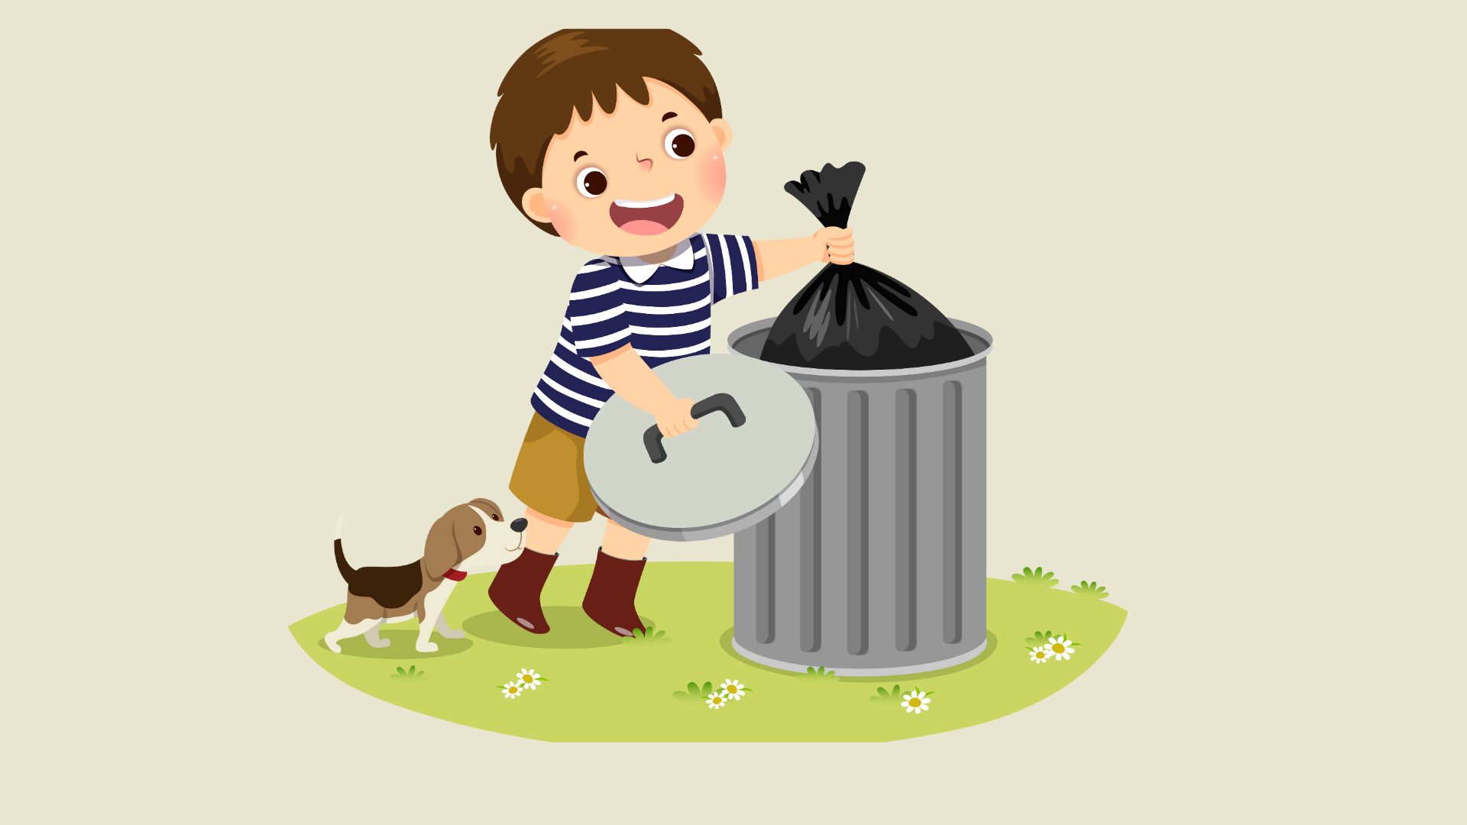
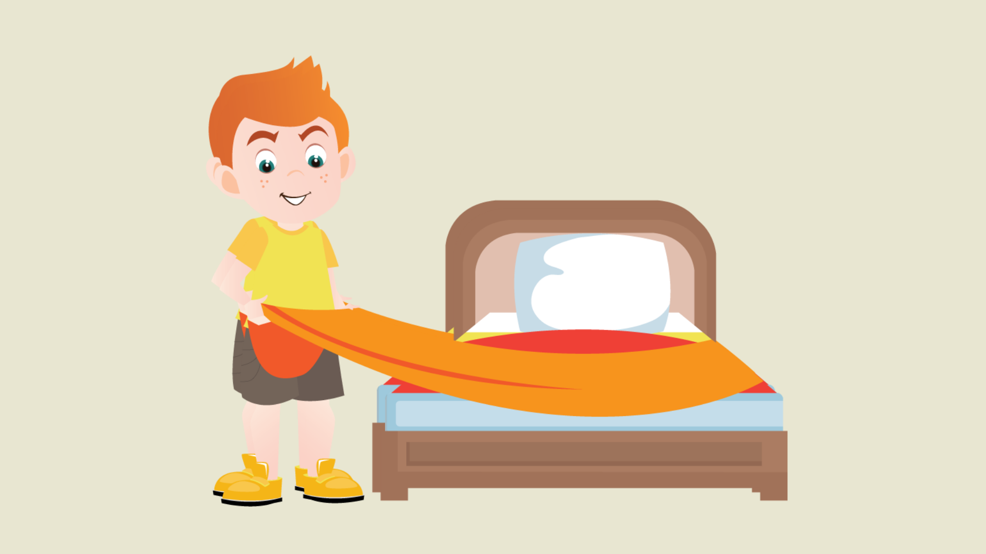

Slide 18

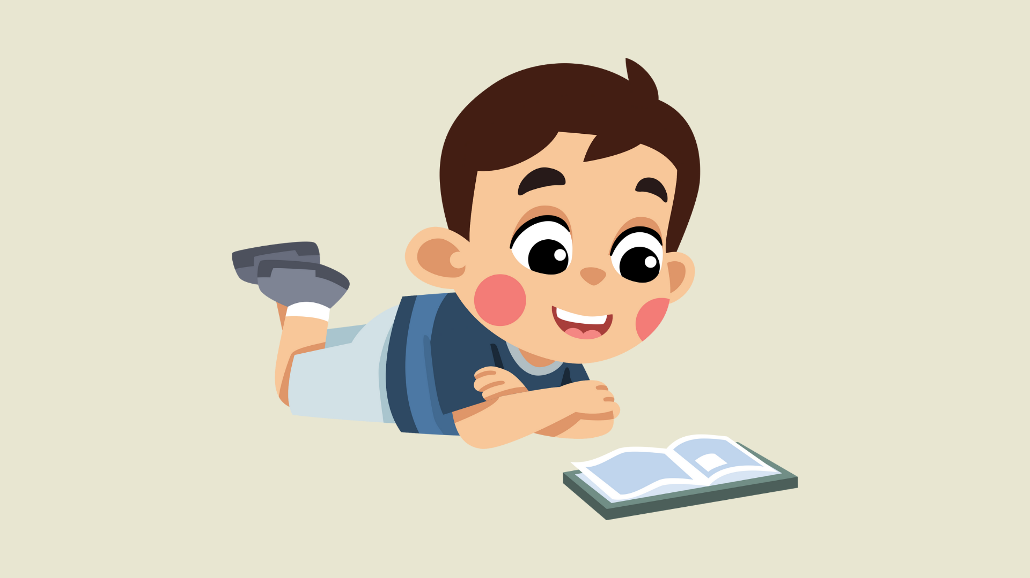

Slide 19
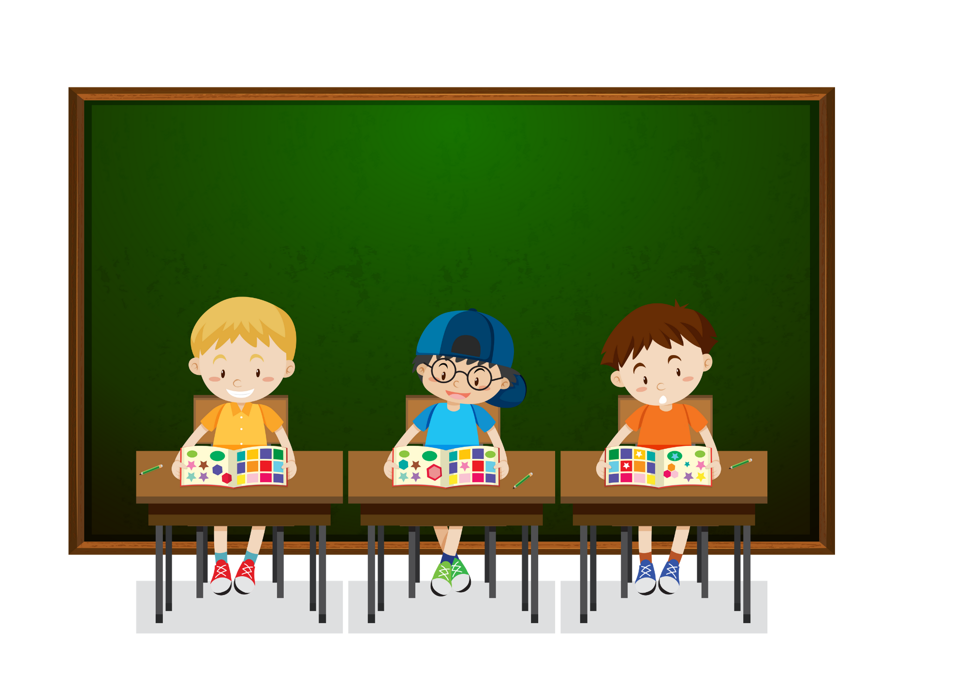
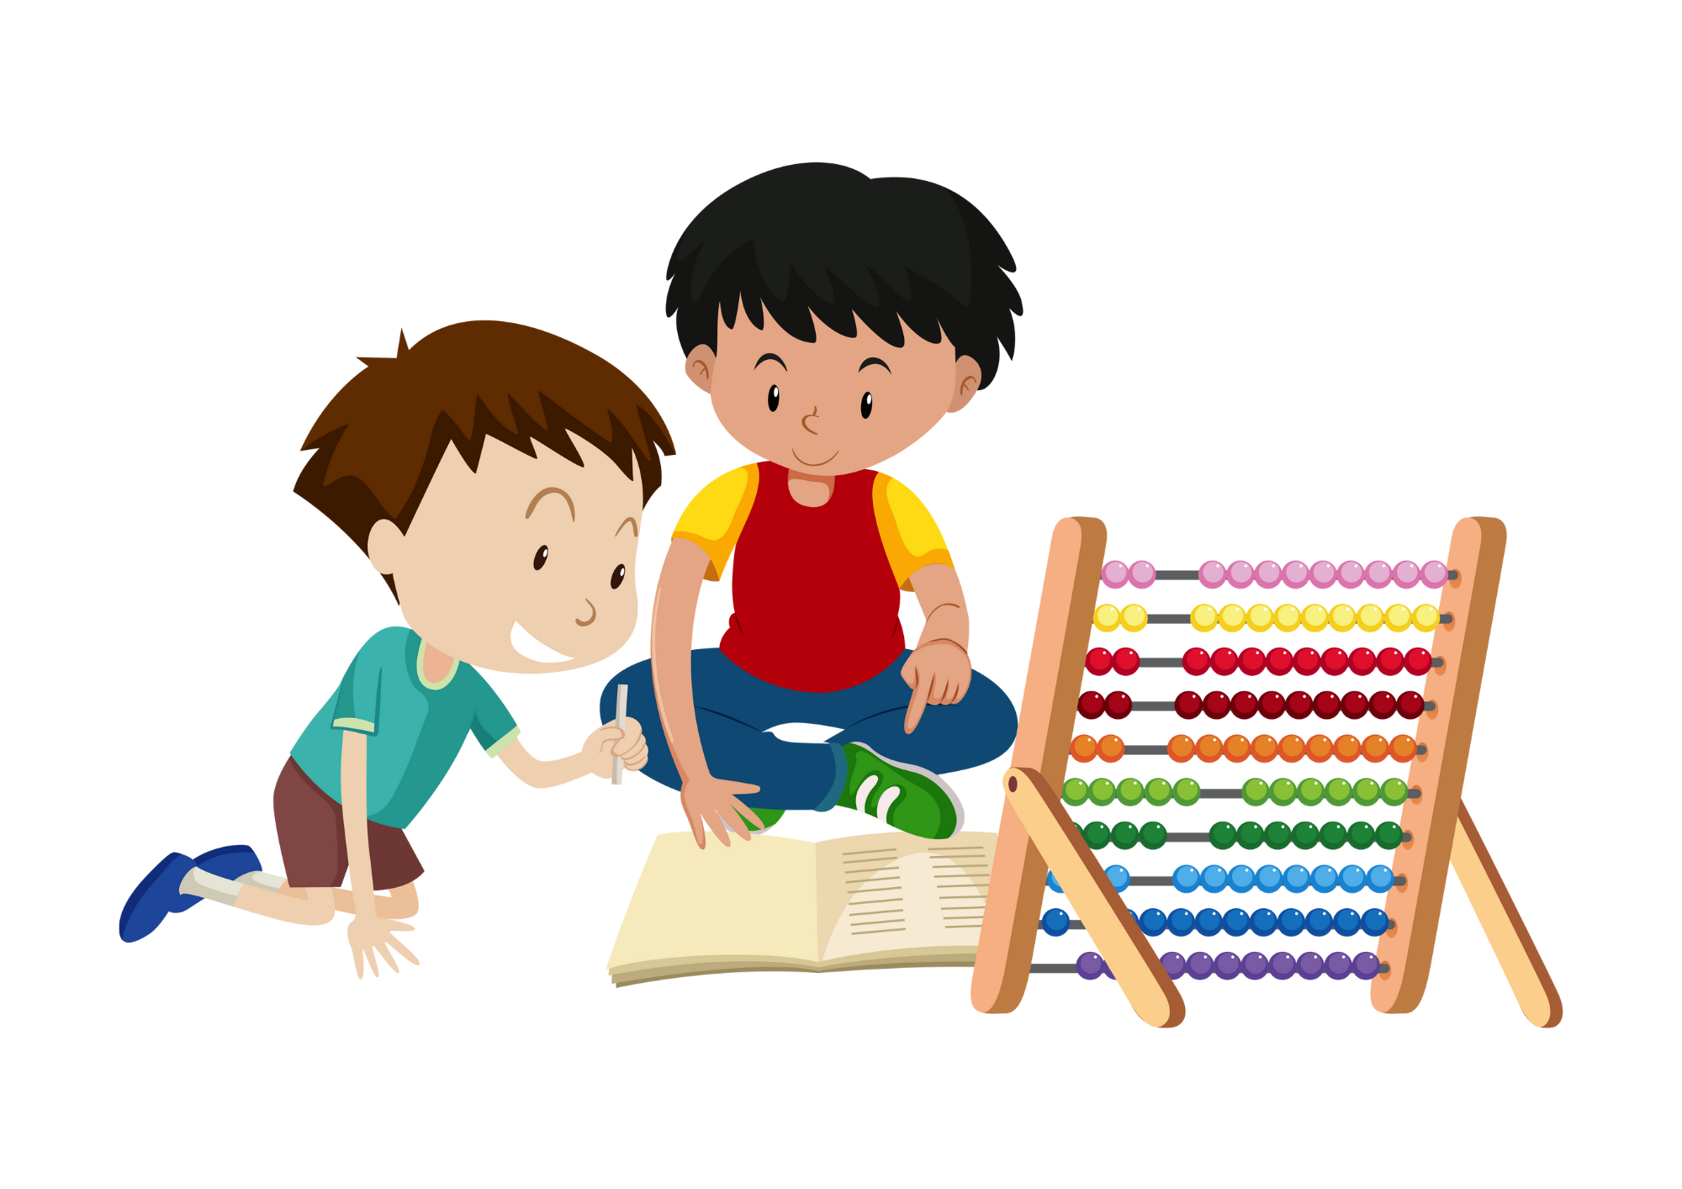
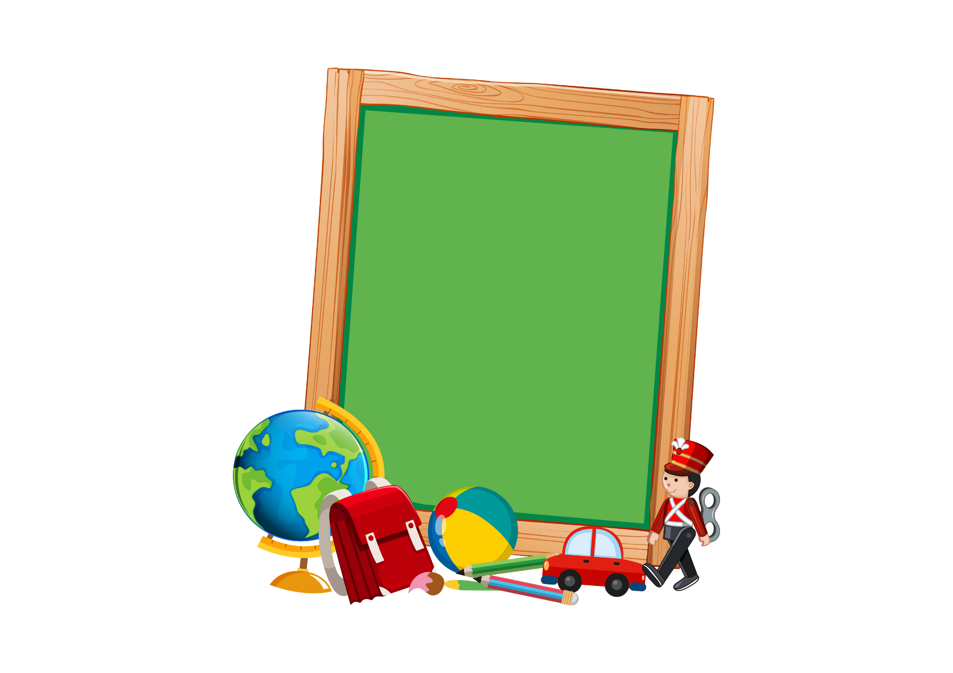


Slide 20



Slide 21


Slide 22

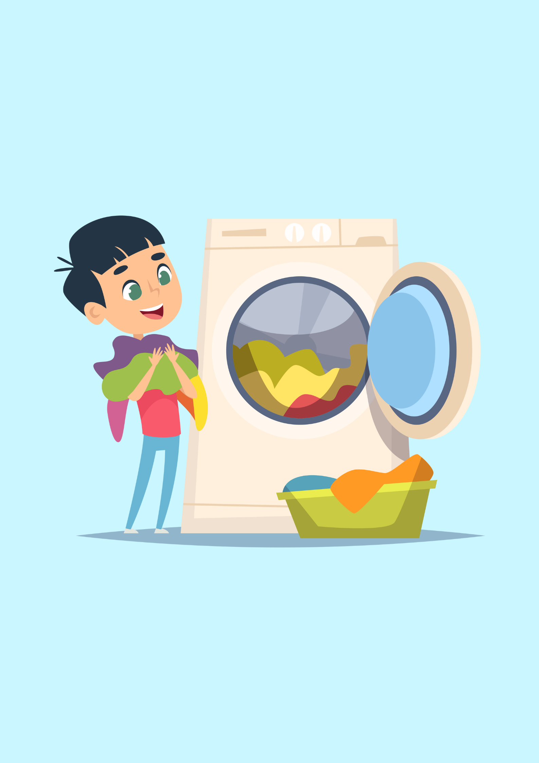
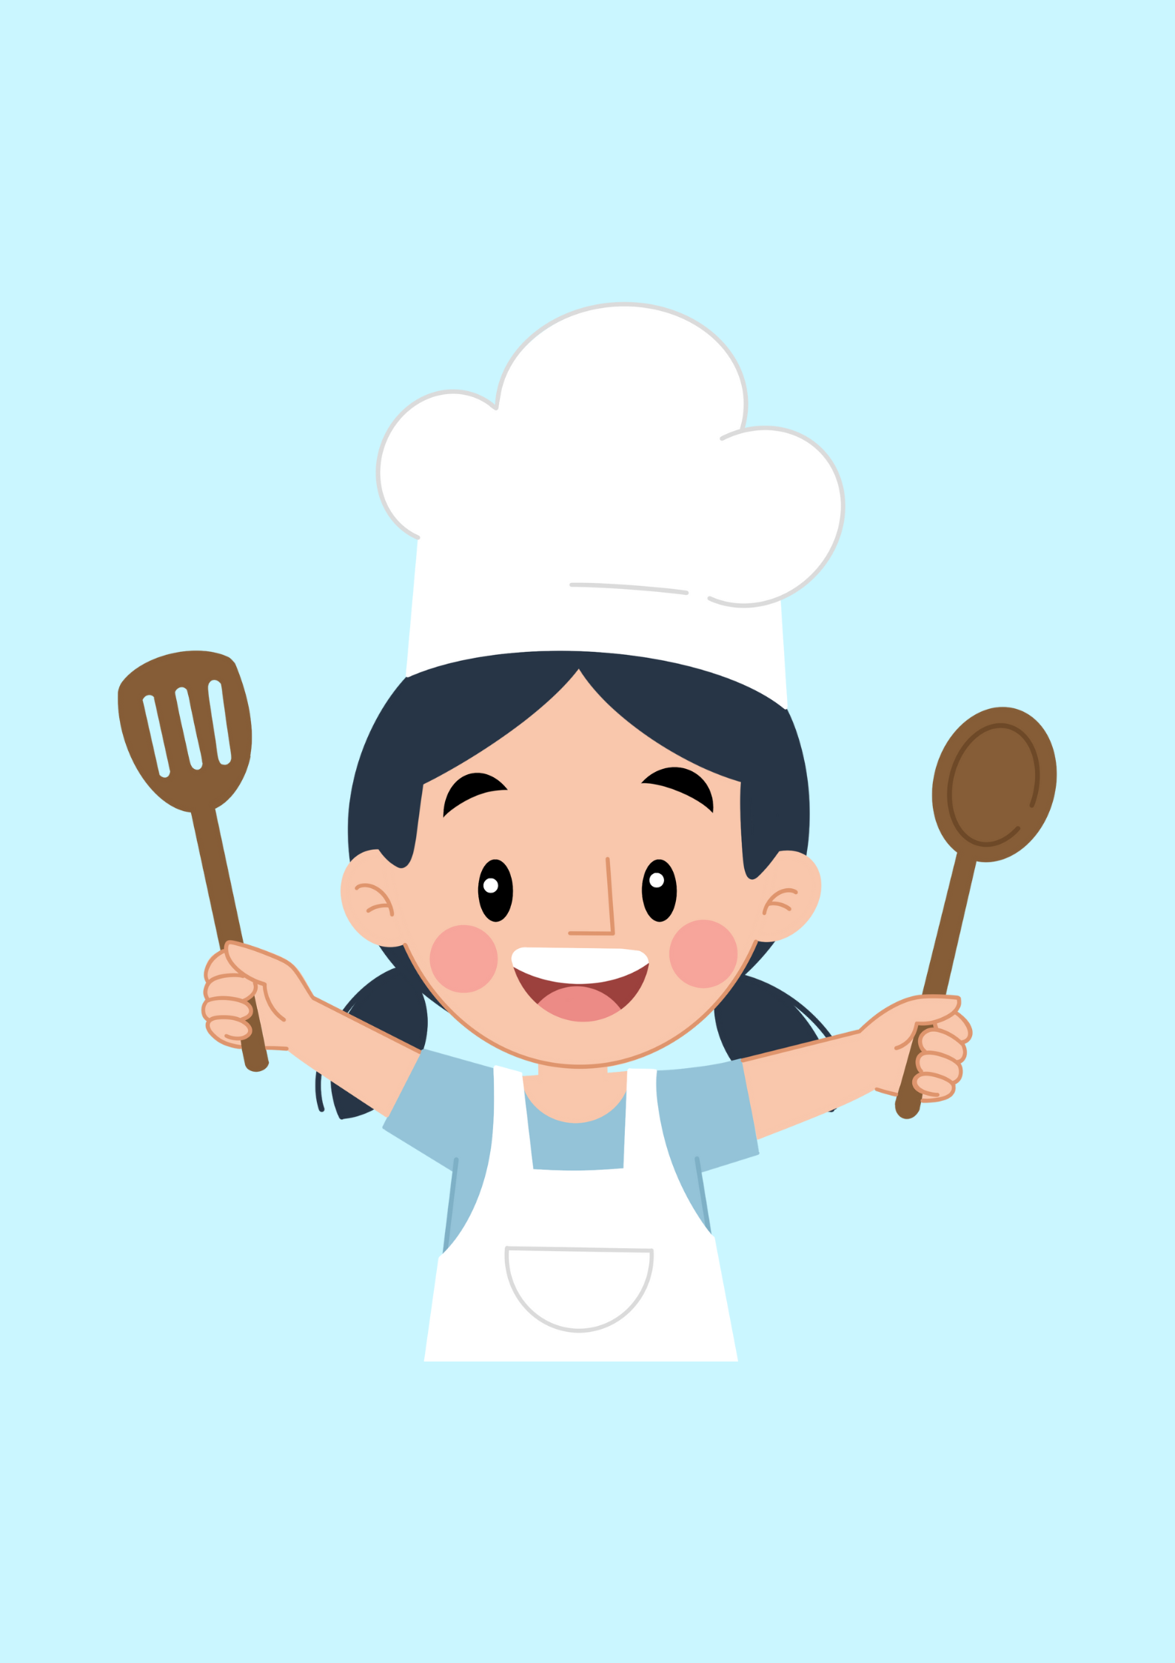


Slide 23
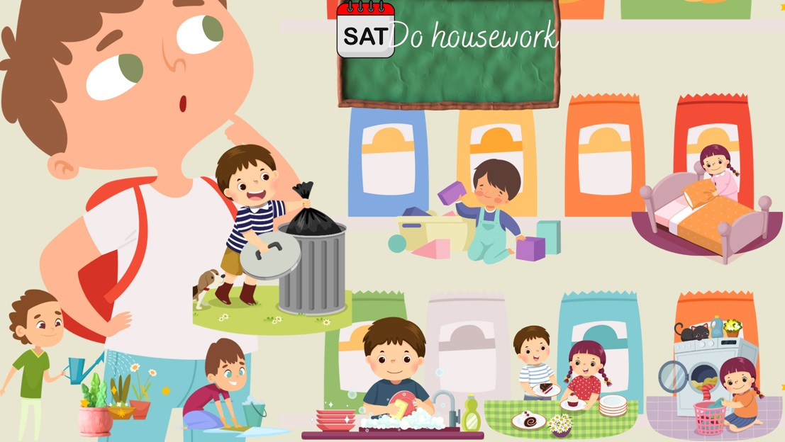

Slide 24
05
Fun corner & wrap-up

Slide 25
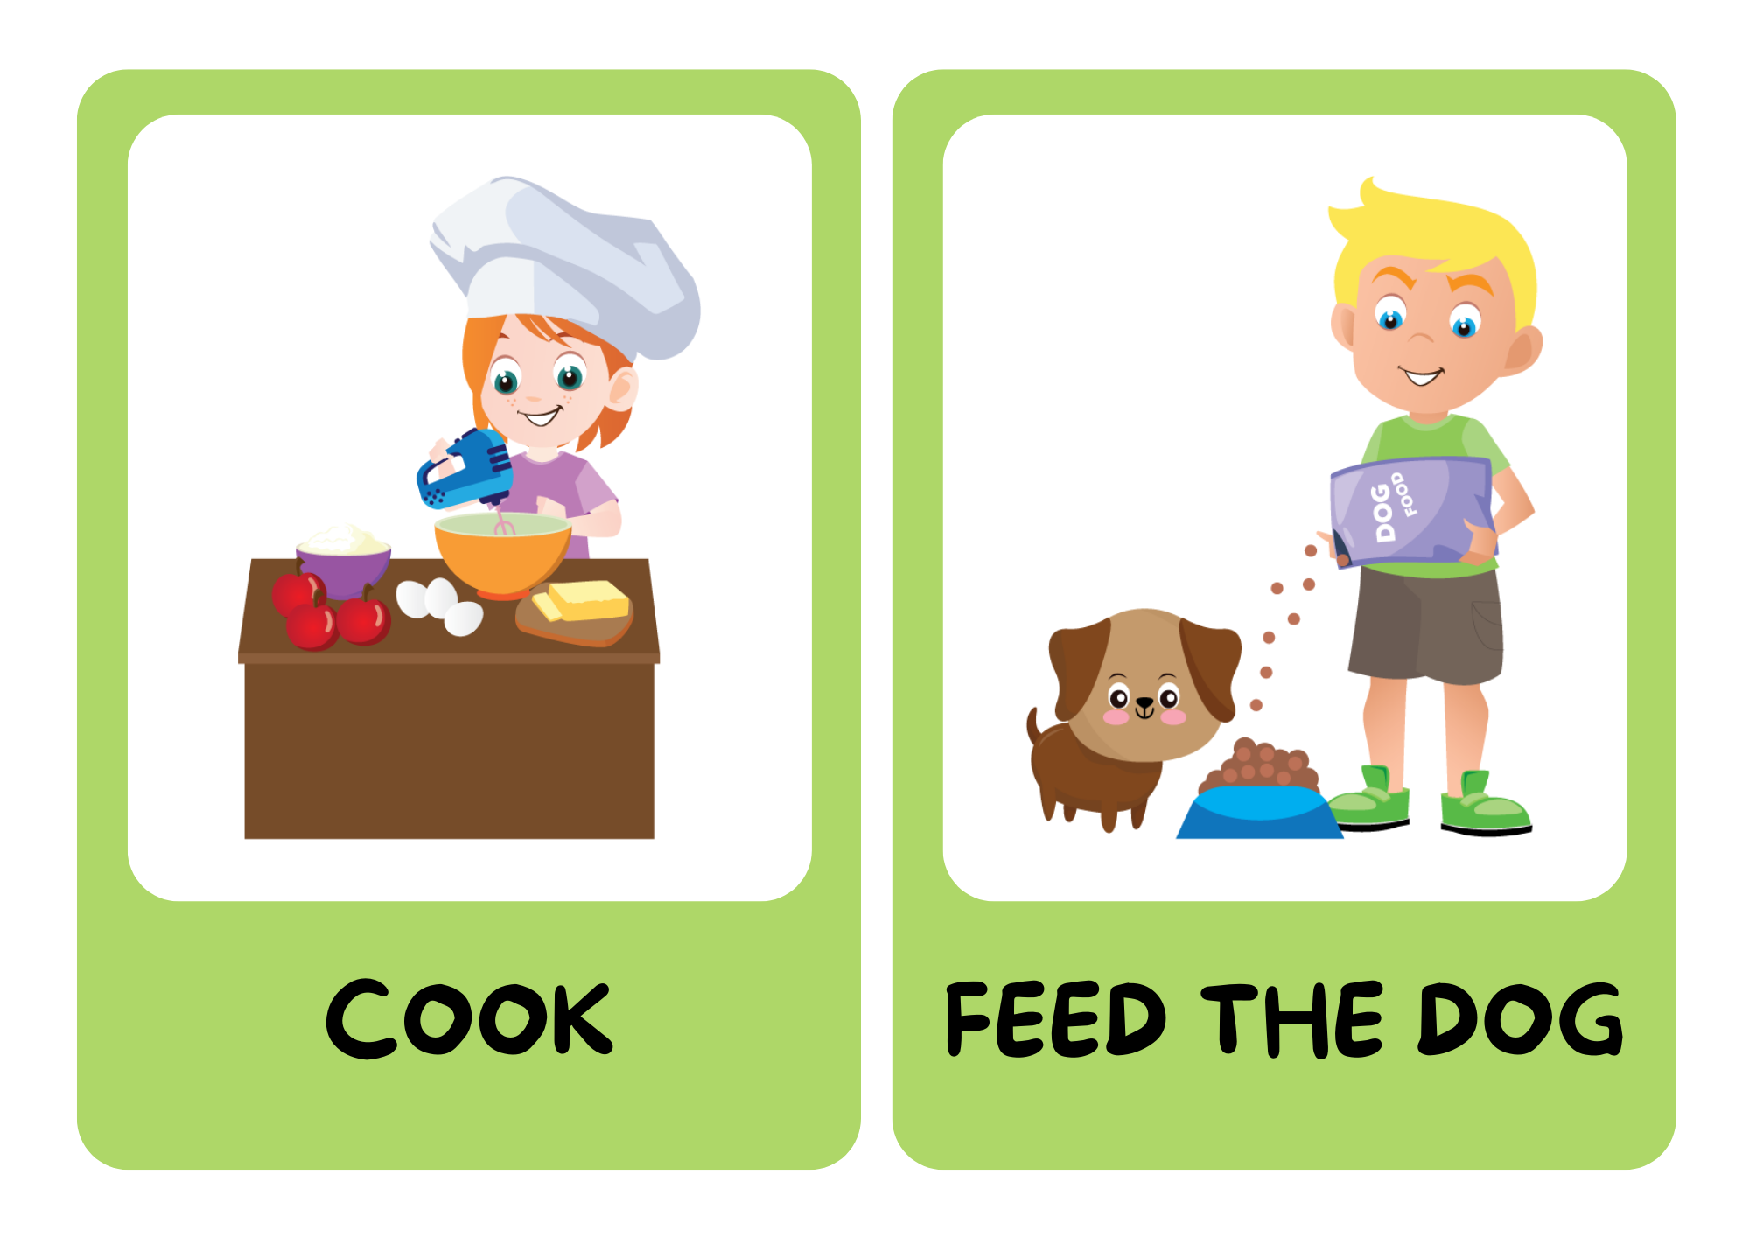

BE A CHANT COMPOSER!

Slide 26

BE A CHANT COMPOSER!
Music, music, music. I listen to music on Sundays.
Football, football, football. I play football on Sundays.
Notes:
listen to the chant to get the rythm
make their own chants

Slide 27
Fridays, Fridays, Fridays. What do you do on Fridays? I do housework on Fridays.
Notes:
give picture cues

Slide 28
Mondays, Mondays, Mondays. What do you do on Mondays? I do homework on Mondays.
Tuesdays, Tuesdays, Tuesdays. What do you do on Tuesdays? I do homework on Tuesdays.

