Slide 1





Slide 2



My week
3
LESSON 3 - PERIOD 5
SUNDAY
SUNDAY
MONDAY
TUESDAY
WEDNESDAY
THURSDAY
FRIDAY
SATURDAY

Slide 3
Table of contents
01
Warm-up
04
02
03
Let’s chant.
Listen and repeat.
05
Fun corner
& wrap-up
Listen and circle.

Slide 4
01
Warm-up

Slide 5
What day is it today?
It’s Monday.

Slide 6
What day is it today?
Tuesday
Wednesday
Monday
Friday
Thursday
Saturday
Sunday
Notes:
quick Q-A

Slide 7
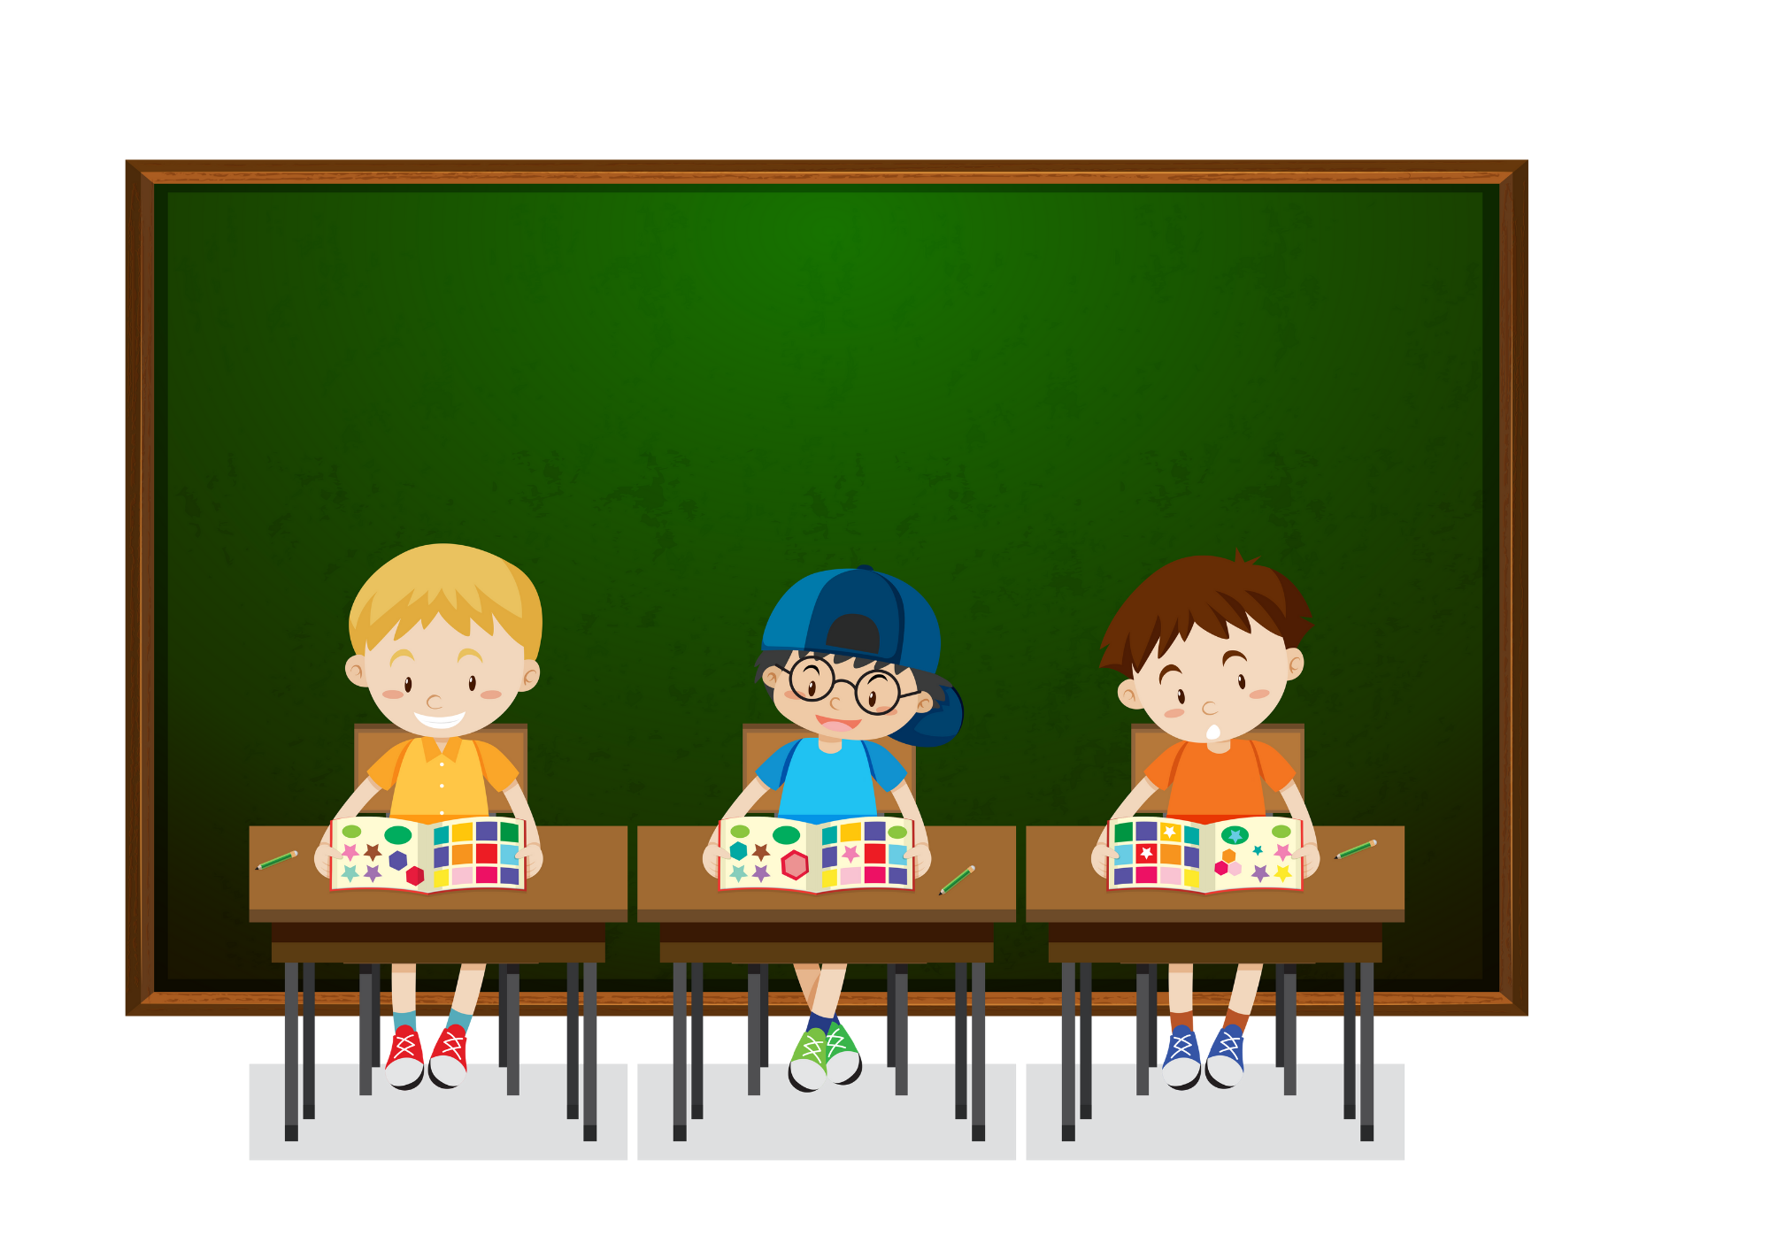
WHAT DO YOU DO ON MONDAYS?
I STUDY AT SCHOOL.

Slide 8
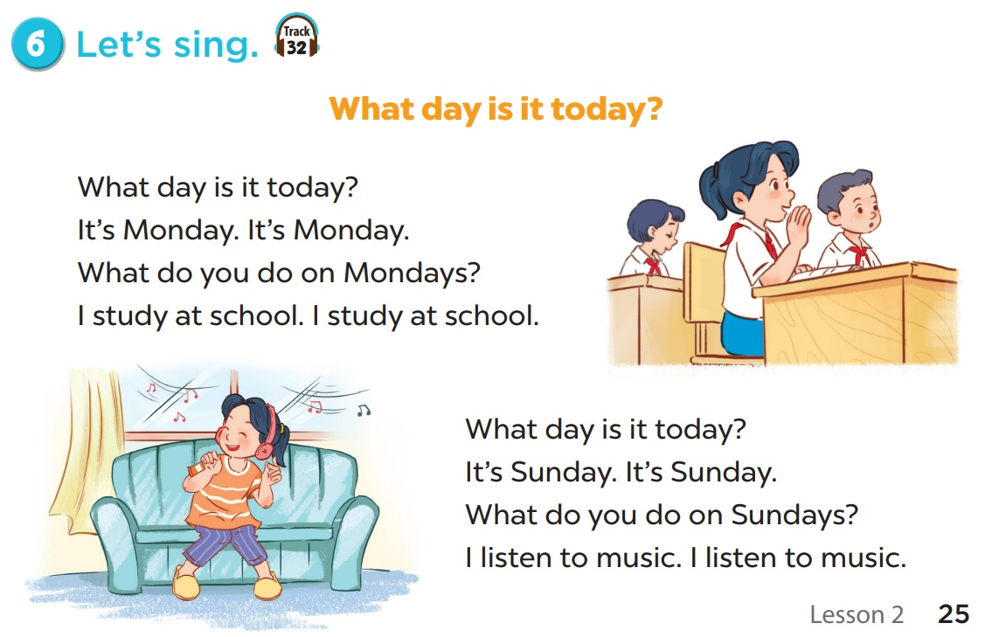

Let’s sing together!

Slide 9
02
Activity 1
Listen and repeat.

Slide 10
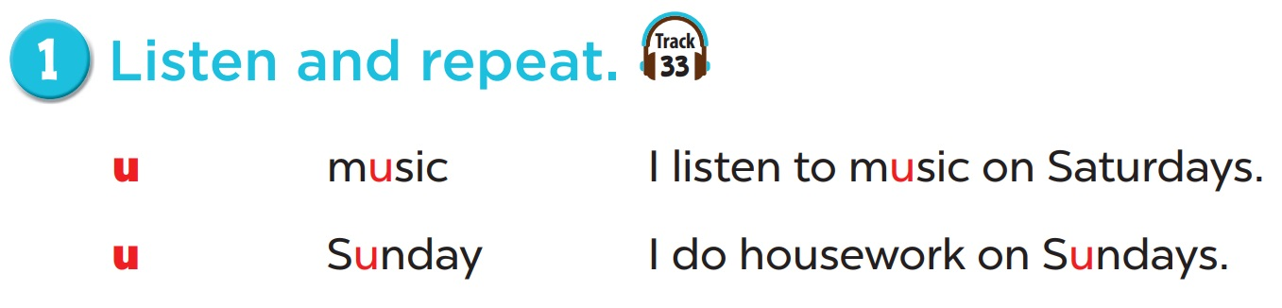

Slide 11
03
Activity 2
Listen and circle.

Slide 12
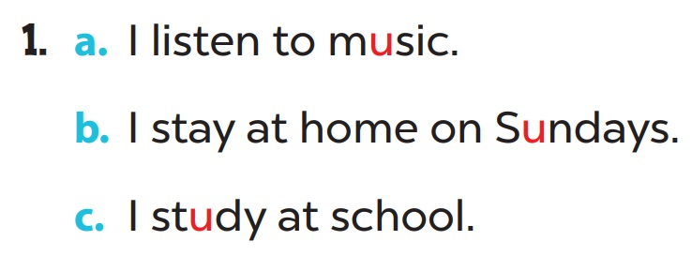

Slide 13
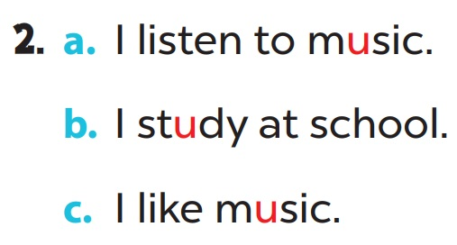

Slide 14
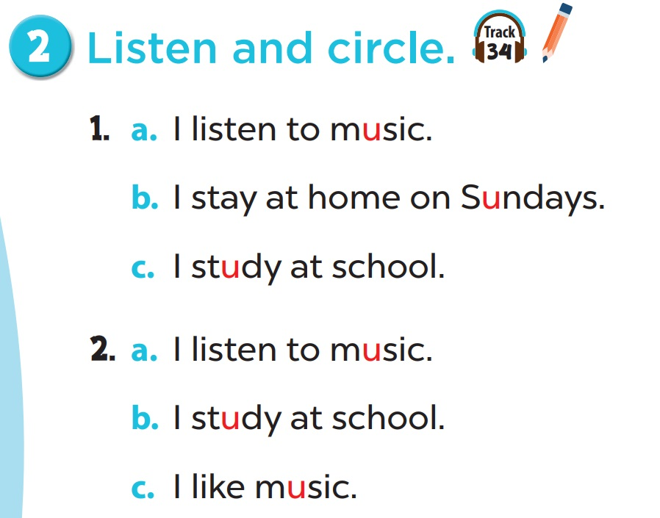

Slide 15
04
Activity 3
Let’s chant.

Slide 16
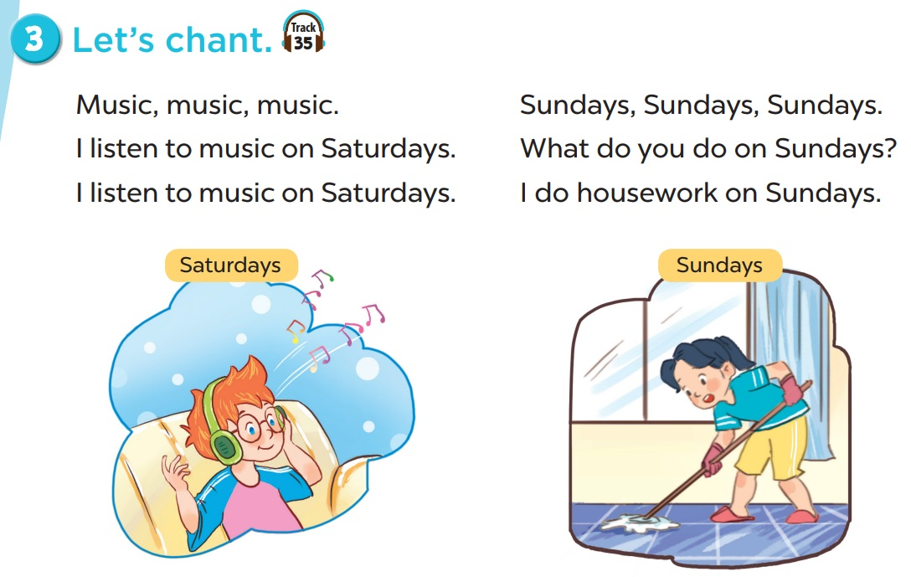

Slide 17
05
Fun corner & wrap-up

Slide 18
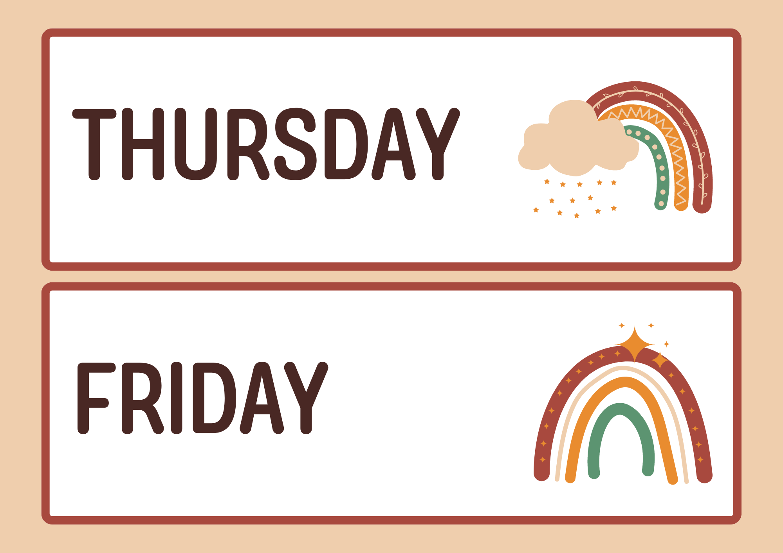
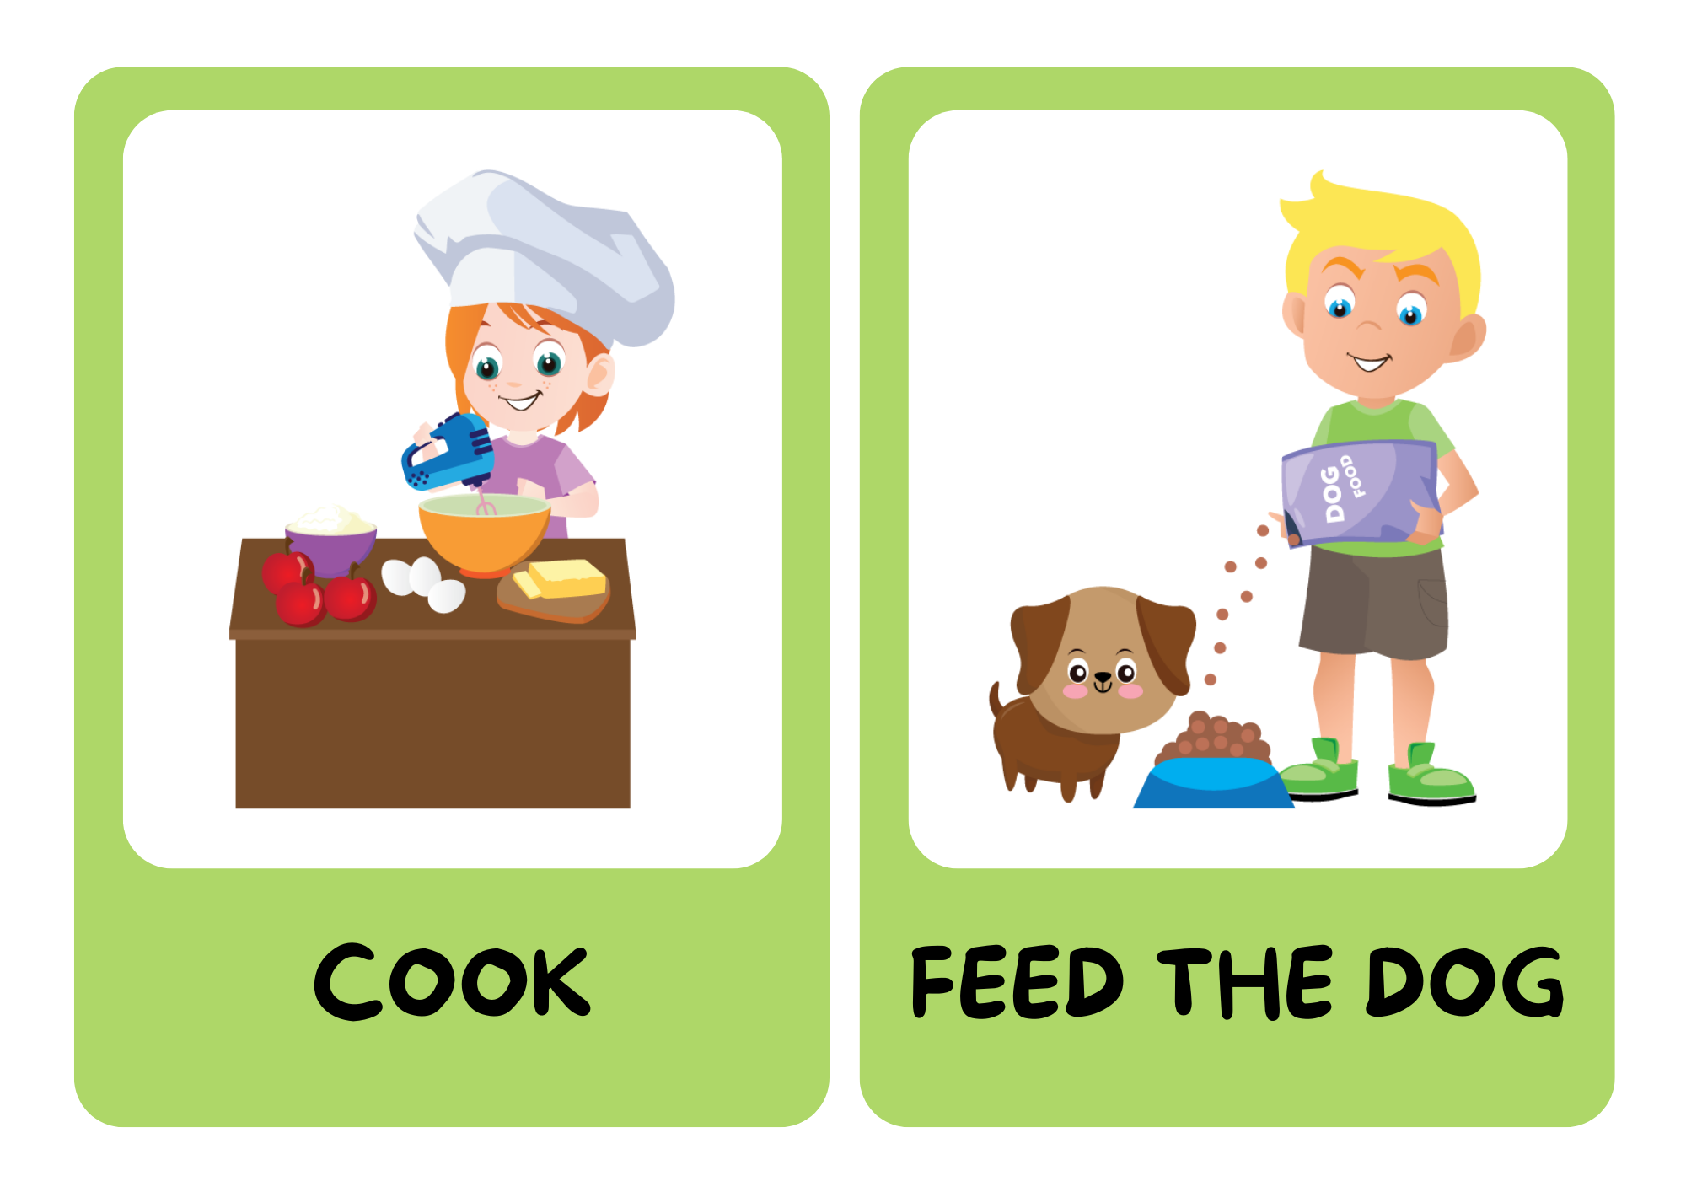

Be a chant composer!

Slide 19
BE A CHANT COMPOSER!
Music, music, music.
I listen to music on Thursdays.
Notes:
look at the pictures
say out loud
combine pictures to make a new chant

Slide 20
Fridays, Fridays, Fridays.
What do you do on Fridays?
I do housework on Fridays.

Slide 21
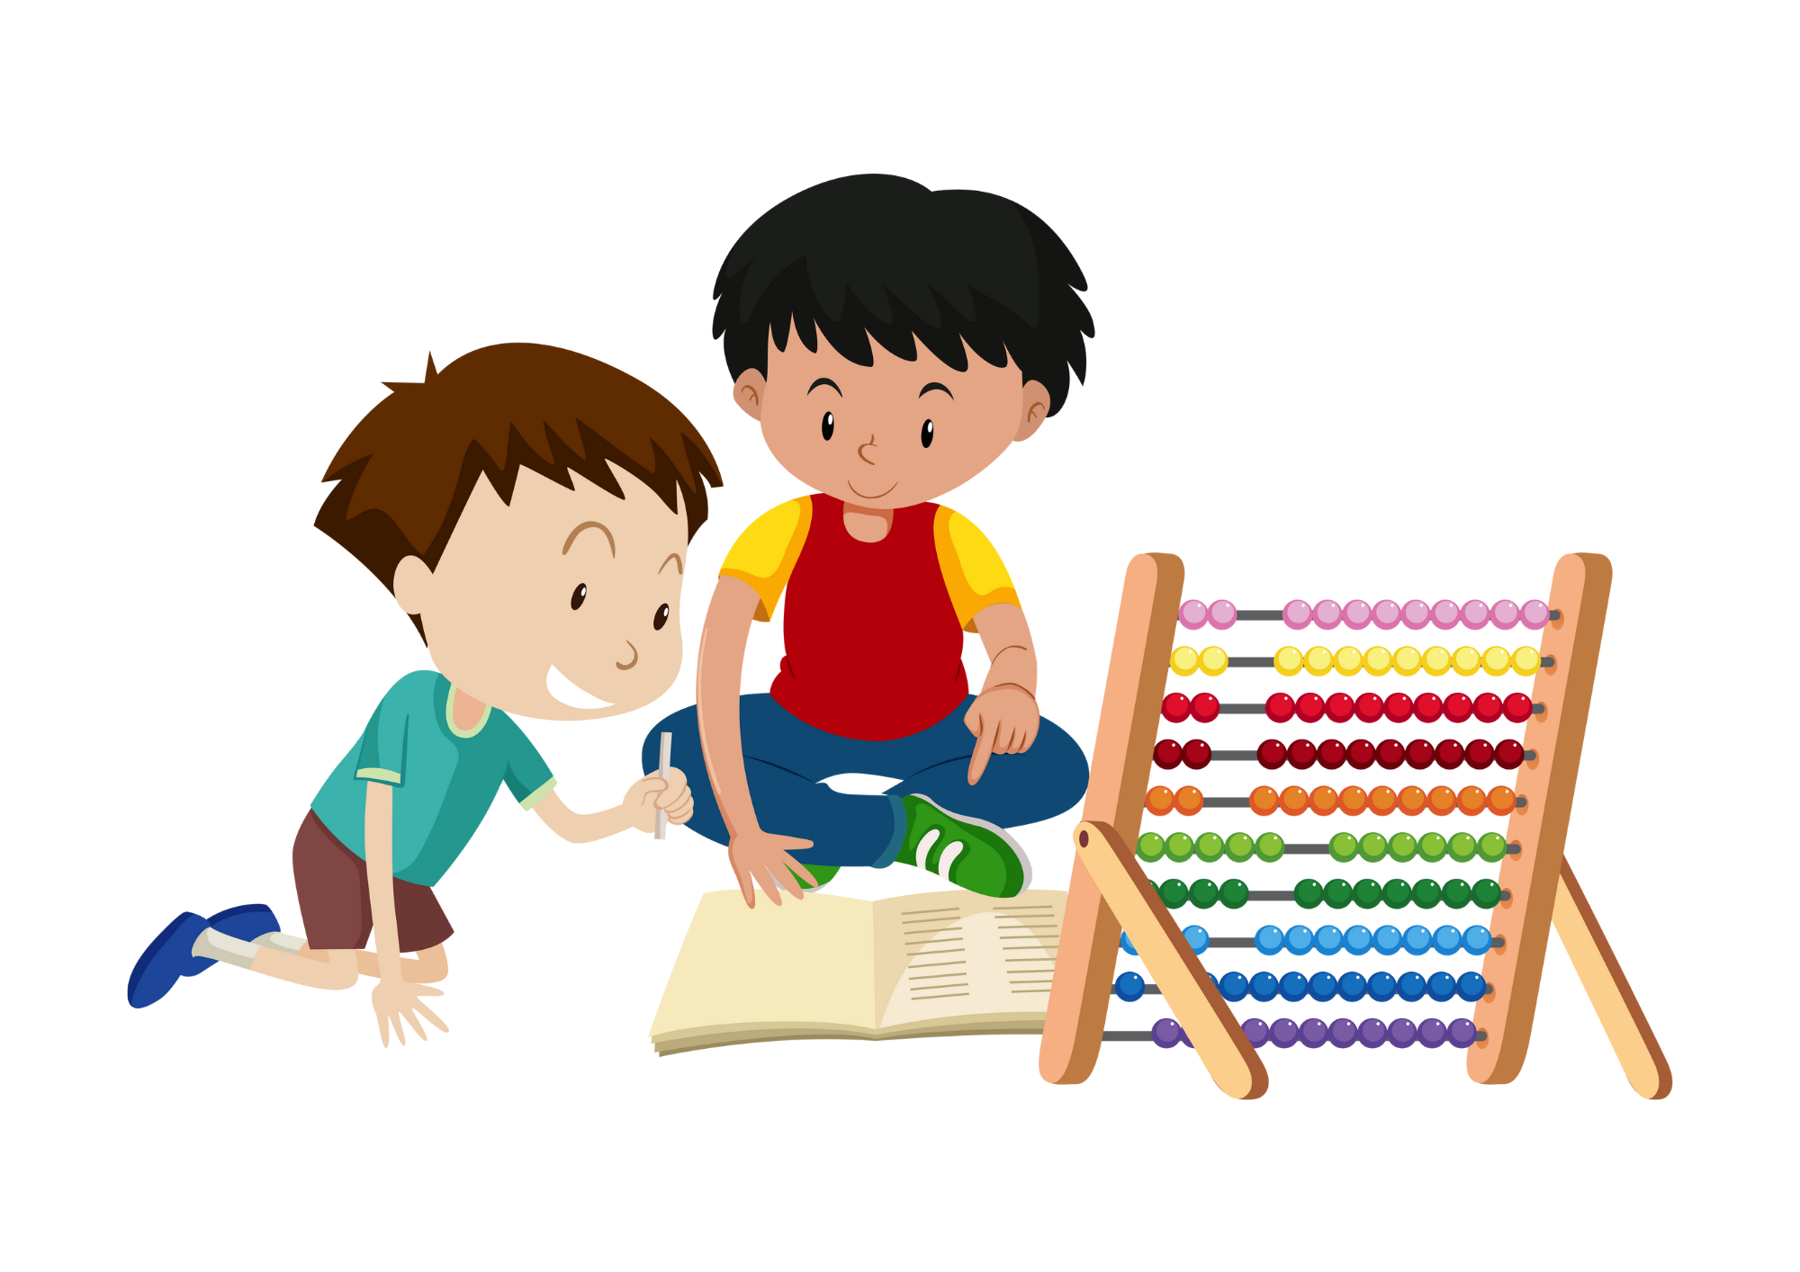
Mondays, Mondays, Mondays.
What do you do on Mondays?
I do homework on Mondays.

