Slide 2





REVIEW 1
Period 2

Slide 3


Table of contents
01
Warm-up and Review
02
Activity 3: Read and match.
03
Activity 4: Read and complete.
05
Fun corner and Wrap-up
04
Activity 5: Let’s write.

Slide 4





01
Warm-up and Review

Slide 5





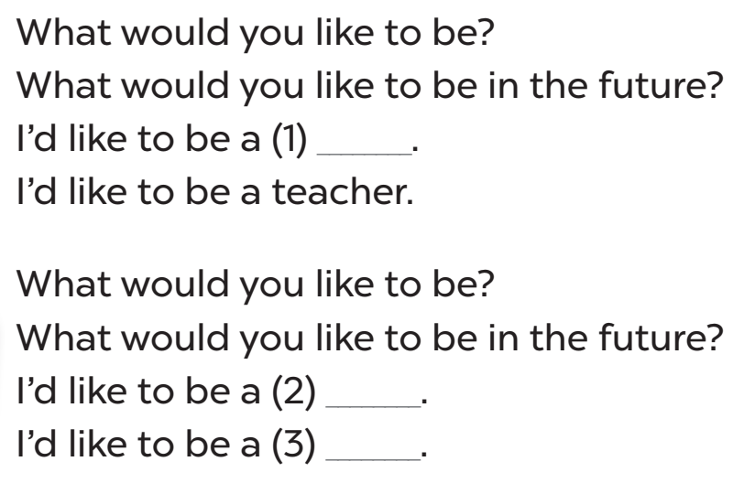
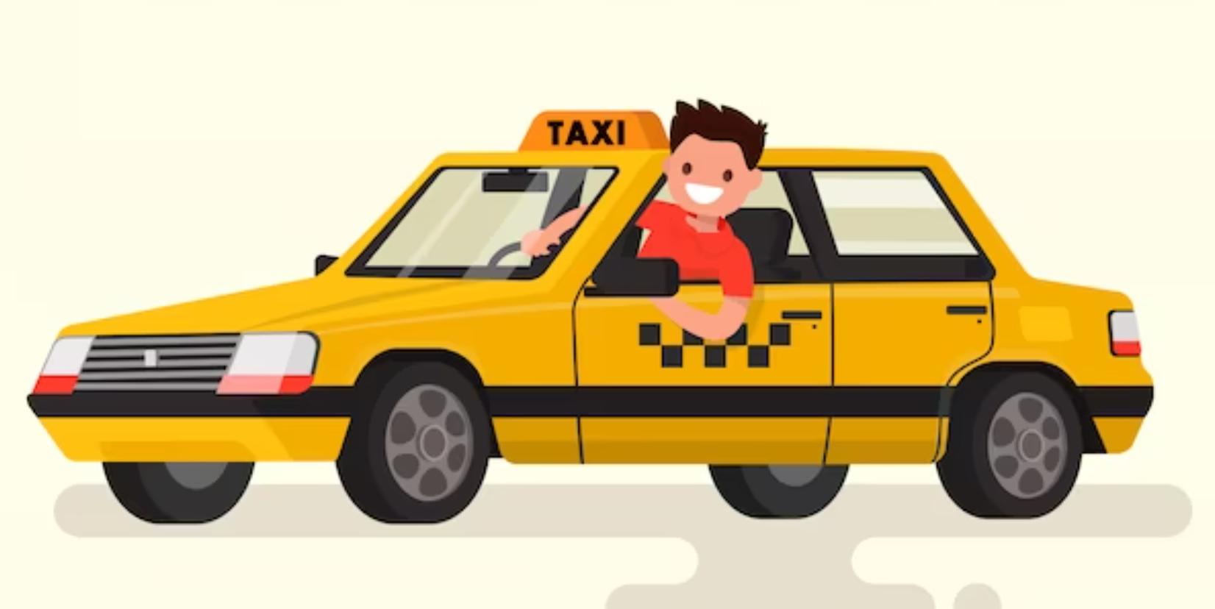



35
Sing and do.
What would you like to be
in the future?
Notes:
Let’s sing.
- Spend a few minutes revising Unit 5 by having pupils sing the song on page 35.
- Play the song for pupils to listen and sing in chorus.
- Play the song again for pupils to sing in chorus and clap hands to reinforce the activity.

Slide 6

02
Activity 3
Read and match.

Slide 7


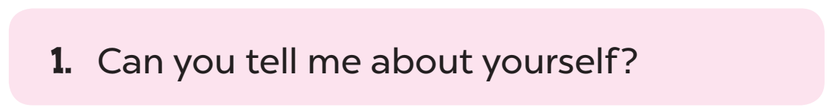
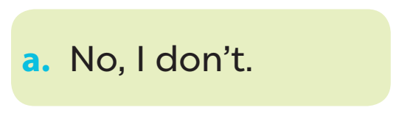

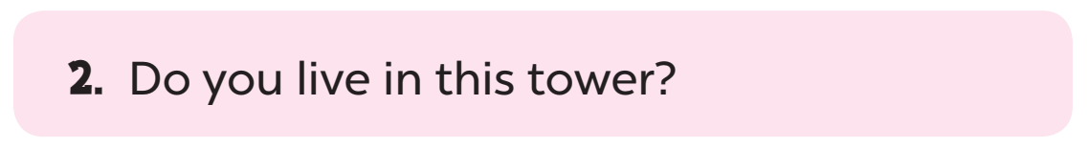
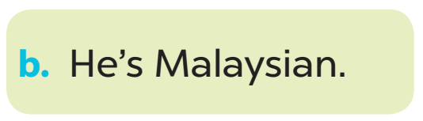
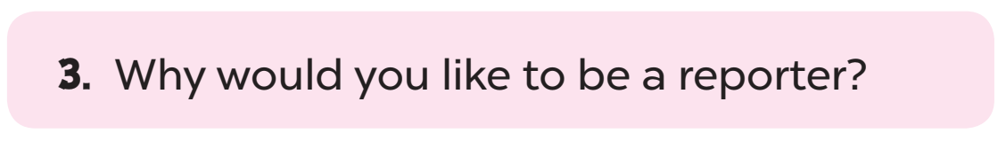
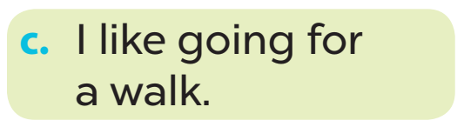
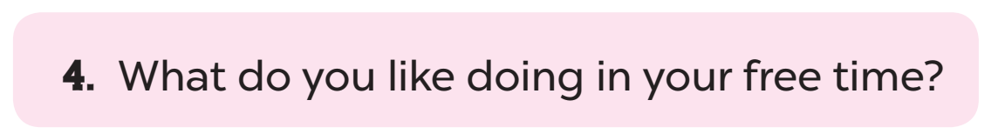
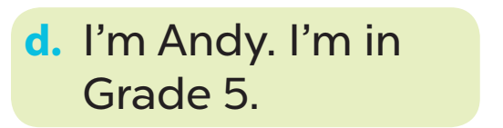
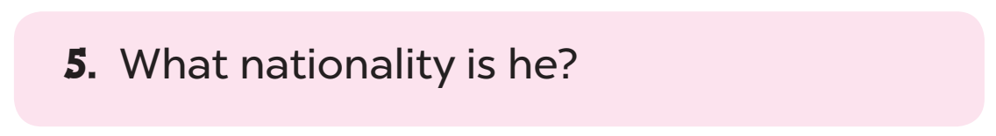
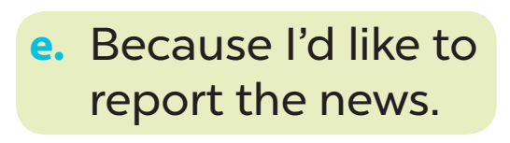
Look and read.
Notes:
Step 1: Draw pupils’ attention to the sentences. Tell them how to do the activity. Point at Sentence 1, elicit the answer and give feedback. Draw a line to match Sentence 1 with the letter d.

Slide 8
Look and read.
Notes:
Step 2: Give pupils time to do the task. Go around the classroom to offer support.

Slide 9


Work in pairs.
Notes:
Step 3: Get pupils to swap books with a partner, then check answers together as a class. Write the correct answers on the board.

Slide 10
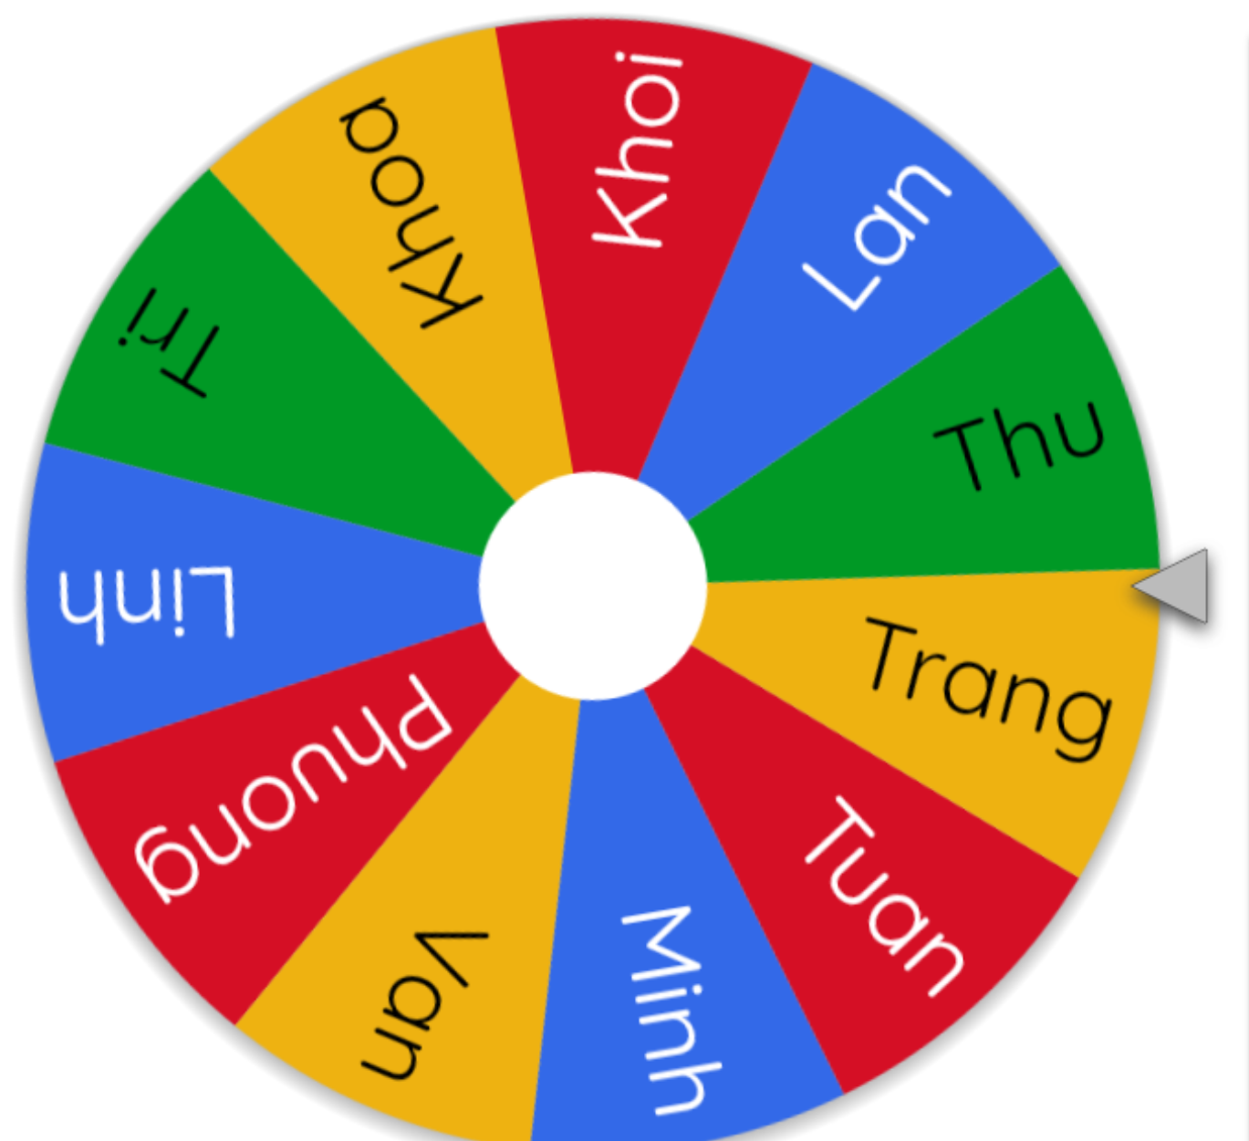
Let’s spin.
Notes:
Extension: Invite pairs of pupils to stand up and read the matched exchanges aloud.
Use this link to play game online: https://wheelofnames.com/

Slide 11
Let’s check.
Notes:
Step 2: Give pupils time to do the task. Go around the classroom to offer support.

Slide 12
03
Activity 4
Read and complete.

Slide 13
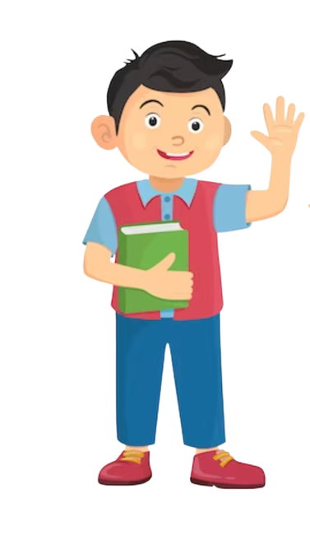
Listen and guess.
future job
name
free-time activities
nationality
favourite subjects
grade
address
Notes:
Introduce the boy. Ask pupils to think and guess about his personal information.

Slide 14
41
Look and read.
My name is Henry. I am Australian. I live in a small town in the south of Australia. My address is 72 Greenwood Street. I think my town is fantastic. It is always clean and beautiful. The people are friendly and helpful. I am a pupil in Grade 5 at Superstar Primary School. My favourite subject at school is science. I have quite good marks in science lessons. In my free time, I like surfing the Internet and planting flowers. I also enjoy going for a walk with my younger sister, Lily. My dream is to become a doctor in the future.
Notes:
Step 1: Have pupils read the passage about Henry. Check comprehension.
- Click to play music for pupils to read in silent.
- Click to show the answers.

Slide 15
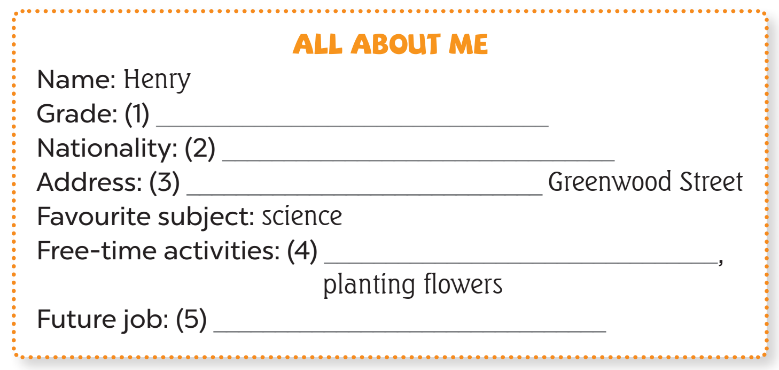

41
Read and complete.
Notes:
Step 2: Have pupils look at the gapped table. Draw pupils’ attention to the gaps in the table.

Slide 16

41
Read and complete.
5
Notes:
Point at the line containing the first gap and read as a class. Elicit the missing word and give feedback.

Slide 17
41
Read and complete.
5
Notes:
Step 3: Ask pupils to complete the gap individually.
- Play music for pupils to do the task.
- Go around the classroom to offer support where necessary.

Slide 18
Work in pairs.
5
Notes:
Step 4: Get pupils to swap books with a partner, then check answers as a class. Write the correct answers on the board.

Slide 19


41
Let’s check.
5
Australian
Notes:
Point at the line containing the first gap and read as a class. Elicit the missing word and give feedback.

Slide 20

41
Let’s check.
5
Australian
72
Notes:
Point at the line containing the first gap and read as a class. Elicit the missing word and give feedback.

Slide 21


41
Let’s check.
5
Australian
72
surfing the Internet
Notes:
Point at the line containing the first gap and read as a class. Elicit the missing word and give feedback.

Slide 22

41
Let’s check.
5
Australian
72
surfing the Internet
a doctor
Notes:
Point at the line containing the first gap and read as a class. Elicit the missing word and give feedback.

Slide 23
04
Activity 5
Let’s write.

Slide 24
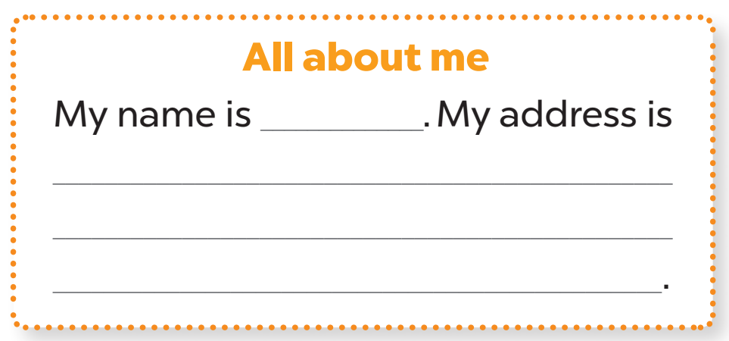
Look and read.
Your name
Your address
Your free-time
activities
Your future job
Notes:
Step 1: Tell the class the goal of this activity: to read the word cues, the gapped text and think about the missing words.

Slide 25

Let’s write.
Your free-time
activities
Your name
Your address
Your future job
All about me
Trang
My name is ______________ .
Notes:
Step 2: Write the first sentence with the gap on the board (My name is ___.). Read the sentence as a class. When you reach the gap, ask pupils to elicit the necessary information (pupil’s name) and write it down to complete the sentence.

Slide 26
Let’s write.
Your free-time
activities
Your name
Your address
Your future job
All about me
Trang
My name is ______________ .
My address is ______________ __________________________________________
Notes:
Step 3: Children continue to write the text individually.

Slide 27
Work in pairs.
Notes:
Step 4: Children work in pairs to read the writing text to each other.
If time allows, invite a few pupils to read the sentences they have completed / written aloud in front of the class. The class observes and praises their work.

Slide 28
Let’s spin.
Notes:
If time allows, invite a few pupils to read the sentences they have completed / written aloud in front of the class. The class observes and praises their work.
Use this link to play game online: https://wheelofnames.com/

Slide 29
05
Fun corner and Wrap-up

Slide 30









Number Race!
Play

Slide 31



























1
2
3
4
5
6
10
10
10
10
10
10
20
20
20
20
20
20
300
30
30
30
30
30
30
Notes:
- Click the number to go to the Question slide.
- Click the colored box to disappear the choice.

Slide 32








1
BACK TO GAME BOARD
When’s your birthday?
ANSWER
10

Slide 33






1
BACK TO GAME BOARD
My birthday is in (January).
10

Slide 34

1
BACK TO GAME BOARD
Where are you from?
ANSWER
20

Slide 35
1
BACK TO GAME BOARD
I am from Viet Nam.
20

Slide 36
1
BACK TO GAME BOARD
Can you tell me
about yourself?
ANSWER
30

Slide 37
1
BACK TO GAME BOARD
Sure. My name is (Trang). I am in Grade 5. My favourite subject is English.
30

Slide 38


2
BACK TO GAME BOARD
Sing a song, please!
ANSWER
10

Slide 39




2
BACK TO GAME BOARD
10

Slide 40
2
BACK TO GAME BOARD
Stand on one foot, please!
ANSWER
20

Slide 41

2
BACK TO GAME BOARD
20

Slide 42
2
BACK TO GAME BOARD
Jump high, please!
ANSWER
30

Slide 43

2
BACK TO GAME BOARD
30

Slide 44






3
BACK TO GAME BOARD
What’s your address?
ANSWER
10

Slide 45





3
BACK TO GAME BOARD
It’s (37 Nguyen Hue) Street.
10

Slide 46

3
BACK TO GAME BOARD
What’s your nationality?
ANSWER
20

Slide 47
3
BACK TO GAME BOARD
I am Vietnamese.
20

Slide 48
3
BACK TO GAME BOARD
Do you live in a flat?
ANSWER
30

Slide 49
3
BACK TO GAME BOARD
Yes, I do.
No, I don’t. I live in ……………….
30

Slide 50





4
BACK TO GAME BOARD
What would you like to be
in the future? Why?
ANSWER
10

Slide 51


4
BACK TO GAME BOARD
I’d like to be (a teacher).
Because I’d like to teach children.
10

Slide 52
4
BACK TO GAME BOARD
What do you do
at the weekend?
ANSWER
20

Slide 53
4
BACK TO GAME BOARD
I always ride my bike.
20

Slide 54
4
BACK TO GAME BOARD
What do you like doing
in your free time?
ANSWER
30

Slide 55
4
BACK TO GAME BOARD
I like (surfing the Internet).
30

Slide 56






5
BACK TO GAME BOARD
What would your best friend like to be in the future?
ANSWER
10

Slide 57



5
BACK TO GAME BOARD
He/She likes to be (a dentist).
10

Slide 58
5
BACK TO GAME BOARD
What would your sister/brother like to be in the future? Why?
ANSWER
20

Slide 59
5
BACK TO GAME BOARD
Because he/she’d like to …….
20

Slide 60
5
BACK TO GAME BOARD
Why would your sister/brother
like to be (..............)?
ANSWER
30

Slide 61
Category 5
BACK TO GAME BOARD
She/He’d like to be (…………….).
Because she/he’d like to …………
30

Slide 62





6
BACK TO GAME BOARD
What’s your father’s job?
ANSWER
10

Slide 63




6
BACK TO GAME BOARD
He’s (………………….).
10

Slide 64

6
BACK TO GAME BOARD
What’s your mother’s job?
ANSWER
20

Slide 65
6
BACK TO GAME BOARD
She’s (…………………….).
20

Slide 66
6
BACK TO GAME BOARD
What do they like doing
in their free time?
ANSWER
30

Slide 67
6
BACK TO GAME BOARD
My father likes …………………… and my mother likes …………………..
30

Slide 68
Website: hoclieu.vn
Fanpage: https://www.facebook.com/tienganhglobalsuccess.vn/

