Slide 2









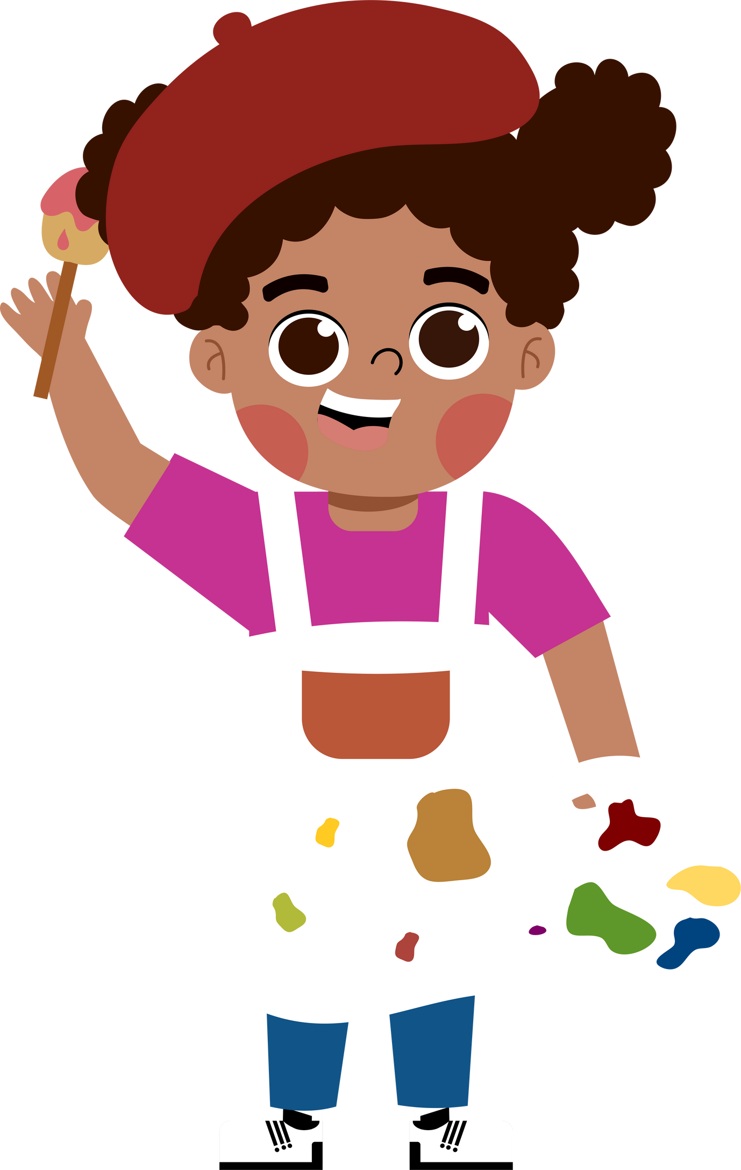
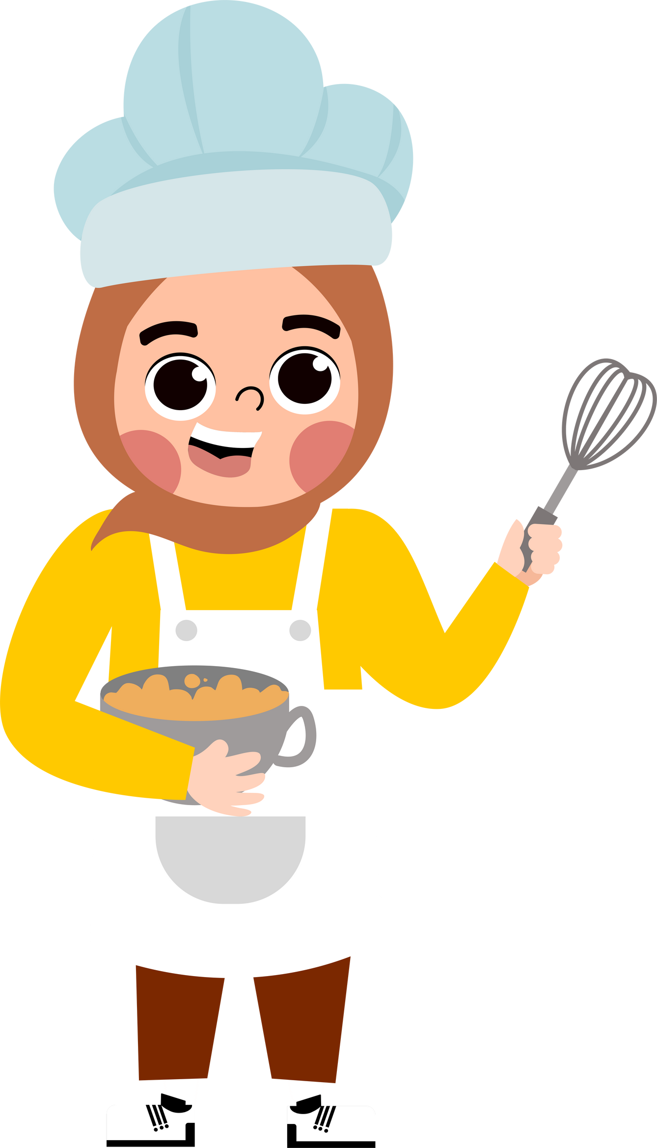


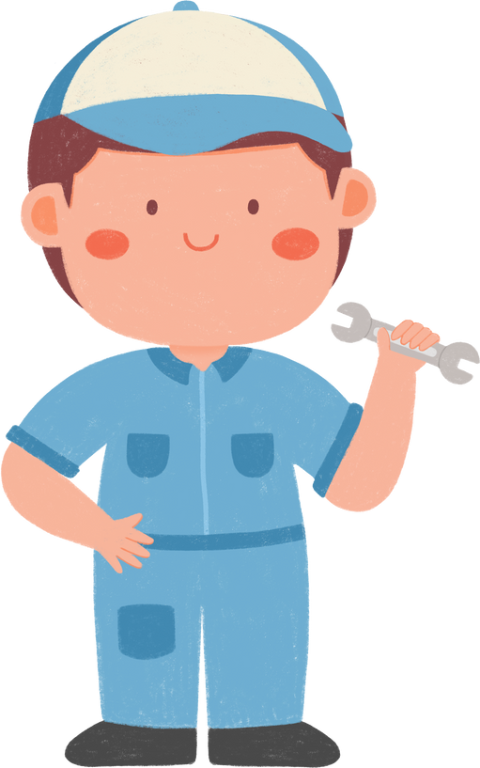




5
My future job
Lesson 2 - Period 4

Slide 3





TABLE OF CONTENTs
01. Warm-up and Review
02. Listen and tick.
03. Read and complete.
04. Let’s play.
05. Fun corner and Wrap-up

Slide 4




01.
Warm-up
and Review

Slide 5











Slide 6






Why would you like to be a teacher?
Because I’d like to …………………………………….
teach children
report the news

Slide 7

Why would you like to be a writer?
Because I’d like to …………………………………….
help sick people
write stories

Slide 8

Why would you like to be a gardener?
Because I’d like to …………………………………….
grow flowers
put out fire

Slide 9

Why would you like to be a doctor?
Because I’d like to …………………………………….
help sick people
grow flowers

Slide 10
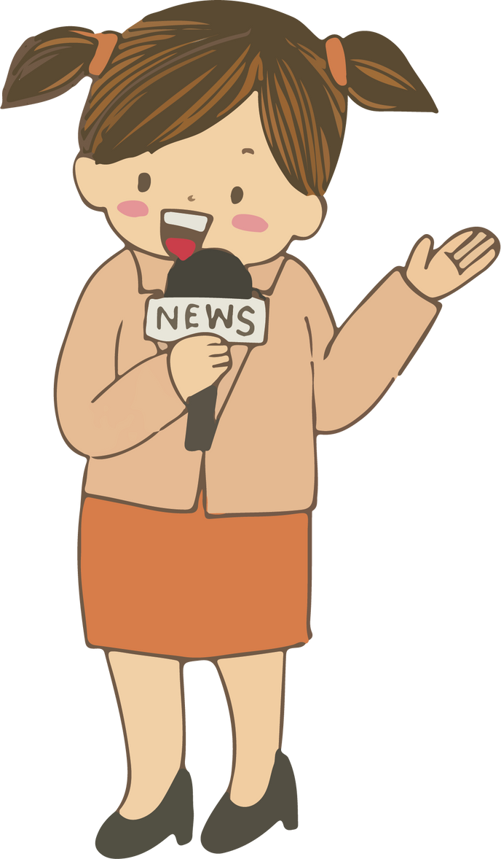
Why would you like to be a reporter?
Because I’d like to …………………………………….
write stories
report the news

Slide 11
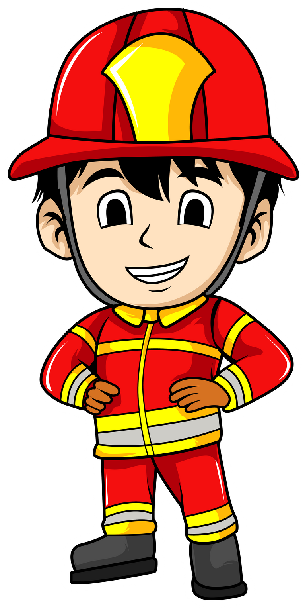
Why would you like to be a firefighter?
Because I’d like to …………………………………….
teach children
put out fire

Slide 12
02.
Listen and tick.

Slide 13

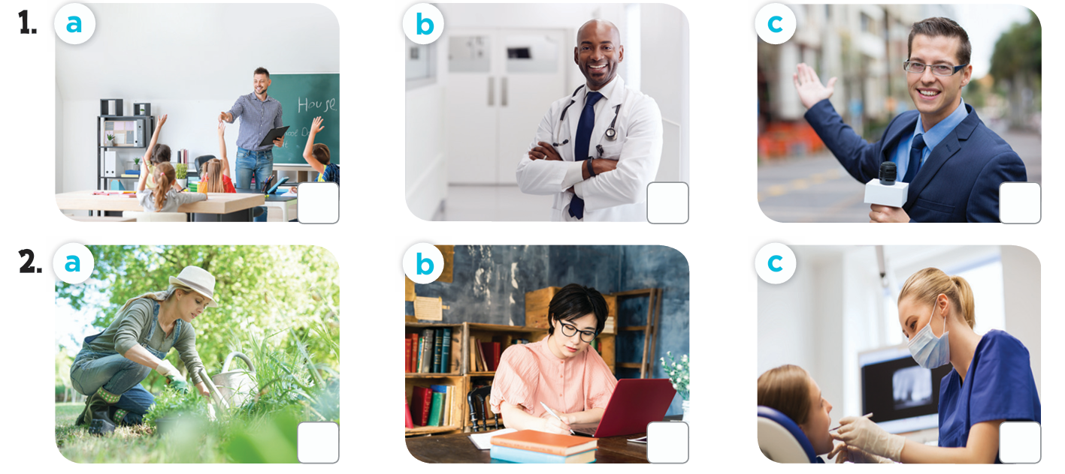

How many pictures are there?
What job can you see in each picture?

Slide 14
03.
Read and complete.

Slide 15
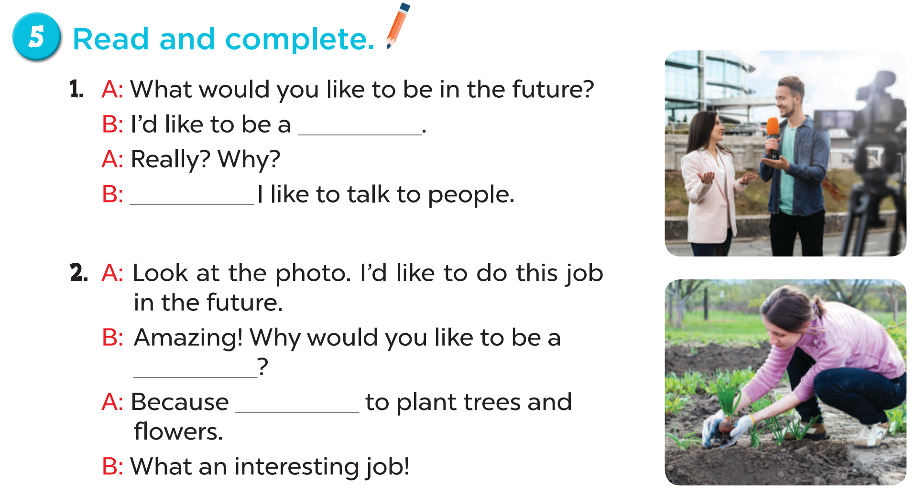
reporter
Because
gardener
I’d like

Slide 16
04.
Let’s play.

Slide 17

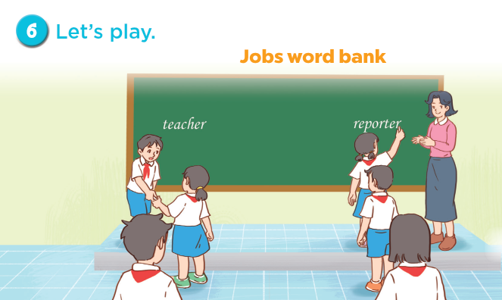


Slide 18
05.
Fun corner and Wrap-up

Slide 19
What would you like to be in the future?
doctor
gardener
teacher
reporter
firefighter
writer

Slide 20
I’d like to grow flowers.
doctor
firefighter
reporter
writer
teacher
gardener

Slide 21
I’d like to report the news.
doctor
firefighter
reporter
writer
teacher
gardener

Slide 22
I’d like to write stories.
doctor
firefighter
reporter
writer
teacher
gardener

Slide 23
I’d like to teach children.
doctor
firefighter
reporter
writer
teacher
gardener

Slide 24
I’d like to help sick people.
doctor
firefighter
reporter
writer
teacher
gardener

Slide 25
I’d like to put out the fire.
doctor
firefighter
reporter
writer
teacher
gardener

Slide 26
Website: hoclieu.vn
Fanpage: https://www.facebook.com/tienganhglobalsuccess.vn/

