Slide 2
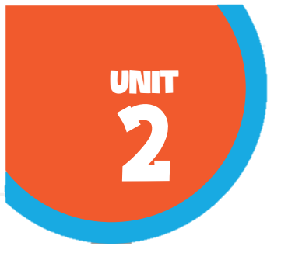








Our home
Lesson 1 – 4,5,6

Slide 3

Table of contents
01
02
03
Listen and number.
Read and complete.
Warm-up and review
04
05
Let's play.
Fun corner and wrap-up

Slide 4



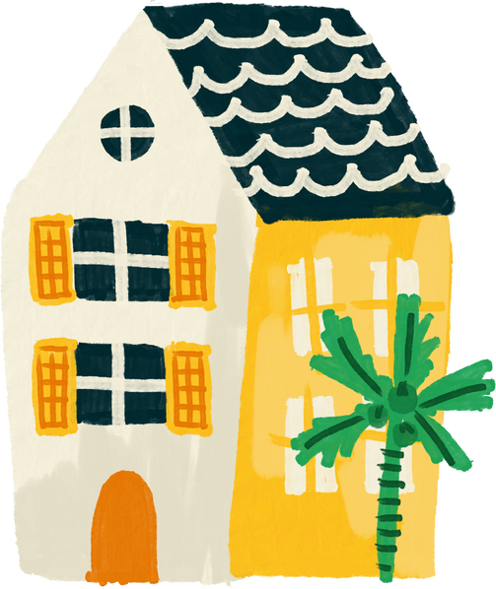


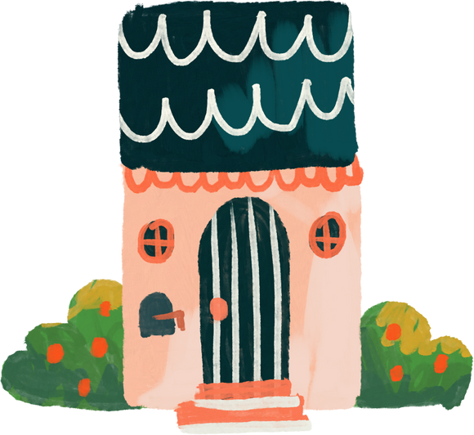
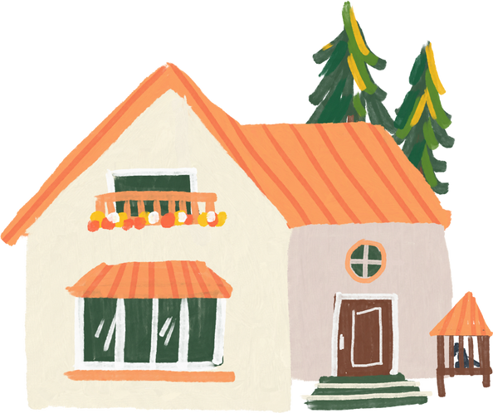
Warm-up and review

Slide 5
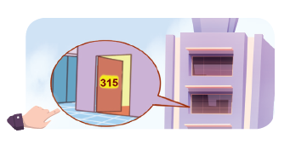
What's the missing letter?
FL__T
A
A
O
I
A
B
C

Slide 6
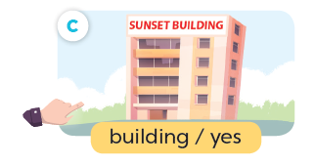
What's the missing letter?
BU__LDING
I
Y
E
I
A
B
C

Slide 7

What's the missing letter?
TO__ER
W
R
W
U
A
B
C

Slide 8

What's the missing letter?
HO__SE
U
U
O
W
A
B
C

Slide 9
Do you live in _____ tower?
that
that
this
A
B

Slide 10
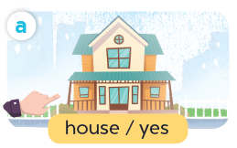
Do you live in _____ house?
this
that
this
A
B

Slide 11



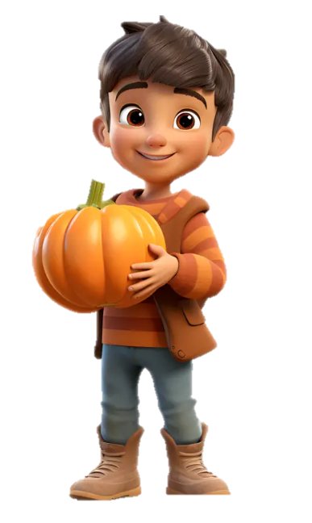
Do you live in this house?
___, I do.
Yes
Yes
No
A
B

Slide 12
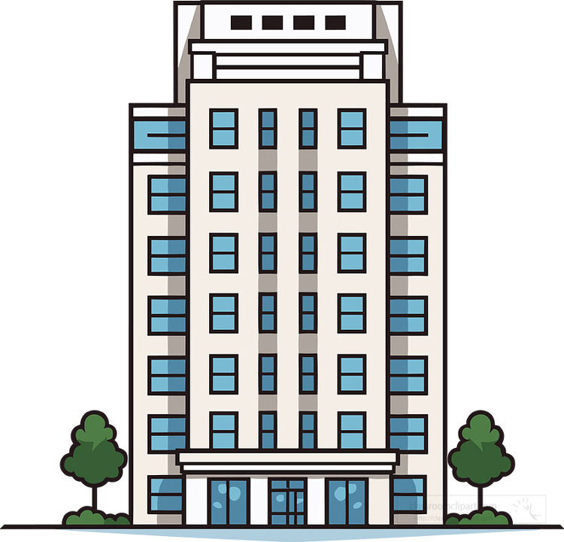



Do you live in that building?
Yes
No
___, I don’t.
No
A
B

Slide 13
4
Listen and number.

Slide 14
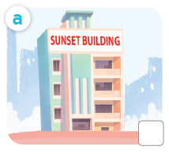
What is it?
building

Slide 15
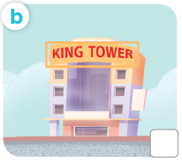
What is it?
tower

Slide 16
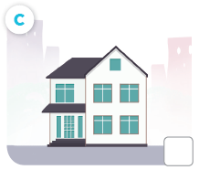
What is it?
house

Slide 17
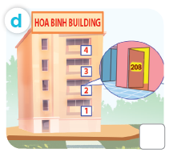
What is it?
flat

Slide 18

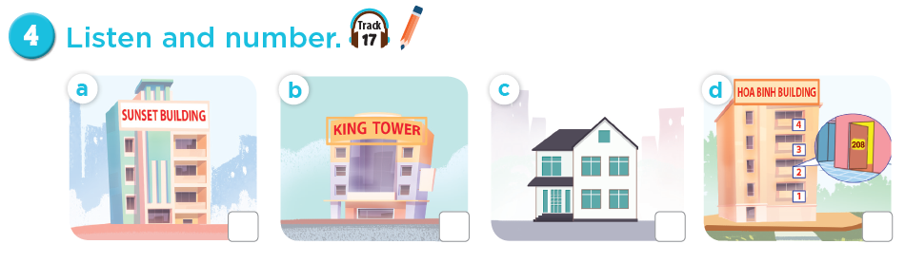
Listen and number.
4
3
1
2

Slide 19
5
Read and complete.

Slide 20


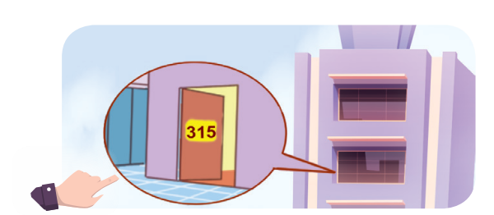


Slide 21

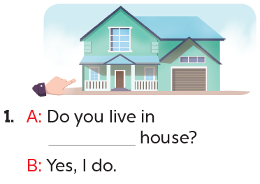
this

Slide 22
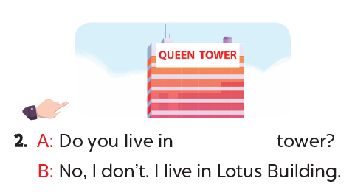
that

Slide 23
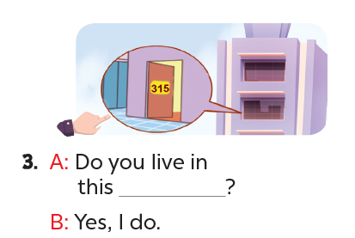
flat

Slide 24
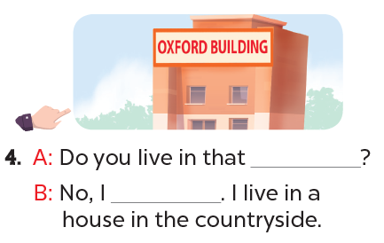
building
don’t

Slide 25
6
Let's play.

Slide 26
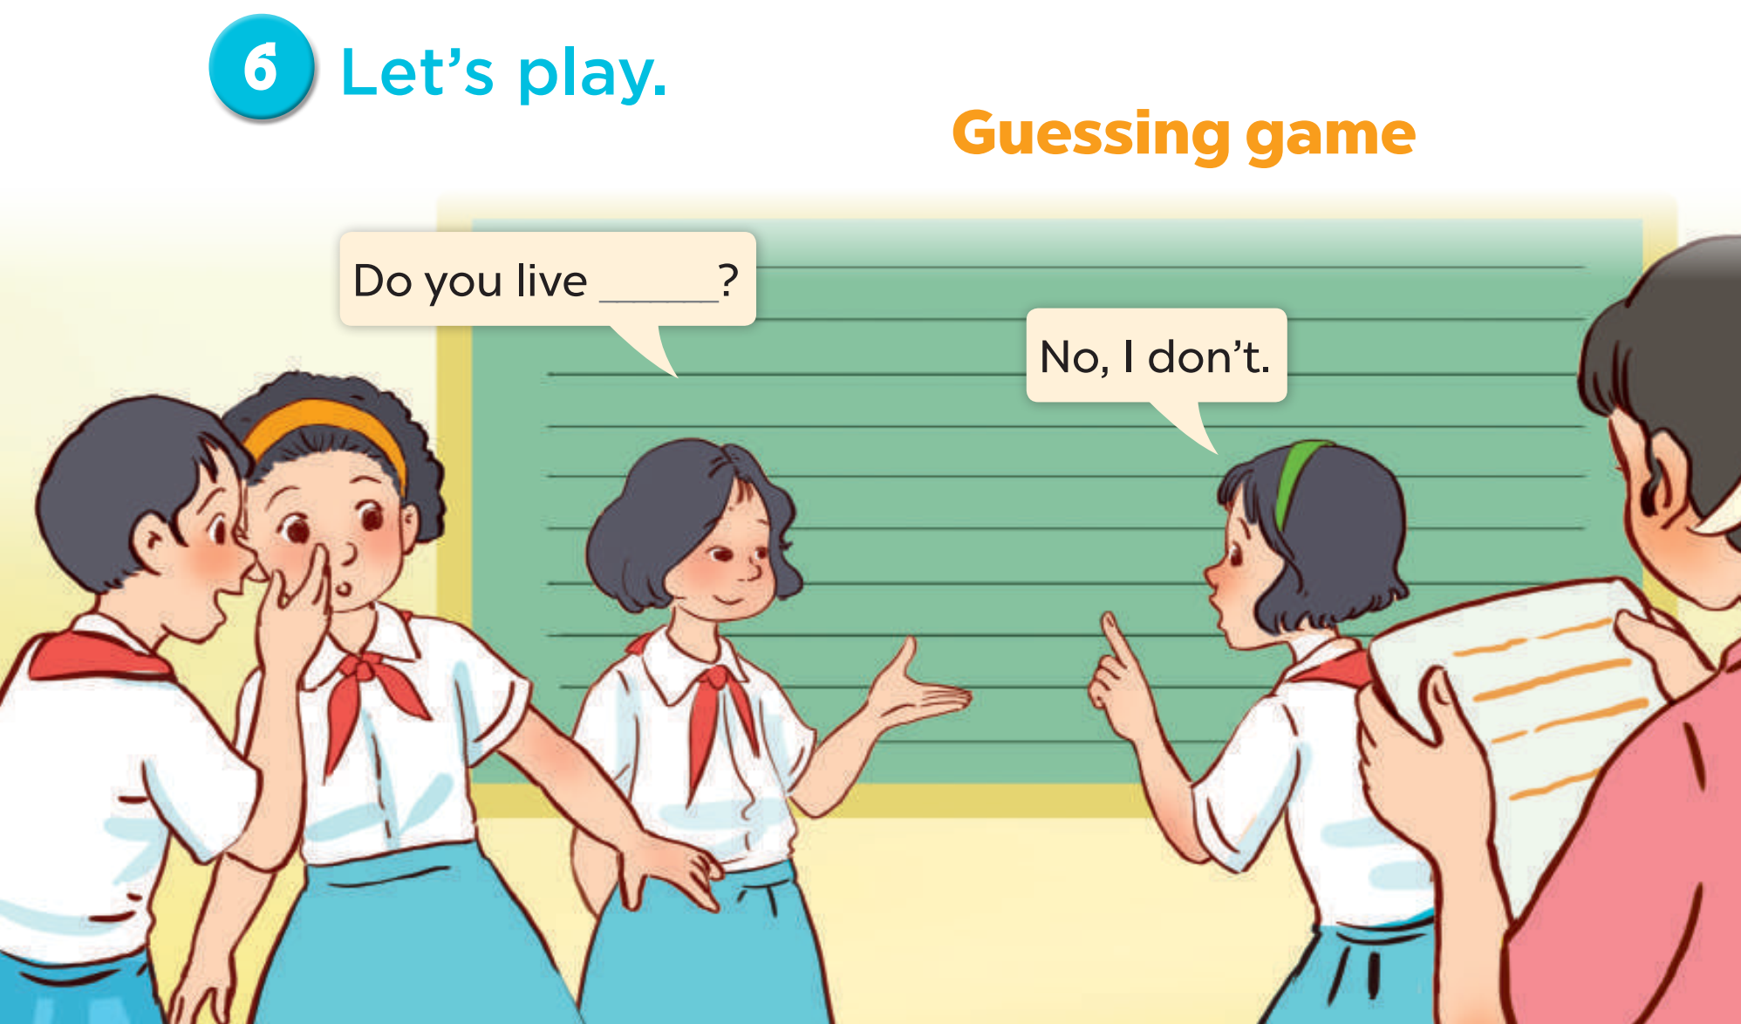
Notes:
Follow instructions in the lesson plan.

Slide 27
Fun corner and wrap-up

Slide 28
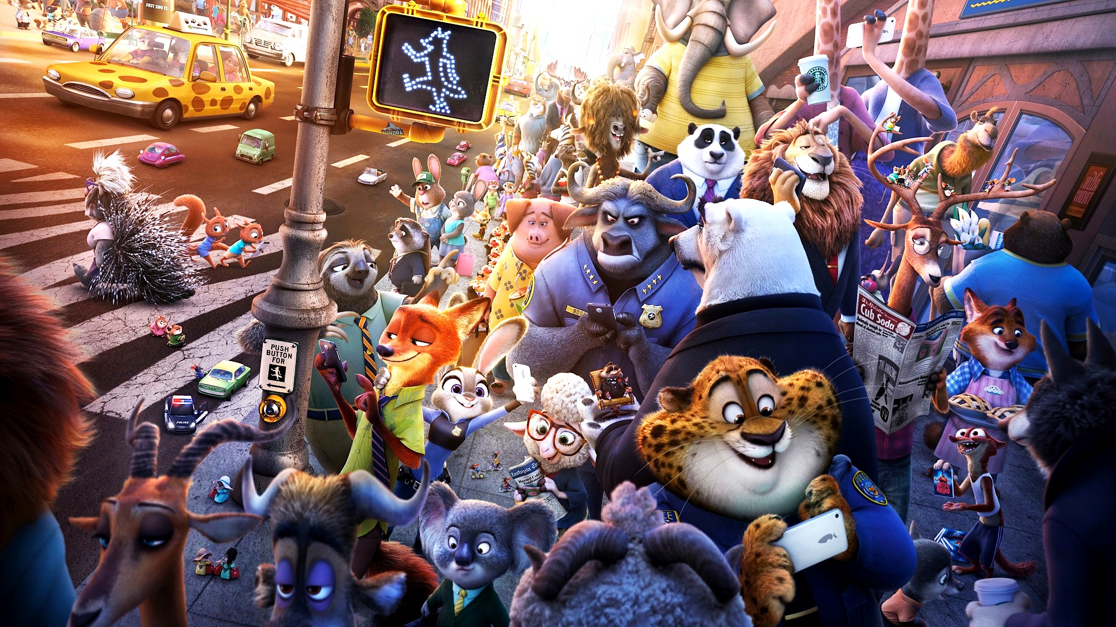
Zootopia

Slide 29

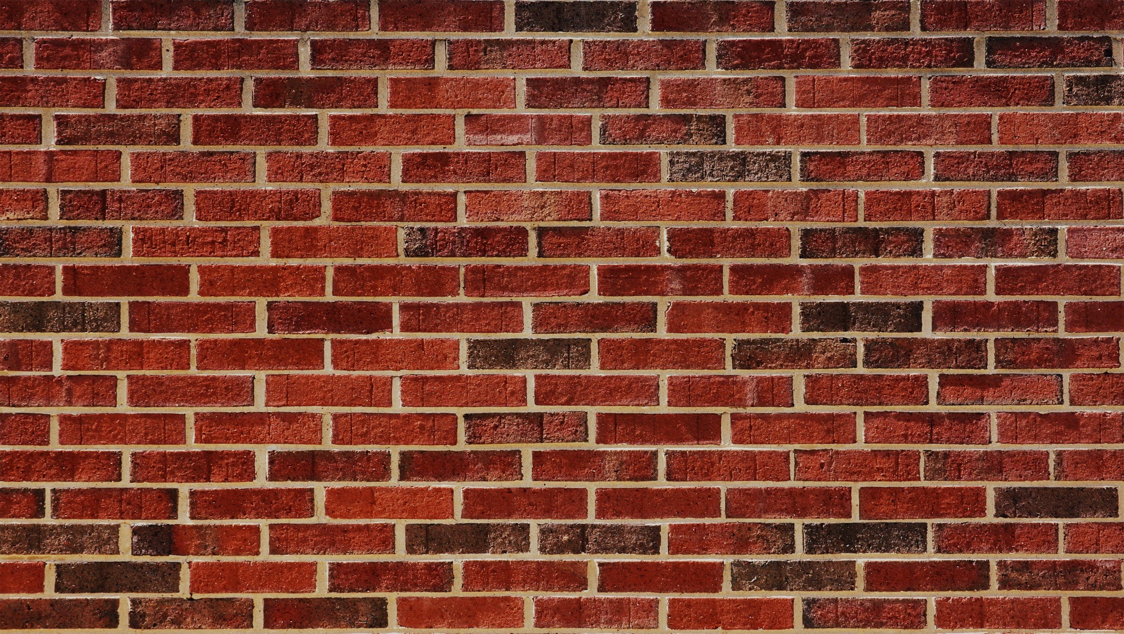


Explore Zootopia and catch the criminals!

Slide 30


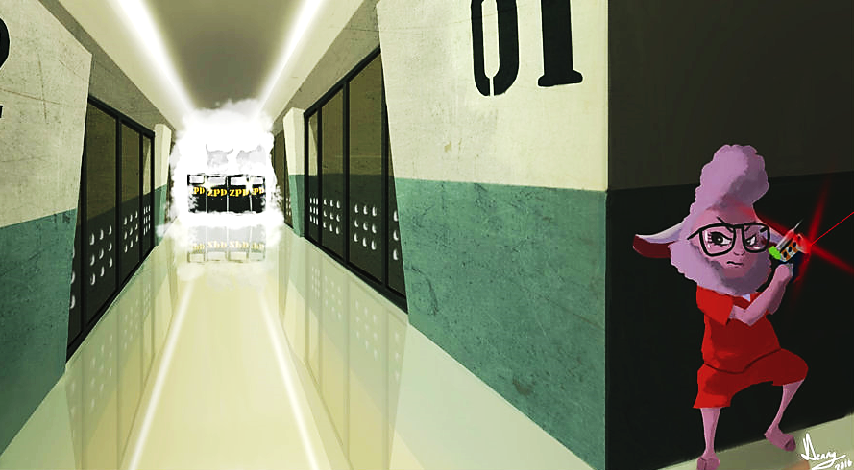

WANTED
B
e
l
l
w
e
t
h
e
r
s
n
E
p
r
i
s
c
a
e
d
p
o
By the ZPD

Slide 31

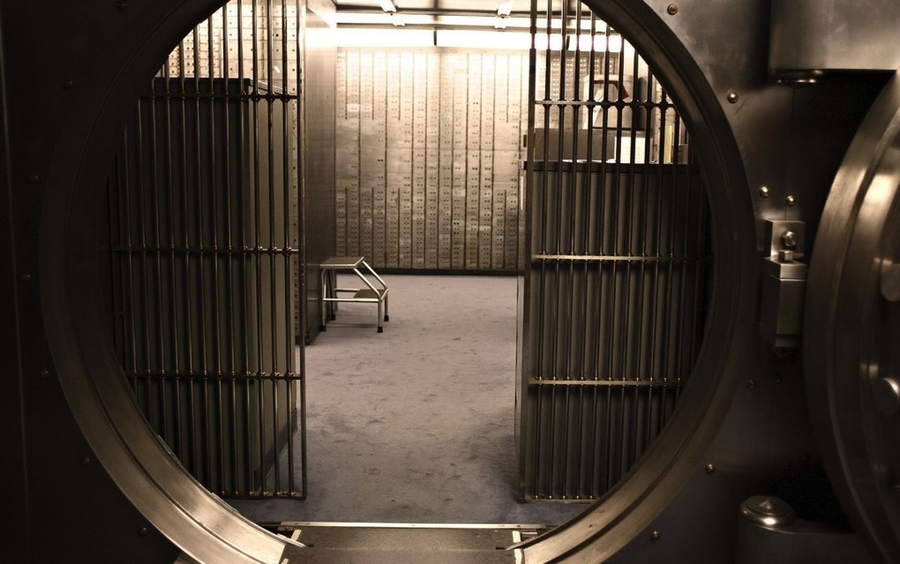
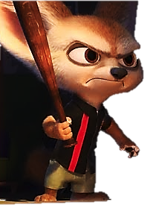


WANTED
F
i
n
n
i
c
k
o
b
a
a
R
b
e
d
b
n
k
By the ZPD

Slide 32

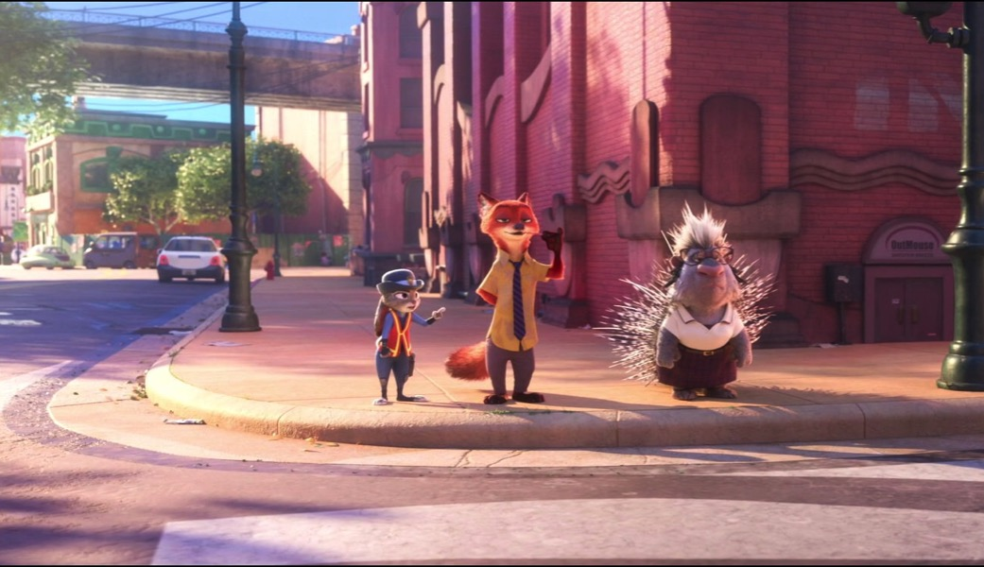
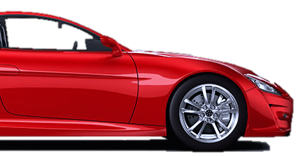

WANTED
F
l
a
s
h
l
t
o
e
r
S
a
c
a
By the ZPD

Slide 33




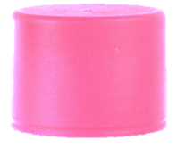


Minus points
+1
+5
Swap points
Steal

Slide 34





Let’s go!

Slide 35
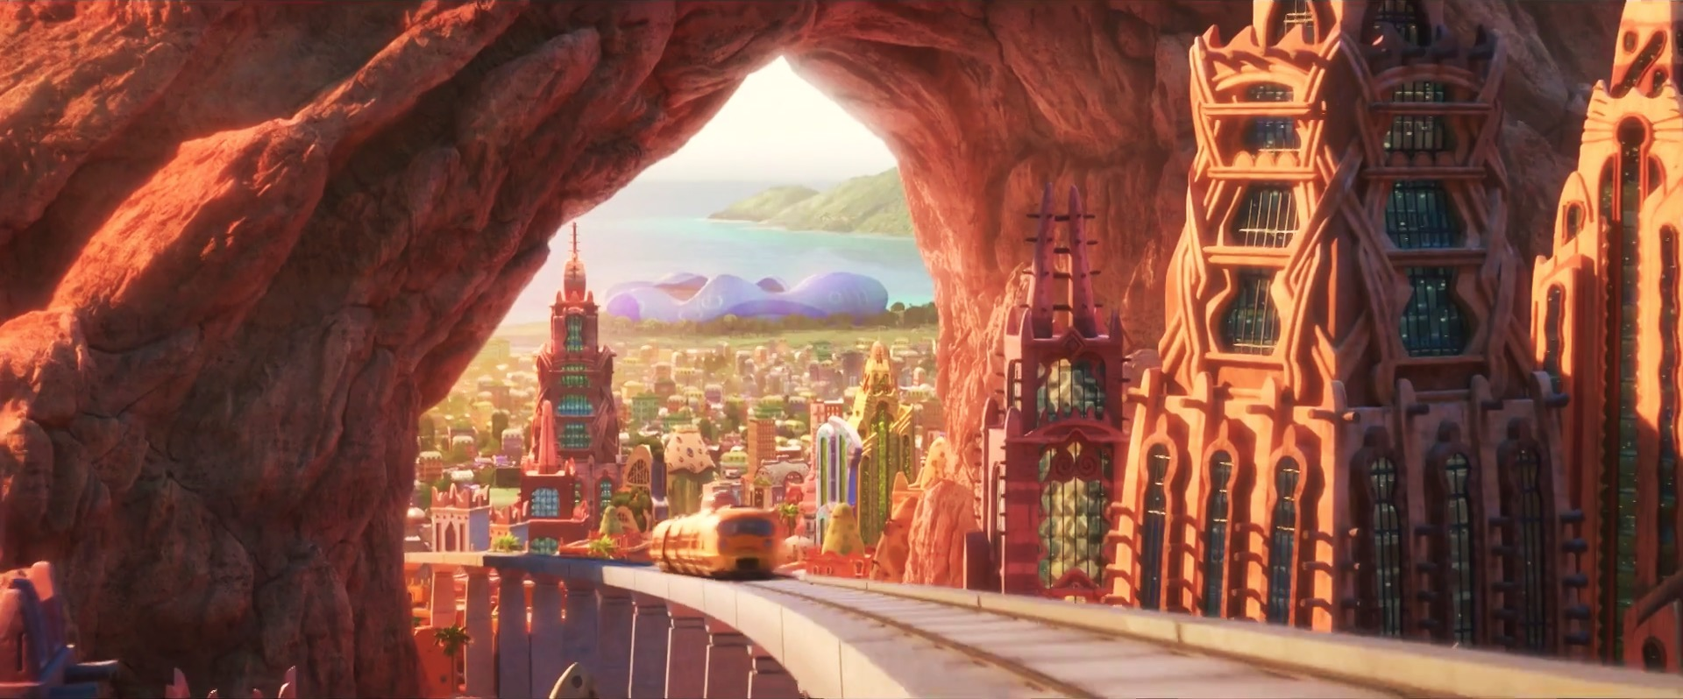


2
4
1
3
5
7
6
8
Notes:
CLICK THE ARROW IN THE BOTTOM RIGHT CORNER TO GO TO THE ENDING SLIDE

Slide 36

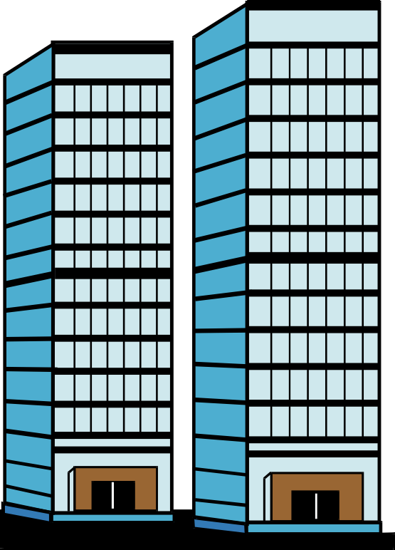


Do you live in this tower?
Queen Tower
No, I don’t.

Slide 37



+3
+3
Notes:
Click Judy to go to the home page

Slide 38
live / Do / this / you / builing / in / ?
Do you live in this building?

Slide 39

Choose!
Choose!
Left
Right

Slide 40

Rock paper scissors ...
Rock paper scissors...
Winner steal
Winner steal
2
2
Notes:
Click Judy to go to the home page

Slide 41
Trade
Swap points
Notes:
Click Judy to go to the home page

Slide 42


Queen Building
Yes, I do.
Do you live in this building?

Slide 43

+2
+2
Notes:
Click Judy to go to the home page

Slide 44
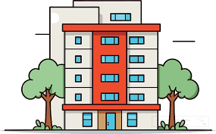
I live in that ____.
house
flat
building

Slide 45

+4
+1
Notes:
Click Judy to go to the home page

Slide 46
Do you live in that ________?
house

Slide 47
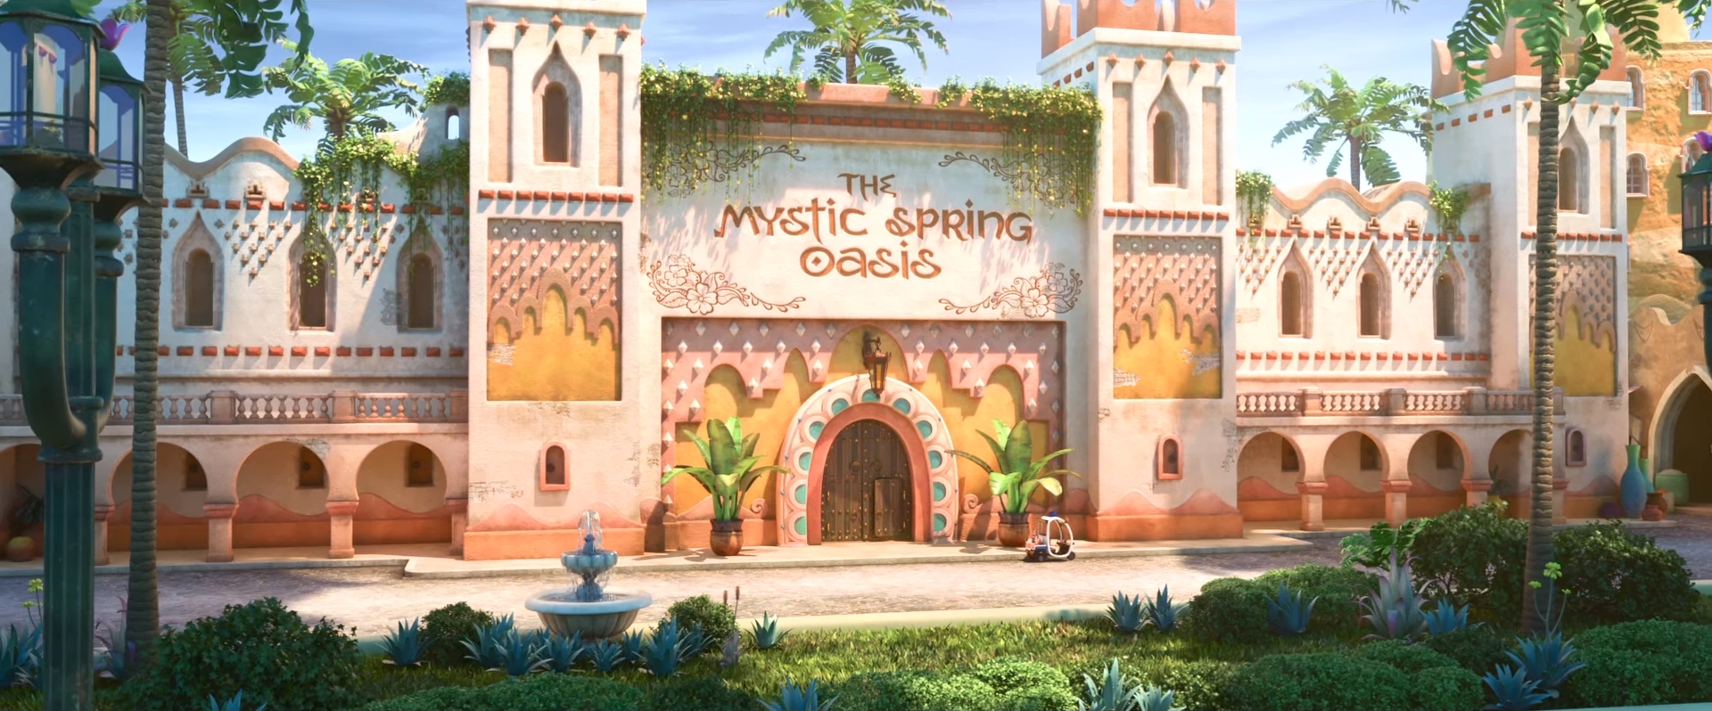
Go inside?
Go inside?
Yes
No

Slide 48
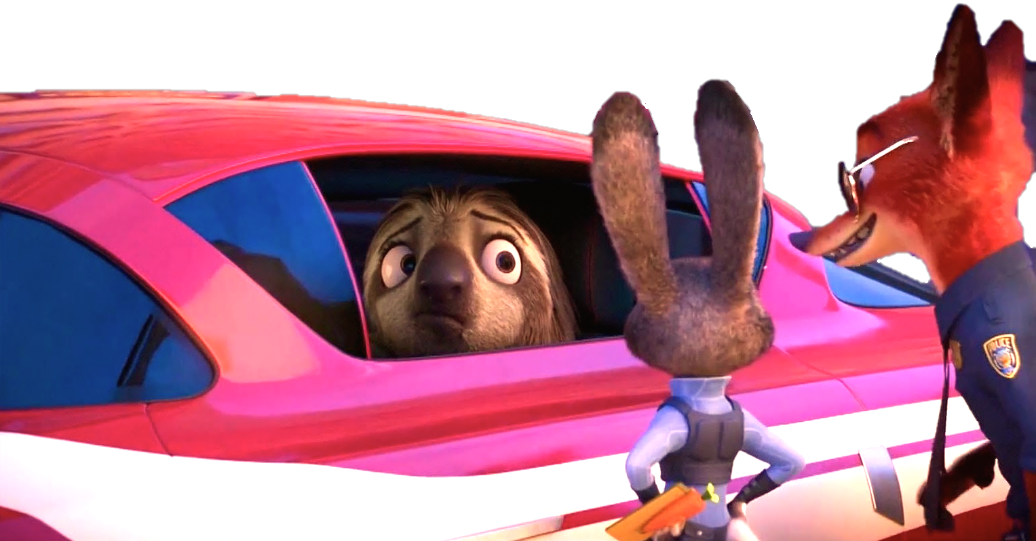
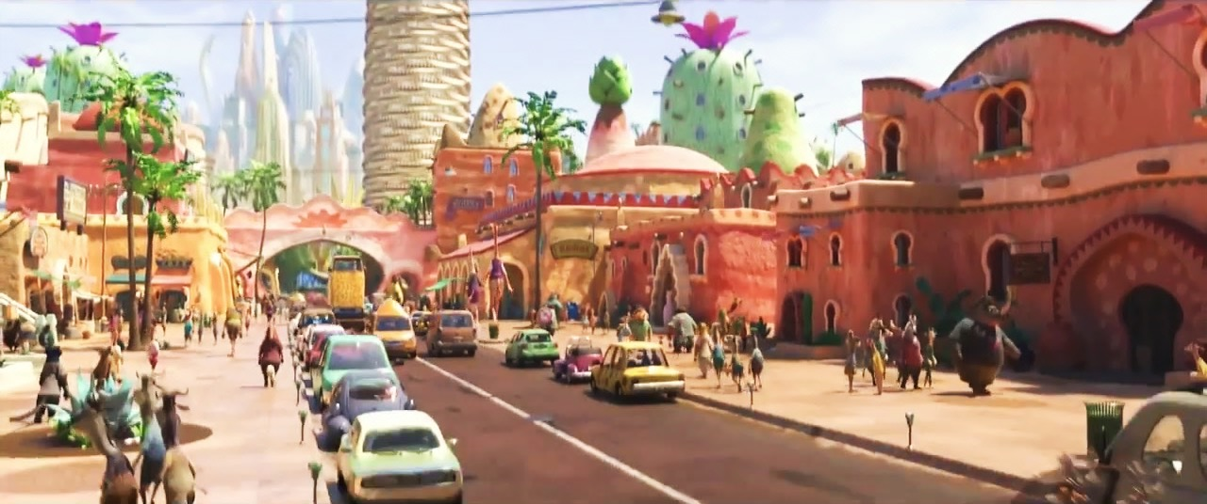
It’s Flash!
It’s
Flash!

Slide 49




WANTED
+10
+15
By the ZPD
Flash
Notes:
Click Nick & Judy to go to the home page

Slide 50




Do you live in this flat?
No, I don’t.

Slide 51

+5
+5
Notes:
Click Judy to go to the home page

Slide 52
Yes, I do.
Do you live in that flat?

Slide 53
+6
Steal 4
Notes:
Click Judy to go to the home page

Slide 54

Complete:
you / live / this / tower?
Do you live in this tower?

Slide 55



Choose!
Choose!

Slide 56




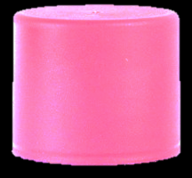
-5
-3
Notes:
Click Judy to go to the home page

Slide 57
+10
+10
Notes:
Click Judy to go to the home page

Slide 58

-5
-5
Notes:
Click Nick to go to the home page

Slide 59
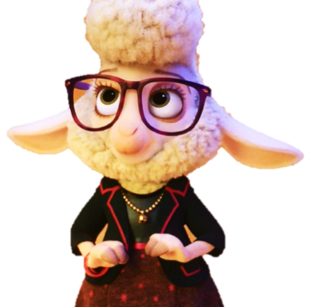





WANTED
WANTED
WANTED
WANTED
WANTED
By the ZPD
WANTED
By the ZPD
By the ZPD
By the ZPD
By the ZPD
By the ZPD
Bellwether
Bellwether
Flash
Flash
Finnick
Finnick

Slide 60

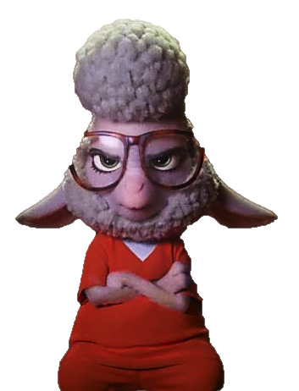







Good job!
Bellwether
Flash
Finnick

