Slide 2









Our Home
Lesson 2 - Period 4

Slide 3

Table of contents
01
02
03
Listen and circle.
Read and complete.
Warm-up and review
04
05
Listen, complete and sing.
Fun corner and wrap-up

Slide 4







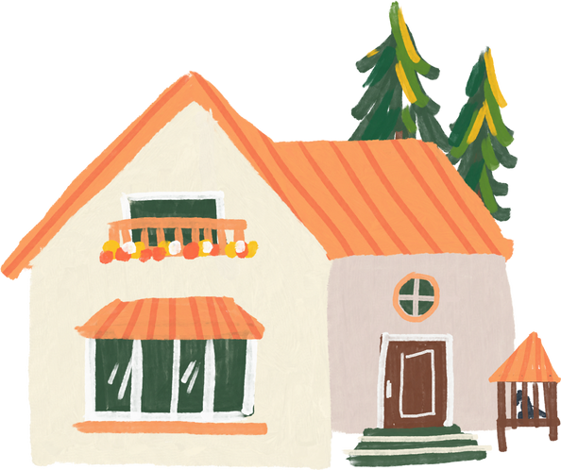
01
Warm-up and review

Slide 5


55
49
45

Slide 6
17
79
97

Slide 7
135
153
159

Slide 8
19
98
89

Slide 9
376
267
276

Slide 10
77
17
70

Slide 11
55
59
45

Slide 12
02
Listen and circle.

Slide 13
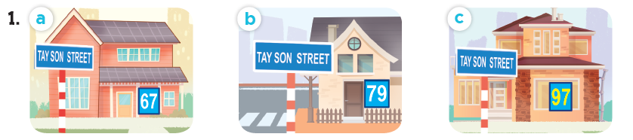
Look and say the number.
sixty-seven
seventy-nine
ninety-seven

Slide 14
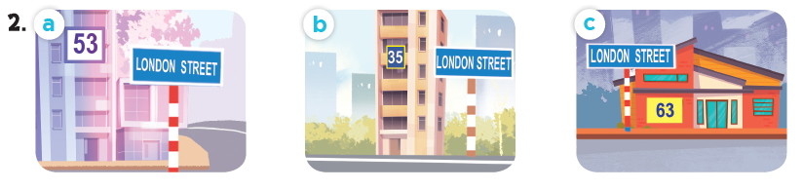
Look and say the number.
fifty-three
thirty-five
sixty-three

Slide 15
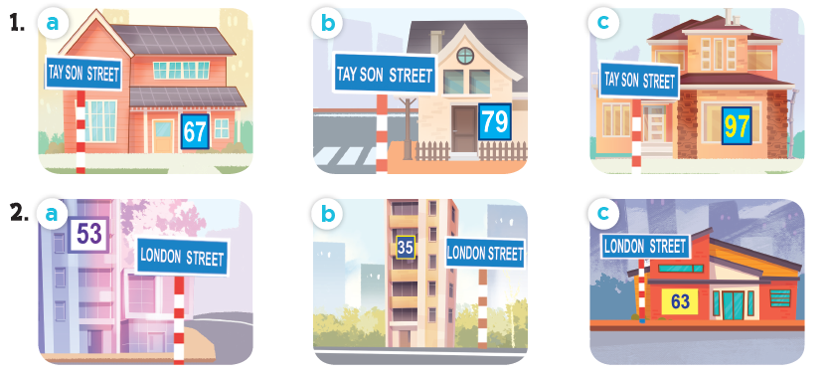
Listen and circle.

Slide 16
03
Read and complete.

Slide 17
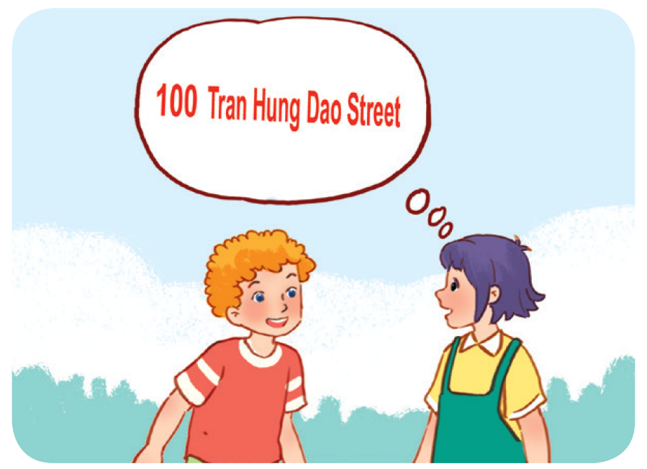
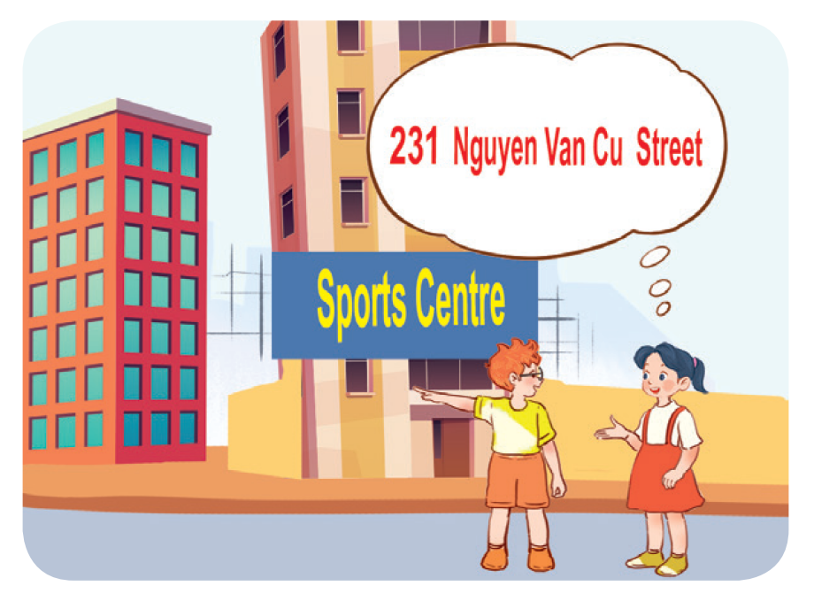
Work in pairs. Read and complete.
1. A: What’s your address?
B: It’s ________________.
A: Is it far ________________ here?
B: Yes, it is. It’s about ten kilometres from here.
2. A: I live in ________________ building over there.
B: Oh, it’s near the sports centre.
A: ________________ do you live?
B: I live far from here, in District 5.
A: ________________ your address?
B: It’s ________________.

Slide 18
Work in pairs. Read and complete.
1. A: What’s your address?
B: It’s ________________________.
A: Is it far ______ here?
B: Yes, it is. It’s about ten kilometres from here.
100 Tran Hung Dao Street
from

Slide 19
Work in pairs. Read and complete.
2. A: I live in ______________ building over there.
B: Oh, it’s near the sports centre.
A: _________ do you live?
B: I live far from here, in District 5.
A: ________ your address?
B: It’s _________________________.
that
Where
What’s
231 Nguyen Van Cu Street

Slide 20
04
Listen, complete and sing.

Slide 21

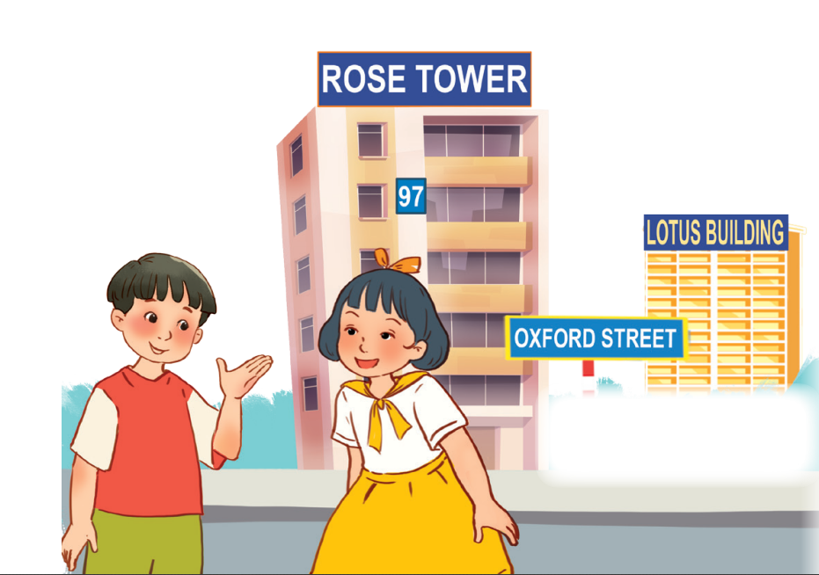
Let’s sing.
Look and read.
Listen and complete.
building
Do you live in that (1) _______?
No, I don’t.
Do you live in this (2) ______?
Yes, I do.
What’s your address?
It’s (3) _____ Oxford Street.
tower
19

Slide 22
05
Fun corner and wrap-up

Slide 23

Where do I live?

Slide 24













boys
girls
Notes:
Teacher can insert a picture of her/ his address behind the puzzles. After the game, students know teacher’s address.

Slide 25


______ is your address?
What
It’s 23 London Street.

Slide 26




Slide 27
I live in Sports Centre Building.
Where
______ do you live?

Slide 29

It’s 126 Tran Phu Street.
What is your _______?
address

Slide 31
No, it isn’t.
Is it far _____ here?
from

Slide 33
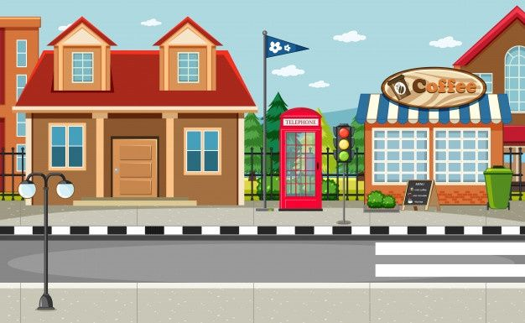


What’s your address?
32
Oxford
It’s _________________.
32 Oxford Street

Slide 35
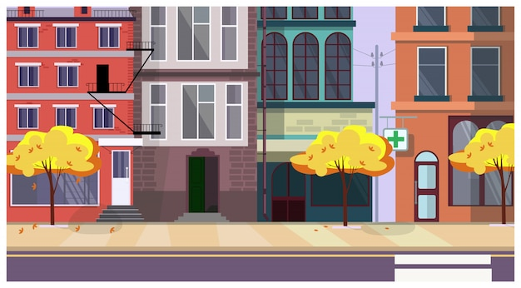
London
I live on London _______.
Street

Slide 37
Website: hoclieu.vn
Fanpage: facebook.com/www.tienganhglobalsuccess.vn

