Slide 2




Unit 2: In the backyard
Lesson 3 – Period 3

Slide 3





TABLE OF CONTENTS
  Warm-up & Review
  Activity 6: Listen and repeat.
  Activity 7: Let’s talk.
  Activity 8: Let’s sing.
  Fun corner & Wrap-up

Slide 4
01
Warm-up & Review

Slide 5




GAME
Making sentences
kite.
a
He’s
flying
1
2
3
4

Slide 6

GAME
Making sentences
bike.
a
riding
He’s
1
2
3
4

Slide 7
GAME
Making sentences
kitten.
playing
with
a
She’s
1
2
3
4
5

Slide 8
02
Activity 6
Listen and repeat.

Slide 9



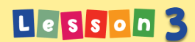




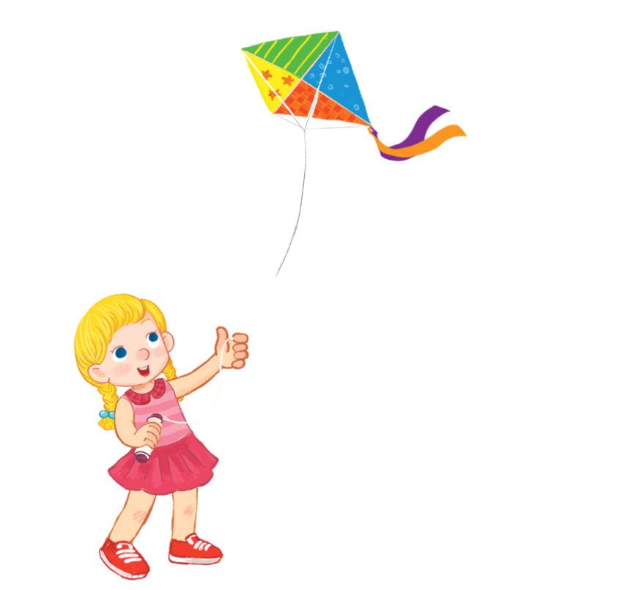
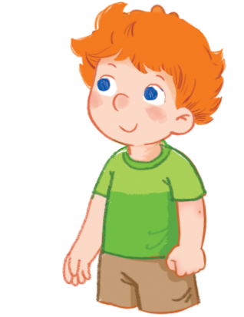


Unit
Listen and repeat.
Yes,she is.
Is she flying a kite?

Slide 10


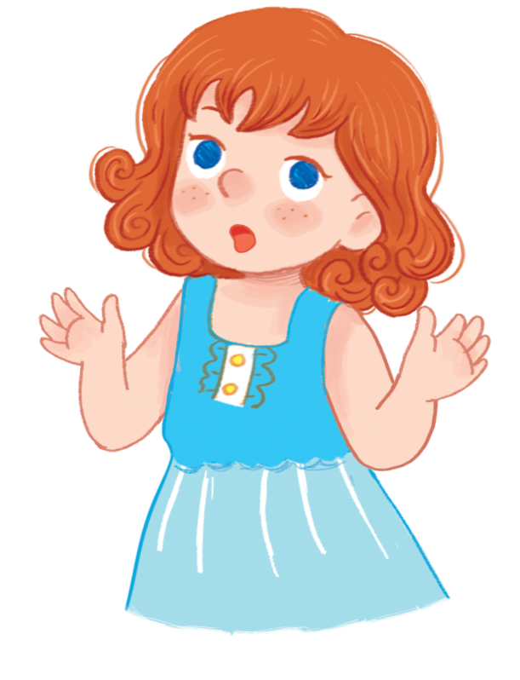
Unit
Listen and repeat.
No,he isn’t.
Is he flying a kite?

Slide 11
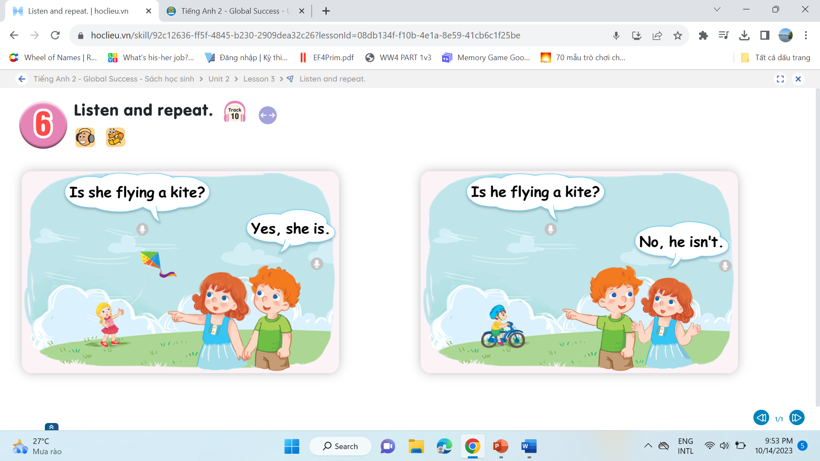

Unit
Listen and repeat.
1
2

Slide 12





Role-play

Slide 13
03
Activity 7
Let’s talk.

Slide 14


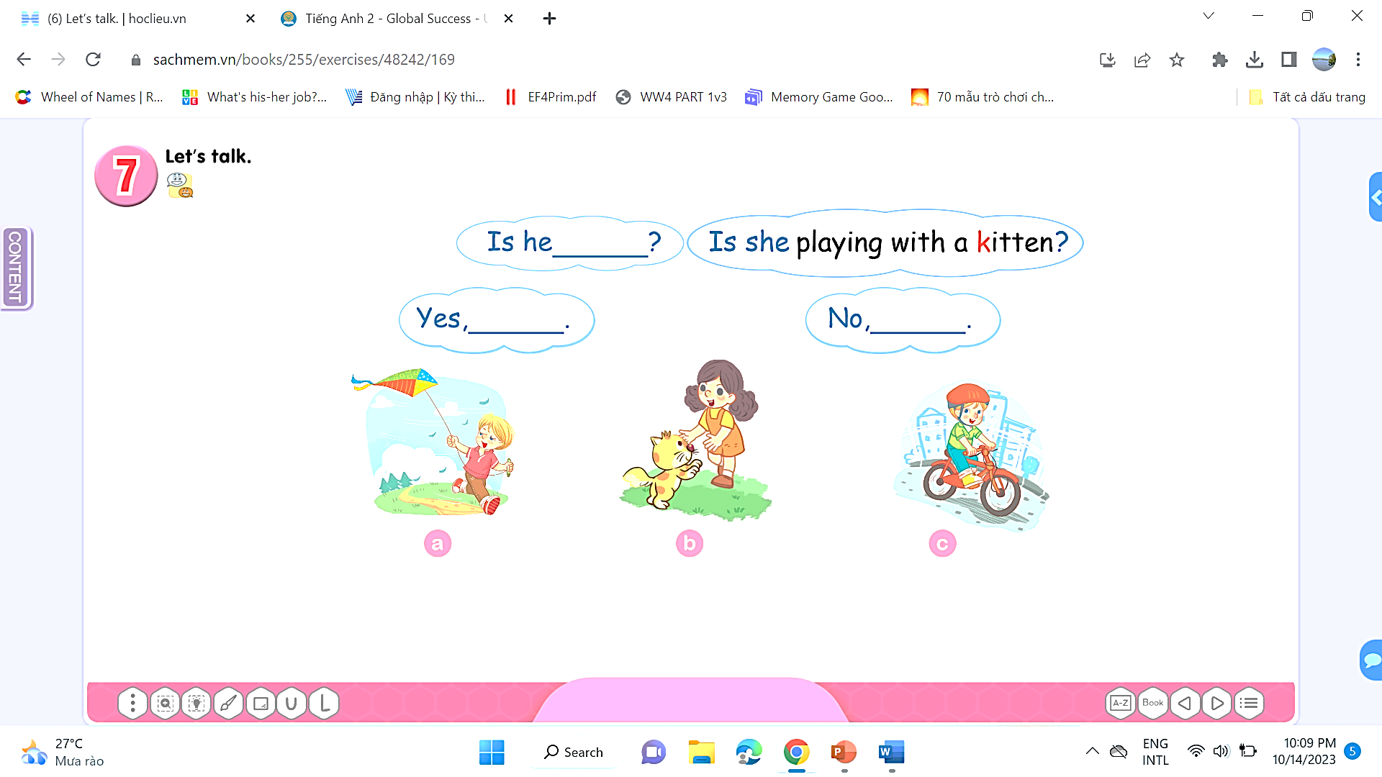



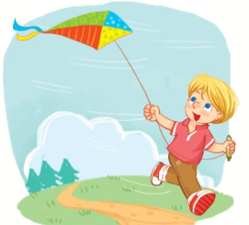



Unit
Let’s talk.
a

Slide 15

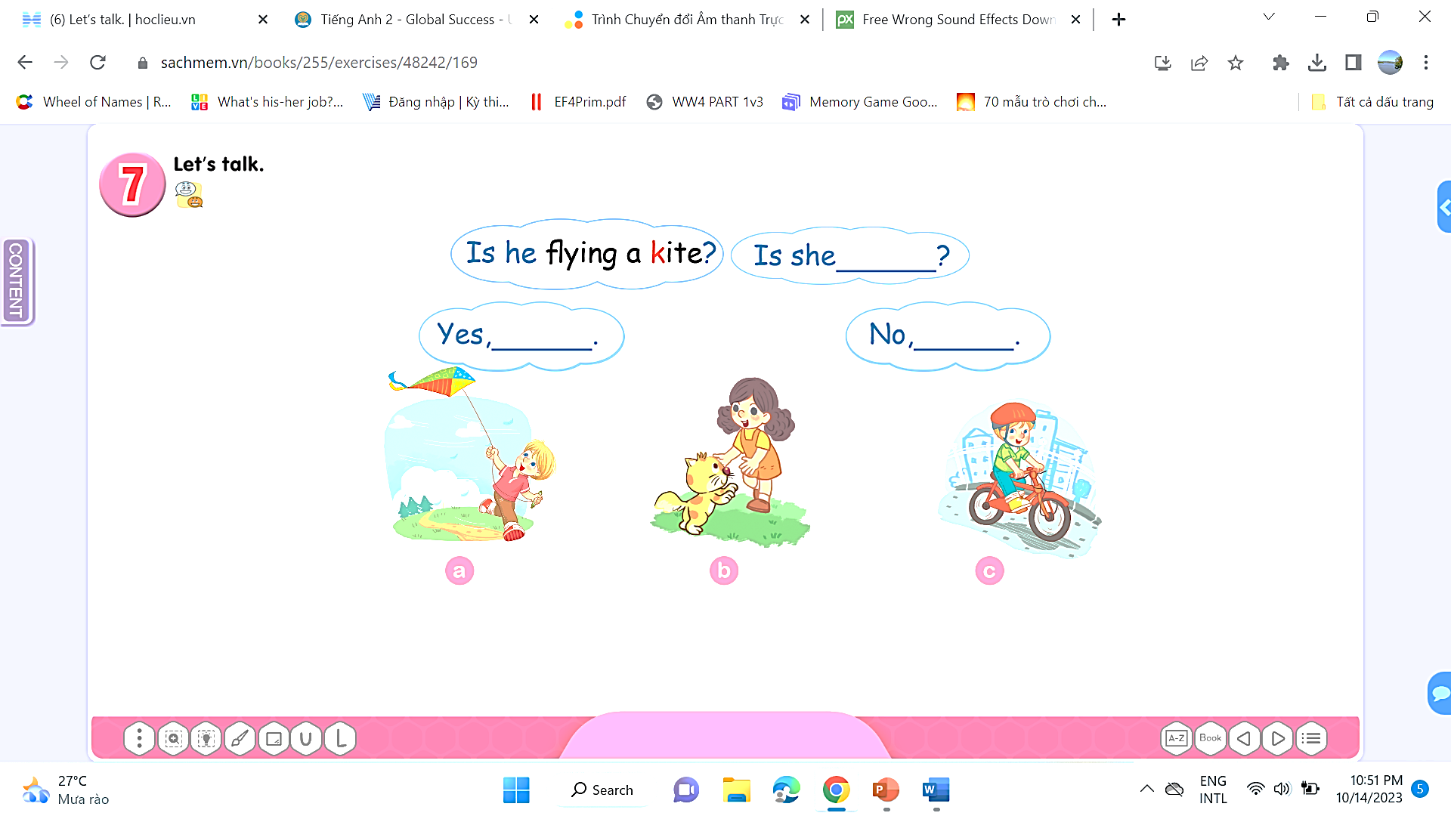


Unit
Let’s talk.
b

Slide 16
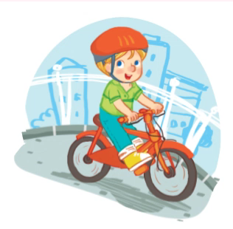

Unit
Let’s talk.
c

Slide 17

Unit
Let’s talk.
d

Slide 18
04
Activity 8
Let’s sing!

Slide 19



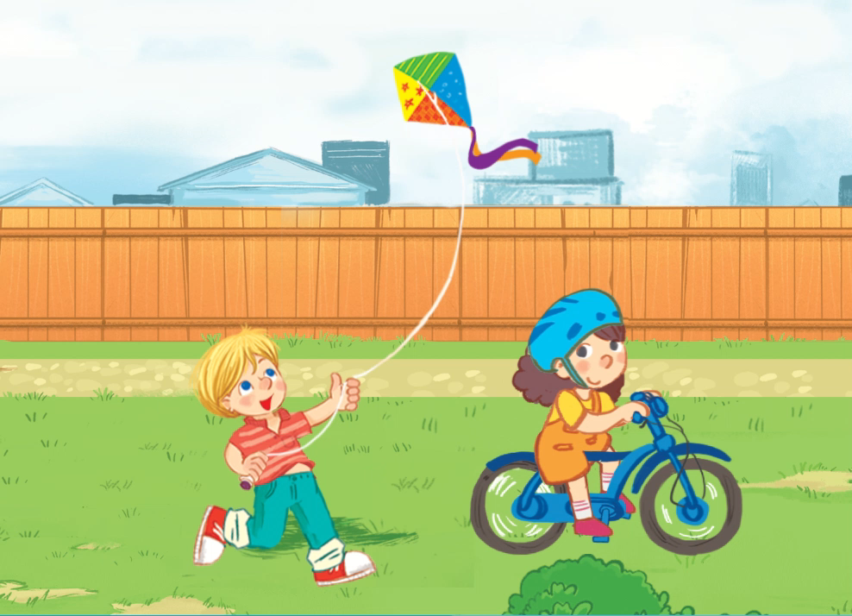

Unit
Let’s sing!

Slide 20
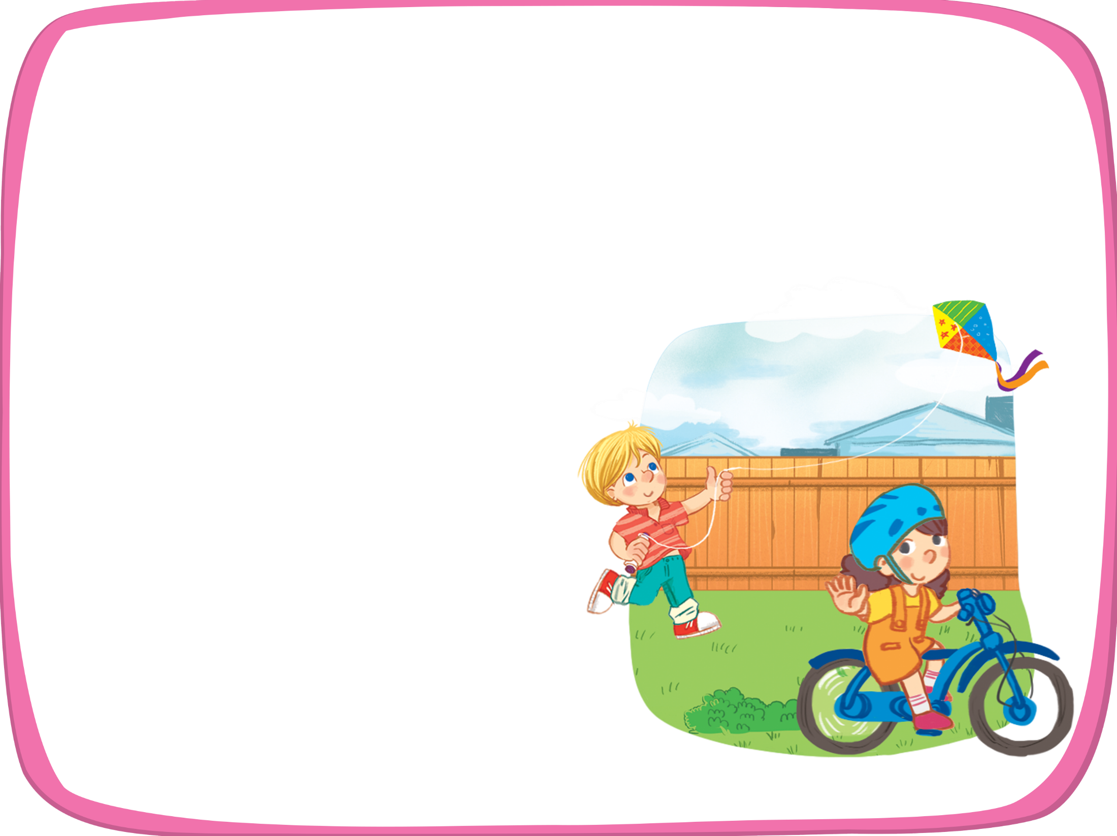
Unit
Let’s sing!
Where’s ate?
K
She’s in the yard.
k
Is she riding a bi e?
Yes, she is. Yes, she is.
Where’s Ken?
He’s in the yard.
k
Is he riding a bi e?
No, he isn’t. No, he isn’t.

Slide 21



Unit
Let’s sing!

Slide 22
05
Fun corner & Wrap-up

Slide 23


Let’s play game
Option 1
Option 2

Slide 24
Option 1
Matching game

Slide 25






Matching game
1. She’s flying a kite.
2. He’s flying a kite.

Slide 26
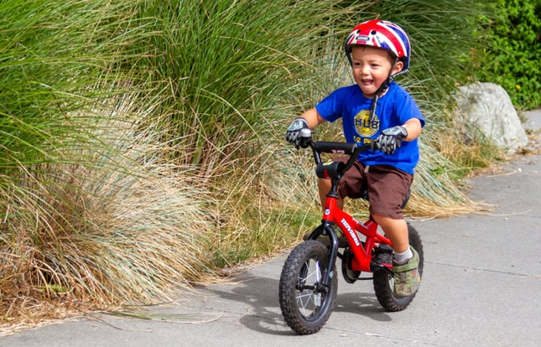
Matching game
1. She’s riding a bike.
2. He’s riding a bike.

Slide 27
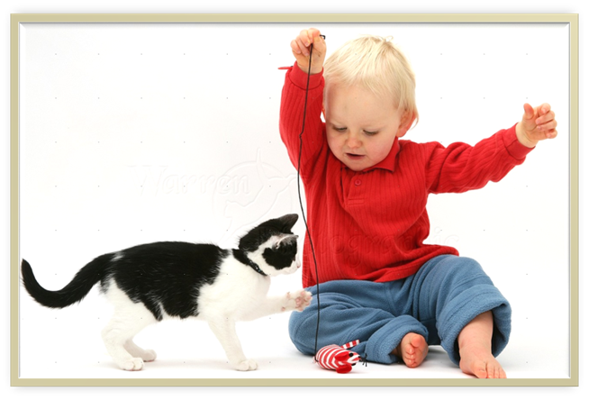
Matching game
1. He’s playing with a bike.
2. He’s playing with a kitten.

Slide 28



Slide 29
Missing game
Option 2

Slide 30


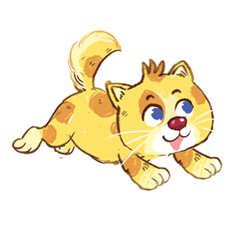

Missing game
bike

Slide 31
Missing game
kitten

Slide 32
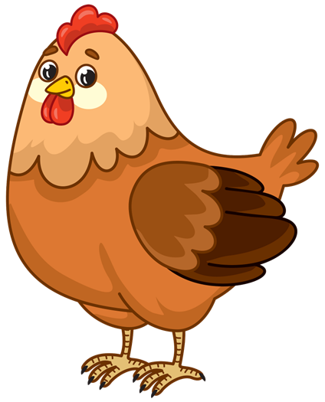
Missing game
chicken

Slide 33

Missing game
cake

Slide 34
GOODBYE!

Slide 35
Website: hoclieu.vn
Fanpage: https://www.facebook.com/tienganhglobalsuccess.vn/

