Slide 1





Slide 2


Time and daily routines
2
Lesson 2 – 4,5,6

Slide 3
Table of contents
Warm-up
& review
6
4
5
Let’s sing.
Listen and number.
Fun corner & wrap-up
Look, complete and read.

Slide 4
Warm-up & review

Slide 5
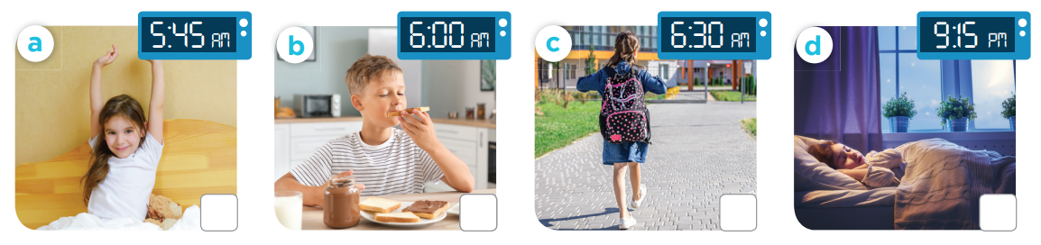
Slap the board!
Notes:
Teacher can read the action or time

Slide 6
4
Listen and number.

Slide 7
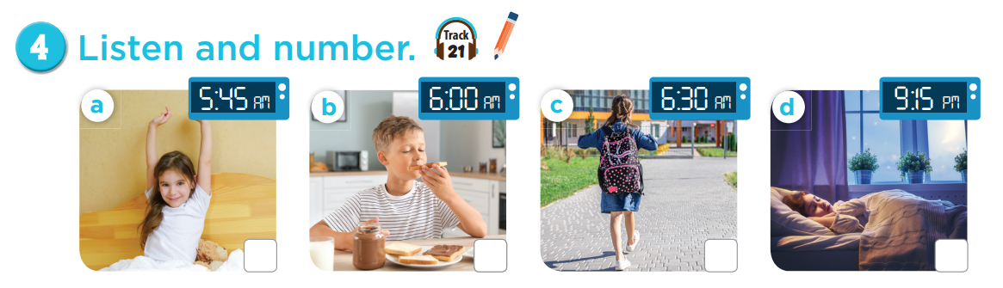

3
4
2
1

Slide 8
5
Look, complete and read.

Slide 9
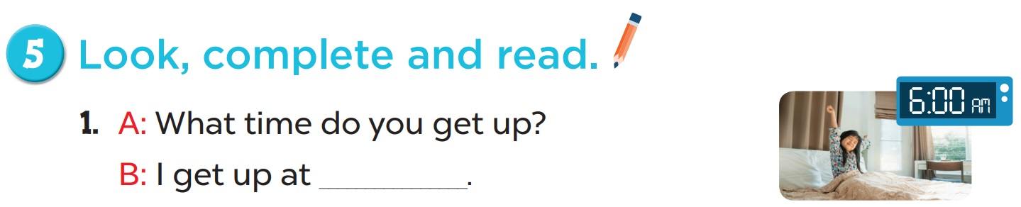
6 o’clock

Slide 10
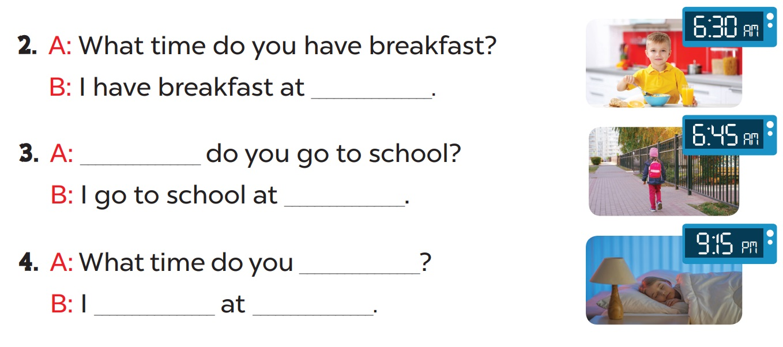
six thirty
What time
six forty-five
go to bed
go to bed
nine fifteen

Slide 11
6
Let’s sing.

Slide 12
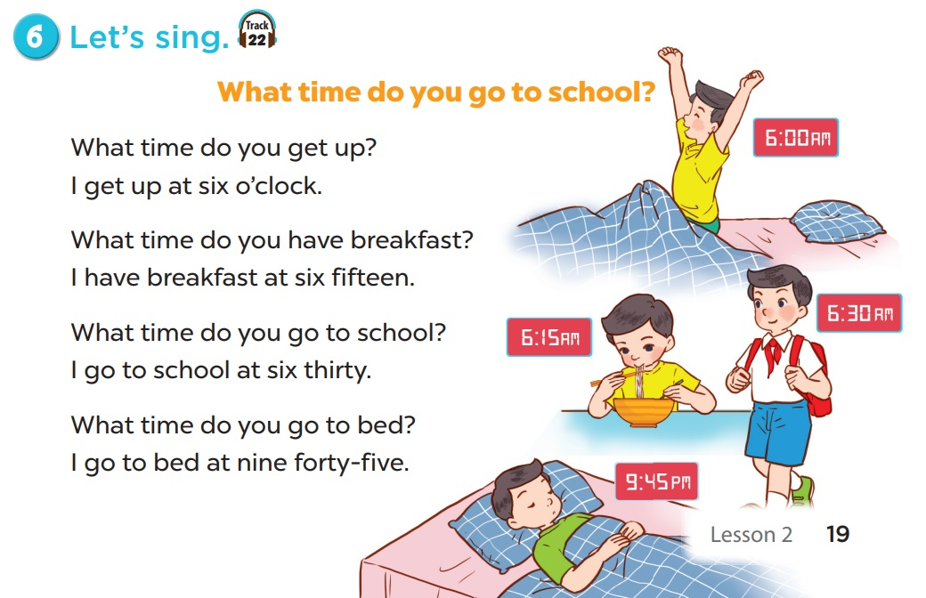

Slide 13
Fun corner & wrap-up

Slide 14
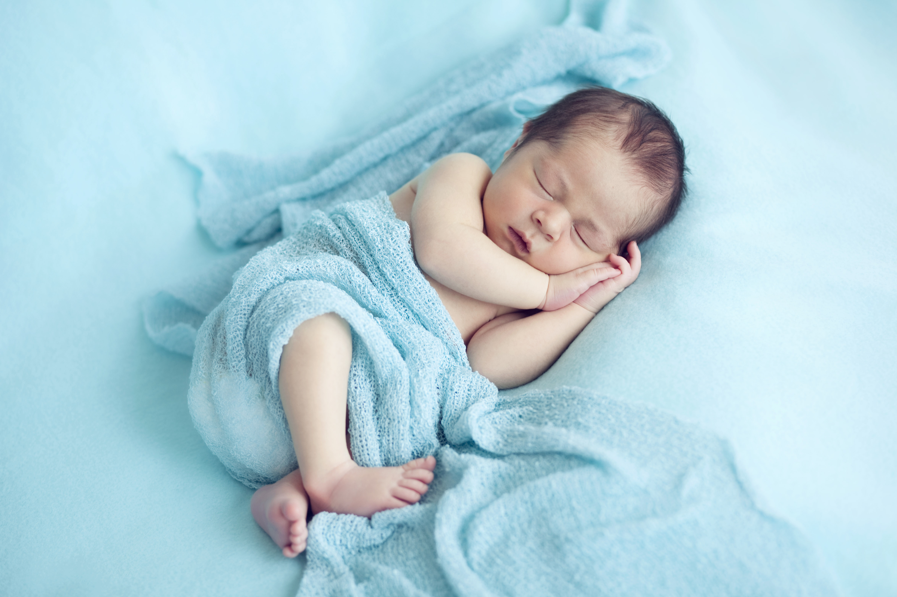

What/ bed/ go/
time/ you/ do/ to/ ?
Check
What time do you go to bed?

Slide 15
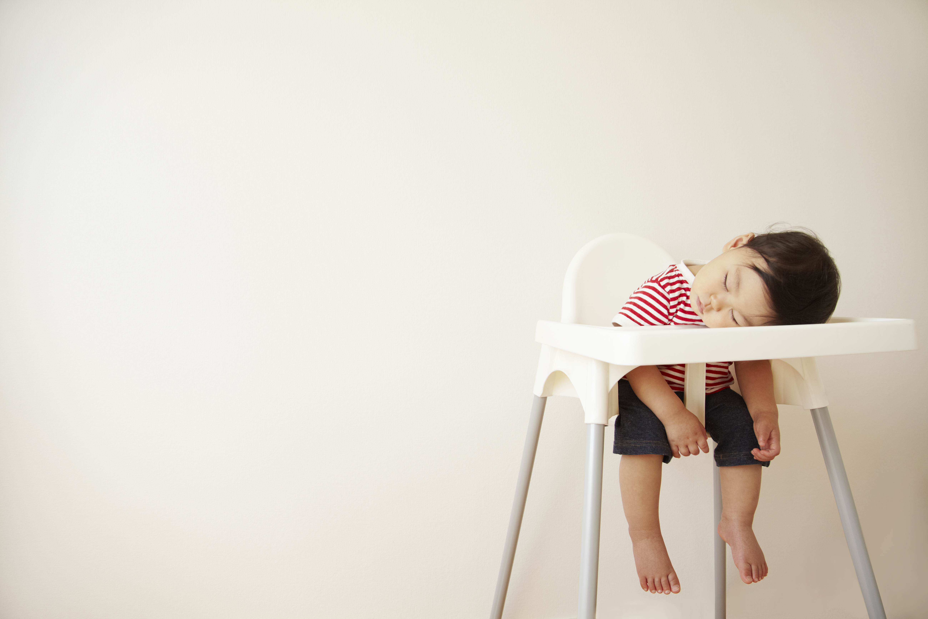
nine/ fifteen/ I/
go/ to/ at/ bed/ .
Check
I go to bed at nine fifteen.

Slide 16
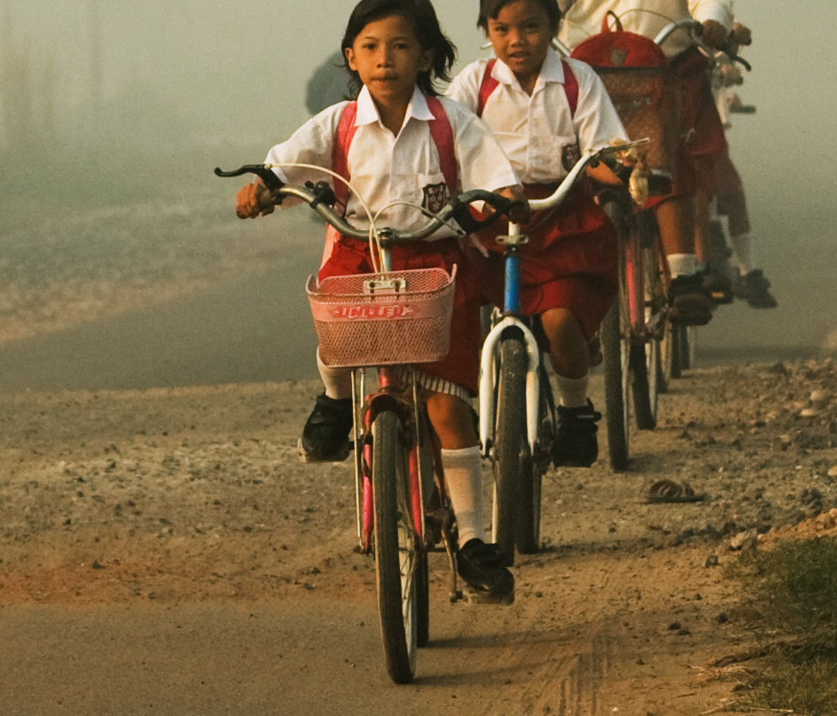
I/ six/ forty-five./
school/ to/ go/ at
Check
I go to school at six forty-five.

Slide 17
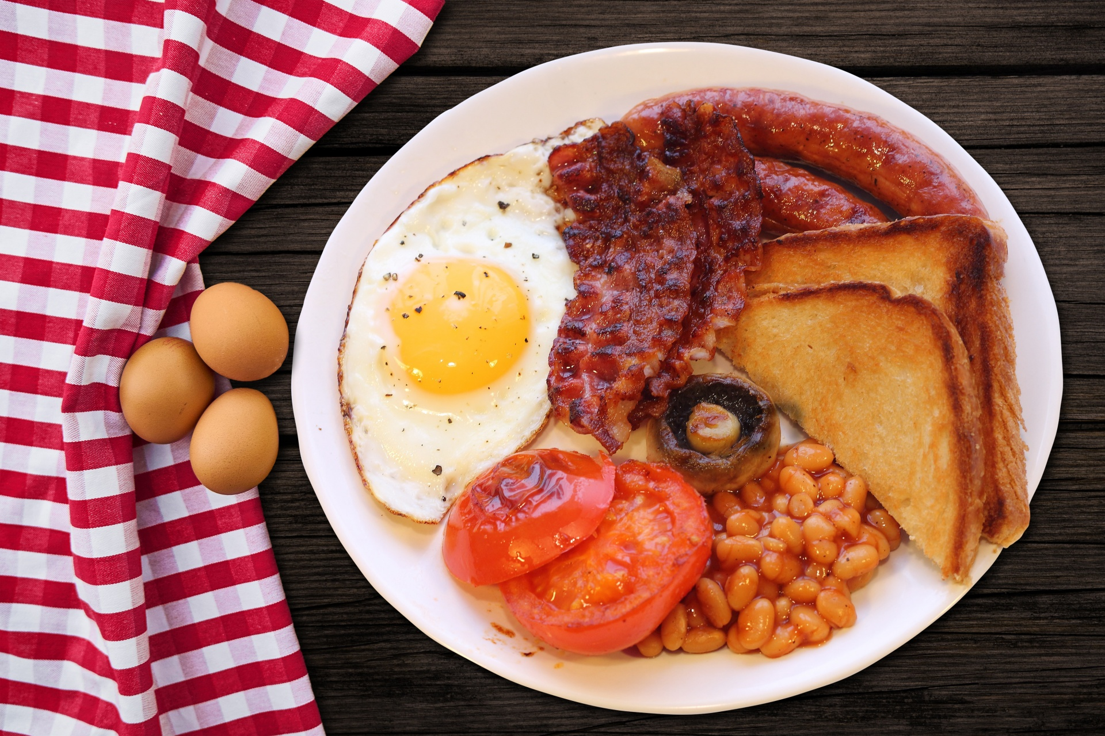
I/ breakfast/ at/
have/ six/ thirty/.
Check
I have breakfast at six thirty.

Slide 18

End

