Slide 1





Slide 2


Time and daily routines
2
Lesson 2 – 1,2,3

Slide 3
Table of contents
Warm-up and Review
3
1
2
Let’s talk.
Look, listen and repeat.
Fun corner & wrap-up
Listen, point and say.

Slide 4
Warm-up & review

Slide 5
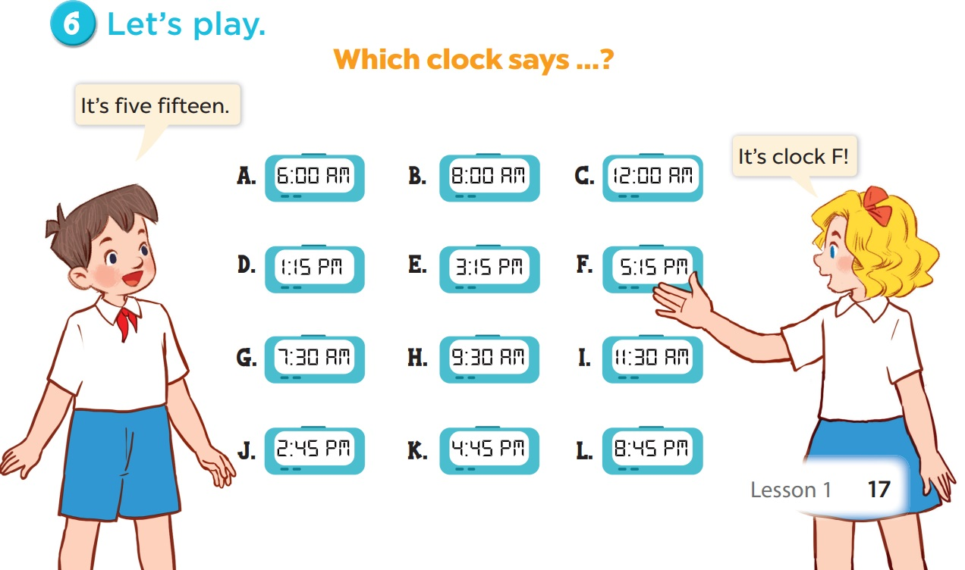

Slide 6
1
Look, listen and repeat.

Slide 7
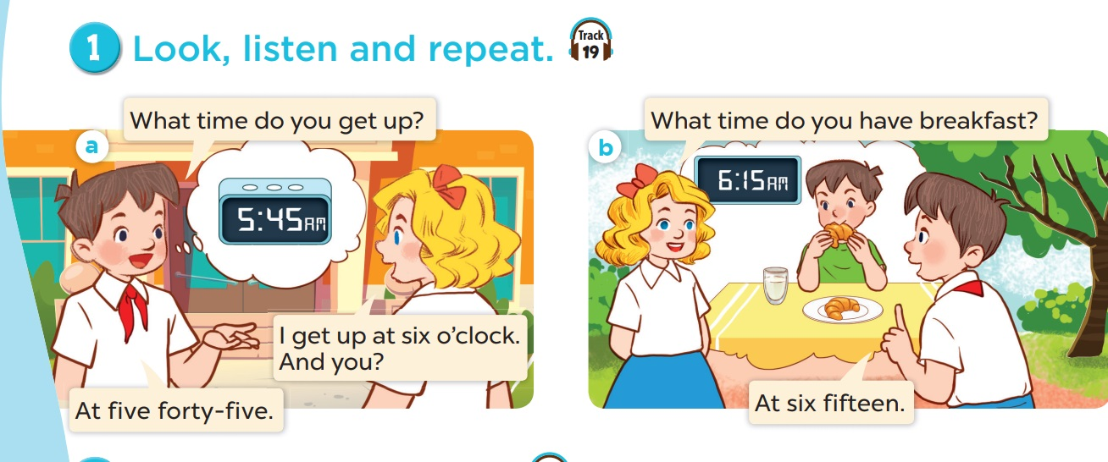


Slide 8
2
Listen, point and say.

Slide 9
vocabulary

Slide 10
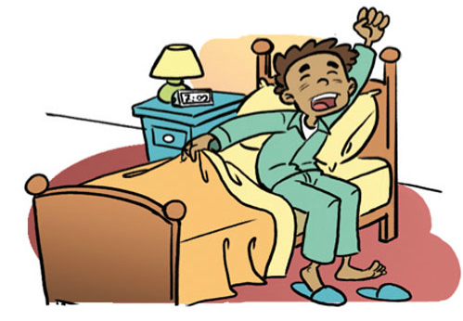
get up

Slide 11
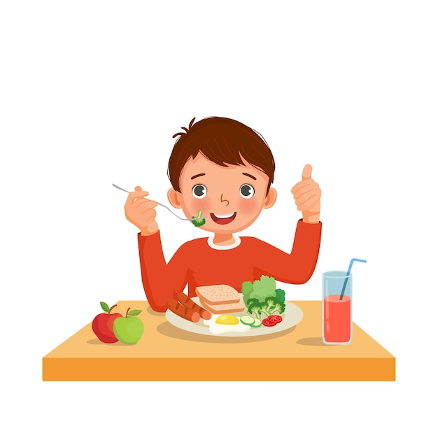
have breakfast

Slide 12

go to school

Slide 13
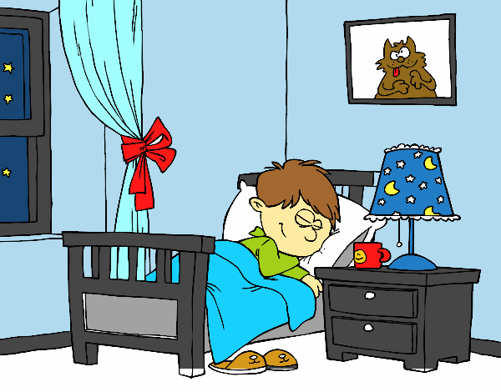
go to bed

Slide 14

What time do you get up?
I get up at
5 o’clock.

Slide 15
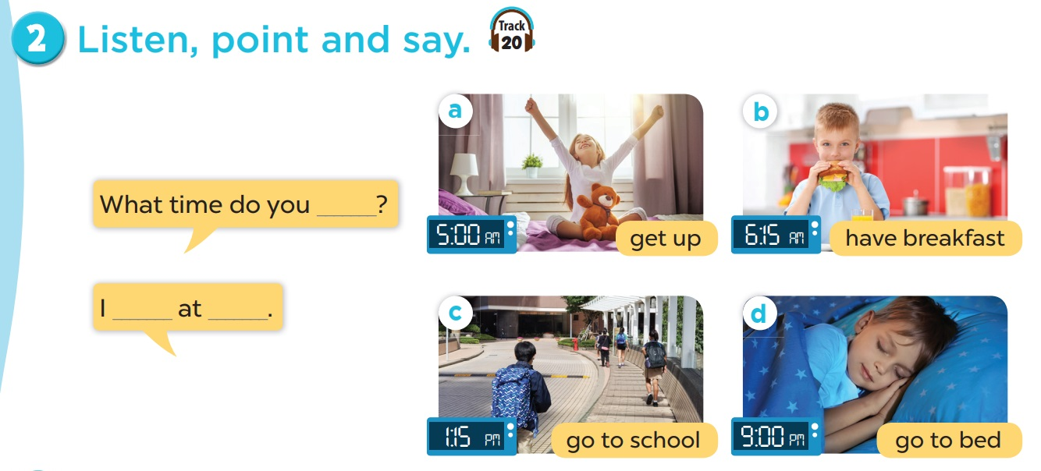

Slide 16
3
Let’s talk.

Slide 17
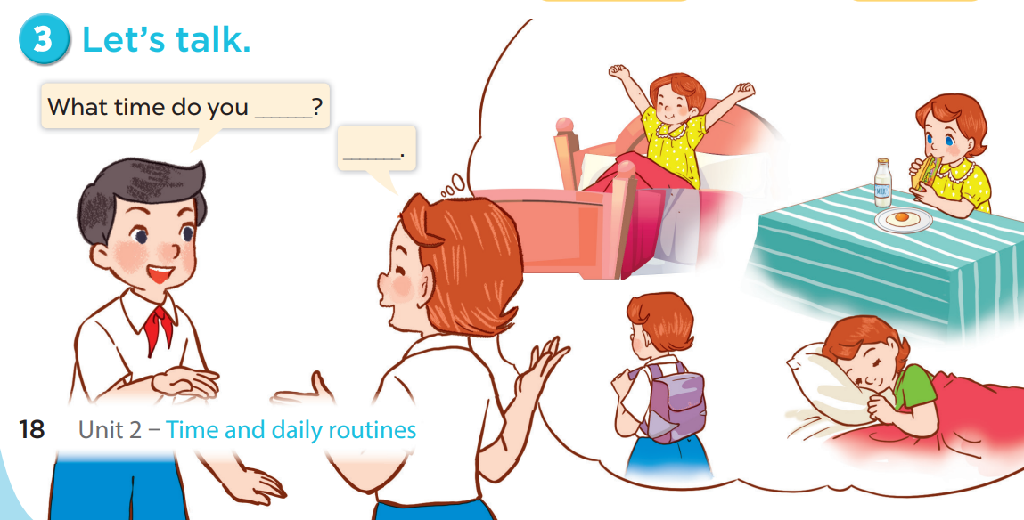

Slide 18
Fun corner & wrap-up

Slide 19

Magic wheel
50
10
20
30
10
20
30
40
Spin
PLAY
LUẬT CHƠI
Nhấn nút để quay.
Trả lời đúng câu hỏi sẽ được cộng số điểm tương ứng vị trí mũi tên dừng.
Kết thúc trò chơi đội cao điểm hơn sẽ chiến thắng.
Spin

Slide 20
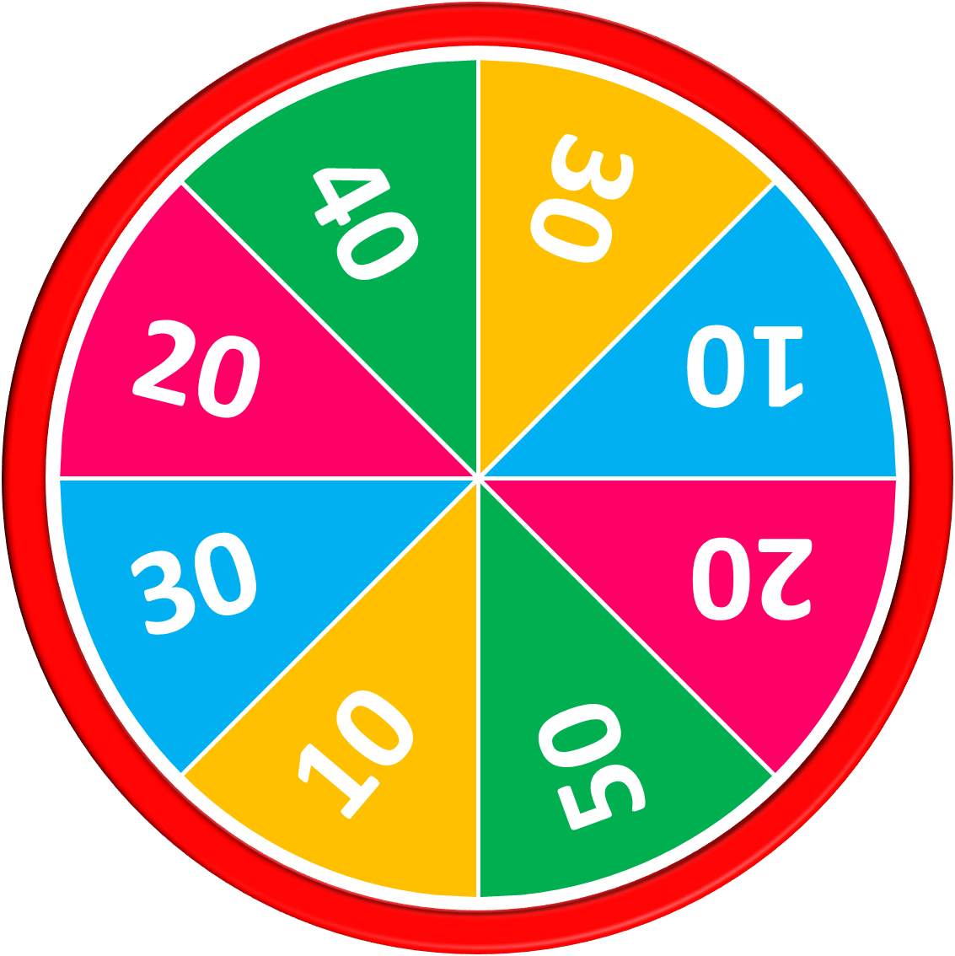
50
10
20
30
10
20
30
40
Answer
get up
Stop
Spin

Slide 21
50
10
20
30
10
20
30
40
Answer
have breakfast
Stop
Spin

Slide 22
50
10
20
30
10
20
30
40
Answer
go to school
Stop
Spin

Slide 23
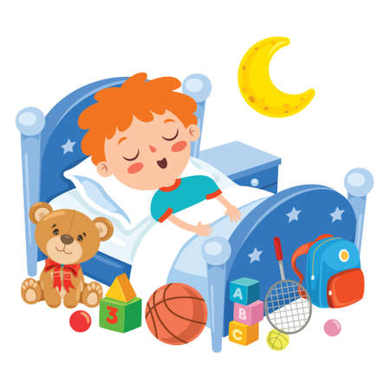
50
10
20
30
10
20
30
40
Answer
go to bed
Stop
Spin

Slide 24
50
10
20
30
10
20
30
40
Answer
A: What time do you get up?
B: I get up at five o’clock.
Stop
Spin

Slide 25
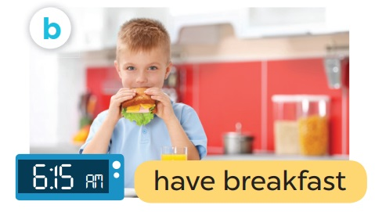
50
10
20
30
10
20
Answer
30
40
A: What time do you have breakfast?
B: I have breakfast at six fifteen.
Stop
Spin

Slide 26
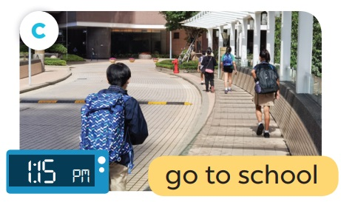
50
10
20
30
10
20
Answer
30
40
A: What time do you go to school?
B: I go to school at one fifteen.
Stop
Spin

Slide 27
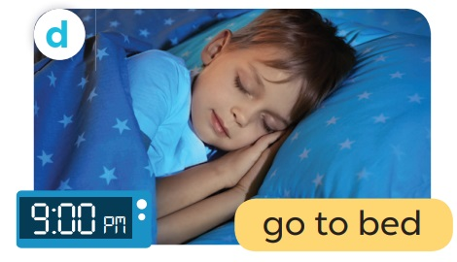
50
10
20
30
10
20
Answer
30
40
A: What time do you go to bed?
B: I go to bed at nine o’clock.
Stop
Spin

Slide 28

50
10
20
30
10
20
30
40
Exit

