Slide 1





Slide 2


Time and daily routines
2
Lesson 1 – 4,5,6

Slide 3
Table of contents
Warm-up and review
6
4
5
Let’s play.
Fun corner & wrap-up
Listen and tick.
Look, complete and read.

Slide 4
Warm-up & review

Slide 5
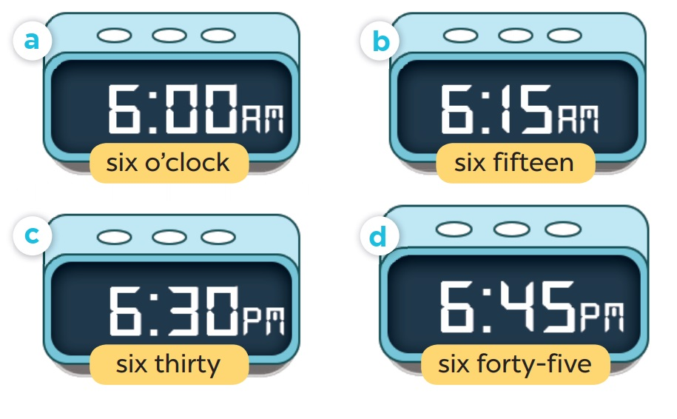
Slap the board

Slide 6
4
Listen and tick.

Slide 7
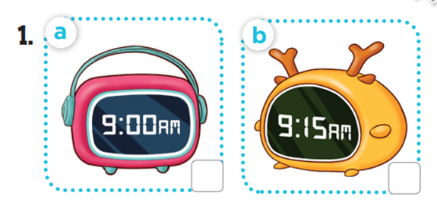

Slide 8
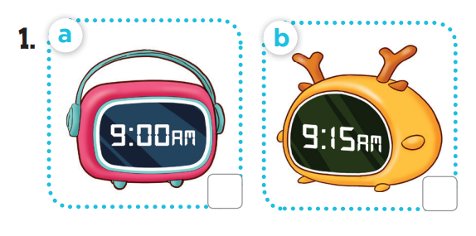
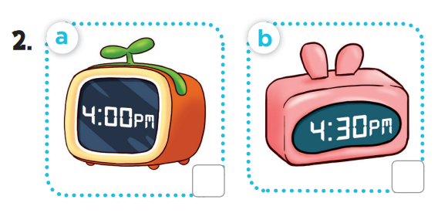

Slide 9
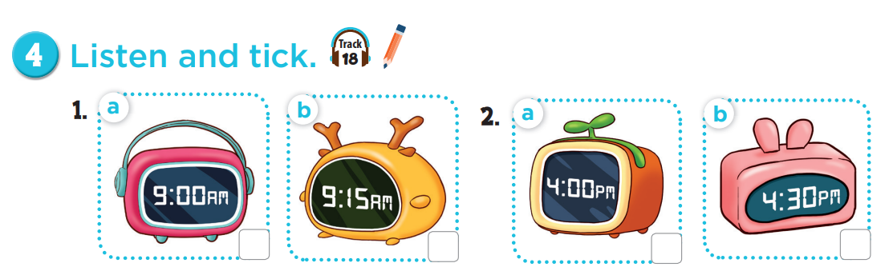



Slide 10
5
Look, complete and read.

Slide 11
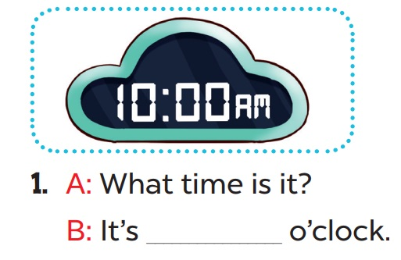
ten

Slide 12
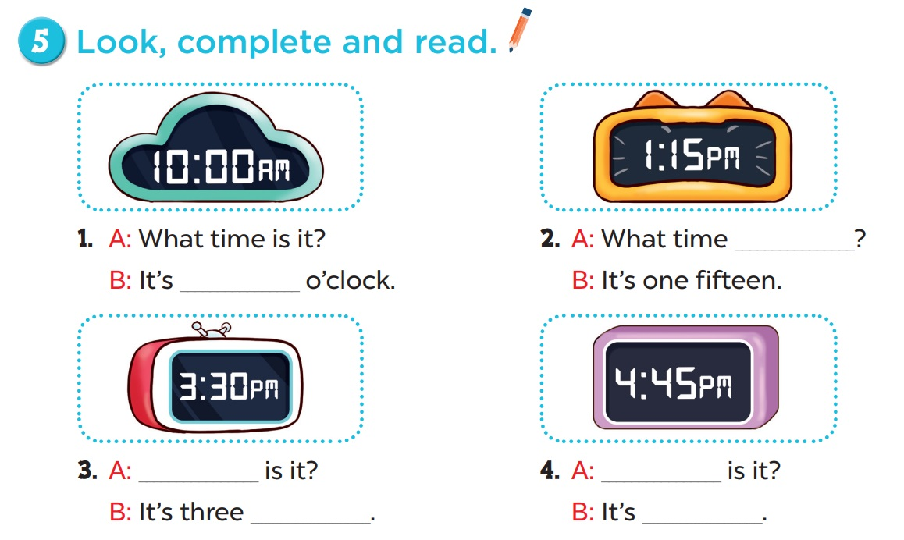
is it
ten
What time
What time
thirty
four forty-five

Slide 13
6
Let’s play.

Slide 14
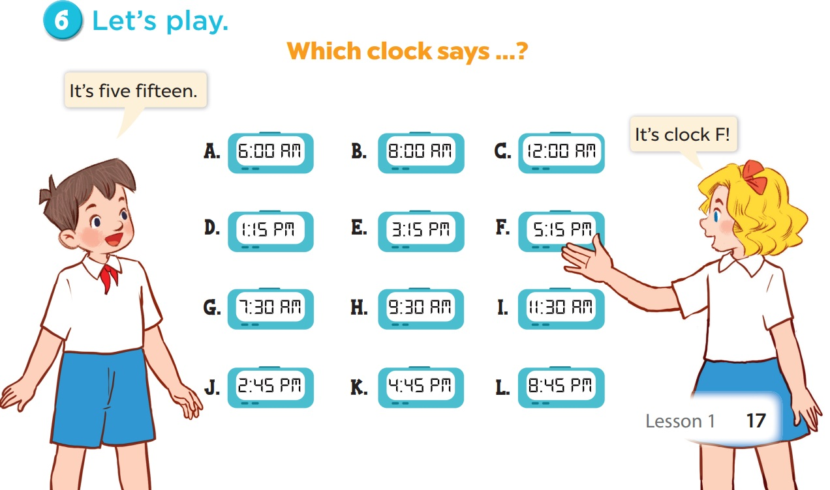

Slide 15
05
Fun corner & wrap-up

Slide 16


What/ is/ time it/ ?
Check
What time is it?

Slide 17
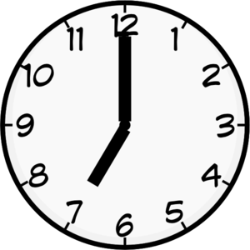
It/ seven/ is/
c’clock/.
Check
It is seven o’clock.

Slide 18

six/ It’s/ o’clock/.
Check
It’s six o’clock.

Slide 19
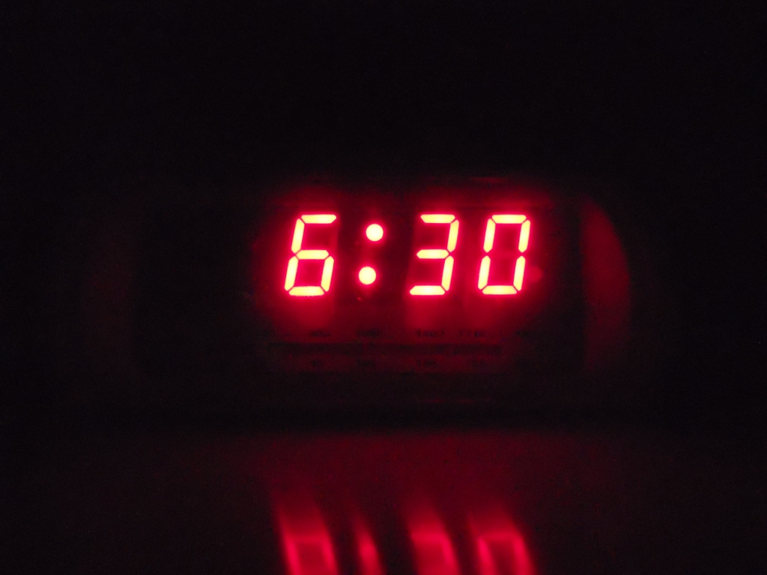
six/ thirty/ It’s/ .
Check
It’s six thirty.

Slide 20

End

