Slide 1





Slide 2


Time and daily routines
2
Lesson 1 – 1,2,3

Slide 3
Table of contents
Warm-up and Review
3
1
2
Let’s talk.
Look, listen and repeat.
Fun corner & wrap-up
Listen, point and say.

Slide 4
Warm-up & Review

Slide 5
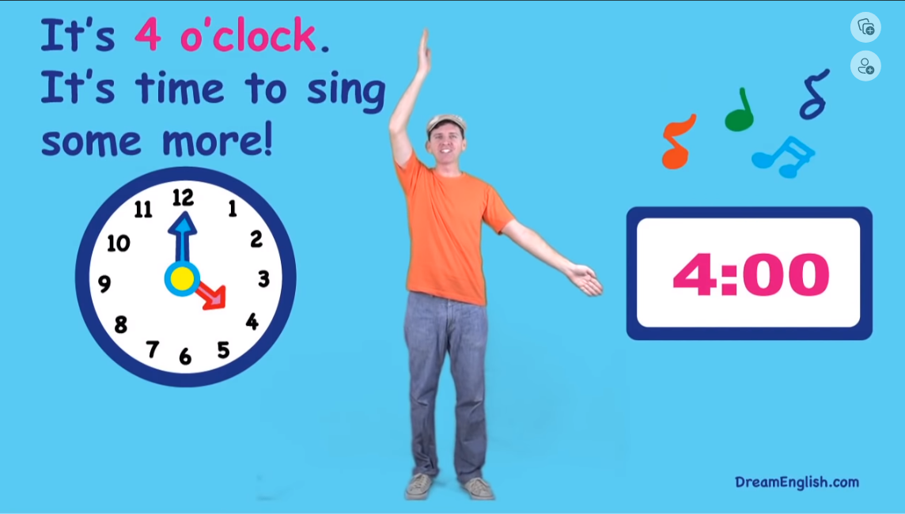
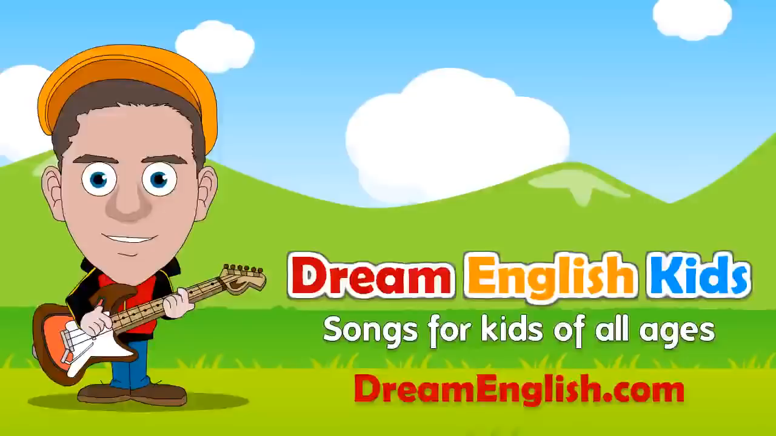
Sing the song.

Slide 6
1
Look, listen and repeat.

Slide 7
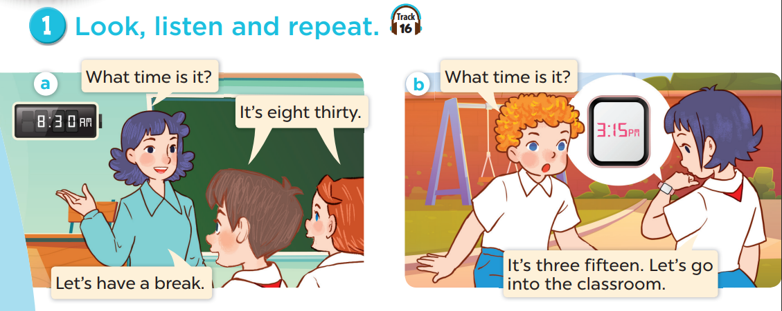


Slide 8
2
Listen, point and say.

Slide 9
Vocabulary

Slide 10
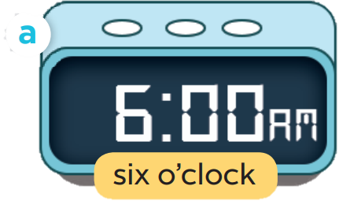
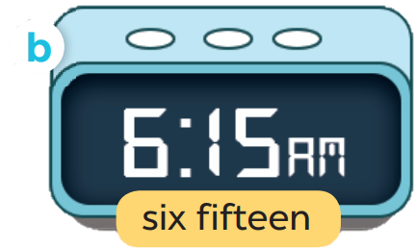
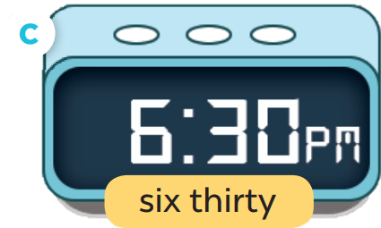
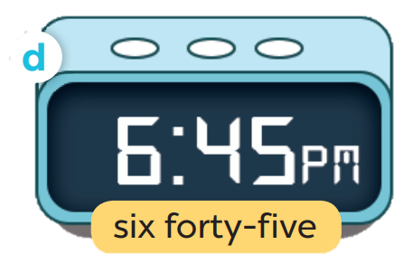

Slide 11
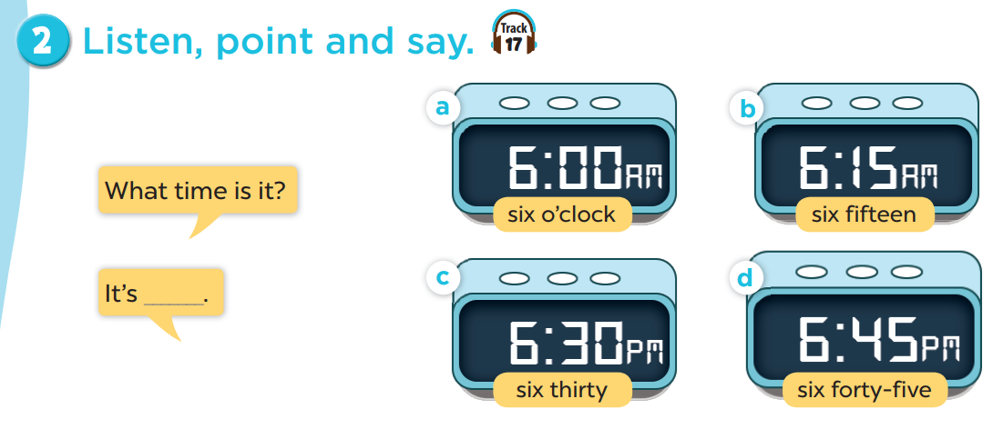

Slide 12

What time is it?
I six o’clock.

Slide 13
3
Let’s talk.

Slide 14
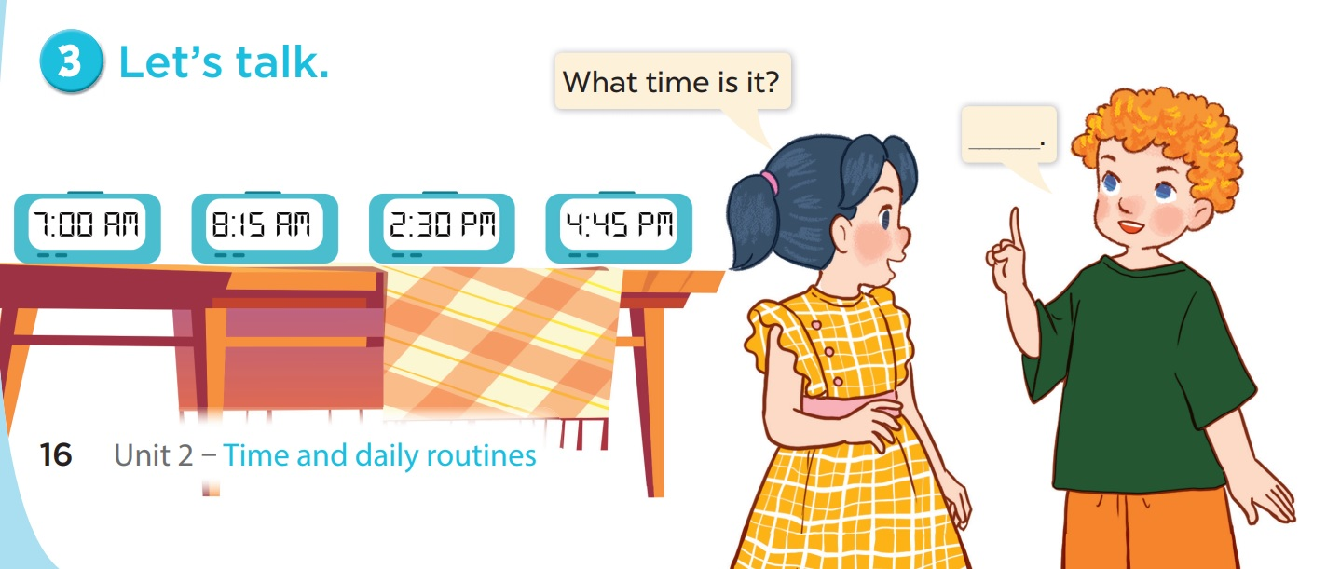

Slide 15
Fun corner & wrap-up

Slide 16



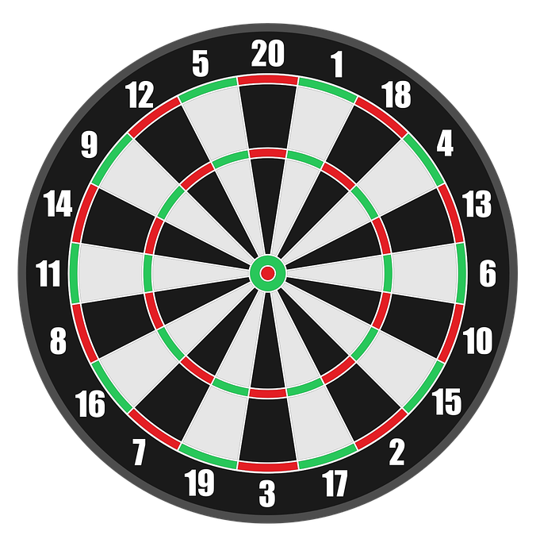

PLAY

Slide 17

A: What time is it?
B: It’s ___________.
+50
b. seven thirty
a. seven o’clock
c. six o’clock
Next

Slide 18
A: What time is it?
B: It’s ___________.
+50
b. eight fifteen
a. eight fifty
c. eight five
Next

Slide 19
A: What time is it?
B: It’s ___________.
+25
b. two three
a. two thirty
c. two thirteen
Next

Slide 20
A: What time is it?
B: It’s ____________.
+25
b. four fifteen
a. four forty
c. four forty-five
Next

Slide 21
WELL DONE!
EXIT

