Slide 2

Unit 1. All about me!
Lesson 1 - Period 1

Slide 3

Table of contents
01
Warm-up and review
02
Look, listen and repeat.
03
Listen, point and say.
04
Let’s talk.
05
Fun corner and wrap-up

Slide 4
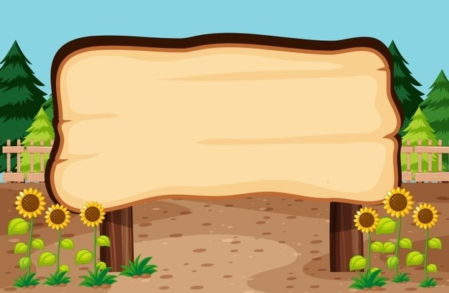

01
Warm-up and review

Slide 5
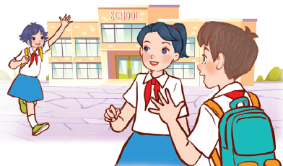
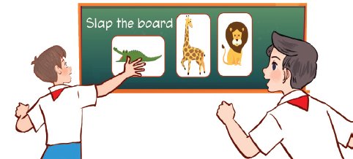
Let’s sing.
Back to school
Back to school.
Happy to see my friends!
Back to school.
Learning and playing are really cool!
Back to school.
Happy to see my teachers!
Back to school.
Learning and playing are really cool!

Slide 6


Perform

Slide 7
02
Look, listen and repeat.

Slide 8

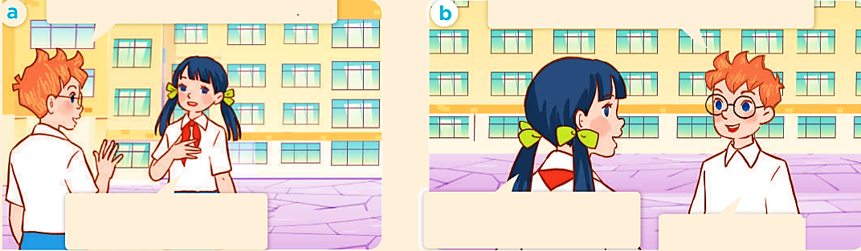
Look, listen and repeat.
a
b

Slide 9
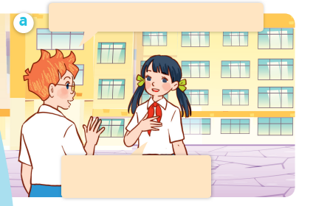
Look, listen and repeat.
Hello. I’m Ben. Nice to meet you.
Hello, Ben. I’m Lan.
Nice to meet you, too.
Notes:
Nháy vào hội thoại để nghe lại âm thanh từng câu.

Slide 10
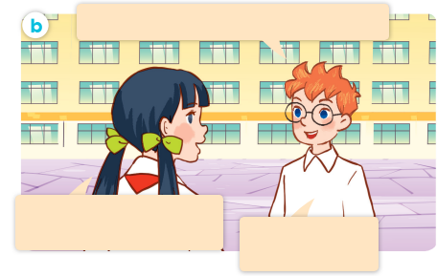
Look, listen and repeat.
Can you tell me about yourself, Lan?
Well, I’m in Class 5C.
I live in the countryside.
I’m in Class 5B.
I live in the city.
Notes:
Nháy vào hội thoại để nghe lại âm thanh từng câu.

Slide 11
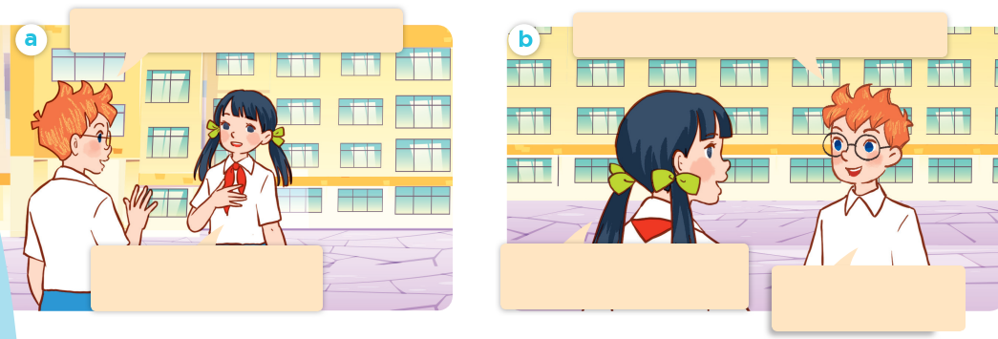
Look, listen and repeat.
Hello. I’m Ben. Nice to meet you.
Can you tell me about yourself, Lan?
Hello, Ben. I’m Lan.
Nice to meet you, too.
Well, I’m in Class 5C.
I live in the countryside.
I’m in Class 5B.
I live in the city.

Slide 12
Can you tell me about yourself, Lan?
Well, I’m in Class 5C. I live in the countryside.

Slide 13
03
Listen, point and say.

Slide 14
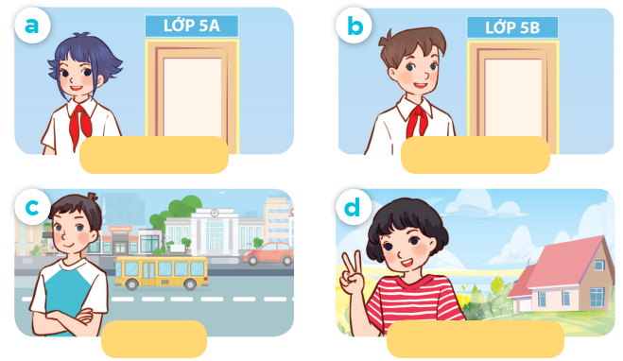
Listen, point and say.
Class 5A
Class 5B
city
countryside

Slide 15
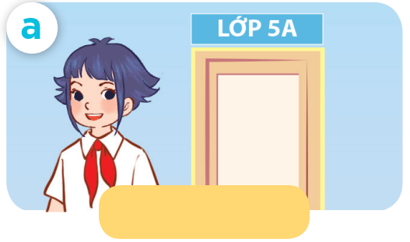
Listen, point and say.
Class 5A

Slide 16
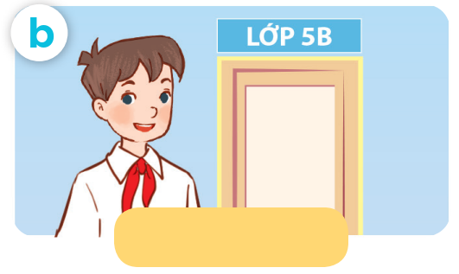
Listen, point and say.
Class 5B

Slide 17
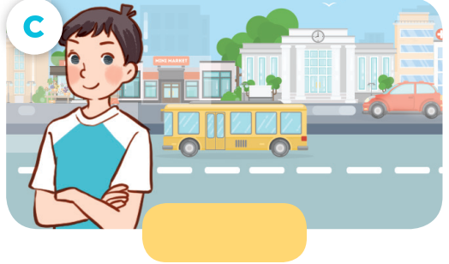
Listen, point and say.
city

Slide 18

Listen, point and say.
countryside

Slide 19

Can you tell me about yourself?
I’m in ____ .
I live in the ___.

Slide 20
Listen, point and say.
Can you tell me about yourself?
I’m in Class 5A .
Class 5A

Slide 21
Listen, point and say.
Can you tell me about yourself?
I’m in Class 5B.
Class 5B

Slide 22
Listen, point and say.
Can you tell me about yourself?
I live in the city.
city

Slide 23
Listen, point and say.
Can you tell me about yourself?
I live in the countryside.
countryside

Slide 24
Can you tell me about yourself?
Class 5A
Class 5B
I’m in ____.
I live in the __.
city
countryside

Slide 25
04
Let’s talk.

Slide 26
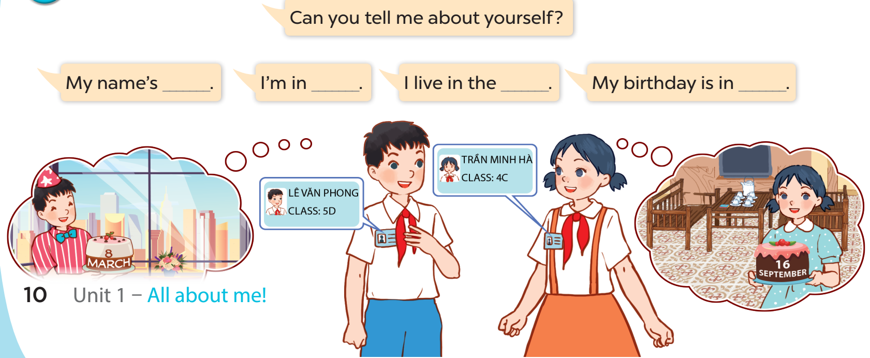
Let’s talk.
Can you tell me about yourself?
My name's ___.
I'm in ___.
I live in the ___.
My birthday is in ___.

Slide 27
Can you tell me about yourself?
I’m in ____.
I live in the ___.

Slide 28
05
Fun corner and wrap-up

Slide 29


Slide 30

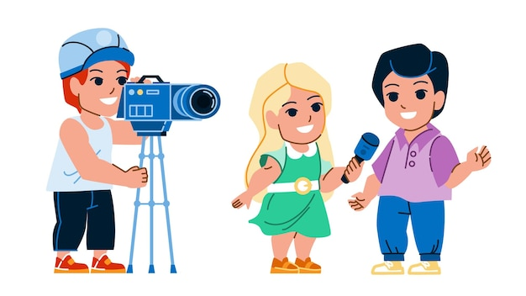
Can you tell me about yourself?
____.

Slide 31
Website: hoclieu.vn
Fanpage: https://www.facebook.com/tienganhglobalsuccess.vn/

