Slide 1



Slide 2



1
Hello
LESSON 2
Part 1,2,3

Slide 3
Contents
Warm-up
1
Look, listen and repeat.
2
Listen, point and say.
3
Let’s talk.
Fun corner and wrap-up

Slide 4
1
Warm-up and review
Game

Slide 5

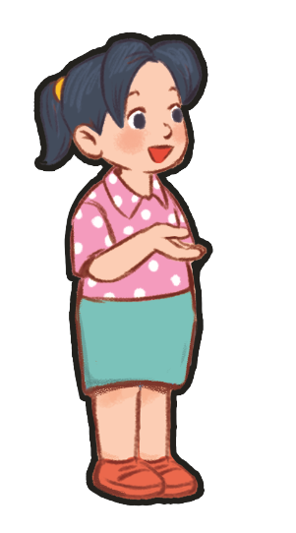


Picking
Coconuts
Notes:
Step 1: Divide the class into 4 teams: A, B, C, D.
Step 2: Set the rules: Teacher says (or plays the recording of) a number and let the teams take turns to answer. Pupils have to click the correct number on the screen. If the answer is correct, 1 point is given to that team.
- Encourage pupils to join the game. Give points to the teams and encourage the students.

Slide 6



Listen and click the right coconut.
5
8
9
We did it!
eight

Slide 7

Listen and click the right coconut.
7
3
10
We did it!
ten

Slide 8
Listen and click the right coconut.
3
2
6
We did it!
three

Slide 9
Listen and click the right coconut.
4
2
9
We did it!
four

Slide 10
1
Look, listen and repeat.

Slide 11

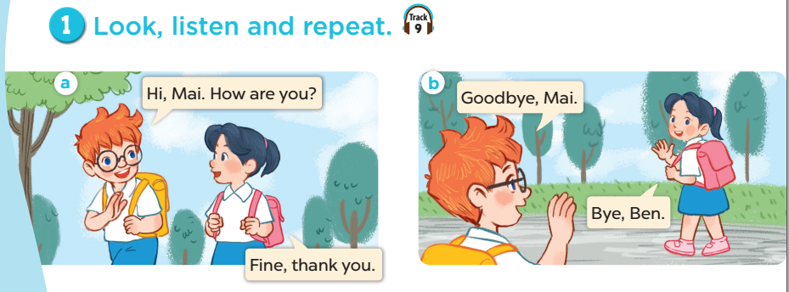

Slide 12
2
Listen, point and say.

Slide 13

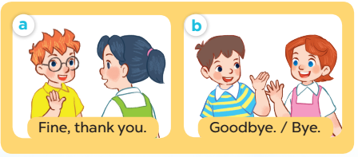
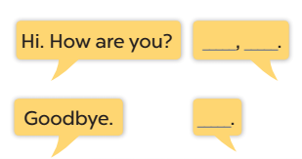

Slide 14

Role play

Slide 15
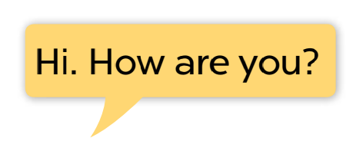
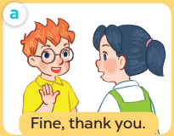

Slide 16

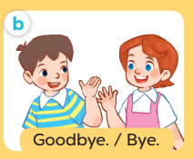

Slide 17
3
Let’s talk.

Slide 18
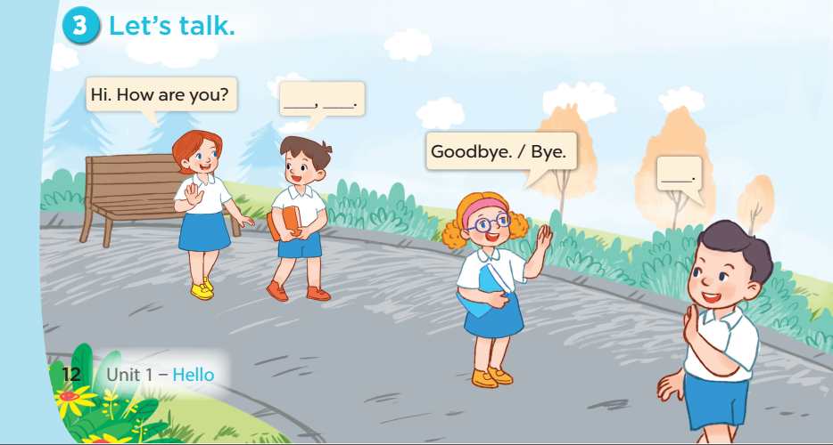

Slide 19
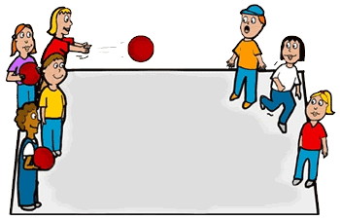
Pass the ball!
Game
Notes:
Step 1: Set the rules: Give 2 balls to pupils and turn on the music. Pupils pass the ball until the music stops. The one who is keeping the ball will talk with his/ her friends, asking “How are you?”, the others have to say the answer.
Step 2: Encourage pupils to practise speaking.
Step 3: Give point to the pupils.

Slide 20
Wrap-up

Slide 21
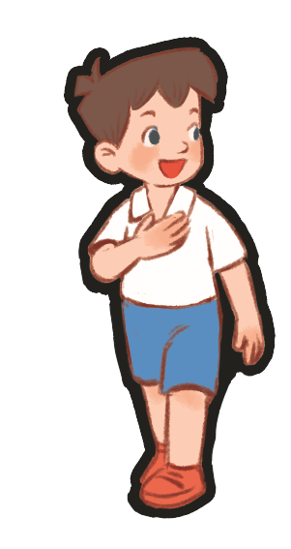
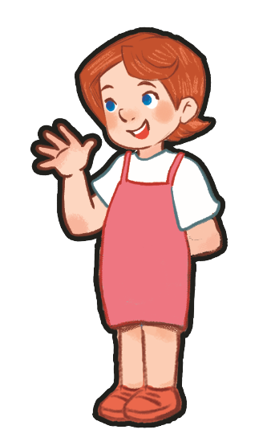
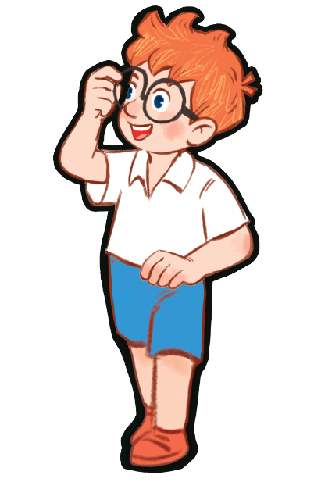
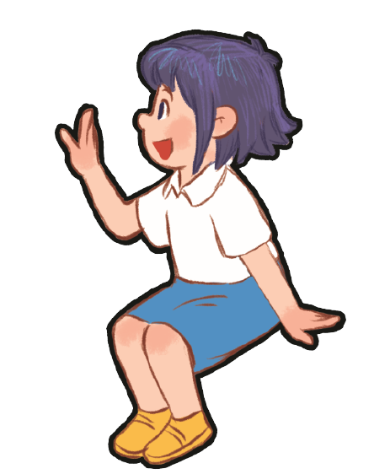
Hi, __. How are you?
Fine, thank you.
Goodbye, __!
Bye, __.

