Slide 1



Slide 2



1
Hello
LESSON 1
Part 4,5,6

Slide 3
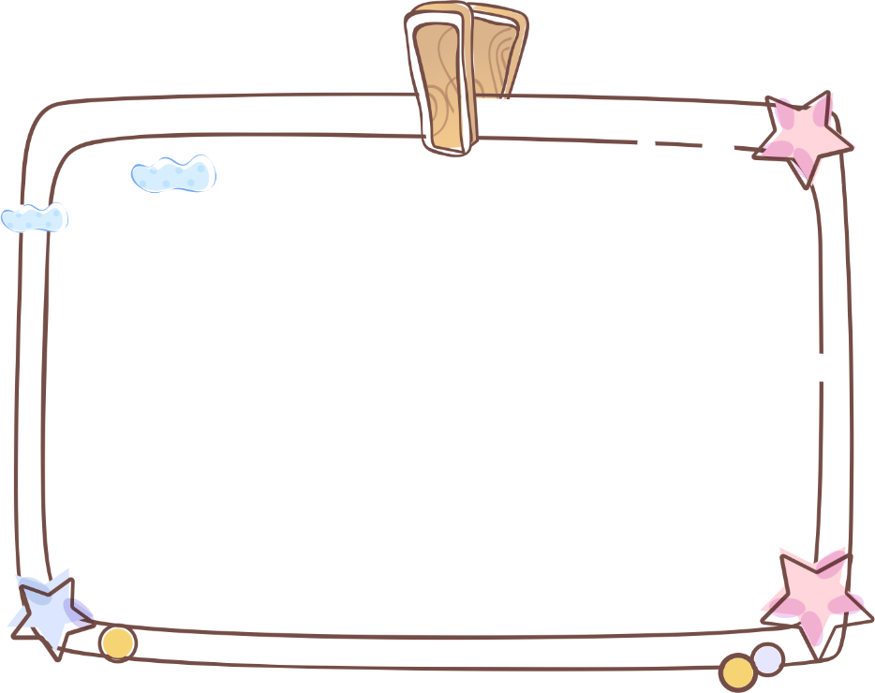
Contents
1.
Warm-up
& review
2.
Listen and circle.
4.
Let’s sing
3.
Look, complete and read.
5.
Fun corner and wrap-up

Slide 4
1
Warm-up and review
Game

Slide 5

a
c
b
d
f
e
g
h
i
j
Notes:
Step 1: Divide the class into 4 teams.
Step 2: Set rule: Pupils go to the monitor/screen and touch/click the correct letter in the tree that is the same to the letter that Mary says.
Step 3: Encourage pupils to join the game.
Step 4: Give points to the teams and encourage them.

Slide 6

v
r
f
o
h
A
a

Slide 7
n
t
w
a
b
c
N
Notes:
\

Slide 8
v
s
l
h
f
H
j

Slide 9
n
r
i
o
B
g
b

Slide 10
n
o
b
a
u
O
s

Slide 11
4
Listen and circle.

Slide 12


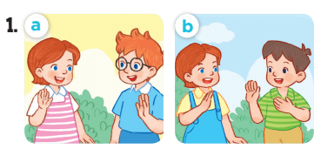
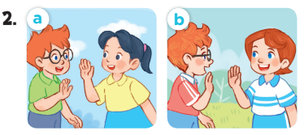

Slide 13
5
Look, complete and read.

Slide 14


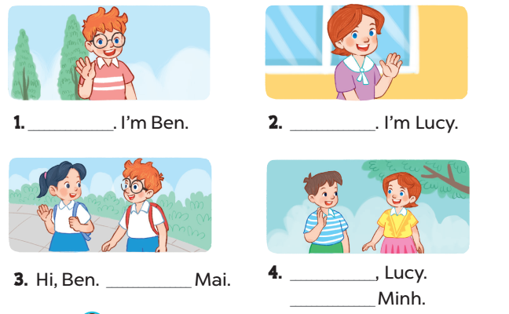
Hello
Hi
I’m
Hello
I’m

Slide 15

Role play
Game time
Notes:
Step 1: Divide the class into 2 teams.
Step 2: Invite 1 student in each team go to the board and role play.
Step 3: Give points to each team.
Step 4: Encourage students to role play to practise speaking English.

Slide 16
6
Let’s sing.

Slide 17
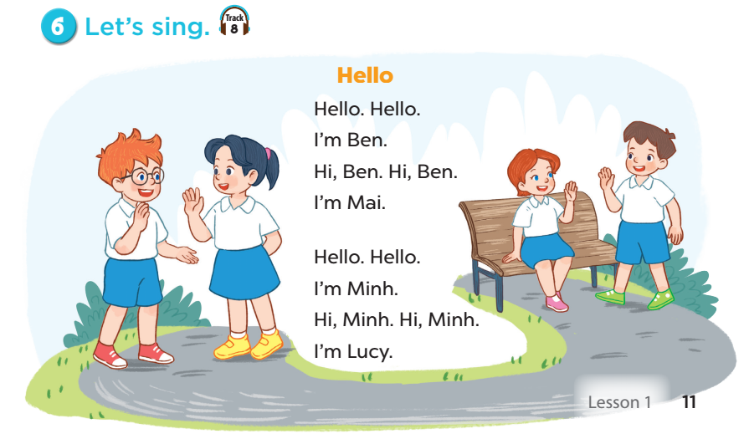

Slide 18
5
Fun corner and wrap-up

Slide 19
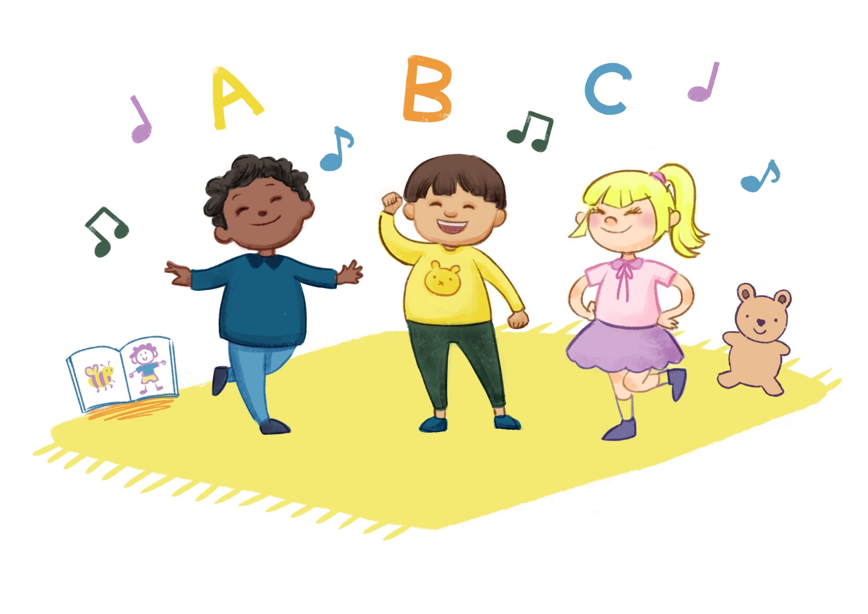
Game:
Sing and do. Then stop!
Notes:
Divide the class into 4 teams: Apple, Banana, Orange, Watermelon. Set the rules: Teacher plays the music, pupils will sing and do the actions of the song. Then teacher stops the music, pupils stop doing. Those who cannot make it have to sit down. The team having more pupils left and more beautiful dancing is the winner. Give points to pupils.

Slide 20




Teams
Notes:
Team winner is …

Slide 21
