Slide 1



Slide 2



1
Hello
LESSON 1
Period 1

Slide 3
Contents
1
Look, listen and repeat.
2
Warm-up
3
4
Practice
Let’s talk.
5
Fun corner and wrap-up

Slide 4
1
Warm-up
Game
Notes:
Review Numbers 1-10 and Alphabet

Slide 5













Notes:
Review numbers 1-10 by picking numbers
Step 1: Say the numbers for pupils to choose.
Step 2: Give points to pupils with the correct choosing.

Slide 6













Slide 7


Slide 8


Slide 9


Slide 10
Game: Look and say the missing letters.
Notes:
Step 1: Ask pupils to say the missing letters, then check with the class.
Step 2: Give points to the pupils and encourage them.

Slide 11
a
b
c
d
e
f

Slide 12
m
n
o
p
q
r

Slide 13
s
t
u
w
x
v

Slide 14
2
Look, listen and repeat.

Slide 15



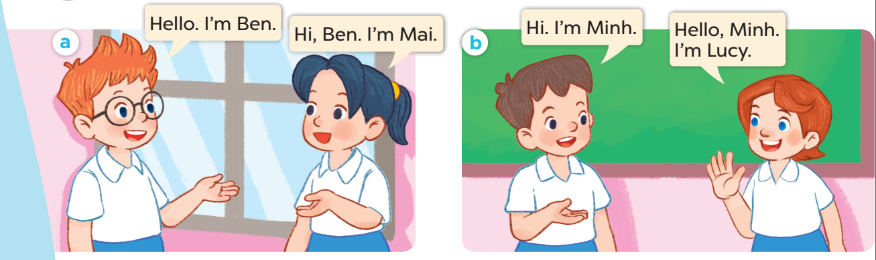

Slide 16
3
Listen, point and say.

Slide 17

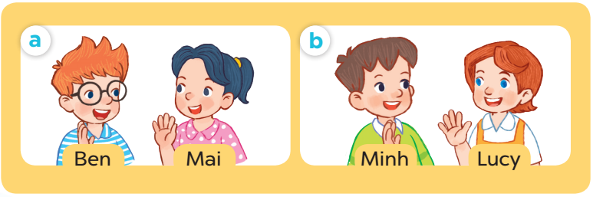
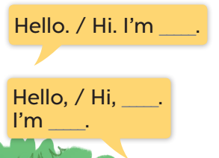

Slide 18

Hello.
I’m Mai.
I’m Minh.
Pair work
Hi, Mai.

Slide 19
4
Let’s talk.

Slide 20
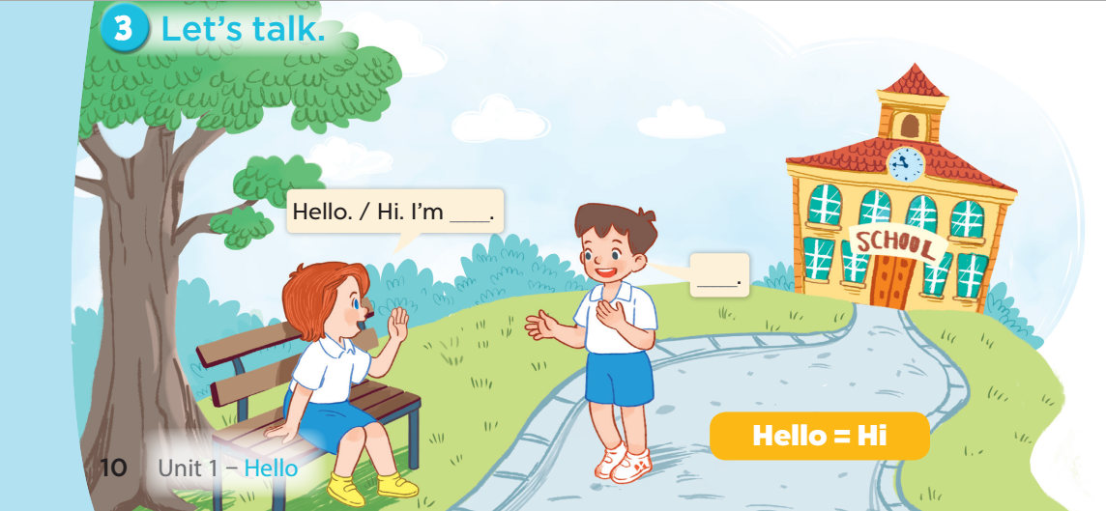

Slide 21


Game time!
Say “Hello”!!!
Notes:
Divide the class into 2 groups: boys and girls. Ask each pupil from one group tp come and practise greeting, self-introducing and responding to greetings with one pupil from the other group. Give points to the groups, praise the pupils.

Slide 22


Slide 23
5
Fun corner and wrap-up
Notes:
Step 1: Ask pupils to look at the pictures and say the sentences.
Step 2: Ask some pupils to say the names or the sentences of the characters.
Step 3: Wrap up the lesson.

Slide 24
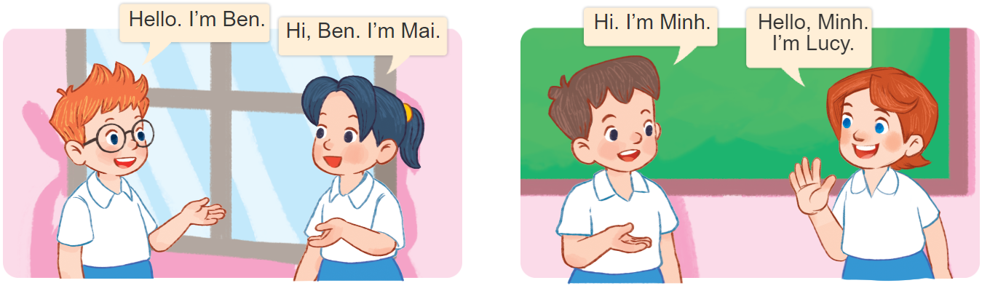
Can you say this?
Notes:
Divide the class into groups of four. Ask pupils of each group to come to the board and practise saying the conversation of the characters. Give point to the groups.

Slide 25

Website: sachmem.vn
Fanpage: www.facebook.com/sachmem.vn

