Slide 1
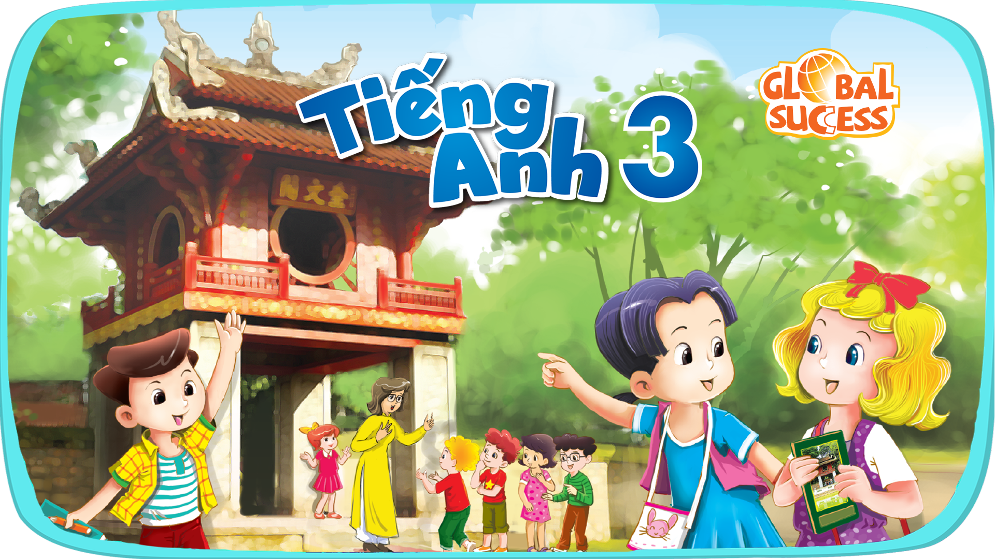

Slide 2


Starter

Slide 3



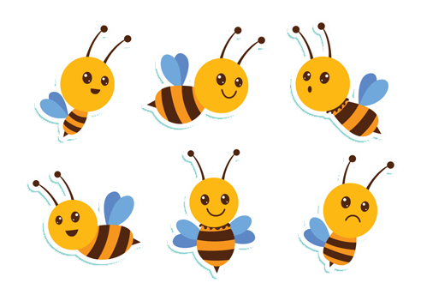
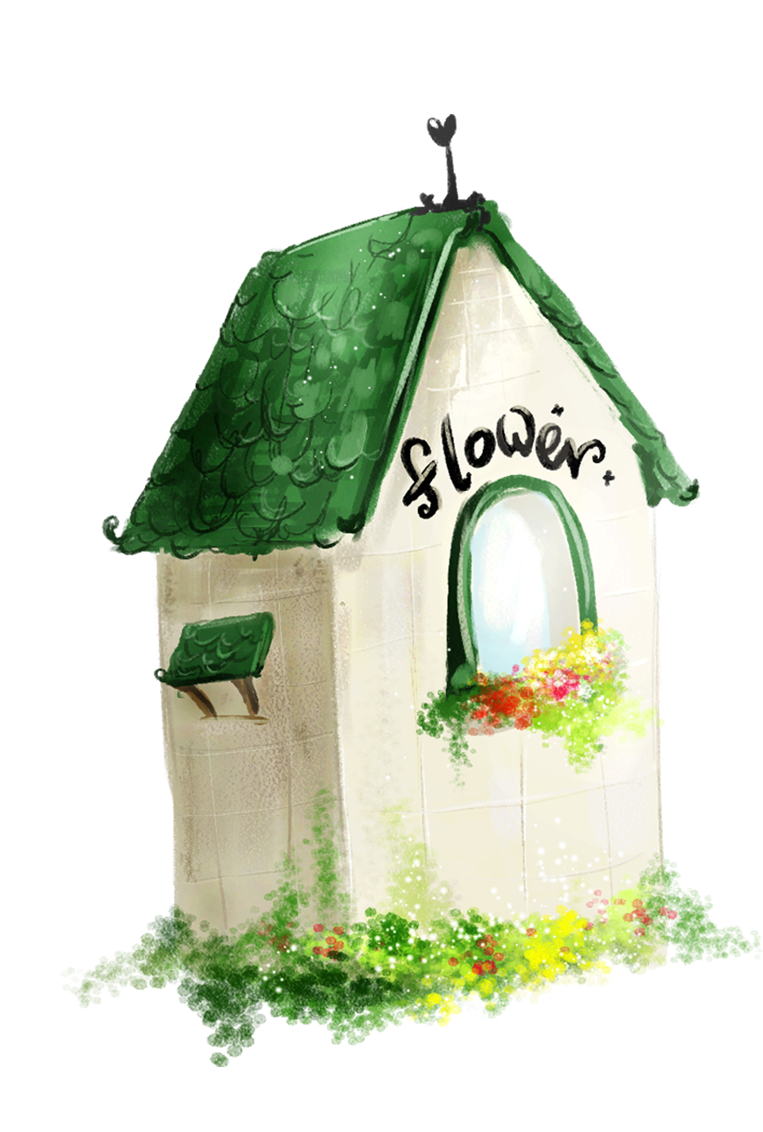
1. Warm-up
2. Count one to ten.
3. Let’s play.
4. Fun corner
5. Wrap-up
Contents

Slide 4

Warm-up
Game: Can you sing?
Notes:
Goal: Review the alphabet.
Step 1: Let the pupils sing the song once.
Step 2: Cover 4 letters at the end of each line, ask them to say what’s missing.
Step 3: Sing the song again with the missing letters .
Step 4: Cover 4 more letters at the middle of each line, ask them to say what’s missing.
Step 5: Sing the song again with the missing letters.

Slide 5
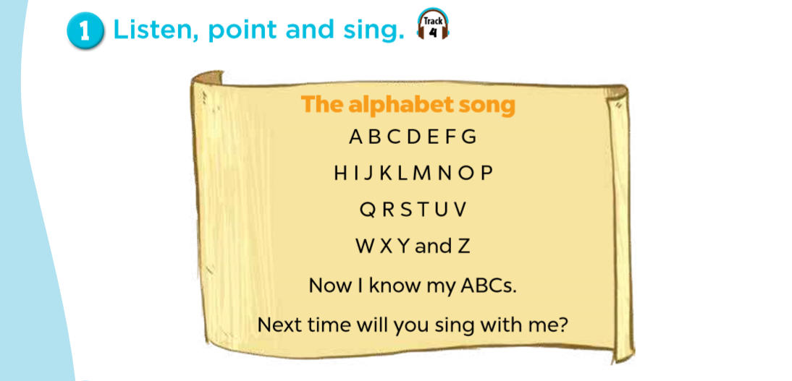

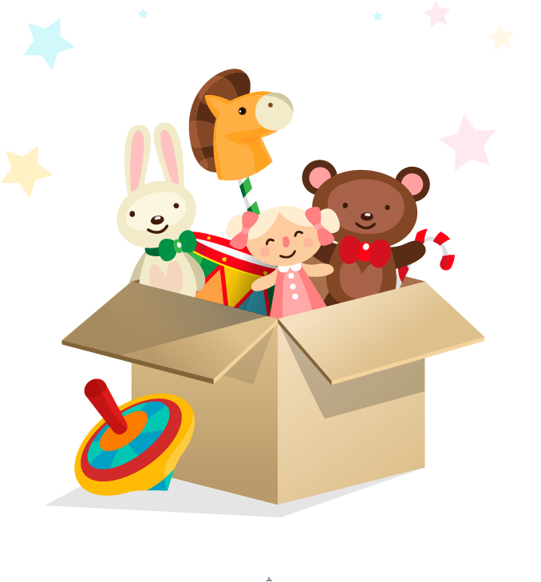
?
?
?
?
?
?
?
?

Slide 6
2. Count one to ten.

Slide 7
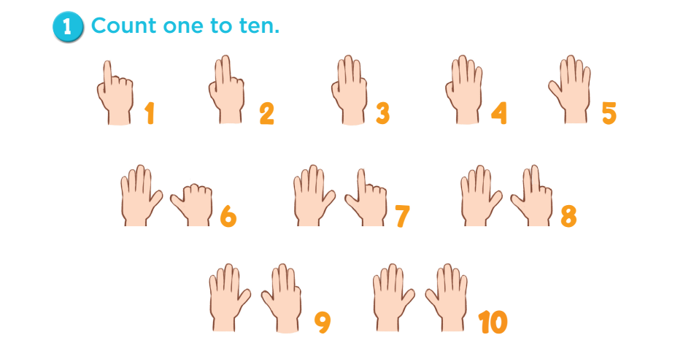

Slide 8
3. Let’s play.

Slide 9
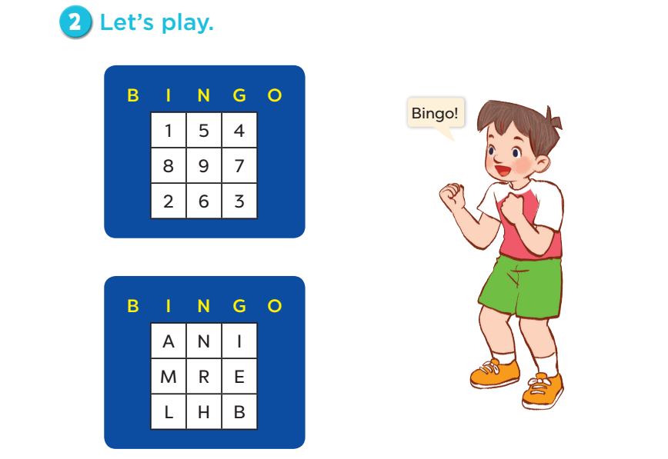

Slide 10
4. Fun corner
Game: Birds come home
Notes:
Tell pupils they are choosing birds with the right number to come home.
Ask them look at the numbers to choose the right bird and click on that bird. The bird with the correct number will fly to the nest.
Give points to the teams/pupils who can do it well.

Slide 11


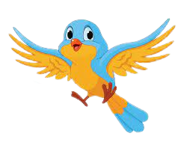


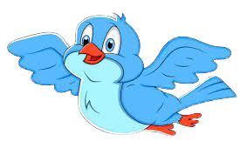

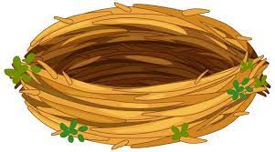
six
7
4
6
8
9
Notes:
https://stock.adobe.com/sk/search/images?k=nest+clipart
Tell pupils they are choosing birds with the right number to come home. Ask them look at the numbers to choose the right bird and click on that bird. The bird with the correct number will fly to the nest.
Give points to the team/pupils who can do it well.

Slide 12
seven
7
6
5
3
2
Notes:
Tell pupils they are choosing birds with the right number to come home. Ask them look at the numbers to choose the right bird and click on that bird. The bird with the correct number will fly to the nest.
Give points to the team/pupils who can do it well.

Slide 13
two
7
4
6
2
5
Notes:
Tell pupils they are choosing birds with the right number to come home. Ask them look at the numbers to choose the right bird and click on that bird. The bird with the correct number will fly to the nest.
Give points to the team/pupils who can do it well.

Slide 14
five
5
9
7
10
2
Notes:
Tell pupils they are choosing birds with the right number to come home. Ask them look at the numbers to choose the right bird and click on that bird. The bird with the correct number will fly to the nest.
Give points to the team/pupils who can do it well.

Slide 15
one
10
4
1
3
2
Notes:
Tell pupils they are choosing birds with the right number to come home. Ask them look at the numbers to choose the right bird and click on that bird. The bird with the correct number will fly to the nest.
Give points to the team/pupils who can do it well.

Slide 16
5. Wrap up.
Game: Get the stars!
Notes:
Goal: Pupils can say the names of letters and numbers.
Step 1: Let the pupils say the names of letters.
Step 2: Divide class into 2 or 4 groups.
Step 3: Each group chooses a letter, open the box, they will see the stars.
Step 4: Groups have the most stars will win.

Slide 17



A
B
C
D
E
F
G
H
I
J
K
L
M
N
Q
R
Notes:
Step 1: Divide the class into 2 or 4 groups
Step 2: Each group chooses a letter by reading its name
Step 3: Teachers clicks that letter to open the box and see how many stars pupils will get for the letter.
Repeat the procedure until the last letter.
Step 4: Groups having the most stars will win.

Slide 18
S
T
U
V
W
X
Y
Z
I
J
L
U
M
N
Q
R

Slide 19
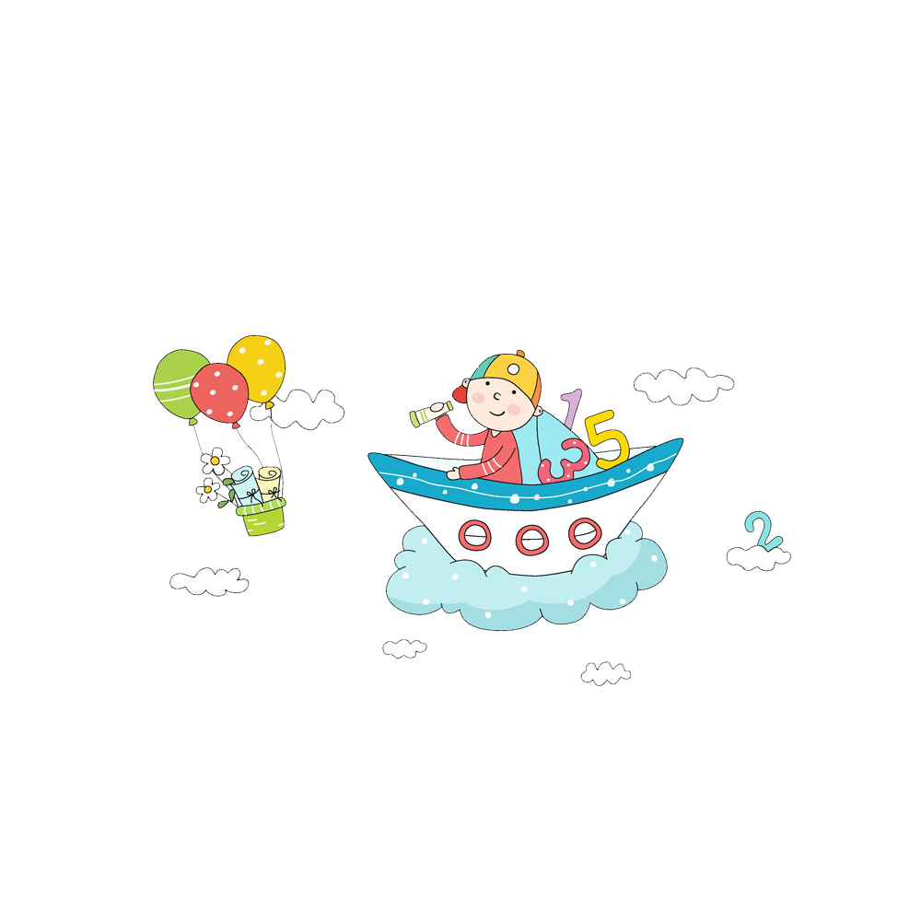
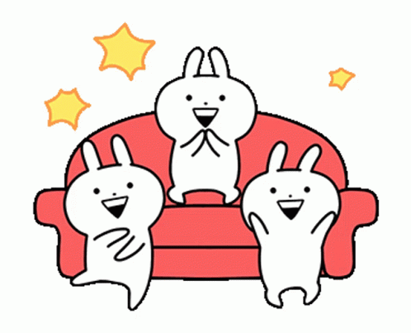
Well done!

Slide 20

Website: hoclieu.vn
Fanpage: facebook.com/www.tienganhglobalsuccess.vn

