Slide 1


Slide 2


Starter

Slide 3




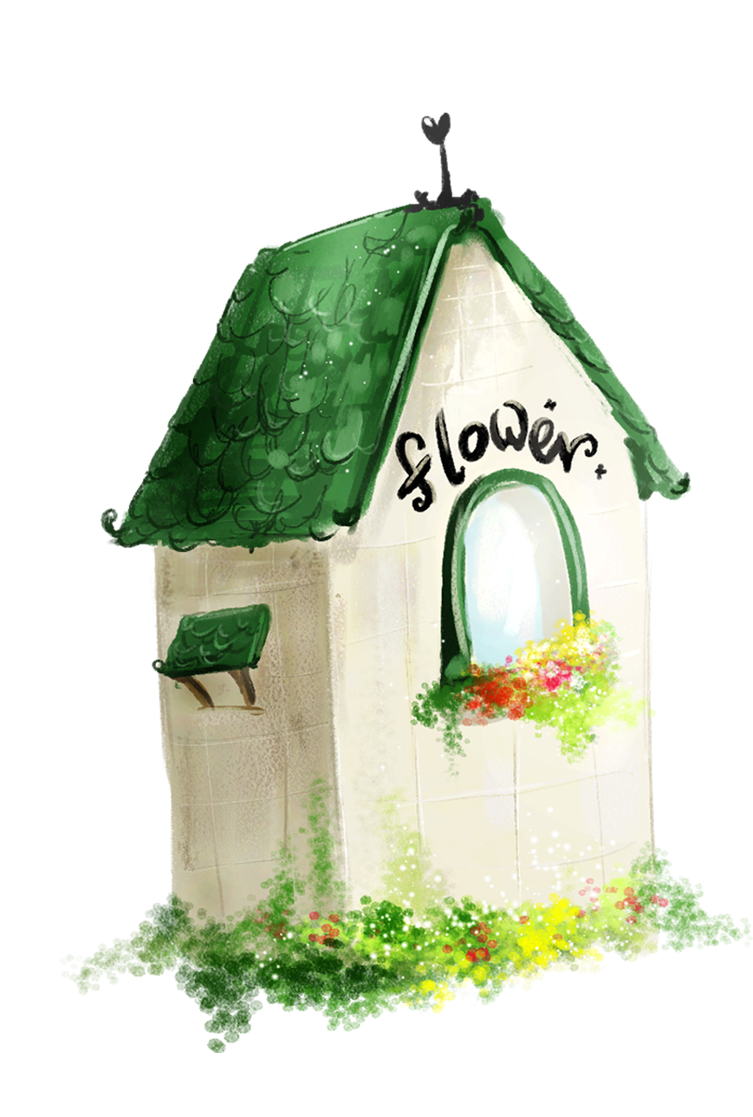
1. Warm-up
2. Listen, point and sing.
3. Read and complete.
4. Count the letters.
5. Fun corner and wrap-up
Contents

Slide 4

Warm-up
Game: Numbers showing
Notes:
Goal: Review the numbers.
Step 1: Teacher says “Numbers, numbers”, then moves hands round and round.
Step 2: Ask pupils to do like teacher.
Step 3: Teacher says a number randomly. Pupils show their fingers in correspondence with the numbers teacher says.
Step 4: Make it become more interesting by doing quicker and quicker.

Slide 5


three

Slide 6

six

Slide 7

five

Slide 8

nine

Slide 9
2. Listen, point and sing.

Slide 10
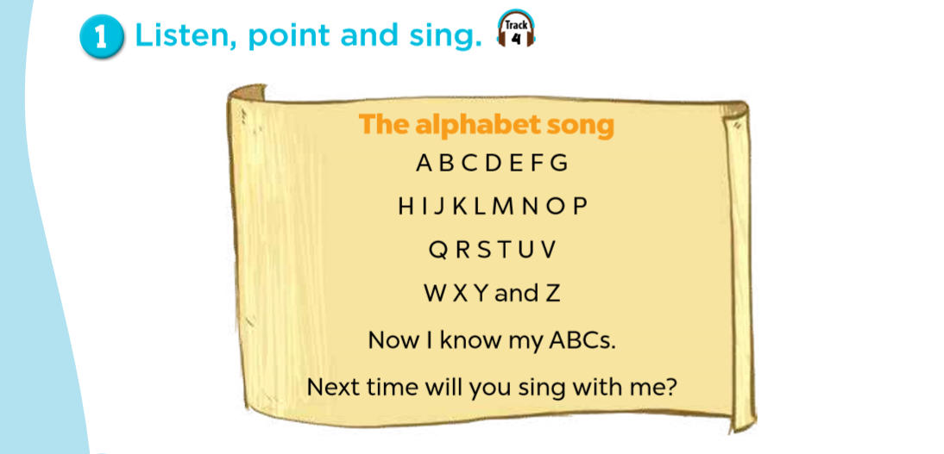



Slide 11

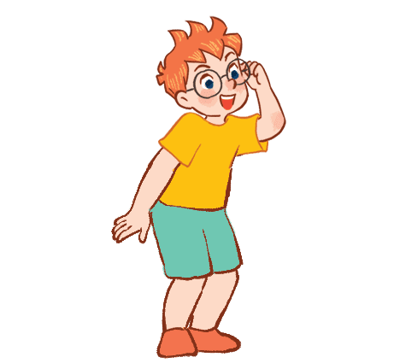




Group singing

Slide 12
3. Read and complete.

Slide 13
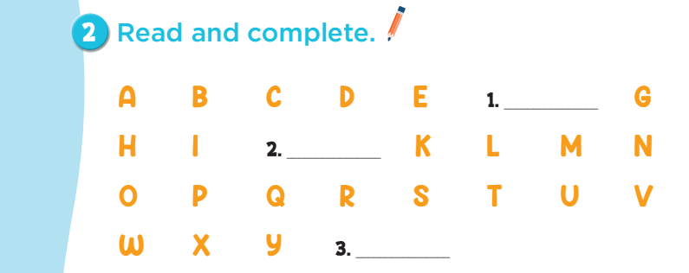
F
J
Z

Slide 14
4. Count the letters.

Slide 15
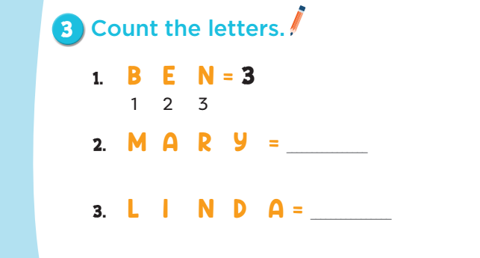
4
5

Slide 16
5. Fun corner and wrap-up
Game: What’s missing?

Slide 17


B E N
?
Notes:
Goal: Pupils can say the names of letters and recognize what’s missing.
Step 1: Let the pupils say the names of letters.
Step 2: One letter goes missing. Pupils have to say what’s missing. (This can be played between groups or individuals)
Step 3: Check the answer. If it’s correct, give points to the groups/ pupils.
Step 4: Ask pupils to say the name of the missing letter again.

Slide 18
?
MARY

Slide 19
LINDA
?

Slide 20
LUCY
?

Slide 21


Well done!

Slide 22

Website: hoclieu.vn
Fanpage: facebook.com/www.tienganhglobalsuccess.vn

