Slide 2



























Unit 1: At my birthday party
Lesson 3 – Period 3

Slide 3











Table of contents
  1. Warm-up & review
  2. Activity 6: Listen and repeat.
  3. Activity 7: Let’s talk.
  4. Activity 8: Let’s sing.
  5. Fun corner & Wrap-up

Slide 4
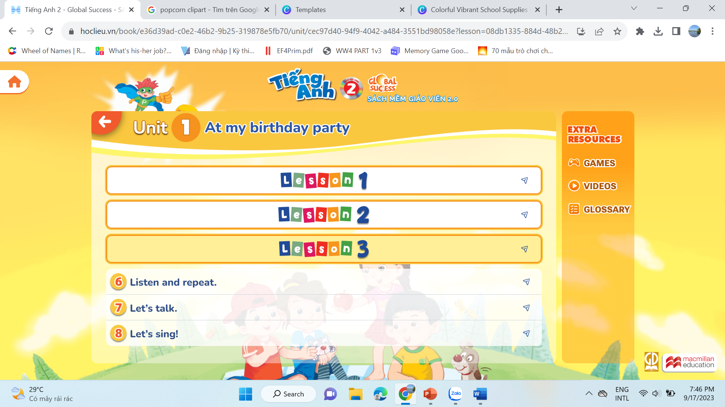

  01
  Warm-up and Review

Slide 5

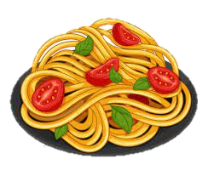
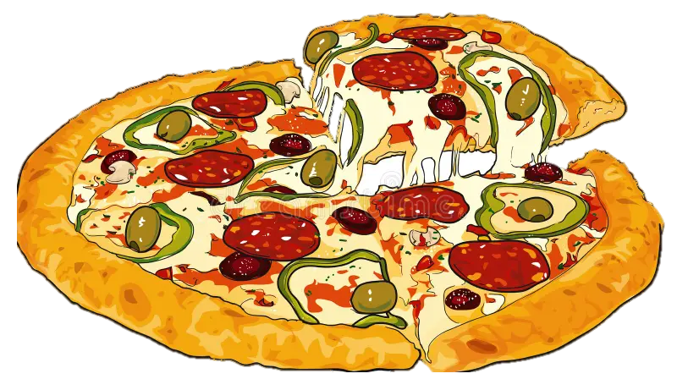

GAME
What’s missing?

Slide 6
GAME
What’s missing?

Slide 7
GAME
What’s missing?

Slide 8
02
Activity 6
Listen and repeat.

Slide 9

6. Listen and repeat.

Slide 10
6. Listen and repeat.
The popcorn is yummy.

Slide 11
03
Activity 7
Let’s talk.

Slide 12


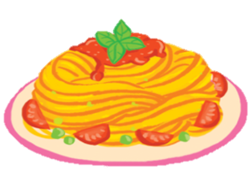
7. Let’s talk.
a. The pasta is yummy.

Slide 13
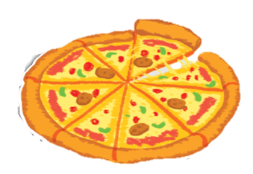
7. Let’s talk.
b. The pizza is yummy.

Slide 14

7. Let’s talk.
c. The popcorn is yummy.

Slide 15
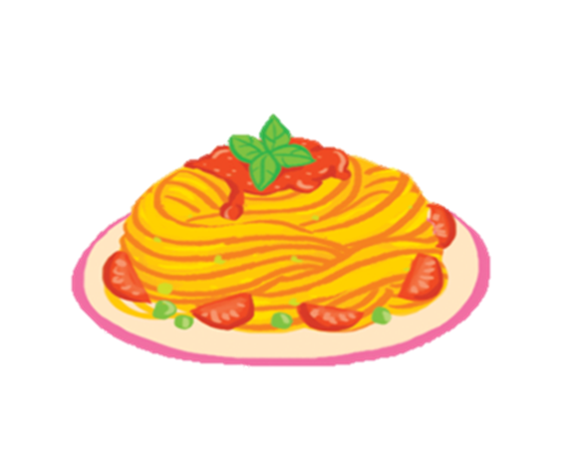

7. Let’s talk.
GROUP WORK
The _______ is yummy.

Slide 16

04
Activity 8
Let’s sing.

Slide 17



8. Let’s sing
It’s my birthday party.
I like pasta.
The pasta is yummy.
I like pizza.
The pizza is yummy.
I like popcorn.
The popcorn is yummy.

Slide 18
WORK IN GROUPS

Slide 19

8. Let’s sing.

Slide 20
  05
  Fun corner & Wrap-up

Slide 21

GAME
Pass the card
The …… is yummy.

Slide 22
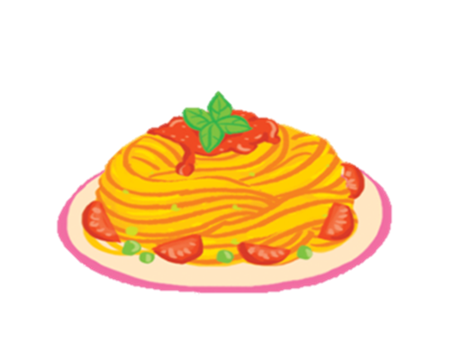


GAME
Pass the card

Slide 23

GAME
Pass the card
The popcorn is yummy.

Slide 24
GAME
Pass the card

Slide 25
GAME
Pass the card
The pasta is yummy.

Slide 26
GAME
Pass the card

Slide 27
GAME
Pass the card
The pizza is yummy.

Slide 28




Slide 29

MOVING TIME
Let’s sing and dance.

Slide 30


Slide 31
Website: hoclieu.vn
Fanpage: https://www.facebook.com/tienganhglobalsuccess.vn/

