Slide 2



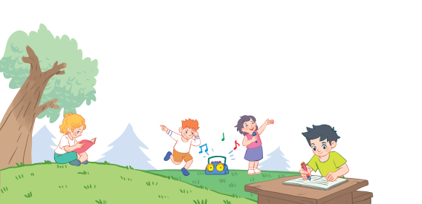
18
Period 1

Slide 3
Contents
1
Warm-up and review
2
3
4
Look, listen and repeat.
Listen, point and say.
Let’s talk.
5
Fun corner and wrap-up

Slide 4
1. Warm-up and review

Slide 5












ELEPHANT
MONKEY
CROCODILE
SNAKE
ZEBRA
GIRAFFE
SNAKE
GIRAFFE
ELEPHANT
FROG
LION
FROG
TIGER
RHINO
HIPPO
ZEBRA
GORILLA
HIPPO
O get
RHINO
CROCODILE
GORILLA
MONKEY
LION
TIGER
Notes:
DOMINO game:
Divide the class into 2 teams: Boys and Girls.
Members of each team try to give answers after seeing the animal’s pictures on the screen to get the points.
If they answer incorrectly, they lose their turns.

Slide 6
2. Look, listen and repeat.

Slide 7
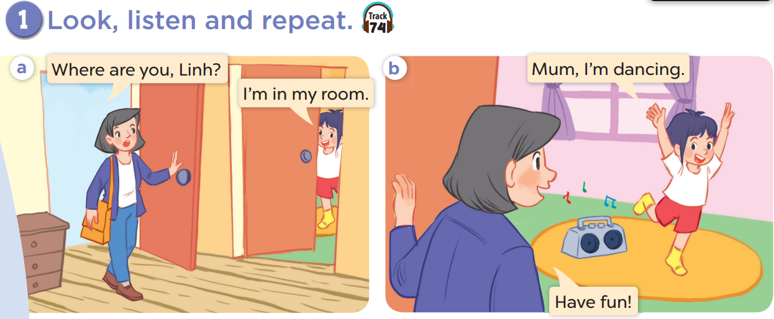


Slide 9
3. Listen, point and say.

Slide 10
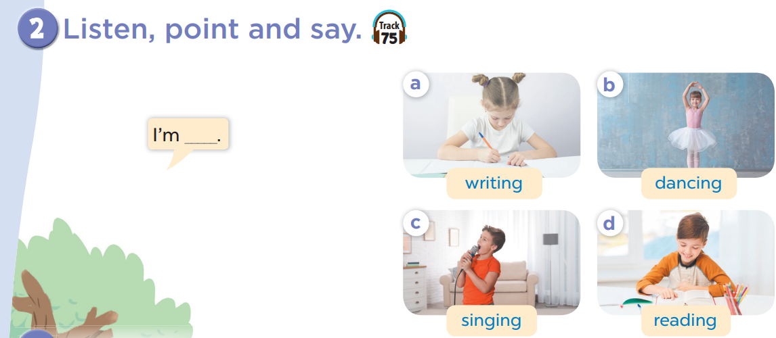

Slide 11


Slide 12
Moving
Matchmaker
Notes:
Game: Moving matchmaker: T divides class into teams Boys and Girls
-T calls each member to choose the numbers of buttons(1-4)-> the pictures will move around the words-> pupils will say STOP to match the correct pictures and words->T clicks again that button to stop-> pupils say the sentences with I’M………

Slide 13
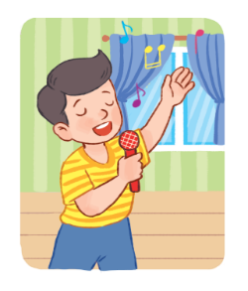
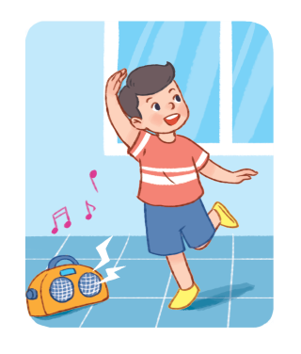


Moving Matchmaker
I’m………………….
dancing
singing
reading
writing
swimming
Notes:
Moving matchmaker:
T divides the class into 2 teams: Boys and Girls.
T calls each member to choose one number.
The pictures will move around the words.
Pupils will say STOP to match the correct pictures and words.
T clicks the button again to stop.
Pupils then say “I’m………”.

Slide 14


AMAZING

Slide 15
4. Let’s talk.

Slide 16
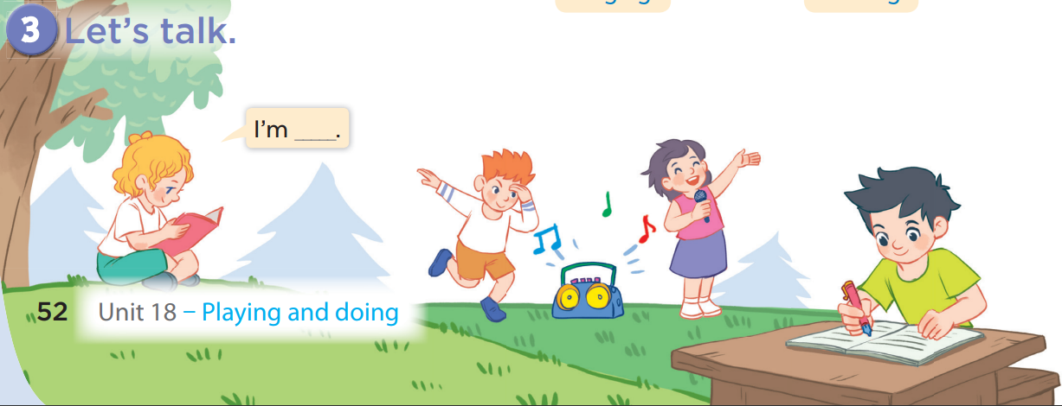
I am singing.
I am reading.

Slide 17
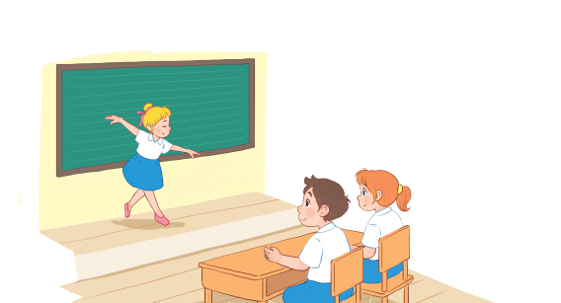
Guess what?
Notes:
Game: Guess what?
T asks some pupils come to the board and do some actions to describe words (dancing, singing, writing, reading) and the others will give their guesses. If pupils can say the answer correctly, they will get points for their teams.

Slide 18
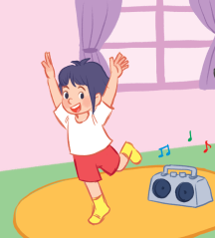


Guess what?
+4
+4
I am dancing.
Notes:
Game: Do and Guess:
-T asks some pupils come to the board and do some actions to describe words(dancing, singing, writing, reading) and the others will give their guess.

Slide 19
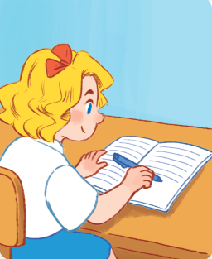

Guess what?
+3
+3
I am writing.
Notes:
Game: Do and Guess:
-T asks some pupils come to the board and do some actions to describe words(dancing, singing, writing, reading) and the others will give their guess.

Slide 20


Guess what?
+3
+3
I am reading.
Notes:
Game: Do and Guess:
-T asks some pupils come to the board and do some actions to describe words(dancing, singing, writing, reading) and the others will give their guess.

Slide 21

Guess what?
+3
+3
I am singing.
Notes:
Game: Do and Guess:
-T asks some pupils come to the board and do some actions to describe words(dancing, singing, writing, reading) and the others will give their guess.

Slide 22
Guess what?
+3
+3
I am writing.
Notes:
Game: Do and Guess:
-T asks some pupils come to the board and do some actions to describe words(dancing, singing, writing, reading) and the others will give their guess.

Slide 23
Guess what?
+3
+3
I am reading.
Notes:
Game: Do and Guess:
-T asks some pupils come to the board and do some actions to describe words(dancing, singing, writing, reading) and the others will give their guess.

Slide 24
Guess what?
+4
+4
I am dancing.
Notes:
Game: Do and Guess:
-T asks some pupils come to the board and do some actions to describe words(dancing, singing, writing, reading) and the others will give their guess.

Slide 25

Guess what?
+3
+3
I am singing.
Notes:
Game: Do and Guess:
-T asks some pupils come to the board and do some actions to describe words(dancing, singing, writing, reading) and the others will give their guess.

Slide 26
5. Fun corner and wrap-up

Slide 27








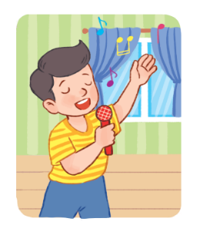


WHERE’S MICKEY?
9
8
7
6
5
4
3
2
1
0
9
8
7
6
5
4
3
2
1
0
9
8
7
6
5
4
3
2
1
0
9
8
7
6
5
4
3
2
1
0
9
8
7
6
5
4
3
2
1
0
9
8
7
6
5
4
3
2
1
0
9
8
7
6
5
4
3
2
1
0
9
8
7
6
5
4
3
2
1
0
Team 1
Team 2
Team 3
Team 4
10
5
3
1
NEXT
Notes:
Game: WHERE’S MICKEY?
A game for up to 4 players. How to play:
Decide on the winning overall score for this game (e.g. 20).
Each player then clicks on the small cube on their cloud to indicate which cube they think Mickey is going to be found under
Click on the Mickey sitting on top of the big cubes. He will fly off and hide in one of the cubes.
Click on each cube to see if Mickey is there.
Any players who have chosen the correct cube can click the numbers on their scoreboards to add the points they get.
Then click the ‘NEXT’ sign for the next game.
Continue to play until one team achieves the winning overall score.
The remaining team can continue.
PRACTICE: when choosing the correct cube, pupils have to say the sentences with I’M…………….

Slide 28

Website: hoclieu.vn
Fanpage: https://www.facebook.com/tienganhglobalsuccess.vn/

