Slide 1
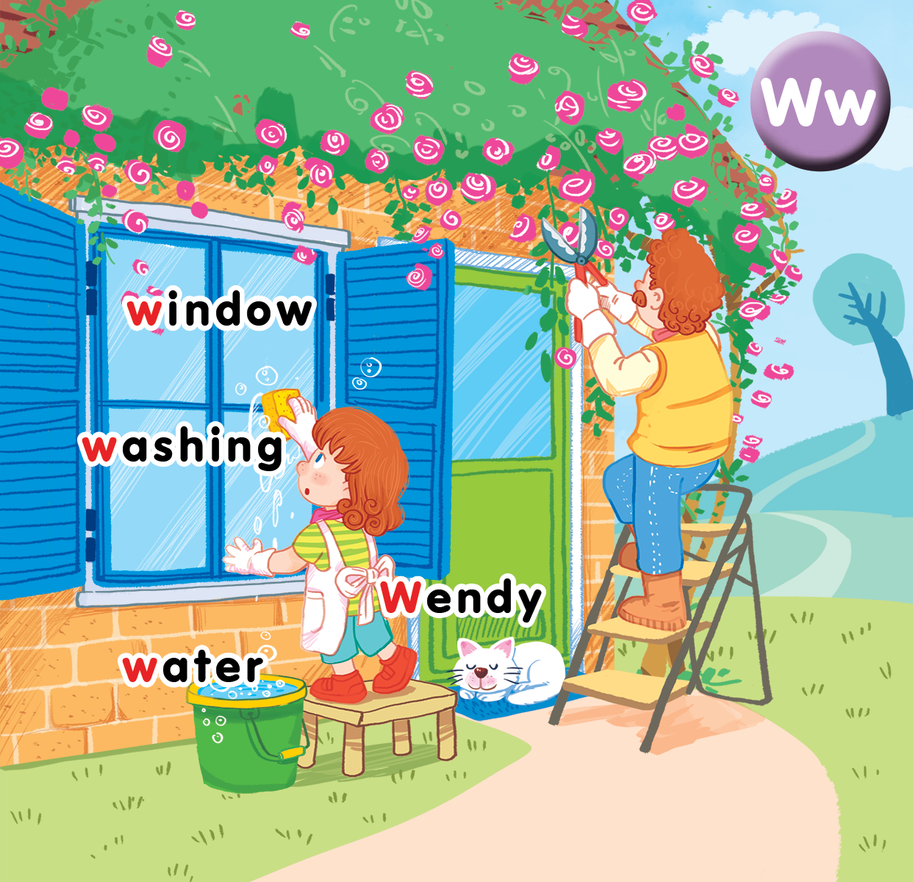
Unit 16 At home Lesson 2
Notes:
Goal:
By the end of the lesson, pupils will be able to:
- say the sound of the letter W/w, the words Wendy, window, washing, water in a chant.
- listen, recognize the words and tick the correct boxes.
- trace the letter W/w and complete the words _endy, _indow, _ashing, _ater.

Slide 2
Warm-up
Notes:
Goal: Warm up, revise the Unit keywords and link to the chant of lesson 2
Time: 5 minutes
Game: Mind map
Have pupils play in groups.
Divide the board into 4, each part for 1 group.
Write each part a letter: W, T, M, H.
In 2 mins, groups have to write down on the board as many words beginning with the letter as possible.

Slide 3
W
Windy

Slide 4
Listen and chant
Notes:
Listen and chant is divided into 3 steps.
Step 1:
Goal: Review the number from 1-10.
Time: 4 minutes.
Review numbers from 1-10 : https://www.youtube.com/watch?v=85M1yxIcHpw or https://www.youtube.com/watch?v=G3zaC5onBvM
Then ask pupils some questions: How many books? How many cats…? (prepare flashcards or picture or real objects)
(Pupils’ answer can be short like: eight, six…).
Step 2
Goal: Pupils will be able to listen, chant and clap along.
Time: 4 minutes
Play the recording
Round 1. Have pupils listen and clap along.
Round 2. Have pupils listen, chant and clap along
Round 3. Have pupils listen, chant and do the action.
Repeat each round 2-3 times in chorus, groups, pairs.
Step 3 (optional)
Goal: Pupils can create their own chant.
Time: 3 minutes
If possible, have pupils work in groups to create their own chant by replacing some words then create their own TPR.
Pupils say the chant in groups.

Slide 5
Listen and chant

Slide 6
Listen and tick
Notes:
Listen and tick is divided into 2 steps.
Step 1
Goal: Pupils will be able to listen and choose the correct pictures.
Time: 5 minutes
Say Listen and tick with the TPR actions.
Play the recording and demonstrate the example.
Play the recording and have pupils do the task.
Step 2
Goal: Check
Time: 3 minutes
Play the recording and have pupils say the answer.
Play the recording again and have pupils repeat then give correct answer.

Slide 7
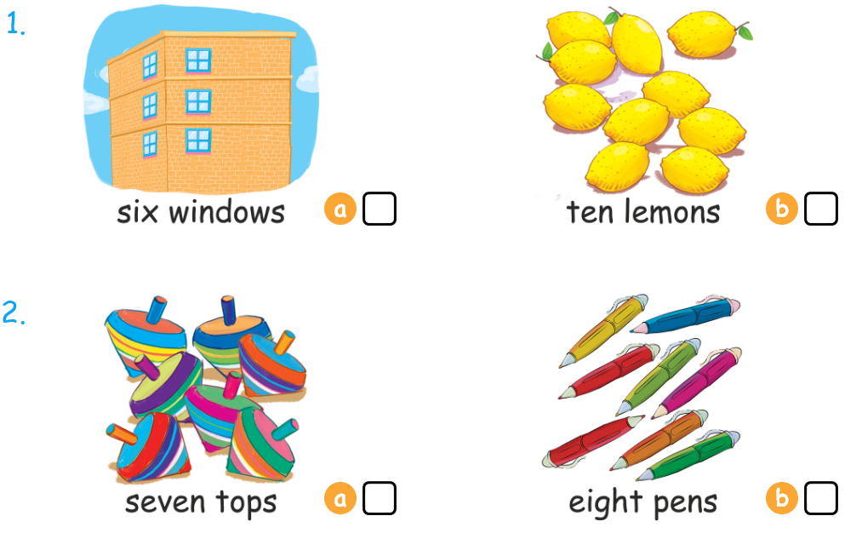
Listen and tick

Slide 8
Look, trace and write
Notes:
Goal: Pupils will be able to trace the letter.
Time: 5 minutes
Have pupils watch the youtube link to know how to write W: https://www.youtube.com/watch?v=lxvPbeQ0kIg
Have pupils write the word by air tracing and say the word.
Demonstrate how to trace the word and have pupils do the task.

Slide 9
Look , trace and write

Slide 10
Game
Notes:
Goal: Pupils will be able to review the new language learnt in the lesson.
Time: 5 minutes
Divide the class into 3 teams.
Call 1 pupil from each team to choose a number and answer the question How many… in that number to get points.
Click on the flower to move to the next activity.

Slide 11
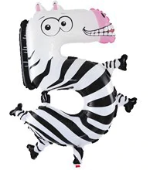

Slide 12
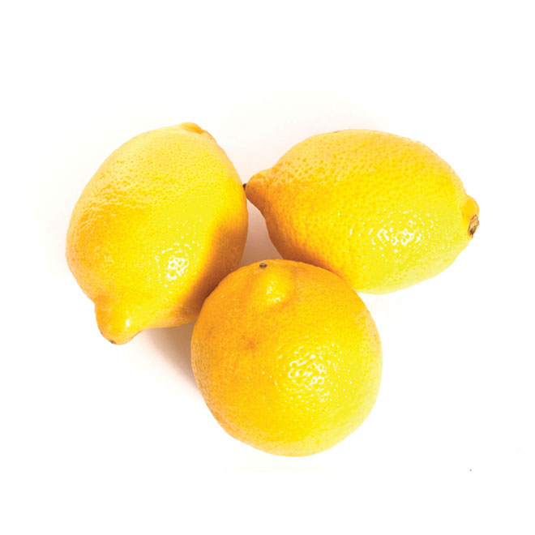
How many lemons?
three lemons

Slide 13
How many balls?
ten balls

Slide 14
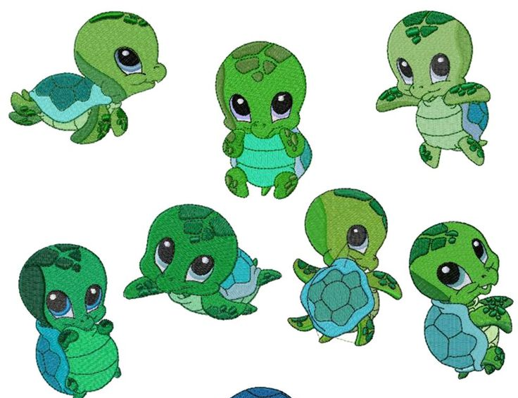
How many turtles?
seven turtles

Slide 15
How many clocks?
one clock

Slide 16
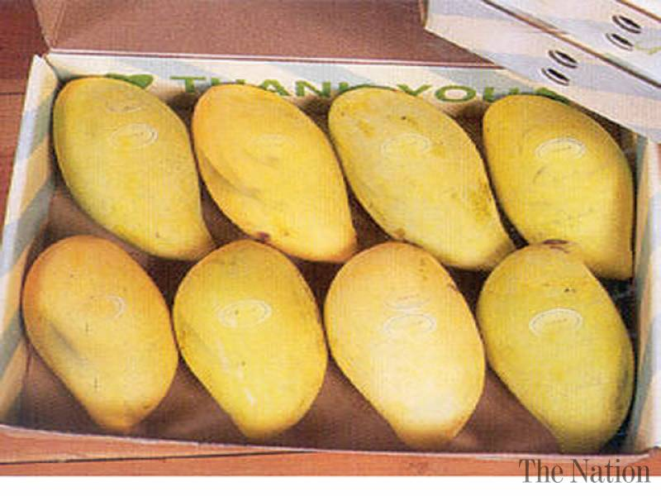
How many mangoes?
eight mangoes

Slide 17
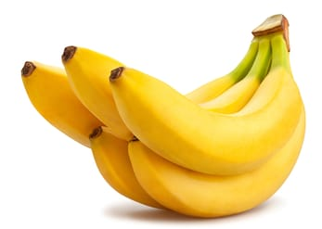
How many bananas?
five bananas

Slide 18
How many pens?
three pens

Slide 19
How many windows?
six windows.

Slide 20
How many pencils?
eight pencils

Slide 21
Goodbye
water
Notes:
Teacher shows the vocabulary of the lesson on slide.
Pupils say goodbye.

Slide 22
Goodbye
Wendy
Notes:
Goodbye
2 phút
Giáo viên và học sinh chào tam biệt các từ vựng và nhân vật.
Nói và kèm hành động

Slide 23
Goodbye
window

Slide 24
Goodbye
wash

Slide 25
Website: hoclieu.vn
Fanpage: facebook.com/www.tienganhglobalsuccess.vn

