Slide 2

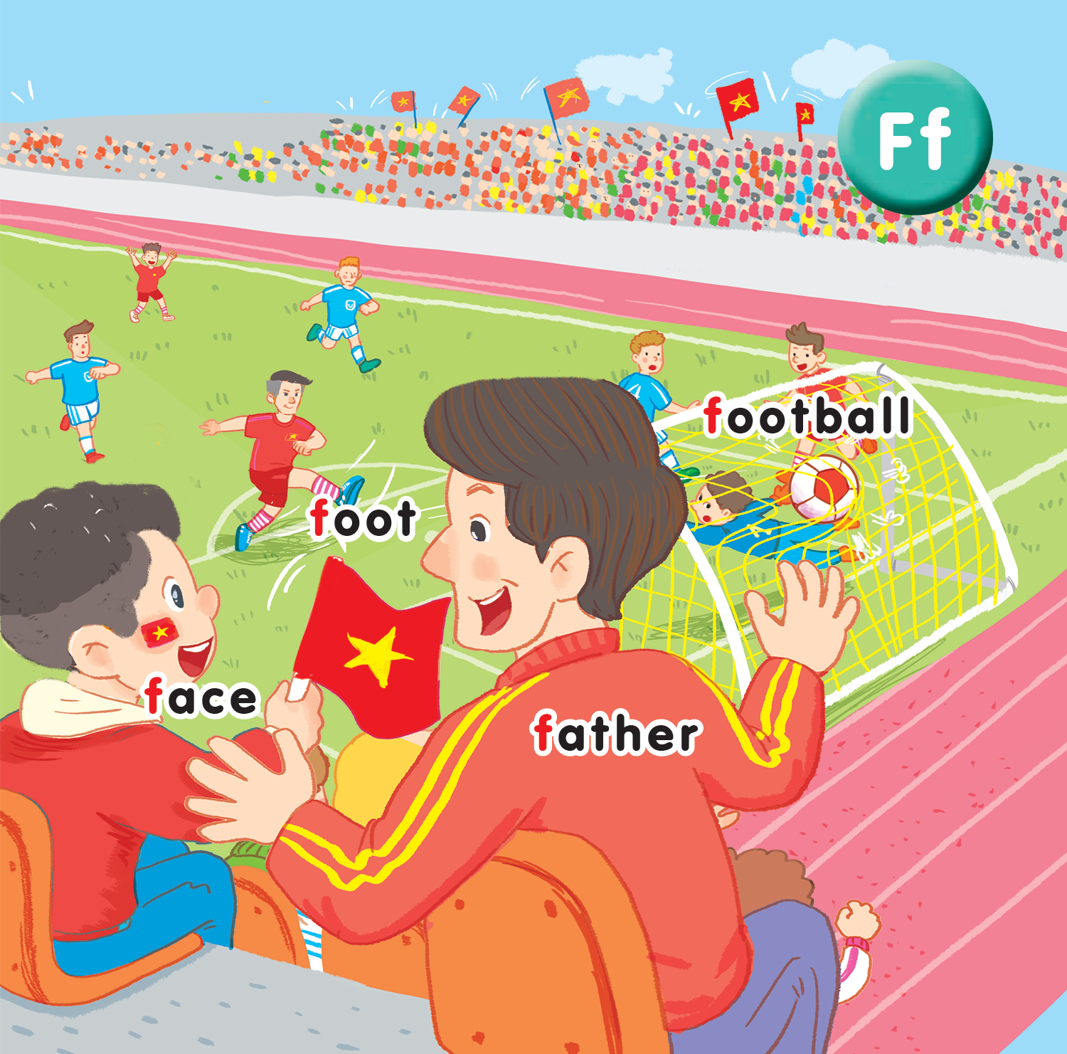
Unit 15
At the football match
Lesson 3
Notes:
By the end of the lesson, pupils will be able to:
- introduce a thing with the structure He’s having_________.
- sing along the unit song.

Slide 3

Warm-up
Notes:
Goals: Warm up and revise the unit keywords.
Practice the model sentence.
Time: 5 minutes
Pupils play the game in groups.
Have pupils look at the screen and guess what it is, using the structure I can see a…
Quick and correct answer will get point to the group.
Have pupils repeat the words.

Slide 4

a kite

Slide 5


Slide 6
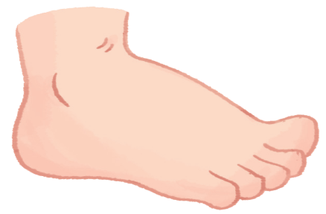

Slide 7


Slide 8


Slide 9


Slide 10


Slide 11


Slide 12


Listen and repeat
Notes:
Listen and repeat is divided in to 2 steps.

Slide 13

Notes:
Step 1
Goal: Pupils will be able to understand the structure Point to your _____.
Time: 3 minutes.
Have pupils look at the screen and ask What can you see?
Then say Yes, I can see a face. Where’s you face?
(Vietnamese if needed)
Say Point to your face then use the finger, point to the teacher’s face.
(Explain in Vietnamese if needed)
Repeat again 2 times and ask student to listen, repeat and do.

Slide 14


Notes:
Step 2
Goal: Pupils will practice listen and repeat.
Time: 3 minutes
Have pupils look at the screen.
Say Point to your hand, then teacher point to teacher’s hand.
Have pupils repeat and do the same.
Repeat it in chorus, group then individual.
Do the same with some more objects that teacher can find in the class (ex: face, foot, book….).

Slide 15


Let’s talk
Notes:
Let’s talk is divided into 2 steps.
Step 1.
Goal: Pupils will be able to point and say using the new structure.
Time: 3 minutes
Have pupils do the activity 7 in the book.
Demonstrate the activity, point and say.
Say Point to your hand and have pupils point to their hand.
Ask pupils to do the same thing in pairs, 1 says, 1 does the action.
Step 2
Goal: Pupils will be able to practice saying more with the new structure in a game.
Time: 5 minutes
Call 1 pupil to be teacher’s assistant: click the timer to count the time for each team.
1 team play at a time.
Call the team to line up.
Says: Point to your head! The 1st pupil does the action, then turns around and says another sentence to his/her friend to act (ex: point to your hand), then he/she comes back to the seat. Continue to the last pupil of the group.
The team can finish in the shortest of time is the winner.

Slide 16
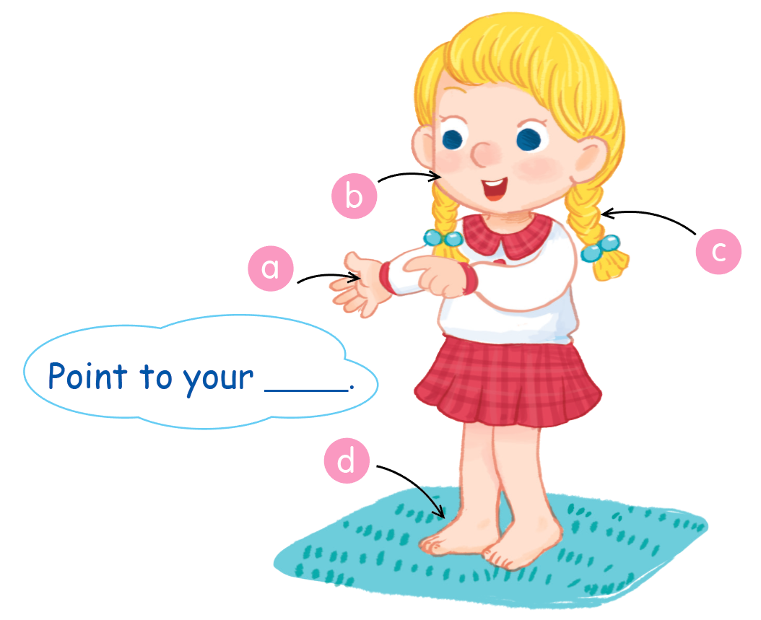

Slide 17

Listen and sing
Notes:
Let’s sing can be divided into 3 steps.
Step 1
Goal: Pupils will be able to read the song lyrics.
Time: 3 minutes
Have pupils read the song lyrics in chorus then in groups.
Step 2:
Goal: Pupils will be able to sing along the song.
Time: 3 minutes
Have pupils listen and sing along the song in chorus then in groups.
Step 3
Goal: Pupils will be able to sing the song with TPR.
Time: 3 minutes
Have groups create their own TPR for the song then present.
Finish the song with the TRP for high five and fist bump.
If possible, have pupils create their own song lyrics.

Slide 18
Game
Notes:
Goal: Review the unit keywords
Time: 5 minutes
Game: https://www.freddiesville.com/games/body-parts-word-search-puzzle-online/
Click on the link and have pupils look at the table of letters.
Group will get star if they can find the meaningful word.

Slide 19
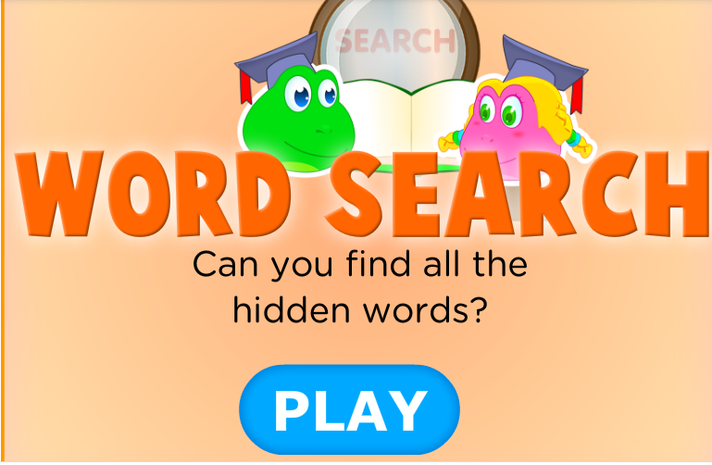

Slide 20
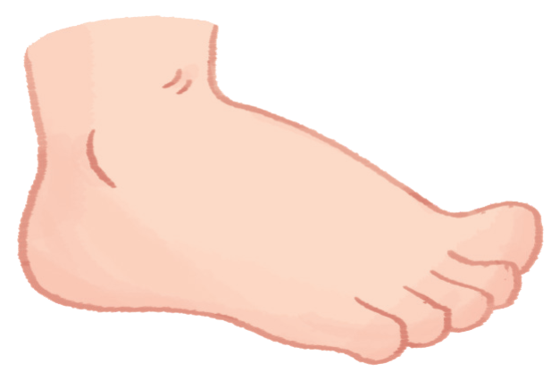
Goodbye
foot
Notes:
Teacher shows the vocabulary of the lesson on slide.
Pupils say goodbye.

Slide 21

Goodbye
face

Slide 22

Goodbye
football

Slide 23
Goodbye
father

Slide 24
Website: hoclieu.vn
Fanpage: facebook.com/www.tienganhglobalsuccess.vn

